Slide 1
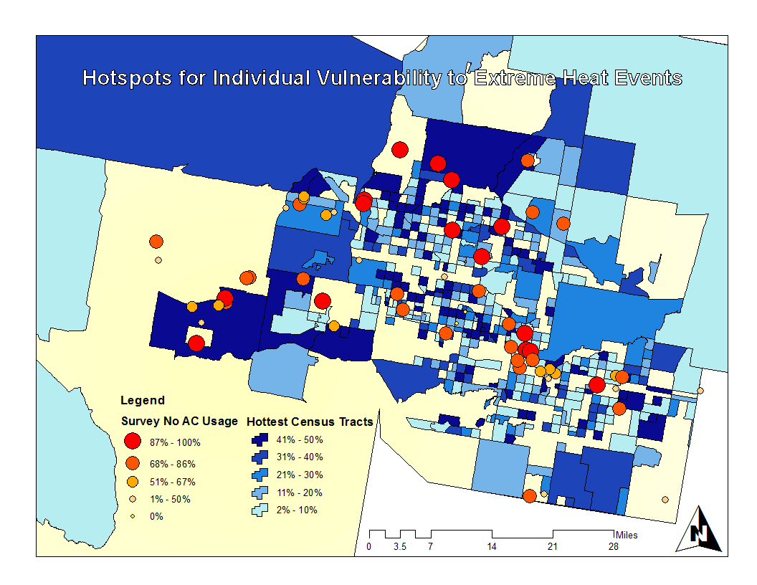
C
A
B
C
B
Suburban neighborhood
outside of downtown
Phoenix composed of
about 22% Hispanic.
The second area represents
a suburban neighborhood
with a large amount of elderly
individuals living alone or in a
retirement home.
Diverse set of suburban
neighborhoods outside the
city center.
A

