Slide 1
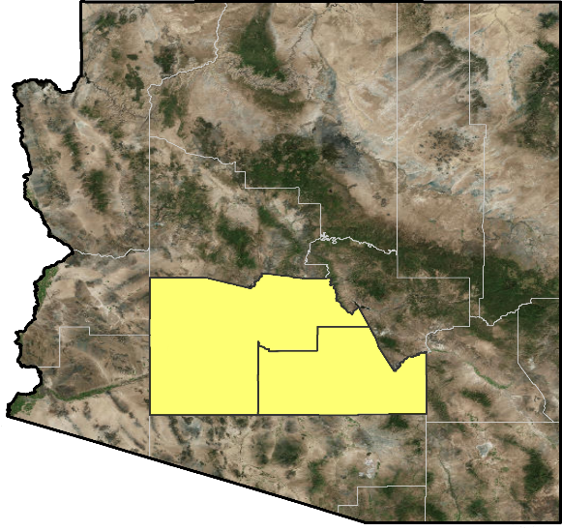
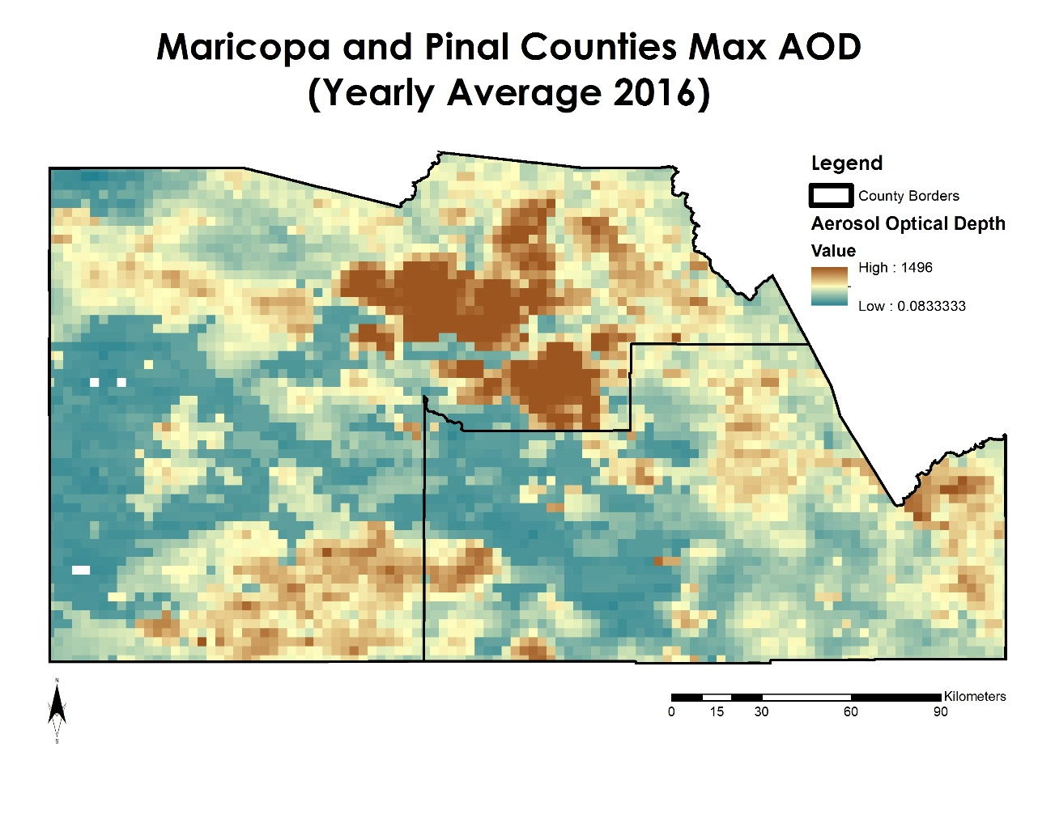
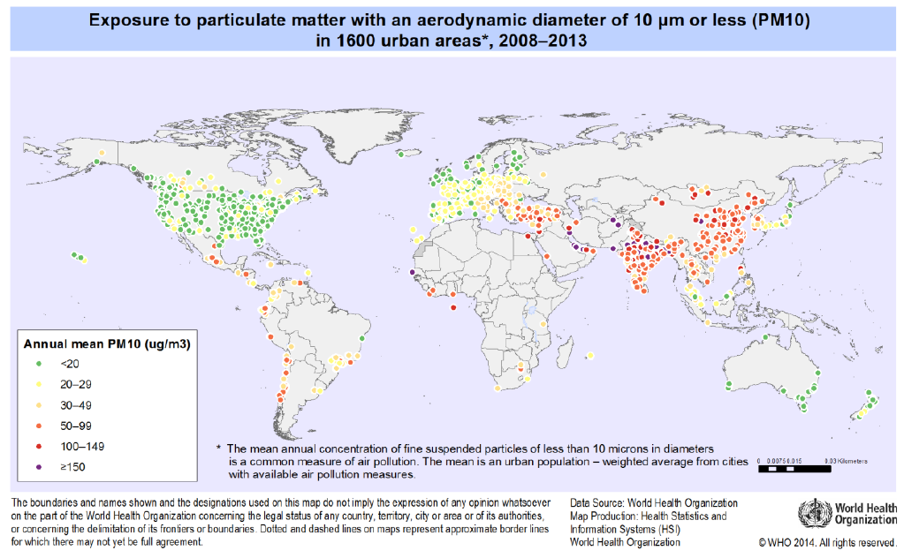
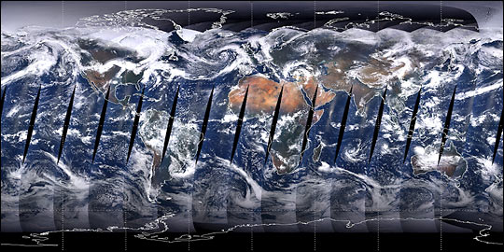
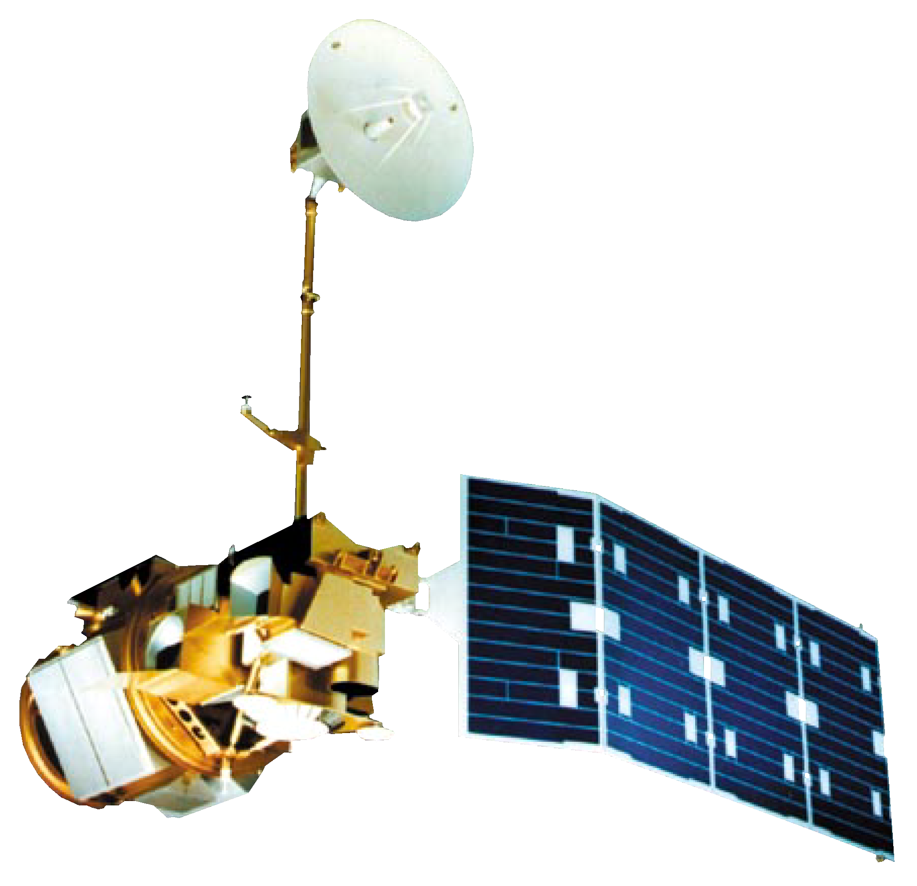
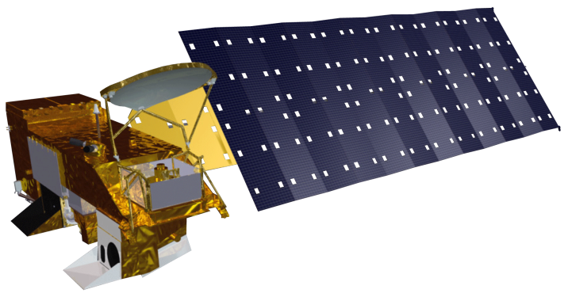
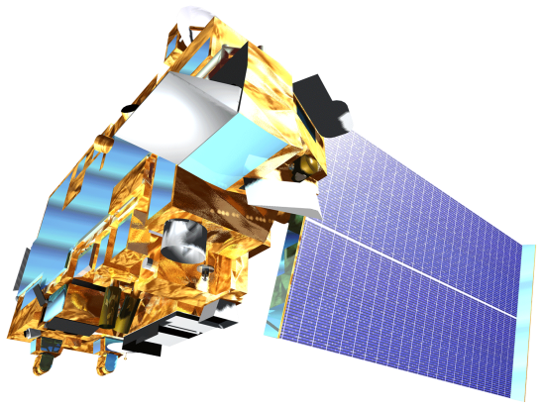
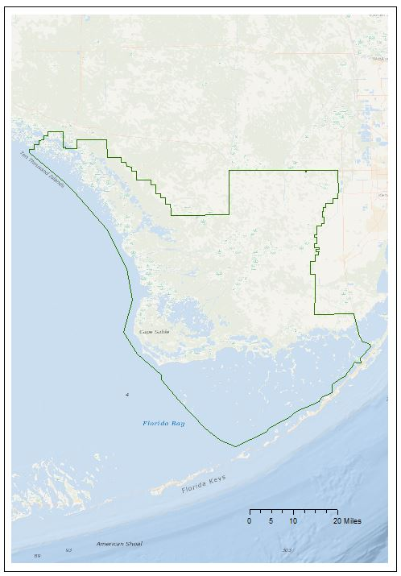
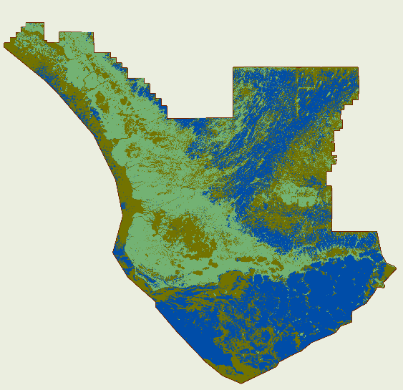
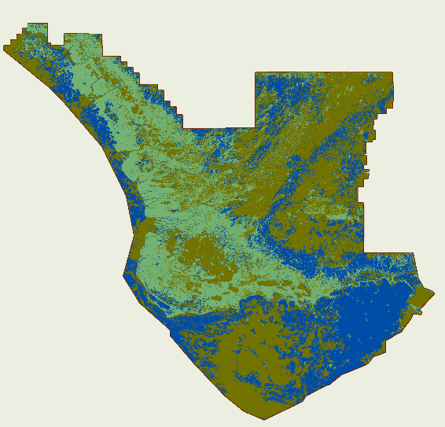
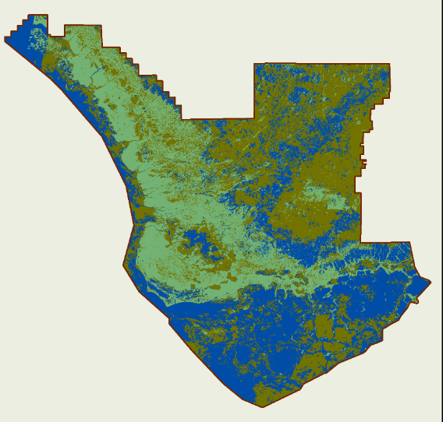
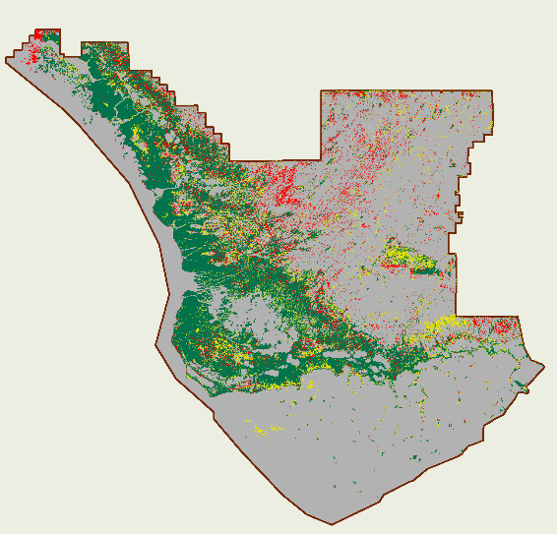
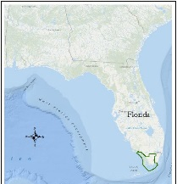
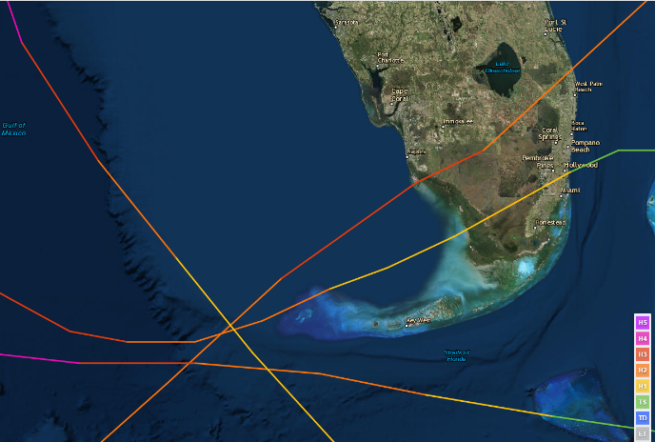
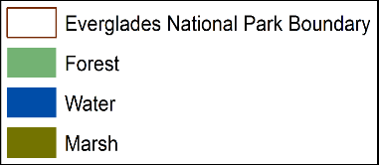
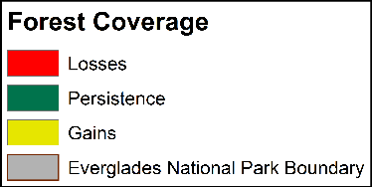
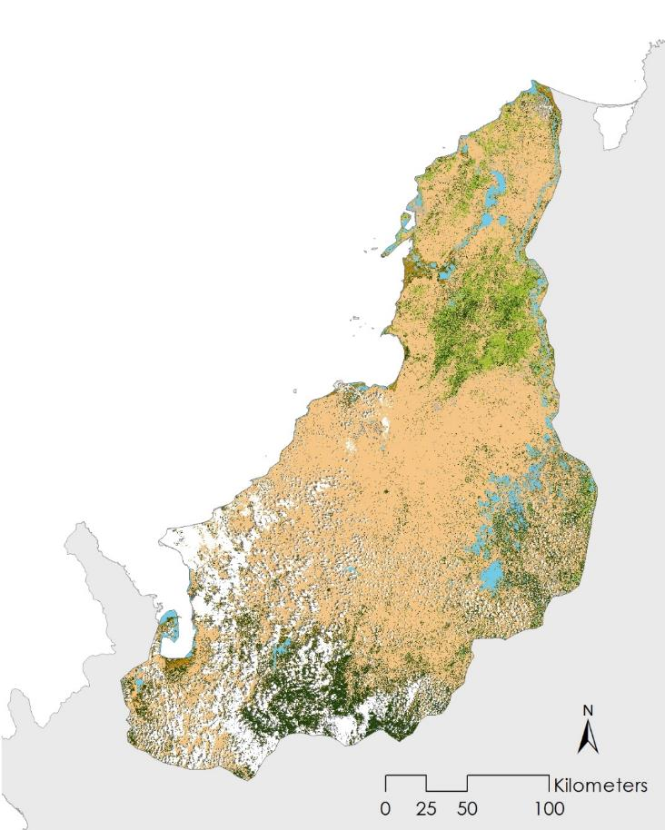
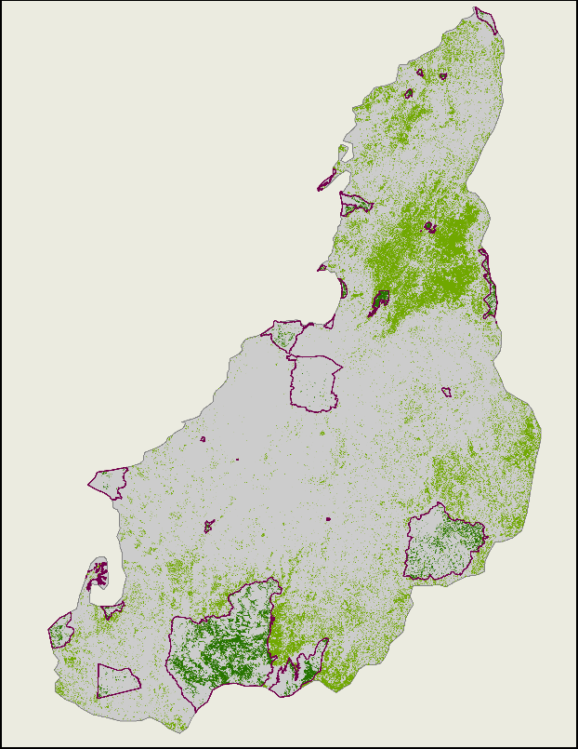
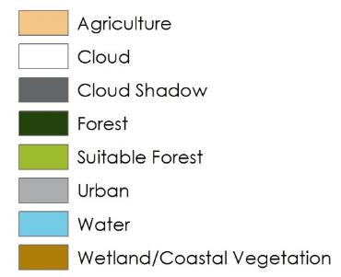
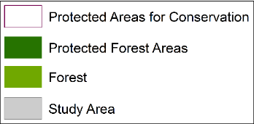
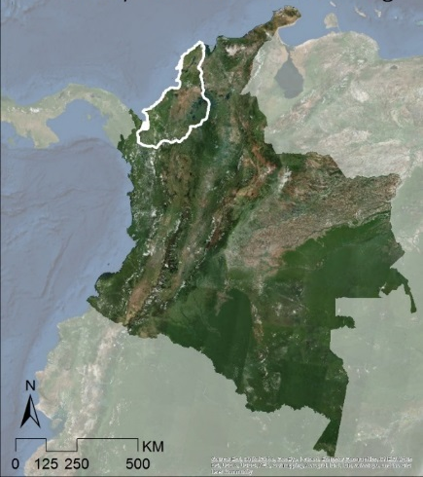
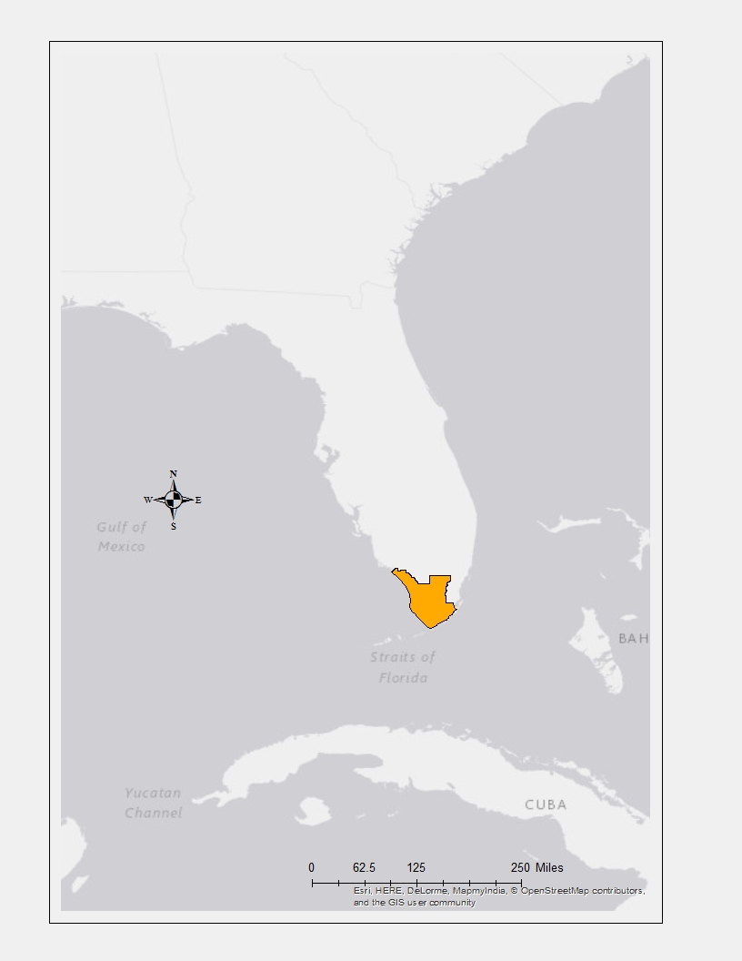
Integrating NASA Earth Observations into the Global Indicator Framework for Monitoring the United Nations’ Sustainable Development Goals
Abstract
Project Objectives
In September 2015, the United Nations adopted the 2030 Agenda for Sustainable Development. This plan outlines 17 Sustainable Development Goals (SDGs) which lay out the overarching objectives for all countries to meet by 2030 in such global concerns as ending poverty and hunger, ensuring gender equality, access to clean water, and environmental sustainability. Each SDG consists of several targets to achieve, as well as a set of indicators that provide the framework by which to evaluate progress towards achieving those targets. Determining appropriate methodologies for the wide array of indicators created is a complex task, with diverse data sources providing various abilities and challenges. This project built upon the Group on Earth Observations (GEO) and NASA Applied Sciences Program efforts to identify SDG indicators that could integrate Earth observations (EO) into the SDG’s monitoring methodologies. DEVELOP projects that align with SDGs were identified and case studies created that provide examples of how EO can be integrated into SDG monitoring. This project identified potential methodologies for indicator 15.2.1 under SDG 15 “Life on Land”, as well as 11.6.2 for SDG 11 “Sustainable Cities and Communities.”
Build upon GEO & NASA Applied Sciences Program efforts to identify SDG indicators that could integrate Earth observations (EO) into their monitoring.
Identify DEVELOP projects that align with SDGs and create case studies that provide an example of how EO can be integrated into SDG monitoring.
Incubate SDG-related methodologies in DEVELOP projects and engage with the SDG community.
SDG Goals & DEVELOP Project Case Studies
11.6.2: Annual mean levels of fine particulate matter (e.g. PM2.5 and PM10) in cities (population weighted)
Arizona
By Month | Avg Max AOD
Jan | 339.6666667
Feb | 382.3846154
Mar | 297.037037
April | 395.5454545
May | 493.6451613
June | 649.516129
July | 764.0689655
Aug | 910.7419355
Sept | 833.7857143
Oct | 754.4516129
Nov | 598.0333333
Dec | 505.4137931
Yearly | 577.0242015
Case Study: Maricopa County Health & Air Quality
Aerosol Optical Depth
Monitoring PM10 Concentrations with MODIS Aerosol Optical Depth Measurements for Enhanced Public Health and Air Quality Decision Making and Epidemiology
High: 1496
Low: 0.833333
11.6.2
Maricopa County
Pinal County
County Borders
By 2030, reduce the adverse per capita environmental impact of cities, including by paying special attention to air quality and municipal and other waste management
Landsat 5 TM
Terra MODIS
Aqua MODIS
Maricopa County Health&AQ Team:
SDGs:
11.6.2 is a reporting of annual mean levels of PM2.5 and PM10. The Maricopa County HAQ Team’s methodology is annual mean max levels of AOD. However, it illustrates the potential for EO air quality data to be applied.
Credit: Image by Mark Gray, MODIS Atmosphere Team, NASA GSFC
The current proposed methodology for 11.6.2 is to use the WHO Ambient Air Pollution in Cities Database. As the WHO coverage map above illustrates there are many data gaps around the world, particularly in Africa. Utilizing an EO-driven methodology like the one shown here with MODIS may help to increase reporting due to the global coverage of many EO satellites.
Considerations
Created mixed model to correlated MODIS AOD with PM10 concentrations
Included period variables including meteorological and environmental factors
Calculated monthly and yearly mean maximum values of AOD
Next steps: Compare accuracy of team’s methodology with that of reporting methods used in WHO database.
Earth observations may provide a useful supplement the data gaps in the WHO Ambient Air Pollution in Cities Database.
15.2.1: Progress towards sustainable forest management
SDGs Cross-Cutting
Case Study: Everglades Eco Forecasting
Sub Indicator 1: Annual average percent change in forest area over most recent available 5 year period
Improving the Capacity of Everglades National Park to Monitor Mangrove Extent using NASA Earth Observations
a)
b)
c)
d)
Figures a – c show the Everglades National Park classified into three categories and illustrate the changing vegetation and coastline within park boundaries.
Figure d shows changes and persistence in forest coverage within the park. Disturbances are one significant source of change in vegetation and coastline, in particular hurricanes.
Landsat 8 OLI
NOAA Historical Hurricane Tracks
1995
2005
2015
1995 - 2015
The image to the left shows the tracks of the four hurricanes that affected the park in 2005 (Dennis, Katrina, Rita, and Wilma).
Year | Total Forested Area
1995 | 2178485100 m²
2005 | 1819418400 m²
2015 | 1842038100 m²
15.2
Everglades Eco Team:
SDGs:
15.2.1 looks at the most recent 5 year period, whereas the Everglades Team’s classifications are at 10 year intervals. However, the variability in annual average percent change resulting from selecting different time periods suggests a potential impact on results.
Considerations
By 2020, promote the implementation of sustainable management of all types of forests, halt deforestation, restore degraded forests and substantially increase afforestation and reforestation globally
Landsat Data Acquired for 1995, 2005, & 2015 and Fmask Cloud Removal
Stratified Random Sampling
Annual Image Aggregation
Supervised Classification in Google Earth Engine & Validation
Extracted Forest Class from LULC
Clipped Forest Cllass to Protected Areas Boundary
Calculated Protected Share of Forested Area
Change in Forested Area | 1995 - 2005 | 2005 - 2015 | 1995 - 2015
Overall Change | -0.1648 | 0.0124 | -0.1544
Est. Annual Change | -0.0165 | 0.0012 | -0.0077
% Est. Annual Change | -1.65% | 0.12% | -0.77%
Next Steps: The Everglades Eco Team had an 85% accuracy assessment of their classification; how that translates for the SDG indicator needs to be addressed.
The dynamic environment of the park illustrates the significance of the time period selected.
Land cover classification and analysis may be a useful tool for country reporting in FAO’s Global Forest Resources Assessment.
Case Study: Colombia Eco Forecasting
Sub Indicator 3: Share of forest area whose primary designated function is biodiversity conservation, most recent period
Utilizing NASA Earth Observations to Enhance Conservation of Endangered Species in Colombia
a)
b)
Figure a shows the Colombia Eco Team’s land cover classification of the study area. Suitable forest refers to the team’s identification of areas most suitable for cotton-top tamarin habitat preservation. Figure b shows all forested area and draws out the area currently protected for conservation efforts.
Indicator | Quantification
Total Forested Area | 10407774600m²
Total Protected Forested Area | 1664601300 m²
% Protected Forested Area | 16%
Colombia
Landsat 8 OLI
SDGs:
Considerations
UGA Colombia Eco III Team:
Next Steps: An accuracy assessment of this methodology needs to be conducted.
Land cover classification and analysis may be a useful tool for country reporting in FAO’s Global Forest Resources Assessment.
Landsat Data Acquired for Feb & Mar of 2014
Masked Images & Performed Atmospheric Correction
ISOdata Unsupervised Classification &Clipped to Study Site
Extracted Forest Class from LULC
Clipped Forest Cllass to Protected Areas Boundary
Calculated Protected Share of Forested Area
Team Members
Acknowledgements
Lawrence Friedl, NASA Applied Sciences Program
Dr. Argie Kavvada, Booz Allen Hamilton
UGA’s Spring 2015 Colombia Eco Forecasting Team
LaRC’s Summer 2016 Everglades Eco Forecasting Team
AZ’s Summer 2016 Maricopa County Health & AQ Team
Dr. Kenton Ross, NASA Langley Research Center
Dr. Christa Peters-Lidard, NASA Goddard Space Flight Center
Dr. Hans-Peter Plag, Old Dominion University / Blue Planet Initiative
Dr. Dalia Kirschbaum, NASA Goddard Space Flight Center
Georgina Crepps
Project Lead
Lauren
Childs-Gleason
Emily Gotschalk
Jamie
Favors
Any opinions, findings, and conclusions or recommendations expressed in this material are those of the author(s) and do not necessarily reflect the views of the National Aeronautics and Space Administration. This material is based upon work supported by NASA through contract NNL11AA00B and cooperative agreement NNX14AB60A.
NASA Langley Research Center – Summer 2016

