Slide 1
Andrea Martinez (Project Lead)
Amanda Clayton
WESTERN U.S. WATER RESOURCES II
Christine Sadlik
Assessing Landscape Vulnerability to Drought and Changing Climate in National Parks of the Western United States
Taryn Smith
Aubry Eaton

Slide 2
Community Concerns
Drought throughout the Western United States
Vegetation is water-limited
Vegetation shifts are early warning signs of Environmental Thresholds
Image Credit: Dinosaur National Monument
Notes:
Aubry: Much of the American West has experienced drought for more than a decade. Combined with rising temperatures, water availability is of increasing concern to land managers in this region.
Prolonged disturbances, such as drought, could push an ecosystem past a threshold which signifies an irreversible change from one type of ecosystem to another.
Climate pivot points are early warning signs of such a threshold. Specifically, they are indicators of when vegetation productivity may either begin to increase or decrease.
Image Source: https://www.flickr.com/photos/dinosaurnps/17557829746/

Slide 3
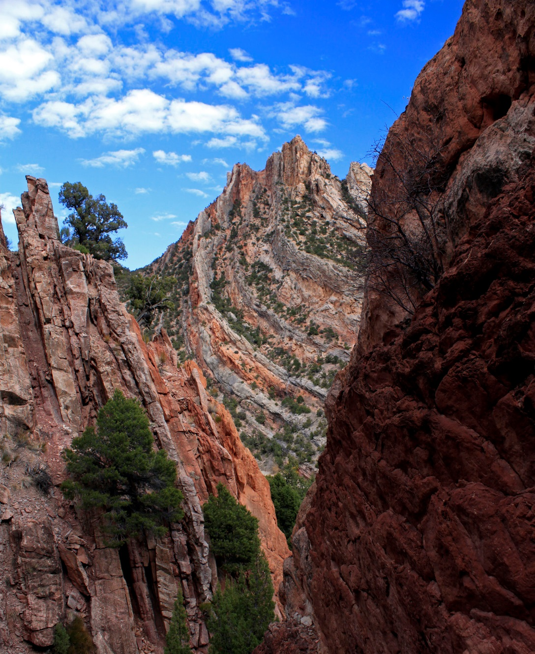
Objectives
Incorporate remote sensing into pivot point framework
Evapotranspiration
Precipitation
Temperature
Improve and expand established Term one methods
Implement a general methodology for the end-user
Image Credit: Dinosaur National Monument
Notes:
Aubry: The primary objectives of this study was to determine climate pivot points of plant communities, sagebrush in particular, for various environmental factors – including evapotranspiration, precipitation, and temperature.
Improve and expand established methodologies from term 1 by determining the most favorable way to partition the land to optimize results.
Implement a methodology that will be offered to land managers at the National Park Service and USGS in the western United States to better understand the response of vegetation to a changing climate.
Image Source: https://www.flickr.com/photos/dinosaurnps/8471165637/in/album-72157632769589812/

Slide 4
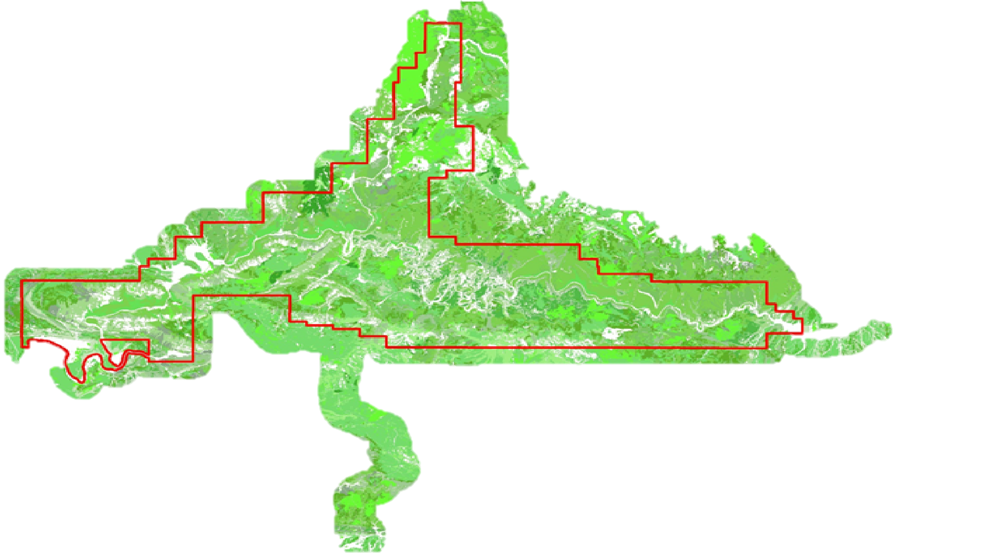
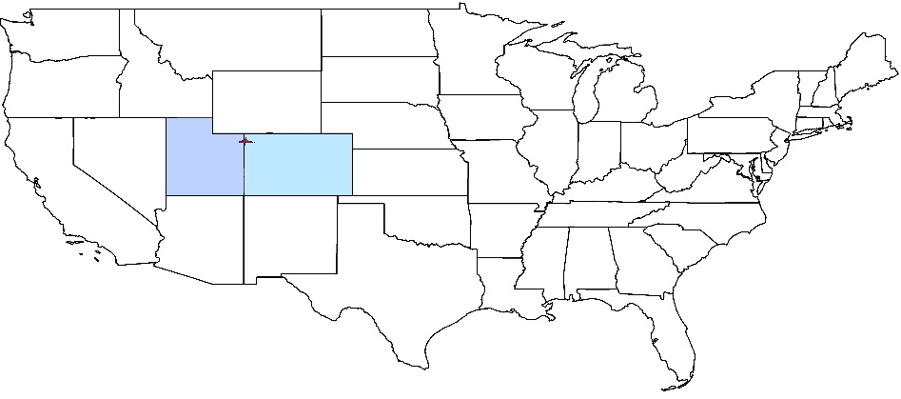
Dinosaur National Monument
Image Credit: NPS
Notes:
Aubry: Our research focused in Dinosaur National Monument, located in the northern portion of Utah and Colorado. The monument’s variety of vegetation types, soils, topographies, and elevations provided a robust ecosystem to analyze.
https://www.nps.gov/media/photo/gallery.htm?id=F0788D48-155D-451F-6708655DFDA49B5E&tagid=0&hiderightrail=true&maxrows=20&showrawlisting=false&startrow=1

Slide 5
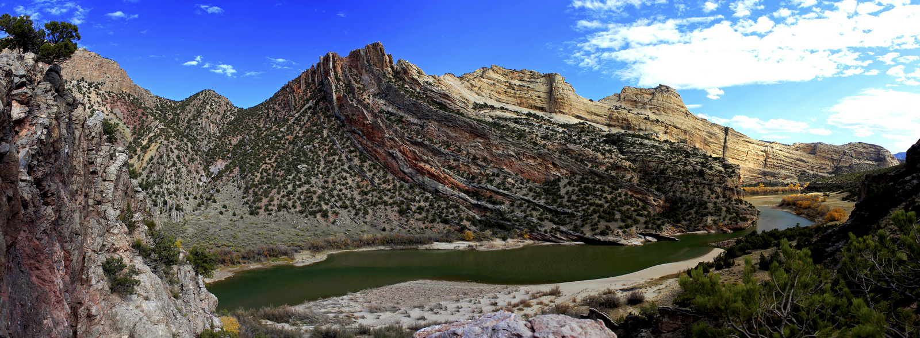
Methods Overview
Data Acquisition
Data Analysis
Linear Regression Model
Pivot Point Extraction
Evapotranspiration
Temperature
Precipitation
January 2000- December 2014
ΔNDVI = Temperature + Precipitation + Evapotranspiration
Image Credit: Dinosaur National Monument
Image Credit: Monet
Notes:
Amanda: The project began with data collection for our selected environmental variables:: evapotranspiration, temperature and precipitation (CLICK). Data was observed at a 15 year span, due to availability of MODIS data (CLICK). These datasets were then analyzed and placed into a linear regression. (CLICK) this regression aided in to determining our pivot point.
Image Source: https://www.flickr.com/photos/dinosaurnps/8473521809/in/album-72157632769589812/

Slide 6
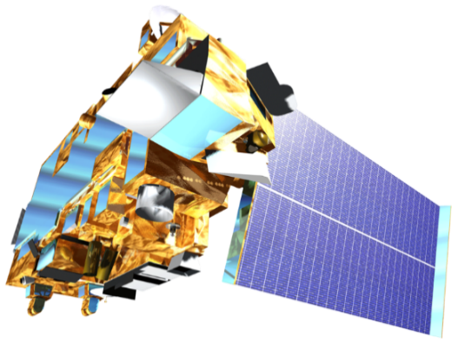
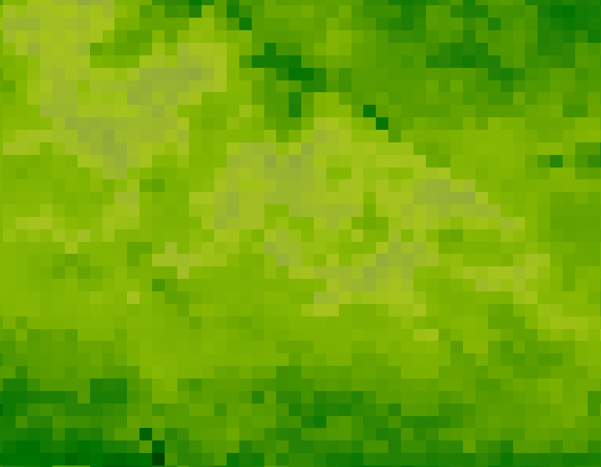
MODIS – NDVI and ET
Moderate Resolution Imaging Spectroradiometer
ForWarn Maximum NDVI
Resolution: 231 m
Global Terrestrial Evapotranspiration
Resolution: 5 km
Terra
Image Credit: NASA
Notes:
Amanda: MODIS aboard the Terra satellite was utilized to obtain ForWarn Maximum NDVI data to provide spatial and temporal comparisons of vegetation canopy greenness;
and evapotranspiration data, to account for the movement of water to the air from sources such as soil and plant canopy.
Image Source: http://www.devpedia.developexchange.com/dp/images/9/91/05_Terra.png

Slide 7
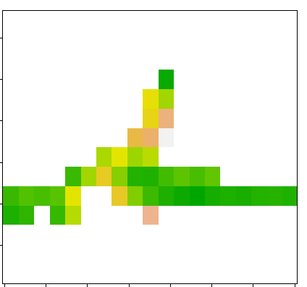
PRISM Climate Group
Temperature
Precipitation
Notes:
Amanda: PRISM data was acquired for mean temperature and precipitation at a resolution of 4km for the entire country. The data was then processed to obtain the monthly average temperature and precipitation for Dinosaur National Monument.

Slide 8
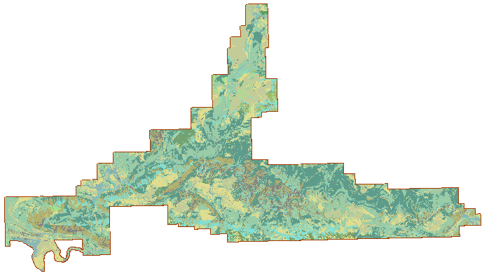
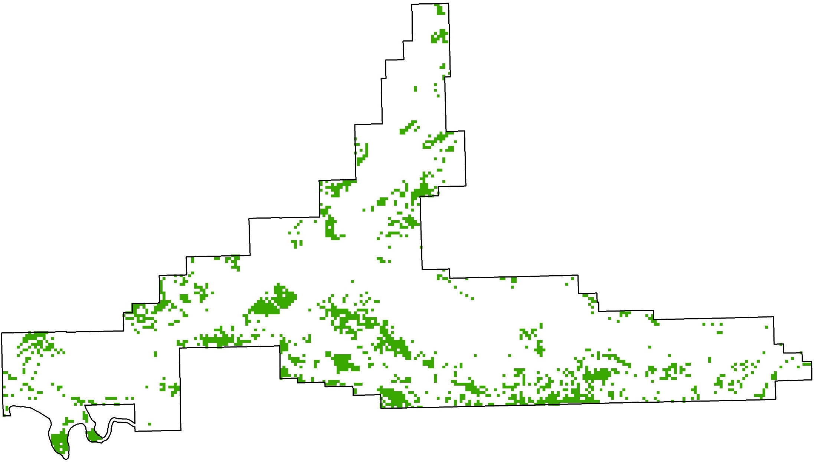
NPS Vegetation
Colorado Plateau Mixed Low Sagebrush Shrubland
Colorado Plateau Pinyon-Juniper Woodland
Notes:
Amanda: We also used vegetation data downloaded from the National Park Service, which represents all of the different vegetation types that are found throughout the national monument.
With this, we created a raster vegetation map and selected to only show Colorado Sagebrush, the main vegetation focus for our study.
Image Source: http://commons.wikimedia.org/wiki/File:Claude_Monet_-_The_Magpie_-_Google_Art_Project.jpg

Slide 9
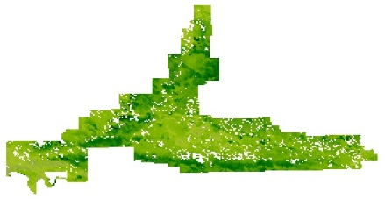
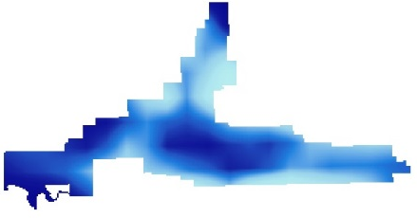
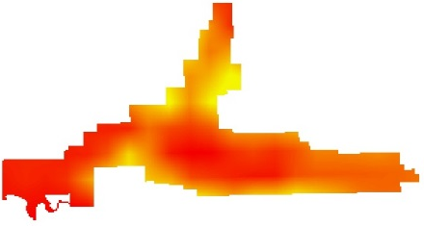
Stepping Window Approach
NDVI
Precipitation ~ NDVI
Evapotranspiration ~ NDVI
Temperature ~ NDVI
Notes:
Christine:
One of our main objectives was to determine the best way to partition the land to optimize our sample size to prevent under- or over-fitting the model used to determine climate pivot points.
We decided to use a stepping window approach to achieve this.
This approach uses a window that steps across 15 years of stacked delta NDVI data and compares it the corresponding window of 15 years of stacked precipitation, evapotranspiration, and temperature data.

Slide 10
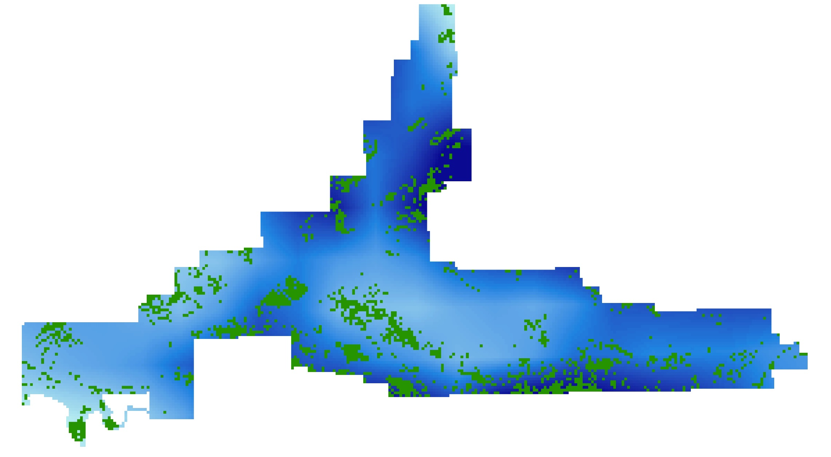
Stepping Window Approach
Notes:
Christine:
Looking closer at the stepping window, we can see a window of 5x5 move across each stack to gather a maximum of 375 data points per step that it takes. This number comes from multiplying 15 years of data by 25 pixels.
During this process, a correlation between each NDVI window with its corresponding variable window, such as precipitation, is conducted.
We set a correlation threshold to determine if we should carry out a regression.

Slide 11
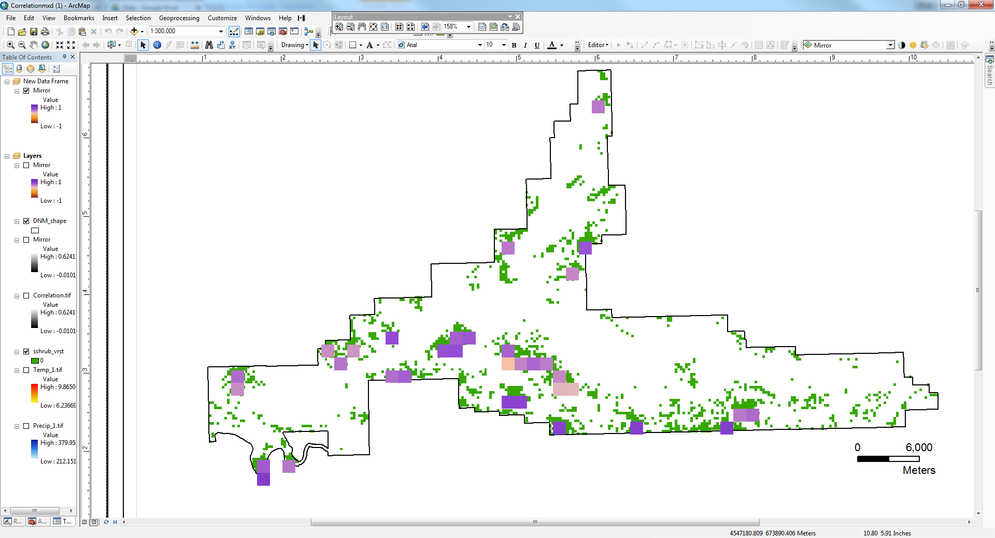
Analysis
More vulnerable to decreased precipitation
Less vulnerable to increased temperatures & change in evapotranspiration
r-value
1
-1
Notes:
Christine:
From our initial results, we found that sagebrush is more likely to have damaging effects by a decrease in precipitation as opposed to changes in temperatures and evapotranspiration.
Therefore, we took a closer look at the relationship between Delta NDVI and precipitation. We found 6 windows that met our threshold and ran a regression on them, which allowed us to extract the pivots points for those locations.

Slide 12
Results
Adjusted R-Squared | 0.306
Pivot Point (mm) | 330.5
Regression: ∆NDVI ~ Precipitation
Notes:
Here is an example of the results of one of our windows.

Slide 13
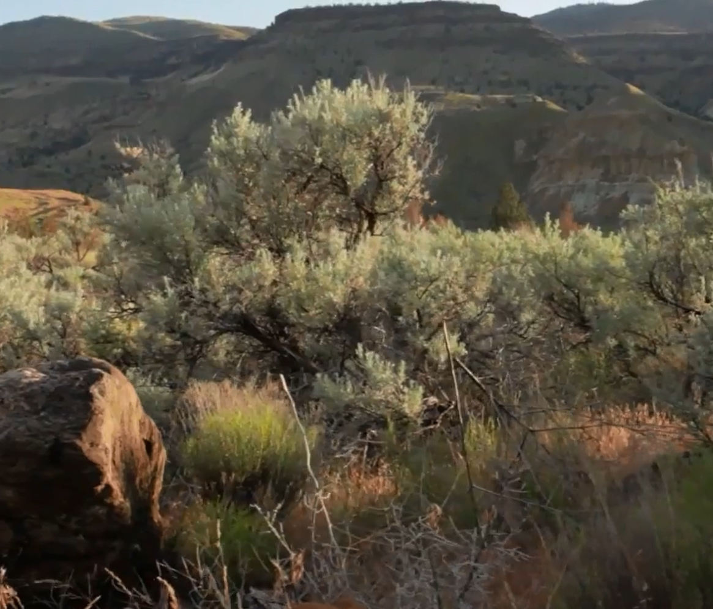
Conclusions
Temperature and evapotranspiration cause less of an impact
Stepping window optimizes sampling size
Sagebrush is reaching the threshold
Image Credit: NPS
Notes:
Taryn: In conclusion, The pivot points derived from this project determined that temperature and evapotranspiration are a lesser variables than precipitation for sagebrush within Dinosaur National Monument. Adding in stepping window optimized our sample size, which helped determine that the sagebrush is reaching the threshold where it could potentially lose productivity.
Image Source: Screen Shot from https://www.youtube.com/watch?v=Sz67kUOAJT0

Slide 14
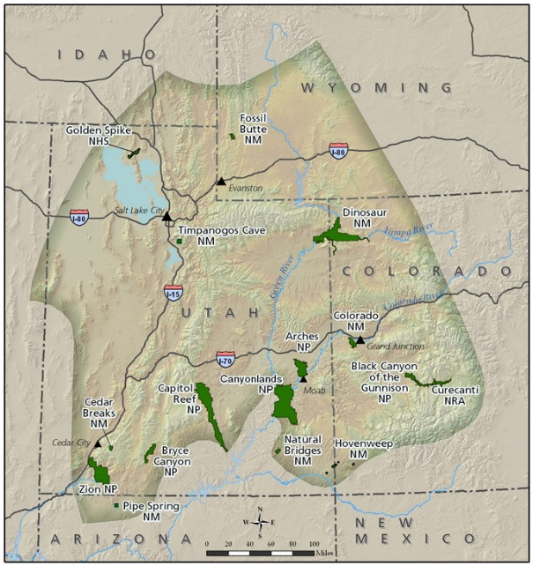
Future Work
Apply to additional parks
Different vegetation types
Integrate soils or other measures of vegetation productivity
Near-Infrared data (NIR)
Image Credit: NPS
Notes:
Taryn: This methodology can be applied to parks outside of Dinosaur National Monument and can be used with different vegetation types.
The model can be further adapted to integrate soils or other measures of vegetation productivity such as NIR, to aid in the understanding of climate impacts on vegetation throughout the West.
Image Credit:http://science.nature.nps.gov/im/units/ncpn/parks/index.cfm#map

Slide 15
Science Advisor
Dr. Kenton Ross, NASA Langley Research Center
Project Partners
Dr. David Thoma, Ecologist, NPS Northern Colorado Plateau and Greater Yellowstone Networks Inventory and Monitoring Program
Dr. Seth Munson, Plant Ecologist, USGS Southwest Biological Science Center
Past Contributors
Kelly Meehan Molly Spater Kaylie Taliaferro
Teresa Fenn Thomas Smith Grant Jaccoud
Image Source: Joshua Hardin
Notes:
Image Credit: http://www.viewfindermedia.com/wordpress/happy-earth-day-good-friday/

