Slide 1
Northwest United States Agriculture II
Evaluating Suitability for Apple Cultivation Based on Accumulated Chill Hours in Washington State from 2003-2065
Lydia Cuker (Team Lead)
Laura Lykens
Alyssa Walzak
Timothy Stelter

Slide 2
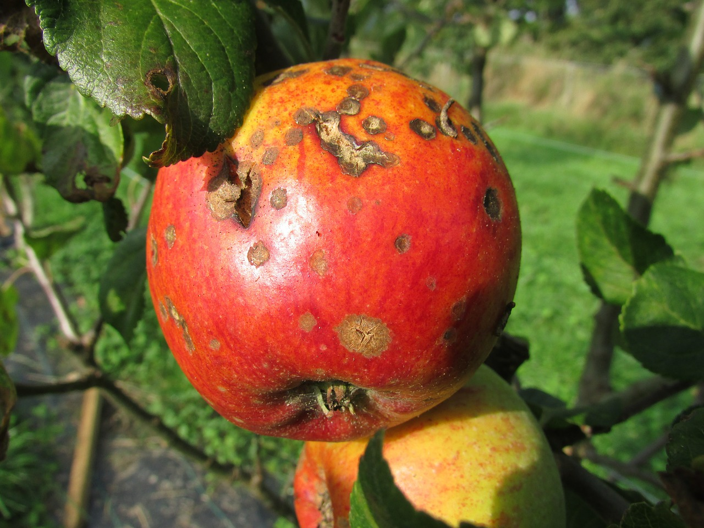
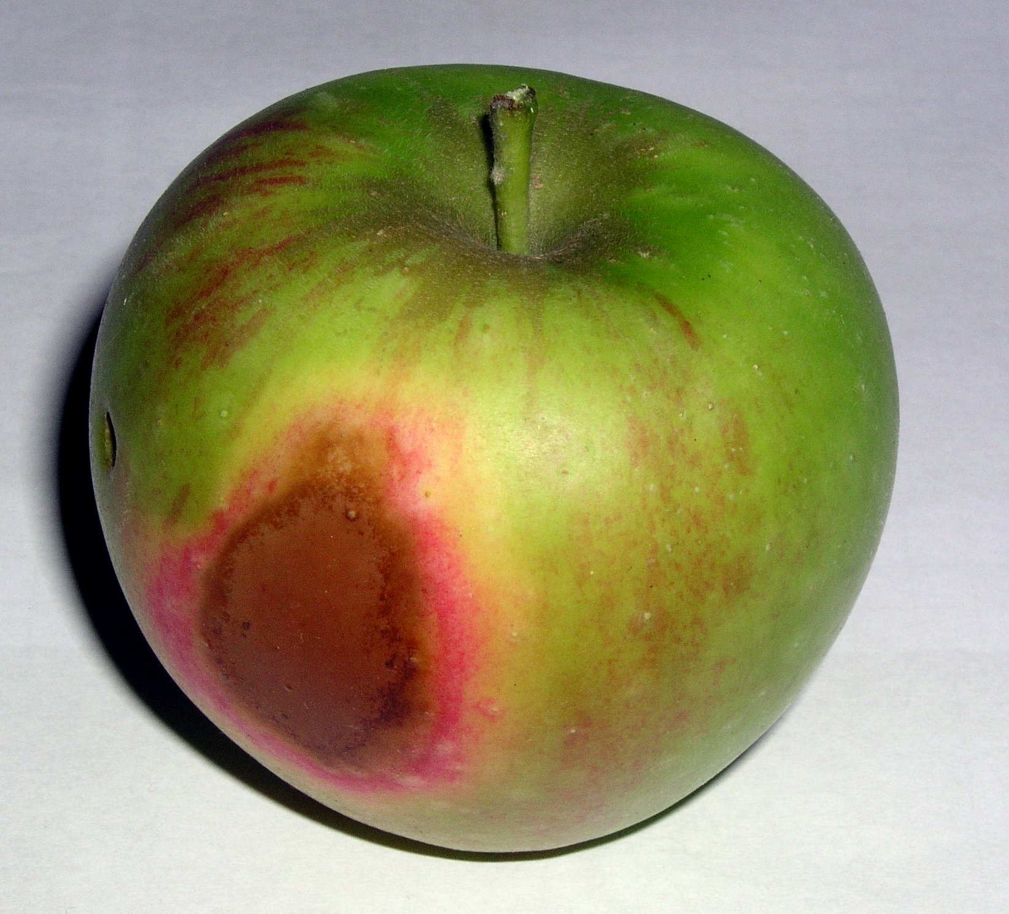
Community Concerns
Washington State is the top apple producing state in US (USDA)
Climate fluctuations may alter temperature trends, resulting in negative impacts on apple growth
If temperatures rise there could be a decrease in chill hours
Apple Blight
Apple Sunburn
Source: Kasman
Source: J. Stein
Notes:
The community concerns centered around apple production and the effect a fluctuating climate may have on it. Washington is the top apple producing state in the US and a rise in temperatures could negatively impact the industry. Two possible negative results could be that current orchards may see a reduction in accumulated chill hours and an increased demand for irrigation water. Both of these situations can lead to trees and fruit overheating, leading to damaged apples like this one here that has been sunburned.

Slide 3
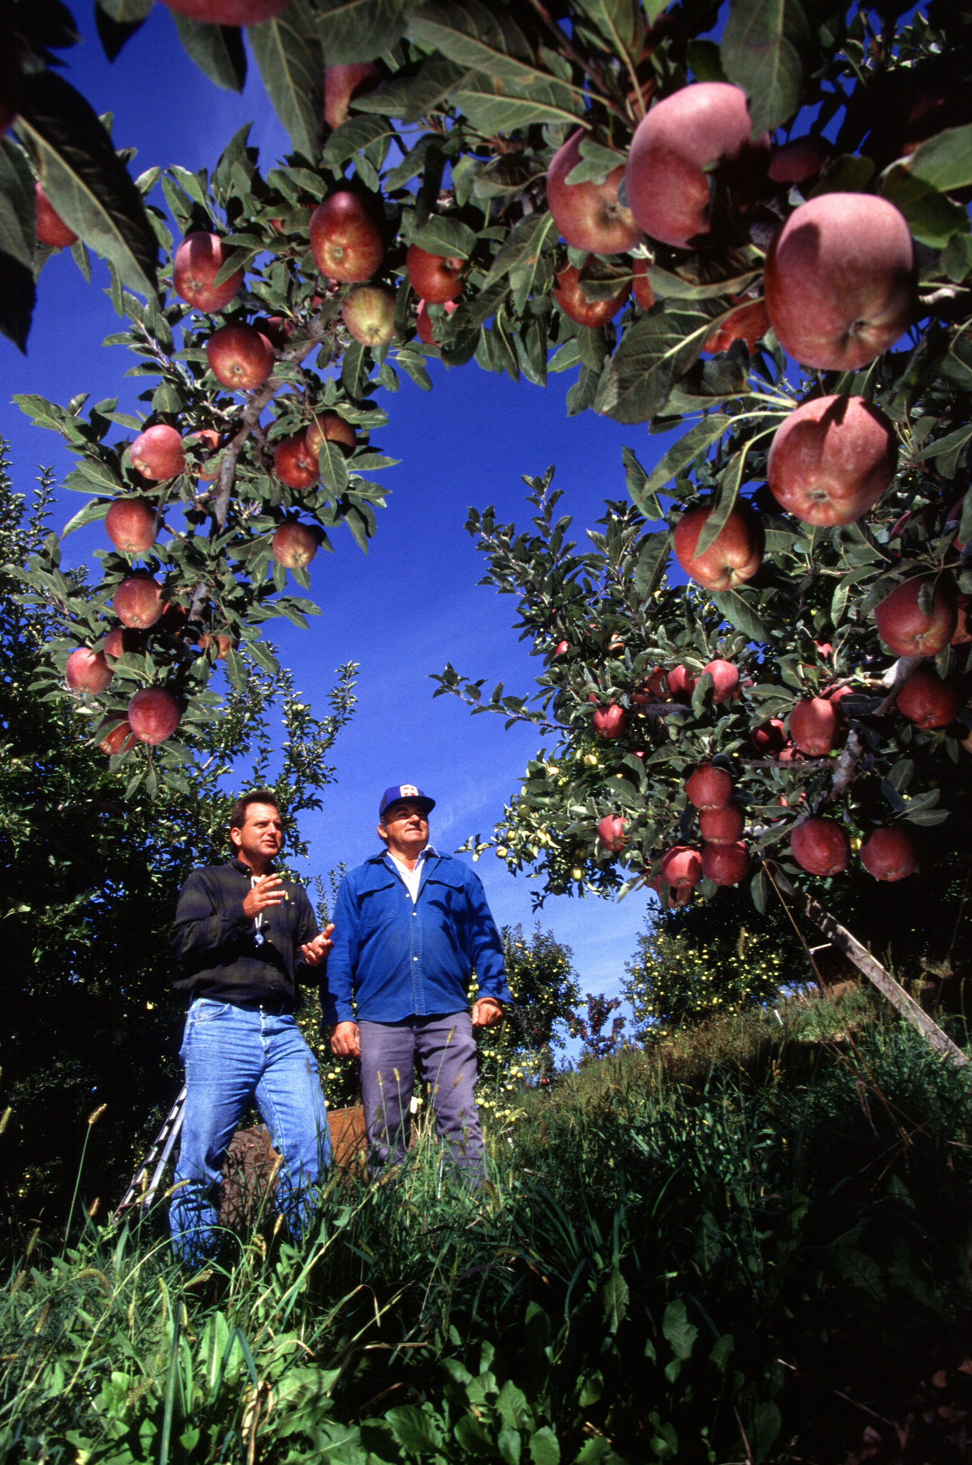

Objectives & Project Partner
Map accumulated chill hours
  Current accumulated chill hours
  Forecasted accumulated chill hours
Dr. Michael Glenn
Appalachian Fruit Research Station
USDA - Agriculture Research Service
Source: S. Bauer, USDA - ARS
Notes:
The objective of the project was to map accumulated chill hours for the region. First, a map of the current accumulated chill hours, and second, a map of forecasted accumulated chill hours for each 2045 and 2065. We partnered with Dr. Glenn from the USDA Agriculture Research Service and he disseminated the findings to growers in Washington.

Slide 4
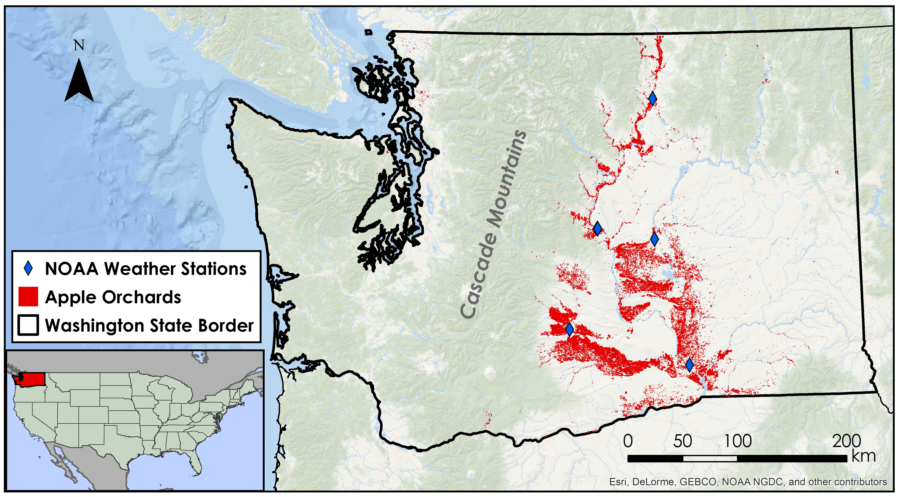
Study Area: Washington, USA
Study Period: 2003 – 2013, 2045, 2065
Notes:
The study area for the project was the state of Washington for the years of 2003-2013 and 2040-2070. The location of apple orchards is shown in red. With the majority of orchards falling in the eastern half of the state, that was where the project focused.

Slide 5
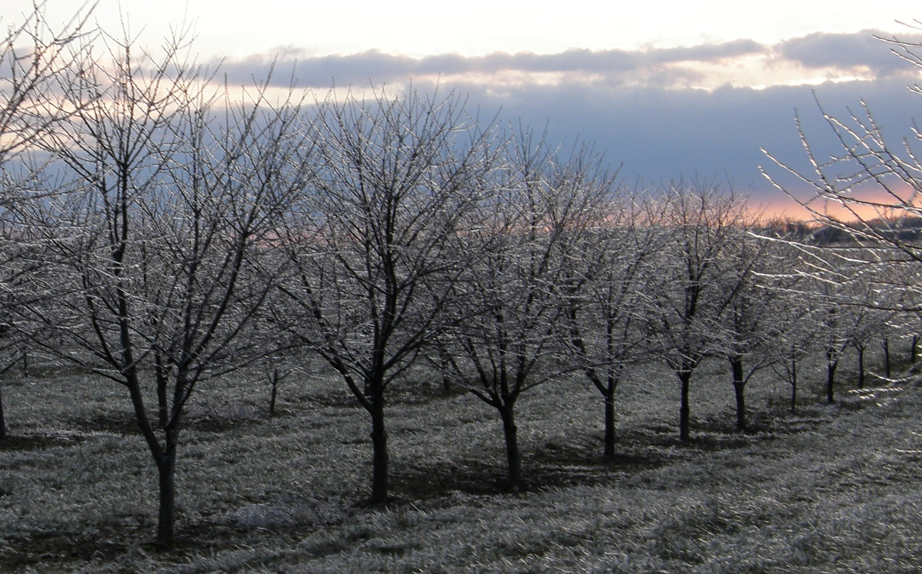
Chill Hours
The number of hours that fruit trees experience within a specific temperature range
  1.4ºC < T_{air} ≤ 12.4ºC
Apple trees require 500 – 1000 chill hours to homogenously break dormancy and bloom
Source: fauxto_digit
Notes:
In order for fruit to thrive in unfavorable weather, it is required for the trees to be accustomed to specific chilled temperature ranges for certain amount of hours, also known as chill hours. Apple trees require 500-1000 chill hours to break dormancy and continue to flower.

Slide 6
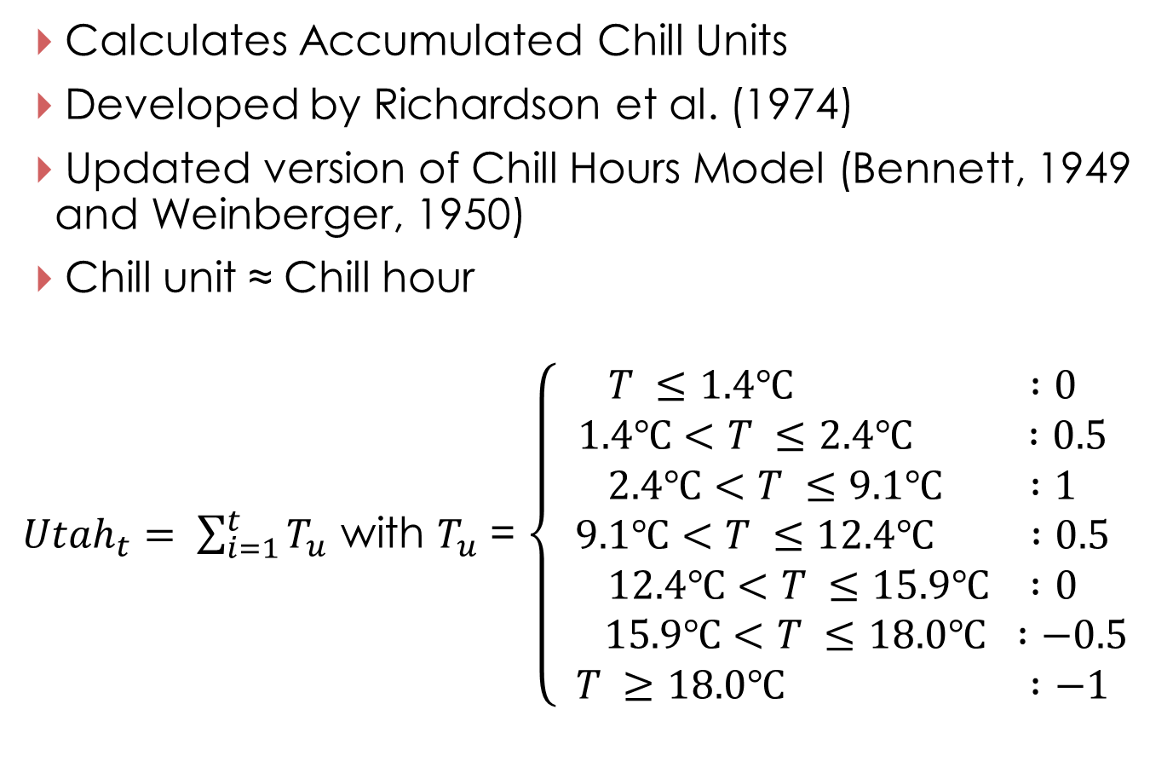
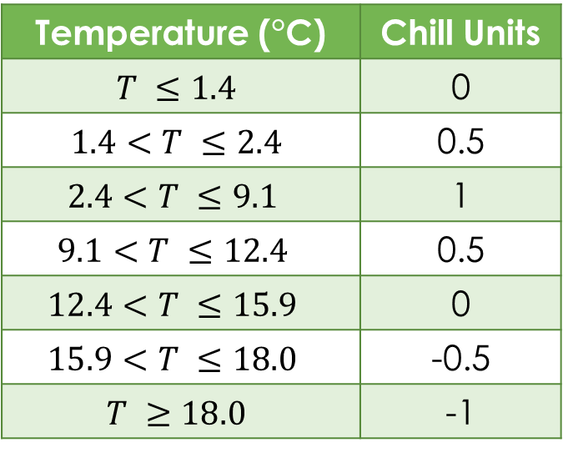
Utah Model
Calculates Accumulated Chill Units
Developed by Richardson et al. (1974)
Updated version of Chill Hours Model (Bennett, 1949 and Weinberger, 1950)
Chill unit ≈ Chill hour
${Utah}_{t}= \sum_{i=1}^{t}{T_{u}}$ with $T_{u}$ = $\left\{\begin{aligned}T ≤1.4℃ :0 \\ 1.4℃<T ≤2.4℃ :0.5 \\ 2.4℃<T ≤9.1℃ :1 \\ 9.1℃<T ≤12.4℃ :0.5 \\ 12.4℃<T ≤15.9℃ :0 \\ 15.9℃<T ≤18.0℃ :−0.5 \\ T ≥18.0℃ :−1\end{aligned}\right.$
Temperature (°C) | Chill Units
$$T ≤1.4$$ | 0
$$1.4<T ≤2.4$$ | 0.5
$$2.4<T ≤9.1$$ | 1
$$9.1<T ≤12.4$$ | 0.5
$$12.4<T ≤15.9$$ | 0
$$15.9<T ≤18.0$$ | -0.5
$$T ≥18.0$$ | -1
Notes:
The Utah Model was used to calculate accumulated chill units. Adapted by Richardson et al., it built off of the Chill Hours Model developed in studies by Bennett and Weinberger.
One chill unit is approximately one chill hour, however chill units are calculated from more temperature divisions with weights applied to them. The whole equation is shown here with the divisions and weights assigned to the temperature ranges and then the number of units summed for the whole “year”. For every hour that there were temperatures between 1.4 C and 12.4 C, 0.5 or 1 chill unit contributed to accumulated chill hours. Meanwhile, for every hour that temperatures were above 15.9 C, units were detracted.
No units count towards the accumulated total for temperatures below 1.4 C because it is too close to freezing or below freezing.
For each temperature range there is an assigned chill unit. The sum of the chill units is accumulated chill units, which are roughly equal to accumulated chill hours, but more accurate because of the temperature divisions and assigned weights. This equation was entered into python to calculate the daily temperature hours and was the basis for project methodology.

Slide 7
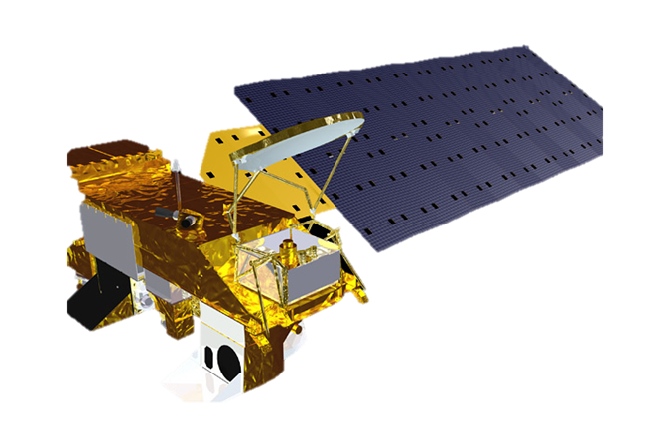
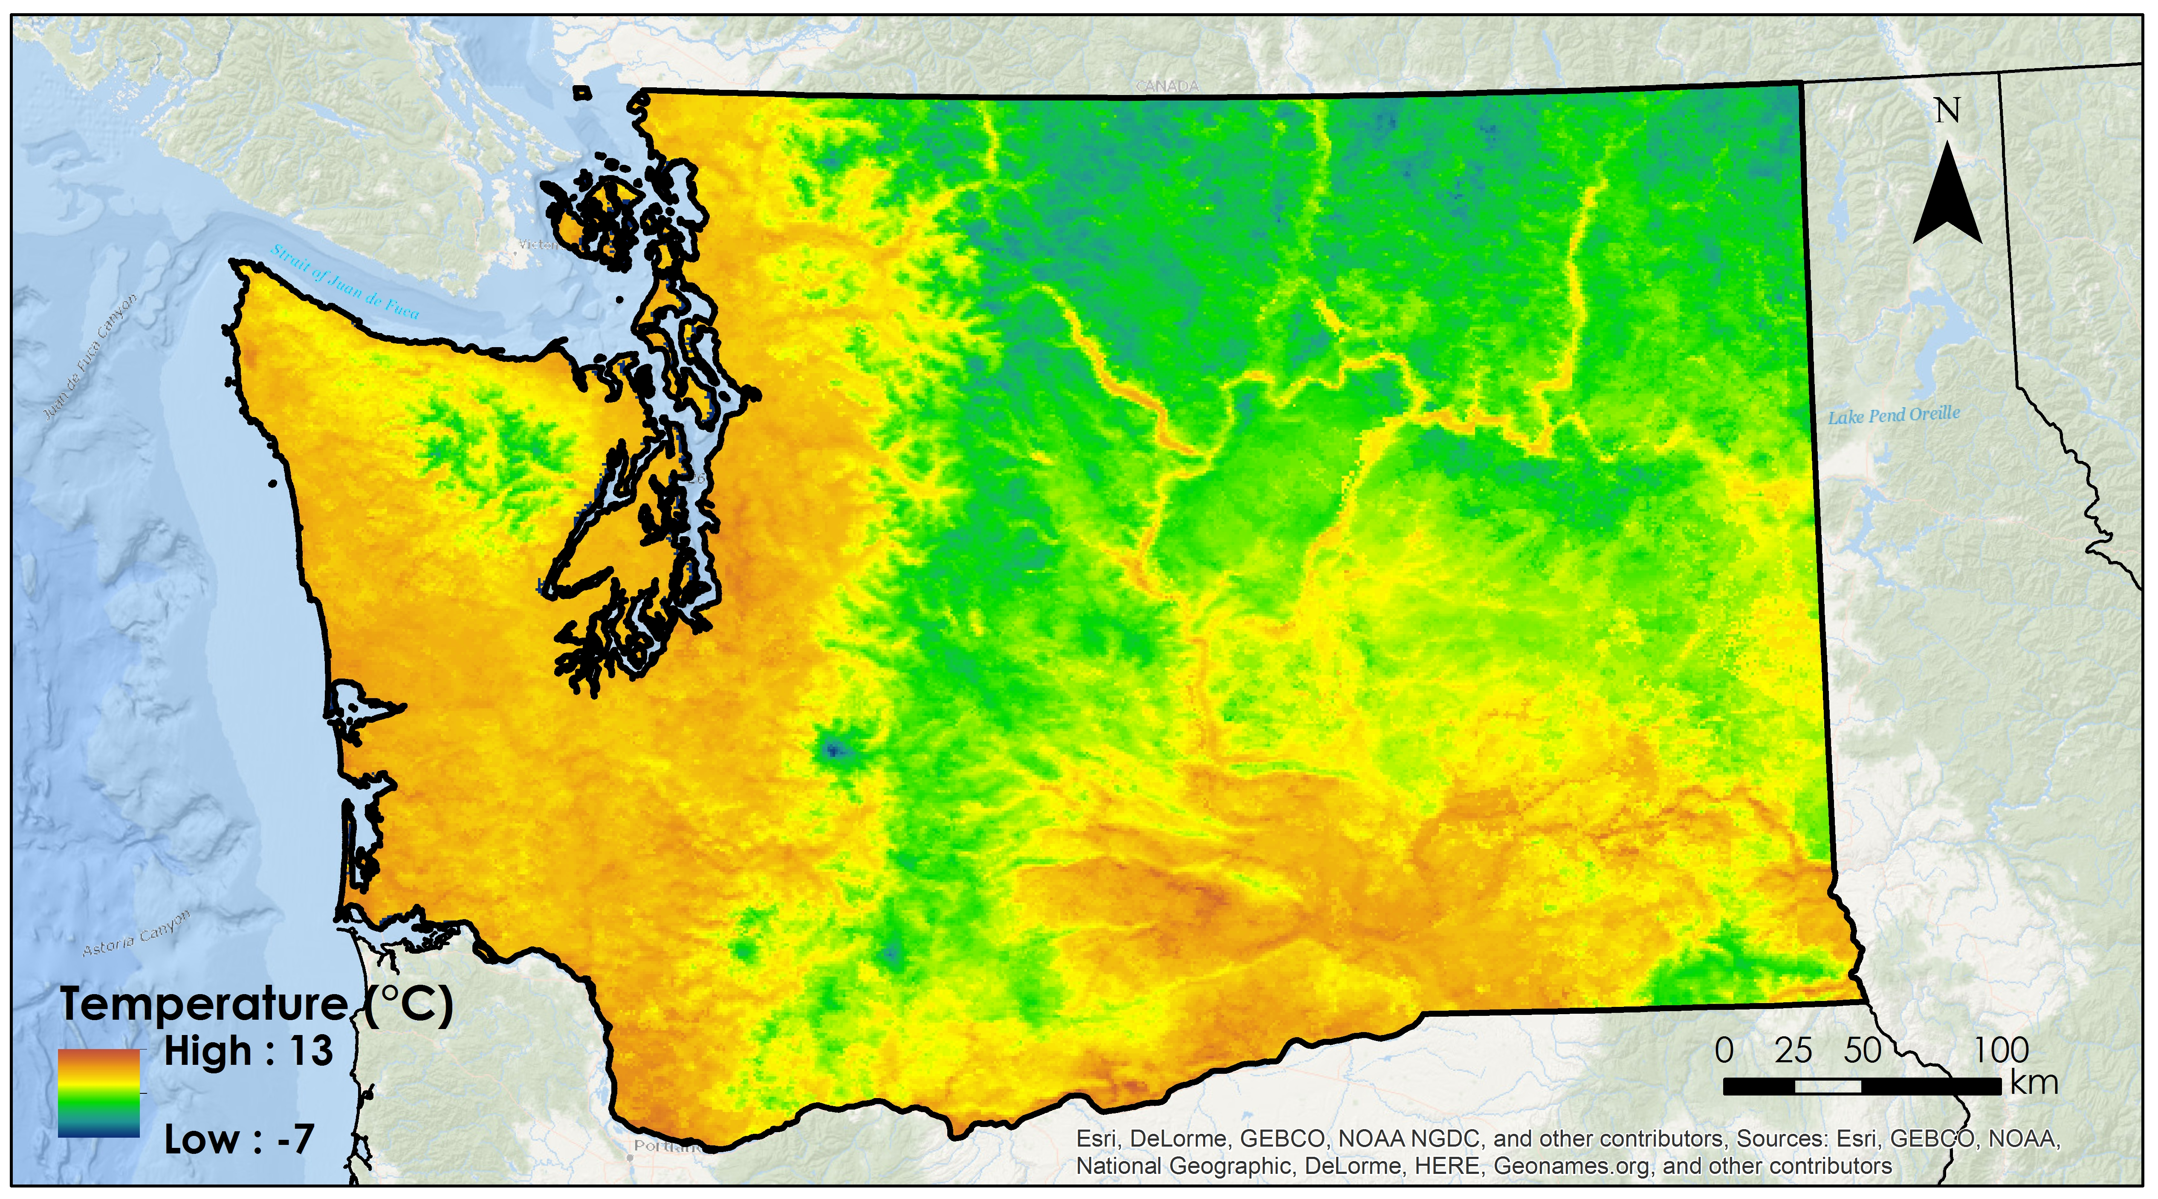
Earth Observations
Aqua
MODIS Land Surface Temperature (LST)
Notes:
The Earth observations used for this project were the Land Surface Temperature product from Aqua MODIS.

Slide 8
Project Methodology
Data Acquisition
Data Processing
Data Analysis
Hourly Temperature
NOAA ASOS
Weather Stations
2003 – 2013
Normalized hourly temperature
Utah Model
Current Accumulated
Chill Units
Averaged normalized diurnal temperature curve
Converted to T_{air}
Land Surface
Temperature (LST)
MODIS
2003 – 2013
Applied averaged normalized diurnal temperature curve to daily T_{max} & T_{min}
Utah Model
Current Accumulated
Chill Units for 24 hours
Hourly temperature for 24 hour period
Notes:
This was the methodology we used.

Slide 9
Project Methodology
Data Acquisition
Data Processing
Data Analysis
Hourly Temperature
NOAA ASOS
Weather Stations
2003 – 2013
Normalized hourly temperature
Utah Model
Current Accumulated
Chill Units
Averaged normalized diurnal temperature curve
Converted to T_{air}
Land Surface
Temperature (LST)
MODIS
2003 – 2013
Applied averaged normalized diurnal temperature curve to daily T_{max} & T_{min}
Utah Model
Current Accumulated
Chill Units for 24 hours
Hourly temperature for 24 hour period
Notes:
First, hourly temperature data was acquired from NOAA ASOS weather stations. The data was normalized by time to account for differences in daylight hours and by temperature range to account for minimum and maximum temperature extremes. From this, an averaged normalized diurnal temperature curve was derived. The hourly data was also used as input for the Utah Model to calculate accumulated chill units.

Slide 10
Project Methodology
Data Acquisition
Data Processing
Data Analysis
Hourly Temperature
NOAA ASOS
Weather Stations
2003 – 2013
Normalized hourly temperature
Utah Model
Current Accumulated
Chill Units
Averaged normalized diurnal temperature curve
Converted to T_{air}
Land Surface
Temperature (LST)
MODIS
2003 – 2013
Applied averaged normalized diurnal temperature curve to daily T_{max} & T_{min}
Utah Model
Current Accumulated
Chill Units for 24 hours
Hourly temperature for 24 hour period
Notes:
Next, MODIS Land Surface Temperature data was acquired and converted to air temperature. The averaged normalized diurnal temperature curve derived from the NOAA hourly temperature data was applied to the maximum and minimum air temperatures to extrapolate hourly temperatures for a 24 hour period. These extrapolated temperatures were the input for the Utah Model to calculate accumulated chill units for the day.

Slide 11
Methods/Results
Averaged Normalized Diurnal Temperature Curve

Slide 12
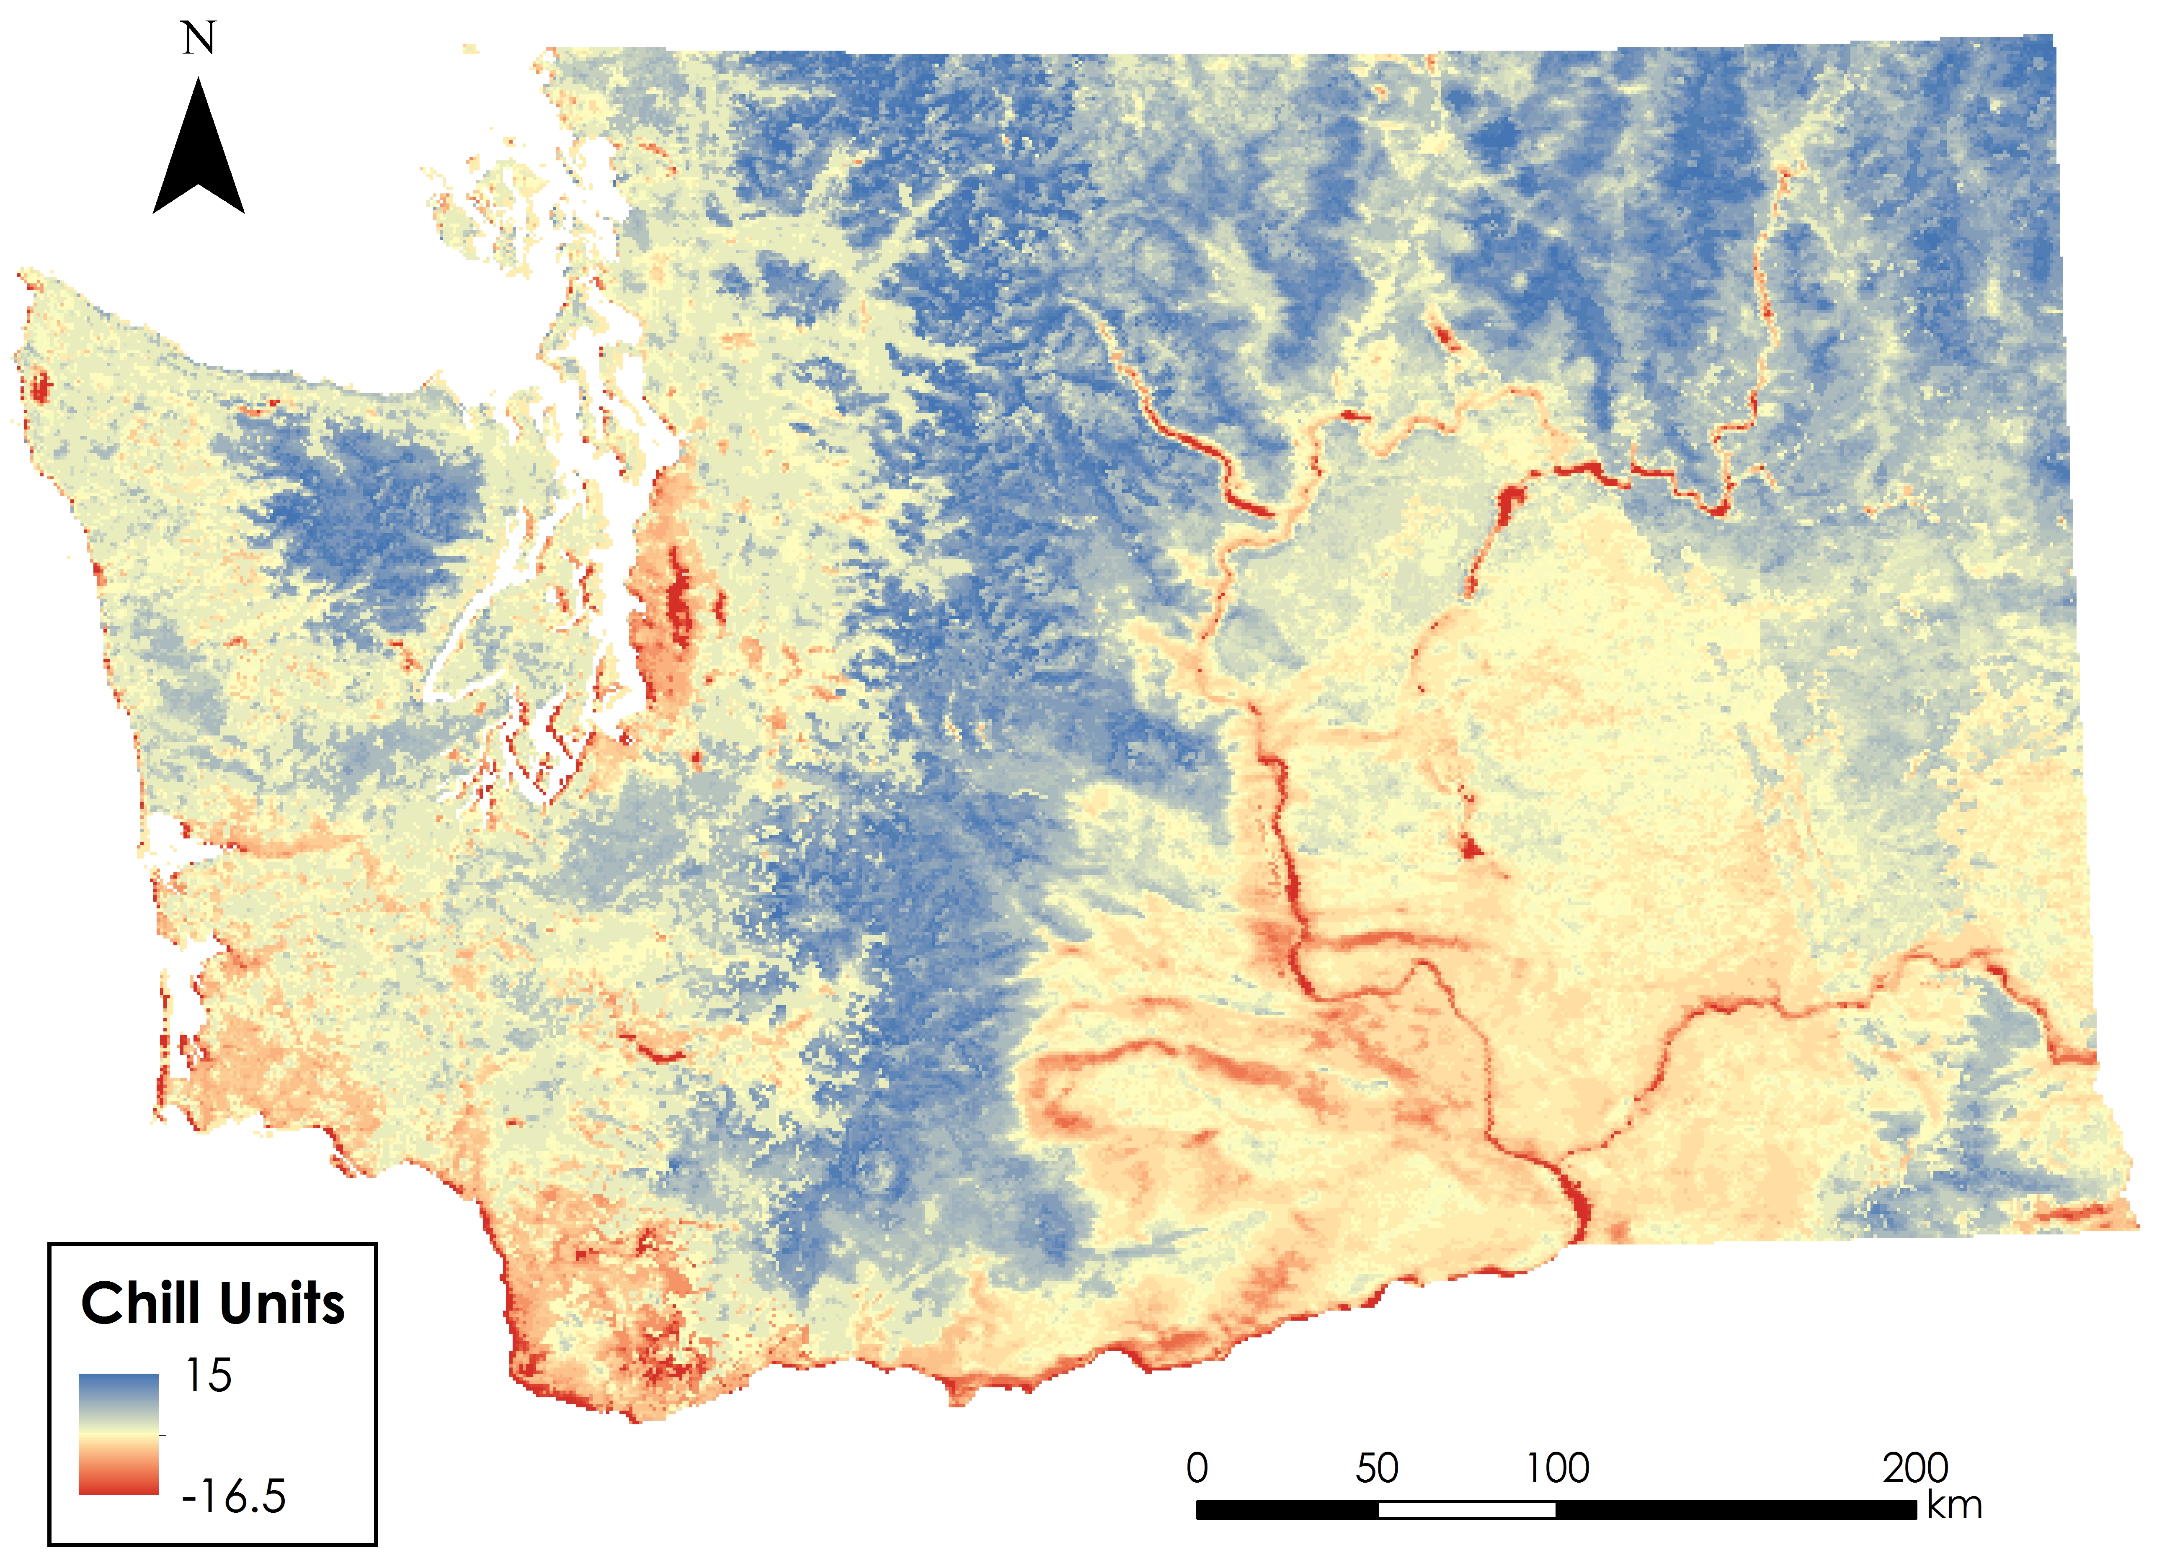
Results
24 Hour Accumulated Chill Hours for October 16
Notes:
TBD

Slide 13
Conclusions
Deriving the averaged normalized diurnal temperature curve enabled the application of MODIS LST data for calculating chill hours
Maps produced help orchard managers in decision making about:
  How to proceed with their apple production
  Altering growing practices
  Moving orchard locations altogether
Notes:
TBD

Slide 14
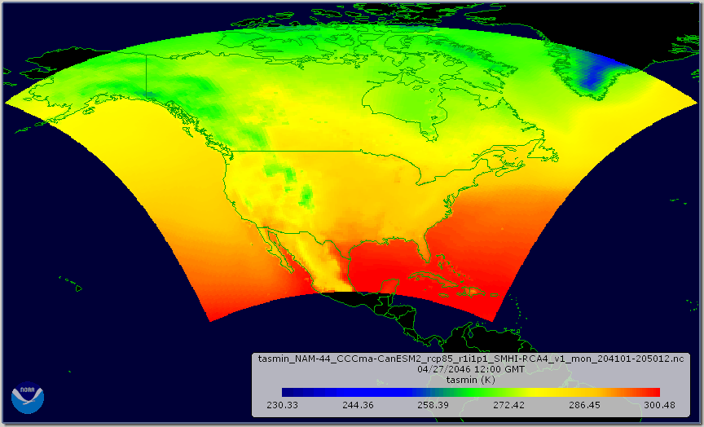
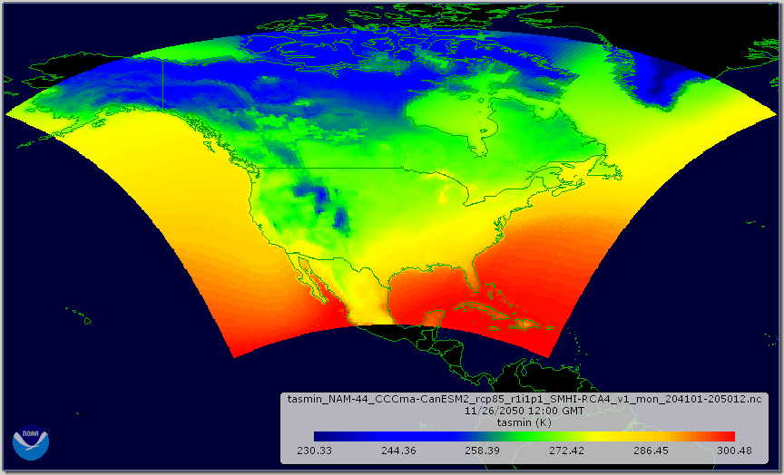
Future Work
Further work needed to calculate accumulated chill hours for a year
  Current trend vs. forecasted accumulated chill hours
Incorporation of CMIP5 climate model data can enable the forecast of accumulated chill units
  2045 and 2065
Can apply methodology to all of Washington, or possibly other locations

Slide 15
Acknowledgements
Dr. Michael Glenn
USDA-ARS Appalachian Fruit Research Station
Dr. Kenton Ross
NASA DEVELOP National Program
Science Advisor
Dr. Noel Baker
NASA Postdoctoral Program Fellow
Nathan Owen
NASA DEVELOP – Langley Center Lead
Jeffry Ely
NASA DEVELOP Geoinformation Scientist
Northwest United States Agriculture I
Fall 2014
This material is based upon work supported by NASA through contract NNL11AA00B and cooperative agreement NNX14AB60A.
Notes:
We would like to thank everyone who helped make this project possible, most notably Dr. Ross and Dr. Baker for their guidance and expertise, and Nathan and Jeff for their invaluable assistance throughout all aspects of the project. And thank you (audience) for your time.

