Slide 1
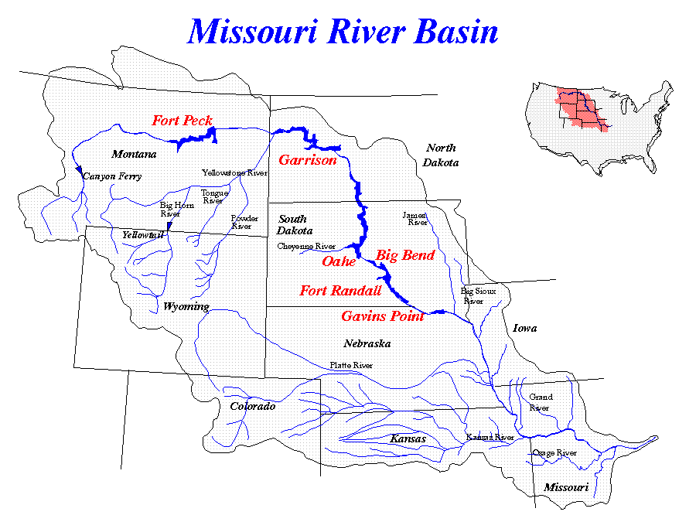
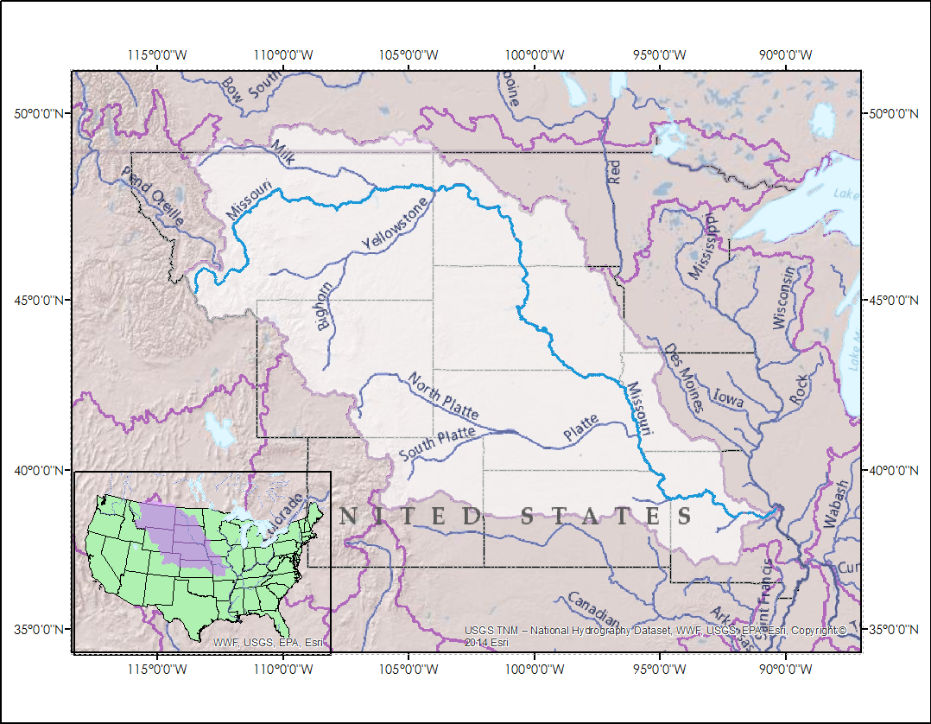
Missouri River Climate
Understanding runoff in the Missouri River Basin using NASA and NOAA satellite observations for improved river system management and decision support.
Emily Sturdivant, Alec Courtright, Nancy Barnhardt, and Sam Swanson
NASA DEVELOP National Program at NOAA NCEI
Abstract
Study Area
Keep this blank for now.
Body text point size should be at least 24.
Caption text point size should be at least 16.
Feel free to rename, move, and resize sections as needed.
Objectives
To detect historic and present winter severity, soil moisture, and snow water equivalents through a combination of NASA Earth Observations, NOAA CDRs, and in situ data.
To document normal and anomalous conditions for the Northern Plains region.
To perform exploratory analyses of the association between these driver variables and stream discharge with a focus on seasonality and anomalous events, in order to better understand water supply and runoff in the Missouri River Basin.
Earth Observations
Placeholder image above. Current study area image highlights main area of focus (Upper MRB and northern plains)
Global Historical Climatology Network (GHCN)
North American Land Data Assimilation System (NLDAS)
Defense Meterological Satellite Program (DMSP)
3. Analysis
Results
Methodology
Methodology flow chart will feed directly into Result images for each variable. (type in what type of graph you anticipate to go here)
*Soil Moisture: Will include GIS map of soil moisture changes over 1979-2015 at most relevant depth.
*SWE: Will include GIS map of change in annual max SWE by pixel over 33 year period 1979-2012
*Winter Severity: Will include GIS map of change in winter severity over 30 year period 1981-2010
2. Processing
Linear Regression
Start and end date trends
Chi Square Test
Validating the utility of each data set
1. Data
Calculate
Monthly averages of soil moisture percent
Soil Moisture
Calculate
1. Annual max SWE by pixel
2. Average max SWE since 1979 by pixel
3. Average daily SWE by region
Linear Regression
Annual max SWE trend since 1979
Compare average daily SWE with average daily streamflow at corresponding gauge
Determine normal vs anomalous years
Data Acquisition
Snow Water Equivalent
Winter Severity
Calculate
Temp. average to Freezing Degree Days
Freezing Degree Days to Air Freezing Index
(FDD & AFI graph here)
Linear Regression
Start date trends of freezing days
End date trends of freezing days
Length
Conclusions
Use bullets.
Use complete sentences with periods.
Team Members
Project Partners
Acknowledgements
Photo will go here
Missouri River Basin Water Management (MRBWM): Kevin Grode, Reservoir Regulation Team Lead
NOAA Regional Climate Services Director (RCSD): Doug Kluck, NCEI Regional Climate Services Director, Central Region
We would like to thank our Center Lead Jessica Sutton and our science advisor Dewayne Cecil for all of their help and guidance throughout this project.
We would also like to acknowledge:
Rocky Bilotta: NOAA NCEI
Anthongy Arguez: NOAA NCEI
Jesse E. Bell: NOAA NCEI and CDC at Emory
Ethan Shepherd: NOAA NCEI
Carrie Vuyovich: Cold Regions Research and Engineering Laboratory USACE
and everyone else at NCEI who gave us guidance along the way.
NOAA National Center for Environmental Information

