Slide 1
TOA BAJA
Disasters
Utilizing Open-Source Earth Observations to Inform the Toa Baja Municipality’s Flood Mitigation Efforts and Educate the Public
Nara McCray, Scott Harrison, Wilfredo García López, Adriana Le Compte Santiago
Virginia – Langley
Notes:
Speaker 1: Hello, we are Nara McCray, Scott Harrison, Wilfredo Garcia Lopez, and Adriana Le Compte Santiago, and we are the Toa Baja Disasters team. Today we will be sharing our results from our ten week project that encompassed using NASA earth observations to create materials that will allow Toa Baja to educate the public on flood risk.
Image Credit: Web Image Generated by Project Team

Slide 2
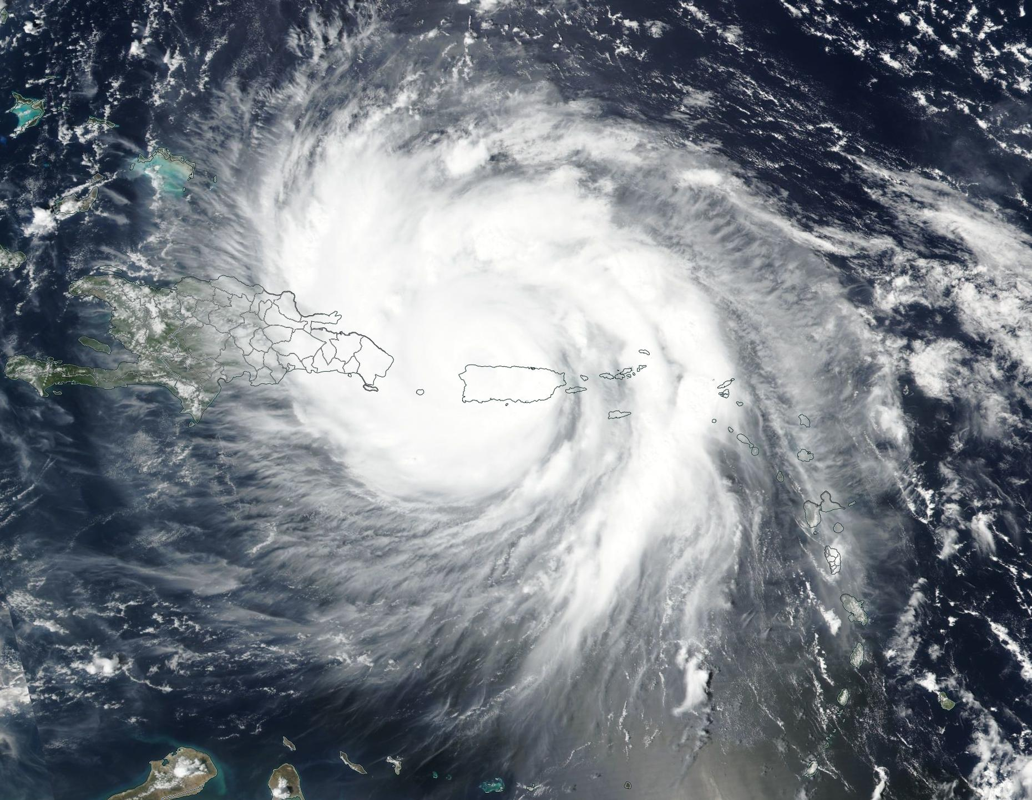
BACKGROUND
On September 20th, 2017, Hurricane Maria made landfall over Puerto Rico contributing to the costliest hurricane season in US history
Image by NASA Worldview
Notes:
Speaker 2: Our project begins with September 20th, 2017. When Hurricane Maria made landfall over Puerto Rico, as part of the costliest hurricane season in US history. It caused an island wide blackout for months, destroyed local’s homes, and caused floods across the island.
This hurricane was especially damaging to the Toa Baja municipality in the North.
------------------------------Image Information Below ------------------------------
•Image Sources: NASA worldview (Free Use): https://worldview.earthdata.nasa.gov/?v=-107.24207099143044,-24.07675494409779,-24.811280146353205,59.84164040667616&t=2017-09-25-T00%3A00%3A00Z&as=2017-09-18-T00%3A00%3A00Z&ae=2017-09-25-T00%3A00%3A00Z&l=Reference_Labels(hidden),Reference_Features,Coastlines(hidden),VIIRS_SNPP_CorrectedReflectance_TrueColor,MODIS_Aqua_CorrectedReflectance_TrueColor(hidden),MODIS_Terra_CorrectedReflectance_TrueColor(hidden)&tr=hurricane_maria_september_2017&al=true&ab=on

Slide 3
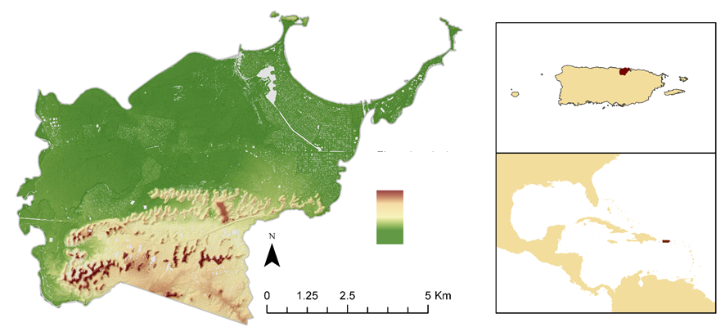
STUDY AREA
Toa Baja is located on the northeast coast of Puerto Rico
60% of its land is designated as floodplain
Nearly 14,000 homes were flooded by Hurricane Maria
$1.3 billion dollars in damage from Hurricane Maria
PUERTO RICO
Elevation
North America
High
Low
Caribbean Sea
South America
Notes:
Speaker 3: The coastal Municipality of Toa Baja, located on the northeast of Puerto Rico, is highly susceptible to flooding due to its unique topography [flat, contains mouth of largest Puerto Rican river of largest catchment area]. According to analysis done by FEMA in 2018, 60% of its land to be designated as a floodplain. Even though the northeast coast floods frequently due to heavy rainfall and storm surge, Toa Baja was not prepared for the damage the Category 5 hurricane Maria brought. During Hurricane Maria around 14,000 homes in Toa Baja were flooded and the Municipality suffered $1.3 billion dollars in damage.
To prepare for the increasing frequency and severity of flooding due to climate change, the city is seeking insight about relative flood risk in the municipality.
Image Credit: Project Team Generated Map

Slide 4

PARTNERS
Municipality of Toa Baja
ResilientSEE
MIT Urban Risk Lab
  NASA DEVELOP
  Virginia – Langley
  Spring 2020
Notes:
Speaker 4: Our project partnered with the Municipality of Toa Baja, the non-profit ResilientSEE, and the MIT Urban Risk Lab. Toa Baja is our end-user and primary stakeholder for the project, who will be using our model results to educate the public on flood risk factors. ResilientSEE and the MIT Urban Risk Lab provided knowledge from their previous work in Puerto Rico through resilient design strategies.

Slide 5
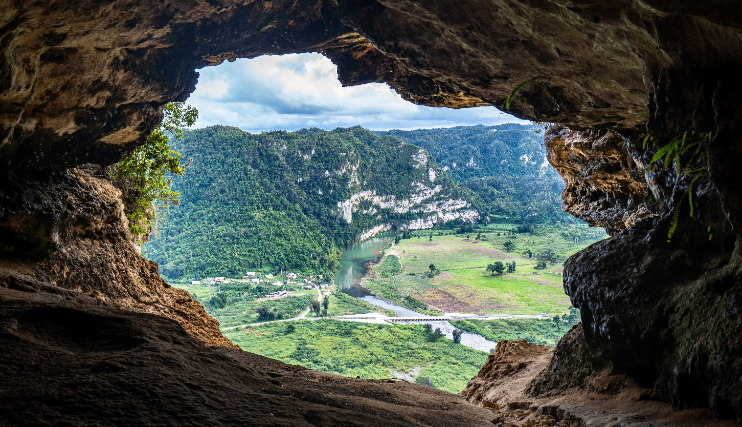
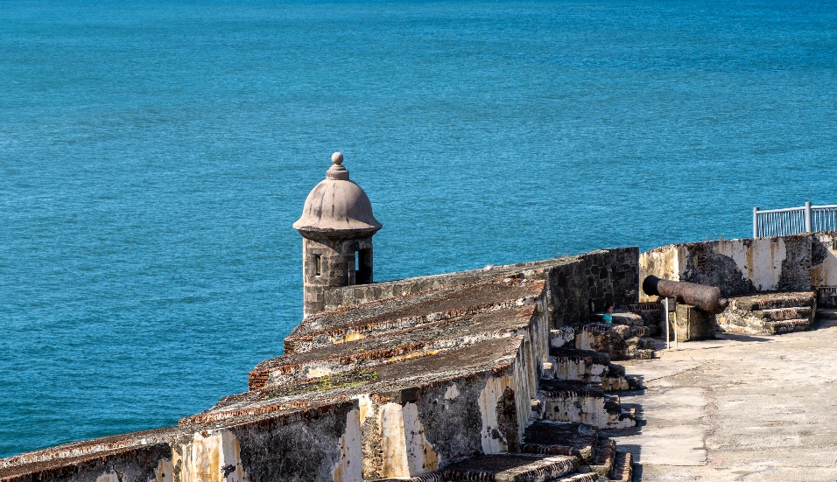
OBJECTIVES
Build a flood susceptibility map
Generate a
flood risk
map
Compare against historical flooding
Create an ArcGIS Online Story Map
Images by Wei Zeng
Notes:
Speaker 1: The are four objectives to our project. The first two are to create a static flood susceptibility map of the study area by combining weighted factors, create a flood risk map by incorporating additional human related variables to account for the flood impacts. Then we will compare our maps against actual historical flooding that occurred during Hurricane Maria in 2017, as well as the 2018 HECRAS FEMA maps. We will also create a Toa Baja ArcGIS Online Story Map to allow Toa Baja residents to easily explore flood risk and susceptibility.
------------------------------Image Information Below ------------------------------
El Morro Fort by Wei Zeng (free use license https://unsplash.com/license) from Unsplash https://unsplash.com/photos/wAEY2TDxXUM
Cave view by Wei Zeng (free use license https://unsplash.com/license) from Unsplash https://unsplash.com/photos/HaFV1cviJ_4

Slide 6
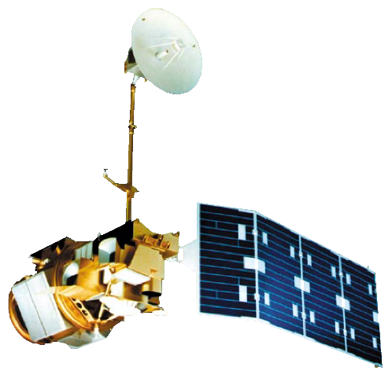
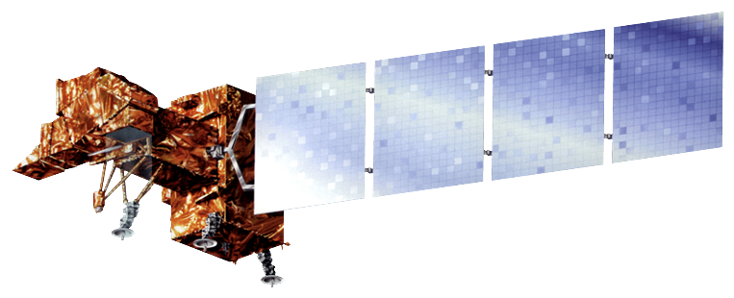
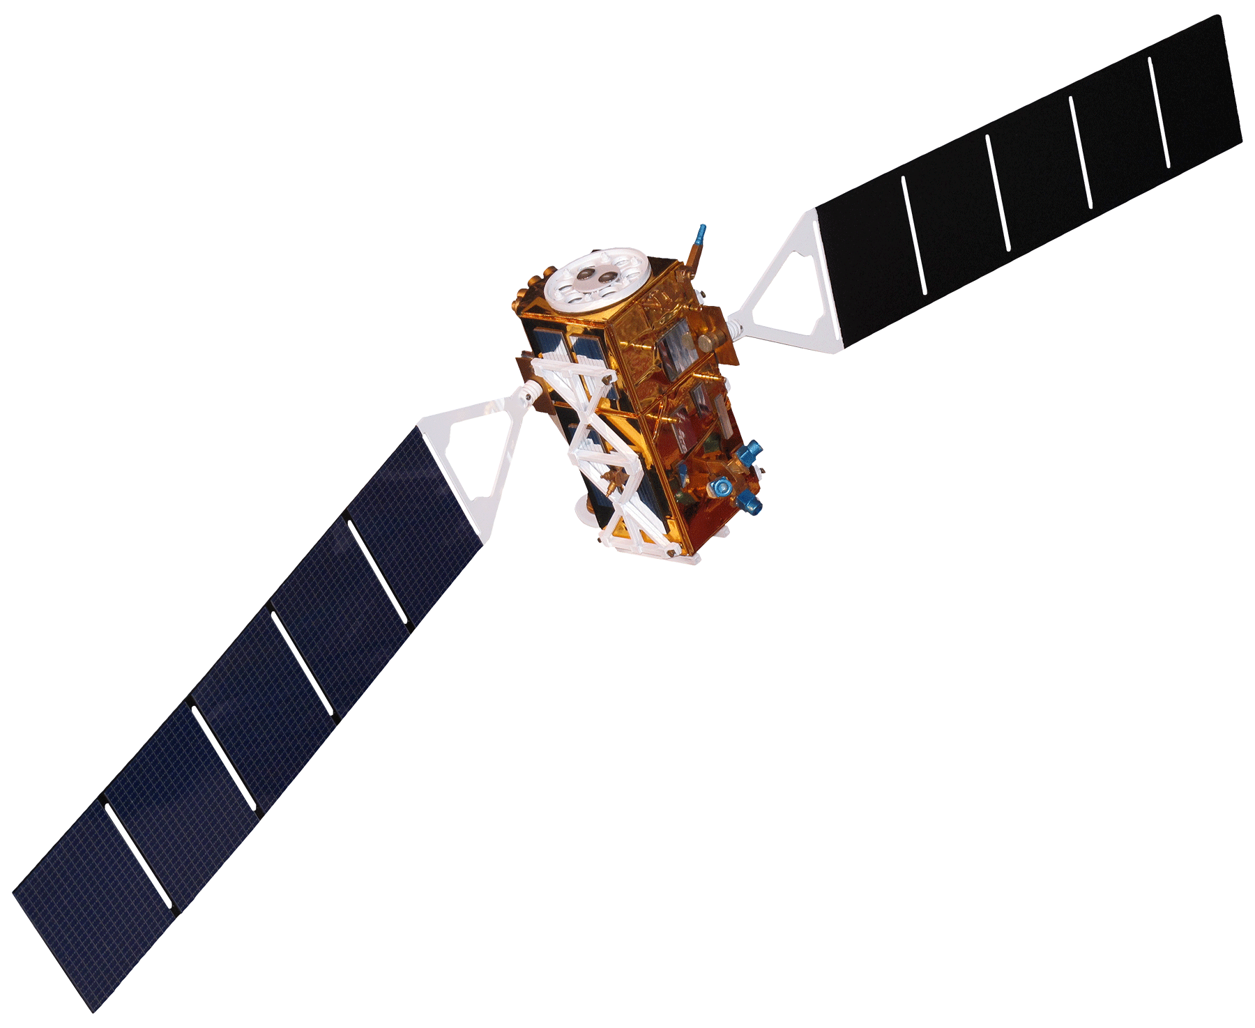
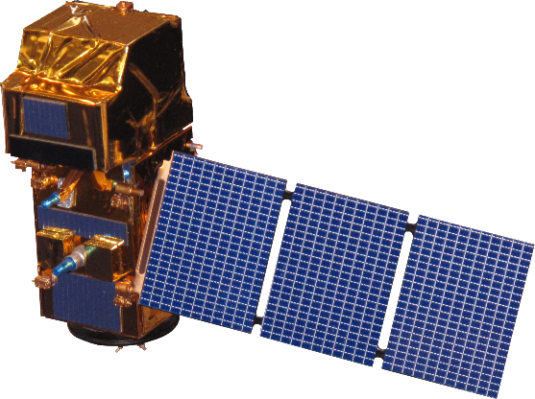
SATELLITES & SENSORS USED
Landsat 7
Enhanced Thematic Mapper Plus (ETM+)
Landsat 5
Thematic Mapper (TM)
Sentinel-1
C-band Synthetic Aperture Radar (C-SAR)
Sentinel-2 Multispectral Instrument (MSI)
Images from NASA, Developedia
Notes:
Speaker 2: To accomplish our objectives, we used ESA’s Sentinel 1, and Landsat 5 & 7 to map Toa Baja inundation events, and we used ESA’s Sentinel 2 to create our NDVI parameter for our flood susceptibility map.
------------------------------Image Information Below ------------------------------
•Images Source : NASA (Public Domain), retrieved from http://www.devpedia.developexchange.com/dp/index.php?title=List_of_Satellite_Pictures

Slide 7
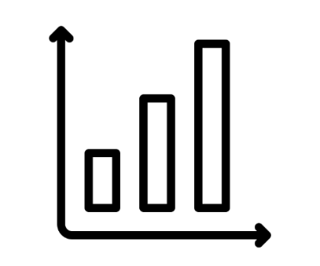


METHODOLOGY
Parameter Standardization
Analytical Hierarchy Process
Multi-Criterion Evaluation
Icons by Path Lord, y.onaldi, Wilson Joseph
Notes:
Speaker 3: For our susceptibility map we followed this workflow. To combine our map parameters, we standardized them by aligning them to the same scale, and spatial reference. Then, to weigh our parameters, we used the Analytical Hierarchy Process, which involves assigning numerical values to abstract concepts. We consulted four experts to determine weights of our parameters. These final weights account for relative influence of a given parameter on flood susceptibility. Then we added the parameters with their respective weights under multicriterion evaluation to create a flood susceptibility and flood risk map.
------------------------------Image Information Below ------------------------------
Icon Analysis chart by Path Lord (creative commons) from the Noun Project https://thenounproject.com/pathlord/uploads/?i=1316213
Icon Magnifying glass by y.onaldi (creative commons) from the Noun Project https://thenounproject.com/search/?q=analytics&i=2266497
Icon Analytics by Wilson Joseph (creative commons) from the Noun Project https://thenounproject.com/term/analytics/64582/

Slide 8
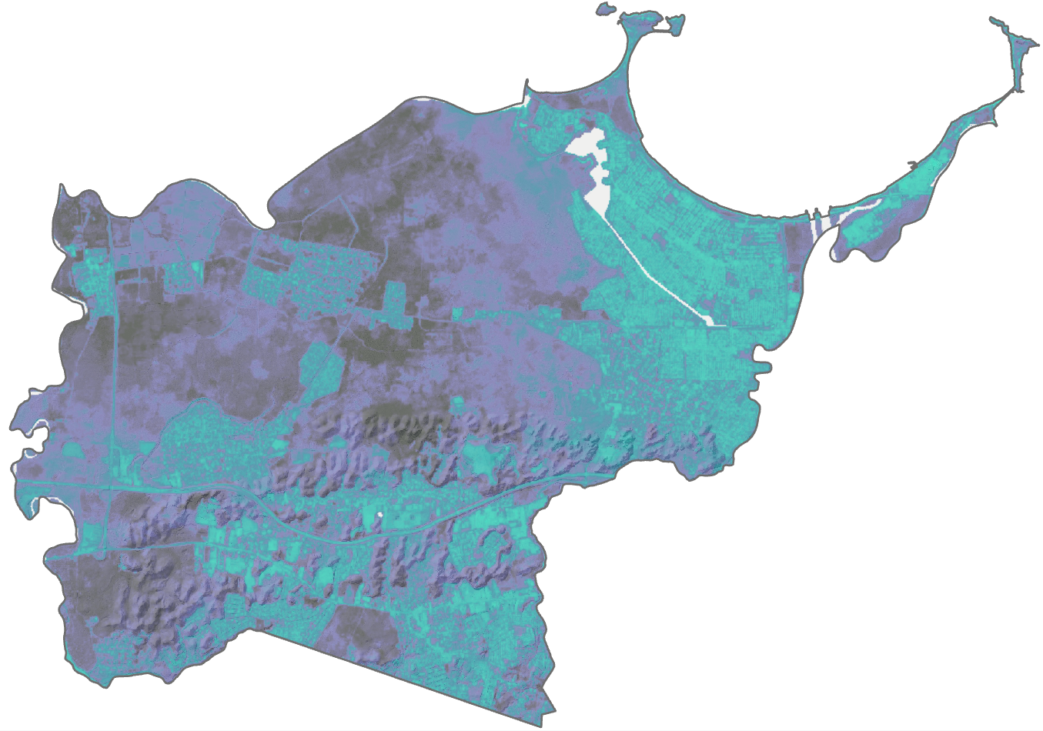
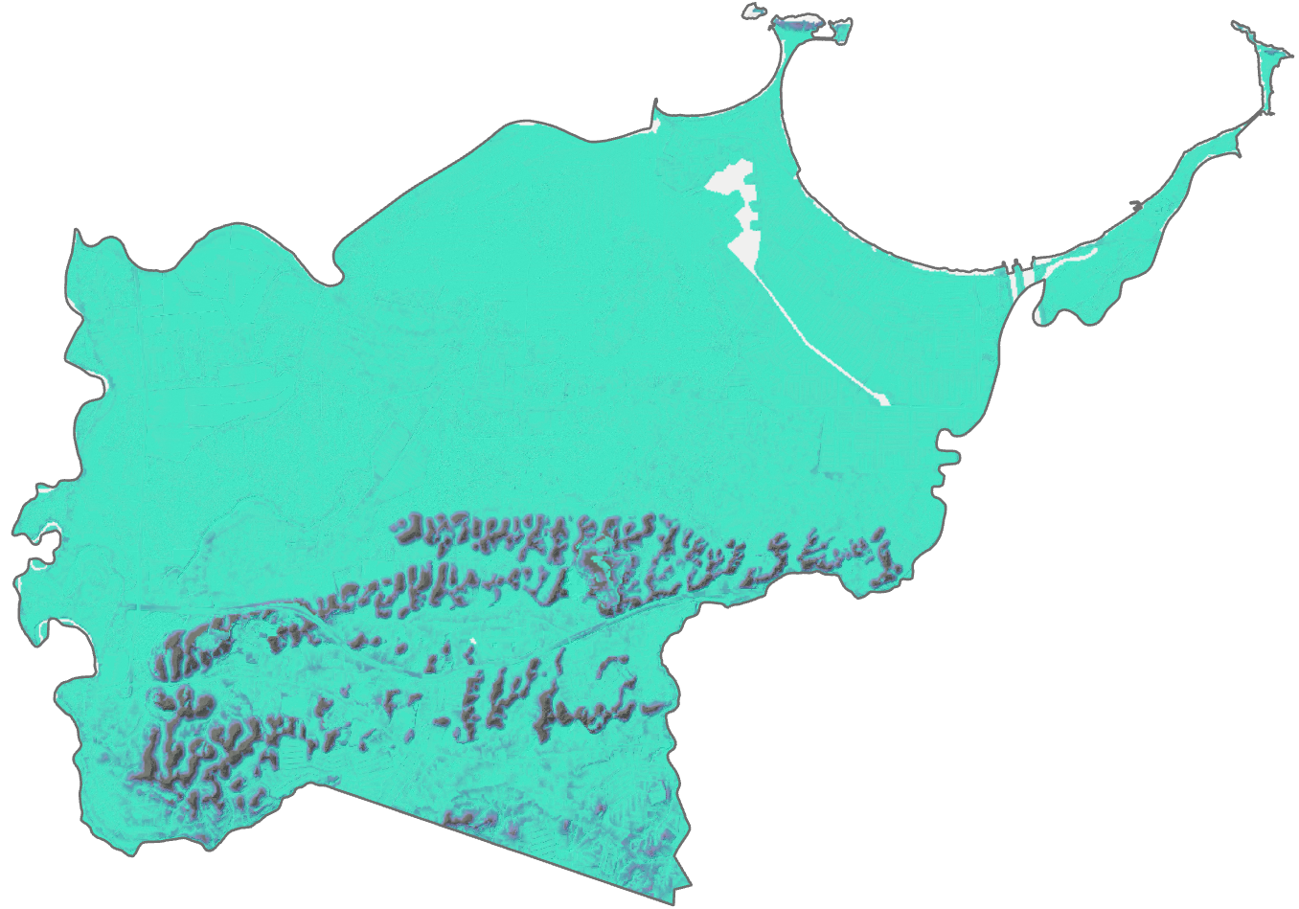
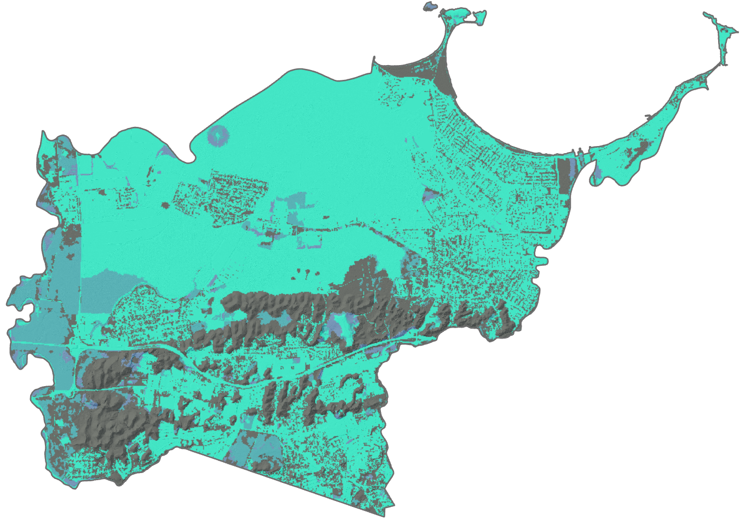
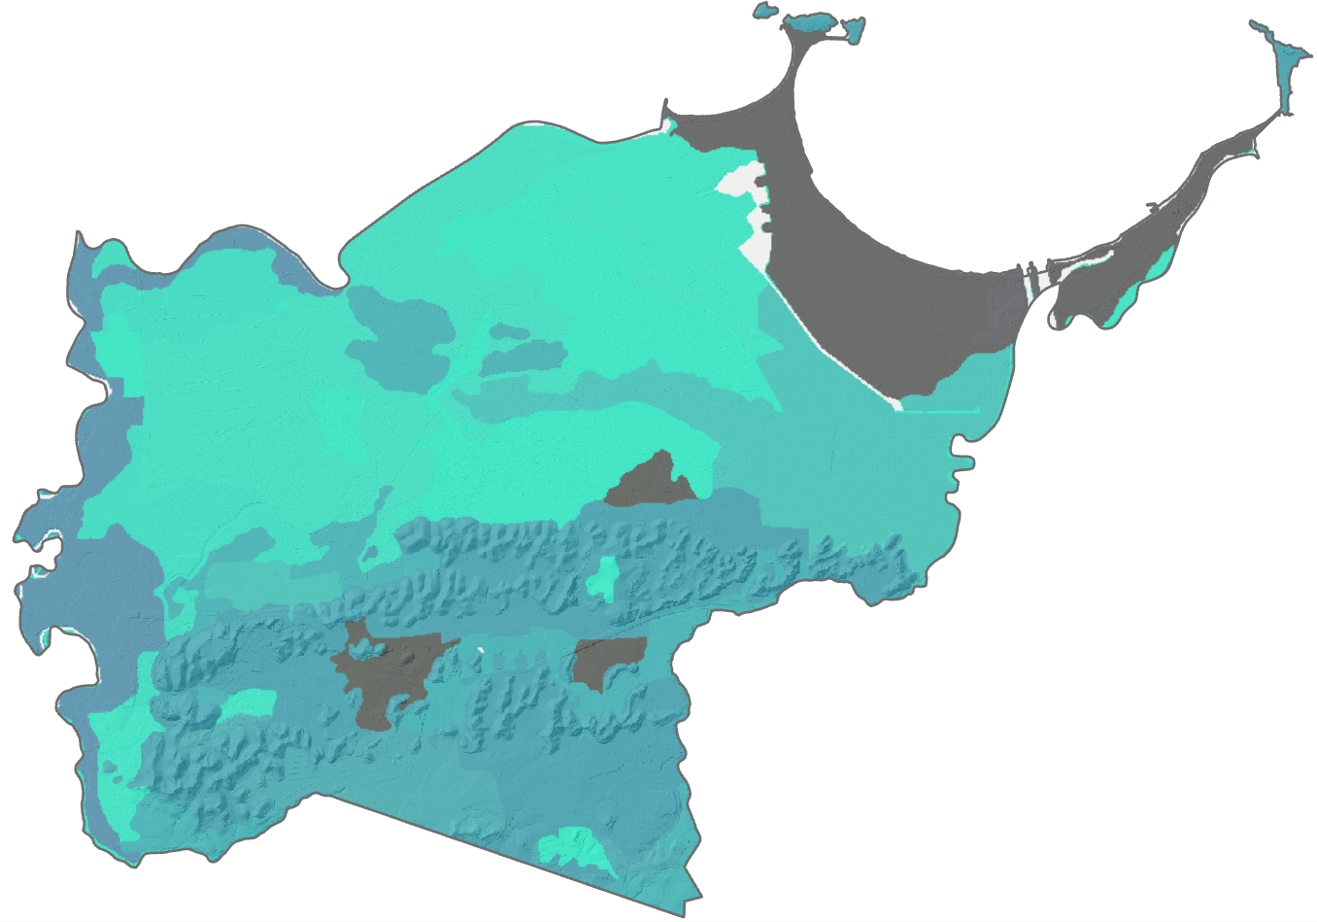
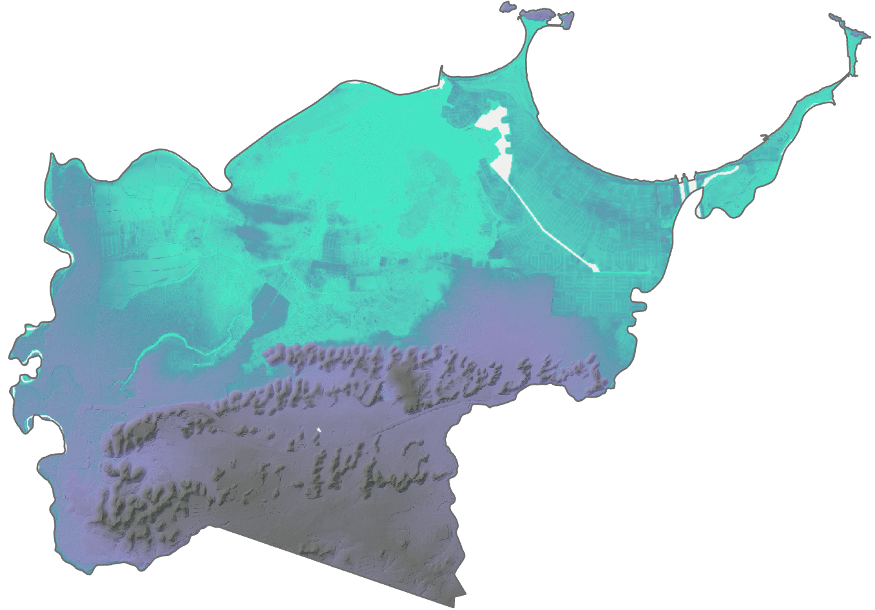
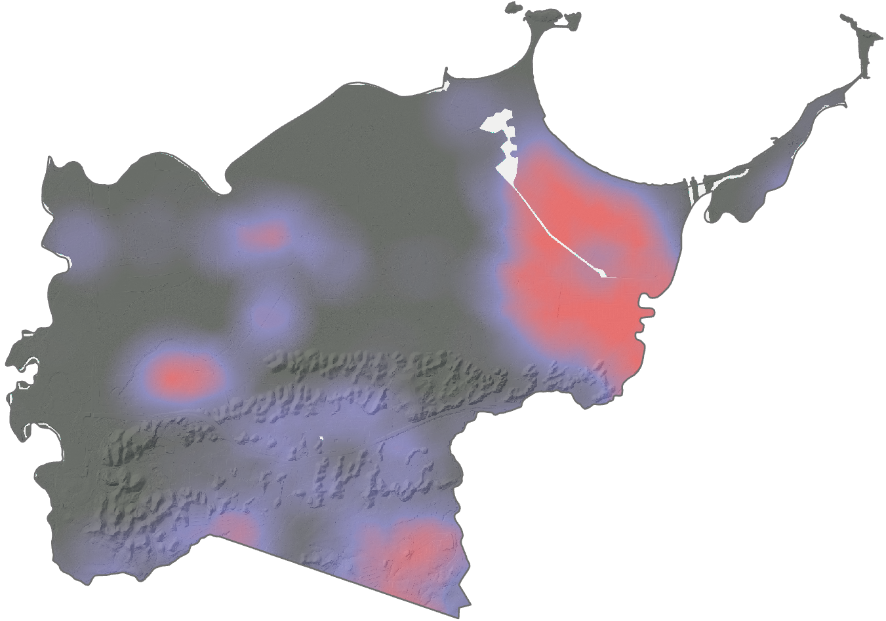
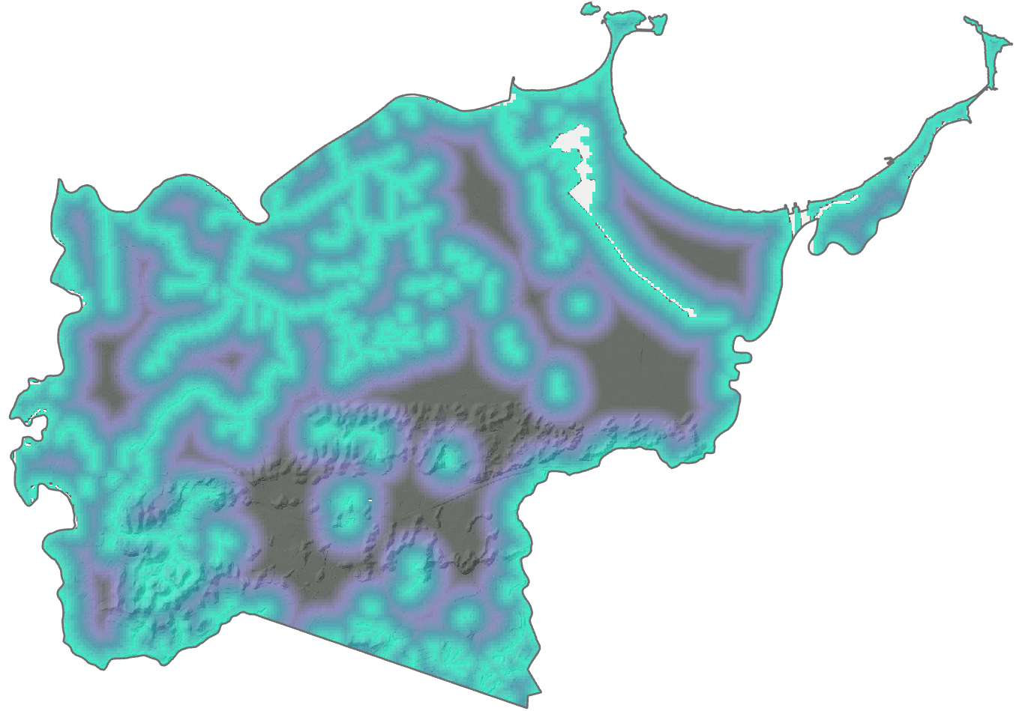
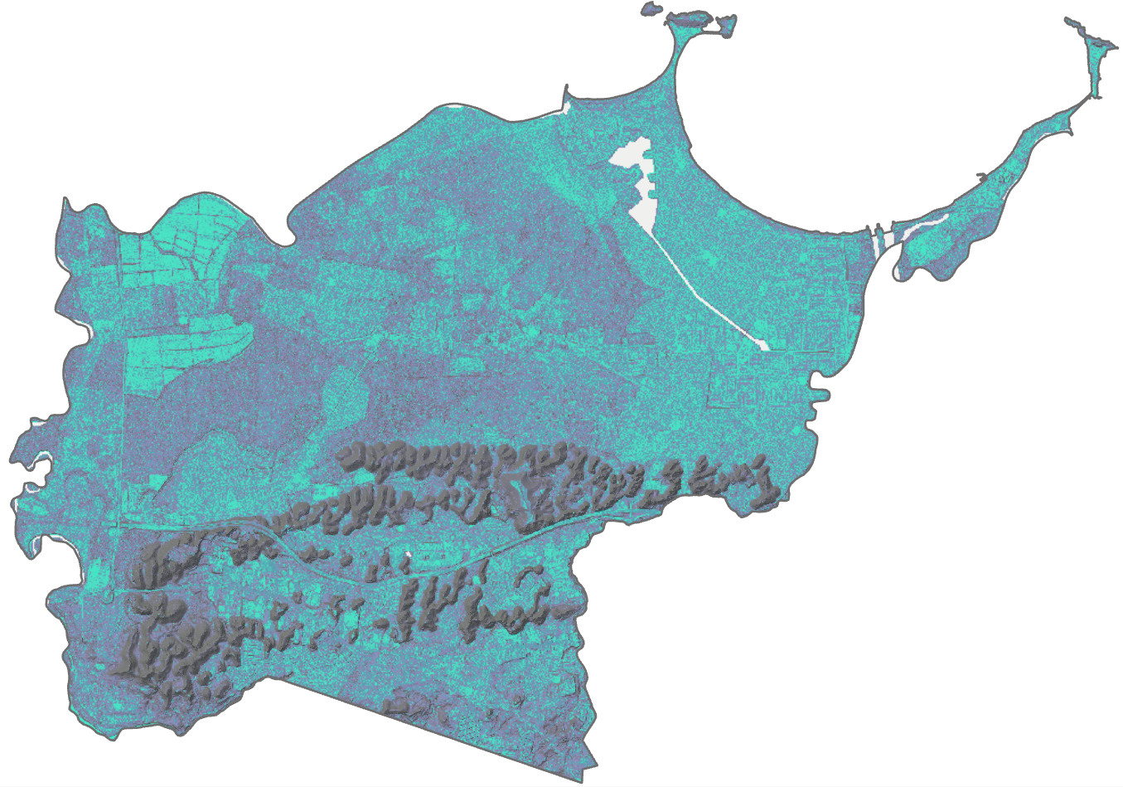
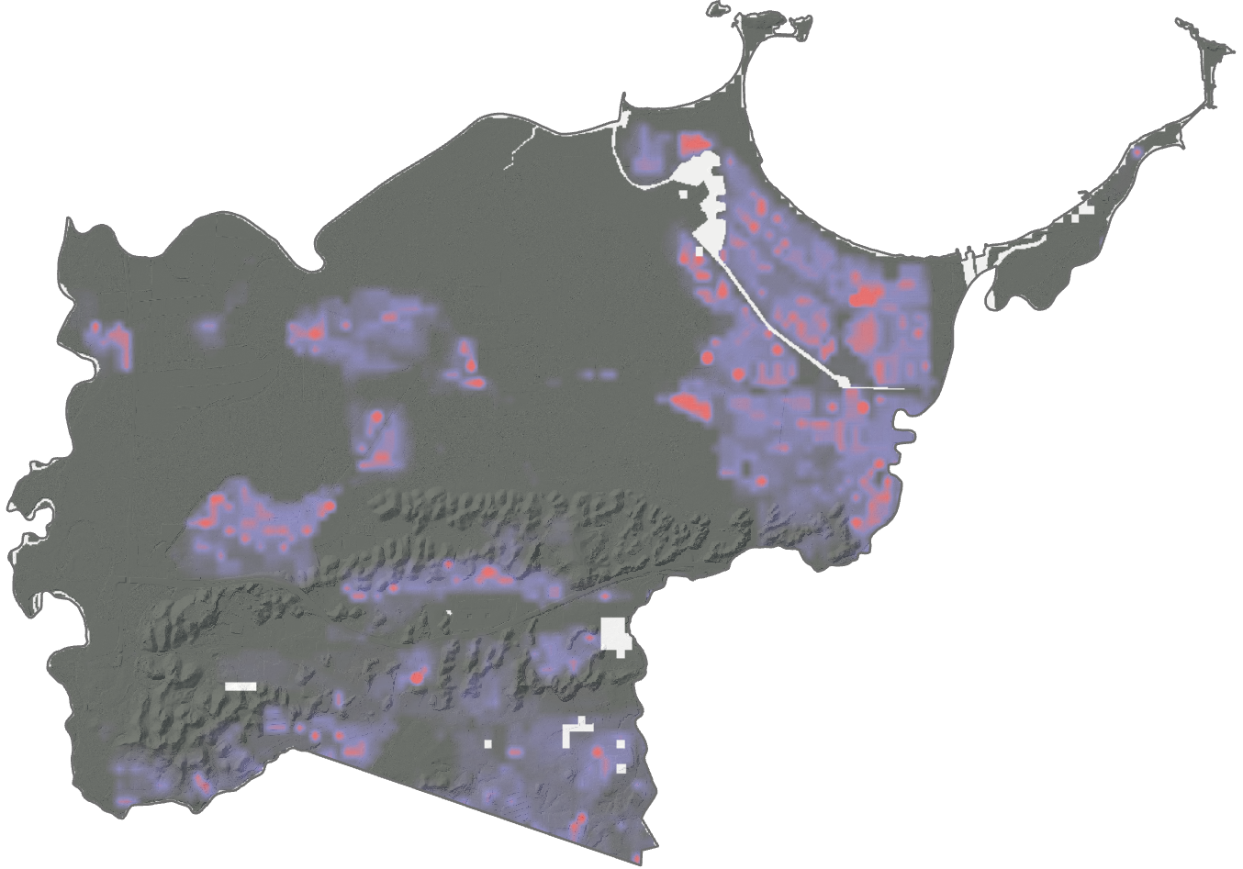
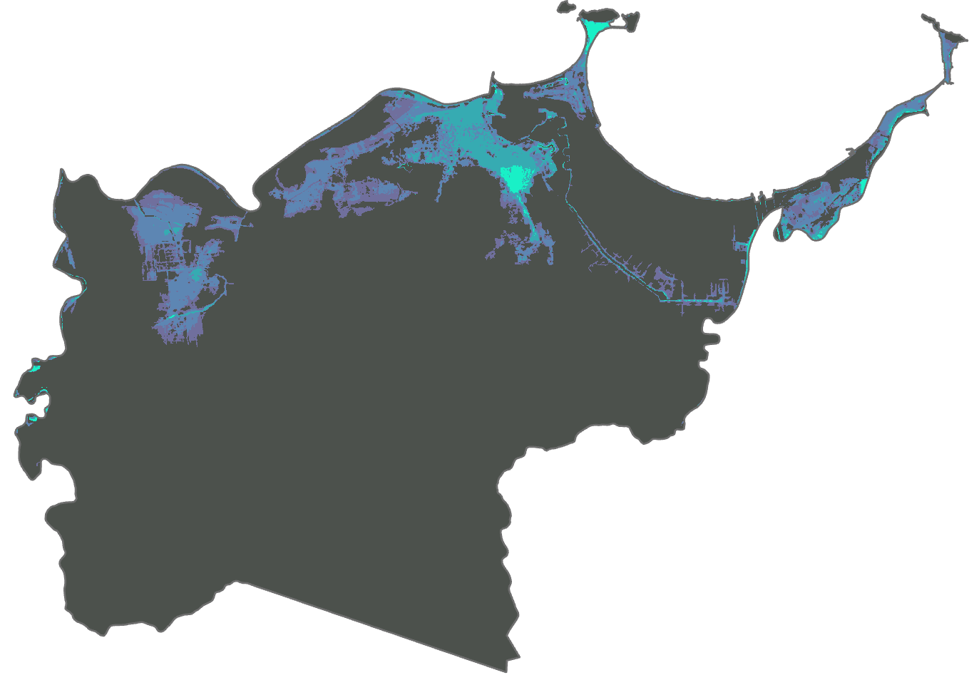
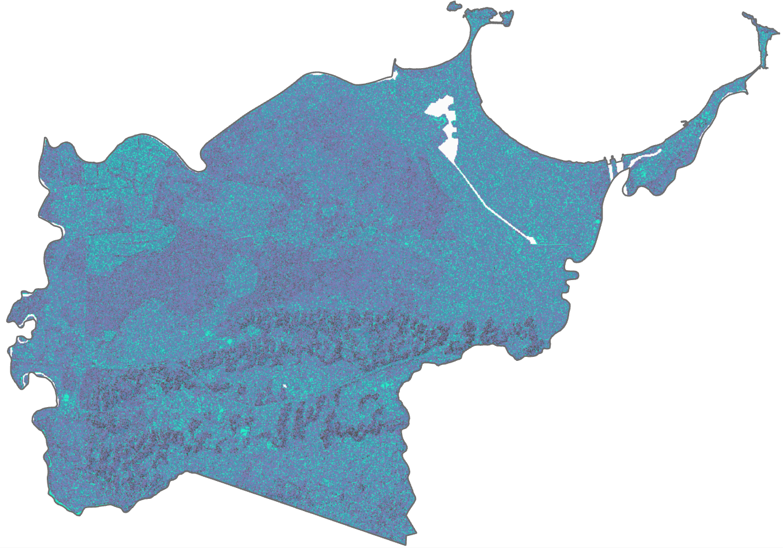
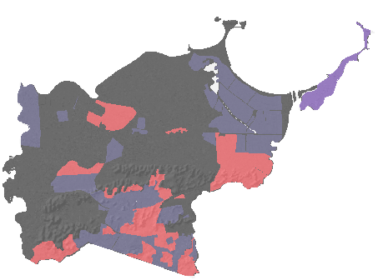
WORKFLOW
Multi-Criterion Evaluation
Flood Susceptibility
Standardization
Analytical Hierarchy Process
Flood Risk
Multi-Criterion Evaluation
Vulnerability
Standardization
Notes:
Speaker 4: Here we illustrate a flowchart that describes what parameters were considered in each map (flood susceptibility and risk) as well as the processing involved in merging these parameters. Nine parameters were included in the flood susceptibility map, and they were weighted using a pairwise comparison matrix to then undergo multicriterion evaluation. Three parameters were included in the flood risk map, and these were not weighed, and were directly measured through multicriterion evaluation.
Image Credit: All Images Created by the Project Team

Slide 9
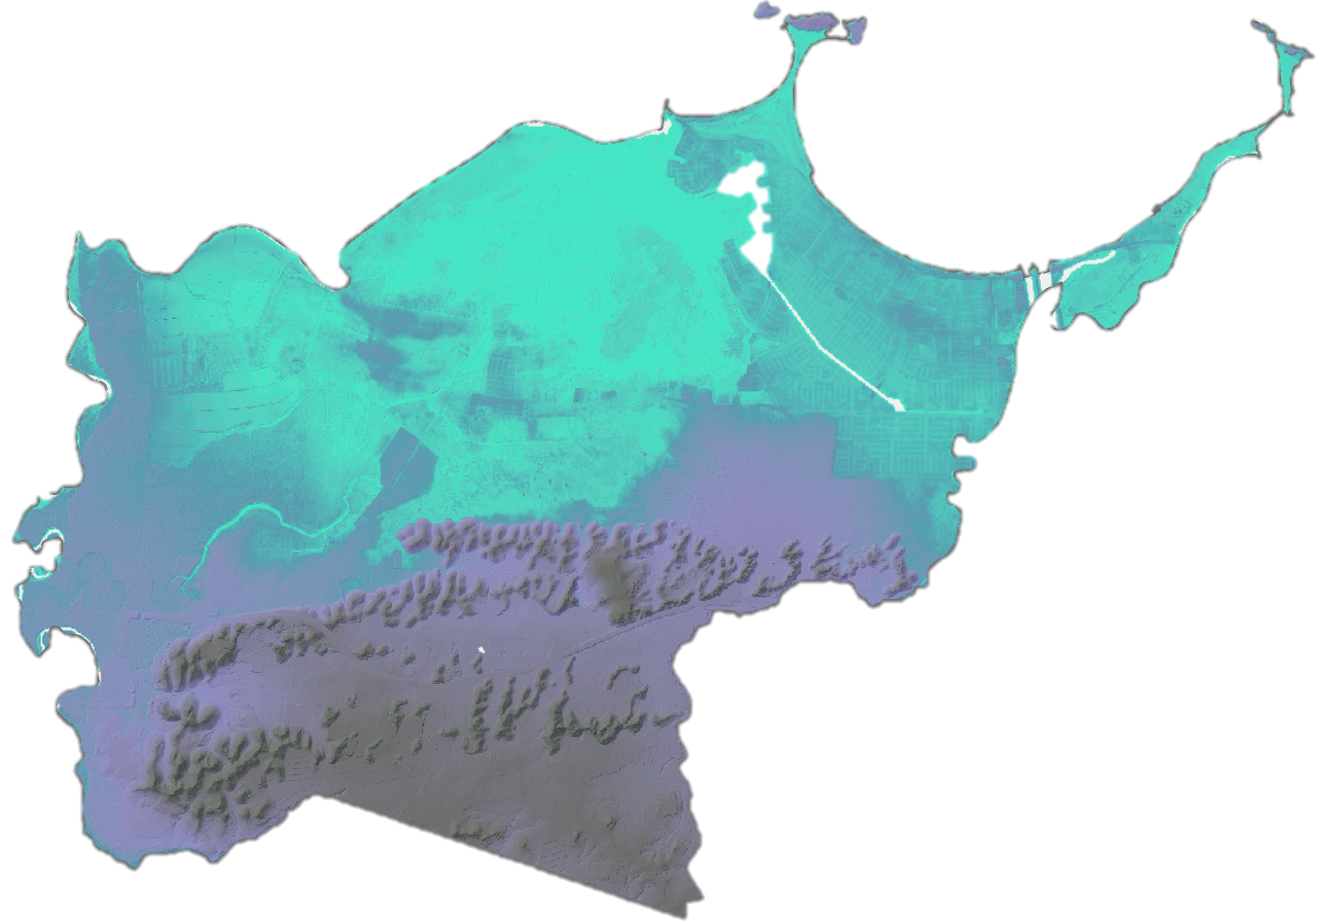
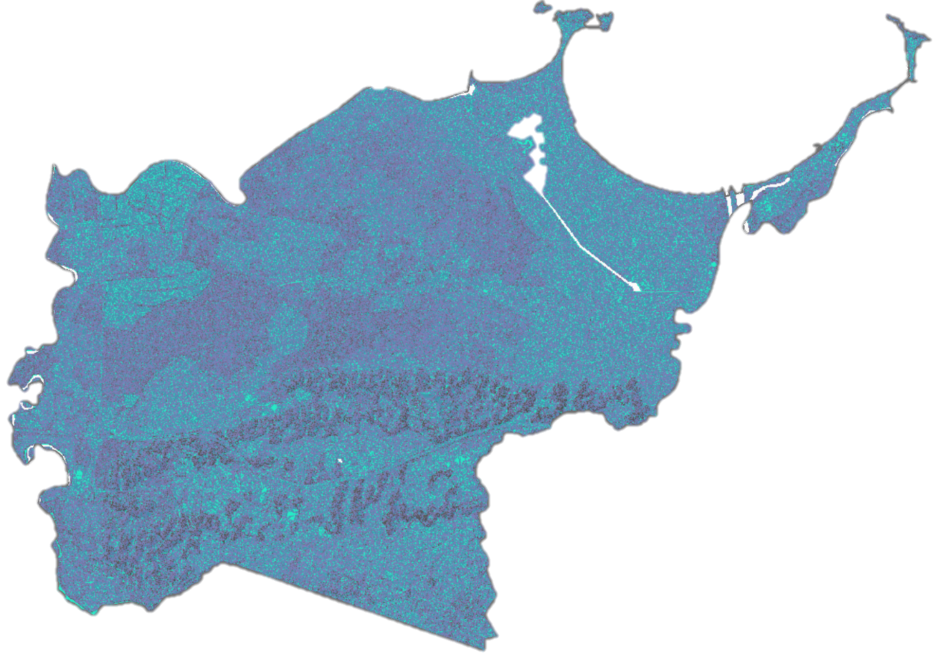
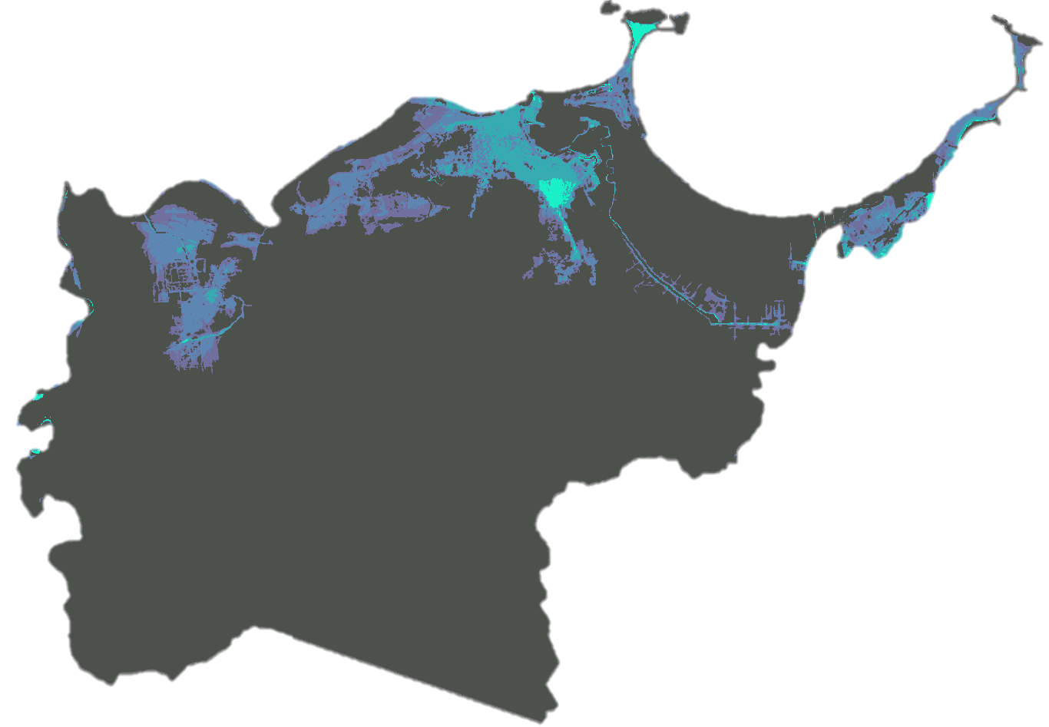

VARIABLES: Susceptibility
Elevation
Topographic Wetness Index
Storm Surge
Flood Susceptibility
Distance from water
Low
High
Slope
NDVI
Height above nearest drainage (HAND)
Landcover
Soil Hydraulic Conductivity
Notes:
Speaker 1:
These are detailed maps that show each of the nine parameters that comprised our susceptibility map. Each map shows high susceptibility in light blue and low susceptibility in dark blue
Elevation accounts for the influence on gravity on the movement of water in the landscape.
Topographic wetness index (TWI) models runoff based on elevation. TWI adds an additional layer of robustness as opposed to factoring only slope and elevation.
Storm surge must also be considered, as Toa Baja is coastal municipality, where tropical storms and hurricanes are a frequent contributor to flooding events.
Speaker 2:
Distance to water accounts for riverine floodplains in the study area.
Slope factors in where water will accumulate based on the land gradient.
NDVI is a measure of relative vegetation cover. This parameter accounts for the associated influence on rain runoff.
Speaker 3:
HAND is an approximate measure of the vertical height of a given pixel from the nearest flow accumulation area.
Landcover accounts for the influence of varying surface types on flood susceptibility. For example, forested areas are less likely to experience flooding than agricultural or developed land.
Saturated hydraulic conductivity (KSAT) measures the speed that water infiltrates soil in mm per second. Infiltration rates influence the amount of runoff during a rainfall event; therefore, it is an important factor in flood susceptibility.
Image Credit: All Images Created by the Project Team

Slide 10


VARIABLES: Vulnerability
Building Density
Population
Informal Settlements
Flood Risk
Low
High
Notes:
Speaker 2: These are detailed maps that show each of the three parameters that comprised our risk map. High Risk is shown in pink and low risk is in grey.
Building density allows us to see what areas can make flood evacuation difficult due to limited road space.
Population density closely relates to building density and is necessary in a flood risk assessment to determine where most people are located
Informal settlements shows what type of community is it.
Image Credit: All Images Created by the Project Team

Slide 11
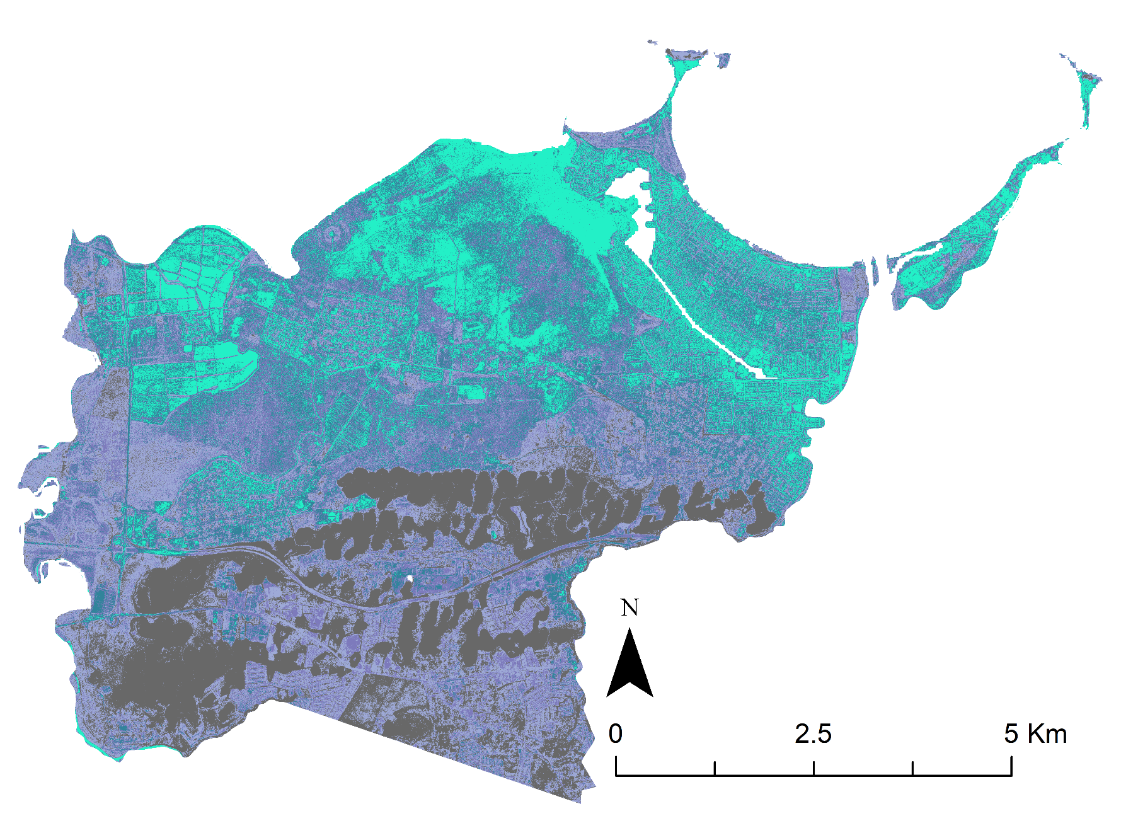
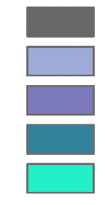
RESULTS: Susceptibility Map
Susceptibility
Very Low
Low
Moderate
High
Very High
Notes:
Speaker 3: Flood susceptibility analysis involves various criteria that influence the likelihood of flooding. This is the map created by adding all nine layers together. Very high susceptibility to flooding is shown in light blue, and very low susceptibility is shown in grey.
Image Credit: Figure Created by the Project Team

Slide 12
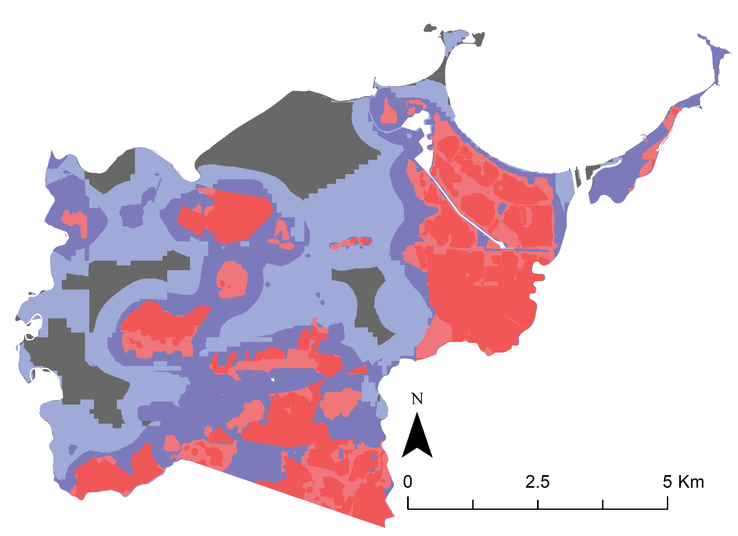
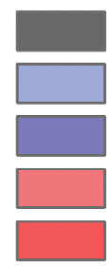
RESULTS: Vulnerability Map
Vulnerability
Very Low
Low
Moderate
High
Very High
Notes:
Speaker 4: Gauging relative flood risk involves the analysis of flood susceptibility, along with socioeconomic factors, which account for the consequential impacts of a flood event on specific populations. The vulnerability map includes the three socioeconomic factors. In this map, very high vulnerability is shown in pink, and very low vulnerability is shown in grey.
Image Credit: Figure Created by the Project Team

Slide 13
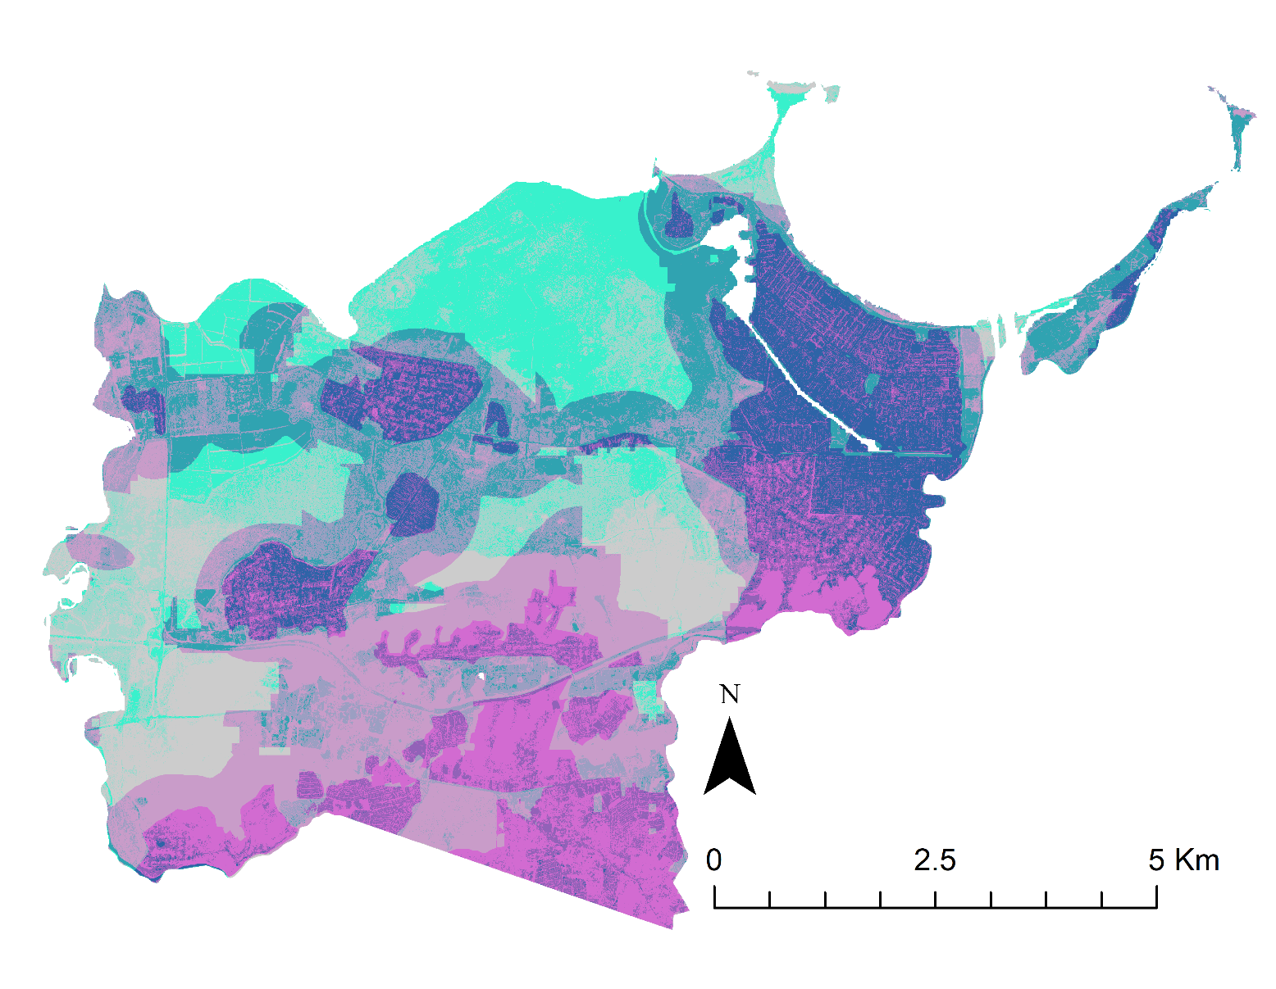

RESULTS: Risk Map
Risk
High
Med
Low
Susceptibility
Low Med High
Vulnerability
Notes:
Speaker 1: Our risk map shows nine levels of varying risk. The bivariate legend (Figure 4) shows areas of high susceptibility and low vulnerability in light blue. These show areas where due to our nine parameters, flooding is likely, yet there is little to no population living there. The light blue in our map aligns with a northern area designated as wetlands. Magenta within the map delineates high vulnerability areas with low susceptibility. This shows us where people are living, yet aren’t as likely to be impacted by flooding. In our case, the magenta is clustered around the foothills of Toa Baja, where elevation and distance from the coast protect people from flooding. The convalescence of high susceptibility and high vulnerability is delineated in the color navy. These areas show a large density of people located where floods are likely to occur. The Municipality is interested in the navy high risk areas, as well as the varying levels of risk in between.
Image Credit: Figure Created by the Project Team

Slide 14
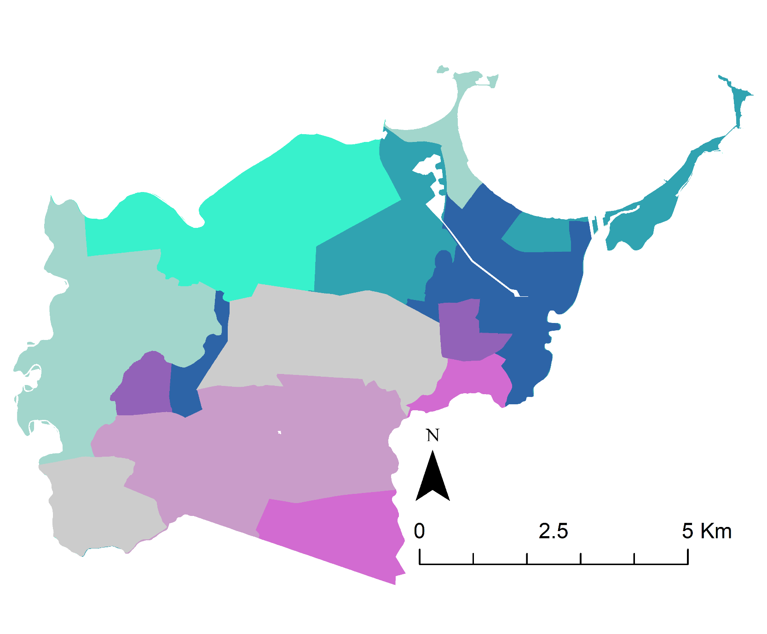
Summarizing Risk Map: Mode by Census Tracts
Risk
High
Med
Low
Susceptibility
Low Med High
Vulnerability
Notes:
Speaker 2: This map shows the census tracts categorized by the most frequent pixel value within them (known as mode). We can then show the municipality a simpler way of understanding the level of risk by census
Image Credit: Figure Created by the Project Team

Slide 15
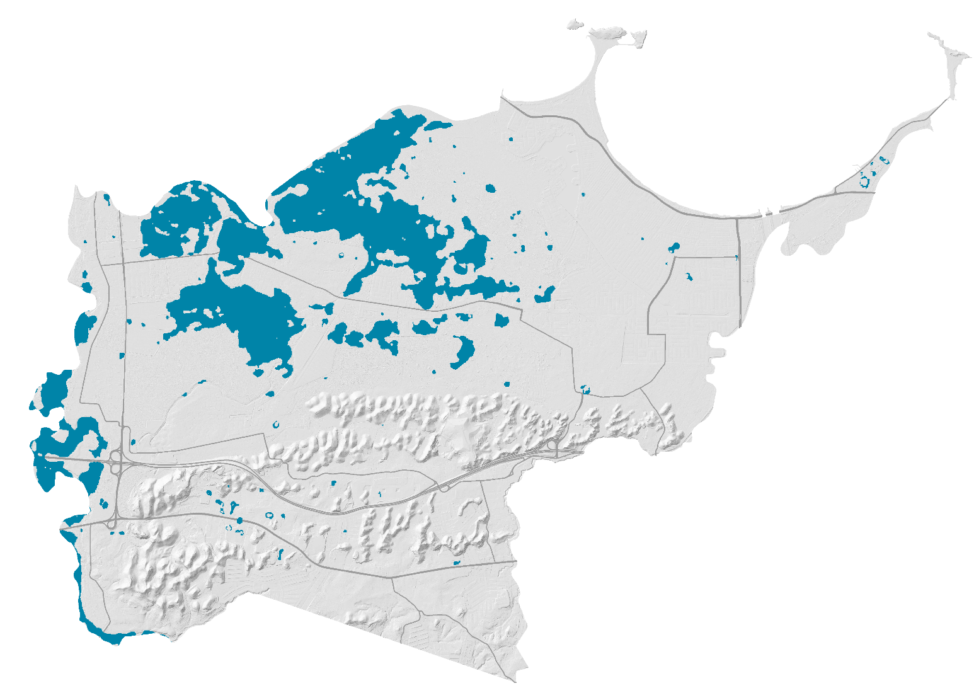
VALIDATION
Detected Flooding
2017 Hurricane Maria Flood Detection
Notes:
Speaker 3: Our susceptibility output was validated against actual inundation detected through Sentinel SAR data. This map shows in blue the detected flooding from Sentinel data.
Image Credit: Figure Created by the Project Team

Slide 16
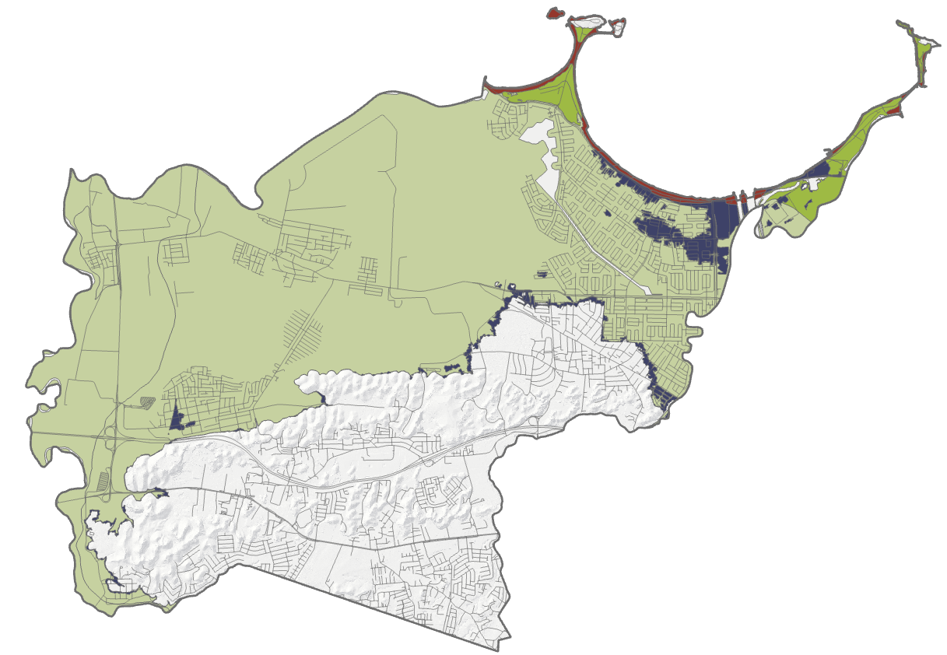
VALIDATION
Zone AE: Coastal A zone
Zone A: Floodway. 1% Annual Chance Flood
Zone X: 0.2% Annual Chance Flood
Zone VE: Coastal Flood Zone
OFZ: Outside HECRAS Flood Zones
2018 HECRAS FEMA Flood Advisory Maps
Notes:
Speaker 4: This analysis is intended to be compared to the 2018 HECRAS FEMA flood hazard maps. The Municipality does not have access to spatial analyst tools, and wanted our map to show more detail than these maps, which are their current guidance for flood risk and mitigation.
Image Credit: Figure Created by the Project Team

Slide 17
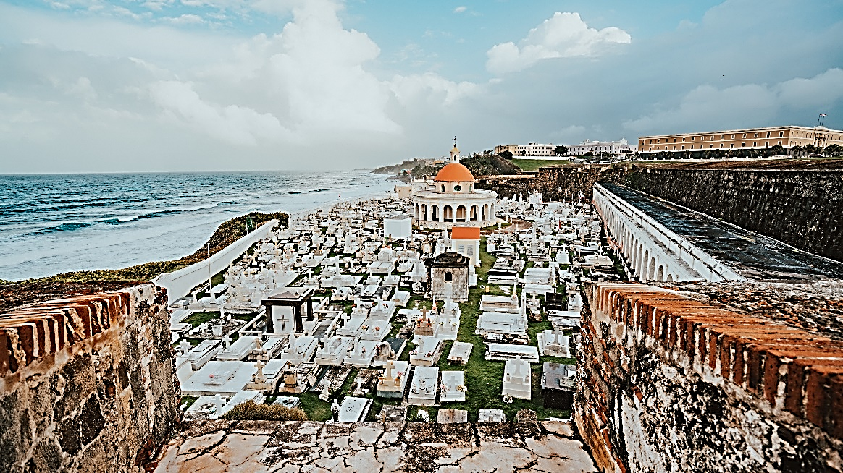

FUTURE WORK
Validate using additional flood events
Utilize NASA NiSAR EO for projects after 2021
Images by kayla Phaneuf, Cody Board
Notes:
Speaker 1: Our study used Sentinel-1 C-SAR data to detect past flooding in Puerto Rico, given that NASA has no current SAR sensor. Future studies can use our project as a template for the NASA NiSAR earth observation, which is scheduled to launch in 2021.
The results in this study are validated with only the one historic inundation event, hurricane Maria in september of 2017. We searched for optical satellite imagery of past inundation, but found no corresponding satellite images. We suggest that future works attempts to validate with a greater number of known inundation events.
Image credits----------
Palm tree by kayla phaneuf (free use license https://unsplash.com/license) from Unsplash https://unsplash.com/photos/EMV_HA7kqOw
City of San Juan by Cody Board (free use license https://unsplash.com/license) from Unsplash https://unsplash.com/photos/8O0sIbePCos

Slide 18
We would like to thank our science advisor Dr. Kenton Ross and our Fellow Sydney Neugebauer for their guidance throughout the project.
We would also like to thank our partners at the Municipality of Toa Baja, ResilientSEE, and MIT Urban Risk Lab for their clear communication and enthusiastic participation.
Additionally we’d like to thank Dr. Venkat Lakshmi, Dr. John Bolten, Dr. Marangelly Colon-Fuentes, and Perry Oddo for their valuable contributions to the project.
This material contains modified Copernicus Sentinel data (2019), processed by ESA.
Notes:
Speaker 2: We would like to thank our science advisor Dr. Kenton Ross and our Fellow Sydney Neugebauer for their guidance throughout the project.
We would also like to thank our partners at the Municipality of Toa Baja, ResilientSEE, and MIT Urban Risk Lab for their clear communication and enthusiastic participation.
Additionally we’d like to thank Dr. Venkat Lakshmi, Dr. John Bolten, Dr. Marangelly Colon-Fuentes and Perry Oddo for their valuable contributions to the project.

