Slide 1
Project Lead Orientation
Project Lead Responsibilities, Logistics, and Opportunities!

Slide 2
What does it mean to be a leader?
Possess a clear vision of the future and be compelled by it
Encourage people to share ideas, needs, perspectives, dreams, and desires
Stand for, demonstrate, and portray what you believe
Empower people with the authority to use their own skills and knowledge
Evaluate the people who work with them and the performance of the team
Inspire and motivate others with passion and example
“When you include and acknowledge those in your corner, you propel yourself, your teammates, and your supporters to greater heights.”
- Simon Sinek

Slide 3
Leadership Styles
 | Directive | Authoritative | Affiliative | Participative | Pacesetting | Coaching
Characteristics | Motivates by discipline, closely controls participants | Firm but fair, motivates by persuasion and candid feedback on performance | “People first”, avoids conflict and emphasizes personal relationships | “Everyone has input”, encourages decision making and rewards team effort | “Do it myself”, expects participants to follow their example of excellence | Encourages participants to develop strengths, improve performance, and seize opportunity
Good when … | There is a crisis or deviations are risky | Clear direction and standards are needed and leader is credible | Used with other styles, tasks are routine | Participants are communicative, experienced, and credible | Participants are highly motivated and competent | Skills need to be developed and participants are motivated to improve
Bad when … | Participants are too underskilled or too overskilled and they rebel | Participants need coaching and the leader is not credible | Performance is inadequate and during crisis situations | Employees need to be managed, lack of competency | Workload requires assistance and coaching is required | Leader lacks expertise and when discrepancy in skill is too large

Slide 4
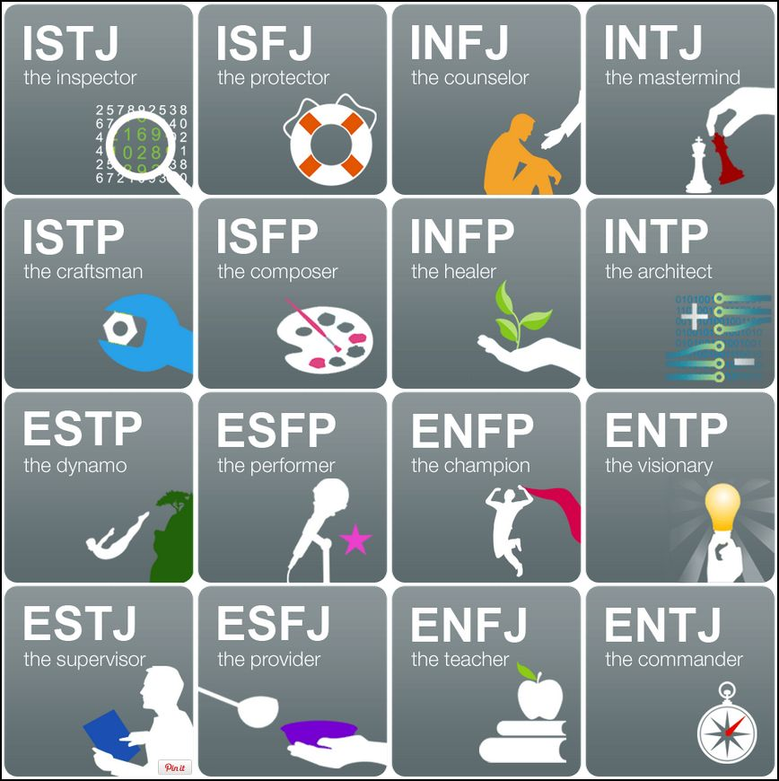
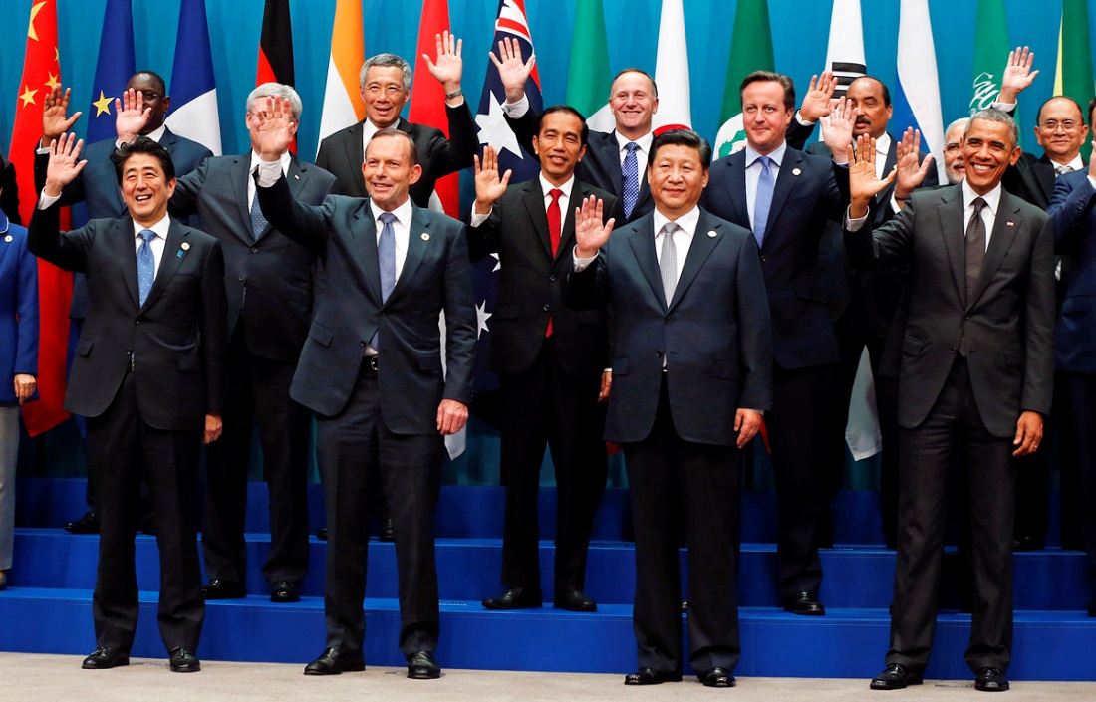

Identifying & Creating Your Own Leadership Style
Response
Leadership Style
Personality
Situational Context

Slide 5
Project Duties & Responsibilities
Your primary responsibility is to ensure the project is completed on time to a high quality
Key Things to Remember | Some Tips & Tricks
Time management | Make a schedule & keep files & tasks organized
Leading a team | Incorporate feedback from team members and center leads. Delegate to team members.
Managing project challenges | Be flexible & build in time to troubleshoot issues with your project methodology
Communication | Maintain open and consistent communication with node leadership, NPO, science advisors & all partners
End products & partner hand-off | Begin planning for hand-off & software release early in the term
Remember: Project Leads are the main point of contact for project communication with multiple parties during (and after) the term

Slide 6
Deliverables & End Products
Deliverables communicate your project purpose, methodology, and results to a variety of audiences
Key Things to Remember | Some Tips & Tricks
Name files according to proper file nomenclature | YearTerm_NODE_DeliverableName_RD/FD_Version#
Follow deliverable template formatting | Reference DEVELOPedia for the deliverable templates & checklists
Review deliverables before submission | Quality of writing, style, accuracy, etc. Incorporate feedback from Node leadership Address edits & comments from the PC team
Submit deliverables on time | Be mindful of deliverable deadlines
Remember: All participants are paid based on deliverable completion

Slide 7
Additional Project Responsibilities
Software Release
Publication
Submit to NPO
Communicate with Partners
Create well documented and transferrable code
Follow-up paperwork & code handoff with Partners
Notify NPO
Research specific Journals’ publication requirements & style guide
Continue working with NPO after the term during the publication process

Slide 8


Team Management & Working with Others
It is important to know your team’s strengths and interests in the project
Consider activities and exercises for team members to get to know each other
  Ice breakers at the beginning of the term
  Continue having team activities throughout the term (lunches & outings!)
Understand team dynamics and delegate tasks accordingly
  Know team members’ personalities (NASA 4D and MBTI) and how they interact with others
  Identify the best ways to handle personnel issues when they arise
Find out the individual goals & expectations of your team members
  Strike a balance between team members’ learning and productivity
  Learn team member objectives for their time with DEVELOP and beyond
  Incorporate feedback from team members (mid-term reviews)

Slide 9
Conflict Resolution & Personality Typing
It is important how different people & personalities can come together as a team.
Some Topics to Discuss with Your Team | How This Can Be Applied
Does your NASA 4D color match what you thought you would get? Why or why not? | Use this discussion to let your team members know that personality typing is a guide, not a verdict
What are the strengths and weaknesses of each team member’s personality type? | Come prepared with some challenge scenarios related to the project and ask each team member how they might handle them (i.e. workload causing stress, collaborating across different work schedules, etc.)
If conflict arises how would you try to mitigate it? | Again, come prepared with scenarios: a team member is making inappropriate comments, showing up to work late, etc. ALL participants should let the Center Lead know of any conflict that arises.
Remember: Communicate with your Center Lead! If personnel issues arise, no matter how minor, you should let your Center Lead know.

Slide 10
Partner Interaction & Communication
DEVELOP projects are created to meet partners’ needs & build capacity
Key Things to Remember | Some Tips & Tricks
Maintain consistency | Establish a regular schedule & follow through
Keep node leadership informed | Include node leadership and your team on all partner communication (email & telecon)
Represent your team & DEVELOP at all times | Always maintain professional email and telecon etiquette
Increase available data/resources | Ask for any data/resources that partners may have that could be useful. And ask early!
Remember: Always be honest with your partners. Do not be afraid to give them updates (good or bad) or ask them for assistance

Slide 11

Managing Partner Expectations
Do not over commit on what you can accomplish or provide in one term
Ensure end products meet partner needs
Maintain communication throughout the term
Always follow through on promises
Remember: Partners are the ones who will be using the project results

Slide 12
Hand-Off & Partner Engagement
Hand-offs are important to transition results and methods to end-users
Hand-off Best Practices
Talk with your project partners early on in the term about scheduling a hand-off
Identify what type of hand-off will be most beneficial (feasible) for partners & the team
Coordinate with all partners to ensure all interested parties can attend (keep in mind there may be differences in time zones)
Include your final draft deliverables in any hand-off package that you share
Explain the Software Release process & timeline to partners in advance
Follow up with your end-users to receive feedback or answer any questions (especially on multi-term projects)

Slide 13
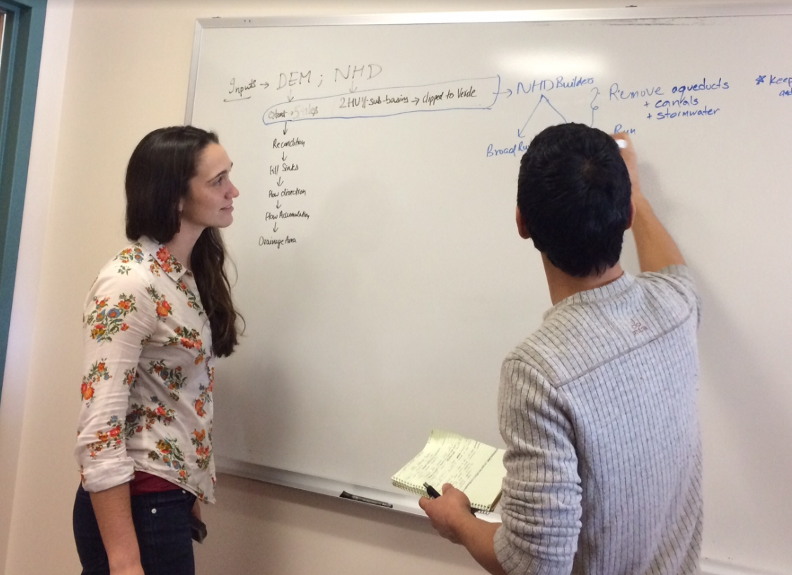
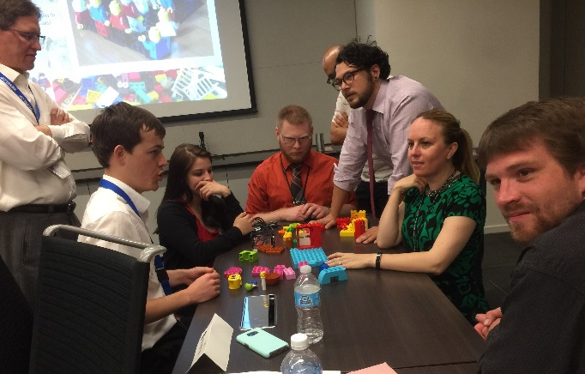
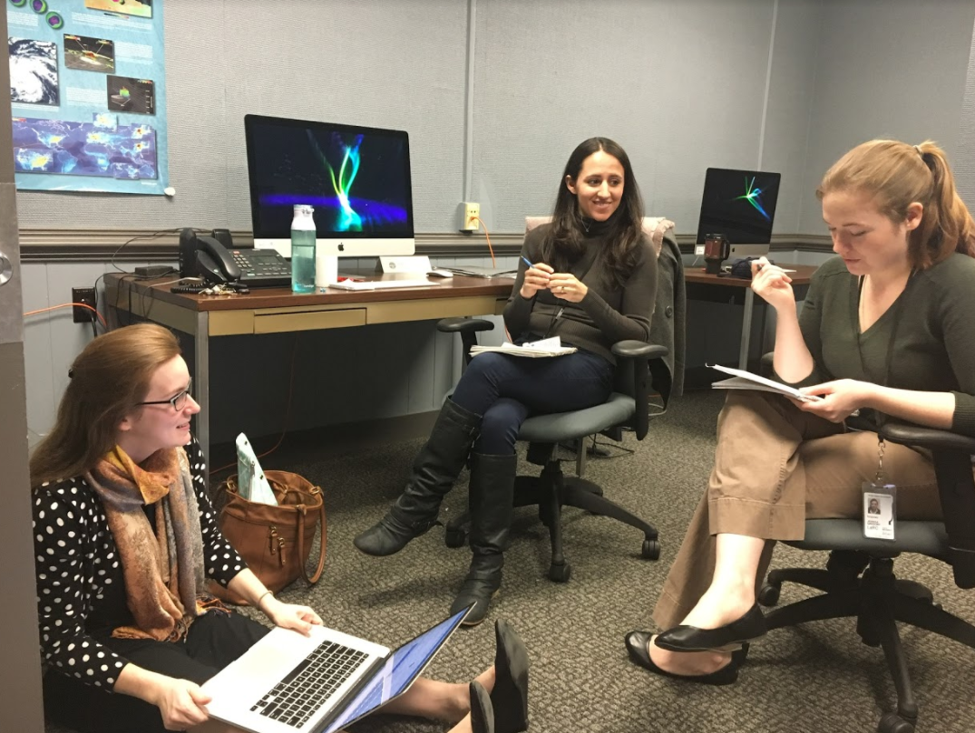
Communicating across DEVELOP
At your node…. | With science advisors...
Talk with node leadership regularly | Invite your advisors to team & partner meetings
Include Center Leads & team on all partner interactions (emails, calls, etc.) | Communicate regularly with advisors as their schedules allow
Ask your node leadership for help if you need additional resources | Ask advisors for help in all aspects of the project (including deliverable edits, methodology, & end products)
Inform your node leadership if you plan on undergoing the publication process | Always exercise professional email & telecon etiquette when communicating with advisors
Ask Fellows for help on tasks related to their Element responsibilities | Include your advisors in email communication with project partners

Slide 14
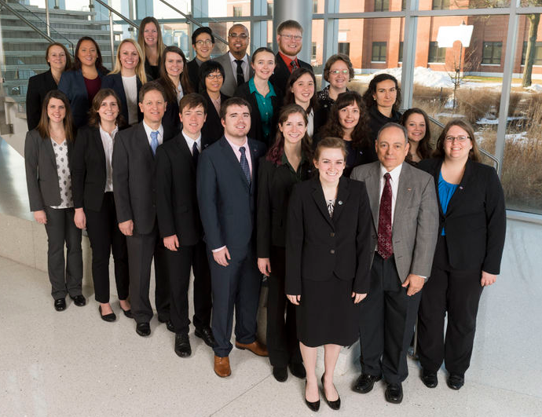
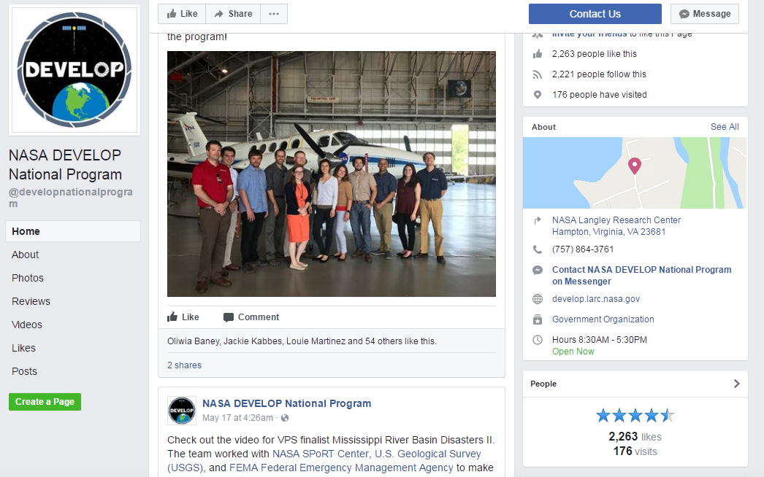
Communicating across DEVELOP
DEVELOP NPO | Ask them about…
Project Coordination | Deliverables & publishing
Geoinformatics | Coding, technical troubleshooting, & data
Impact Analysis | Program, project, & partner metrics
Communications | Graphic design, social media, & creating the project video
IT | DEVELOPedia, software release, licensing, & general computer issues
NPO Contact Information

Slide 15
Email Signatures & Résumé/LinkedIn Fodder
Being the lead of your team is great opportunity and you should highlight it!
Colloquially leads are referred to as “Team Lead”, but formally it’s “Project Lead” – this is a bit more clear external to DEVELOP as you are leading a science project
Email Signature:
Name
Project Short Title Project Lead
Science Systems and Applications, Inc. OR Wise County
Node |NASA DEVELOP National Program
Office: XXX-XXX-XXXX
Example:
Loretta Landsat
Ohio Ecological Forecasting Project Lead
Science Systems and Applications, Inc.
Virginia – Langley |NASA DEVELOP National Program
Office: 757-555-5555
  Colors and fonts, etc. are up to you, but the above information and basic format should be used.

Slide 16
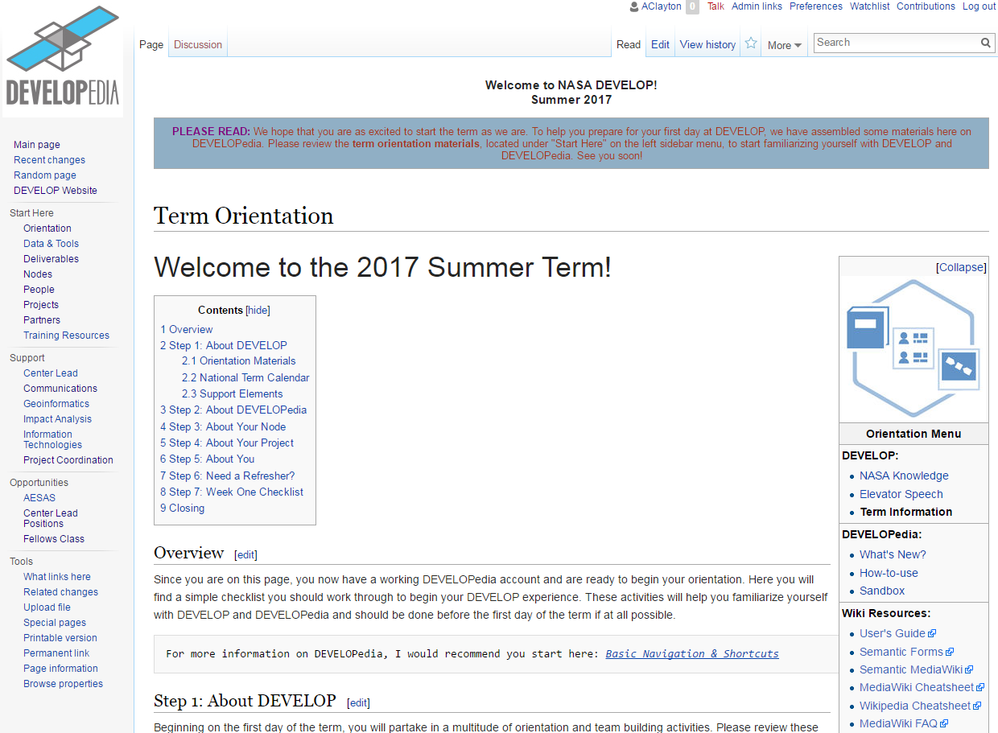
If all else fails, DEVELOPedia is a great resource!
DEVELOPedia

Slide 17

“The function of leadership is to produce more leaders, not more followers”
- Ralph Nader
“Being positive in negative situations is not naive. It’s leadership”
– Ralph Marston
“You get in life what you have the courage to ask for”
- Nancy D. Solomon
“To lead people, walk behind them”
- Lao Tzu
“To succeed, jump as quickly at opportunities as you do at conclusions”
– Ben Franklin

