Slide 1
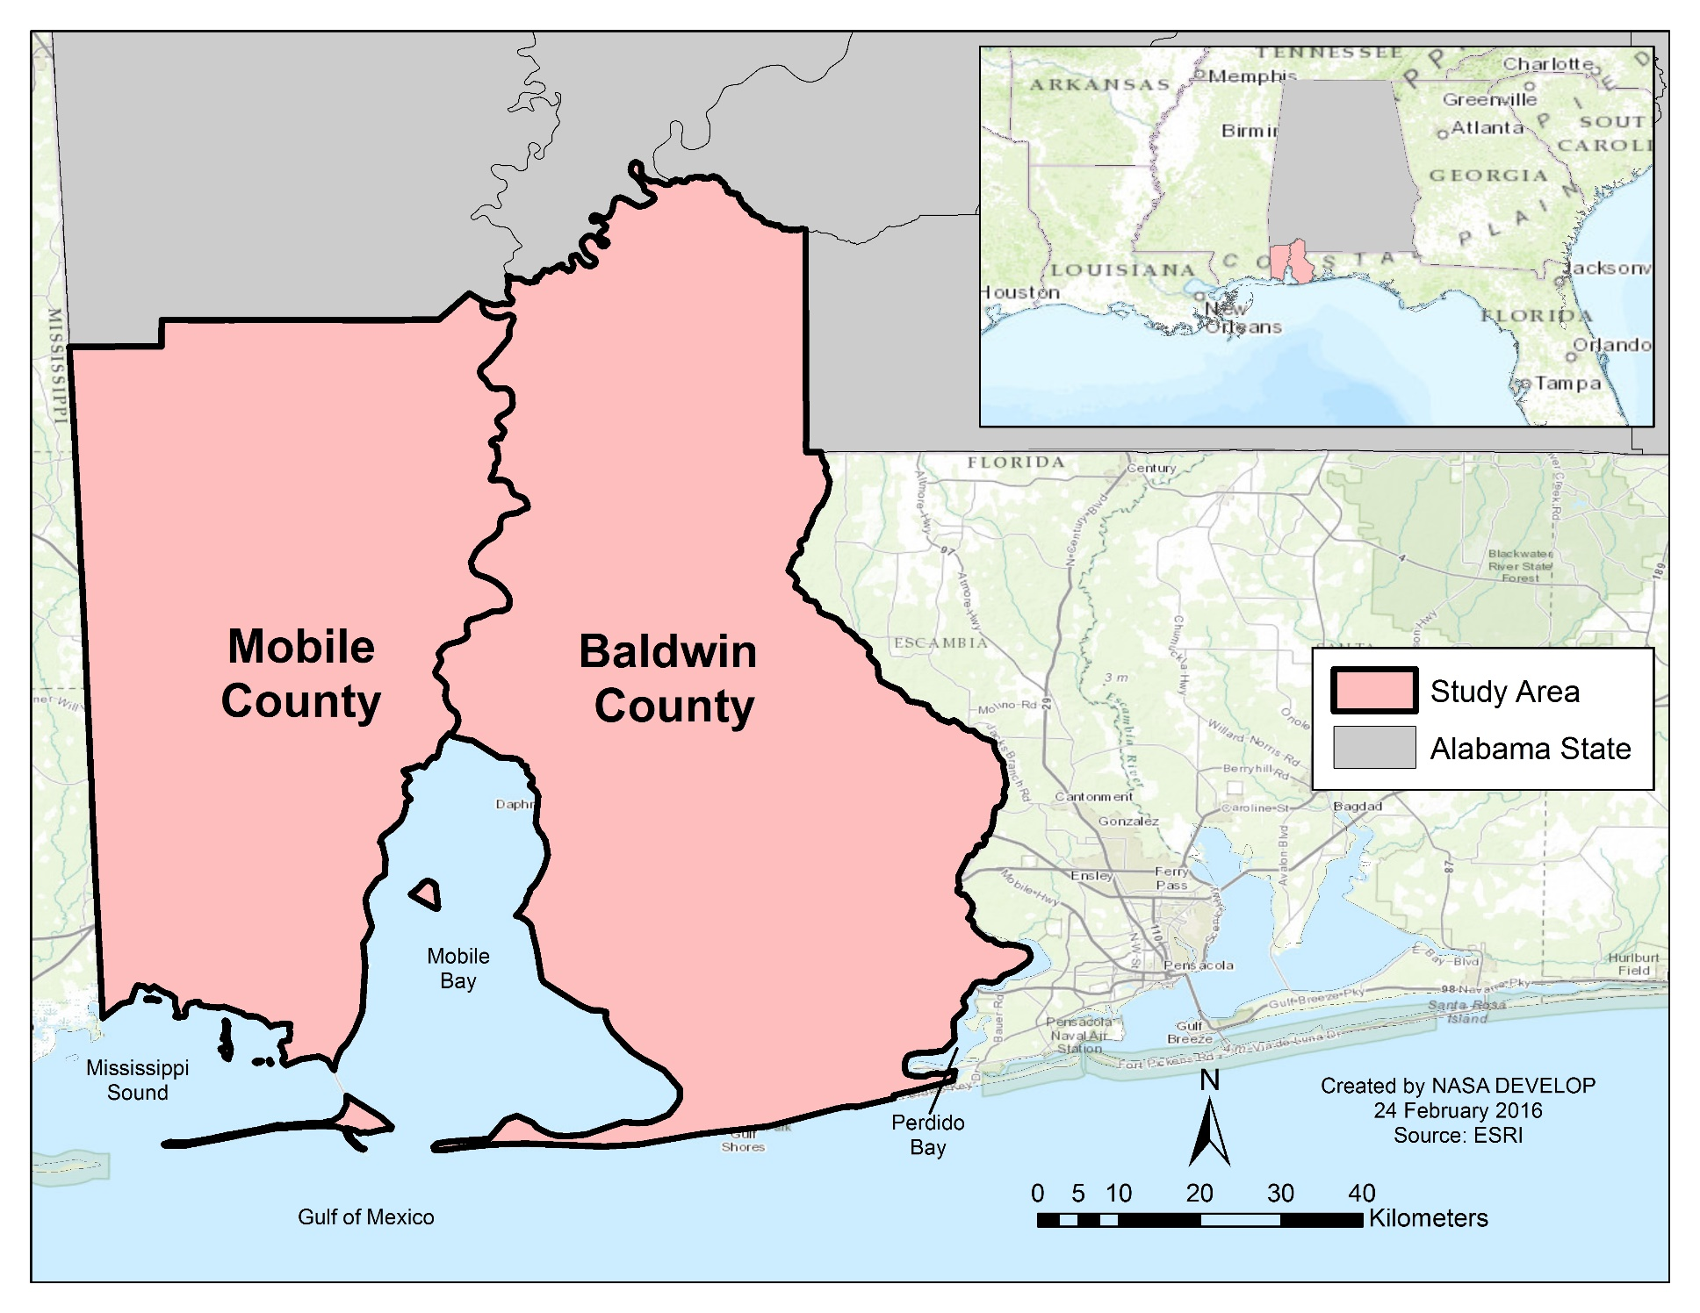
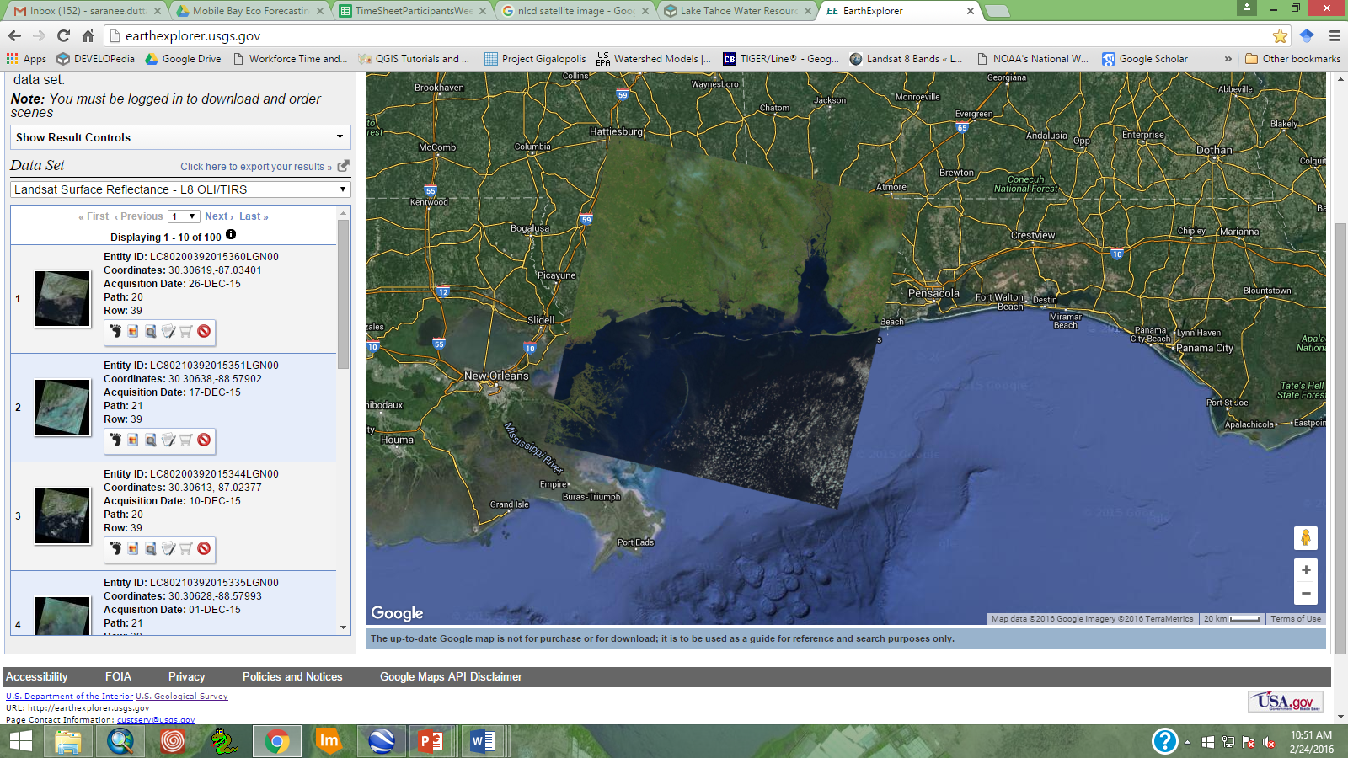
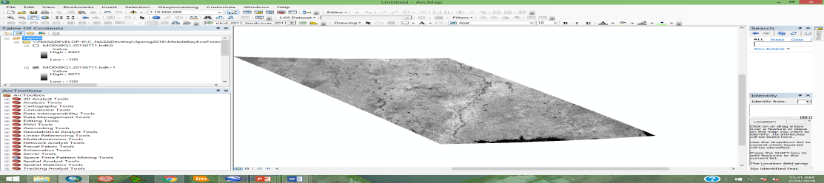
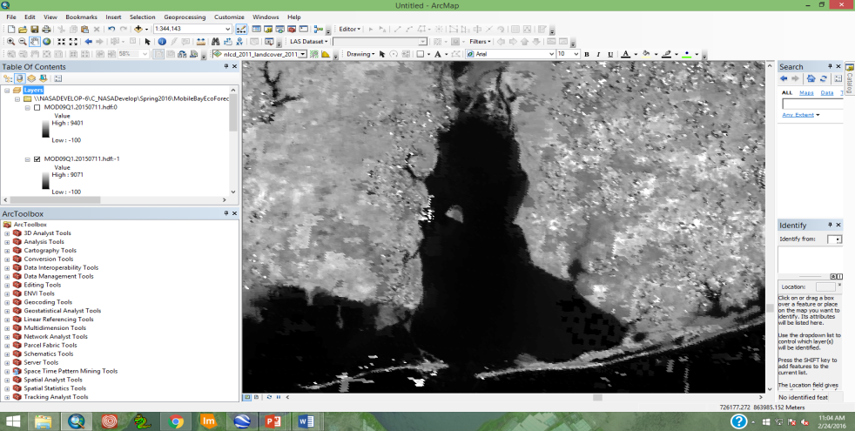
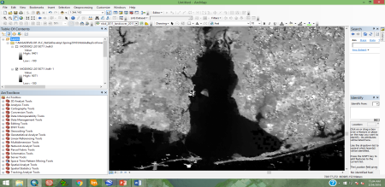
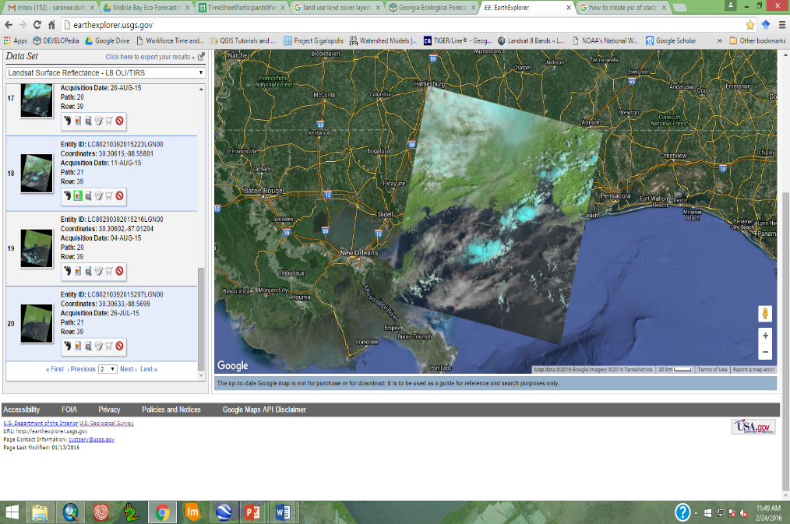
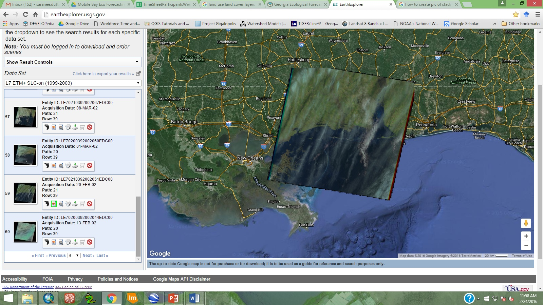



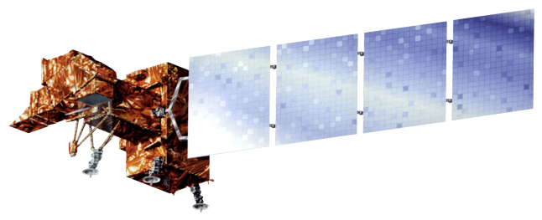

Mobile Bay Ecological Forecasting
Monitoring marsh conditions in coastal Alabama using NASA earth observations to support the Alabama Coastal Foundation’s restoration and conservation initiatives.
Saranee Dutta(Project Lead), Jeanett Bosarge, Courtney Kirkham, Tyler Lynn…
DEVELOP National Program at the Mobile County Health Department
Abstract
Objectives
Keep this blank for now.
Body text point size should be at least 24.
Caption text point size should be at least 16.
Feel free to rename, move, and resize sections as needed.
Apply NASA satellite data to assess historical and current marsh conditions
Predict future marsh extent using land change models and trend data
Assist the Alabama Coastal Foundation by providing data that will help focus funding and efforts in appropriate areas
Provide project partners with a cost-effective methodology to improve monitoring and restoration efforts
Study Area
Methodology
Landsat 8 (OLI)
MODIS / Terra (Surface Reflectance)
Landsat 5 (TM), Landsat 7 (ETM +), Landsat 8 (OLI), MODIS / Terra
Supervised / Unsupervised Classification
Subset creation
Earth Observations
LULC Map
NDVI = $\frac{NIR −Red}{NIR+Red}$
Accuracy Assessment
Marsh Health Trend Map
Landsat 5 ( TM)
Landsat 7 ( ETM +)
Landsat 8 (OLI)
Terra, MODIS
NDVI Map
Conclusions
Results
Use bullets.
Use complete sentences with periods.
Use images.
Make sure that it has some sort of flow, that it makes sense. Show your results in a logical order.
No bullets.
Team Members
Project Partners
Acknowledgements
Use a professional-looking photo.
Individual headshots are ok, if they aren’t pixelated and are all the same size.
Include a caption that states the team members’ names.
Alabama Coastal Foundation
Dauphin Island Sea Lab
The project team would like to thank our mentor, Bernard Eichold, M.D., Dr. PH (Mobile County Health Department), and our science advisor, Dr. Kenton Ross (NASA Langley Research Center). Their assistance was a valuable resource for the completion of this project.
This material is based upon work supported by NASA through contract NNL11AA00B and cooperative agreement NNX14AB60A.
DEVELOP Program at Mobile County Health Department

