Slide 1
Yonkers
Urban Development
Utilizing NASA Earth Observations to Identify Environmental and Social Drivers of Urban Heat Vulnerability and Model Urban Cooling Interventions in Yonkers, New York
Jillian Walechka, Tanya Bils, Kathryn Greenler, Samain Sabrin, & Joseph Scarmuzza
Arizona – Tempe

Slide 2
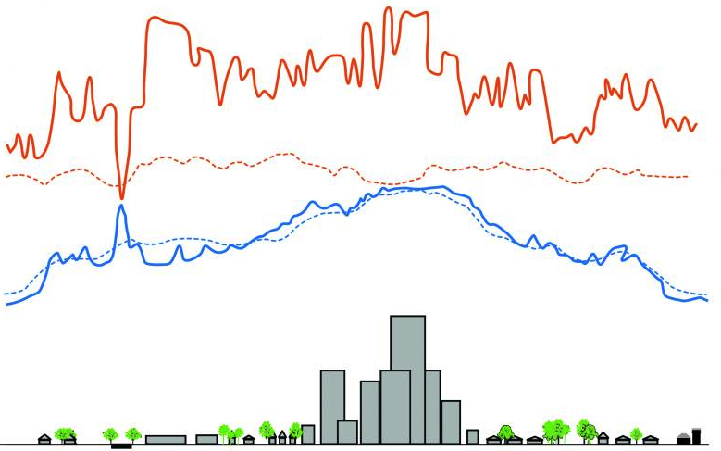
Background
Surface Temperature (Day)
Air Temperature (Day)
Surface Temperature (Night)
Air Temperature (Night)
The Urban Heat Island (UHI) effect
  Thermal hotspots in urban canopies
  Surface Heat Island Effects (SUHI) as proxy of air temperature
Day
(4 pm)
Temperature
Night
(2 am)
Rural
Suburban
Pond
Industry &
Warehouses
Urban
Residential
Downtown
Urban
Residential
Park
Suburban
Rural
Image Credit: Environmental Protection Agency
Notes:
Speaker notes: Heat accumulates in cities as energy is absorbed by impervious materials found in buildings, roads, parking lots and other built spaces, and transportation emissions and air conditioning output create additional heat sources, all accumulating to make urban areas much hotter than surrounding undeveloped areas. This Urban Heat Island Effect is measured by the temperature difference between cities and surrounding areas. On the other hand, urban parks, ponds, and residential areas are cooler than highly developed downtown areas.
Surface heat and air temperatures create different effects. surface heat islands and atmospheric heat islands, both higher above the city. Different techniques are used to identify and measure these differing effects and their impacts. Lacking atmospheric air temperature data, we use surface heat as a proxy to measuring air temperature hotspots in Yonkers city.
-------------------Image Credits------------------------------
https://www.epa.gov/heatislands/learn-about-heat-islands
* Part of image modified. Enlarged text, made editable

Slide 3
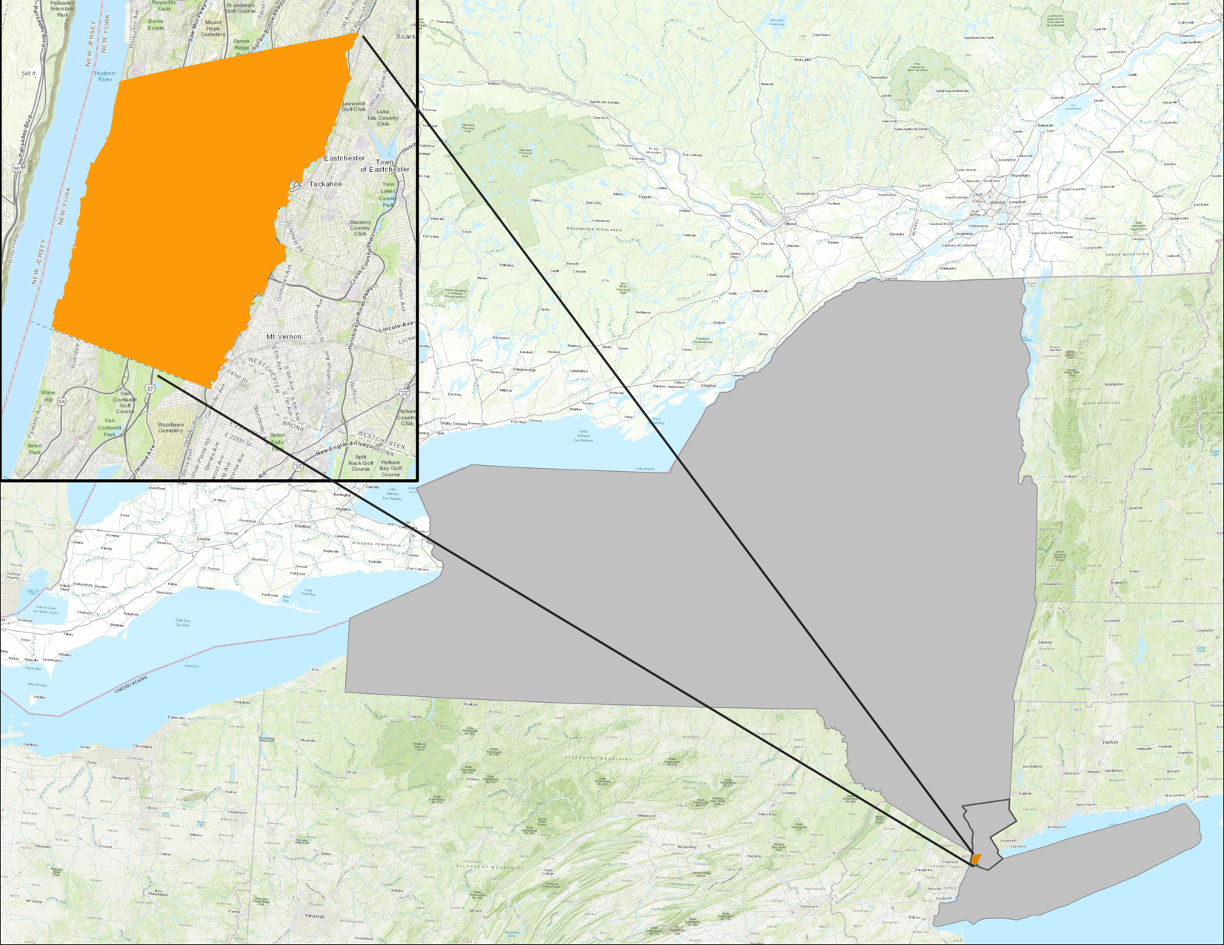
Study Description
Study Area
  City of Yonkers, New York
    Population: 201K
    Climate: Humid continental hot summers
    35% Hispanic/Latino
    Founded in 1646, grew from farming village around Saw Mill River
N
Yonkers
0
1
2
3
Miles
New York
Study Period
  2015 to 2020
    Summer months: June 1st – August 31st
Westchester County
Sources: County of Westchester, Esri, HERE, Garmin, INCREMENT P, USGS, METI/NASA, NGA, EPA, USDA, OpenStreetMap contributers, FAO, NPS, AAFC, NRCan
Notes:
Yonkers is an inner Suburb of New York City, located on the Hudson River just North of the Bronx in New York City. It is {insert demographic summary}. Due to the Urban Heat Island effect and multiplicative effects from nearby New York City, Yonkers has been impacted by increasing temperatures. We were particularly interested in the hot summer months of July through August.

Slide 4
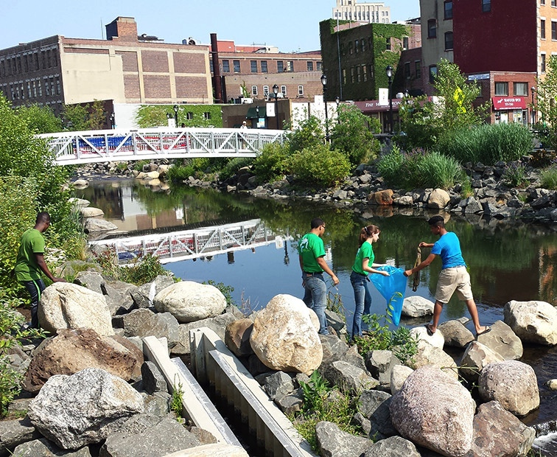
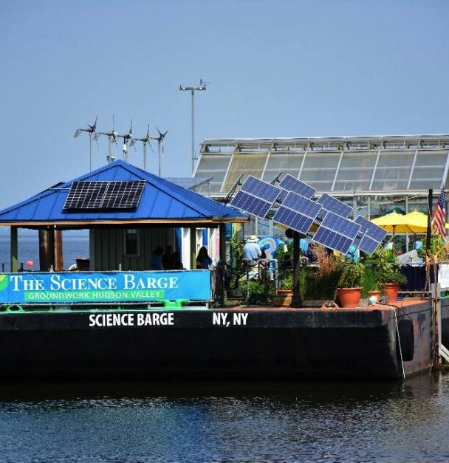
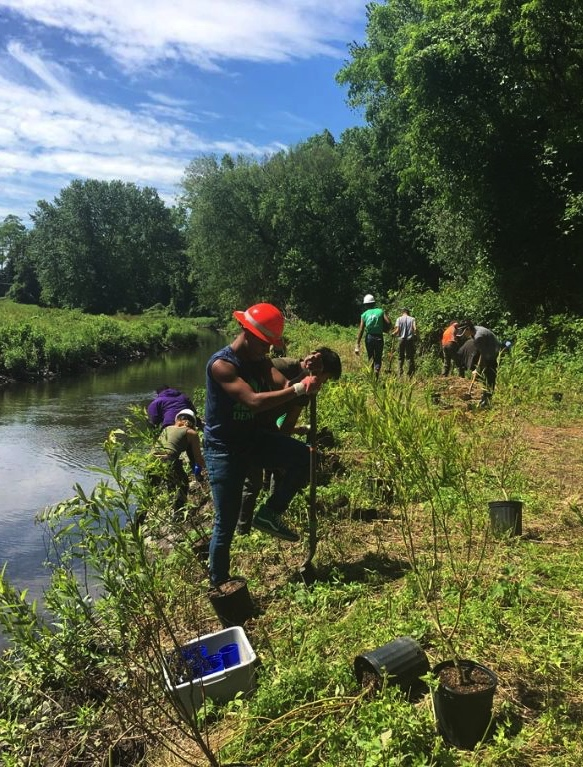
Project Partners
Groundwork USA, Groundwork Hudson Valley
Image Credit: Groundwork Hudson Valley
Notes:
Speaker Notes
-Groundwork Hudson Valley, is a subset of Groundwork USA which seeks to create sustainable environmental change in urban neighborhoods through community-based partnerships that promote equity, youth leadership, and economic opportunity via the Climate Safe Neighborhoods initiative
-Oded Holzinger, Climate Resilience Manager, served as the DEVELOP team's point of contact for the project
-------------------Image Credits------------------------------
Photo of volunteers tree planting by Groundwork Hudson Valley courtesy of Groundwork Hudson Valley, used with permission

Slide 5



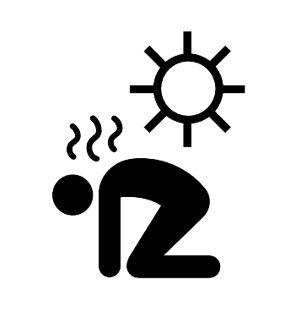

Community Concerns and Community Needs
Increasing Temperatures
Urban Greening
Social & Health Vulnerability
Future Interventions
Icon Credit: LA Great Streets​
Notes:
Through ongoing community efforts, Groundwork Hudson Valley understands Yonkers' increasing struggles with urban heat, and asked us to approach the issue from a few fronts. Increasing temperatures pose a greater risk to all residents and health disparities and social vulnerabilities raise risks even further. These factors are spatially intertwined with vegetation across the city, both physically and historically. Increasing vegetation and urban design interventions in the built environment can cool the city, redistribute the benefits of the urban landscape and combat community concerns. All of these factors are spatial elements which NASA’s Earth observations can help us to understand.
-------------------Image Credits------------------------------
Vacant lot activation by LA Great Streets, US (Public Domain) from the Noun Project
https://thenounproject.com/search/?q=urban+development&i=476745
Tree canopy by LA Great Streets, US (Public Domain) from the Noun Project
https://thenounproject.com/term/tree-canopy/476740/
Heat Stroke by Luis Prado, US (Creative Commons) from the Noun Project
https://thenounproject.com/search/?q=heat+stroke&i=924682
Global Warming by Creative Mania, IN (Creative Commons) from the Noun Project
https://thenounproject.com/term/global-warming/1028784/
Offices by Made by Made, AU (Creative Commons) from the Noun Project
https://thenounproject.com/term/offices/707660/

Slide 6



Project Objectives
Integrating Earth observations with environmental, sociodemographic and health data to address urban heat and environmental inequality
Create Heat Maps & Identify Heat Islands
Map Heat Risk & Conduct Vulnerability Analysis
Evaluate Cooling Strategies
NY State CSC Action Plans: Decreasing Energy Use, Local Forestry, Cooling Centers, Shade Structures, Community Climate Action, Community Education
Icon Credit: Microsoft PowerPoint Clipart
Notes:
The objectives of this project are to identify surface heat islands across the city of Yonkers, to integrate environmental, sociodemographic, and health data into a heat risk index, and to identify areas of potential intervention across the city by creating a model to evaluate their impacts. These objectives are in support of New York State’s Climate Smart Communities’ Certifiable Action Plans, including Decreasing Energy Use, Local Forestry, Cooling Centers, Shade Structures, Community Climate Action, and Community Education.
Icon Credit: Microsoft PowerPoint Clipart

Slide 7
Methodology: Overview
Social & Health Variables
Temperature
Day & night
Surface temperature from satellites
Air temperature from in-situ
Environmental Variables
Vulnerability Analysis
Heat Maps
Mitigation Modelling
Notes:
Identifying locations experiencing exaggerated heat effects required mapping heat. To create the heat risk index, exposure to heat was analyzed with sociodemographic and health variables to understand vulnerability. Urban cooling and priorities for intervention were evaluated using a heat mitigation Model. The model required the input of temperature maps, as well as layers for other physical properties.

Slide 8
Heat Mapping

Slide 9
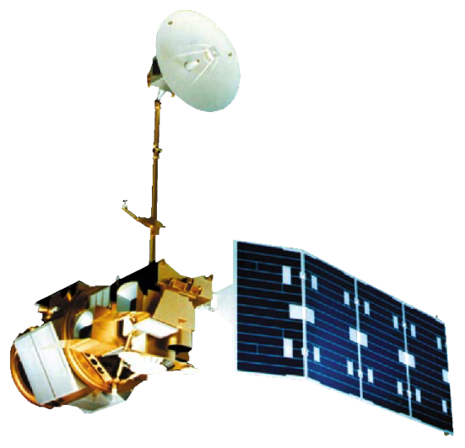
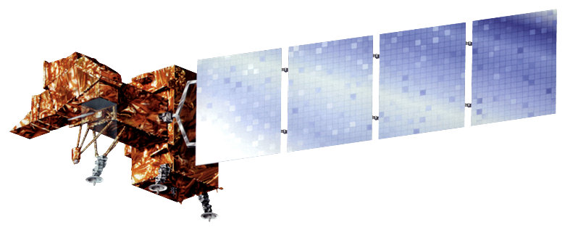
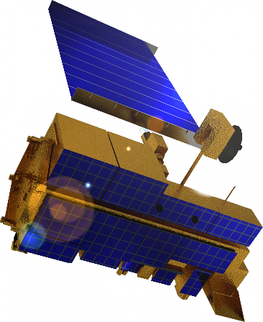

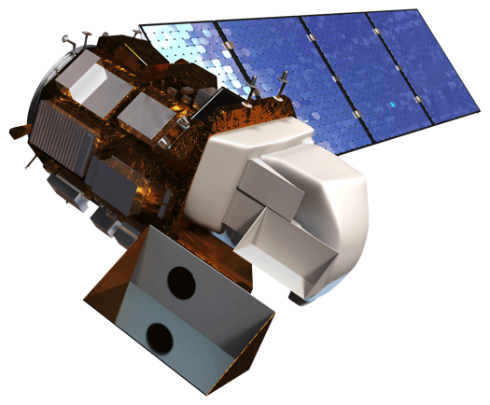
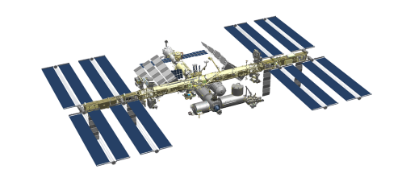
Earth Observations
Landsat 7
ETM+
Landsat 4&5
TM
Terra MODIS & ASTER
Landsat 8
OLI
TIRS
ISS ECOSTRESS
Image credit: NASA, Microsoft PowerPoint Clipart​
Notes:
… such as the five shown here. All sensor images except ECOSTRESS were directly retrieved and analyzed in the Google Earth Engine platform to derive several environmental variables. ECOSTRESS data was retrieved using NASA Application for Extracting and Exploring Analysis Ready Samples (AppEEARS).
Image Credit:
NASA
Microsoft PowerPoint Clipart​

Slide 10

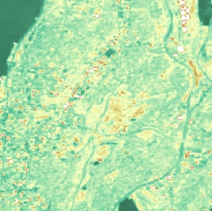

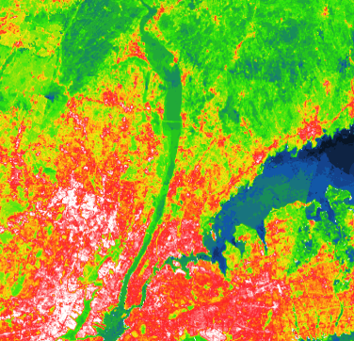
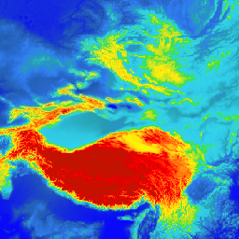
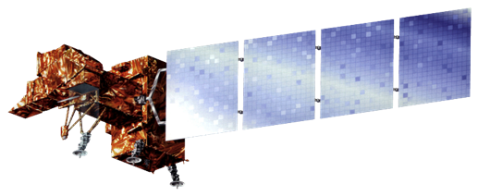
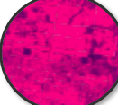
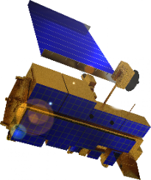
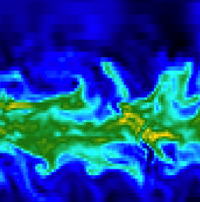
Deriving Daytime LST
Red, Green, Blue
Near-Infrared
Shortwave Infrared
Thermal Infrared
NDVI
Landsat 4&5 TM
Landsat 8
OLI/TIRS
Emissivity
Daytime Land Surface
Temperature
(LST)
Brightness
Temperature
Landsat 7 ETM+
NOAA
Climate Reanalysis
Water
Column
Volume
Terra ASTER
Image credit: NASA
Notes:
Data from NASA Landsat series and ASTER from the Terra satellite were used to derive daytime Land Surface Temperature, using thermal bands and a few corrections.
Image Credit: NASA (Public Domain), retrieved from DEVELOPedia

Slide 11
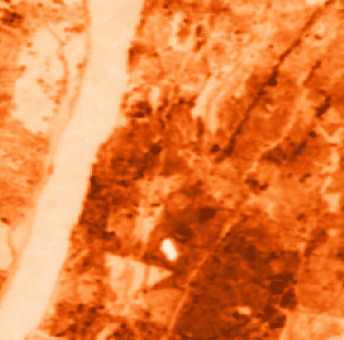
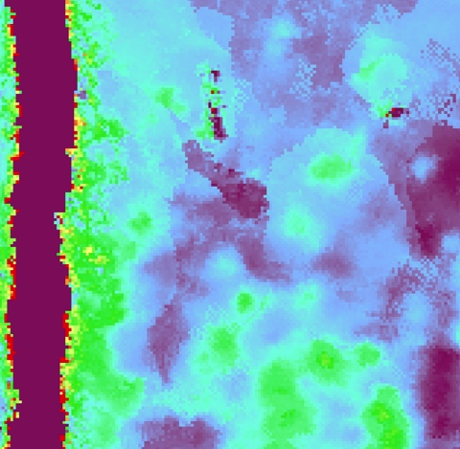
ISS ECOSTRESS
Nighttime Surface Temperature
Evapotranspiration Product
ISS ECOSTRESS
Image credit: NASA
Notes:
The ECOSTRESS satellite was used to map nighttime Land Surface Temperature and Evapotranspiration. Using a script in R, we extracted nighttime LST images from the whole collection. Finally, these images were corrected with a few reference control points to adjust with base NAIP imagery.
Image credit: NASA (Public Domain), retrieved from DEVELOPedia

Slide 12
Data Acquisition
Google Earth Engine (GEE)
Application for Extracting and Exploring Analysis Ready Samples (AppEEARS)
Data Processing
Filter by Study Area
Filter by Study Period
Outputs
Reflectivity
Daytime Land Surface Temperature
Select Median per Pixel from Image Collection
Nighttime Land Surface Temperature
Evapotranspiration
Shade
Methodology:Heat Data Preparation
Earth Observations
Urban Heat Watch 2019 Campaign (NIHHIS)
Filter by time of day
Filter by data quality
Air vs. Surface Comparisons
Diurnal Temperature Change Maps
Air Heat Magnitudes
In-situ
Data
Notes:
Speaker Notes: Raster data from NASA Earth observations were acquired through Google Earth Engine and NASA Application for Extracting and Exploring Analysis Ready Samples (AppEEARS). The images were filtered by the study area and period, and then the mean pixels from each image collection were chosen resulting in an image output for reflectivity, shade, day and night LST, and evapotranspiration, all used to model heat. In-situ data, used for air temperatures which are difficult to assess from satellites, came from the Urban Heat Watch which did a campaign in Yonkers in August 2019. This data was sorted by time of day and helped us produce other heat maps and assess urban island air heat magnitudes.

Slide 13
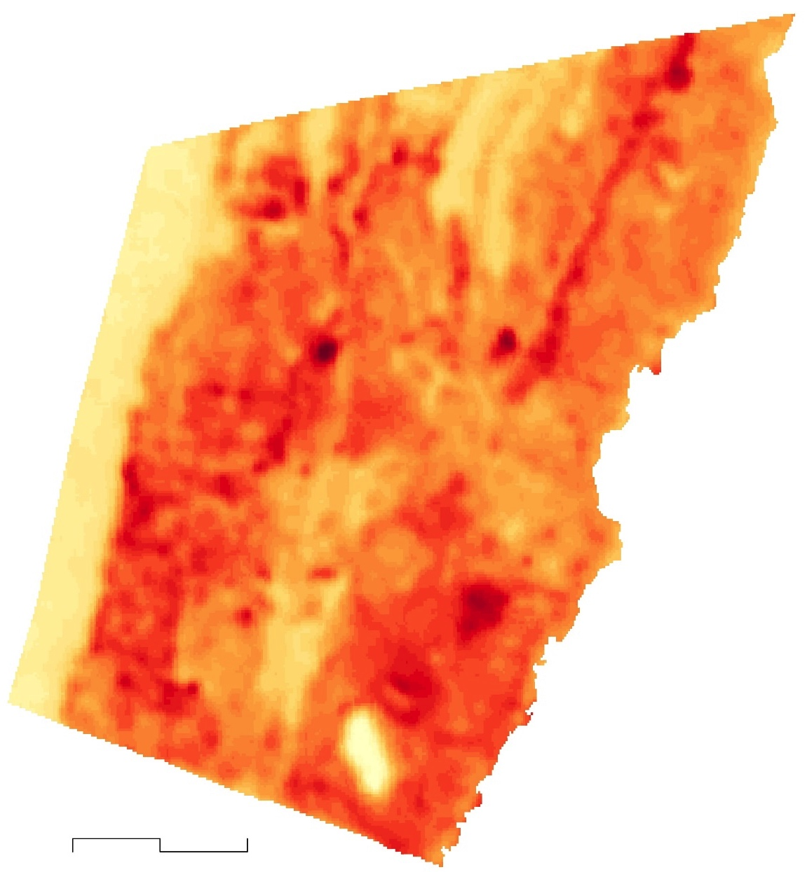
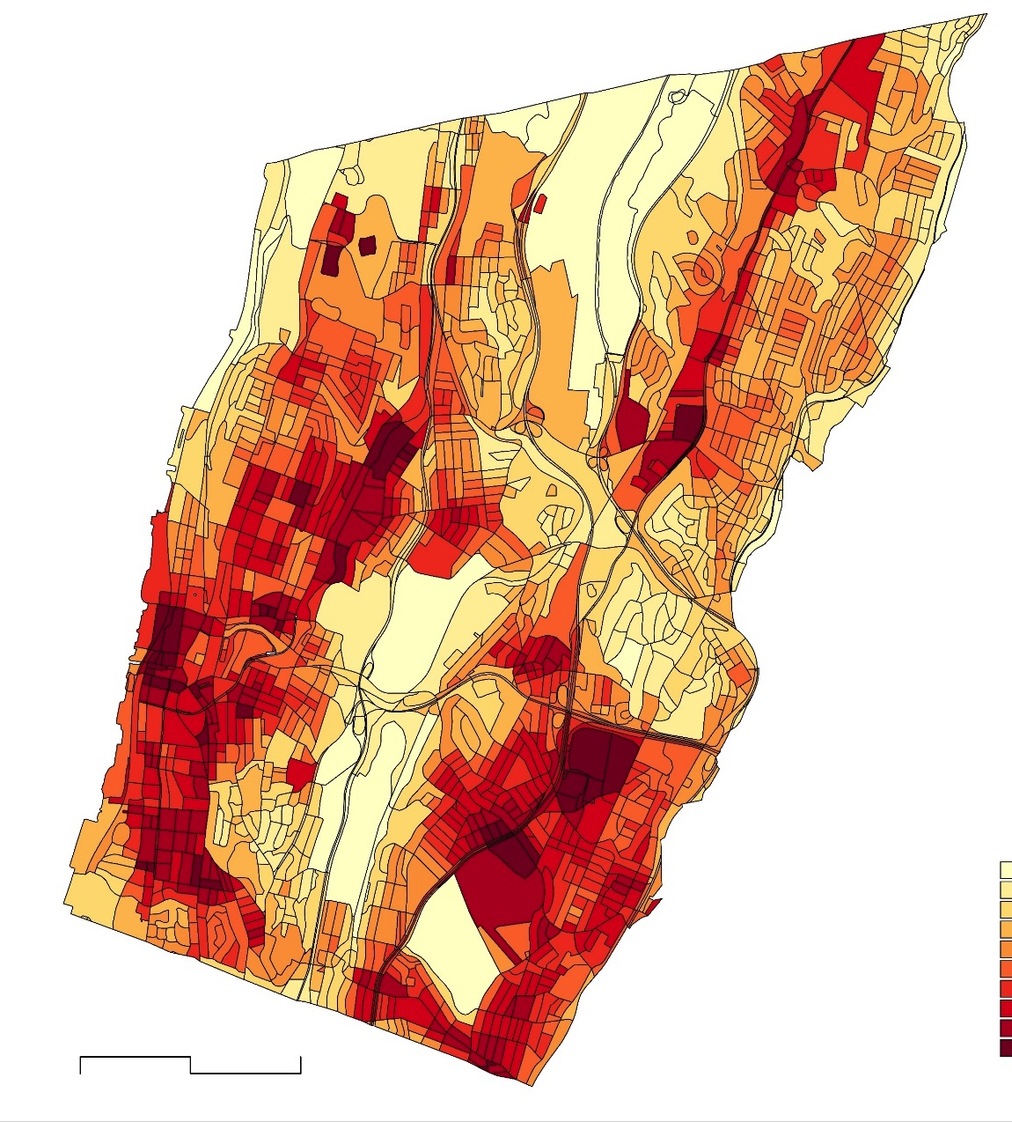

Daytime Land Surface Temperature in Yonkers
LST at 30 m. Resolution
(11:39 am ET , June-August)
LST by Census Block
(11:39 am ET, June-August)
39 °C
<33.5 °C
N
0
1
2 Km
0
1
2 Km
18 °C
<24.9 °C
Notes:
Speaker notes: Next, we needed Land Surface temperatures in each location. Surface temperature is not the same as air temperature, but the surfaces and materials which are heated and reradiate heat, are what cause higher air temperatures in cities. From Landsat and ASTER data, average daytime surface temperatures were derived for summer of 2020 using Google Earth Engine, an open-source remote sensing tool.

Slide 14
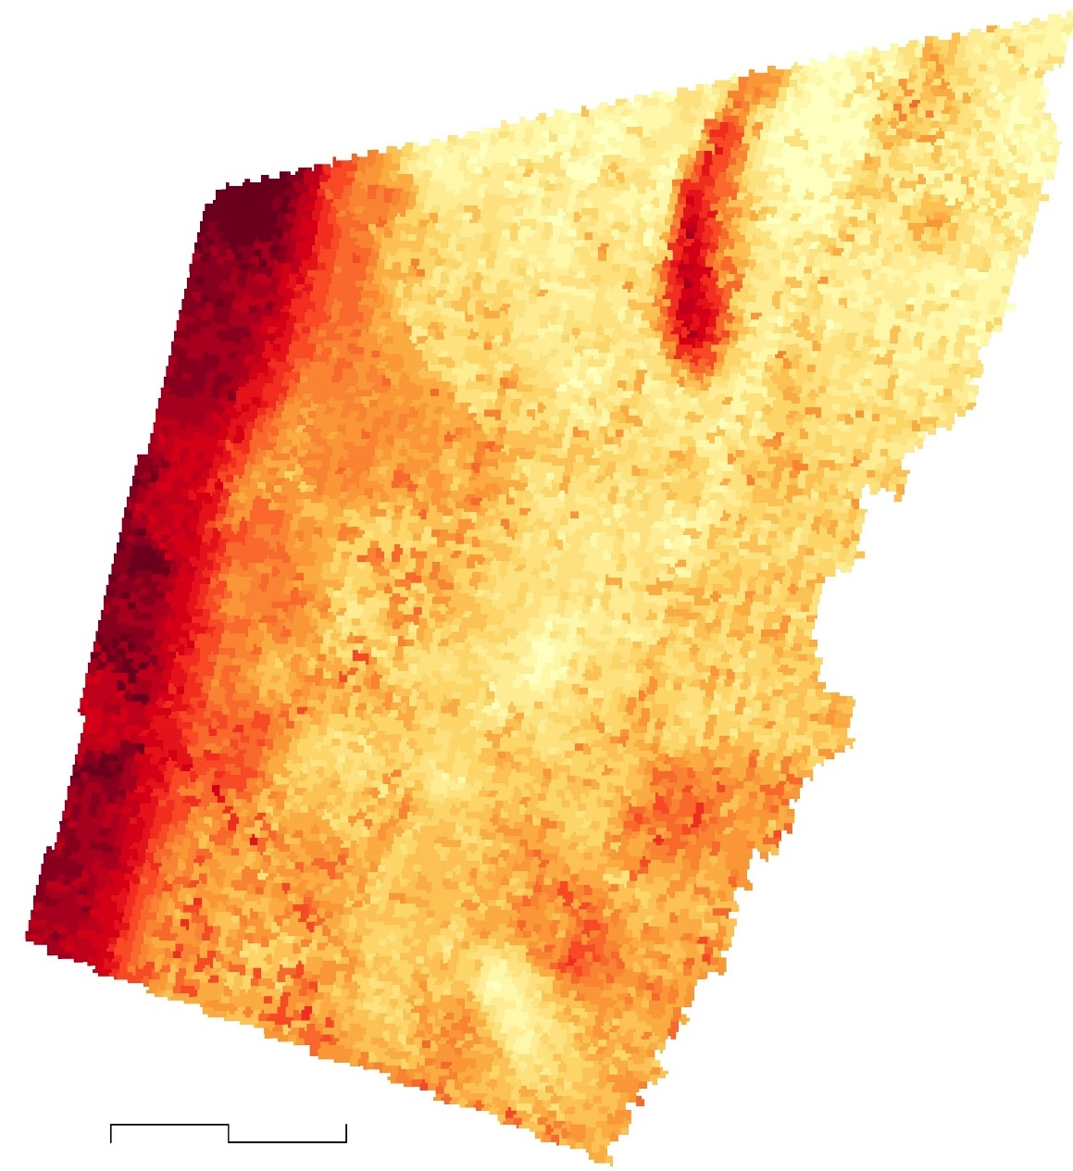
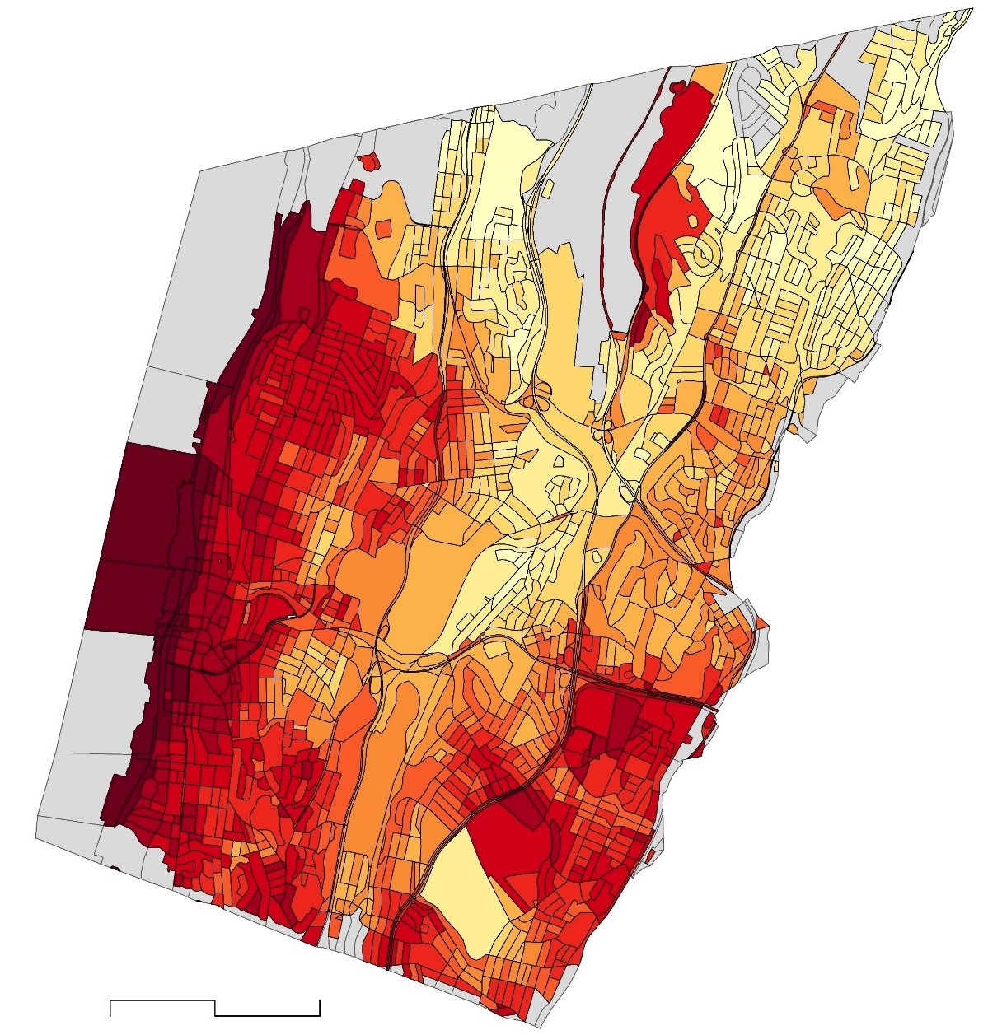
Nighttime Land Surface Temperature in Yonkers
LST at 70 m. Resolution
(10 pm- 5 Am, June-August)
LST by Census Block
(10 pm- 5 Am, June-August)
<23.7 °C
24.8 °C
N
<18.7 °C
0
1
2 Km
0
1
2 Km
20.2 °C
No Data
Notes:
Here, we showed nighttime temperature gradient and aggregated values for census blocks of the city. Similar to previous slide, surface temperatures in nighttime are mostly concentrated over the west side and south-east part of the city, but high and low clusters have a lower degree of anomaly.

Slide 15
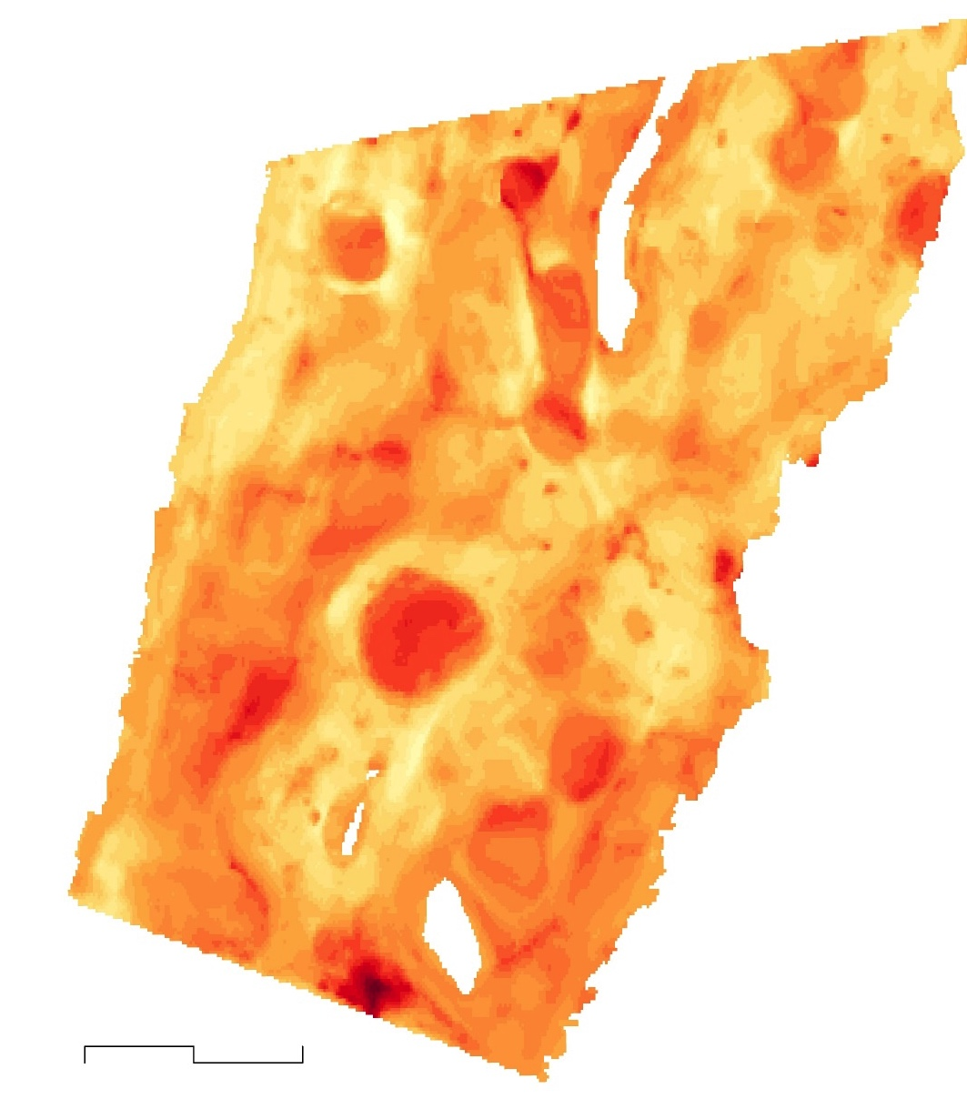
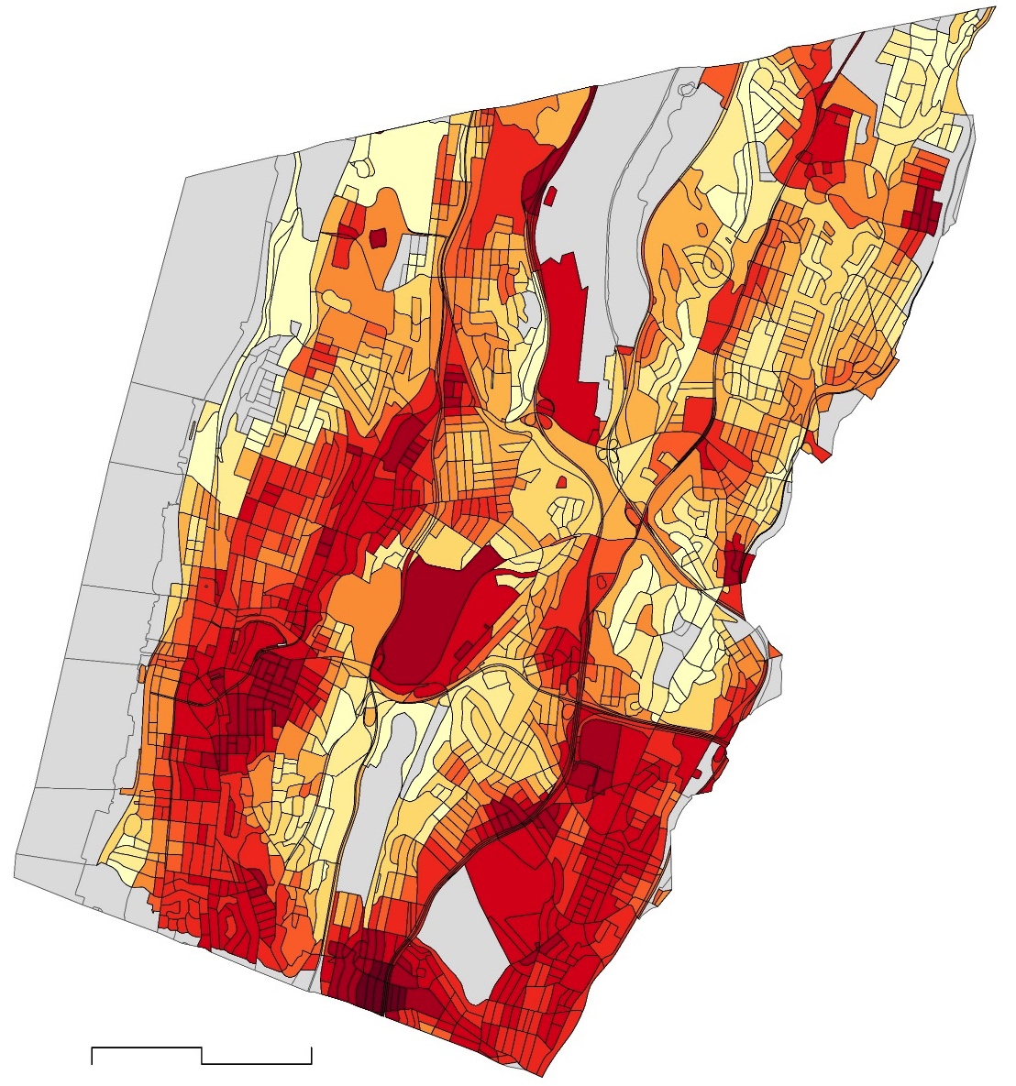
Afternoon Air Temperature in Yonkers
Air Temperature by Raster
(3-4 pm, August 4th 2019)
Air Temperature by Census Block
(3-4 pm, August 4th 2019)
35 °C
N
<34.5 °C
<29.3 °C
0
1
2 Km
0
1
2 Km
27 °C
No Data
Notes:
The air temperatures obtained from the Urban Heat Watch project give us a sense of afternoon air temperature gradient over the city, which has also been aggregated for census blocks. Compared to land-surface temperature shown in the previous slides, we found some divergence in air temperature patterns specially in the center and north of the city.

Slide 16
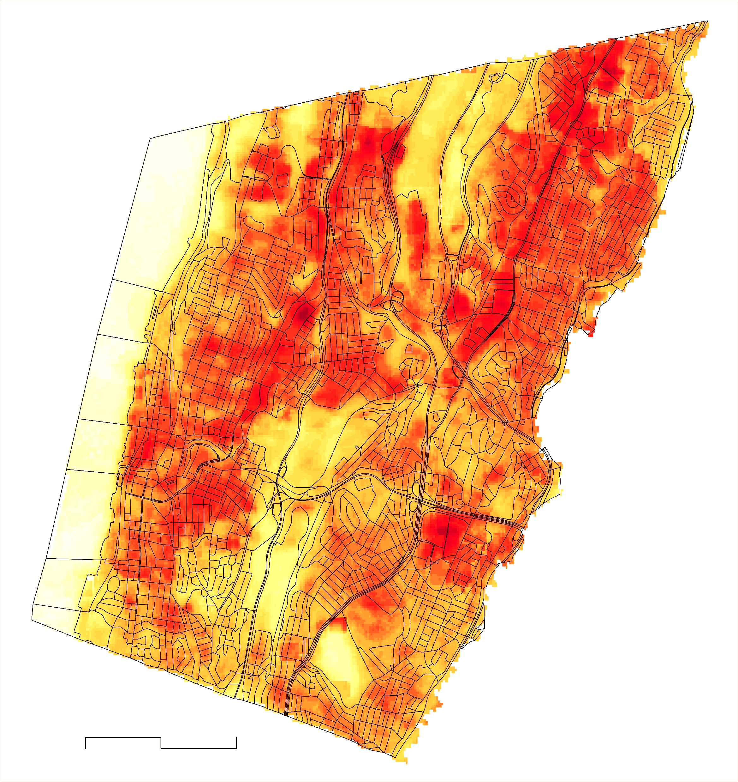
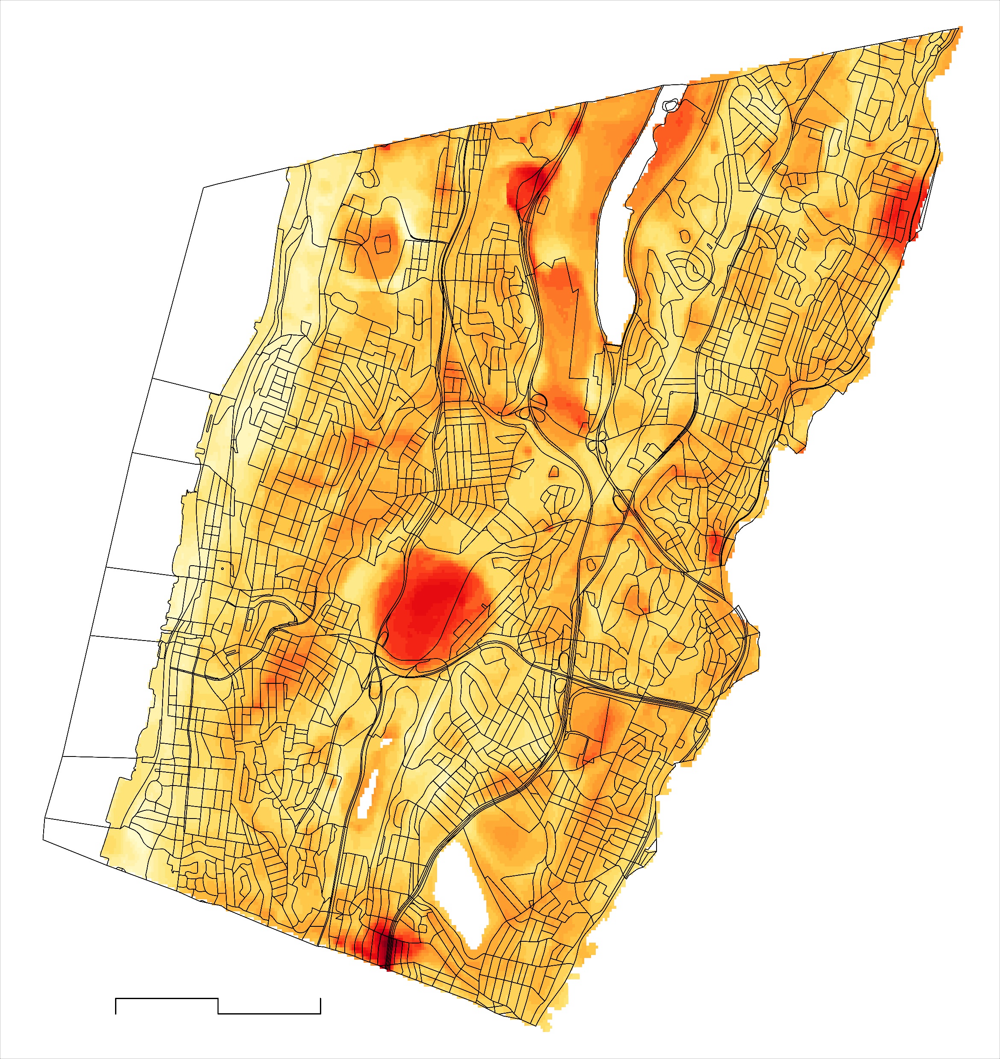

Diurnal Change in LST and Air Temperature
~12-hour Change in LST
9-hour Change in Air Temperature
27.7 °C
N
11 °C
4.6 °C
0
1
2 Km
0
1
2 Km
No Data
-2.5 °C
Notes:
We also investigated the amount of change in temperature over the course of a day, in terms of both air temperature from the Urban Heat Watch Project and Land Surface Temperature collected from Landsat 8 and ECOSTRESS. The two types of heat show very different spatial patterns of change from day to night. Maximum surface temperature change occurs in impervious areas where solar radiation makes materials hot in the daytime, while vegetated areas show the most change in air temperature, as cooling effects lower nighttime temperatures.

Slide 17
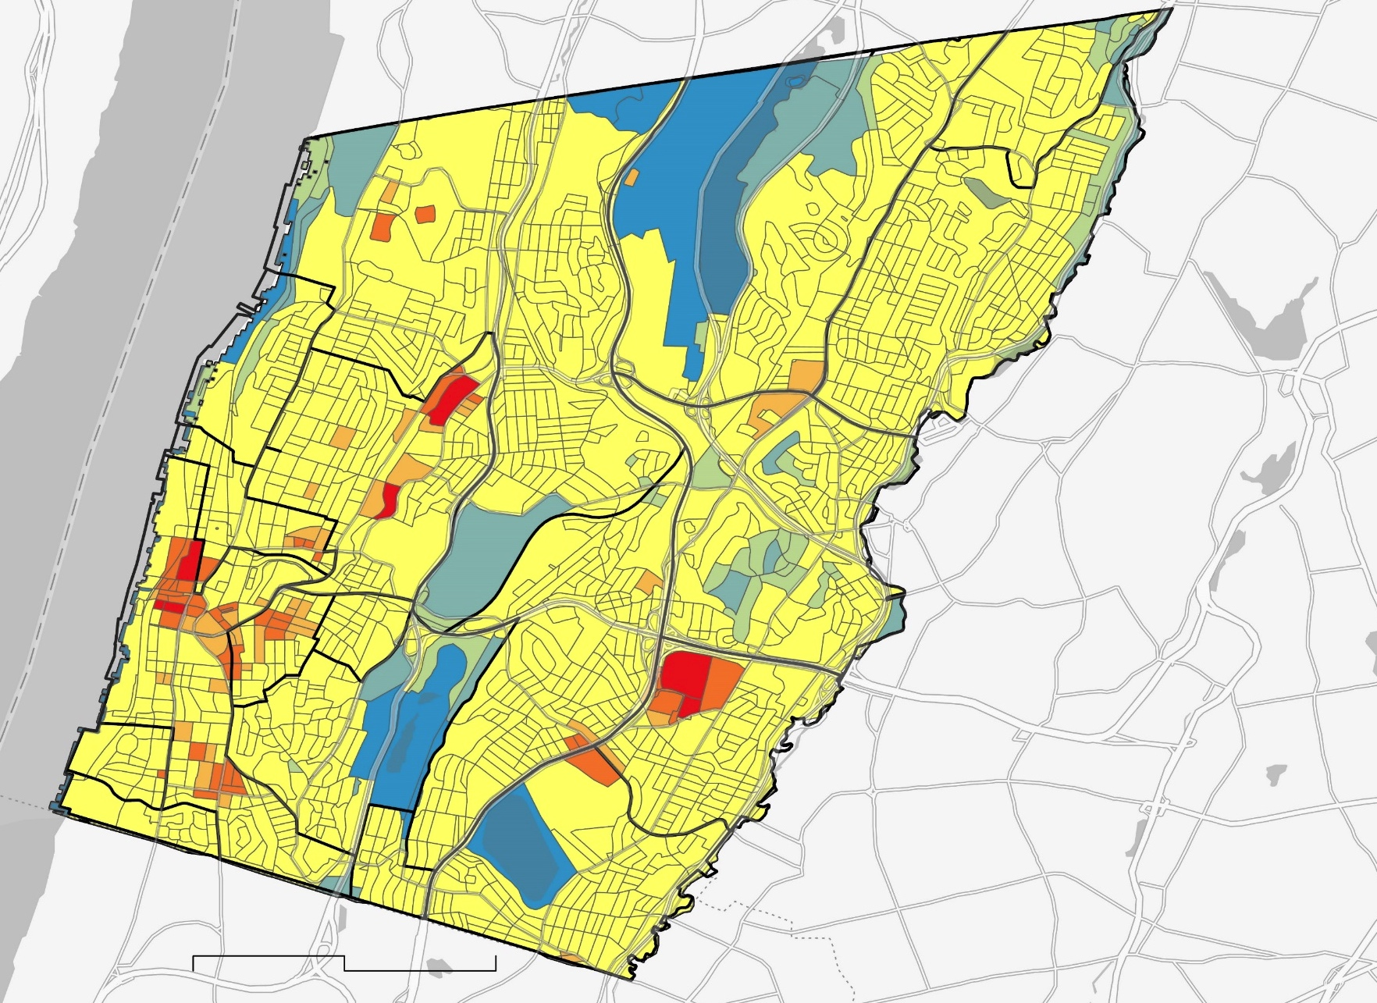
Results: UHI Hotspot Analysis
Hot-spot analysis using Surface Temperature in Yonkers, NY
Hot Spot Neighborhoods
Getty Square
Old 7th Ward
Radford
Kimball
Lamartine Heights
Glenwood
Cold Spot Neighborhoods
Park Hill
Beach Hill
Sprain Lake Knolls
Sunnyside Park
Crestwood Lake
Woodstock Manor
Beach Hill
Nepera park
Sprain Lake Knolls
Crestwood Lake
Woodstock Manor
GlenWood
Sunnyside Park
Lamartine Heights
Location of Hot and Cold Spots of LST
Getty
Square
Nodine Hill
Old 7th Ward
Dunwoodie
Cold Spot – 99% confidence
Cold Spot – 95% confidence
Ludlow Park
Park Hill
Kimball
Cold Spot – 90% confidence
Not significant
Riverdale
Hot Spot – 90% confidence
Radford
Tibbetts
Hill
Beverly Crest
Hot Spot – 95% confidence
N
Hot Spot – 99% confidence
Neighborhood boundaries
0
3.05 Km
Notes:
Using the summer Surface Temperature derived from Landsat, we derived a mean surface temperature value for each census block. In ESRI's ArcPro GIS software, we calculated the Getis-Ord-Gi* statistic of each census block, to separate out statistically-significant clusters of anomalies. This revealed locations and neighborhoods which consistently experienced high surface temperatures during 2015-2020.
Base layer credit: County of Westchester, Esri, HERE, Garmin, SafeGraph, METI/NASA, USGS, EPA, USDA

Slide 18
Vulnerability Analysis

Slide 19
Provider | Parameter(s)
American Community Survey (ACS) | Yonkers city boundary, demographic data
CDC PLACES: Local Data for Better Health | Health indicators & outcomes data
National Land Cover Database (NLCD) 2019 | Land Use/Land Cover
Global Forest Watch (University of Maryland) | Percent Tree Canopy
Westchester County GISHub | Building Footprints
National Integrated Heat Health Information System (NIHHIS) Urban Heat Watch Campaign (2019) | Yonkers Near-Surface Air Temperature
NASA Earth Exchange (NEX), Downscaled Climate Projections (NEX_DCP30) | Reference Region Near-Surface Air Temperature
 | Precipitation
NOAA Global Forecast System (GFS), Gridded Surface Meteorological (gridMET) Dataset | Relative Humidity
U. S. Geological Survey (USGS) National Elevation Dataset (NED) | Elevation
U.S. Environmental Protection Agency | Eco-Regions (Level IV)
Ancillary
Datasets
Notes:
In the next processes of mapping vulnerability and modelling with InVEST, we relied on a wide variety of datasets from many sources on a range of variables. For vulnerability and heat risk assessment, we used National Land Cover Database (NLCD) 2019 % imperviousness data, U. S. Geological Survey (USGS) National Elevation Dataset (NED), ACS and CDC health data for vulnerability assessment. For heat mitigation scenario modelling , we used building footprint, Global Forest Watch tree canopy data, Near-Surface Air Temperature from NIHHIS Urban Heat Watch Campaign, relative humidity data from NOAA Global Forecast System (GFS), Gridded Surface Meteorological (gridMET) Datasets. Additionally, to select appropriate reference sites to compare city temperature, we used Eco-Regions (Level IV) Data from USEPA and precipitation data from NASA Earth Exchange (NEX) Downscaled Climate Projections (NEX_DCP30) datasets.

Slide 20







Methodology: Vulnerability Assessment
Input Data:
Analysis:
Output:
PCA on Social
Variables
Social, Health Vulnerability
1. Environmental
Data
2. Heat exposure
Mapping
2. Social Data
2. Regression
Analysis
3. Heat Risk
Index
Mapping
3. Proximity
Analysis
4. Accessibility Maps
3. Health Data
Icon Credit: Microsoft PowerPoint Clipart​
Notes:
Speaker Notes: Our vulnerability assessment incorporated several environmental, socio-demographic and health indicator data, which were further processed using Principal Component Analysis and regression modeling. Results from both algorithms were used to generate our final heat risk map and study existing social and health inequality .

Slide 21


Sociodemographic and Health Data
2015-2019 (5-year Estimate)
2020 Estimate
Population Density
Poverty Rate
Unemployment Rate
Race
Foreign-born Residents
Vulnerable Age Residents
Health Insurance Rate
Residents' Mode of Commuting
Unit A/C Availability
% with Asthma
% with Diabetes
% with Heart Disease
% with Obesity
% with Chronic Obstructive Pulmonary Disease (COPD)
Notes:
Speaker Notes: We collected the following social variable data at Census Tract Level from the 2019 5-year American Community Survey. In addition, 2020 estimates of several health indicators data such as crude prevalence of asthma, COPD, cardiovascular heart disease, obesity and diabetes were collected from CDC’s Places: Local data for better health project.
--------------------------------------------------------------------------------------------------------------------------------------------------------------------------------------------------------------------
Image Credit: US Census Bureau, https://www.census.gov/programs-surveys/acs
Center for Disease Control, https://www.cdc.gov/

Slide 22

Methodology: Vulnerability Assessment
Exposure
x
Vulnerability
=
Heat Risk
Index
Factors combined by PCA:
Explained in terms of
3 aspects:
Environmental parameters
(3 variables)
Sociodemographic factors (17 variables)
Variables selected by Multicollinearity tests
Health outcome
(5 variables)
Variables selected by literature review
Notes:
Speaker Notes: We used LST as a measure of exposure which was explained in terms of environmental indicators data using spatial regression modeling, where three variables were selected by repeated multicollinearity tests. Additionally, we performed PCA analysis on 17 demographic variables and 5 heat outcomes to explain underlying heat vulnerability in Yonkers.
-----------------Image Credits--------------------------------------------------
Safety Support by Hawaii Open Data, US, The Noun Project Public Domain
https://thenounproject.com/search/?q=vulnerable&i=41337

Slide 23
Results:
Underlying Social & Health Vulnerability
Vulnerability
0
Kilometer
2
Health outcomes
Living and health condition of elderly population
Minority and language efficiency
Access to transportation
Measure of Vulnerability with PCA
Public transportation use and walking as commuting mode
Low vulnerability
Unemployment and access to air-condition
N
High vulnerability
1st 6 principal components explain 82.5% of all variables
Notes:
Speaker Notes: As mentioned before, we used PCA to generate vulnerability scores for Yonkers at for both census tract Level.
We selected 16 socio-economic and 6 health indicator variables after thorough literature review and analyzed them using the PCA method for census tracts. We then selected 6 components that explained at least 82.5% of the data variation. These components were then used to develop an overall score that represents underlying social and health vulnerability.

Slide 24
Results: Mapping Heat Exposure
Heat Exposure in Yonkers, NY (in 0-1 scale)
Exposure
Spatial lag Autoregressive (SAR) model
1
0.8
Environmental parameters
LST ~ Albedo + DEM + Imperviousness
0.6
Impact of individual variables on LST
0.4
Variable | Direct Impact | Indirect impact | Global Impact
Albedo | -2.07 | -4.55 | -6.62*
DEM | 0.004 | 0.01 | 0.012*
Imperviousness | 0.027 | 0.06 | 0.09*
0.2
Weights
used to
Estimate
Exposure
Index
0
2Km
0.0
* statistically significant global impact
Notes:
Speaker Notes: This slide shows how we developed the heat exposure index using a spatial regression model, Spatial lag Autoregressive (SAR). Initially, we started with simple Ordinary least squares regression models to estimate LST exposure in the aspects of environmental indicators. After several trials of multicollinearity testing, three variables were selected for final model. The OLS model detected spatial correlation upon conducting Moran’s I tests which indicated further improvement with spatial regression modeling approach. We used a global spatial model called Spatial Lag Autoregression (SAR) model which includes the effects of neighboring LST and other dependent variables in explaining independent LST. We did an impact analysis on the SAR model to derive both direct and indirect effects of each dependent variable which were used as weight values for the explanatory variables to finally generate our heat exposure index in a scale of 1 to 0.

Slide 25
Results: Mapping Heat Risk
Heat Risk Index in Yonkers, NY
Social and Health Vulnerability in Yonkers, NY
100
Heat Exposure in Yonkers, NY
40.98°N
1
1
80
0.8
0.8
40.96°N
x
=
60
0.6
0.6
0.4
0.4
40.94°N
40
0.2
0.2
40.92°N
20
0
2 Km
0.0
0
2 Km
0.0
0
2 Km
0
73.9°N
73.88°N
73.86°N
73.84°N
73.82°N
Notes:
Speaker Notes: Here, we are showing, how we combined our previously derived heat exposure index and social-health vulnerability index to finally formulate the overall heat risk index. The calculated values for Yonkers were later normalized in a scale of 0-100.

Slide 26
High-Risk Areas: Patterns
Heat Risk Index in Yonkers, NY
Neighborhoods at Most Risk:
1. Old 7th Ward
2. GlenWood
3. Kimball
4. Getty Square
Neighborhood Characteristics:
High population densities
High rates of renters
Over 50% no college
Over 35% not U.S.-born
GlenWood
100
40.98°N
Getty
Square
80
40.96°N
60
40.94°N
40
40.92°N
Kimball
20
Old 7th Ward
0
2 Km
0
73.9°N
73.88°N
73.86°N
73.84°N
73.82°N
Notes:
Speaker Notes: By mapping neighborhoods most at risk, we were able to identify some typical characteristics of high-risk areas. This included high population density, high renter rates, over half without any college experience, and over a third not US-born, with Kimball as the exception to a couple of these.

Slide 27
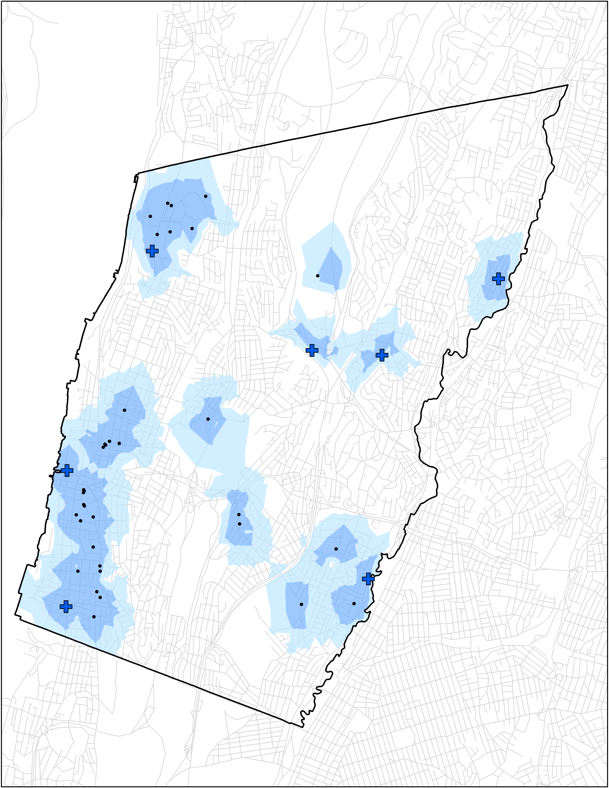

Methodology: Proximity Analysis
Designated Cooling Center and Health Facility locations geocoded
N
Network Analysis
0.25 mi and 0.5 mi buffers around each location (walkability)
Walking Distance to Resources
0.25 mi Buffer
0.5 mi Buffer
Cooling centers
Health Facilities
0
2 Km
Streets
Notes:
Speaker Notes
As an additional analysis, we decided to perform a proximity analysis of Yonkers Cooling Centers and Health Facility locations. First, the Cooling Center and Health Facility locations were geocoded and added as a shape file to ArcGIS Pro. Next, the Network Analysis tool was used to generate walkability from nearby areas towards each point location from quarter and half mile distances. According to the US Dept. Transportation, most commuters are willing to walk approximately 5-10 minutes, equating to around 0.25-0.5 mi (https://safety.fhwa.dot.gov/ped_bike/ped_transit/ped_transguide/ch4.cfm). In this analysis we excluded major road ways as they do not provide sidewalks for safe walkability for community members. These buffers were compared to the Heat Exposure Index described earlier in the presentation to show high exposure areas in comparison to where cooling centers are currently located and visualize which areas within the community are being underserved. A cooling center is defined by the city of Yonkers as…
Map credit: County of Westchester, Open NY

Slide 28
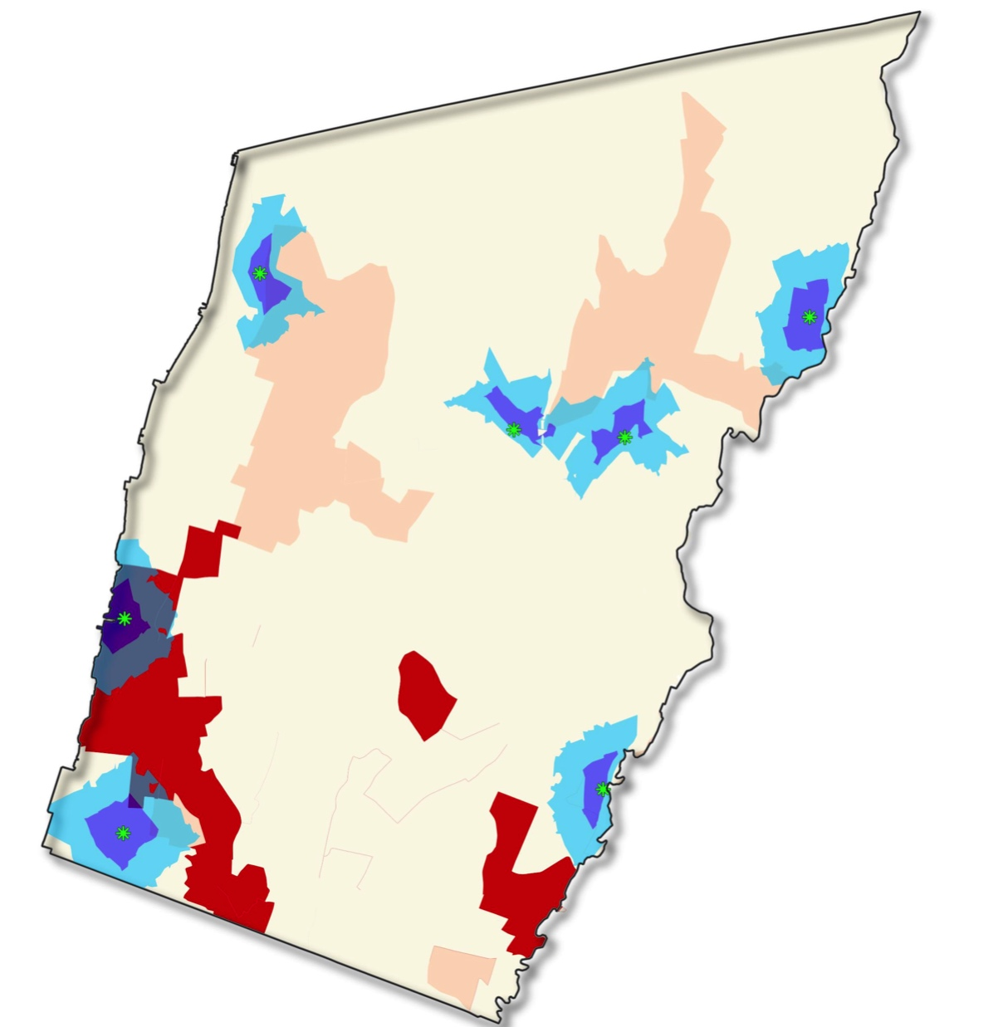
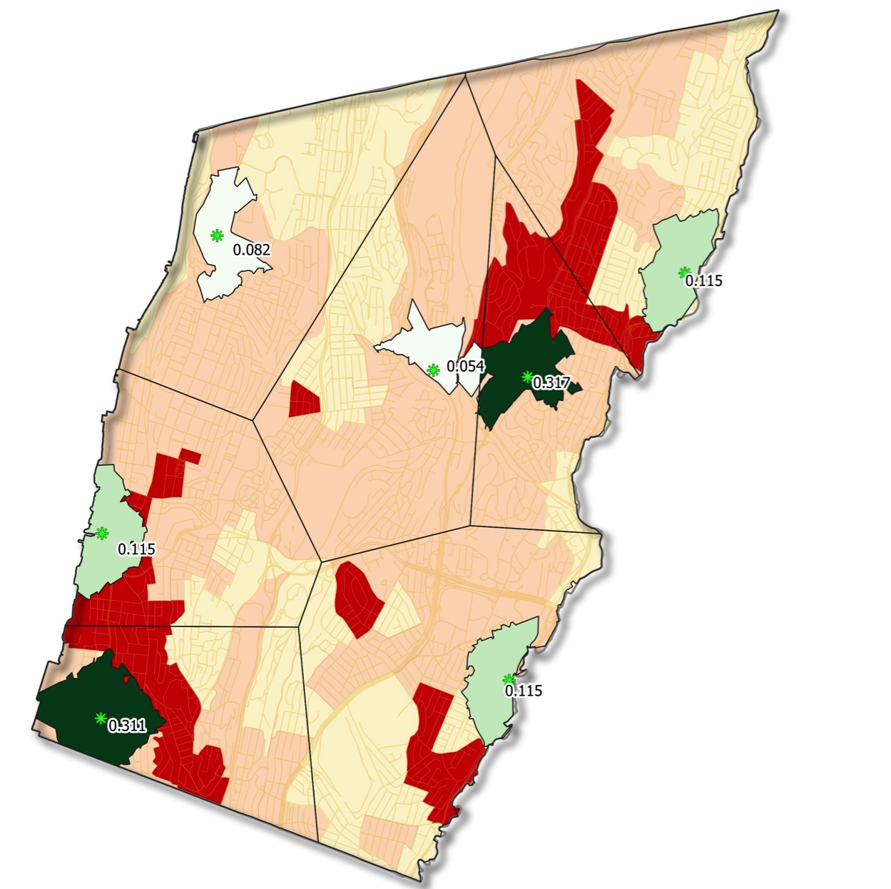

Results: Cooling Centers
N
N
0
2 Km
0
2 Km
Cooling Centers
Cooling Centers
0.25 mi Buffer
Proportion of Population within Walking Distance
0.5 mi Buffer
5% – 9%
Heat Exposure Index
9% – 11.4%
0 – 0.6
11.5%
0.6 - 0.68
11.6 – 27%
0.6 - 1
27% – 32%
Notes:
Speaker Notes
The map on the left displays each cooling center buffer compared to the Heat Exposure Index. While some cooling center buffers overlap with the highest heat exposure areas, many are outside of a the usual 0.25-0.5 mile walking distance buffers cited by the US Dept. Of Transportation. The map on the right displays the proportion of each service area's population that is within walking distance of each cooling center. Each service area is denoted by a black border within the city boundary.

Slide 29
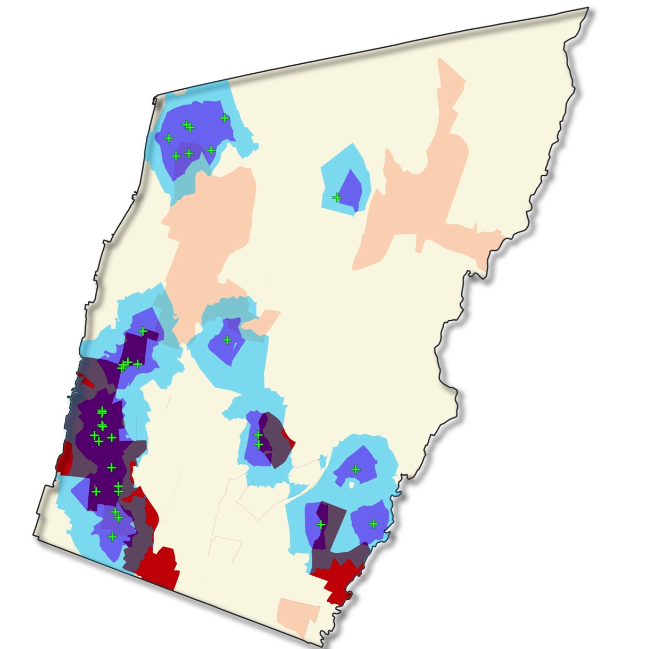
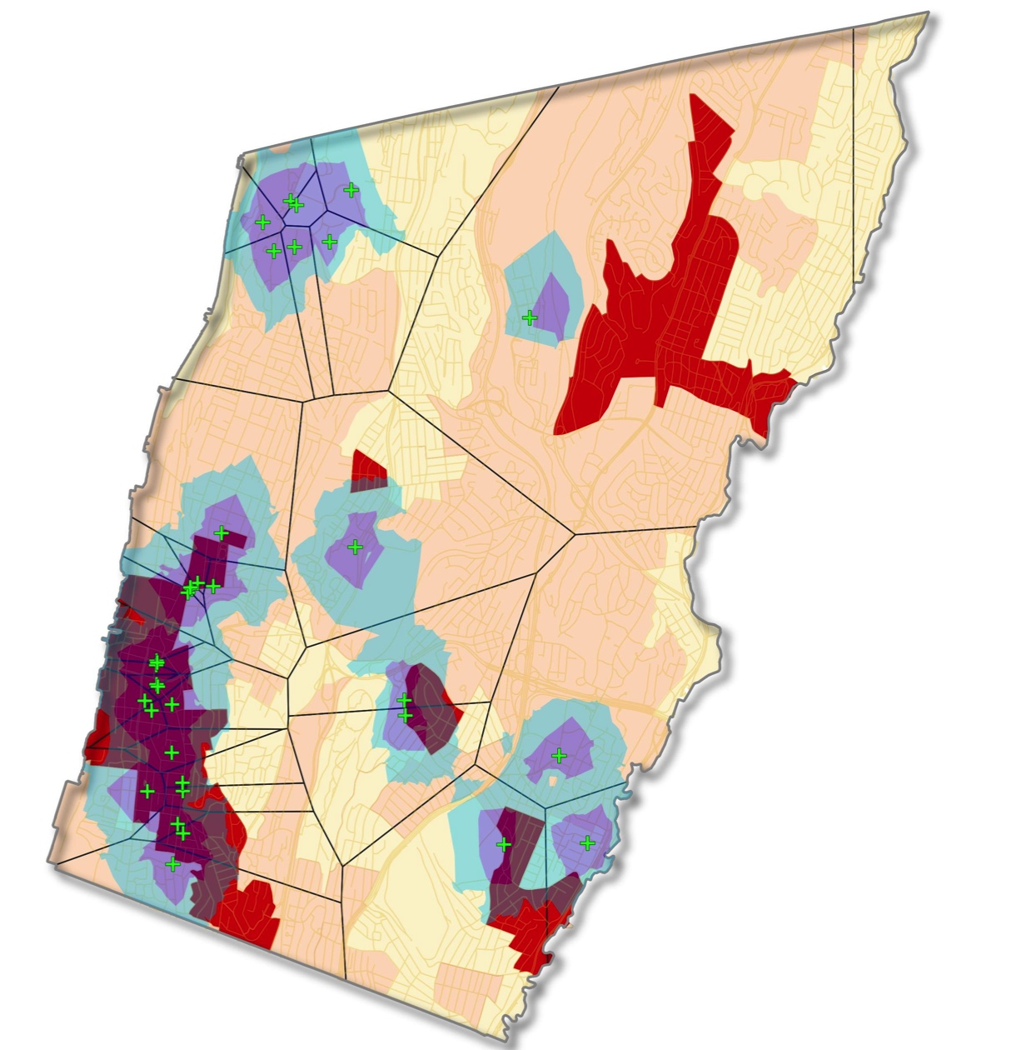

Results: Health Facilities
N
0
2 Km
N
0
2 Km
Health Facility Locations
0.25 mi Buffer
Health Facility Locations
0.5 mi Buffer
Service Areas
Heat Exposure Index
Heat Exposure Index
0 – 0.6
0 – 0.42
0.6 - 0.68
0.42 - 0.62
0.6 - 1
0.62 – 0.86
Notes:
The map on the left displays health facility locations compared to the Heat Exposure Index. Several health facility buffers overlap with the highest heat exposure areas, however, several high exposure areas found toward northeast Yonkers are not located within the 0.25-0.5 mile walking distance buffers. The map on the right displays the Health Facility locations and compared to the derived service areas. Unfortunately, we were not able to complete further analysis on these locations due to time constraints. This is a potential analysis that can be completed by a follow-up term.

Slide 30
Mitigation Modeling

Slide 31
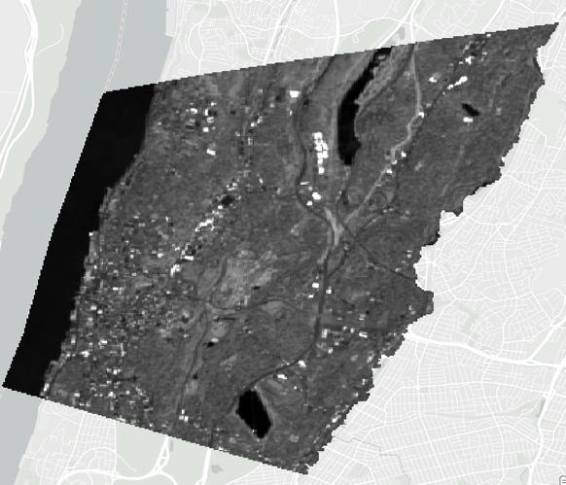
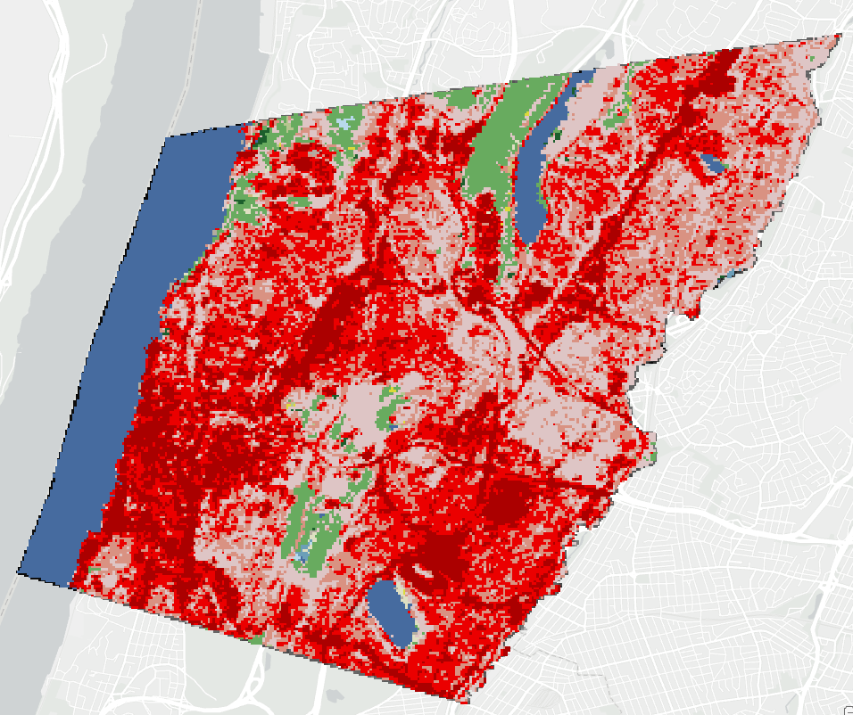
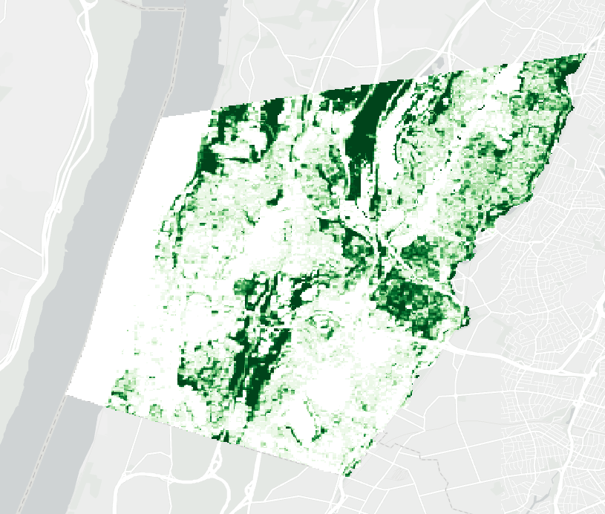
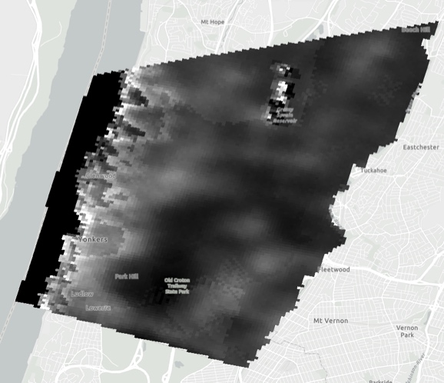
InVEST Model Daytime Cooling
Reflectivity
Land Cover/Land Use
Greenspaces
INPUTS:
Greenspace Effects
Climate Parameters
Tree Cover
Daytime Cooling Capacity
Albedo
INPUTS:
Evapotranspiration
Shade
Potential Evapotranspiration
Notes:
Speaker Notes: Integrated Evaluation of Ecosystem Services and Tradeoffs, or InVEST, Urban Cooling Model was created by the Natural Capital Project, based at of Stanford University. The model aims to quantify the impacts of green infrastructure and other ecosystem services. For the daytime, the urban cooling model uses reflectivity and tree cover to calculate the albedo and shade of each landcover type. With climate parameters such as humidity and wind speeds defined, albedo and shade are combined with evapotranspiration to estimate daytime cooling capacity at each pixel. This indicates the degree to which local physical factors are providing cooling effects nearby. Greenspaces derived from landcover are used to model greenspace cooling effects.

Slide 32
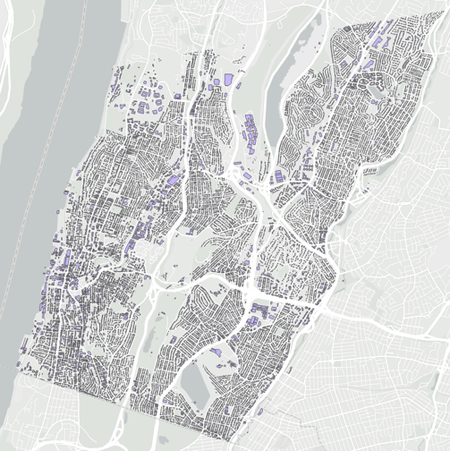
InVEST Model Nighttime Cooling
Land Cover/Land Use
Greenspaces
Greenspace Effects
Building Data
Climate Parameters
Nighttime Cooling Capacity
Building Intensity
Evapotranspiration
Potential Evapotranspiration
Notes:
Speaker Notes: For the nighttime, during which urban heat is mostly effected by materials instead of the solar radiation, we used building footprints and heights to calculate the building intensity of each landcover type present, which was combined with evapotranspiration to estimate nighttime cooling capacity per pixel.

Slide 33
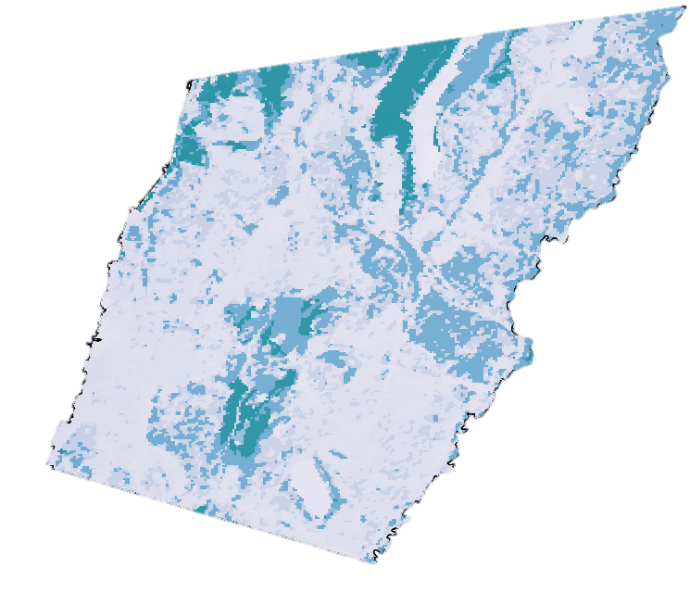
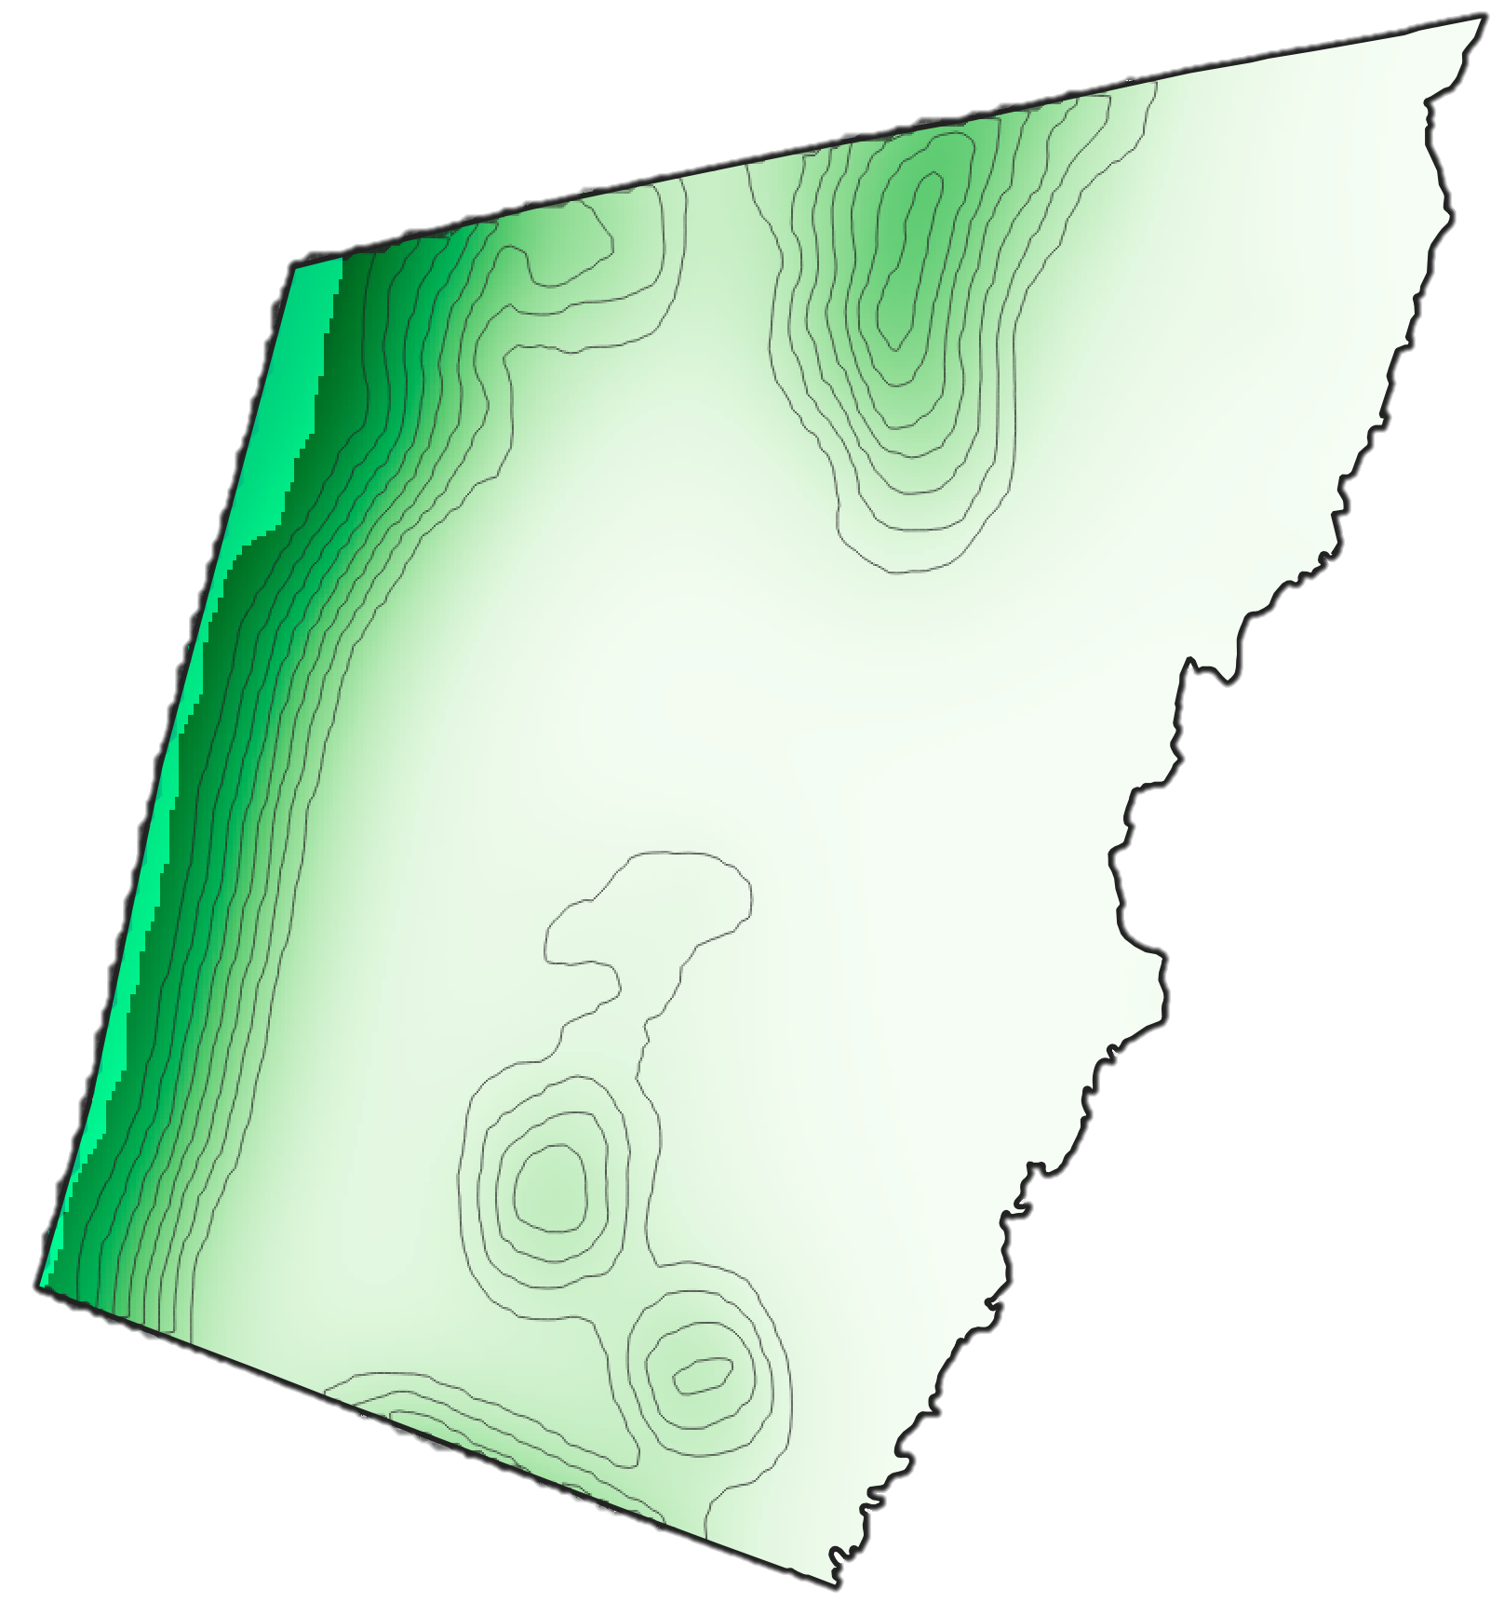
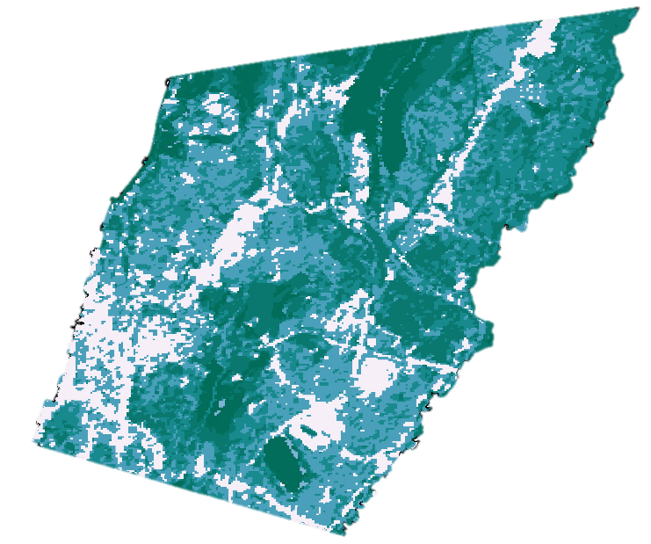
InVEST Model Heat Mitigation
Daytime Cooling Capacity
Greenspace Effect
Nighttime Cooling Capacity
N
Cooling Capacities
0.0000
0.2500
Daytime Heat Mitigation Index
Nighttime Heat Mitigation Index
0.5000
0.7500
1.0000
Notes:
Speaker Notes: The maps of Daytime and Nighttime cooling capacities shown on the left were each joined with the greenspace cooling effects from landcover to estimate total Daytime and Nighttime Heat Mitigation Indexes, respectively.

Slide 34
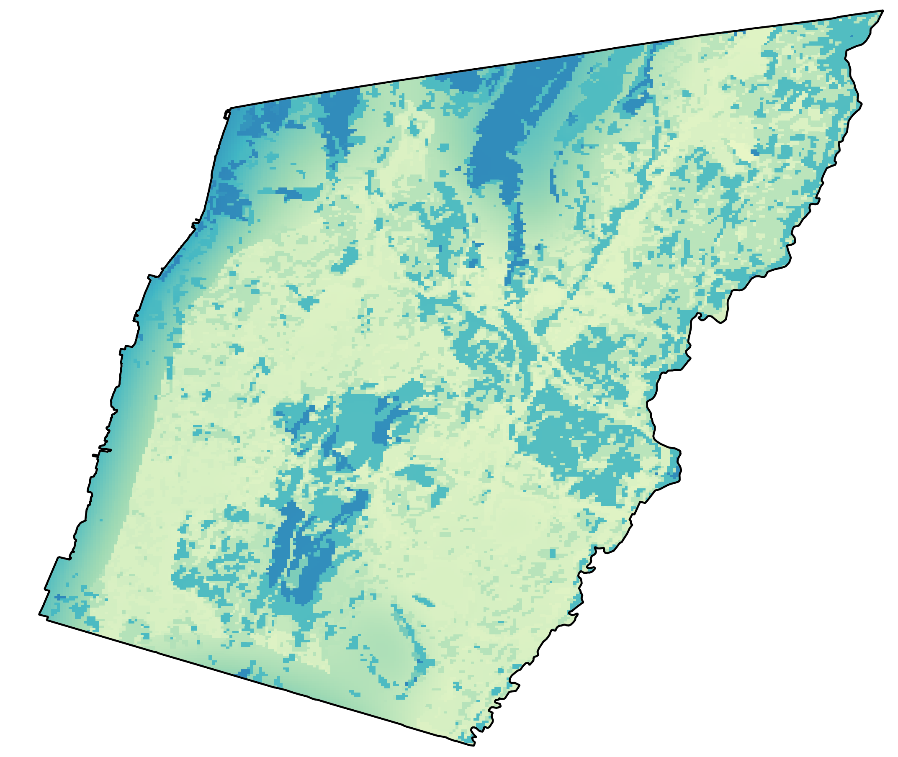
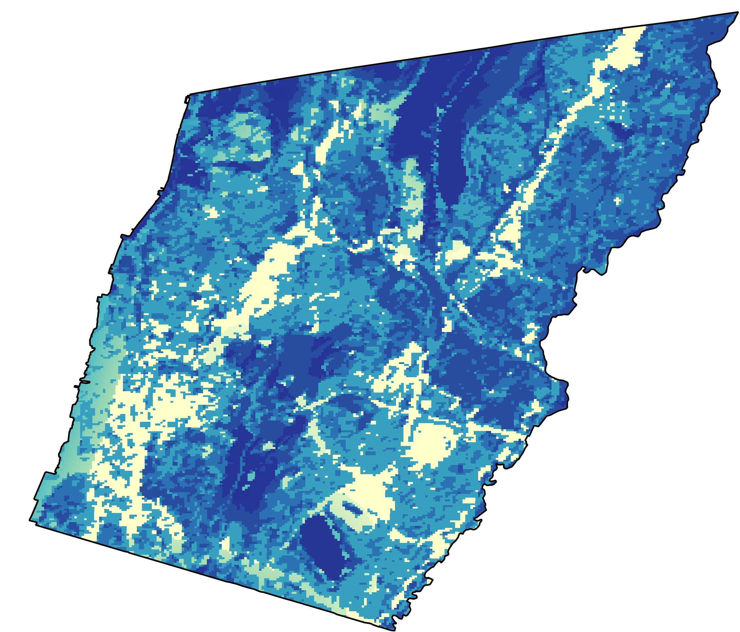
InVEST Model Current Heat Mitigation
Heat Mitigation
0.0000
0.2500
0.5000
Daytime
Nighttime
N
0.7500
1.0000
Kilometer
0
2
Notes:
Speaker Notes: As you can see here, some locations, especially during the night, provide vast differences in amount of cooling.

Slide 35
InVEST Model Heat Mitigation
Daytime
Heat Mitigation
0.0000
Heat Modeling & Mitigation Valuation
0.2500
0.5000
0.7500
N
1.0000
Nighttime
UHI Magnitude
Energy Savings
Daytime Heat Mitigation Index
Nighttime Heat Mitigation Index
Work Loss
Notes:
Speaker Notes: These heat mitigation maps were used to model heat itself and to evaluate mitigations in terms of their monetary benefits. To do this, the indexes were weighted against the Yonkers-wide UHI magnitude.

Slide 36
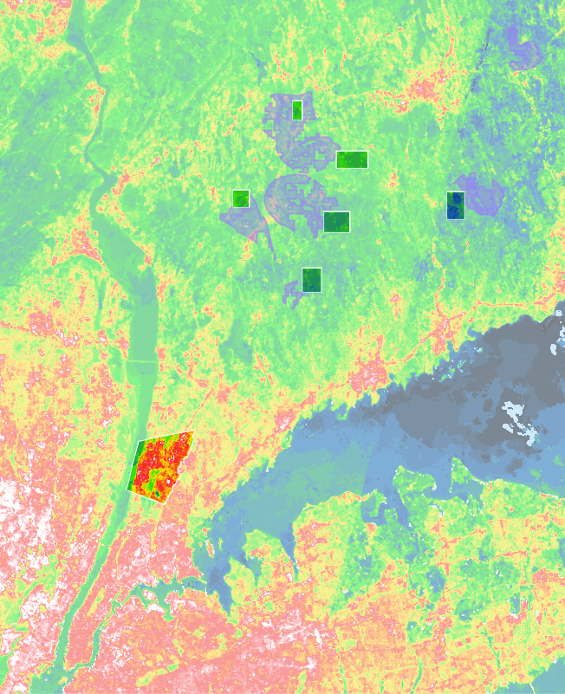
UHI
Magnitude: urban vs. rural temperature difference
Environmental Proxy Filter
Methodology:
Reference Site
Selection
Reference Regions
Environmental filters applied (physical Yonkers proxies)
  Proximity to bodies of water
  Precipitation projections
  Elevation
  Ecological regime
Excluded
  surface water
  areas within 8 km. of major human development
Daytime: 4.83°C
Nighttime: 6.79°C
Yonkers
N
17
22
27
32
37
42
° C
LST
Manhattan
Kilometers
0
15
Notes:
This city-wide UHI magnitude is calculated as the difference between rural and urban temperatures. To put Yonkers' temperatures into relative context, we selected a set of reference regions for statistical comparisons. For accuracy, we selected areas with similar physical and climatic properties to Yonkers, except with as little human development as possible. This map shows Yonkers and its temperatures in relation to New York City, along with the reference locations we selected, matching Yonkers' characteristics based on our filter. You can easily tell how different surface temperatures are within the city, and this gave us UHI magnitudes of 4.8 degrees Celsius in the day and 6.8 at night. Multiplying these magnitudes by day and night heat mitigation maps, the data we used in InVest Model allowed us to…

Slide 37
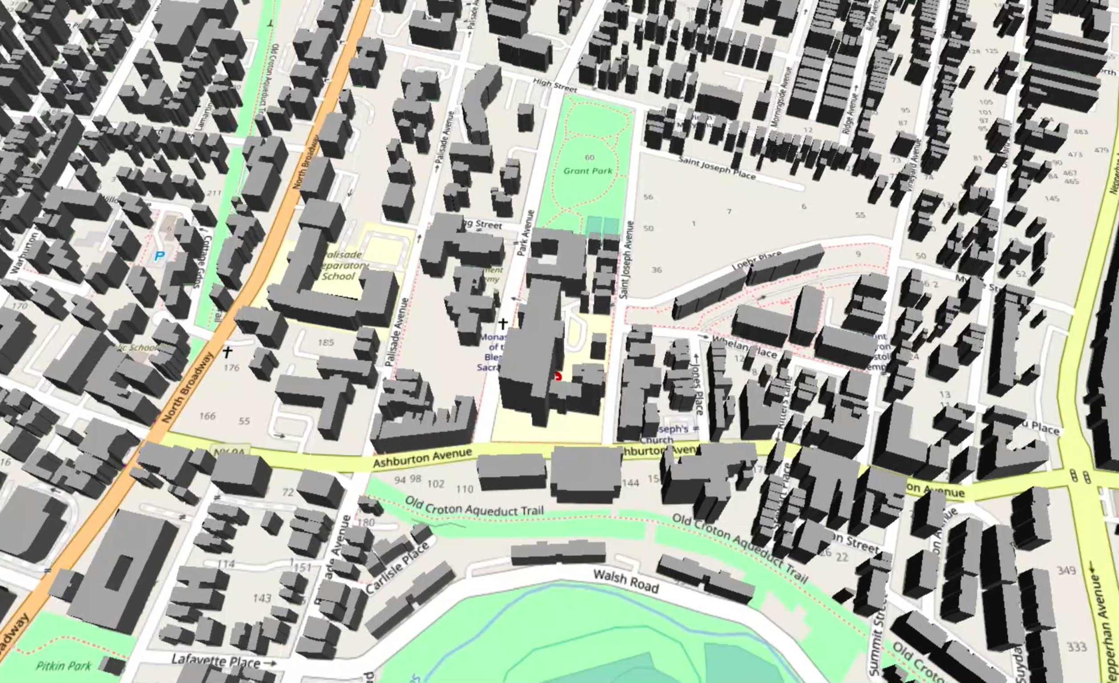
Day Temp. Anomaly: 3.48°C
Night Temp. Anomaly: 2.60°C
Day Energy Savings: $135
Night Energy Savings: $391
Work Productivity Loss: 49%
Day Temp. Anomaly: 3.52°C
Night Temp. Anomaly: 2.71°C
Day Energy Savings: $76
Night Energy Savings: $234
Work Productivity Loss: 50%
Day Temp. Anomaly: 3.13°C
Night Temp. Anomaly: 2.34°C
Day Energy Savings: $622
Night Energy Savings: $1,628
Work Productivity Loss: 25%
Day Temp. Anomaly: 3.25°C
Night Temp. Anomaly: 2.63°C
Day Energy Savings: $1,602
Night Energy Savings: $4,204
Work Productivity Loss: 21%
Day Temp. Anomaly: 3.53°C
Night Temp. Anomaly: 2.74°C
Day Energy Savings: $155
Night Energy Savings: $486
Work Productivity Loss: 49%
Day Temp. Anomaly: 3.40°C
Night Temp. Anomaly: 2.70°C
Day Energy Savings: $2,979
Night Energy Savings: $8,497
Work Productivity Loss: 46%
Notes:
… model conditions affecting specific buildings, generating on a per-building basis temperatures, avoided energy consumption in cost, and manual labor productivity loss. We summed, averaged, and segmented these statistics to assess cumulative effects.

Slide 38
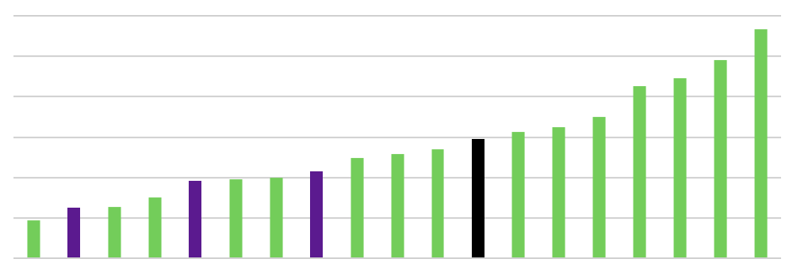

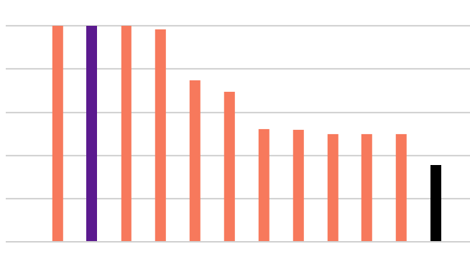
InVEST Results:
Current Heat Mitigation by Neighborhood
Average Energy Savings
per Person
by Neighborhood
Average Heavy Work Loss
By Neighborhood
600
25
500
20
400
15
Annual Savings per Resident (US Dollars)
Summer Manual Labor Productivity Lost (Percent)
300
200
10
100
5
0
0
  Sunnyside Park
  8 Other Neighborhoods: 0%
  Nepara Park
  Riverdale
  Beverly Crest
  Dunwoodie
  Victory Heights
  Ludlow Park
  Glenwood
  Dunwoodie
  Victory Heights
  Old 7th Ward
  Riverdale
  Nepara Park
  Radford
  Kimball
  Glenwood
  Nodine Hill
  Park Hill
  Nodine Hill
  Tibbetts Hill
  Old 7th Ward
  Park Hill
  LaMartine Heights
  Tibbetts Hill
  Crestwood Lake
  LaMartine Heights
  Yonkers Average
  Yonkers Average
  Woodstock Manor
  Sprains Lake Knolls
  Woodstock Manor
  Getty Square
Neighborhood
Neighborhood
Notes:
The spatial distribution of cooling is certainly not uniform. Productivity loss, which are highly reflective of humidities, are also lopsided. The focus neighborhoods of Getty Square, Radford, and Old 7th Ward are among the least cooled, on average.

Slide 39
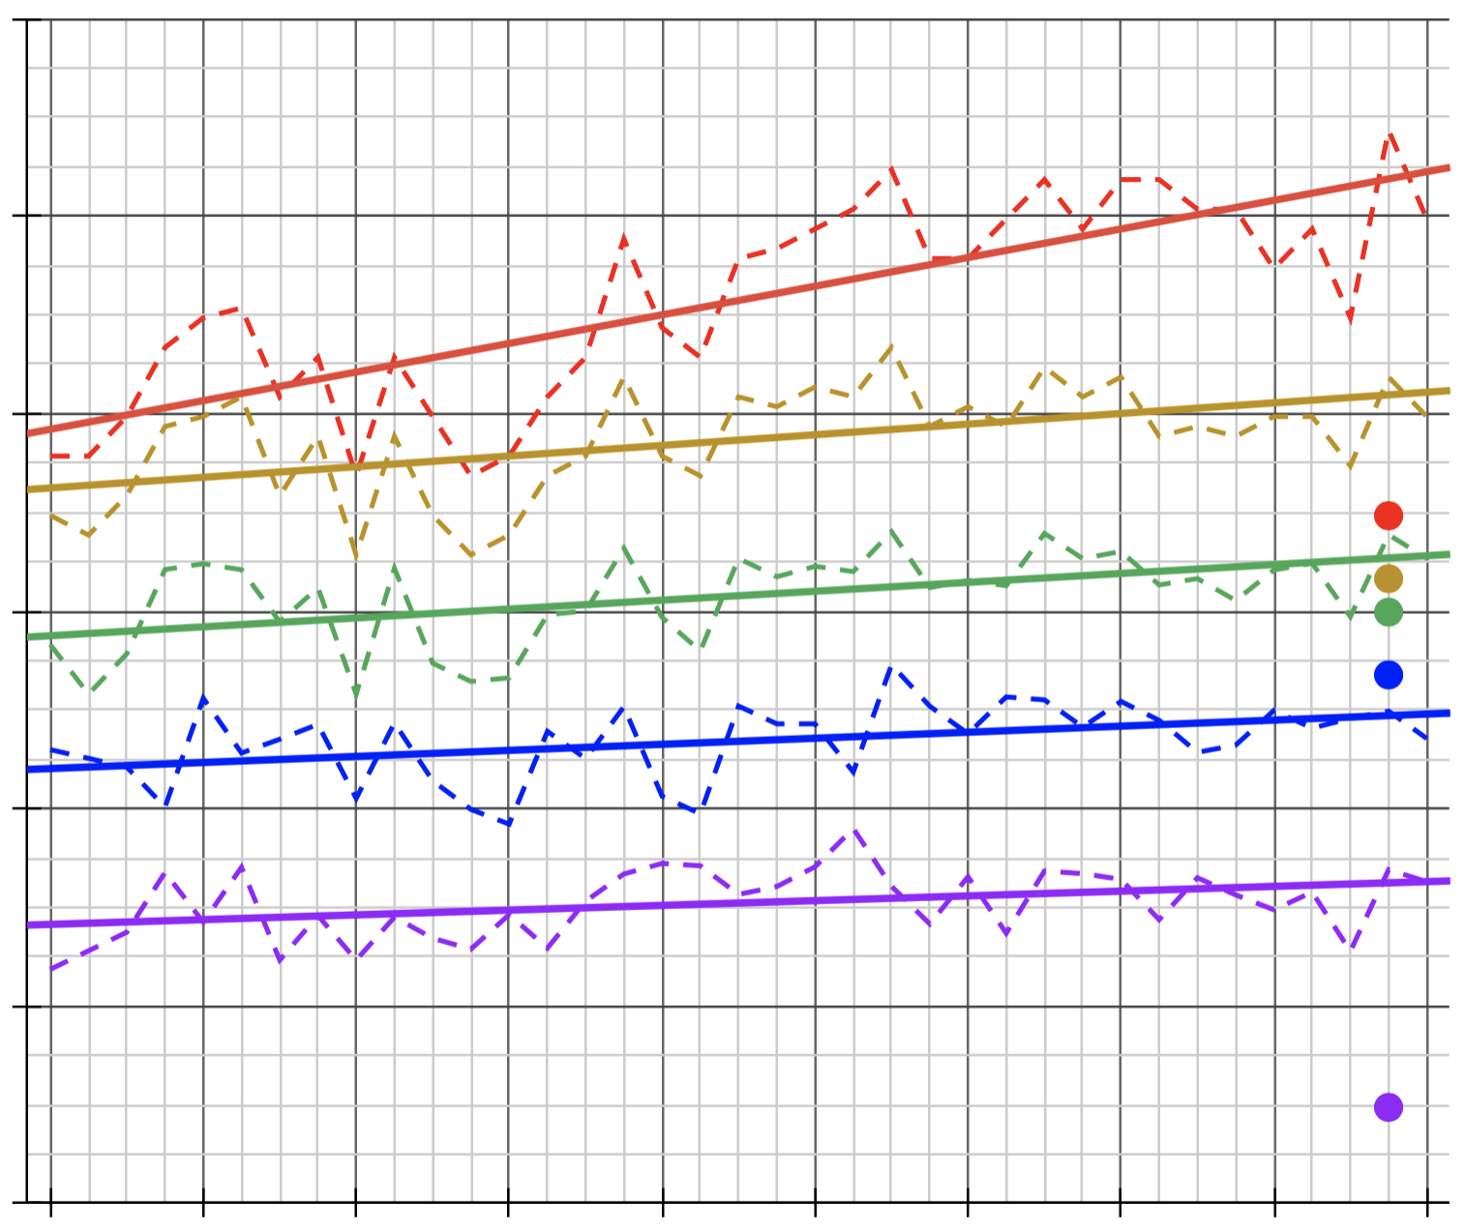
Trends in Temperature
60
60
Yonkers Summer Heat:
Air UHI Magnitude (2020)
12.6°C / 22.68°F
Surface UHI Magnitude (2019)
16.3°C / 29.34°F
Yearly Magnitude Trends (1984-2020)
+0.06°C / +0.11°F
50
50
40
40
34.83
31.64
30
29.95
30
Landsat LST
26.77
LST Trends
Daytime Temperature (°C)
NIHHIS Air Temperatures
20
20
Study Area Maximum
Study Area 99th Percentile
Study Area Average
10
10
4.87
Reference Region Average
UHI Magnitude (Difference)
0
0
1984
1988
1992
1996
2000
2004
2008
2012
2016
2020
Notes:
InVEST weighs the effects of locational urban cooling against a city-wide UHI Magnitude, which it defines as the difference between temperature in the study area and the reference regions. For daytime and nighttime separately, we referred to air temperature measurements from the Urban Heat Watch Campaign in Yonkers in 2019. Air temperatures on this graph are the labelled dots in 2019, while surface temperatures are the dotted lines, with solid lines as trends. On this graph, red indicates the highest observed temperature. UHI Magnitude, or most intense urban heat effect, is the purple data at the bottom, calculated as the temperature difference between the 99th percentile in the study area, shown in yellow, and the average temperature across the reference regions, shown in blue. The green line indicates the average surface temperature across the city. When analyzed using data since 1984 from Landsats 4, 5, 7, and, 8, all of these temperature benchmarks, including the magnitude of difference, are increasing over time. Future estimates were also incorporated into InVEST model scenarios.

Slide 40
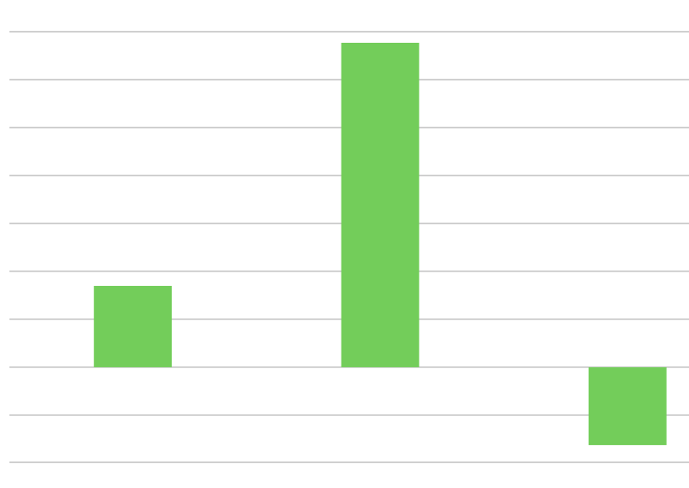

575
InVEST Results: Future Scenarios
Cooling Provided Under Rising Heat
Cooling Provided Under Site Interventions
140
1600
120
1400
100
1200
1000
80
800
Change in Annual Energy Savings (Thousands of US Dollars)
Change in Annual Energy Savings (US Dollars)
60
600
40
400
Increased Building Intensity
200
20
0
0
+2°C
(~2050)
Chicken Island
Palisades Tower
Calcagno Projects
Hudson GreenLink
Yonkers GreenWay
+0.5°C
(~2028)
-20
-40
Scenario
Scenario
Notes:
InVEST allowed us to model the behavior of cooling under different scenarios, displayed here in terms of dollars of avoided spending on energy consumption. As our inputs were annual cooling, which occur mostly in the summer, our night and day averages create season-long estimates. On the left, we see how cooling features become more beneficial under greater heat but less valuable with urban intensification. On the right, the impacts of several sample projects, suggested or underway by Groundwork Hudson Valley, were evaluated in monetary terms.

Slide 41


InVEST Results: Shade and Albedo
Reduction in Consumption by Intervention Location
Reduction in Consumption by Intervention Type & Magnitude
per 100 sq. m. of Shade increase of 25%
4.8
20
4
3.2
15
Change in Annual Savings (Thousands of US Dollars)
per 100 sq. m. of
Albedo increase of 25%
Change in Annual Savings (Thousands of US Dollars)
2.4
10
1.6
5
0.8
0
0
Open Spaces
Medium Development
Open Spaces
Medium Development
+10%
Albedo
+25%
Albedo
+5%
Shade
+20%
Shade
Low Development
High Development
Low Development
High Development
Landcover Type of Intervention
Intervention
Most room for cooling improvement: Open Spaces & High Development
Most effective at reducing energy consumption: Shade
Notes:
Iterating the InVEST model helped understand intervention in even greater detail. On the left, increases in shade and albedo were conducted on different landcover types separately. Interventions would be most beneficial in open spaces, which is surprising but presents a much cheaper alternative for the city's shading efforts. On the right, the difference between shade and albedo increases, as well as increases different magnitudes, are show to have vastly different effects on savings. The goal here is for Groundwork to be able to compare these annual effects with their implied costs and advise the city on the most efficient strategies.

Slide 42


InVEST Results:
Locating Interventions
Shading Efficiency by Neighborhood
8
6
per 100 sq.m. area shaded
Change in Total Savings Generated
(US Dollars)
4
2
Urban Heat
more Locally Concentrated
0
  Nepara Park
  Riverdale
  Dunwoodie
  Victory Heights
  Sunnyside Park
  Park Hill
  Old 7th Ward
  Tibbetts Hill
  Beverly Crest
  Kimball
  Nodine Hill
  Radford
  Ludlow Park
  Glenwood
  Sprains Lake Knolls
  Crestwood Lake
  LaMartine Heights
  Woodstock Manor
  Getty Square
3
per person in neighborhood
2
Change in Total Savings Generated
(US Dollars)
Local Interventions
more Significant
in Total
1
0
  Riverdale
  Nepara Park
  Ludlow Park
  Beverly Crest
  Glenwood
  Sunnyside Park
  Radford
  Old 7th Ward
  Victory Heights
  Dunwoodie
  Nodine Hill
  LaMartine Heights
  Kimball
  Park Hill
  Tibbetts Hill
  Crestwood Lake
  Sprains Lake Knolls
  Woodstock Manor
  Getty Square
Notes:
We compared the savings from intervening in across each neighborhood separately to the area impacted (a proxy of cost) to understand relative efficiency of shading per square meter. Generally, areas of more concentrated heat result in greater efficiency of shading. However, this relationship is not clear-cut, being influenced also by the other environmental input layers. The focal neighborhood of Getty Square, or downtown, for example, has a surprisingly low cost efficiency of shading, despite being one of the hottest neighborhoods, likely due to over-building. When compared to savings increases per resident, intervening in the focal neighborhoods have a high cumulative impacts, but these impacts are well-distributed and received by more residents.
When we are normalizing our values in terms of efficiency (either by dividing by the amount of area shaded or dividing by number of people affected), our numbers for 'change in total annual savings' are in the 0-3 dollars range per person or per 100 sq. m. shaded. the overall effect might be thousands of dollars but in this case we want to compare efficiency, so this is different from the previous slides. InVEST also does not relay statistical significance of results and our calculations for mitigation value are based on a lot of assumptions so our results are more useful for relative comparison of the options than for absolute costs.

Slide 43

InVEST Results:
Locating Interventions
Efficiency of Intervention by Spatial Concentration
0.016
0.012
Intervention more Concentrated
Locations of Priority
0.008
Decrease in Temperature
(Degrees Celsius)
0.004
Interventions
more Significant
in Total
0
+20% albedo in 3 focal neighborhoods
+1.34% albedo across Yonkers
(same area)
+25% shade in 3 focal neighborhoods
+1.67% shade across Yonkers
(same area)
Intervention
Notes:
Lastly, we compared the decreases in temperature, averaged from all pixels across Yonkers, between intervening across the entirety of Yonkers versus that same total amount of intervention, in terms of area changed, happening within just the three focal neighborhoods. This revealed that concentrating strategies in particular areas provides a relative boost to cooling benefits.

Slide 44



Limitations & Uncertainties
Data Resolution:
Temperature and evapotranspiration measurements only during particular hours, but not at constant times
Temperature dataset disparities
Most sociodemographic data unavailable at census block level
Limited spatial resolution of environmental and landcover layers
Model Simplicity:
Lack of complexity to model specific interventions
Lack of accounting for effects of water
Valuation methods not fine-tuned
InVEST Urban Cooling Model is still new; lack of information about parameters
Data Quality:
Uncertain spatial shift in ECOSTRESS LST data
Global Forest Watch Project algorithm not locally-trained
Icon Credit: Microsoft PowerPoint Clipart
Notes:
The specificity of our study was limited by the resolution and quality available data, and the accuracy of our outputs are limited by the model's complexity. The results of InVEST modelling are more useful for comparison than absolute expectations for outcomes.

Slide 45
Conclusions
Paired with remote sensing methods, InVEST is a useful model for evaluating the impacts of urban landscapes and possible interventions
In Yonkers, socio-demographics and physical properties are linked to urban heat and heat risk
Locating interventions in high- risk areas would provide the most benefits
Increasing shade is the most cost-effective way of cooling Yonkers
Concentrating interventions provides greater energy savings
Open spaces are an opportunity for impactful interventions
Notes:
Remote sensing and InVEST together allowed for the evaluation of urban heat and interventions. In Yonkers, socio-demographics and physical properties are linked to urban heat. Locating interventions where these variables make UHI effects worse would most provide the most benefits. Increasing shade through tree cover would be a cost-effective way of cooling Yonkers.

Slide 46





Future Work
Connect Google Earth Engine with InVEST Python API to make intervention/scenario modelling possible for partners
Fine-tune valuation of urban heat mitigation methods; further study spatial dynamics of intervention locations
Integrating InVEST Urban Cooling Model with InVEST Urban Stormwater Model for more comprehensive valuations
Use micro-climatic modelling to better understand small-scale heat dynamics
Further refine and add proximity analysis variables, such as public transportation
Icon Credit: Microsoft PowerPoint Clipart
Notes:
A future DEVELOP team will continue this project. Their main objectives will be to build on this project.

Slide 47
A special thank you to our Science Advisors, Mentors and Fellow for their direction and support:
Dr. David Hondula (Arizona State University, Associate Professor)
Dr. Kenton Ross (NASA Langley Research Center)
Lauren Childs-Gleason (NASA Langley Research Center)
Ryan Hammock (NASA DEVELOP, Fellow/Lead)
We would also like to thank our wonderful project partner and collaborator at Groundwork USA, Groundwork Hudson Valley:
Oded Holzinger, Climate Resilience Manager of Groundwork Hudson Valley
Notes:
Speaker Notes:

Slide 48
EXTRA/BACKUP SLIDES:
Notes:
Speaker Notes:

Slide 49


InVEST Model Daytime Cooling
Land Cover/Land Use
Greenspaces
Reflectivity
Greenspace Effects
Climate Parameters
Albedo
Daytime Cooling Capacity
Tree Cover
Evapotranspiration
Shade
Potential Evapotranspiration
Notes:
Speaker Notes: Integrated Evaluation of Ecosystem Services and Tradeoffs, or InVEST, Urban Cooling Model was created by the Natural Capital Project, based at of Stanford University. The model aims to quantify the impacts of green infrastructure and other ecosystem services. For the daytime, the urban cooling model uses reflectivity and tree cover to calculate the albedo and shade of each landcover type. With climate parameters such as humidity and wind speeds defined, albedo and shade are combined with evapotranspiration to estimate daytime cooling capacity at each pixel. This indicates the degree to which local physical factors are providing cooling effects nearby. Greenspaces derived from landcover are used to model greenspace cooling effects.

Slide 50
InVEST Model Nighttime Cooling
Land Cover/Land Use
Greenspaces
Greenspace Effects
Building Data
Climate Parameters
Nighttime Cooling Capacity
Building Intensity
Evapotranspiration
Potential Evapotranspiration
Notes:
Speaker Notes: Integrated Evaluation of Ecosystem Services and Tradeoffs, or InVEST, Urban Cooling Model was created by the Natural Capital Project, based at of Stanford University. The model aims to quantify the impacts of green infrastructure and other ecosystem services. For the daytime, the urban cooling model uses reflectivity and tree cover to calculate the albedo and shade of each landcover type. With climate parameters such as humidity and wind speeds defined, albedo and shade are combined with evapotranspiration to estimate daytime cooling capacity at each pixel. This indicates the degree to which local physical factors are providing cooling effects nearby. Greenspaces derived from landcover are used to model greenspace cooling effects.

Slide 51






InVEST Model: Heat Mitigation Scenario
Heat Mitigation in Existing Condition
Heat Mitigation in Increased Shade Scenario
Efficiency of Intervention
by Spatial Concentration
0.016
0.012
0.008
Decrease in Temperature
(Degrees Celsius)
0.004
0
+20% albedo in 3 focal neighborhoods
+25% shade in 3 focal neighborhoods
+1.34% albedo across Yonkers
(same area)
+1.67% shade across Yonkers
(same area)
N
Intervention
0.064
0.875
0.064
0.875
Notes:
These heat mitigation maps were used to model heat itself and to evaluate mitigations in terms of their monetary benefits. To do this, the indexes were weighted against the Yonkers-wide UHI magnitude. The maps on the left highlight a specific area of Yonkers under an increased shade scenario.
For the graph on the right, we compared the decreases in temperature, averaged from all pixels across Yonkers, between intervening across the entirety of Yonkers versus that same total amount of intervention, in terms of area changed, happening within just the three focal neighborhoods. This revealed that concentrating strategies in particular areas provides a relative boost to cooling benefits.
Same graph as slide 43.

Slide 52

Imperviousness
DEM
Fractional vegetation
NDVI
Albedo
Land surface temperature
Population Density
% with disability
% W/O health insurance
% Living alone & >65
% Black
% below age 5
% Foreign born
% Hispanic
% Less English proficiency
% over 65
Results: Correlation & Association Between Variables
% under poverty status
% unemployed
% using public transportation
% walk to work
% household W/O vehicle
Imperviousness
% buildings built before 1980
1
DEM
High Blood pressure
Fractional vegetation
Asthma
NDVI
COPD
0.8
LST has positive correlation with:
%Imperviousness (High)
Population Density (moderate)
Foreign population (moderate)
language proficiency (moderate)
Obesity (moderate)
Household without vehicle (low)
People without health insurance (low)
Asthma, COPD, Diabetes, Stroke (low)
Diabetes
Albedo
Obesity
Land surface temperature
Stroke
0.6
Population Density
% with disability
% W/O health insurance
0.4
% Living alone & >65
% Black
0.2
% below age 5
% Foreign born
% Hispanic
0
% Less English proficiency
% over 65
% under poverty status
-0.2
% unemployed
LST has negative correlation with:
NDVI, fractional vegetation (High)
Hispanic population (low)
People over 65 (low)
% using public transportation
% walk to work
-0.4
% household W/O vehicle
% buildings built before 1980
-0.6
High Blood pressure
Asthma
COPD
-0.8
Diabetes
Obesity
Stroke
-1
Notes:
Speaker Notes: The slide shows correlation between the variables collected for our analysis, although correlation does not imply causation. The color shows high positive correlation in dark blues and high negative values in darker red. From the plot we can see that LST shows high positive correlation with %imperviousness, moderately correlates with population density, lesser language proficiency, foreign population and people with obesity. LST has high negative correlation with NDVI, and low correlation with elderly and Hispanic population.

Slide 53

Results: Landsat Change Over Study and Reference Areas
Study Area Maximum Summer Mean
Study Area Average Summer Mean
Reference Region Average Summer Mean
Surface UHI Magnitude (Difference)
Landsat 8 OLI & TIRS
60
Landsat 7 ETM+
Landsat 5 TM
50
Landsat 4 TM
40
30
Land Surface Temperature (degrees Celsius)
20
10
0
1984
1988
1992
1996
2000
2004
2008
2012
2016
2020
Year

