Slide 1
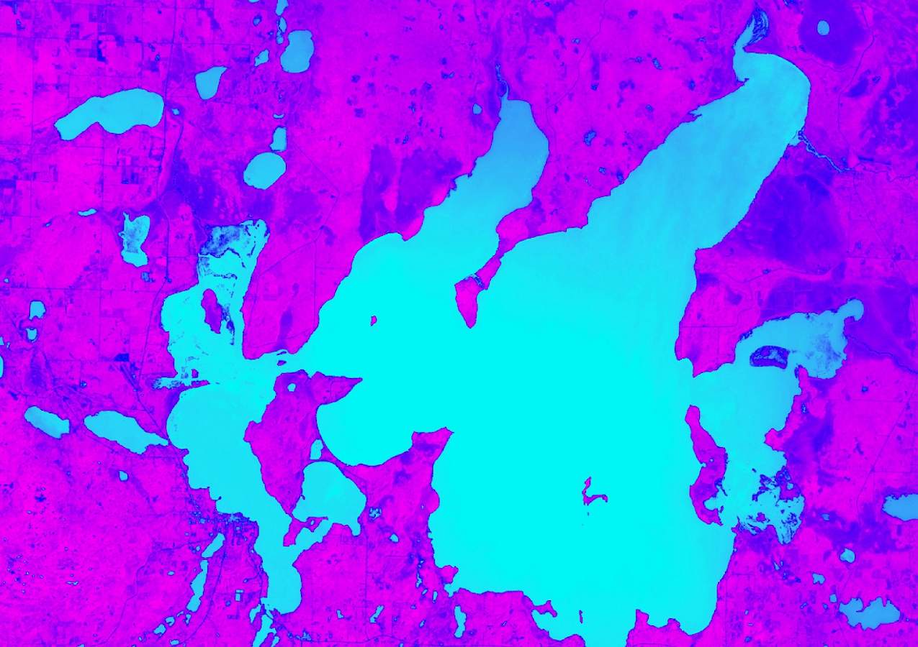
MINNESOTA & TEXAS AGRICULTURE
Employing NASA Earth Observations to Model Current and Historic Distribution of Crop Wild Relatives, in Support of USDA ARS Genetic Resource Conservation Efforts
Kaitlin Walker (Project Lead)
Daniel Carver
Jillian LaRoe
Nick Whittemore

Slide 2
Study Area
San Marcos River (Hays County), Texas
Minnesota
Notes:
Our study is focused on two species of North American wild rice. One is distributed across Minnesota, and the other is endangered, and only grows along a specific stream in Hays County, Texas.

Slide 3
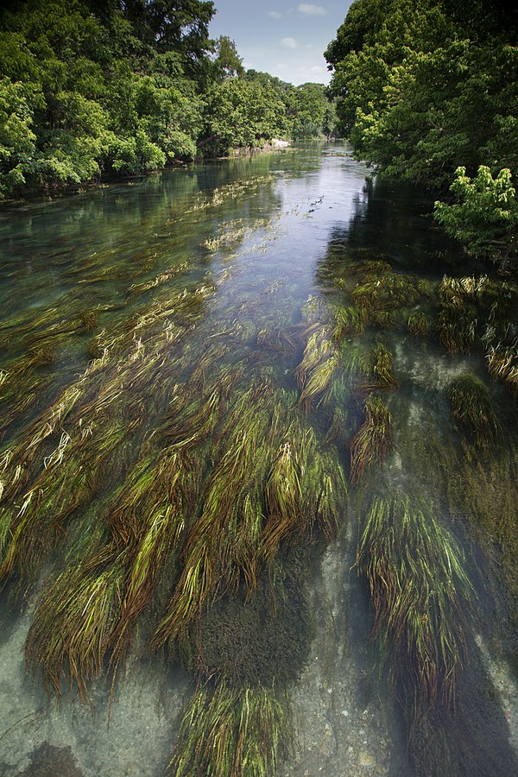
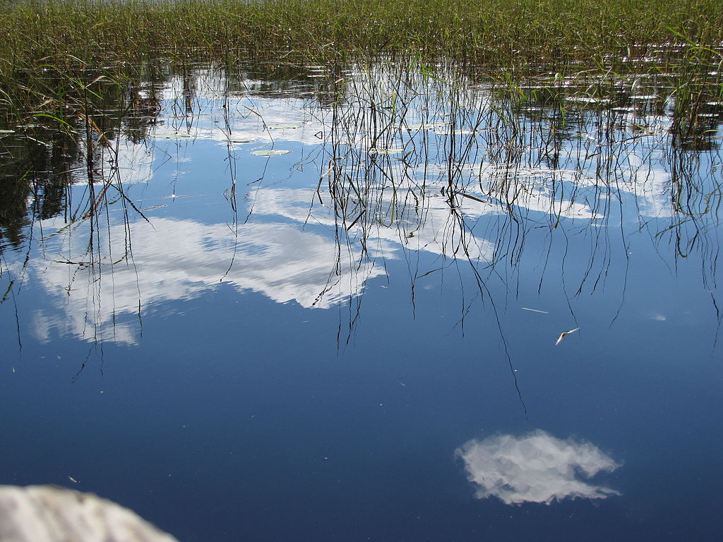
Study Period
Study Period: 2005 and 2015
June - October (growing season)
Minnesota
San Marcos River, Texas
Image Credit: Superior National Forest, C.C. 2.0
Image Credit: US Fish and Wildlife Service, C.C. 0
Notes:
Our research focuses on mapping historic wild rice distribution in 2005, and recent or present distribution in 2015. We used the growing season of wild rice, from June to October, to create our models.
On the left is an image of wild rice growing in a Minnesota lake. Minnesota is one of our focus areas because wild rice has a broad distribution across the state. Wild rice is commonly harvested here and is an important food crop.
On the right is an image of wild rice growing in the San Marcos River in Texas. This species is endangered and grows only in this particular river. Thus, it is of particular interest for conservation efforts.
Image Credit (left): https://commons.wikimedia.org/wiki/File:Wild_rice_reflections_(6130398588).jpg
Image Credit (right): https://commons.wikimedia.org/wiki/File:Zizania_texana_(Texas_wild_rice)_FWS_20540.jpg

Slide 4
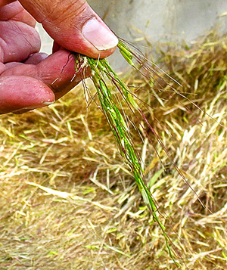
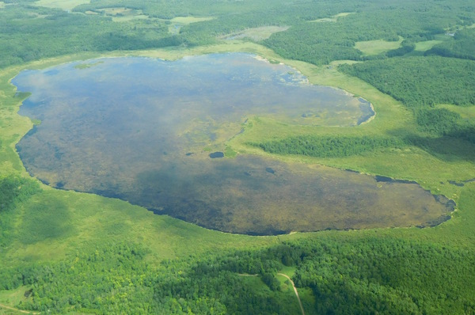
Partners
US Department of Agriculture, Agricultural Research Service
Assess current distribution of wild rice
Provide methods with potential applications for efforts mapping wild crop relatives
Image Credit: Cheryl Katz
Image Credit: Great Lakes Indian Fish and Wildlife Commission
Notes:
Our team partnered with the USDA Agricultural Research Service to assess wild rice distribution. The goal of the USDA ARS is to conserve and study valuable agricultural resources. However, they currently rely on field surveys to detect these species, and have not thoroughly explored the use of remote sensing methods. The USDA ARS can apply our methods to other crop wild relatives to aid in conservation and preservation efforts.
Image source right: https://indiancountrymedianetwork.com/news/environment/bad-weather-cuts-2016-manoomin-harvest-in-half/
Courtesy Great Lakes Indian Fish and Wildlife Commission
Image Source USDA logo: Image Source: https://encrypted-tbn0.gstatic.com/images?q=tbn:ANd9GcRBW1rExEzxQ79g6mq2zBGGiwxUZAYMNfE15Bgg6pp1g1VVkRtz
Image source middle : https://e360.yale.edu/features/for_us_tribes_a_movement_to_revive_native_foods_and_lands

Slide 5
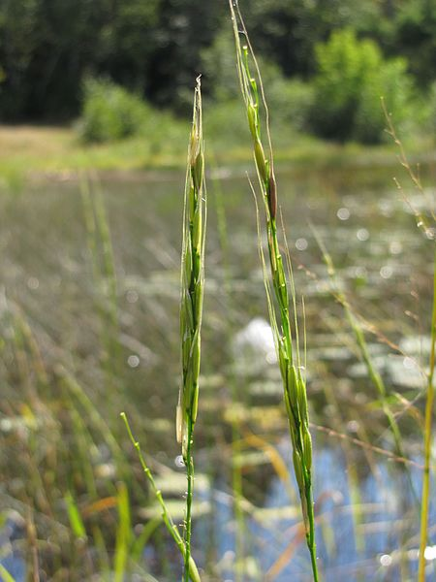
Background
Aquatic species
Three species of North American wild rice
Sensitive to changes in water level
Peak height and harvest in mid-August
Image Credit: Superior National Forest, C.C. 2.0
Notes:
Wild is a unique plant for remote sensing applications for several reasons.
There are three species of wild rice in North America.
It is an aquatic species, and their growth and distribution can be impacted by water level and other environmental variables.
It also has a unique phenology. It has multiple growth stages, starting with a flat, floating-leaf stage, with peak height in mid-August.
Image Source: https://commons.wikimedia.org/wiki/File:Wild_rice_2_(6129846019).jpg

Slide 6
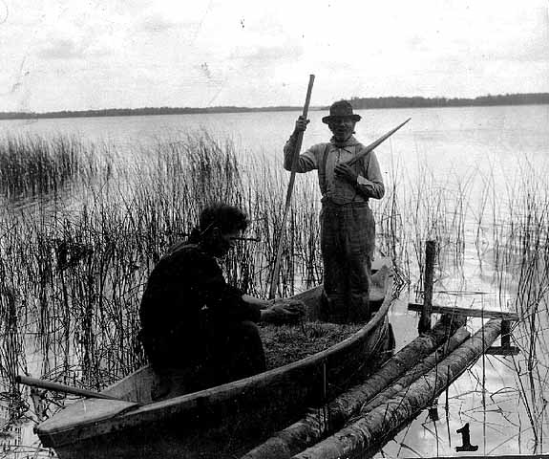
Cultural Significance
Native Americans of Minnesota have harvested wild rice for centuries.
Harvesting is still practiced with less labor-intensive methods.
Harvesting takes place as a family.
Present methods require knocking ripe grains off the stand into a canoe.
Ojibwe men gathering rice or manoomin at Mille lacs , ca 1920
Image Credit: Minnesota Historical Society Collection
Notes:
Humans have gathered wild rice for as long as 2000 years. The Ojibwe people in particular have a very spiritual connection to wild rice or as they refer to it, manoomin. Their migration from the east coast was guided by the tribal prophets to find the “food on water”. In tradition, the gathering of wild rice takes place as family. The first methods used were rather labor intensive. Today, the rice is gathered used a canoe. One person with a larger pole guides the canoe through the water, while the second will gently bend the top of a ripe stand over the interior. The ripe rice grains are gently knocked into the boat with a smaller pole specifically for harvesting.
http://files.dnr.state.mn.us/fish_wildlife/wildlife/shallowlakes/natural-wild-rice-in-minnesota.pdf was used for first two bullets
http://www.jstor.org/stable/3795695?seq=3#page_scan_tab_contents used for second two bullets
Image is from https://ojibwe.lib.umn.edu/collection/ojibwe-gathering-wild-rice-at-mille-lacs

Slide 7
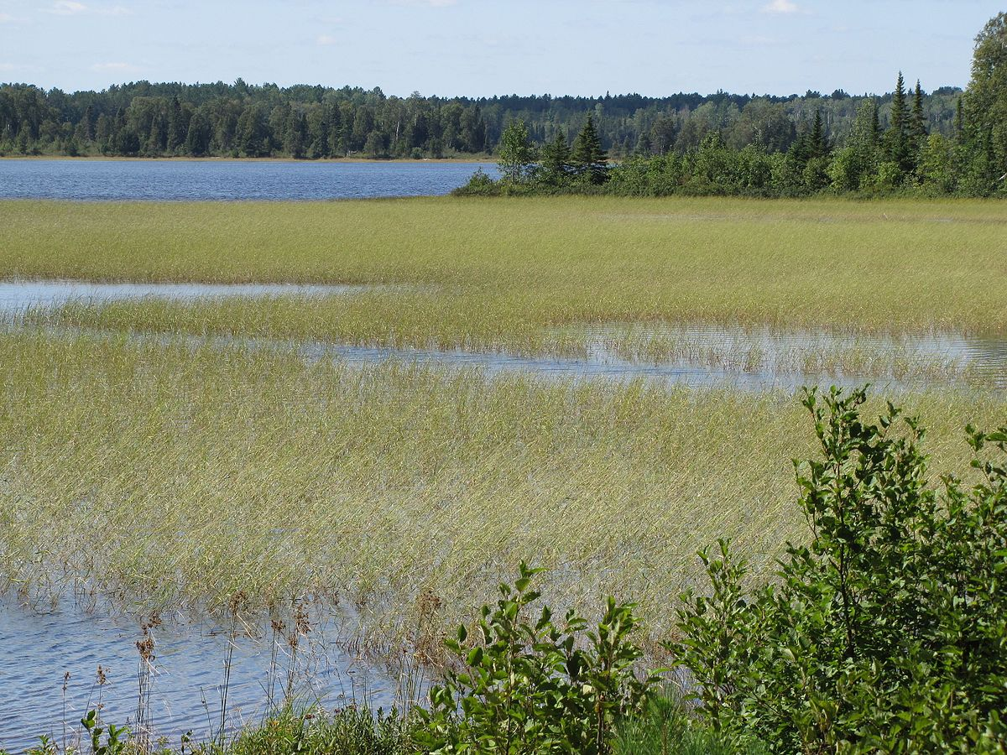
Objectives
Create presence maps of wild rice for 2005 and 2015 in Minnesota and Texas using NASA Earth observations
Track the distribution of wild rice over time
Upscale methods for use in other regions
Provide a tool to transfer methods
Image Credit: Superior National Forest, C.C. 2.0
Notes:
We had four main objectives for this project.
(state objectives)
Image Source: https://commons.wikimedia.org/wiki/File:Wild_rice_1_(6129843903).jpg

Slide 8
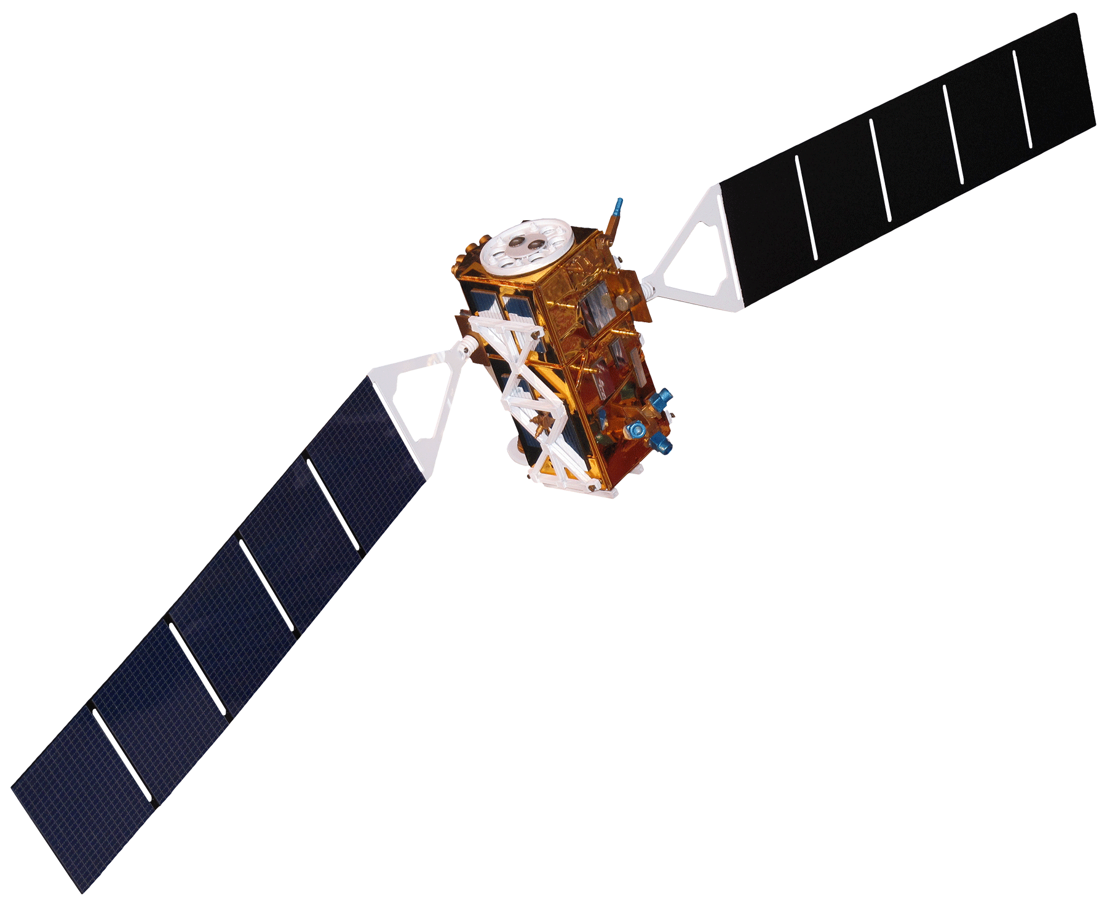
Satellites & Sensors
Sentinel-1
SAR
Landsat 8 OLI & TIRS
Landsat 5 TM
10 m
30 m
30 m
Image Credit: NASA
Notes:
This study utilized NASA Earth Observations from Landsat 5 Thematic Mapper and Landsat 8 Operational Land Imager to model aquatic vegetation cover. To assess emergence of wild rice we derived seasonal variance from Sentinel 1 synthetic aperture radar using the c-band.
Earth Background Image Source: https://www.nasa.gov/sites/default/files/bwhi1apicaaamlo.jpg_large.jpg
Satellite Image Source: http://www.devpedia.developexchange.com/dp/index.php?title=List_of_Satellite_Pictures, NASA DEVELOP

Slide 9
Methodology
NASA Earth Observations
Landsat 8
Google Earth Engine
R
Random Forest
Wild Rice Presence Map
Environmental layers
ESA Sentinel-1 SAR
Field Data
Data
Software
Algorithm
Output
1
2
3
4
Notes:
We used NASA and ESA Earth observations, as well as other ancillary datasets, such as bathymetry measurements and field survey presence points, to create our model.
First, due to inconsistencies in the collection of field survey data, we collected our own large dataset of presence and absence points manually for aquatic vegetation using Google Earth Engine. Ancillary datasets were used to aid in sampling, and for reference.
Next, we calculated a large set of vegetation and water indices, Landsat spectral reflectance bands, and the Sentinel-1 SAR band to use as predictor variables to train our model. Our sample points were extracted from these indices. Model predictors were parsed and selected using the VSURF function in R.
Once we had our model predictors, we trained and ran a RandomForest model in R. These results were then mapped over our study areas in MN and TX.
Next, we’ll discuss some of these steps in more detail.

Slide 10
Methods: Modeling Regions
Model Runs:
Region | Year
Minnesota State | 2005
Minnesota State | 2015
Minnesota, Path Row 28, 28 | 2005
Minnesota, Path Row 28, 28 | 2015
San Marcos River, Texas | 2005
San Marcos River, Texas | 2015
Notes:
In order to address each of our research questions, we ran a number of models for our two study regions and years. This table lists those model runs. We decided to test our modeling methodology over a smaller region of Minnesota first, Landsat path row 28, 28, in order to obtain a more accurate model based on a single scene in which we collected sample points. Then, we modelled over the entire state of Minnesota to address the question of whether we can upscale our modeling methods to a larger region. Lastly, we applied our Minnesota models to Texas in order to evaluate our model performance when applied to other regions. We addressed the question of distribution over time by modeling in both 2005 and 2015, and exploring a back-casting methodology.

Slide 11
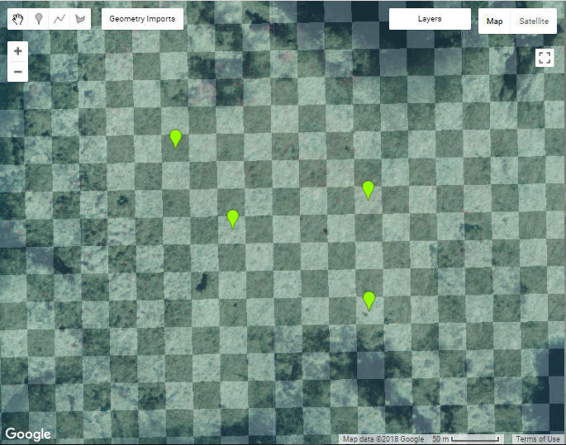
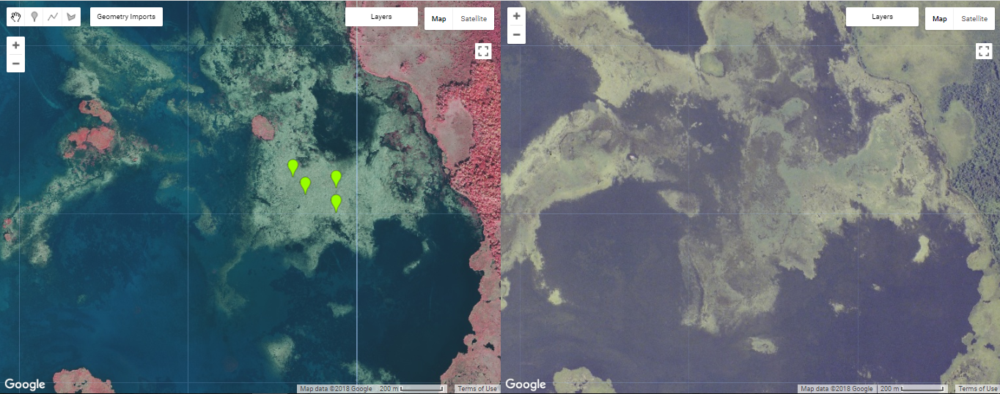
Methods: Sampling in Google Earth Engine
Opportunistic approach
Presence vs Absence
2015 vs 2005 NAIP
50% cover threshold indicates presence
Points centered within 30m quadrats
Referenced relevant datasets
False Color NAIP acquired Oct. 2015
Leech Lake, Headquarters Bay, MN
Notes:
Here is our Google Earth Engine sampling in more detail.
Our team used points created through opportunistic sampling in the Google Earth Engine interface. These points were collecting utilizing NAIP (National Agriculture Imagery Program) aerial imagery at a 1m resolution for presence and absence of wild rice in 2005 and 2015. The points were collected for presence and absence of wild rice within a 30m by 30m quadrat aligned to Landsat imagery. 50% or greater cover of wild rice within a quadrat was used as a threshold for indicating presence of wild rice.
Bathymetry data was acquired from ____ and filtered to ____ to indicate suitable depths within lakes for wild rice growth. We also used a wetlands layer acquired from ____ to indicate potential regions with wild rice. The DNR __ Minnesota wild rice lakes layer was retrieved through ESRI to filter the number of lakes down to those reported to have wild rice through the DNR’s comprehensive report.
Each of these points were sampled from the Landsat multispectral imagery and the values of each environmental predictor as inputs for our random forest model.
(Top left) Headquarters Bay with known wild rice presence
(Top right) 30m quadrat grid aligned to Landsat Path 28 Row 27
(Bottom left) 2015 false color NAIP image with presence points
(Bottom right) 2005 NAIP imagery
Image from Google Earth Engine

Slide 12
Methods: Random Forest
Extracted values of various spectral indices at sampled points
Vsurf variable selection
Covariate and correlation removal where values > 0.7
Resulting map of aquatic vegetation
Accuracy Assessment
Presence
Absence
Notes:
Random forest is a machine-learning algorithm based on a set of decision trees. We used this algorithm to create a model based on our presence and absence sample points.
Our workflow consisted of extracting values of spectral indices at sampled point locations, running a variable selection algorithm in R, and then running the random forest algorithm. We were then able to map our results.

Slide 13
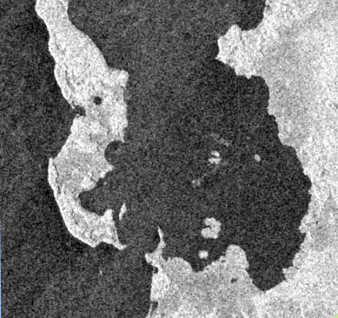
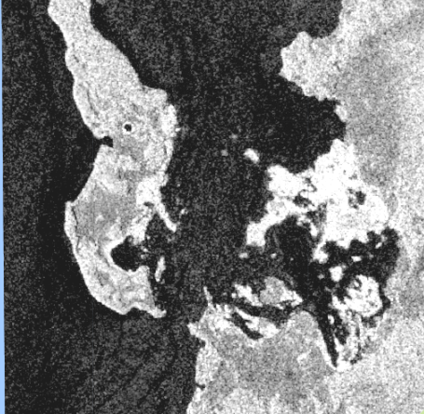
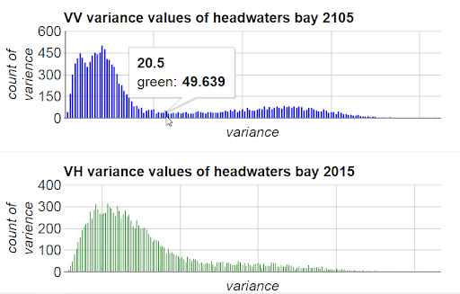
Methods: RADAR
Computed seasonal variance using c-band
Emergent vegetation alters backscatter of water
Wild rice growth peaks in August
Set variance threshold to filter emergent aquatic vegetation
2015
Refine random forest results
May (top) and August (bottom) backscatter using c-band Leech Lake, Headquarters Bay, MN Radar 2015
Notes:
The use of Sentinel-1 radar makes this project particularly unique and interesting.
Because wild rice has a unique seasonal phenology, we were able to use radar to detect changes in the structure and height of the plant, which helped us differentiate it from other aquatic species.
We calculated seasonal variance in radar backscatter using the C-band, set a threshold for variance, then used this filter to further refine our RandomForest model results.

Slide 14
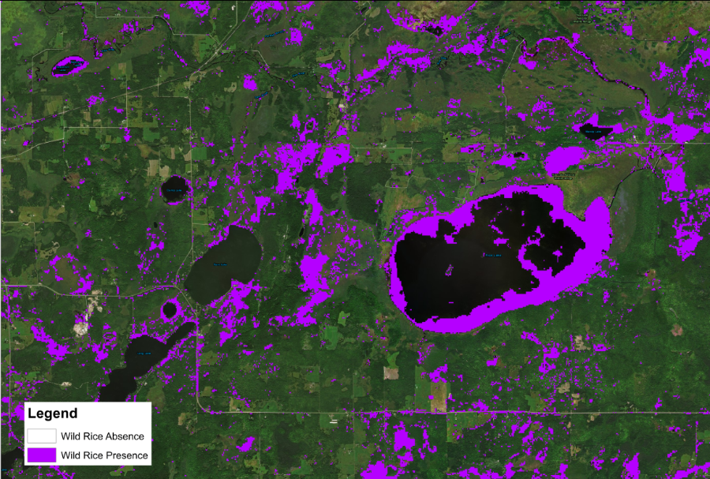
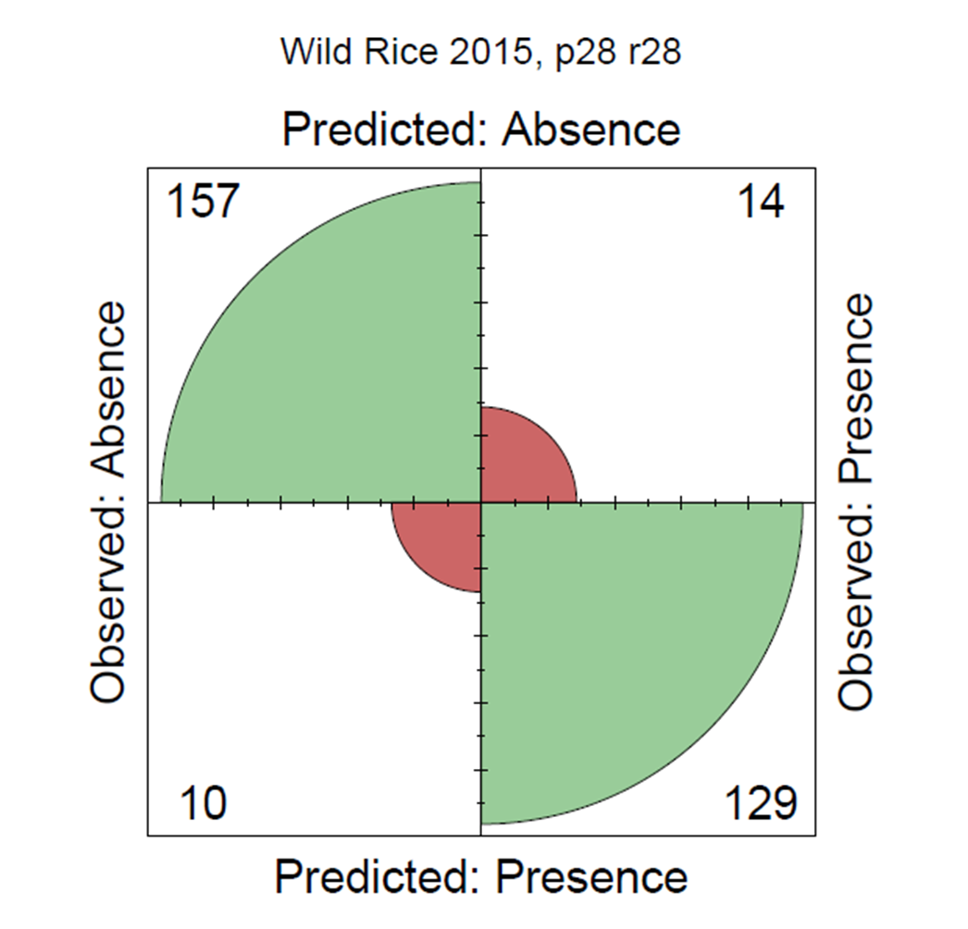
Results: Random Forest
Landsat Path/Row 28, 28 (MN)
Notes:
This is example output map showing wild rice presence in a small region of MN. The largest lake shown here is Rice Lake. Here you can see rice mapped in many areas known to be suitable for wild rice growth: for example, the edges of Rice Lake, and some surrounding wetlands. Although the models we produced showed relatively high accuracy, a visual inspection revealed that there were false positives mapped especially in crop lands. So, we masked out these areas using National Land Cover Database (NLCD) data, as well as our radar variance layer, to improve our maps.

Slide 15
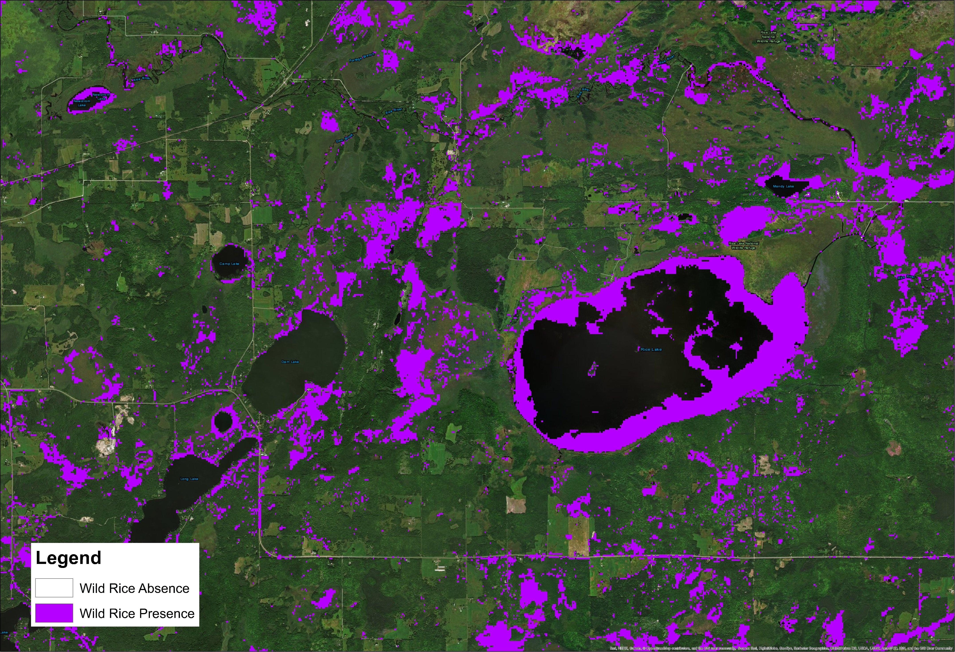
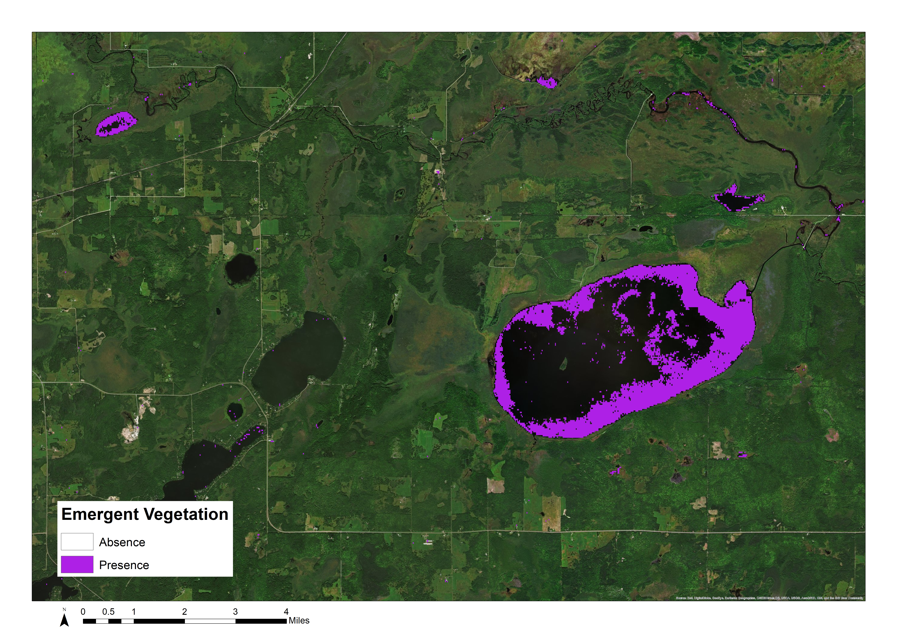
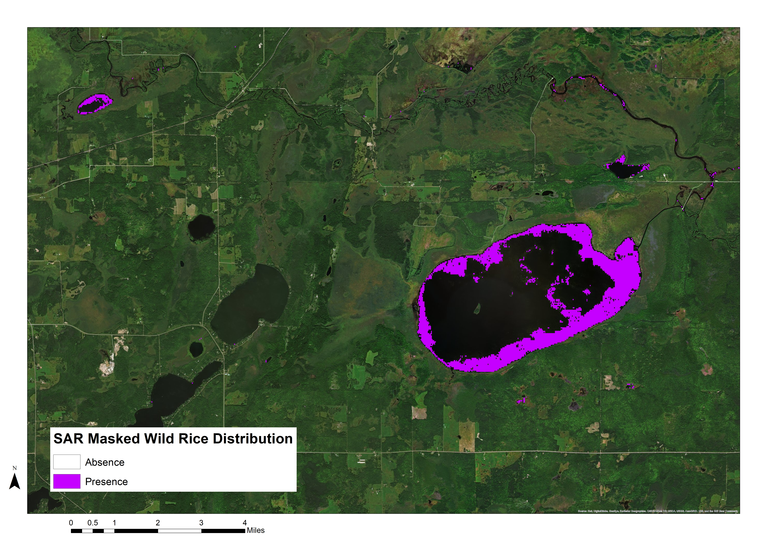
Results: Radar and Masking
Wild Rice Model Distribution
Wild Rice Binary Map: Rice Lake, MN (2015)
Binary SAR Variance Based on Threshold: Rice Lake, MN (2015)
Wild Rice Presence Masked by Variance: Rice Lake, MN (2015)
Notes:
These images show how using another type of imagery can help distinguish wild rice. By taking the variance of radar C-Band VV imagery and setting a threshold, we can clearly see where emergent vegetation with high variance from May to October is located. This gives us a good idea of where rice may be present, and helped us mask out noise and distinguish rice from other aquatic vegetation.

Slide 16
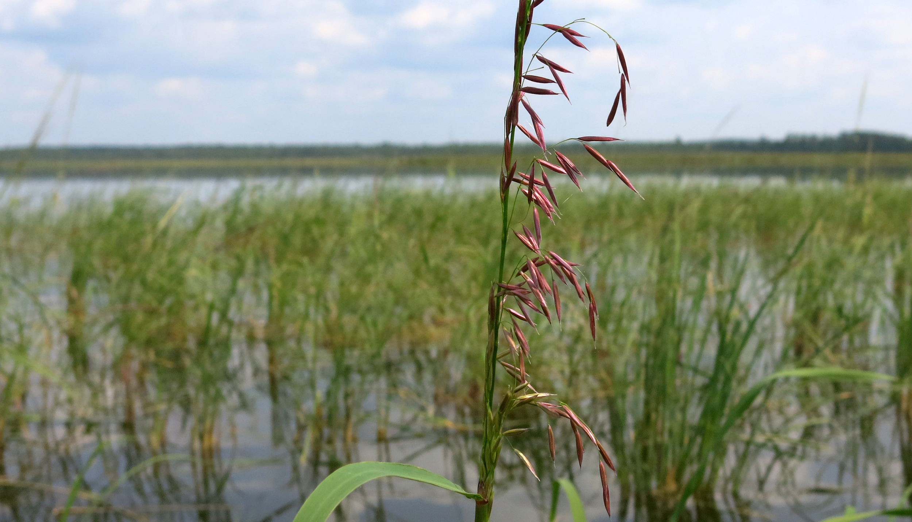
Errors and Uncertainties
Limitations of data availability, clouds
Visual sampling discrepancies
Field data not collected for remote sensing purposes
Masked regions and model performance
Did not apply radar to non-aquatic species
Image Credit: John Enger
Notes:
The NAIP imagery in this study was limited to October for the recent sampling date. This was the collection available on google earth engine and processing time would have been lengthy to mosaic and import NAIP from other sources. Landsat imagery was limited by the 30m resolution, while monitoring rice which can be found in regions much smaller. The results and accuracy of models may improve using Sentinel multispectral imagery at a finer 10m resolution.
Visual interpretations may have varied between the different individuals sampling from NAIP. We may have also encountered errors utilizing field data that was not specifically collected for remote sensing application. Also, without refining the study area to _____ our models may have performed less accurately. As far as applications of this methodology, we have not applied radar data to model non-aquatic species and cannot speak to the accuracy in such cases.
Image Source: http://publicradio1.wpengine.netdna-cdn.com/capitol-view/files/2015/03/20140811_wildrice01.jpg

Slide 17
Conclusions
The team successfully detected wild rice using NASA Earth observations.
Remote sensing may be a useful tool for the detection of other crop wild relatives.
It is difficult to distinguish wild rice from other emergent aquatic vegetation using NAIP imagery.
Incorporating the phenology of wild rice is necessary.
Using two types of imagery (radar and Landsat spectral) helps to distinguish the unique spectral signatures and structure of wild rice.
Notes:
Models based solely on Landsat Spectral imagery over-predicted wild rice presence, or there were many false positives, especially over croplands. Thus, it may be difficult to distinguish crop wild relatives from their domesticated counterparts. However, our models performed relatively well within water bodies.

Slide 18
Acknowledgements
Dr. Paul Evangelista (Colorado State University, Natural Resource Ecology Laboratory)
Colin Khoury (US Department of Agriculture, Agricultural Research Service)
Catherine Jarnevich (US Geological Survey)
Nicholas Young (Colorado State University, Natural Resource Ecology Laboratory)
Tony Vorster (Colorado State University, Natural Resource Ecology Laboratory)
Brian Woodward (Colorado State University, Natural Resource Ecology Laboratory)
Notes:
We’d like to thank all of our advisors and partners for this project.

