Slide 1
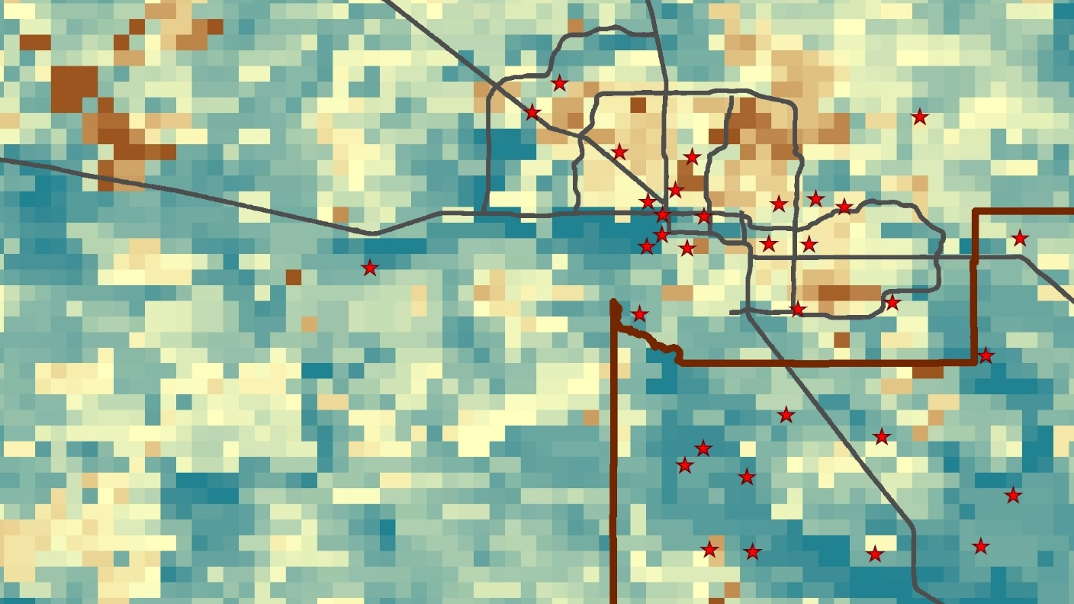
Maricopa County Health & Air Quality
Maricopa County Health & Air Quality
Jason Hodgson (Project Lead)
Monitoring PM₁₀ Concentrations with MODIS Aerosol Optical Depth Measurements for Enhanced Public Health and Air Quality Decision Making and Epidemiology
Leslie Araujo
Tamara Dunbarr

Slide 2
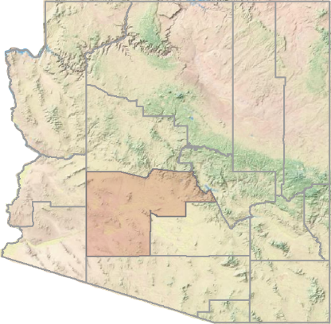
Maricopa County, Arizona
132.3 miles
Semi-arid region
Significant dust storm events
Very hot, dry summers, mild winters
Relatively small study area (AOD)
Global sub-tropical high-pressure zone
Urban area in continental valley
4 million people (US Census 2010)
Image Credit: Mircea Goia/Flickr
Notes:
The Maricopa County region is a special case for PM10 concentrations and pollution in general given its unique environmental and urban characteristics.
*Click to reveal characteristics*
*Speak briefly about each one*
Image Source: https://www.flickr.com/photos/mirceagoia/16178060444/

Slide 3
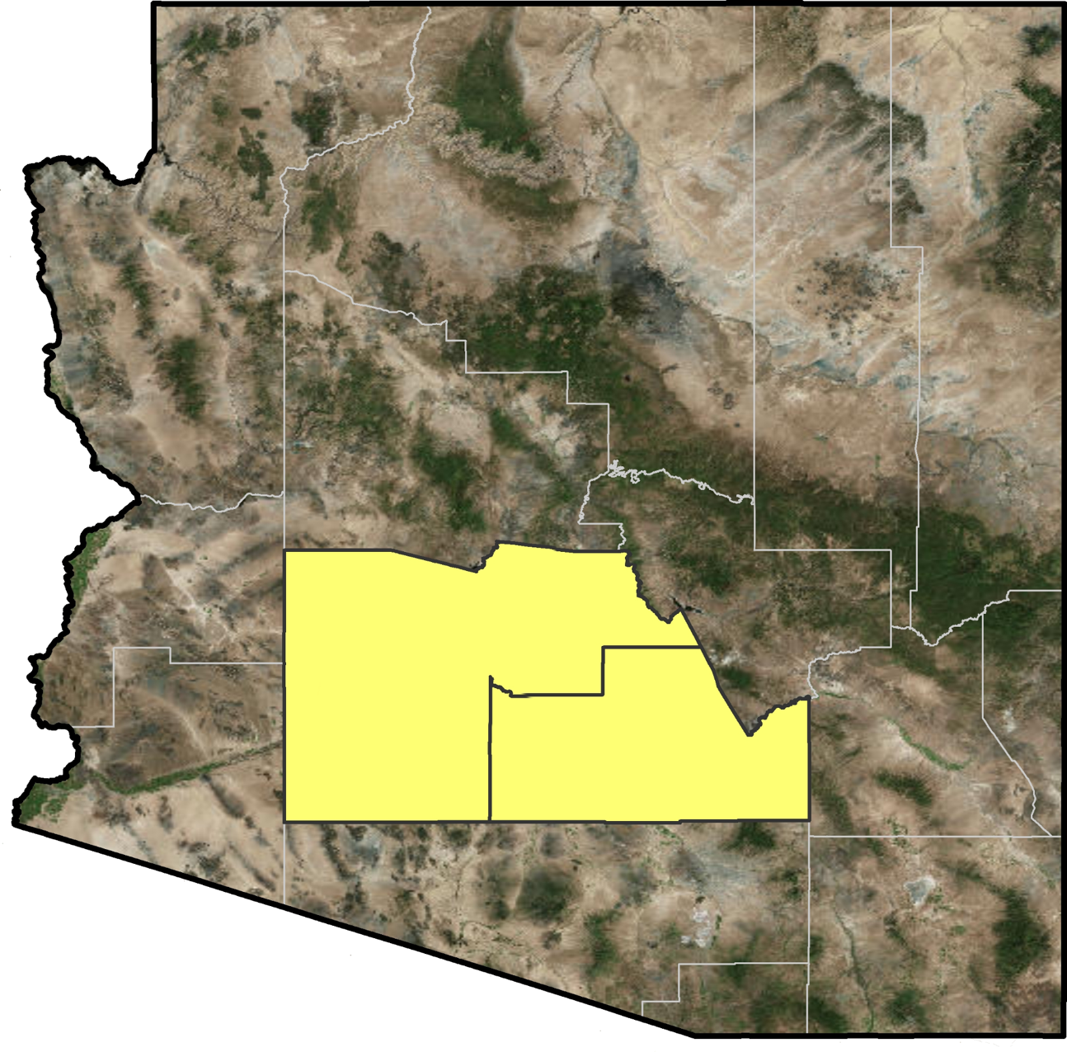
Pinal County, Arizona
Pinal County was also included in this study given that:
It’s an EPA PM₁₀ compliant area
PM₁₀ monitoring data is available
Neighbors Maricopa County
Similar to Maricopa County
Notes:
Pinal County, located on the southeastern side of Maricopa County, was also incorporated into the study area
*click In particular, it is an interesting area to analyze given its PM10 compliant status with the EPA
Other than not having densely urban areas, Pinal County is very similar to Maricopa

Slide 4
Particulate matter <10 µm in aerodynamic diameter
Anthropogenic and natural sources
Harmful health effects → increased morbidity and mortality with higher concentration
About PM₁₀
Image Credit: Quality Aire AZ/Cheyenne Hines
Notes:
PM10, also known as coarse particulate matter, is a type of aerosol that is between 2.5 and 10 micrometers in aerodynamic diameter
*Click
It is typically derived majorly from suspended dust due to agriculture, dust storm events, and high winds
*Click
PM10 poses respiratory health risks, especially when in high concentrations
Image Source: http://qualityaireaz.com/blog/how-to-prepare-for-the-arizona-monsoon-season/
Image Source: http://qualityaireaz.com/blog/how-to-prepare-for-the-arizona-monsoon-season/

Slide 5
Aerosol Optical Depth
Dimensionless (a ratio)
Measures all pollutants in air
About AOD
$$τ= \ln\left(\frac{φ_{e}^{i}}{φ_{e}^{t}}\right)=−ln{T}$$
$φ_{e}^{t}$ is the radiant flux transmitted by that material
$φ_{e}^{i}$ is the radiant flux received by that material
$T$ is the transmittance of that material.
Notes:
Aerosol Optical Depth (AOD for short) is a dimensionless value measuring the total amount of pollutants in the air
*Click
AOD is derived from ratio involving radiant flux and trasmittance
*Click
This NASA image was derived from a MODIS AOD product, showing how polluted the air is across the globe
Image credit: https://upload.wikimedia.org/wikipedia/commons/thumb/3/33/Modis_aerosol_optical_depth.png/1280px-Modis_aerosol_optical_depth.png (NASA)

Slide 6
Terra Satellite
Aqua Satellite
MODIS
MODerate resolution Imaging Spectroradiometer
Provides aerosol optical depth (AOD) data at a 3 km spatial resolution
Aboard the Terra and Aqua satellites (Earth Observing System)
Notes:
Aerosol Optical Depth can be measured from satellite sensors, such as the MODIS sensor on the Earth Observing Systems, Terra and Aqua
*Click
The MODIS sensors provide Level 2 AOD products at a 3km resolution, which allows for analysis of air quality at a finer resolution over a specified study area, such as Maricopa County
Image Sources: http://www.devpedia.developexchange.com/dp/images/9/91/05_Terra.png, http://www.devpedia.developexchange.com/dp/images/b/bf/06_Aqua.png

Slide 7
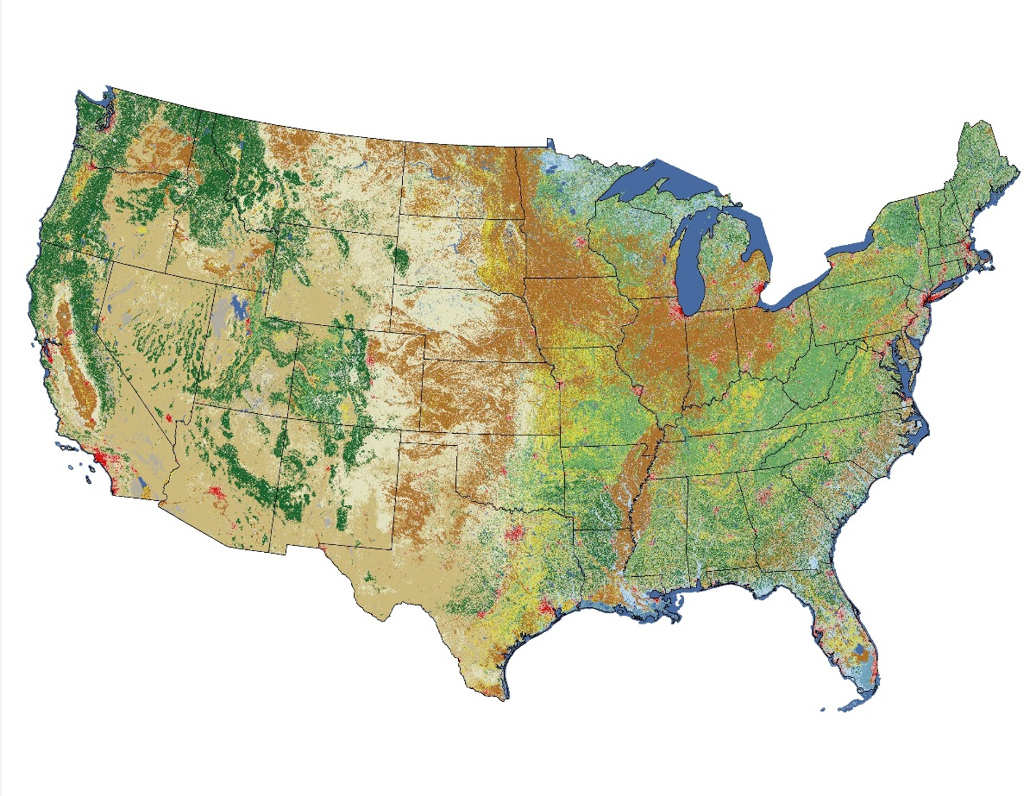
Image Credit: USGS
Landsat 5
Used by the USGS National Land Cover Database (NLCD) 2011
Incorporated into this study to determine percent of open space via land cover data
Notes:
The Lansat 5 satellite was also used indirectly in this study, as the USGS’ NLDC was created using Landsat 5.
*Click
The percentage of open space dataset was derived from the NLCD
Image Sources: http://www.devpedia.developexchange.com/dp/images/6/69/01_Landsat5.png, https://upload.wikimedia.org/wikipedia/commons/8/85/NLCD11_CONUS.jpg

Slide 8
Objectives
Model PM₁₀ concentrations with a mixed model including aerosol optical depth (MODIS)
Produce monthly continuous maps of PM₁₀ concentrations in Maricopa County for a 10-year period
Perform hotspot analysis on spatial and/or temporal areas of interest for further epidemiological research
Image Credit: Mircea Goia/Flickr
Notes:
The objectives of this study were to create a mixed model predicting PM10 concentrations over a large study area
*Click
To produce monthly maps of PM10 concentrations in Maricopa County over a span of 10 years
*Click
And to perform hotspot analyses useful in public health and epidemiological research
mage Source: https://www.flickr.com/photos/mirceagoia/16180477833/

Slide 9
Data & Methodology I
Data Materials:
MODIS AOD observations
PM₁₀ monitoring data (MCDAQ/EPA)
Percent of Open Space/Land Use
Road Data
Elevation
Meteorological Data
Image Credit: Kevin Dooley/Flickr
Notes:
The data materials used for this project were
*Click (keep clicking to bring up new data material)
AOD, PM10 data, percent of open space, road data, elevation, and meteorological data
Image source: https://www.flickr.com/photos/pagedooley/7899921242/

Slide 10
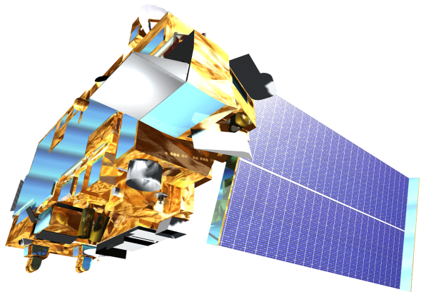
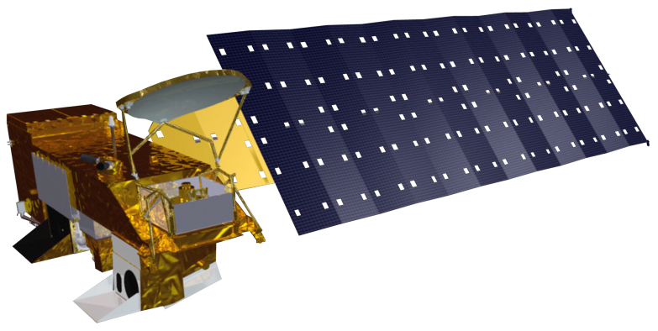
AOD Measurements → PM₁₀ Surfaces
MODIS AOD Rasters
one month of raster images
=
Terra Satellite
Monthly PM₁₀ Surface
Aqua Satellite
Apply PM₁₀ mixed model
Pm_{ij} = (α + u_{j}) + (β₁ + v_{j})AOD_{ij} + (β₂ + k_{j})Temperature_{ij} + β₃Elevation_{i} + β₄Major Roads_{i} + β₅OpenSpace_{i} + ε_{ij}(u_{j}v_{j}k_{j})~[(0 0 0), Σ]
x 120 months (10 years)
AOD Raster Pixel
PM₁₀ Surface Pixel
Pm_{ij} = (α + u_{j}) + (β₁ + v_{j})AOD_{ij} + (β₂ + k_{j})Temperature_{ij} + β₃Elevation_{i} + β₄Major Roads_{i} + β₅OpenSpace_{i} + ε_{ij}(u_{j}v_{j}k_{j})~[(0 0 0), Σ]
Pm_{ij} = (α + u_{j}) + (β₁ + v_{j})AOD_{ij} + (β₂ + k_{j})Temperature_{ij} + β₃Elevation_{i} + β₄Major Roads_{i} + β₅OpenSpace_{i} + ε_{ij}(u_{j}v_{j}k_{j})~[(0 0 0), Σ]
Notes:
The methodology for this project included obtaining raw monthly AOD surfaces of the study area for 10 years,
*Click
Applying the derived PM10 mixed model
*Click
And to create predicted PM10 surfaces for every month
*Click
The mixed model was based on several variables, including MODIS AOD and percent of open space among other factors
Monthly calibration allowed the model to be effective in predicting PM10 concentrations on a monthly timescale
Satellite images sources: http://www.devpedia.developexchange.com/dp/images/9/91/05_Terra.png, http://www.devpedia.developexchange.com/dp/images/b/bf/06_Aqua.png

Slide 11
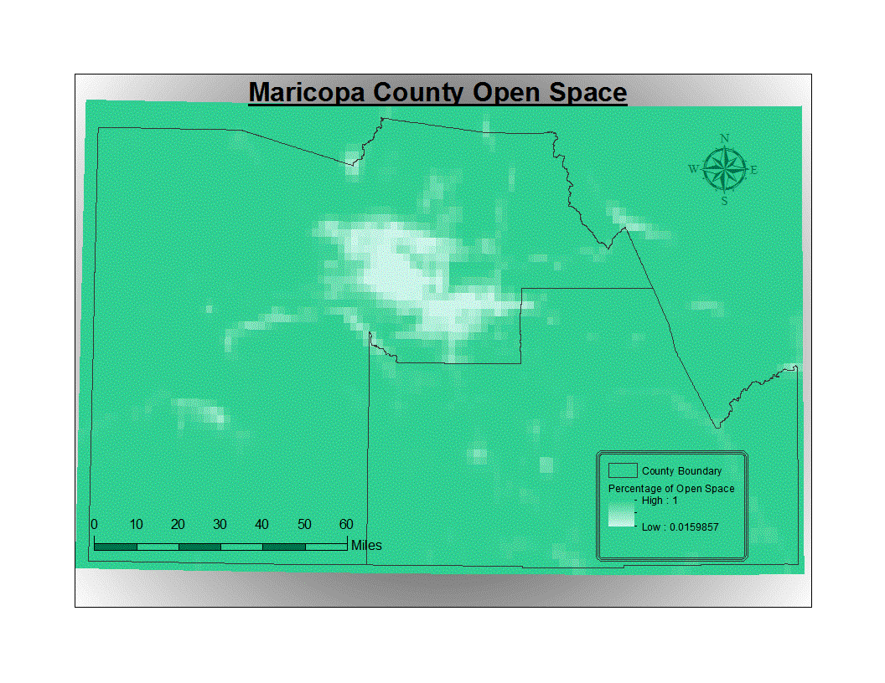
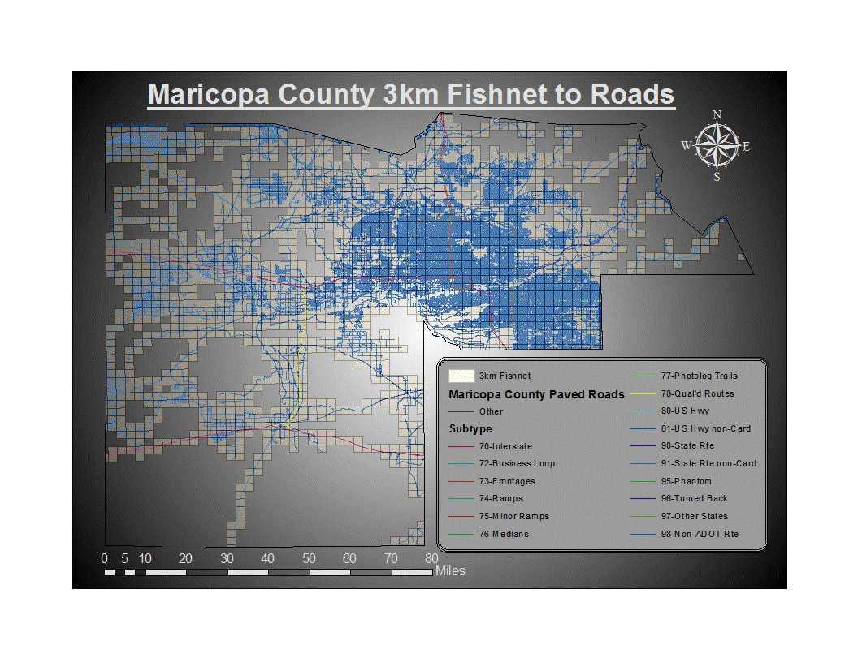
Open Space and Roads
Green indicates higher percentage of open space
Sum of road lengths were calculated within each 3km grid square
Notes:
Some examples of the raw datasets, such as
*Click
percent of open space and
*Click
road density surfaces, are shown here

Slide 12
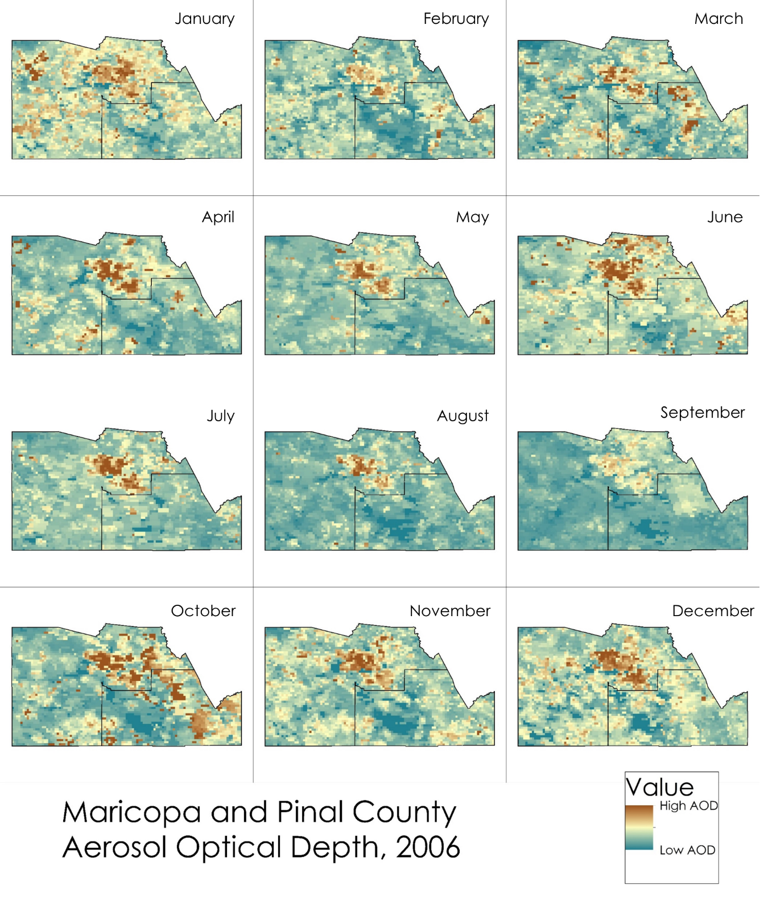
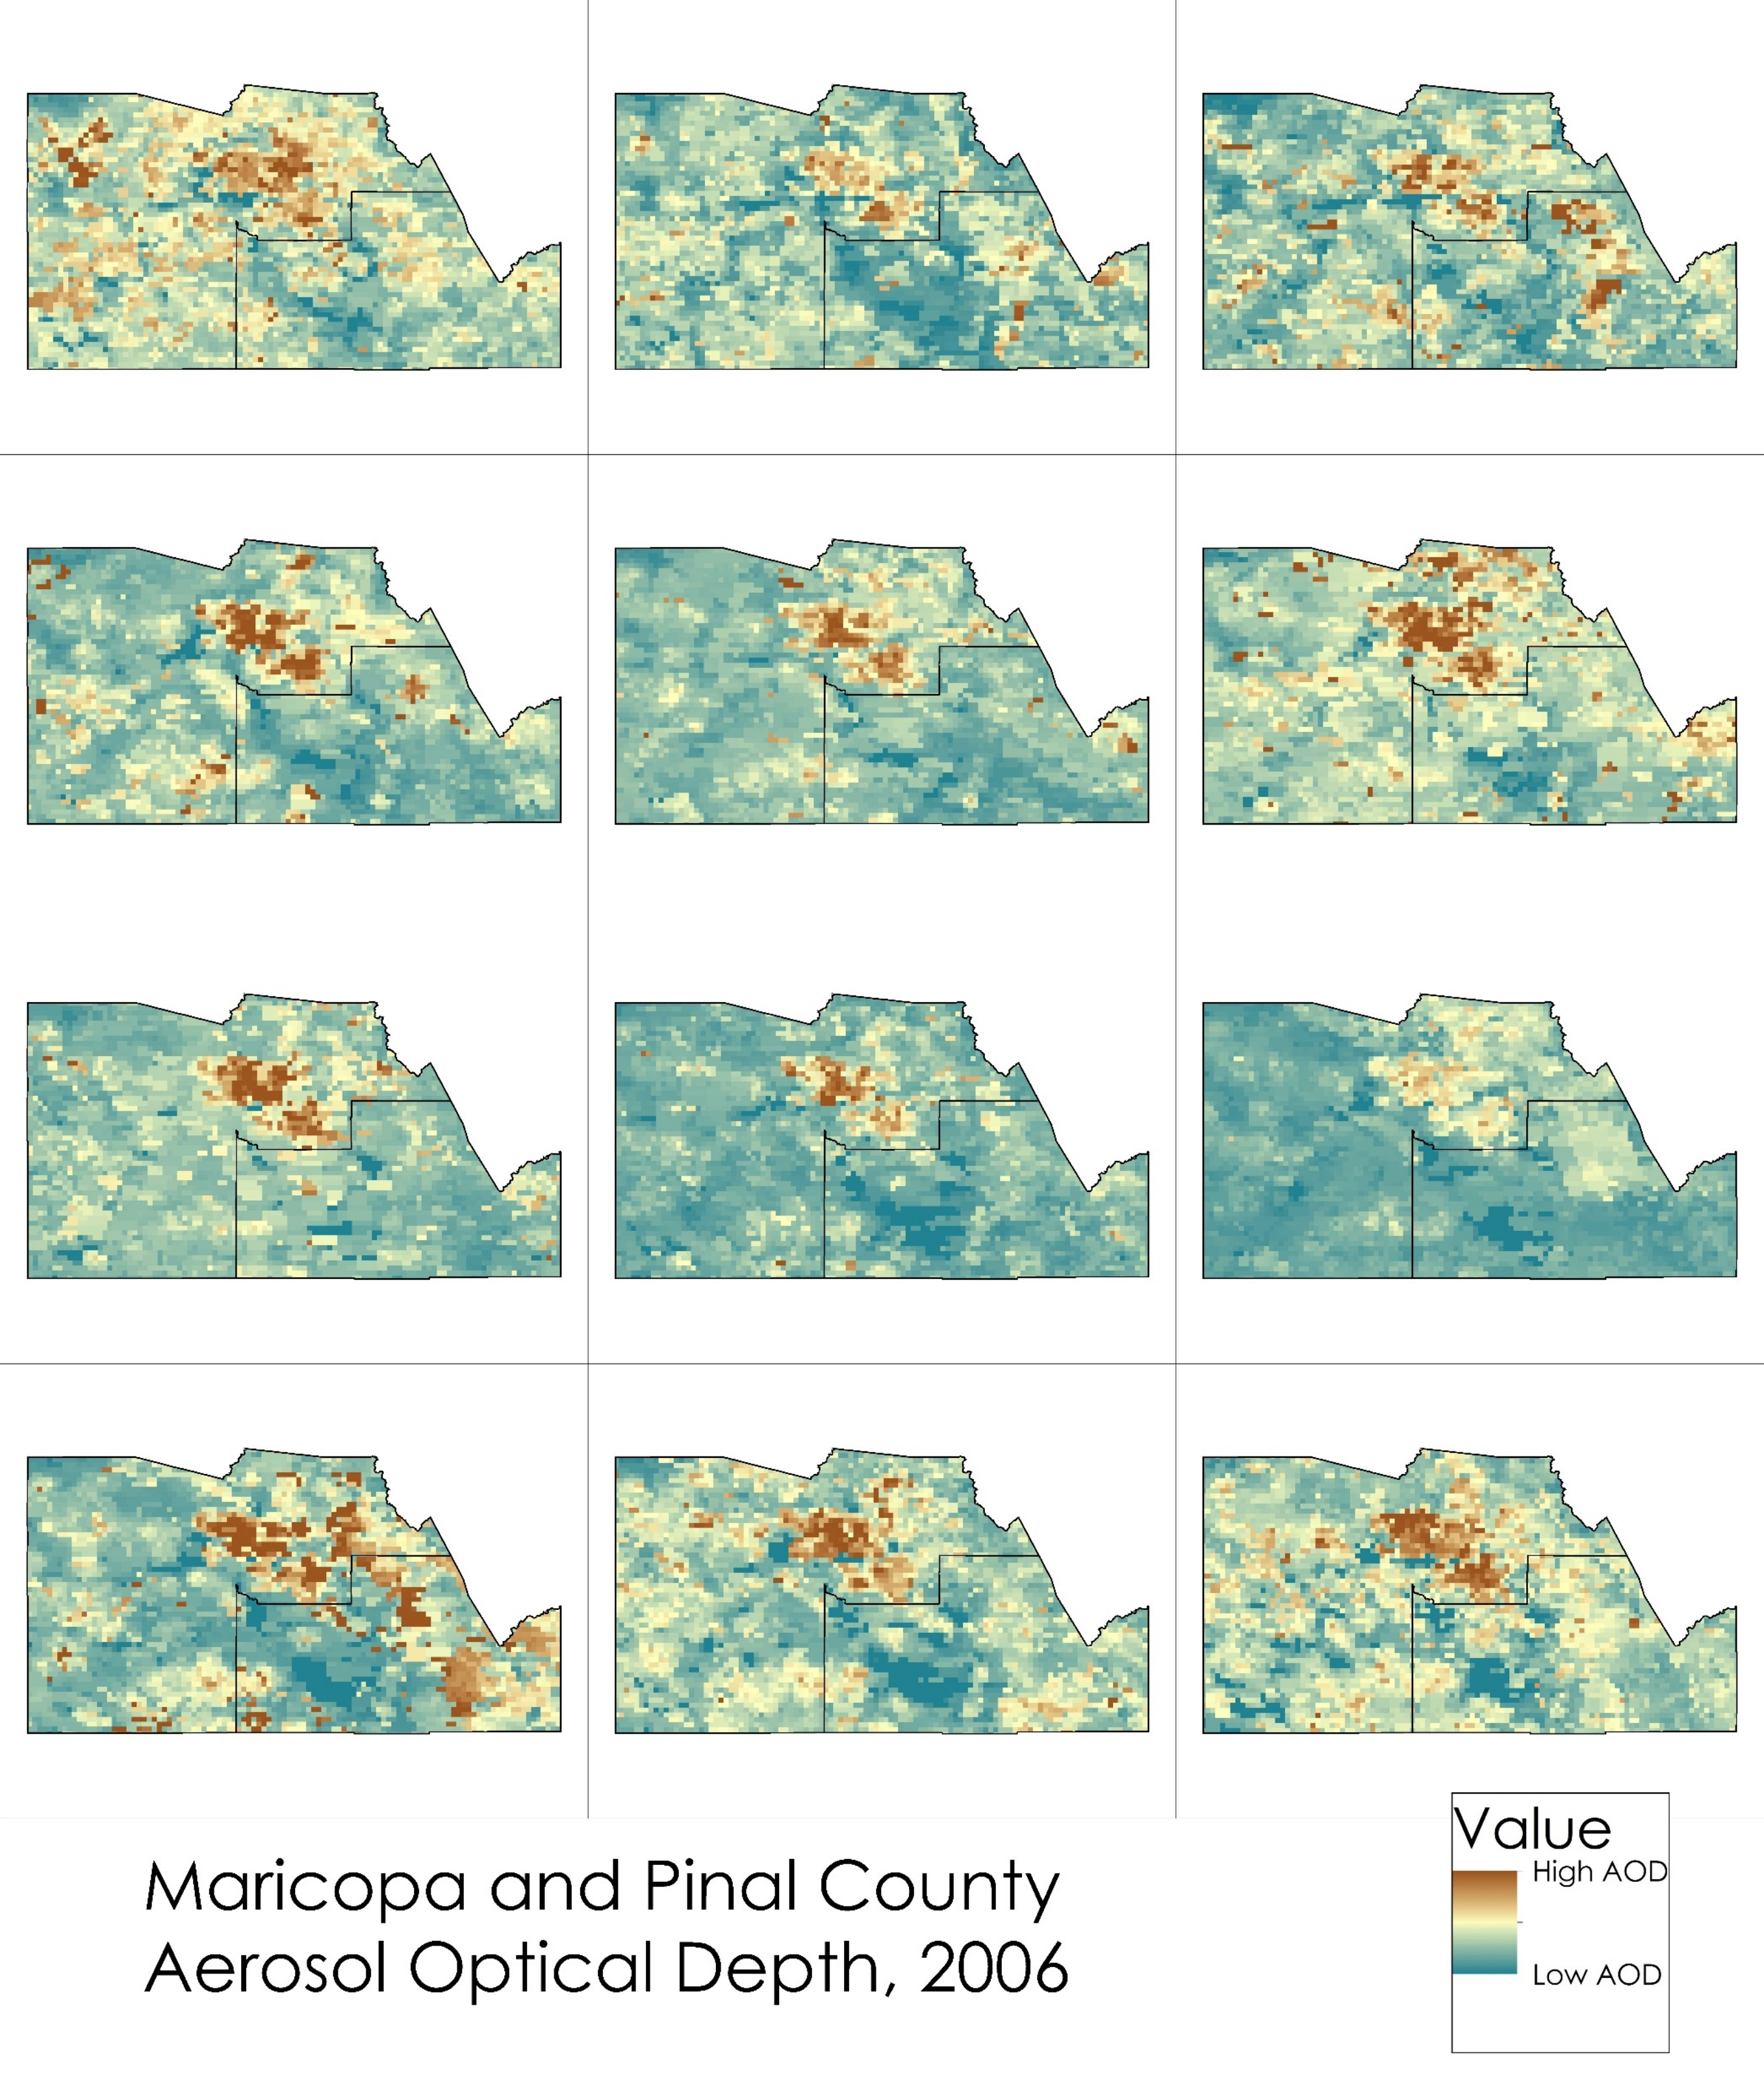
Snapshots of Max AOD in a Year (2006) for Maricopa and Pinal Counties
Brown = higher AOD value
Blue = lower AOD value
AOD tends to be concentrated in/near urban areas, as expected
January
February
March
April
May
June
July
August
September
October
November
December
Notes:
A snapshot of a year’s raw maximum AOD monthly surfaces can give an idea as to how air quality varies month by month
This map set shows the AOD for every month in 2006
Notice that the Fall and Winter have higher AOD values, and higher AOD values in general are concentrated in densely urban areas and areas with a lot of agricultural activity

Slide 13
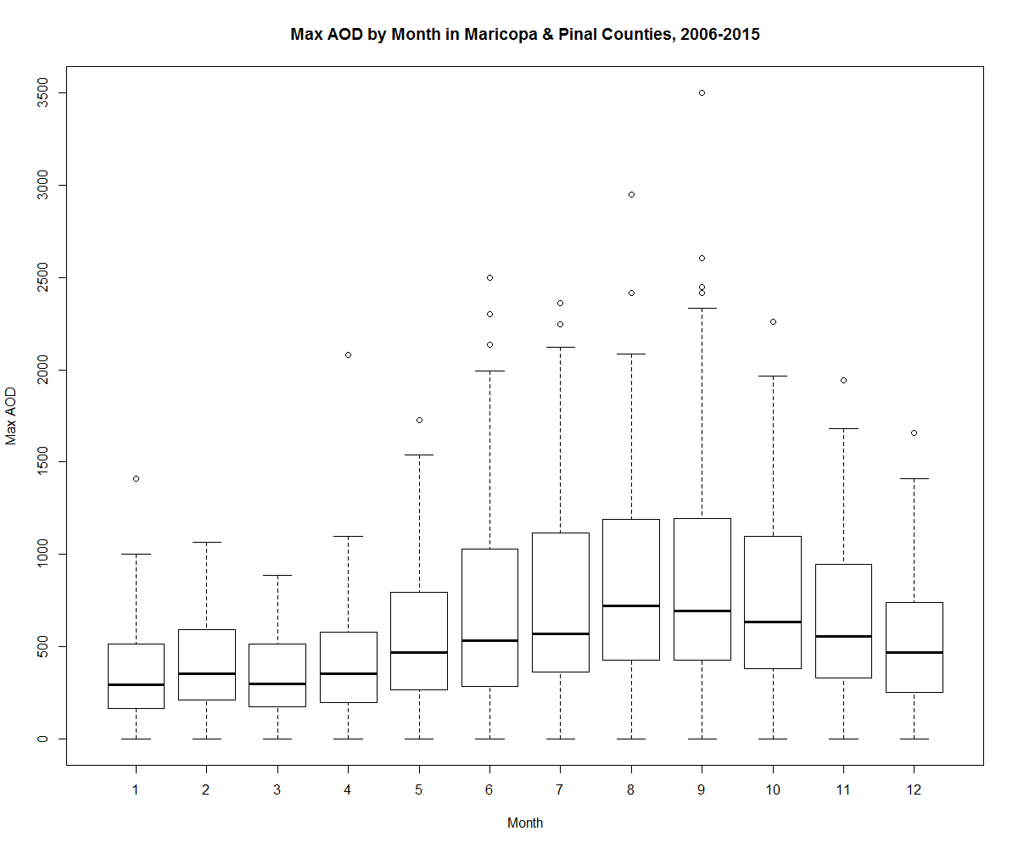
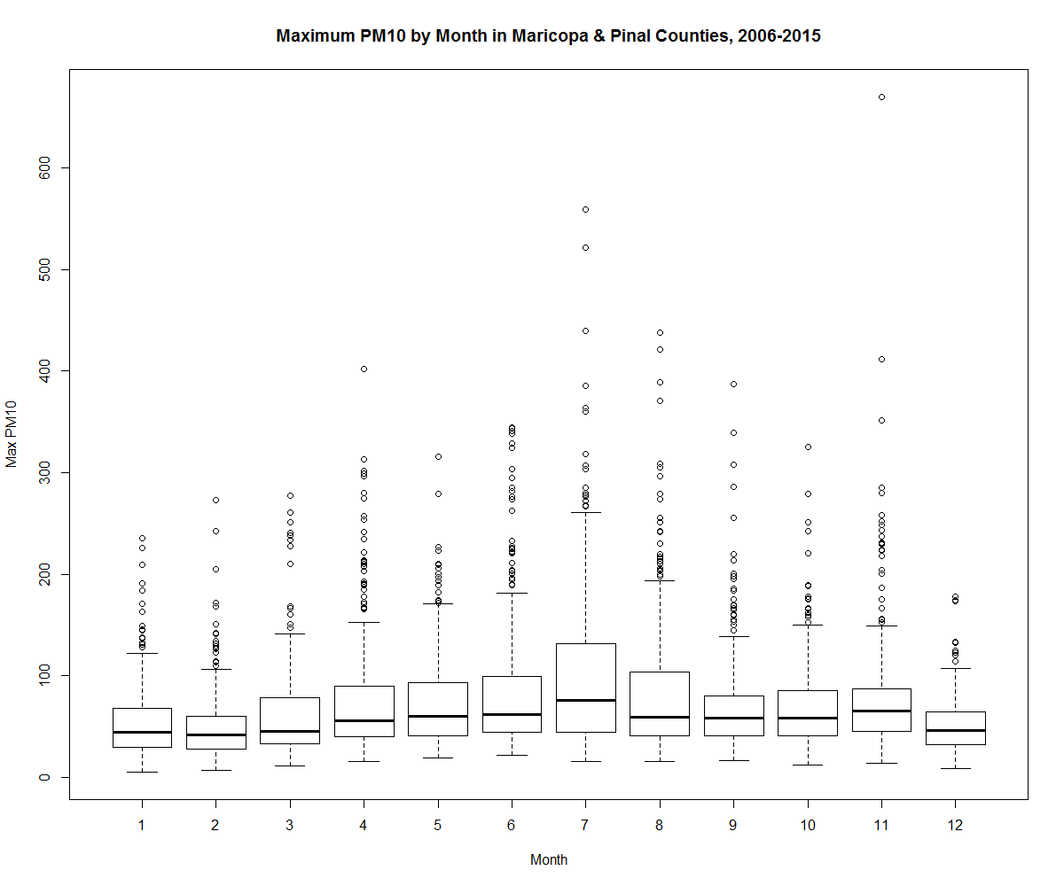
Monthly Trends from 2006-2010
Max AOD
Max PM₁₀
Notes:
This boxplot comparison of max AOD per month for the 10 years has a similar trend to max PM10 readings for the same 10 years

Slide 14
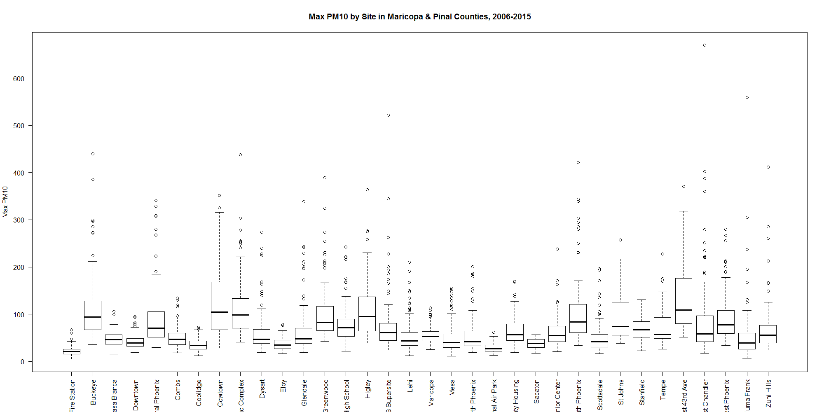
Monitoring Site Trends from 2006-2010
Notes:
Maximum PM10 shown varies for those same 10 years for every site. These graphic include Maricopa County and Pinal county sites.

Slide 15
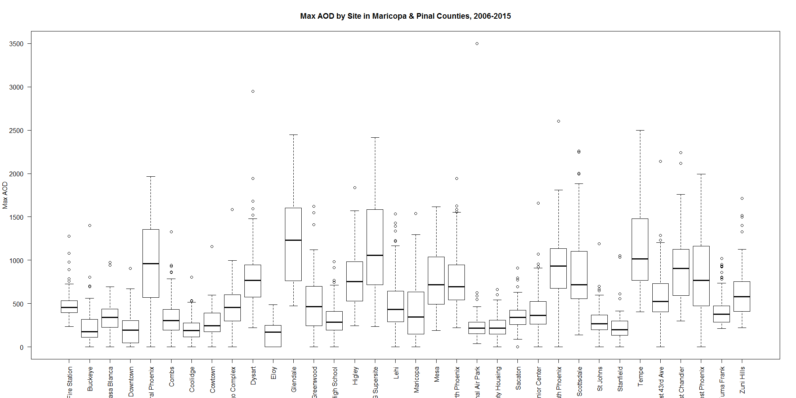
Monitoring Site Trends from 2006-2010
Notes:
Thus they can similarly be compared to the AOD value observed for those specific sites throughout the 10 years.

Slide 16
Results
Computed in R:
Mixed Effect Model:
m1.formula <-
as.formula(pm10max ~ aodmax + TempMthAvg + Elev + Roads+ prctOpen + (1+aodmax|month))
Notes:
The mixed model was formulated as such and was computed in R.
The lme4 R package allows random and fixed effects to be used in the same linear model, thus resulting in a mixed model.

Slide 17
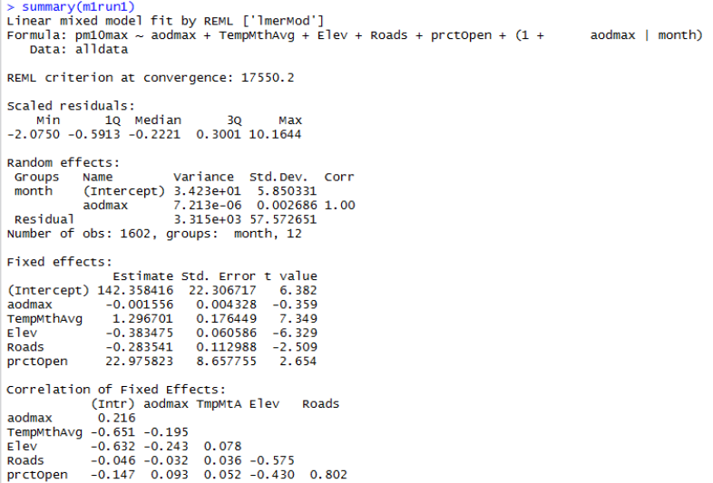
Results
m1.formula <-
as.formula(pm10max ~ aodmax + TempMthAvg + Elev + Roads+ prctOpen + (1+aodmax|month))
Notes:
The results mainly yielded positive correlations.
However the most conclusion drawn is that the more variables related to PM10 included in the model, the better the model performed. This is something key to keep in mind for future work.

Slide 18
Conclusions & Uncertainties
Conclusions:
More variables in AOD and PM₁₀ model results in better model accuracy
AOD data needs to be refined specifically for bright areas (desert regions)
Uncertainties:
Insufficient data (missing AOD pixels, missing PM₁₀ measurements for sites or time periods)
Credit: Alan Levine
Notes:
Ultimately, more variables lead to better model outputs.
*Click
One of the suggestions derived from this study for future work includes using AOD datasets that better account for the bright areas in desert regions, as satellite sensors often have difficulty performing well in these regions.
*Click
Models will ultimately be better with more complete datasets for all variables, but particularly PM10 and AOD.
Different operation lifetimes of different monitors can often interfere with obtaining accurate results and thus an accurate model.
Image: https://www.flickr.com/photos/cogdog/2696694881/in/photolist-57igrk-7SDNF-armXqm-dTAm3Y-arn4sU-8Uj7tm-afKQPF-a4Wgti-eqSY8D-hn9bwW-rBoGVq-yuV6T3-8UwqnW-6c37X1-a4Wgjp-qhKYQ2-4hDPgF-4FFrLq-HECkvv-8n2nVb-2oAbMf-5mbC2s-8n3GQi-8UgdZR-vzCEq-4MDq7p-a4Whbt-nTXsoW-7xvfZr-8TLax6-7oedw-5q5TUS-9f8dDp-gzyPSs-dEz38i-hvzc36-kNJrdB-Mu5S-bxghmD-aL17ok-2j5EMv-9GJcbe-5hUVkG-8UBuFN-Ba78Xh-M2H1j-8tPXE-hggttH-3R96Z-rzh6cX

Slide 19
Future Work
Good platform for modeling PM_{2.5} in Maricopa County
Daily Calibration for finer temporal resolution and better overall fit
Image Credit: Friends of Earth Scotland/Flickr
Notes:
By providing a more spatially and temporally resolved surface of PM₁₀ concentrations, this study may be applied to epidemiological studies and future policy decisions regarding air quality in Maricopa County.
Image Source: https://www.flickr.com/photos/friendsoftheearthscotland/20845924986

Slide 20
This project could not have been accomplished without the support of…
Advisor
Dr. Dave Hondula, Arizona State University, Assistant Professor
Partners
Maricopa County Department of Public Health:
Kate Goodin, Epidemiologist and Data Services Program Manager
Vjollca Berisha, Senior Epidemiologist
Maricopa County Air Quality Department:
Ronald Pope, Atmospheric Scientist
Ira Domsky, Planning Consultant
School of Geographical Sciences & Urban Planning at Arizona State University
Other Support
Dr. Itai Kloog, Ben-Gurion University of the Negev, Senior Lecturer
Notes:
We would like to thank the following partners and organizations for their support throughout this term. Thank you!

