Slide 1
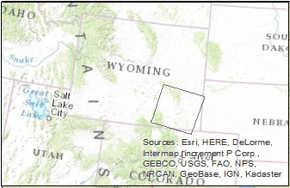
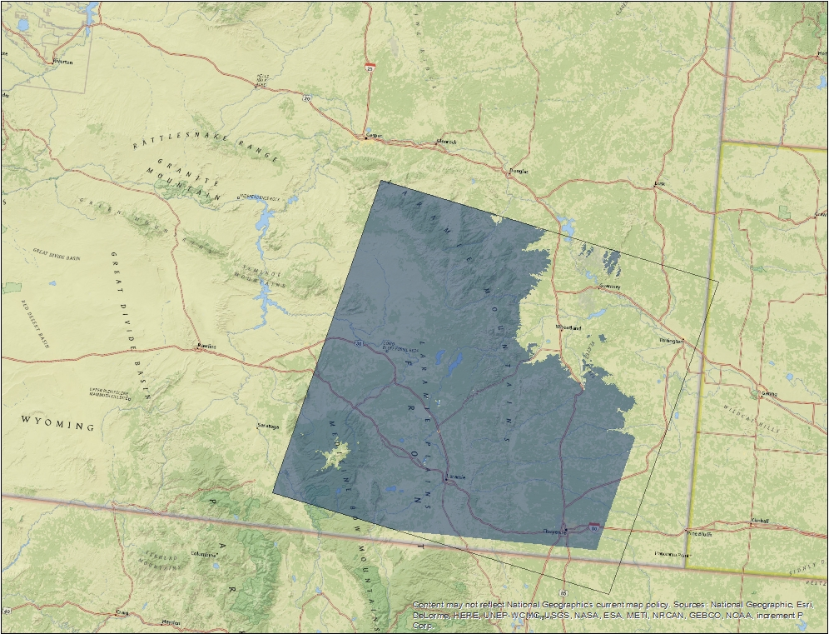


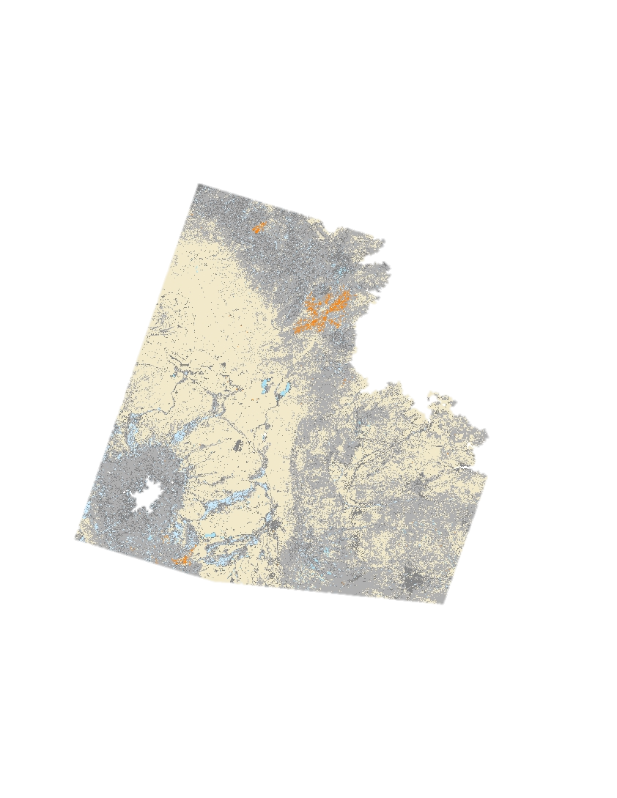
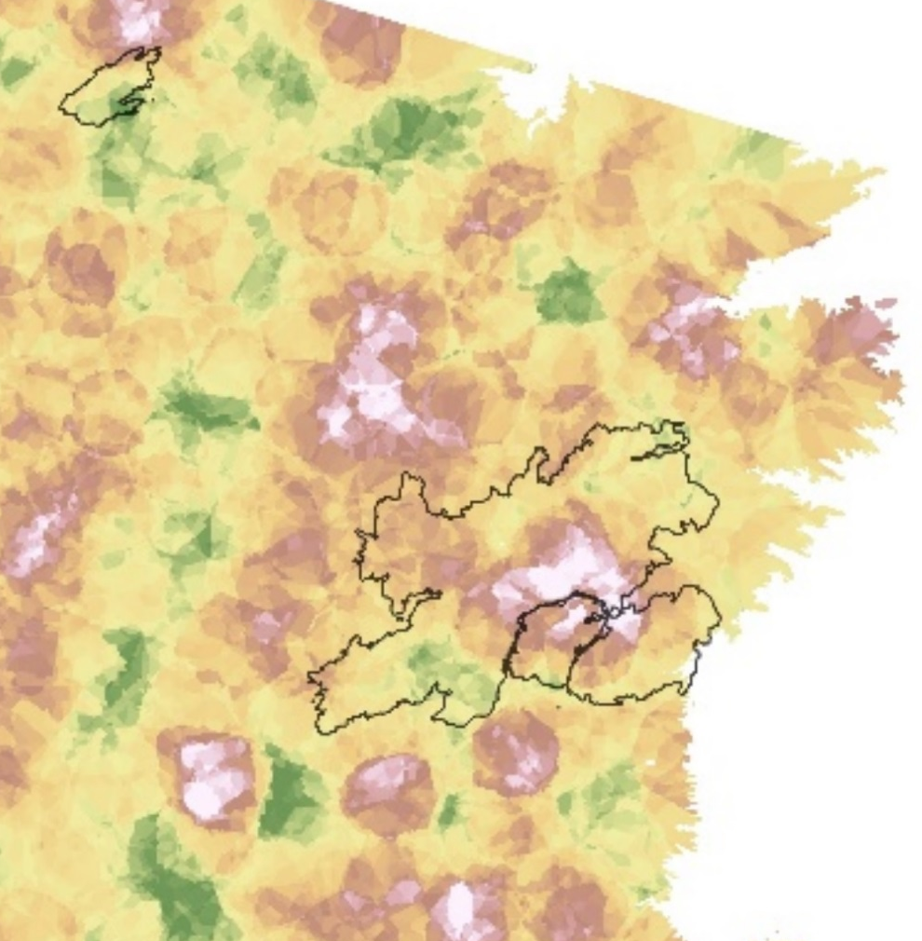
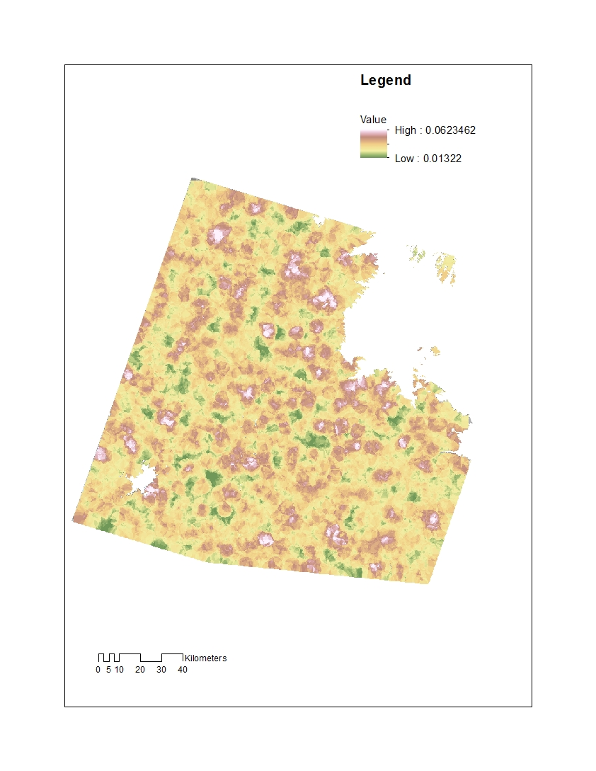
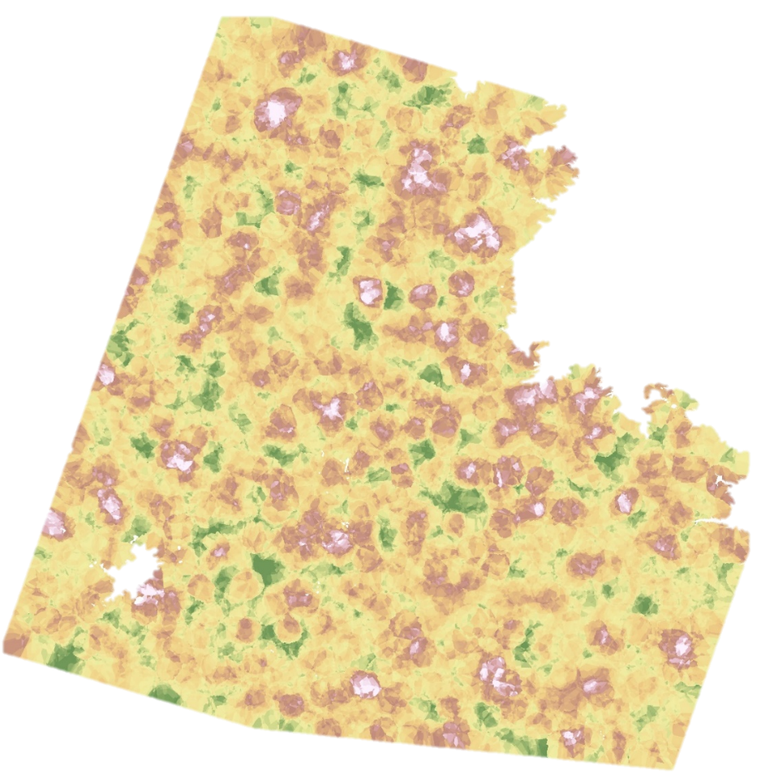
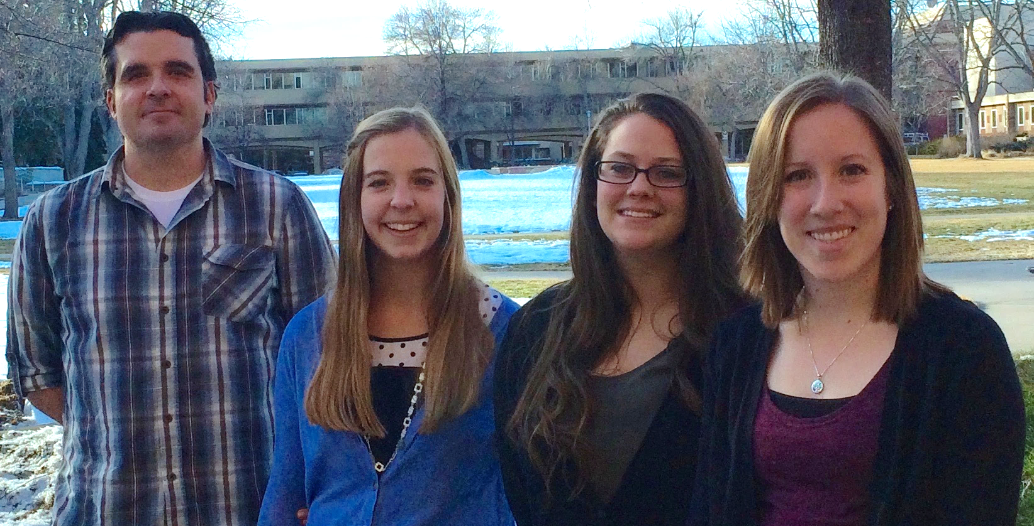
Laramie Mountains Ecological Forecasting
Mapping fire history in the Laramie Mountain Range, Wyoming with a 31-year Landsat time series
Stephanie Krail (Project Lead), Alexa Grafton, Aubrey Hilte, and Darin Schulte
DEVELOP National Program at USGS Colorado State University, Fort Collins
Abstract
The Laramie Mountain Range, located in southeastern Wyoming, supports a multitude of plant and animal communities as well as human activities. Recreational opportunities, ample views, and critical mule deer (Odocoileus hemionus) and elk (Cervus canadensis) habitat are facets that depend heavily upon the presence of aspen (Populous tremuloides) communities. However, the success of these relationships is inhibited by the limited distribution of aspen in the Laramie Mountain Range. The ultimate objective of this two term project is to evaluate the carrying capacities of mule deer and elk habitat in the Laramie Mountain Range by identifying current aspen distribution. Due to the scattered distribution of aspen trees in southeastern Wyoming, understanding historic fire patterns and future fire susceptibility in areas of close proximity to aspen stands can inform management practices. Thirty-one years of remotely sensed data were processed to create a spectrally and spatially consistent tasseled-cap time series. Tasseled-cap indices were utilized to estimate fire frequency and perform a supervised classification to detect burned areas. Results from both processes were compared with the Monitoring Trends in Burn Severity product (which employs the Normalized Burn Ratio) to evaluate the use of tasseled-cap indices for fire monitoring. A fire hazard analysis was conducted to quantify fire susceptibility throughout the study area. Multi-temporal pixel values were extracted from spectral and topographic indices, and compared to pre-fire pixel values at historic fire locations. The similarity of a given pixel to previously burned pixels was estimated with a series of distance metrics.
Objectives
Delineate fire history of the Laramie Mountain Range
Calculate fire frequency by combining fire occurrence datasets
Assess the use of annual composite imagery for fire susceptibility mapping
Study Area
Earth Observations
Methodology
Laramie Mountains Ecological Forecasting
Study Area
Shuttle Radar Topography Mission (SRTM)
Landsat 5 Thematic Mapper (TM)
Study area extent
Path, row outline
Data Acquisition
Data
Processing
Modeling
Results
Landsat Imagery
LandsatLinkr
Program
Supervised
Classification
Fire History
Time Series
Landsat 8 Operational Land Imager/Thermal Infrared Sensor (OLI/TIRS)
SRTM
Data
Topographic
Indices
Cluster Analysis
Fire
Frequency
Landsat 7 Enhanced Thematic Mapper Plus (ETM+)
Ancillary
Data
Fire Occurrence Database
Fire Susceptibility
Map displaying the extent of the study area and the outline of Path 34, Row 31. The study area was restricted to an elevation range of 1,580 to 3,200 m to encompasses aspen species range.
Graphics of the NASA Earth Observations that were used in the Laramie Mountains Ecological Forecasting Project.
Work flow displaying the methodology for the project. The graphic lists the four main stages throughout the term and includes specific tasks for each stage.
Results
Legend
Legend
Legend
Russel’s Camp Fire
Burned once
Fire affected pixels
High: 0.06235
Low: 0.01322
Burned twice
Burned three times
Arapaho Fire
Fire frequency map highlights where fires were the most prevalent within the study period. The different colors represent how many times a pixel burned between 1984 and 2015.
Fire classification map created with Landsat imagery from 2012. Areas in orange represent pixels that were classified by the model as affected by fire.
Fire susceptibility map with interpolated distance to fire points for 2012 created with a cluster analysis. Areas in white and pink represent pixels that have a higher risk of future fires.
Conclusions
Results indicate that the use of Landsat data accurately identifies fire history and predicts fire susceptibility in remote areas.
With these final products, project partners will better understand the fire ecology of southeastern Wyoming, further assisting in land management and conservation efforts.
Team Members
Project Partners
Acknowledgements
Wyoming Game and Fish Department
USDA Forest Service,
Laramie Ranger District
Colorado State University,
Natural Resource Ecology Laboratory (NREL)
We would like to thank Dr. Paul Evangelista, Dr. Amanda West, and Dr. Bill Romme, Colorado State University, Natural Resource Ecology Laboratory (NREL).
We would also like to thank Ryan Amundson, Wyoming Game and Fish Department, and Daron Reynolds, USDA Forest Service, Laramie Ranger District.
Brian Woodward, the Fort Collins Center Lead, deserves a big thank you for his support, advice, and guidance throughout the term.
Left to right: Darin Schulte, Alexa Grafton, Aubrey Hilte, and Stephanie Krail
USGS at Colorado State University
Notes:
Final

