Slide 1
Ethiopia Ecological Forecasting
Mapping Four Decades of Fire History for Targeted Conservation in the South-Central Highlands of Ethiopia
Stephen Chignell (Project Lead)
Kelly Hopping
Chandra Fowler
Darin Schulte

Slide 2
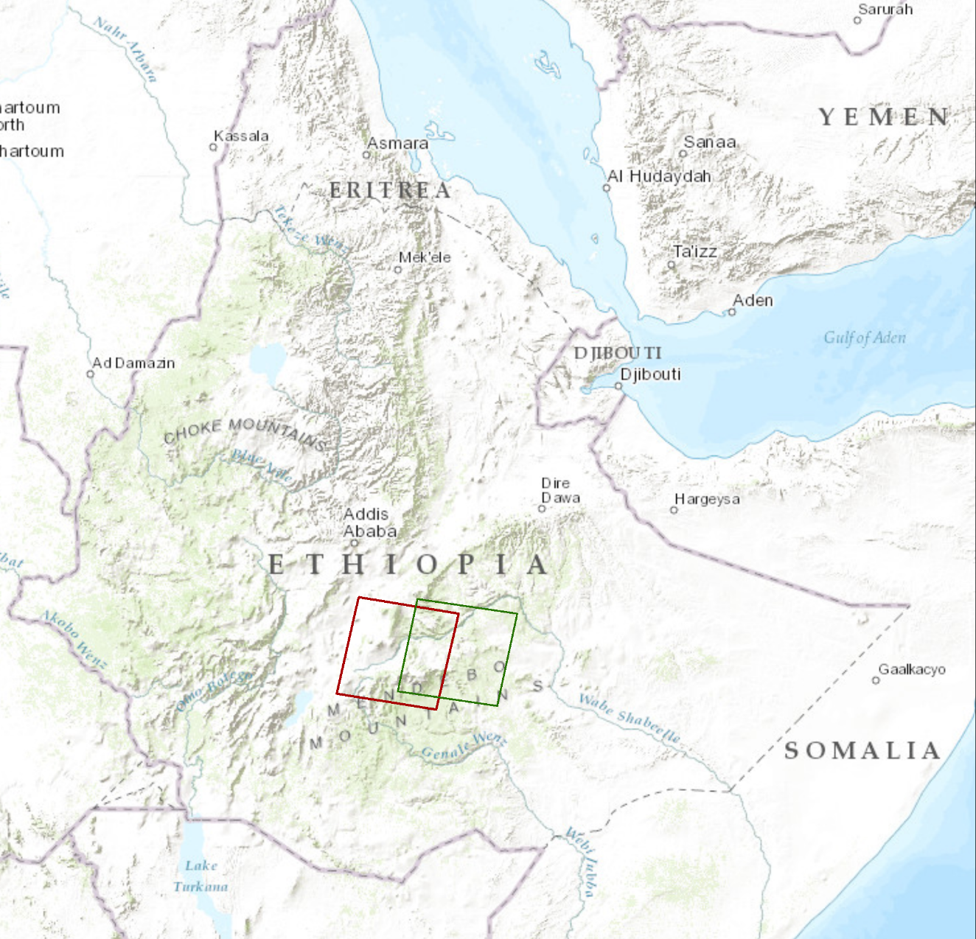
Bale-Arsi Massif, Ethiopia
Bale Mountains National Park
High
Elevation
Low
WRS1 Path180 Row 55
WRS2 Path 167 Row 55
Notes:
South-Central Ethiopian Highlands and Bale-Arsi Massif
- Critical water catchment, High Biodiversity, Endemism, Bale Mountains National Park

Slide 3
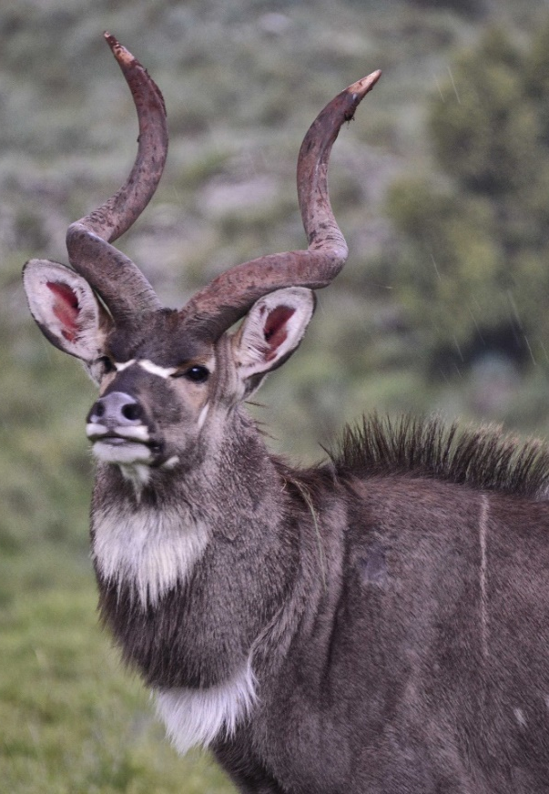
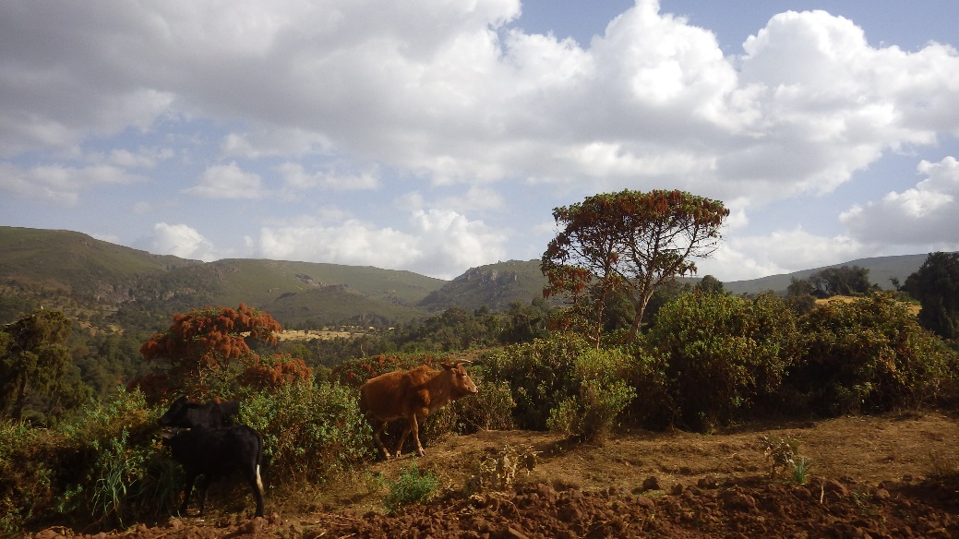
Community Concerns
Positive effects of intentional burning on social-ecological system functioning
Negative effects of forest fires on habitat and erosion potential
Negative ramifications of forced burning cessation
Efficacy of past and future conservation efforts
Limited capacity and data availability
Credits: (Top) Rod Waddington (Bottom) Stephen Chignell
Notes:
-Burning shrubs increases grazing value, controls toxic caterpillars, and reduces predator attacks on livestock.
- Natural and intentional burning of Afro-alpine grasslands and Ericaceous heath shrublands in the Bale-Arsi massif may reduce the critical habitat of the endangered Mountain Nyala and increase soil erosion.
-Cessation of intentional burning is expected to allow shrubs to replace Afro-alpine grasslands, to grow out of reach of pastoralists’ cattle, and to create high fuel loads susceptible to much larger, high-intensity fires when they do eventually burn.
Photo By Rod Waddington: https://flic.kr/p/j94bxw

Slide 4
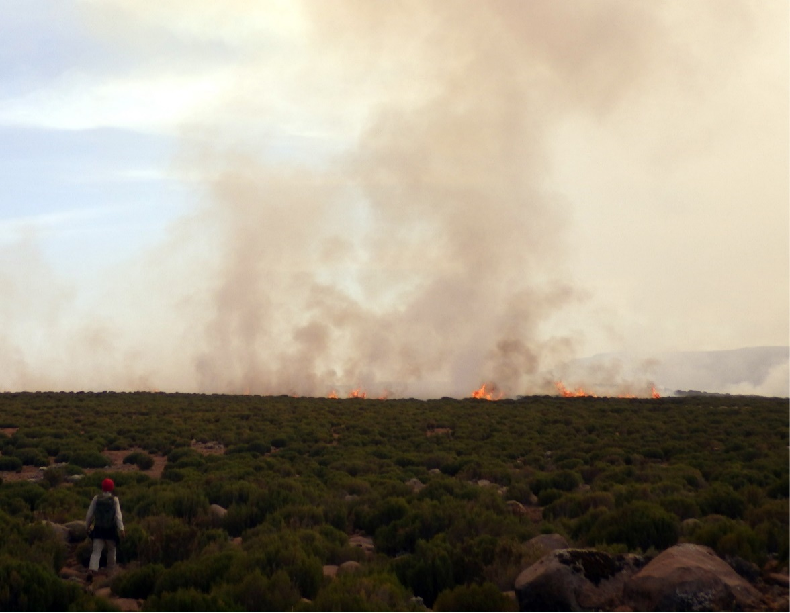
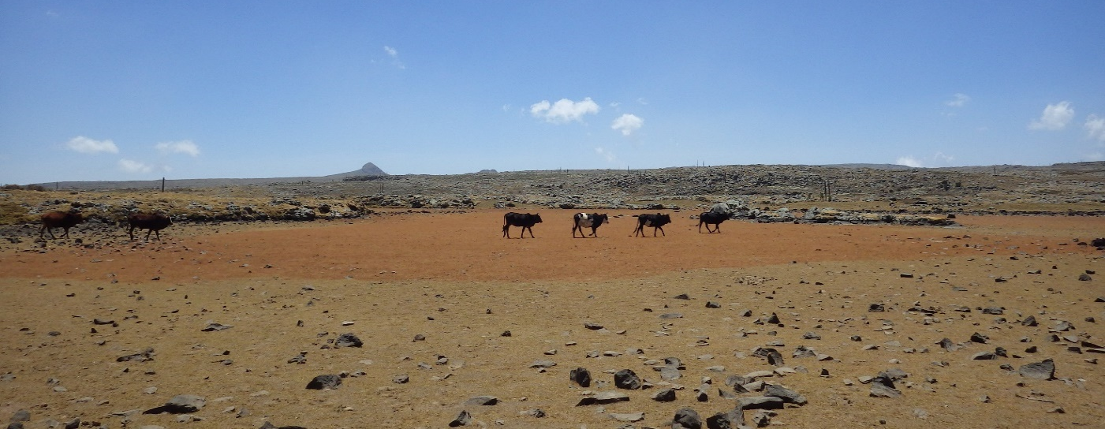
Objectives
Quantify fire extent and distribution on the Bale-Arsi massif over a 42 year time period
Provide the most current and complete record of fires to land managers in the region
Compare patterns of burning to observed land changes
Demonstrate a novel and reproducible methodology
Credits: Stephen Chignell
Notes:
-We quantified fire extent and distribution in Ericaceous shrublands of the Bale-Arsi massifover a 42 year time period (1973-2015), utilizing the entire Landsat record
-We validated and filled data gaps with the Moderate Resolution Imaging Spectroradiometer Burned Area product, as well as ancillary fire records collected in the field

Slide 5
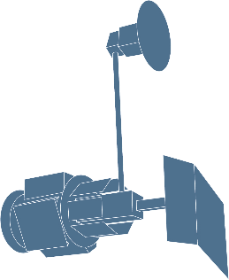

Methodology
Data Processing
LandsatLinkr
Aggregation & Sampling
Calibration
Data Acquisition
MSS, TM, ETM+
SRTM 30m
MODIS Burn Area
OLI
Analysis
LandTrendr
NBR
Results
Historical Disturbance, Magnitude & Year
Validation
Recent
Disturbances

Slide 6
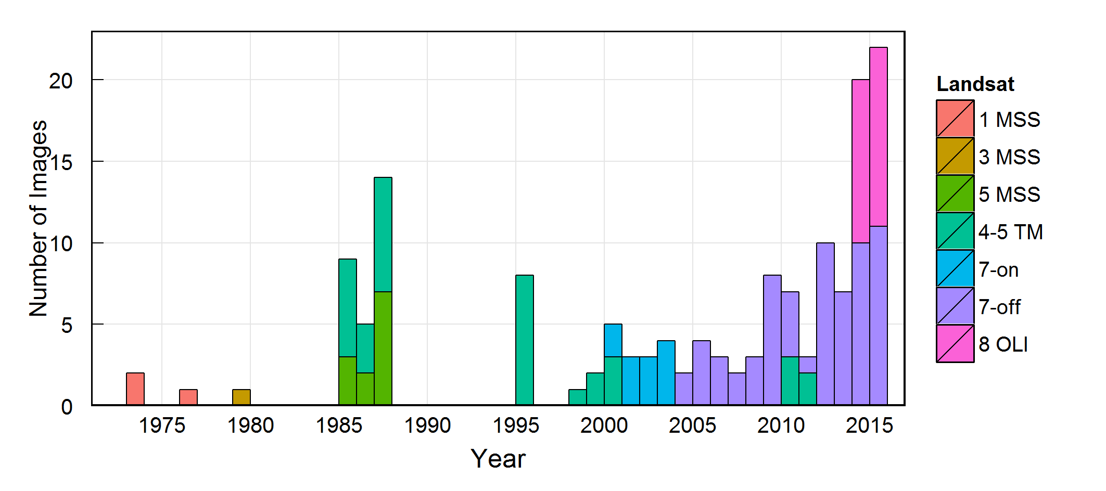
Methodology: Data Acquisition

Slide 7
Methodology
Data pre-processing and analysis coming soon!

Slide 8
Results and Conclusions
Coming Soon!
Notes:
These notes should be thorough enough for someone not familiar with the project to clearly present the material.
Image Source: http://commons.wikimedia.org/wiki/File:Claude_Monet_-_The_Magpie_-_Google_Art_Project.jpg

Slide 9
Uncertainties and Future Work
Coming Soon!
Notes:
These notes should be thorough enough for someone not familiar with the project to clearly present the material.
Image Source: http://commons.wikimedia.org/wiki/File:Claude_Monet_-_The_Magpie_-_Google_Art_Project.jpg

Slide 10
Advisors
Dr. Paul Evangelista, Natural Resource Ecology Laboratory, Colorado State University
Partners
The Murulle Foundation
Natural Resource Ecology Laboratory at Colorado State University
Others
Nicholas Young, Murulle Foundation and Natural Resource Ecology Laboratory at Colorado State University
Justin Braaten, Oregon State University
Brian Woodward, NASA DEVELOP

