Slide 1
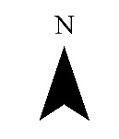
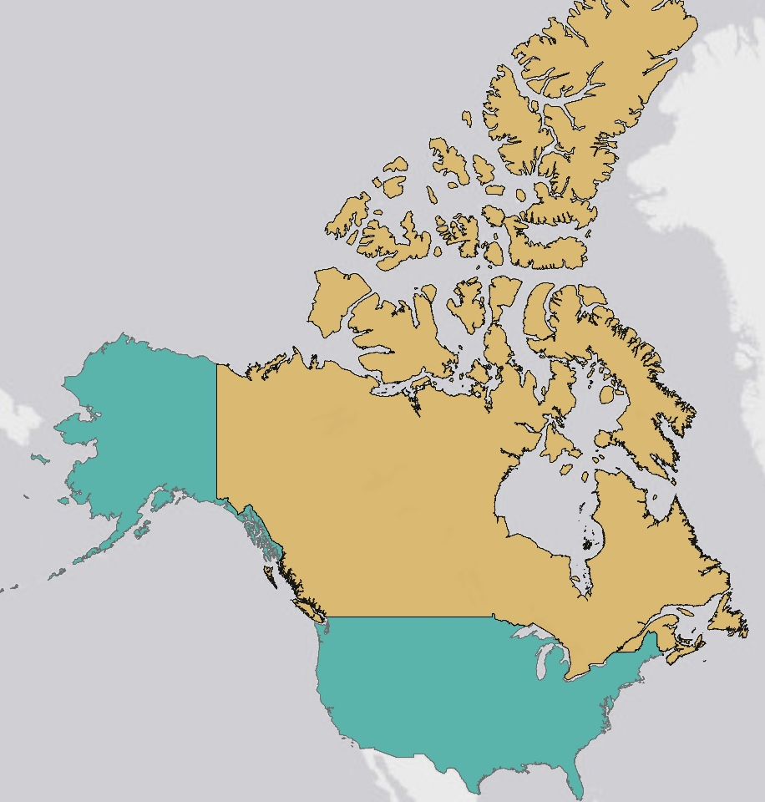
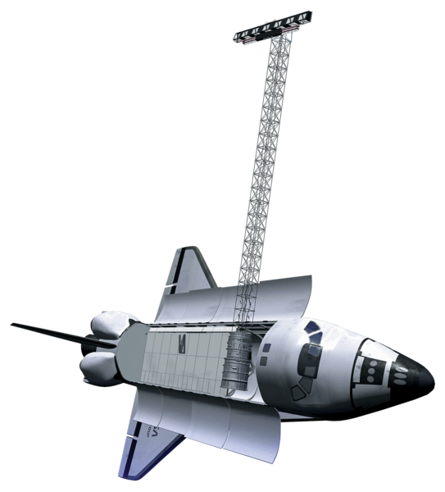
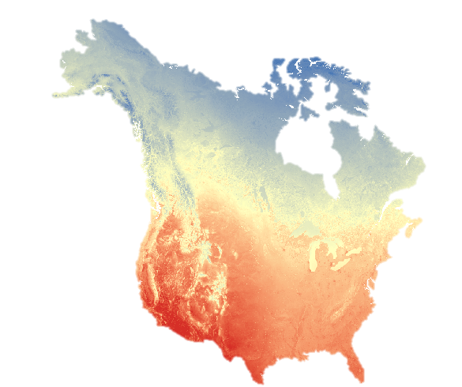
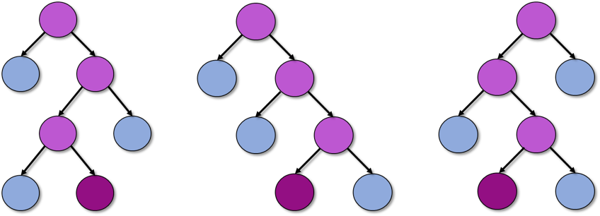
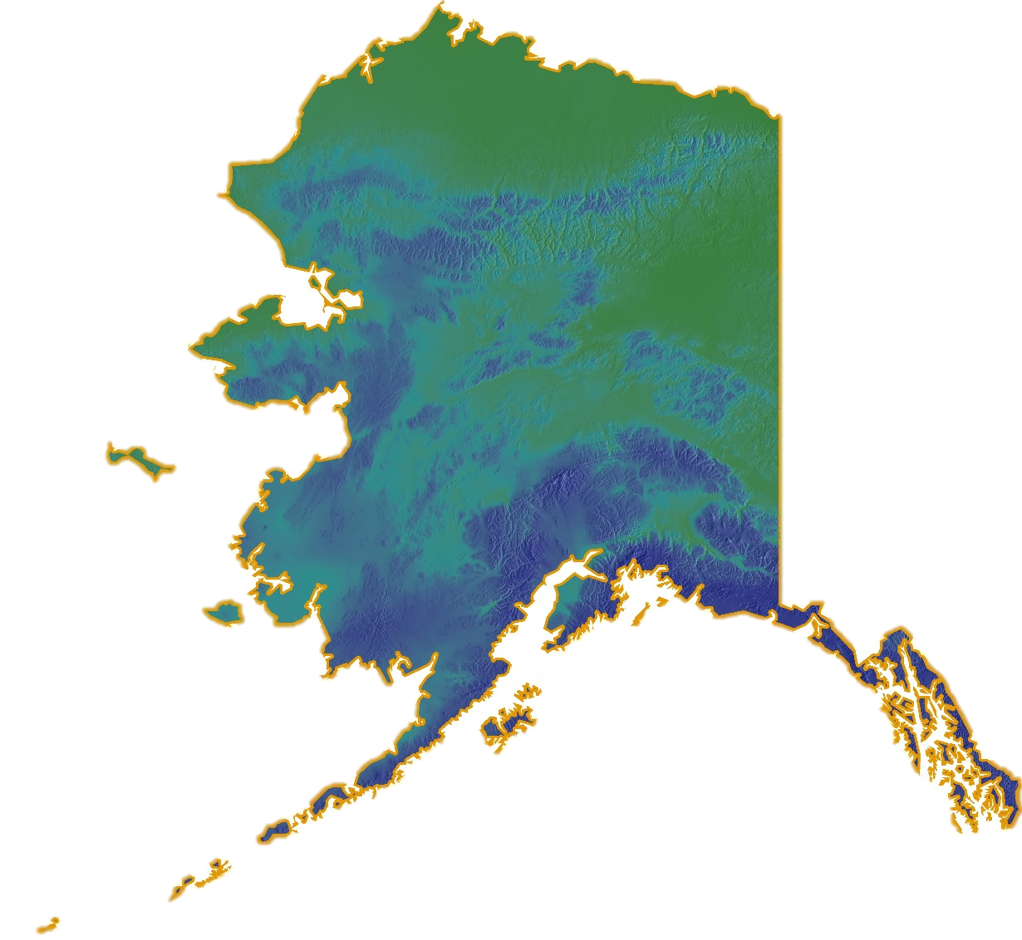
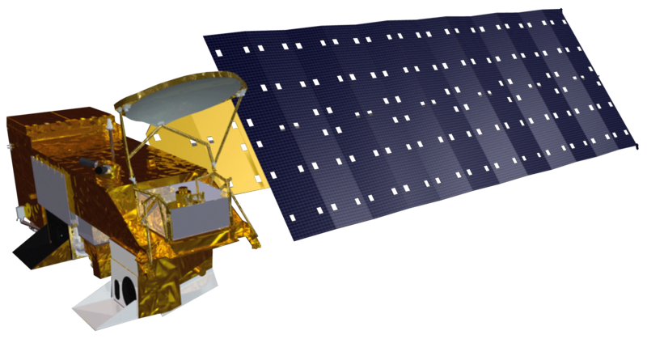

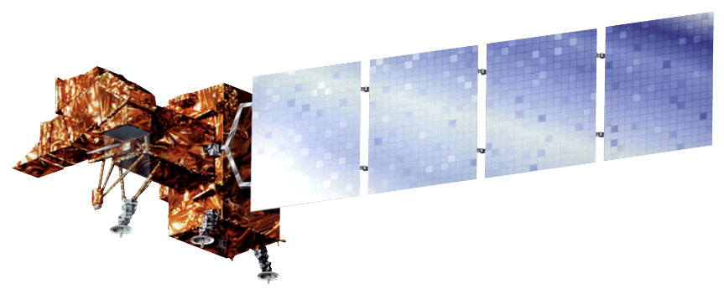

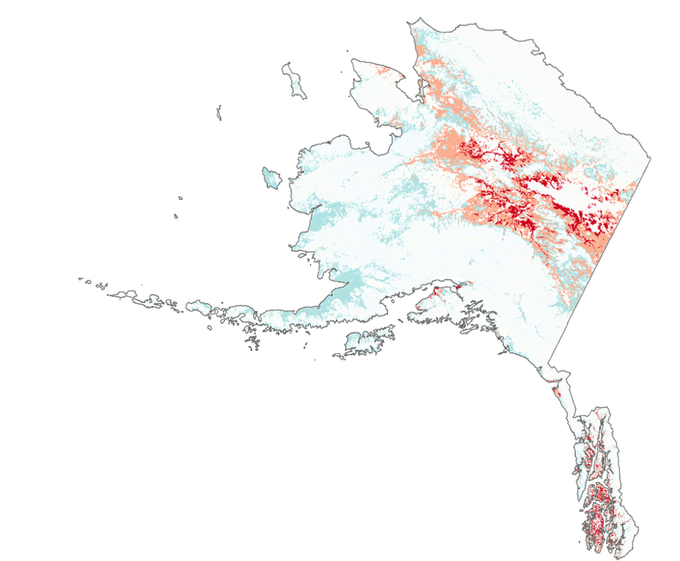
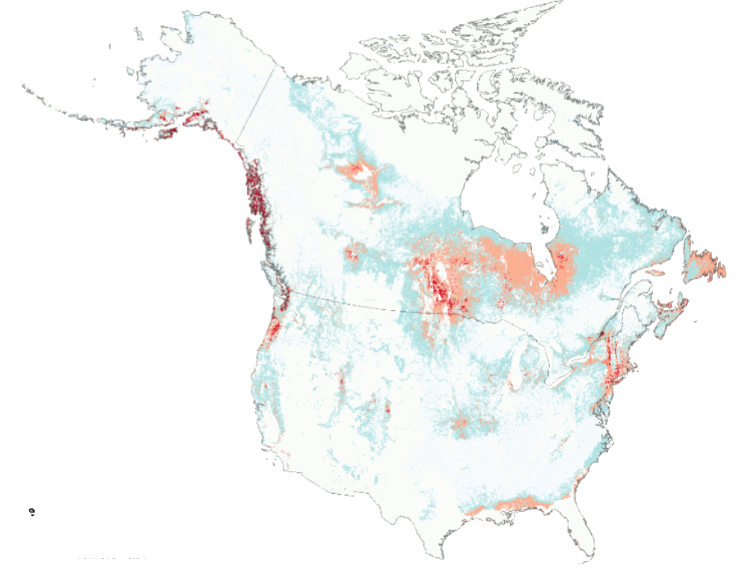
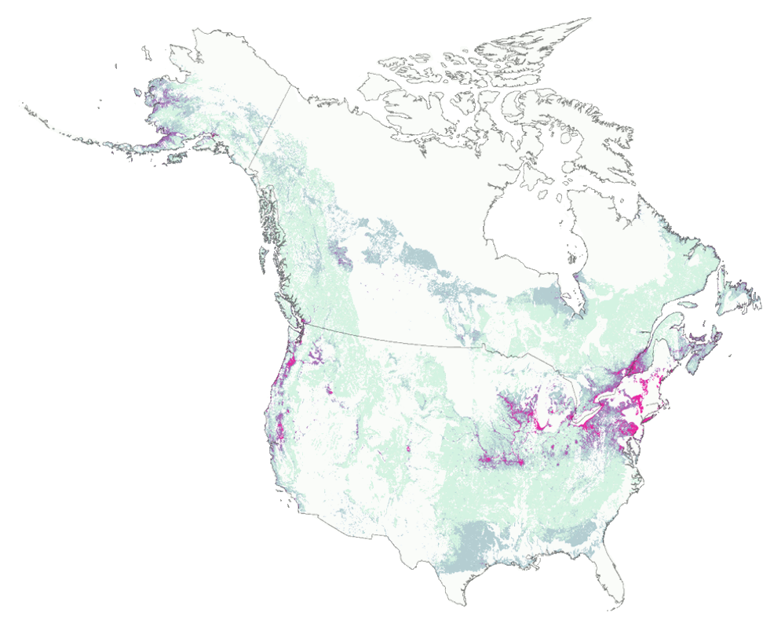
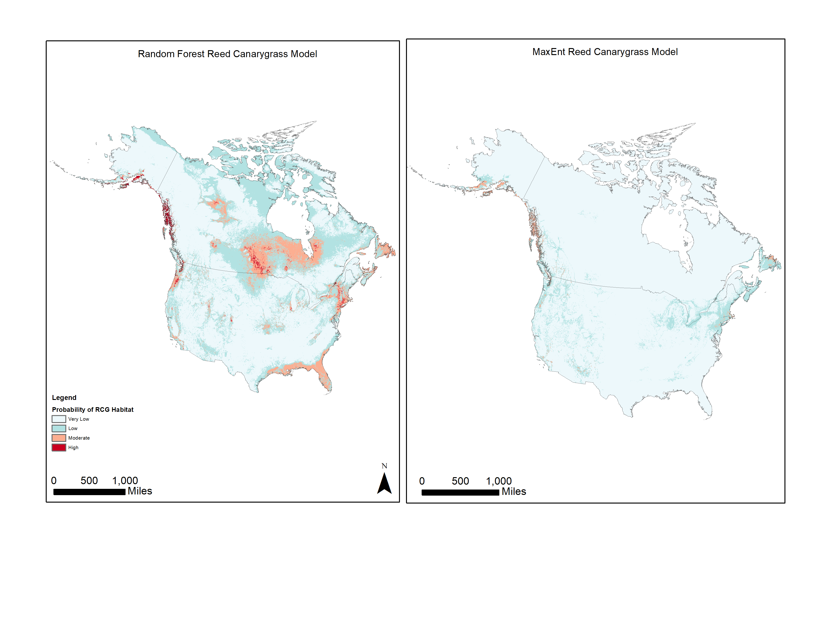
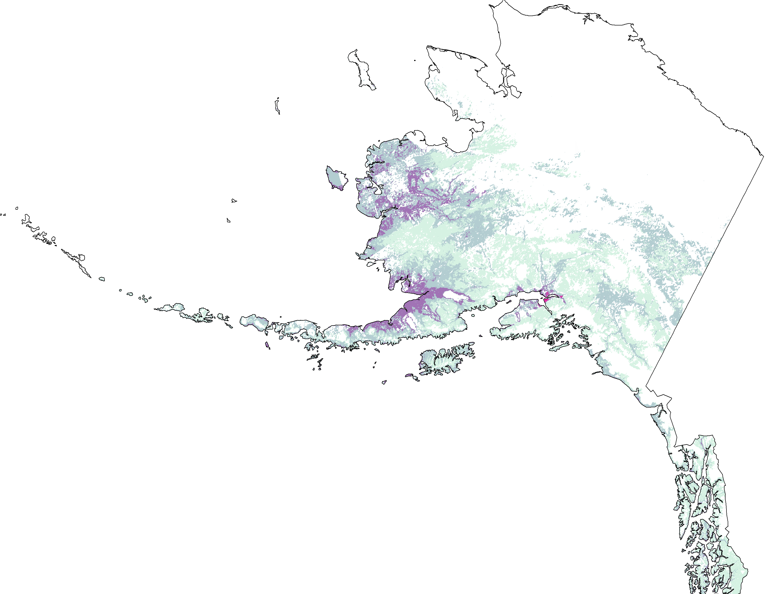
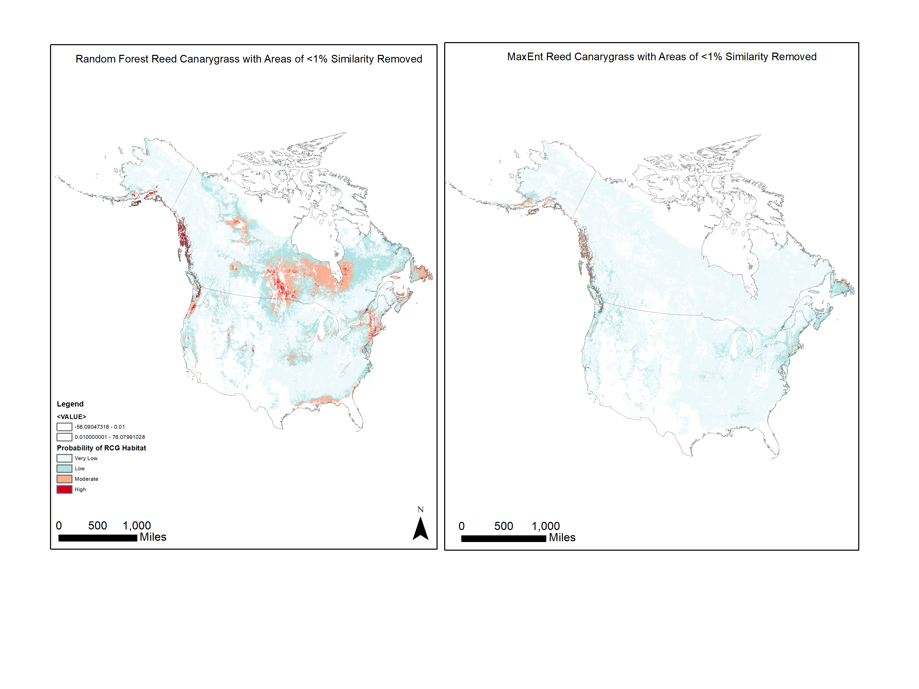
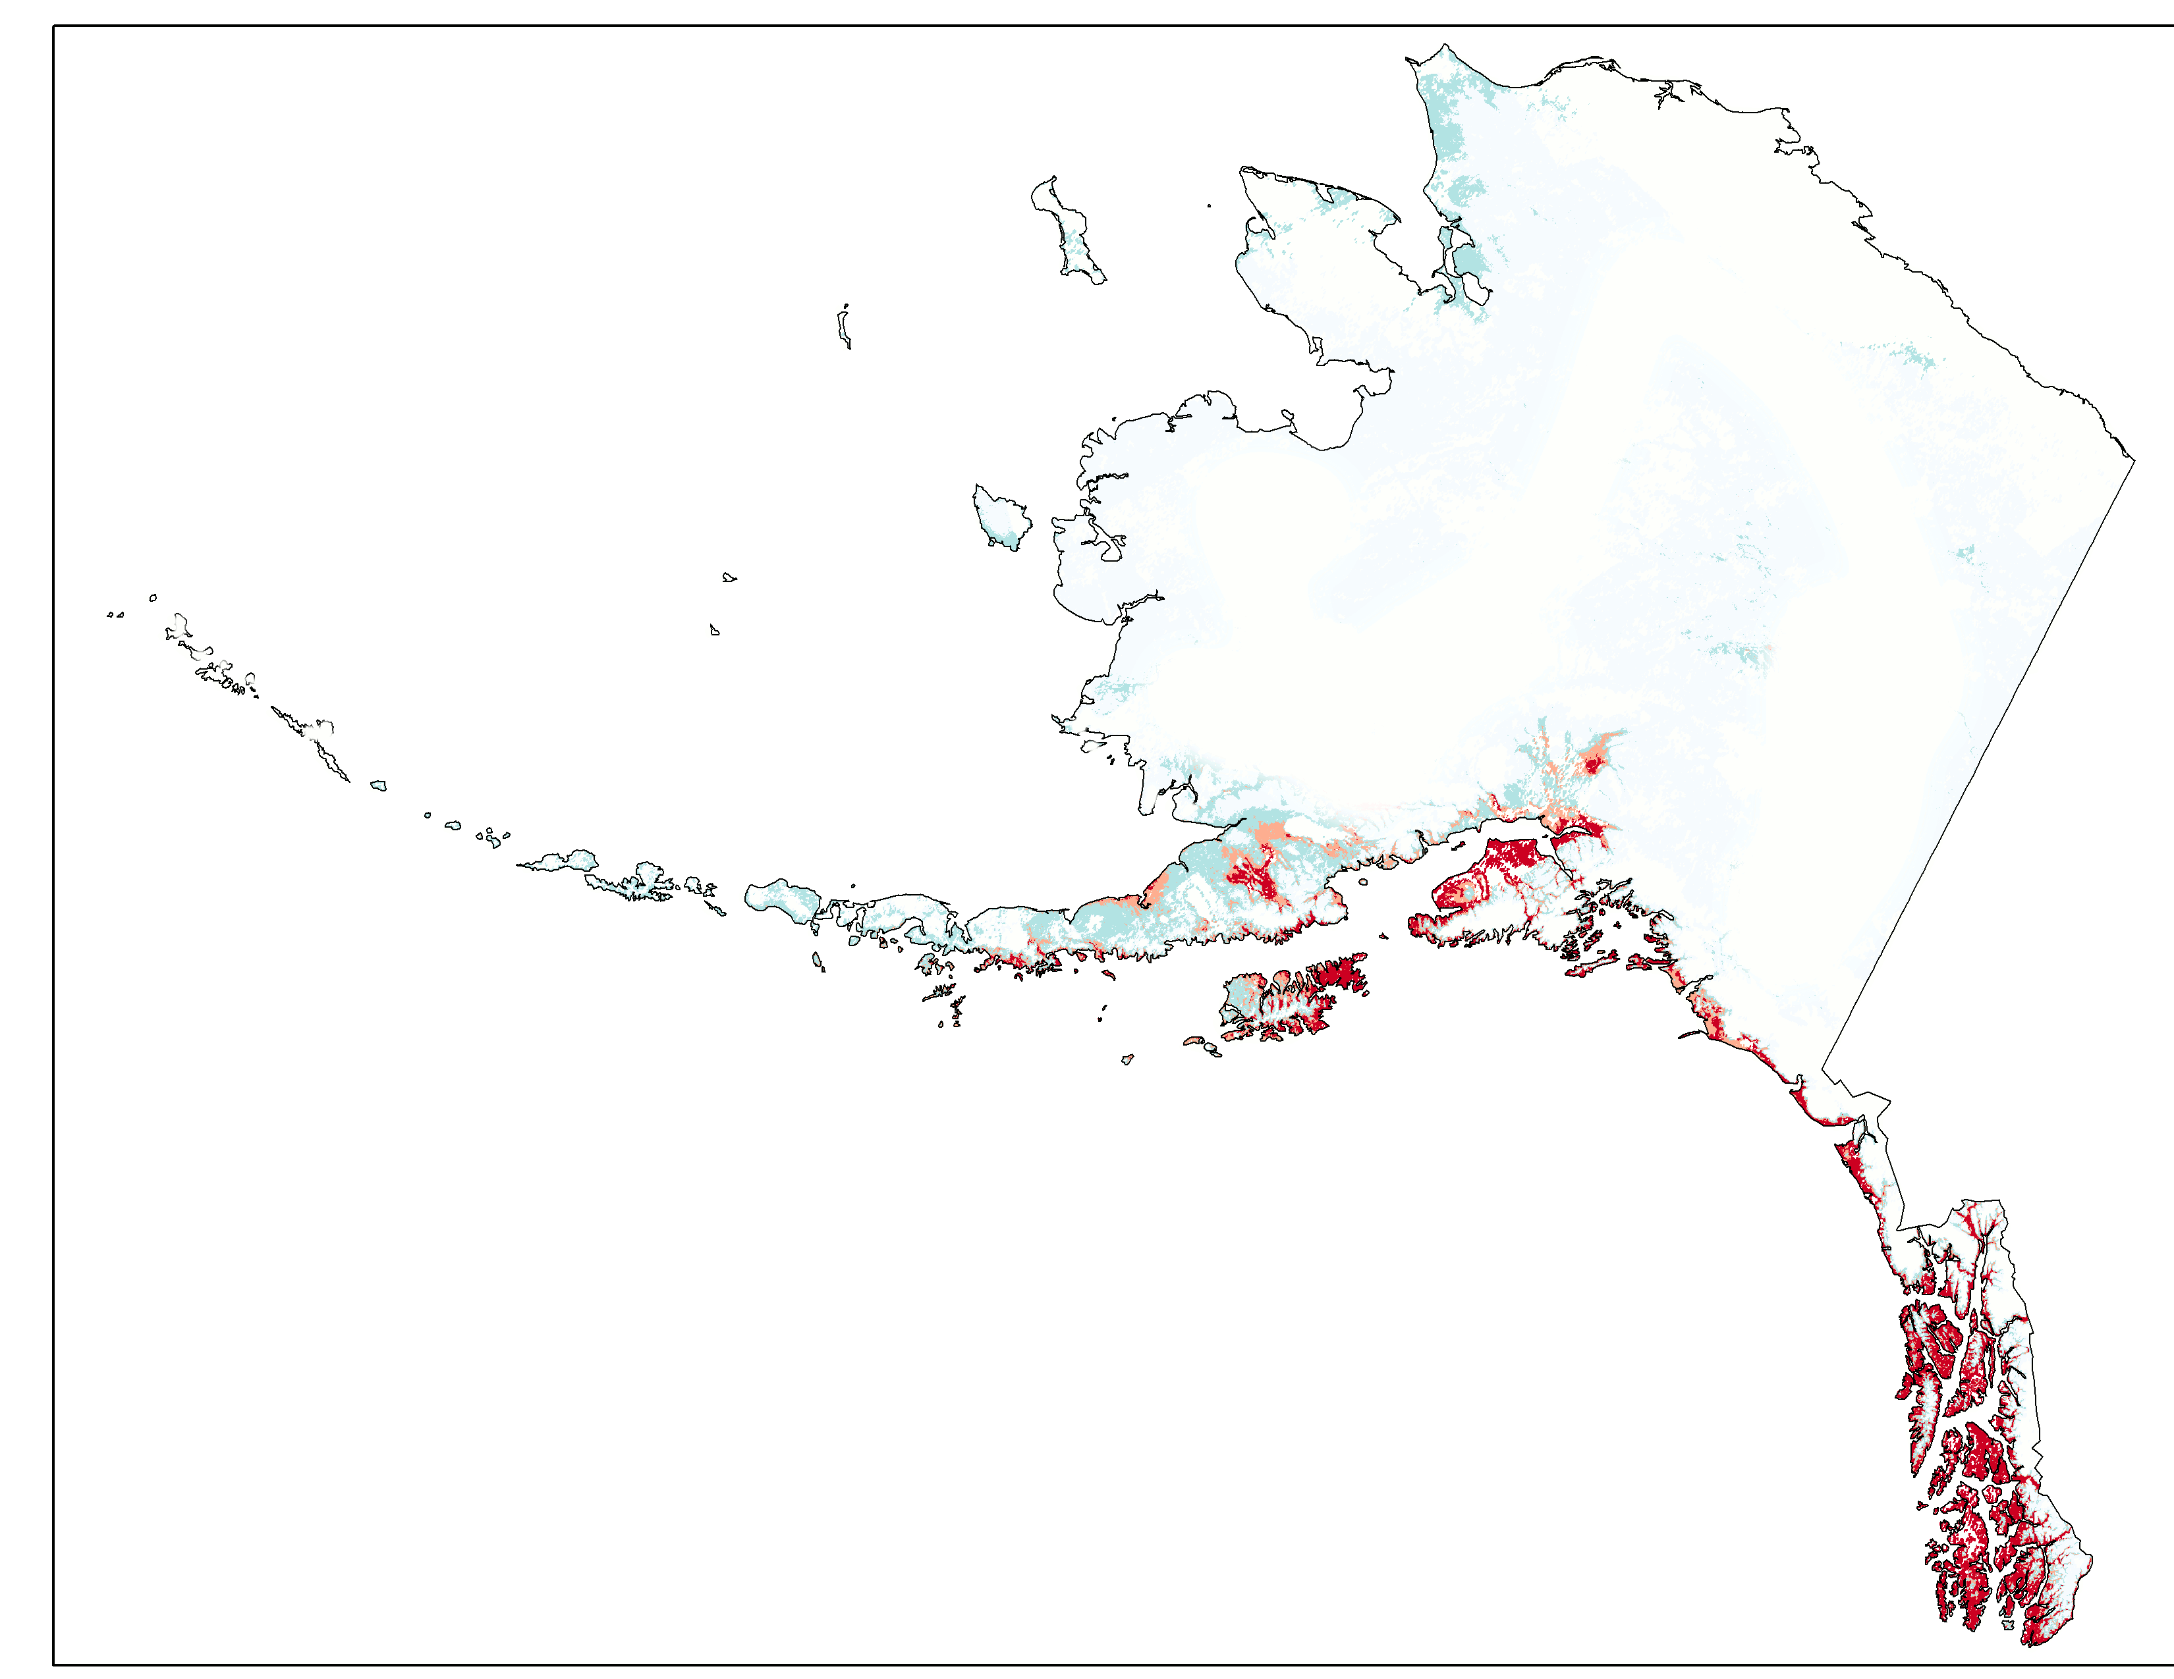






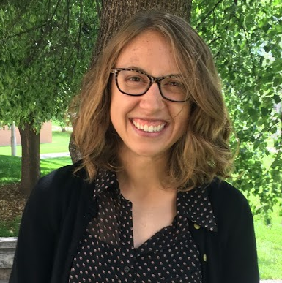
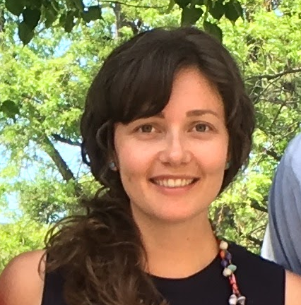
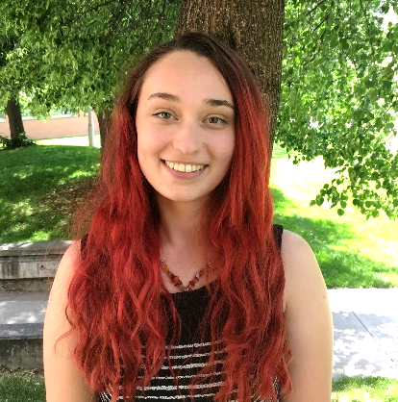
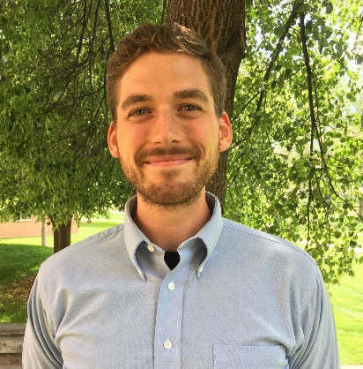
Utilizing NASA Earth Observations to Model Present Distributions of Invasive Species in Alaskan Wetlands
Abstract
Objectives
The rapid expansion of purple loosestrife (Lythrum salicaria) and reed canarygrass (Phalaris arundinacea L.) into aquatic and wetland systems has reduced native plant abundance, decreased species diversity, and degraded wetlands habitats in North America. This trend is particularly concerning in Alaska, where wetlands are of major economic and ecological importance. The expansion of these invasive species into northern latitudes as a result of changing climate trends poses mitigation challenges to natural resource managers. This project developed habitat suitability models utilizing spectral data from Terra and Aqua MODIS in conjunction with topographic and climatic variables to map historic and current suitable habitat for purple loosestrife and reed canarygrass across Canada and the United States. The resulting habitat suitability maps will support decision making and the planning of management actions by partners at the Alaska Region US Fish and Wildlife Service in the “Early Detection, Rapid Response” program for invasive species management.
Provide the distribution of suitable niches on a continental scale for the invasive species reed canarygrass, and purple loosestrife (Lythrum salicaria) utilizing an ensemble modeling approach.
Model the current potential distribution of reed canarygrass (Phalaris arundinacea L.) in Alaska to provide a region-specific model that can be compared to the continental model that includes Canada, Alaska, and the continental United States.
Create reference maps to support invasive species management in Alaska, and produce a tutorial for natural resource managers at the US Fish and Wildlife Service to reproduce the methods employed in this study.
Study Area
Earth Observations
Methodology
AK
Canada
SRTM V2
Data Acquisition and Processing
Topographic data (SRTM)
Vegetation indices and land cover (MODIS)
Climate variables (ClimateNA)
Species presence data
Modeling
Habitat suitability modeling with predictors and presence data:
Boosted Regression Trees
Random Forests
MaxEnt
Results and Evaluation
Final model selections
Ten-fold cross validation
Analyze statistical metrics to evaluate model performance
CONUS
MODIS Terra
Alaska
MODIS Aqua
520
1,040
Landsat 7
miles
Results
Alaska Climate
Alaska Reed Canarygrass
Continental Reed Canarygrass
Continental Purple Loosestrife
Random Forest
Relative Probability of Suitable Habitat
Moderate
Random Forest
Random Forest
Very low
Low
High
Eliminated due
to extrapolation
Relative Probability of Suitable Habitat
AUC (Train/ CV):
0.941 / 0.941
% Correctly Classified (Train/CV): 87.9 / 88.7
AUC (Train/ CV):
0.962 / 0.961
% Correctly Classified (Train/CV): 89.3 / 93.4
Very low
Moderate
AUC (Train/ CV):
0.950 / 0.949
% Correctly Classified (Train/CV): 88.4 / 93.0
Low
High
Eliminated due to extrapolation
Results displaying the relative probability of suitable habitat where red and purple represent high relative probability of occurrence, for reed canarygrass and purple loosestrife respectively.
Conclusions
Project Partners
Coastlines, wetland areas, and waterways represented areas of high suitability for both species.
The continental approach revealed the unique climate extremes and environmental conditions of Alaska relative to the lower continental United States, and presented a challenge for models extrapolating across novel environments.
To refine and improve future models, we suggest the development of ecological variables pertinent to the focal species, as well as a finer scale modeling approach.
MESS maps, which show areas of extrapolation, can be used to target underrepresented areas for survey.
Alaska Region:
Aaron Martin
Aquatic Division-
Program Coordinator
Team Members
Acknowledgements
Many thanks to our Center Lead Brian Woodward, and our science advisors Dr. Paul Evangelista and Dr. Amanda West
Special thanks to:
Dr. Catherine Jarnevich (USGS Fort Collins Science Center)
Aaron Martin (USFWS, Alaska Region)
.
Emma Hatcher
Team Lead
Sarah Carroll
Audrey Martinez
Tim Mayer
USGS at Colorado State University– 2017 Summer

