Slide 1
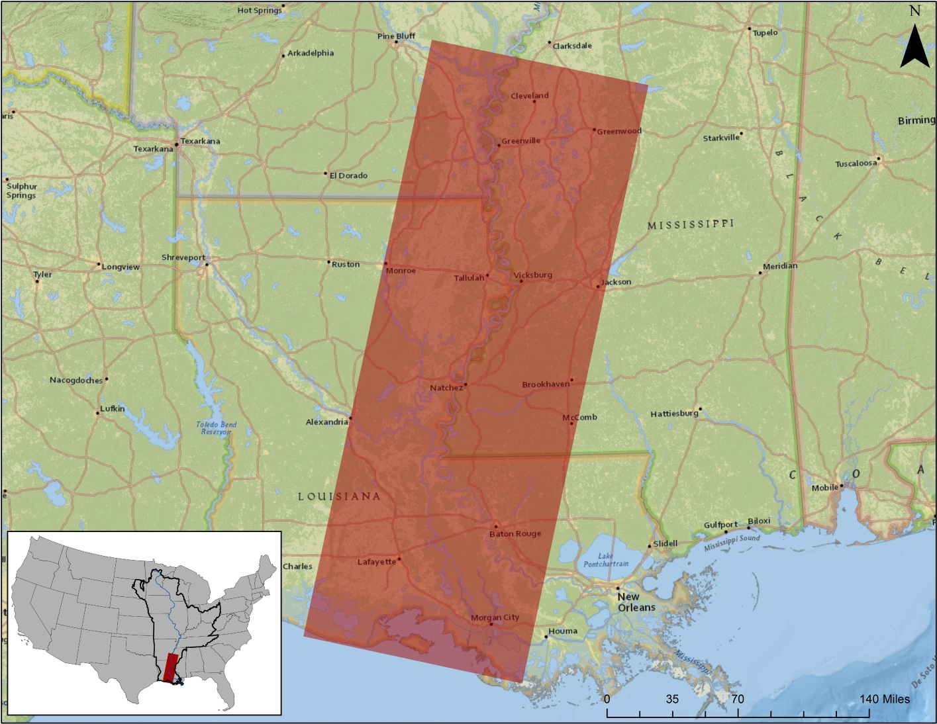
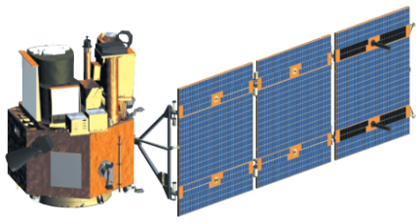
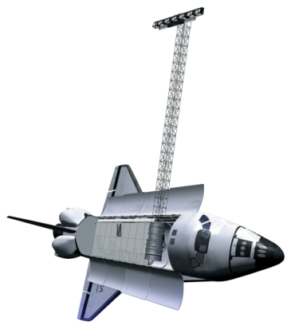
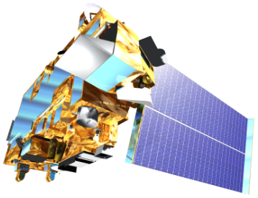
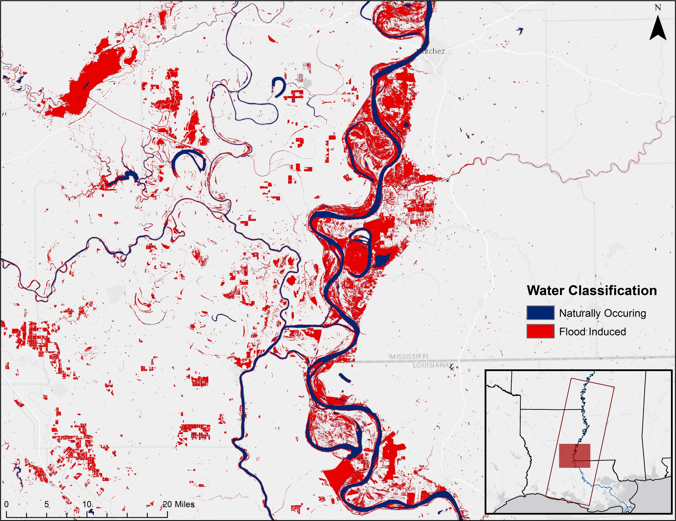
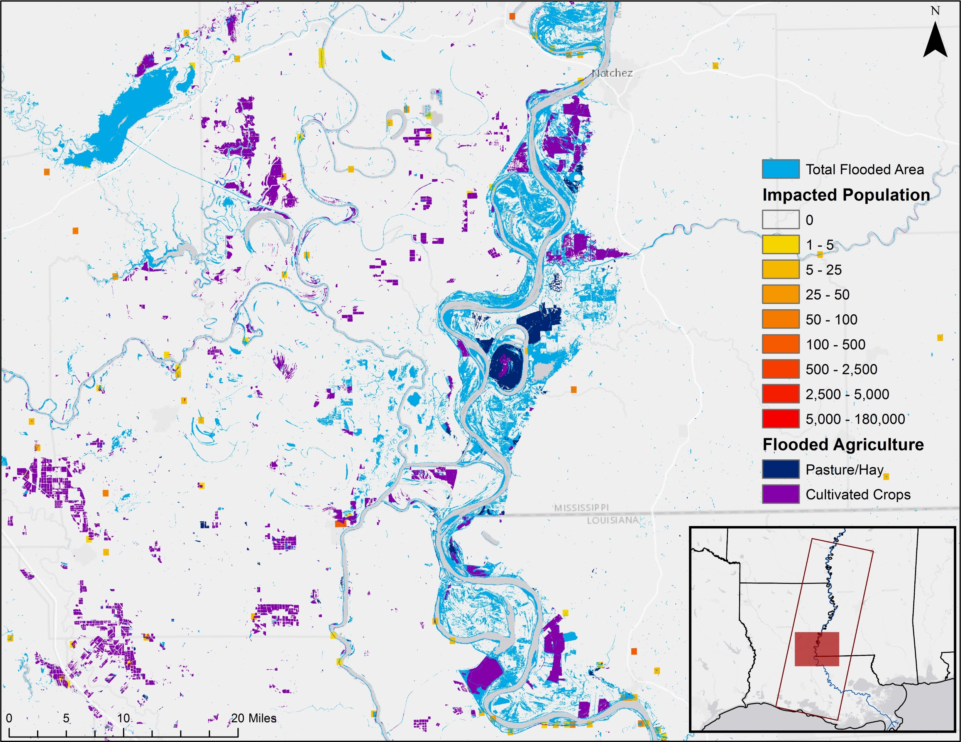
Utilizing NASA Earth Observations to Enhance Flood Monitoring Throughout the Mississippi River Basin
Earth Observations
Abstract
Study Area
The Mississippi river basin is an area prone to multi-level flood events of various intensities, as well as a home to millions of Americans. Stretching from Louisiana to Minnesota and draining 41 percent of the contiguous US, the basin covers 13 states and 1.245 million miles making it the third largest drainage basin in the world. This large area is susceptible to water level rises following changes in precipitation, snow melt, and water table levels, which can cause both small and large scale flooding. Disaster relief agencies, such as the Federal Emergency Management Agency (FEMA) and the United States Geologic Survey (USGS) are interested in the creation of a more precise and comprehensive method to use in their decision making process for locating and prioritizing areas that require aid. The flood map algorithm created in this project will help identify the probability of flooding within a given area for use in flood monitoring and the decision making process of relief efforts. The map incorporates the Landsat 8 Operational Land Imager and Digital Elevation Model derived from Shuttle Radar Topology Mission v2 to determine the probability of flooding in an area. Additionally Landscan and Security Infrastructure Preparedness Data were also used to create an exposure map.
EO-1 (ALI)
SRTM v2
Landsat 8 (OLI)
MODIS
Results
Flood Exposure Map
Objectives
Improve understanding of flood prediction mapping in the Mississippi river basin
Determine areas of probable flooding for the December – January flood event
Create a flood probability algorithm for mapping floods in the Mississippi river basin and Flood Exposure and Impact maps for the December 2015 – January 2016 flood events
Methodology
Data Acquisition
MODIS MFW
SRTM DEM data
NLCD 2011 & HSIP data
Landsat 8
NDVI, NDWI,
& Supervised Classification
Mississippi River Basin Disasters
Data Processing
Flood Impact Map
Dr. Jeffrey Luvall
NASA at NSSTC
Dr. Robert Griffin
UAH
Dr. Andrew Molthan
NASA SPoRT
Daryl Ann Winstead
NASA DEVELOP
Leigh Sinclair
UAH/ITSC
Maggi Klug
NASA DEVELOP MSFC Center Lead
Accuracy Assessment
Fill/Flow Direction
End-Products
Flood Extent Map
Flood Impact Map
Conclusions
The NDWI and NDVI spectral signatures had the highest accuracy
Because time of year can potentially impact NDVI more than NDWI, NDWI was selected for use in the flood algorithm.
The flood map algorithm created will help identify the probability of flooding within a given area for use in flood monitoring and the decision making process of relief efforts.
Team Members
Project Partners
Acknowledgements
NASA Short-term Prediction Research and Transition Center (SPoRT)
Dr. Andrew Molthan
USGS Hazards Data Distribution System
Brenda Jones
Federal Emergency Management Agency (FEMA)
Christopher Vaughan
Dashiell Cruz
Team Lead
Chris Ploetz
Team Lead
This material is based upon work supported by NASA through contract NNL11AA00B and cooperative agreement NNX14AB60A. Any mention of a commercial product, service, or activity in this material does not constitute NASA endorsement. Any opinions, findings, and conclusions or recommendations expressed in this material are those of the author(s) and do not necessarily reflect the views of the National Aeronautics and Space Administration and partner organizations.
Mercedes Bartkovich
Olivia Callaway
Nicholas McVey
NASA Marshall Space Flight Center – 2016 Fall

