Slide 1
North Carolina Ecological Forecasting
Monitoring Wetland Health in the Albemarle Pamlico Watershed
Zand Bakhtiari (Team Lead)
Brad Gregory
Stephen Zimmerman
Kayla Patel

Slide 2
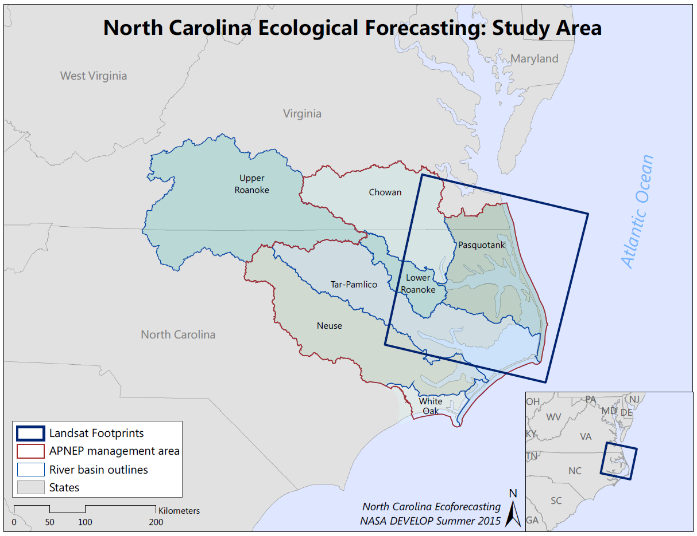
Study Area – Study Period
Albemarle-Pamlico watershed
2000-2015 study period
Albemarle Pamlico National Estuary Partnership (APNEP)
Notes:
Albemarle-Pamlico Watershed:
Second largest estuary system in the United States
Water from 43 North Carolina and 38 Virginia counties drains into the A-P watershed
There are 6 major river basins that drain water from these counties into the A-P watershed → Chowan, Roanoke, Tar-Pamlico, Neuse, Pasquotank, and White Oak
Drainage from the NC/VA counties and the major river basins all end up in one of the 8 major sounds in this region → Albemarle, Pamlico, Back, Bogue, Core, Croatan, Currituck, and Roanoke
National Estuary Program (NEP):
Deemed an “estuary of national significance” in 1987 among the first 28 National Estuary Programs (NEP) established by the U.S. Environmental Protection Agency (EPA) through amendments of the federal Clean Water Act (CWA).
Study Period:
2000-2015 → We decided on this period simply because of time constraint.

Slide 3
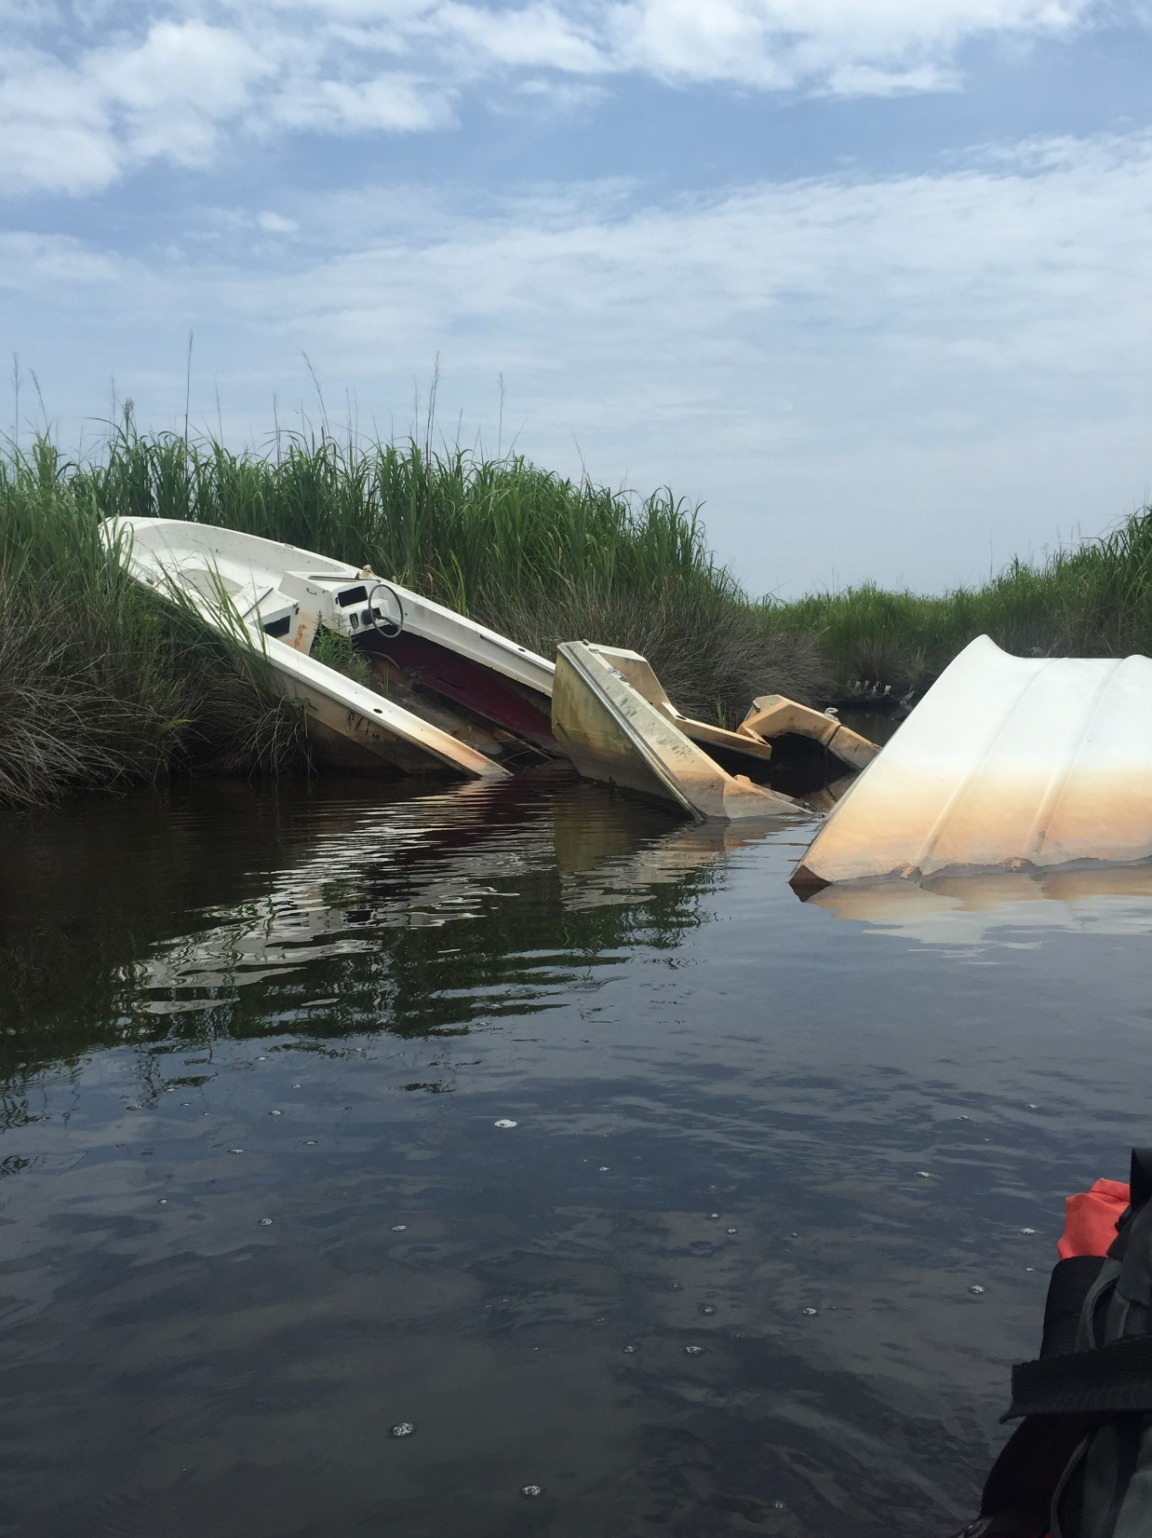
Community Concerns
Impacts of wetland degradation:
  Local ecosystems
  Local and regional economies
Image Credit: Zand Bakhtiari
Image Credit: Stephen Zimmerman
Notes:
Wetland degradation is a major concern because of all the services these ecosystems provide not only for the general health of the wetland ecosystem itself but other surrounding ecosystems, and also for the economic services provided for humans.
Local ecosystems:
Wetlands are good at filtering excess nutrient and toxic heavy metals
Wetlands provide nursery for many juvenile fish species
Wetlands have high primary productivity and effectively sequester CO₂ in the form of plant biomass
Local and regional economies:
Because many juvenile fish species rely on wetlands for nursery the local fishing industry success is dependent on healthy wetlands to nurse juvenile fish species and sustain adult fish populations
Eco-tourism and recreation is a major economic opportunity in this region and would likely diminish with loss of healthy wetlands

Slide 4
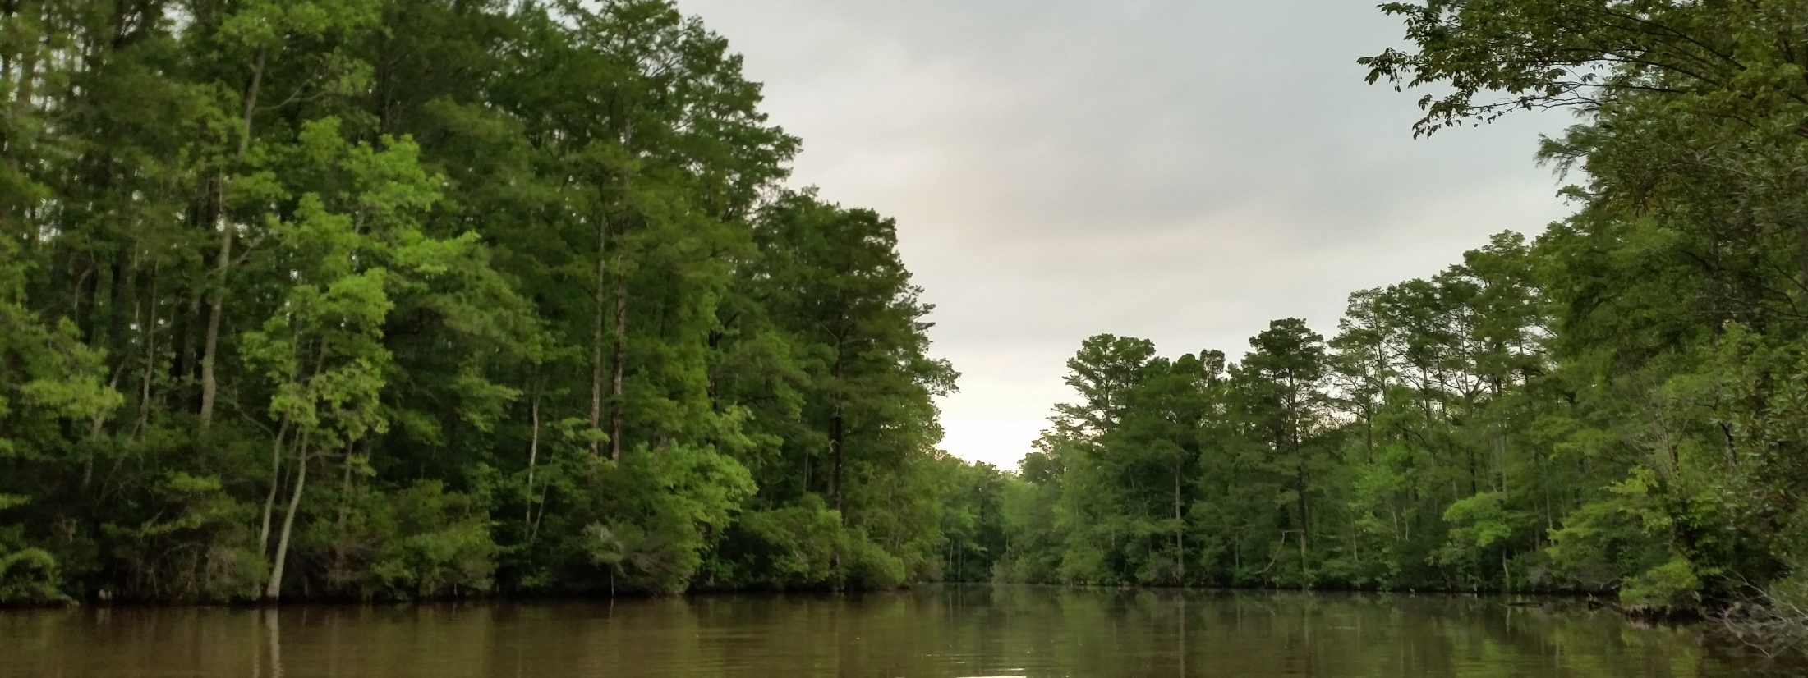
Image Credit: Stephen Zimmerman
Objectives
Determine shoreline extent
Assess relative wetland health by measuring carotenoid/chlorophyll-a ratios
Notes:
We determined the extent of the shoreline by applying a Normalized Difference Water Index (NDWI) that tracks the changes in water extent over the years of our study period.
We also assessed the relative health of wetlands by applying a [specific wetland health index TBD] that determines the carotenoid/chlorophyll-a ratio, a good indicator of healthy vegetation.

Slide 5


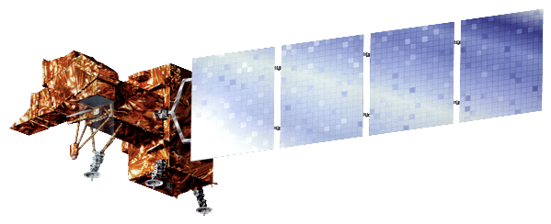
NASA Satellites/Sensors
Landsat 5 Thematic Mapper (TM)
Landsat 7 Enhanced Thematic Mapper (ETM+)
Landsat 8 Operational Land Imager (OLI)

Slide 6



Methodology
$$NDPI=\frac{(Red −Blue)}{(Red+Blue)}$$
Green NDVI $=\frac{(Green − NIR)}{(Green + NIR)}$
Wetland Health Index $=\frac{(NIR∗SWIR)}{(NIR+SWIR)}$
Notes:
Summer, fall, winter, spring images collected from Landsat 5, 7, and 8 for 2000-2015 to account for seasonal changes in wetland health
We tried to acquire images with the least amount of cloud cover possible
Summer images – late July/early August
Fall images – late October/early November
Winter images – late January/early February
Spring – late March/early April
A python script was built that unzips the images and separates them by year
important that in the original image file the year is specified correctly – for example we used an image from December 28th, 2002 as the winter 2003 image and we needed to change the initial tar.gz file path to have a 2003 in it so the image would not be thrown in with the 2002 images.
Top-of-atmosphere reflectance was calculated for each image using the dnppy module
NDWI, wetland health index, NDPI were calculated for each image
A threshold was applied to the NDWI images – anything above 0 = water, below 0 = not water
Threshold images for each year were summed together and a shoreline was derived without the influences of tides or seasons
Shoreline images and wetland health images were integrated with existing C-CAP to gain a visual sense of wetland extent throughout the time series

Slide 7
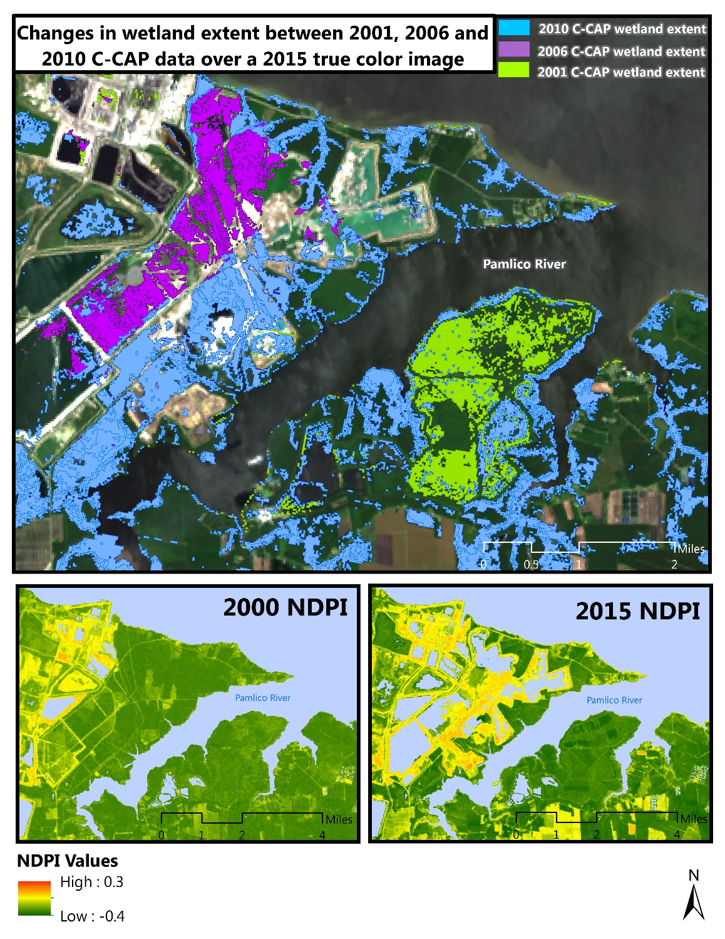
Results
Top Image: C-CAP data shows changes in land use that were previously wetlands.
Bottom Images: Wetland health index (NDPI), low values represent healthy vegetation while high values are unhealthy. This is a clear example of direct human destruction of wetlands.

Slide 8
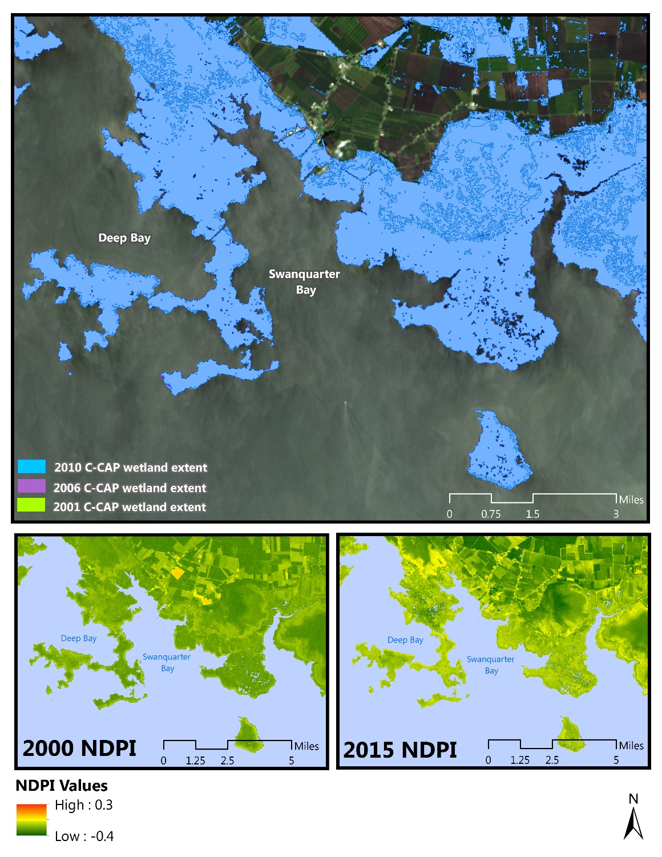
Results
Top Image: C-CAP data shows no change in wetland extent.
Bottom Images: Wetland health index (NDPI), low values represent healthy vegetation while high values are unhealthy. Wetland heath is decreasing due to unknown factors

Slide 9
Conclusion
From 2000 – 2010 there was minimal change in wetland extent (approximately 30 mi² )
Noticeable decrease in the overall wetland health detected from health index (NDPI)
According to C-CAP wetland area will remain relatively consistent, our assessment predicts wetland health will continue to decrease

Slide 10

Advisors
Dr. Kenton Ross – DEVELOP National Science Advisor
Jeff Ely – DEVELOP Geoinformatics Fellow
Partners
Albemarle-Pamlico National Estuary Program (APNEP)
Others
N/A (may change?)

