Slide 1
Natchez Trace
Ecological Forecasting
and Water Resources
Utilizing NASA Earth Observations to Assess Current and Historic Wetland Conditions along the Natchez Trace Parkway
Jennifer Rackley (Project Lead)
Ashley Gideon
Tyler Lynn
Notes:
Good morning everyone! I’m Jennifer Rackley. I’m a graduate from the University of West Florida, with a master’s in environmental science and a graduate certificate in geographic information systems. I am the project lead for the Natchez Trace Ecological Forecasting and Water Resources project. I’m Tyler Lynn, (background); and I’m Ashley Gideon (background).

Slide 2
Background
Wetlands provide habitats for hundreds of species throughout the parkway
Beavers (Castor canadensis) are a keystone species occupying wetland habitats
Parkway quality is a focus for management strategies
Image Credit: National Park Service
Notes:
Ashley: The wetlands are a valuable ecological resource for hundreds of species within the parkway region. Their presence is necessary for healthy species diversity and habitats, as well as the parkway’s scenic and environmental quality. Beavers are a keystone species for wetland habitats since they are capable of drastically altering the landscape to flooded conditions to better suit their needs. While this provides the necessary habitats for wetlands species, it can have important impacts on parkway quality and adjacent lands by affecting maintenance and damaging property. The National Park Service prioritizes parkway quality in its management strategies, and this often involves dismantling dams and managing beaver populations within the parkway.
Image URL: http://www.nps.gov/media/photo/gallery.htm?id=8A813BA3-1DD8-B71C-07EAEA16F240BC89

Slide 3
Community Concerns
NPS is developing a management strategy for beaver populations
Beaver damming activity, causing damage to roads, property, and private lands
Knowledge of previous and expected parkway wetland conditions is needed for future management purposes
Image Credit: Deanna Boensch
Notes:
Ashley: Community concerns included factors which involve the quality of the parkway. The National Park Service is in the process of developing a new management strategy for beaver populations along the parkway in order to better manage their damming activity. Beaver dams have impeded parkway maintenance and impacted the quality of private lands. A better understanding of current and possible future wetland conditions is needed to inform future parkway management.
Image URL: http://www.nps.gov/media/photo/gallery.htm?id=88B142F5-1DD8-B71C-075F53D23FFAE592

Slide 4
Objectives
Provide information on wetland conditions to aid management and maintenance strategies
Produce a time series of wetland areas for the Natchez Trace Parkway from1992 to 2015
Produce a predictive map of modeled wetland conditions for 2020
Image Credit: National Park Service
Notes:
Ashley: Our objectives for this project were to examine both past and future contexts for wetland extents to provide a management resource for the NPS for both conservation and maintenance purposes. To do this, we produced a time series of wetland extent maps for the parkway over a 23-year period, from 1992 to 2015. We also produced a modeled map of expected wetland extents for the year 2020.
Image URL: http://www.nps.gov/media/photo/gallery.htm?maxrows=20&showrawlisting=false&tagid=0&id=88B142F5-1DD8-B71C-075F53D23FFAE592&startrow=21

Slide 5
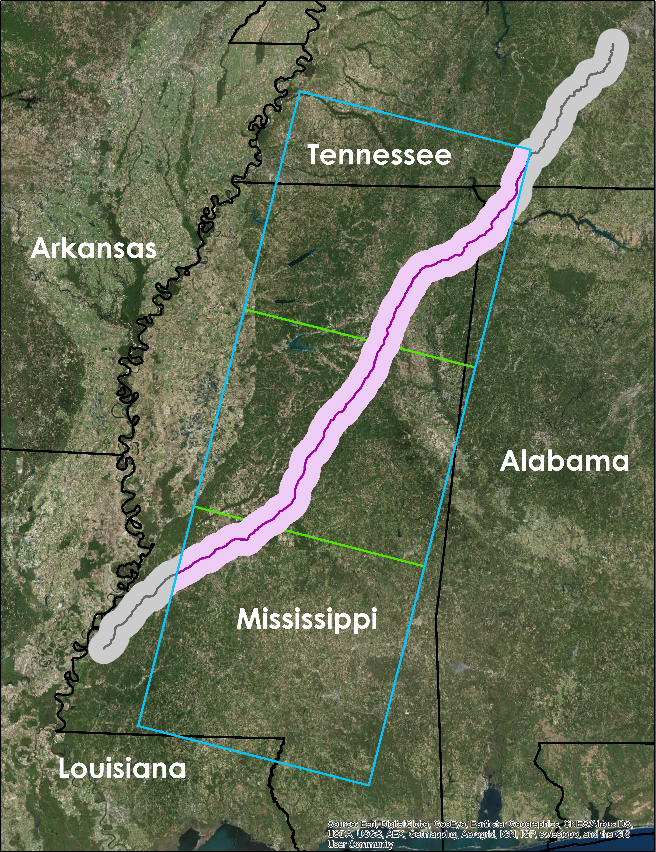
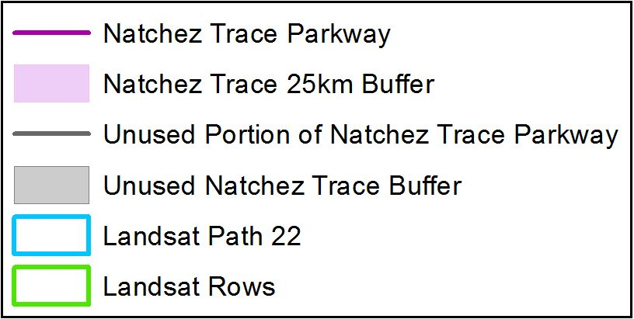
Study Area and Study Period
Parkway contained within Landsat path 22, using rows 36, 37, and 38
25km parkway buffer
Time series years: 1992, 2002, and 2015
Modeled result year: 2020
Notes:
Ashley: Our study area was for the majority of the parkway, which is contained within the Landsat path 22, using rows 36, 37, and 38. Our selected portion of the parkway spans across Mississippi and into portions of Alabama and Tennessee. We then created a 25km buffer around the parkway boundary to provide adequate area for the classification. For the time series, we processed the years 1992, 2002, and 2015. Our modeled projection year was for 2020.

Slide 6
NASA Satellites and Sensors
Landsat 7
Enhanced Thematic Mapper Plus (ETM+)
Landsat 5
Landsat 8
Thematic Mapper (TM)
Operational Land
Imager (OLI)
Notes:
Ashley: For this project, we used the Landsat 5 Thematic Mapper, Landsat 7 Enhanced Thematic Mapper Plus, and Landsat 8 Operational Land Imager data to perform our land cover time series classifications.

Slide 7
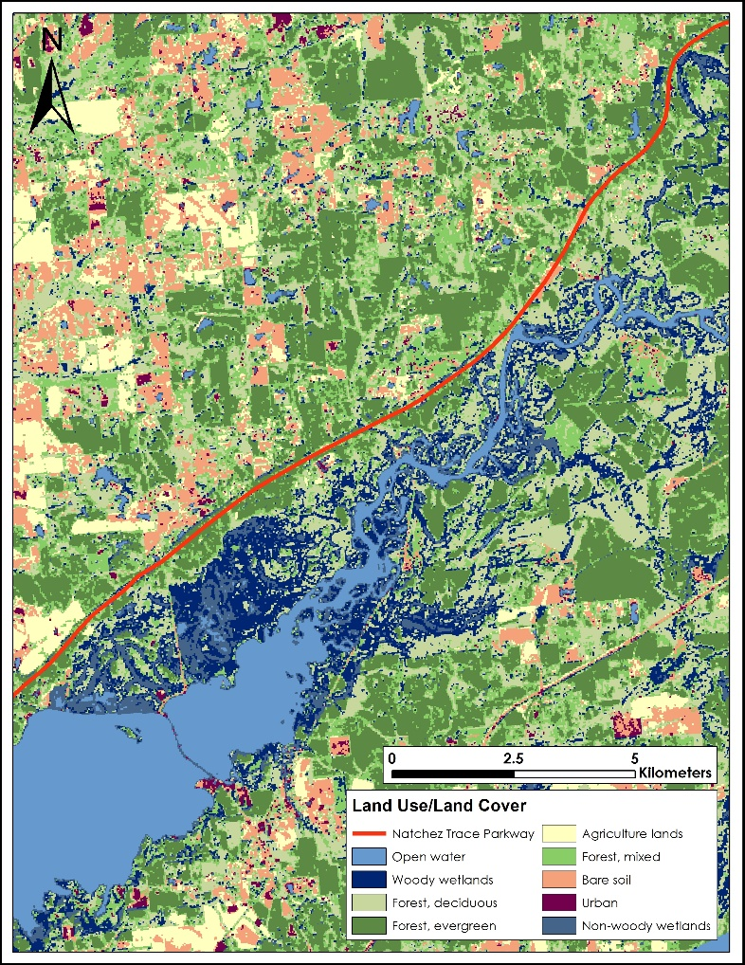
Land Cover Classification Methods
2015 Leaf-on data
Landsat 5 TM
Red
NIR
SWIR
2015 Composite Image
2015 Leaf-off data
Landsat 5 TM
2015 Land Use/Land Cover Classification
Notes:
Jenna: We used ERDAS Imagine 2015 to perform the land cover classifications using leaf-on and leaf-off Landsat data for the years 1992, 2002, and 2015. This slide is an example of our process using the 2015 data. DEVELOP dnppy Python scripts were used to make atmospheric corrections, then each Landsat date was stacked using the visible red, near-infrared, and shortwave infrared bands. The leaf-on and leaf-off dates for each year of interest were stacked into a composite image that was used in the classification process.

Slide 8
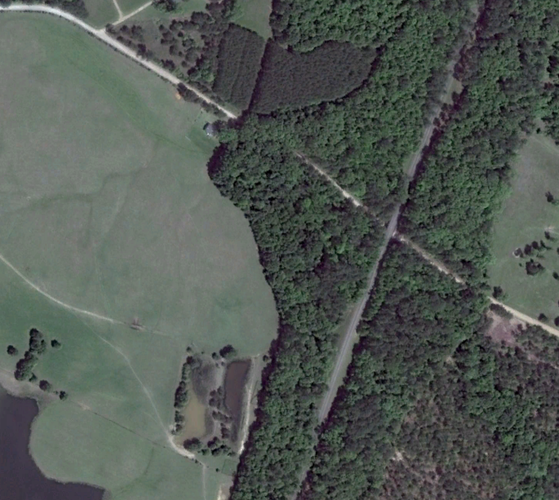
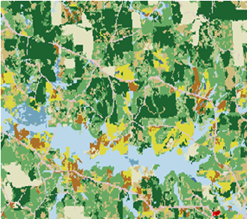
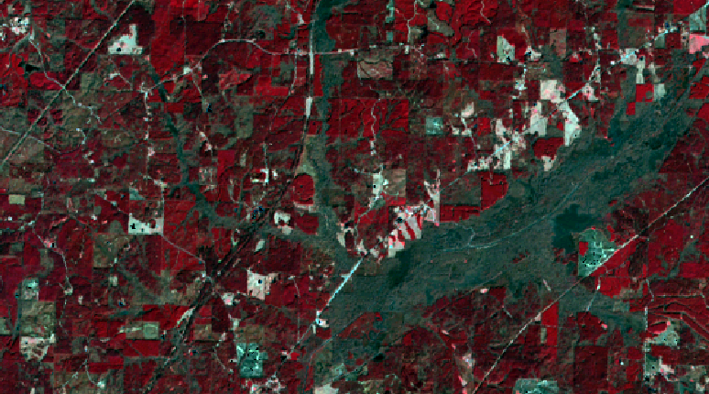
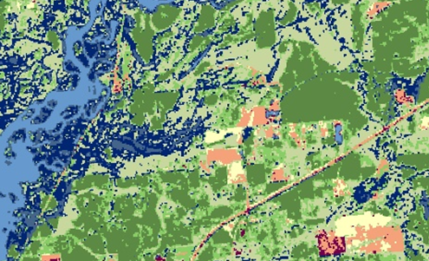
Land Cover Classification Methods
Composite Landsat Data
Accuracy Assessment
Google Earth and NLCD data
Unsupervised Classification
Cluster Busting
35-class ISODATA
Refining confused classes
Notes:
Jenna: We converged similar spectral signatures into 35 classes using an unsupervised ISODATA classification. We then identified classes that contained dissimilar sub-classes and performed a “cluster bust”. This process involved isolating confused classes and performing another unsupervised ISODATA classification on them to further refine their classes. Finally, we performed an accuracy assessment for each classified year using Google Earth imagery and land cover data from the USGS National Land Cover Database.

Slide 9
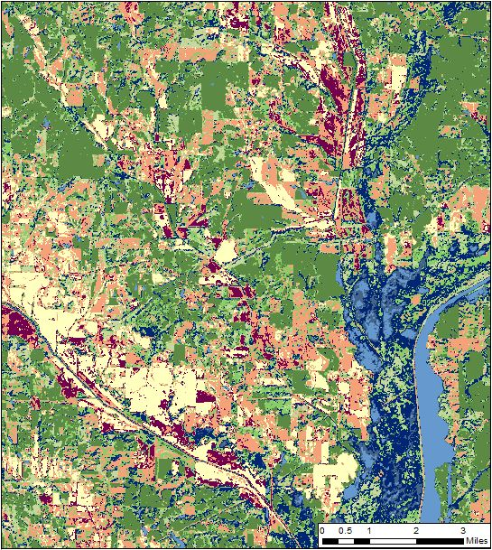
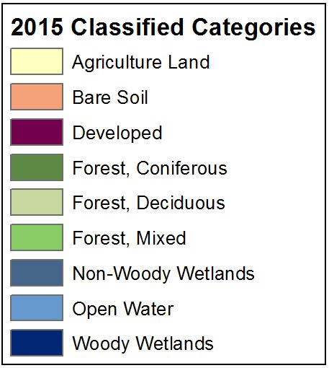
Land Cover Classification
Results
Notes:
Jenna: Our land cover classifications were grouped into 9 categories, including woody and non-woody wetlands, mixed forest, and developed. This image shows the some of the classified output for the year 2015. The dark blue colors represent wetland areas.

Slide 10
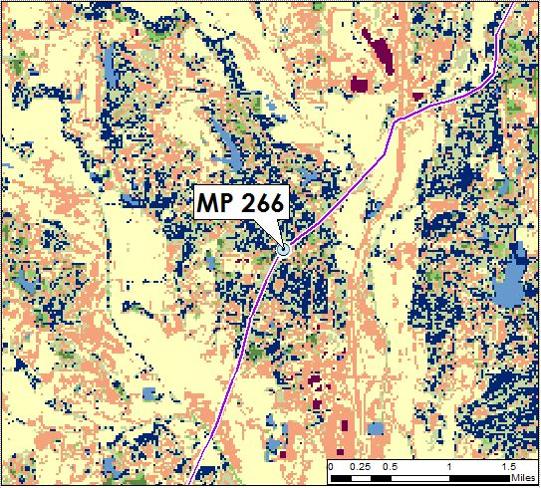
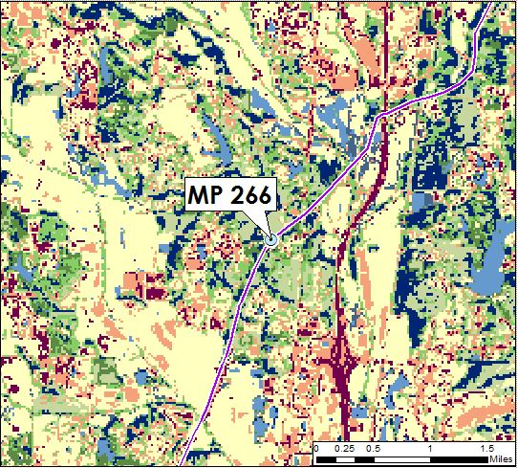
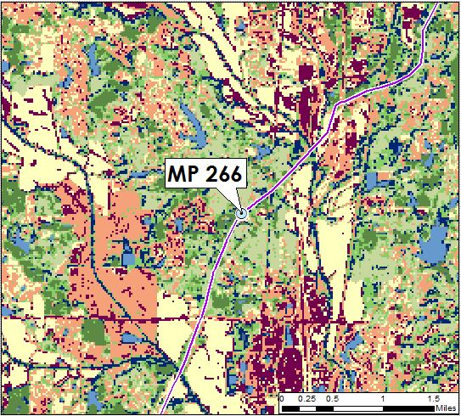
Land Cover Classification
Results
1992 MP 266
2002 MP 266
2015 MP 266
Notes:
Jenna: This slide shows an example of how wetland extents have changed throughout the years for milepost 266, around the Natchez Trace Visitor Center. This is one of a few priority areas for the National Park Service, since it has a history of damming issues with beavers, which leads to flooding and maintenance problems.

Slide 11
LULC Accuracy Assessment
Error Matrix
2002 Error Matrix
Notes:
Jenna: For the accuracy assessment, 180 randomly generated points were checked against Google Earth imagery and NLCD data to determine the accuracy for each classification. We used the accuracy report to produce an error matrix, which compared the amount of random points that were correctly classified against points that were incorrectly classified. This is an example of the error matrix for the 2002 assessment.

Slide 12
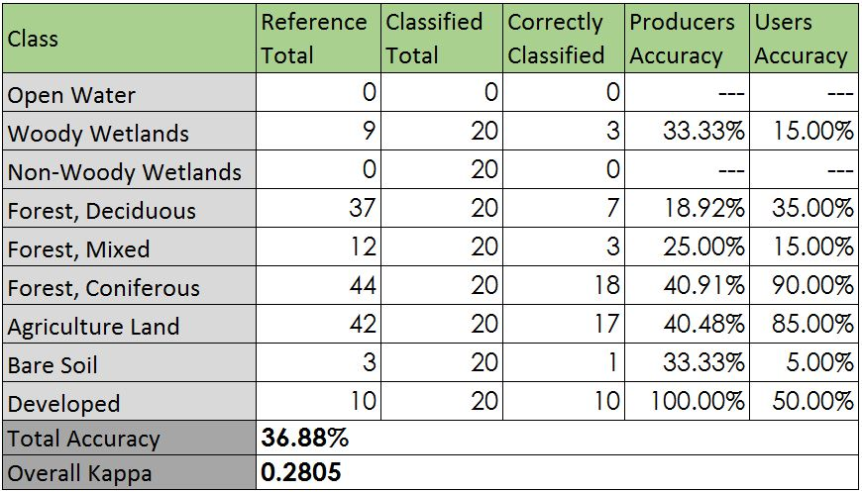
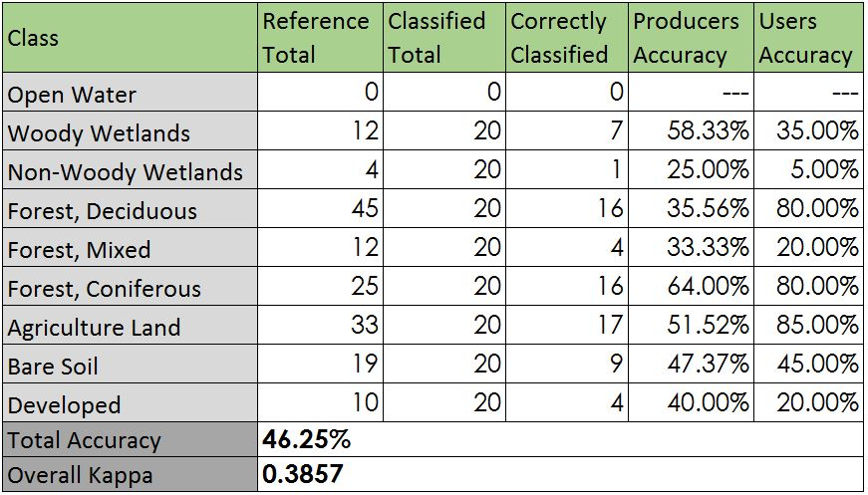
LULC Accuracy Assessment
Classification Accuracy Table
1992 Accuracy Table
2002 Accuracy Table
2015 Accuracy Table
Notes:
Jenna: Using the error matrix, we created an accuracy table, which shows the accuracy for each class as well as a total percent accuracy for each year’s land cover classification. Our 1992 classification had an accuracy of 37%, with a kappa statistic of 0.28; 2002 had an accuracy of 46%, with a kappa statistic of 0.39; and 2015 had an accuracy of 52%, with a kappa statistic of 0.45.

Slide 13
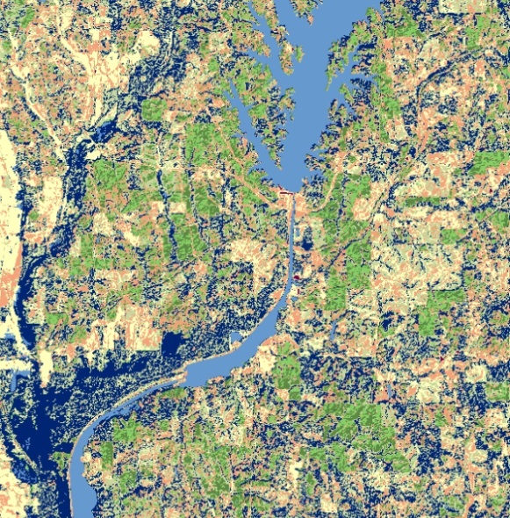
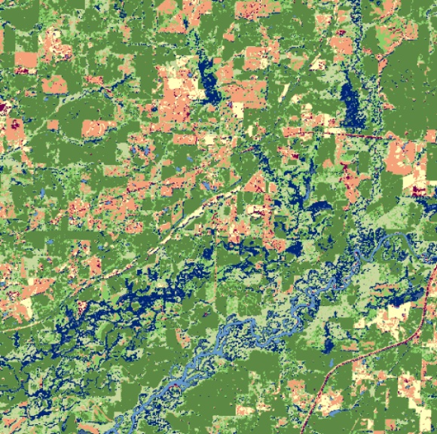
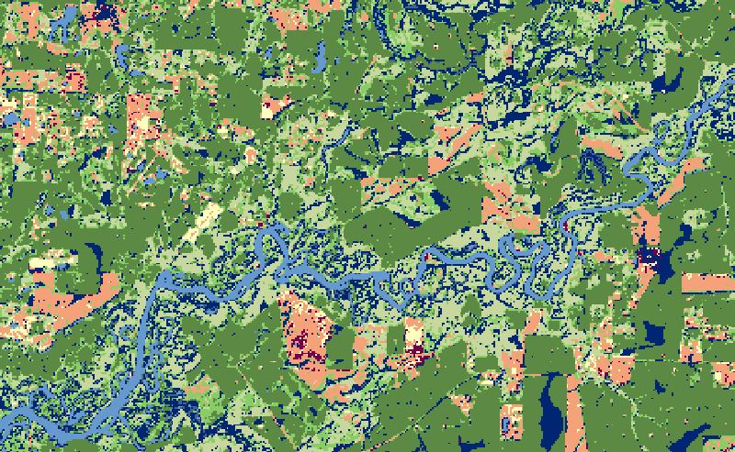
TerrSet Land Change Modeler Methods
TerrSet Land
Change Modeler
1992 Classification
2015 Classification
Projected Model for 2020
Notes:
Tyler: After classifying each date, we used the TerrSet Land Change Modeler with the 1992 and 2015 classified years. Based on the changes between these dates, the Land Change Modeler calculated the likely changes in conditions by the year 2020.

Slide 14
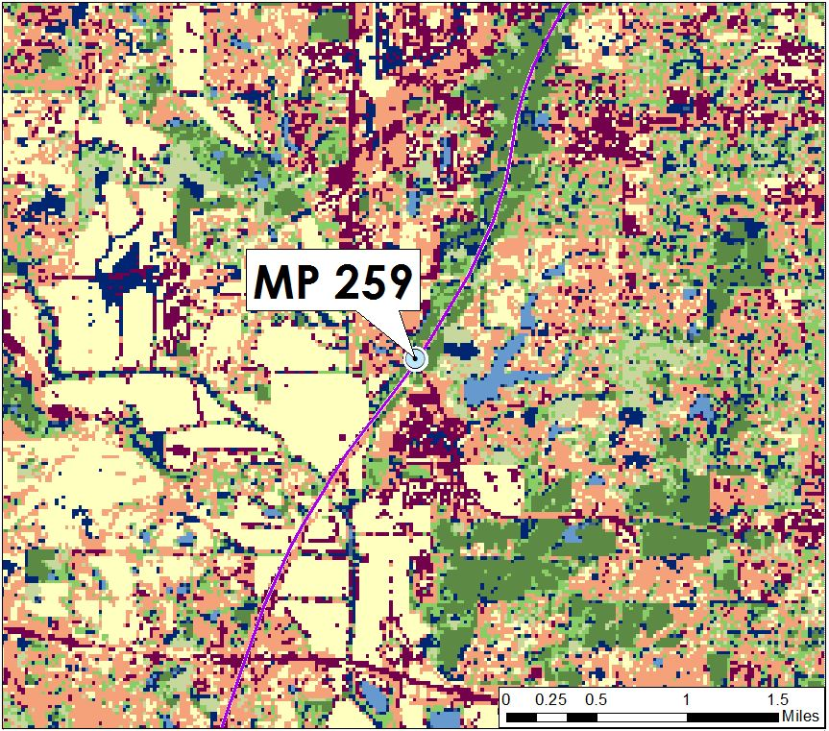
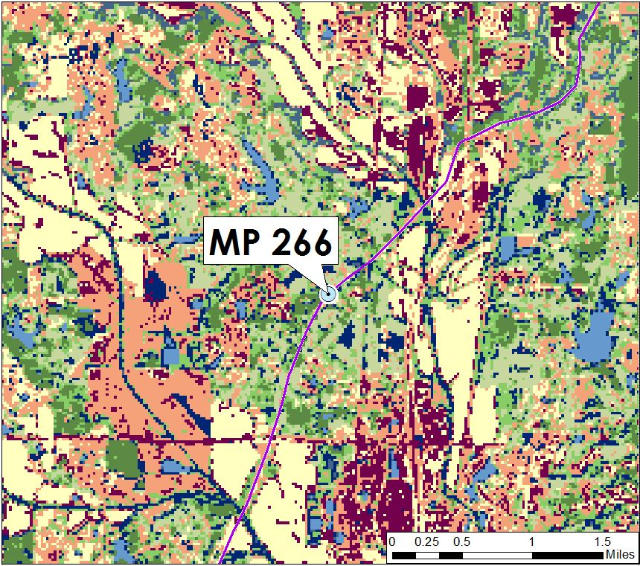
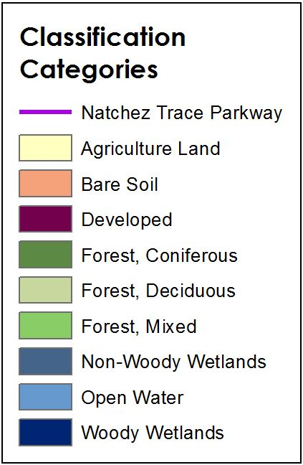
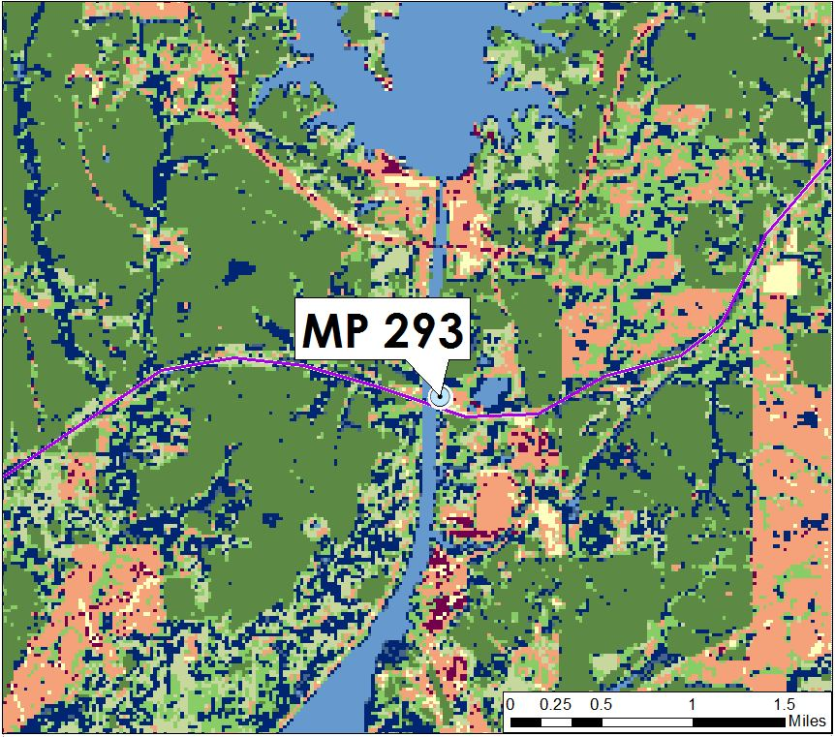
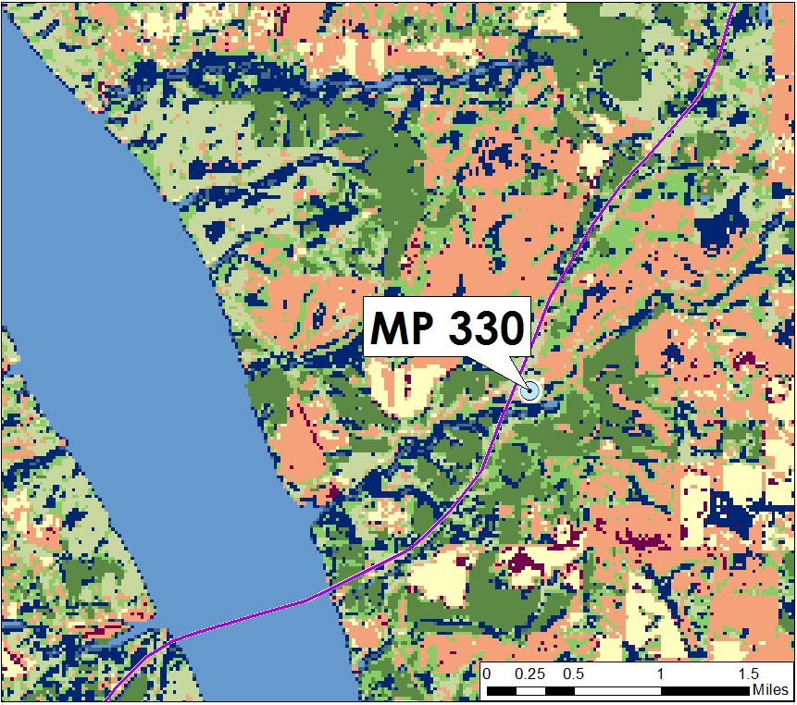
TerrSet LCM
Results
Main St., Tupelo
Visitor Center
Tenn-Tom Waterway
Rock Spring
Notes:
Tyler: These are selected areas of interest for the National Park Service along the parkway that have historically been difficult to manage or administer maintenance. This slide shows the predicted wetland extents for these areas as modeled by the LCM for the year 2020.

Slide 15
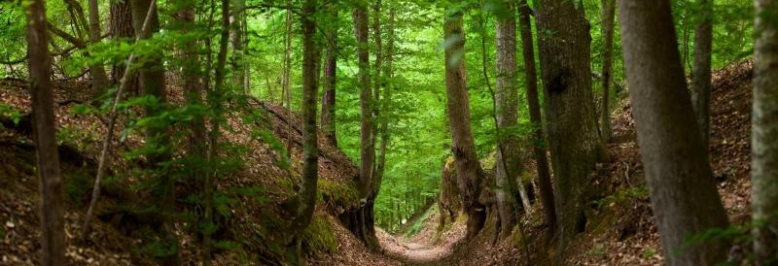
Conclusions
1992 – 2015: General trends
Decreases in agriculture land; large increase in coniferous
Net loss in wetland classes
2015 – 2020: Wetland changes for NPS priority areas
Increases in all priority areas
MP 293 had few changes
MP 330 developed several new pockets
Image Credit: National Park Service
Notes:
Tyler: There were some general trends in our results. Overall, between 1992 and 2015, there were net losses in agriculture land and bare soil, losing almost 900 square miles combined. However, coniferous forests gained over 1,100 square miles. Woody and non-woody wetland classes experienced a net loss of over 400 square miles combined.
The wetland prediction map showed a general increase in wetland regions for all four of the priority areas. Milepost 293 had the fewest changes, with only a few small pockets developing on bare soil. Milepost 330 had the most changes, with several long, narrow pockets developing near the parkway road on bare soil and forested areas.
Image URL: http://www.nps.gov/media/photo/gallery.htm?id=88B142F5-1DD8-B71C-075F53D23FFAE592

Slide 16
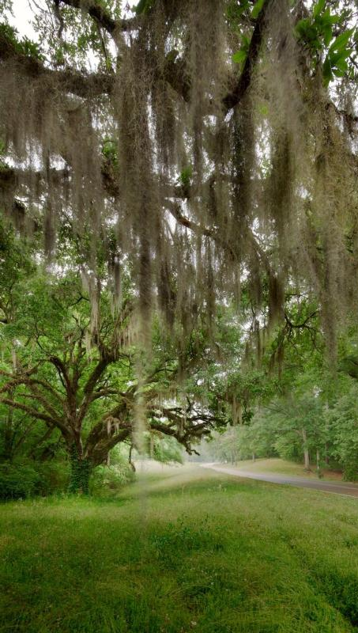
Product Uncertainties
Resolution coarseness prevented aerial identification of beaver dams
Difficulties discerning similar spectral signatures for certain classes
Some topographic shadows classified as wetlands
Land cover classification error impacts modeled output
Image Credit: National Park Service
Notes:
Tyler: There were a few uncertainties with this project. It was initially the goal to identify all beaver dams within our study area from aerial and Landsat imagery. However, this proved prohibitively difficult due to resolution coarseness and leaf cover with available imagery. It was also challenging to distinguish between some classes with similar spectral signatures, such as with impervious surfaces and barren soil. Additionally, topographic shadows in the far northern regions of our study area were incorrectly classified as woody wetlands. Attempts were made to correct this using our cluster busting method, but this was unsuccessful. These classification errors impact the accuracy of the modeled output generated by the Land Change Modeler.
Image URL: http://www.nps.gov/media/photo/gallery.htm?id=88B142F5-1DD8-B71C-075F53D23FFAE592

Slide 17
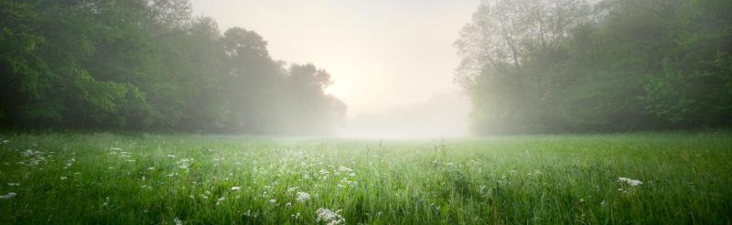
Image Credit: National Park Service
Future Work
Expand study area buffer to also assess adjacent areas
Include products for all portions of parkway
Model beaver impacts for more future years
Incorporate data on known beaver presence
Notes:
Tyler: Future work could include expanding the project study area. This could mean increasing the buffer size around the parkway, both to improve classification and to identify problems in outlying areas which could potentially create issues within the parkway. The project study area could also be expanded to include all portions of the parkway - this project focused on the portion contained within Landsat path 22. Future work may also include modeling for more years for farther in the future, past 2020. Finally, having more information on known beaver presence on a subsequent project could be useful in locating areas which have the potential to become more problematic for the National Park Service.
Image URL: http://www.nps.gov/media/photo/gallery.htm?id=88B142F5-1DD8-B71C-075F53D23FFAE592

Slide 18
Advisors
Joe Spruce (NASA Stennis Space Center)
Dr. Kenton Ross (NASA Langley Research Center)
Partner
National Park Service (Deanna Boensch)
Mentor
Bert Eichold, M.D., Dr. PH (Mobile County Health Department)
Notes:
Tyler: We would like to thank all of our advisors and contributors for this term’s project! This includes our science advisors, Joe Spruce from Stennis Space Center and Dr. Kenton Ross from Langley Research Center. We’d also like to thank our mentor, Dr. Bert Eichold from the Mobile County Health Department. Deanna Boensch, the Natural Resource Specialist at the National Park Service, was also a great help in collecting project materials and providing advice.

Slide 19
Thank You!
Notes:
Tyler: Thanks for listening!

