Slide 1
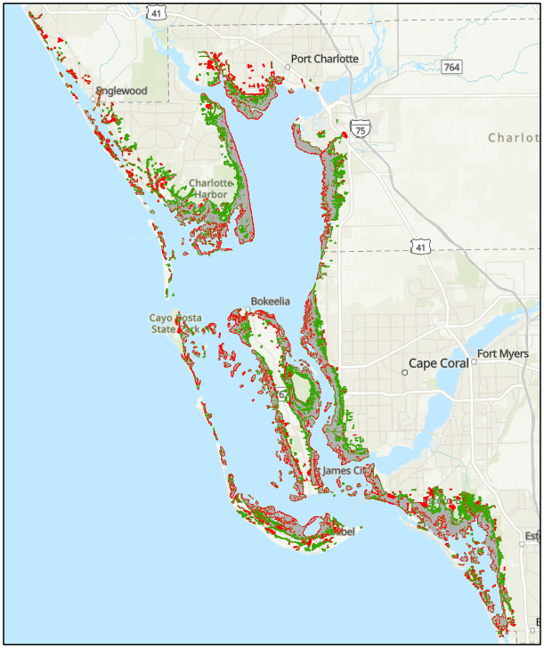
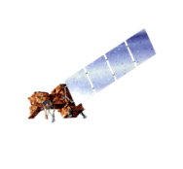
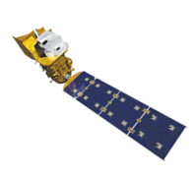
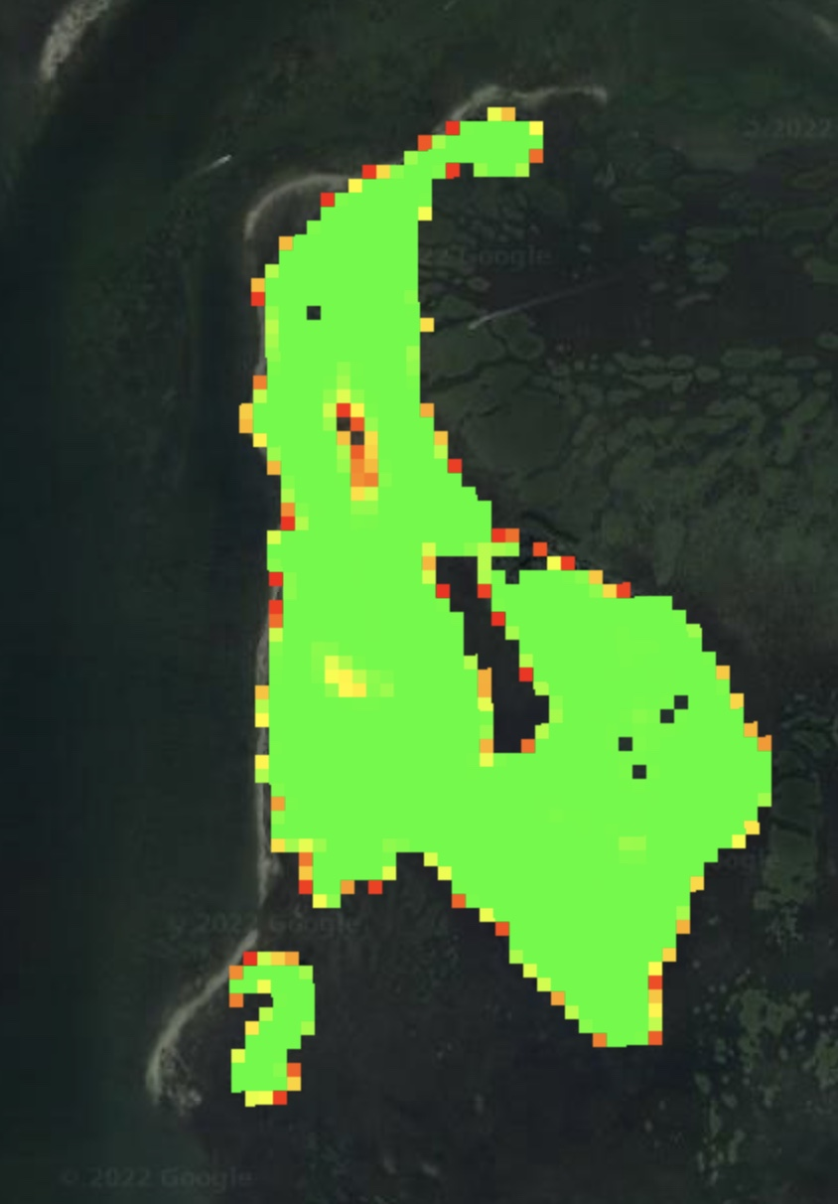
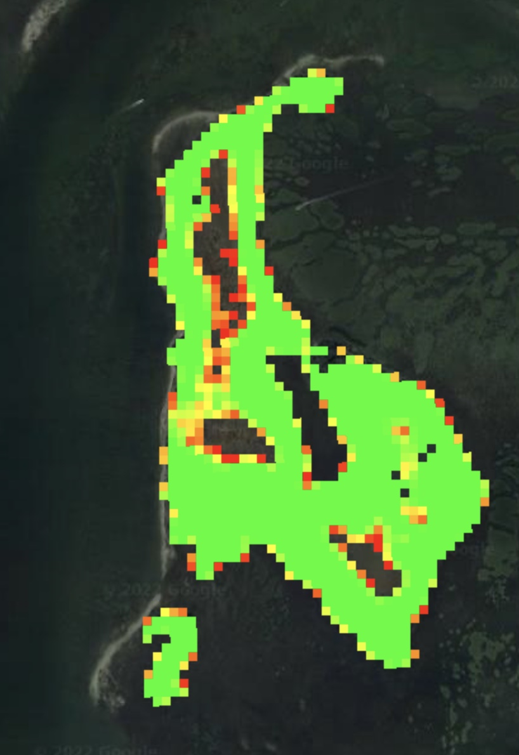
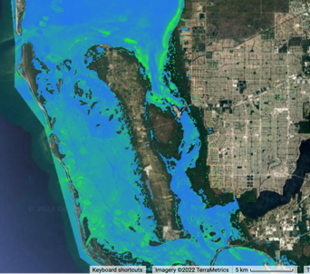
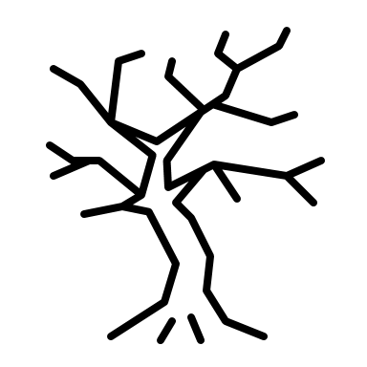
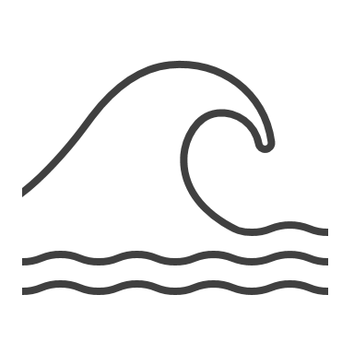
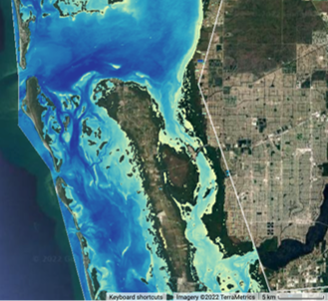
Assessing Coastal Resiliency Across Florida’s Aquatic Preserves in Response to Hurricane Forces
Mangrove forests are an important part of Florida's coastal ecosystem. They absorb excess water and prevent erosion during extreme weather, filter nutrients and pollutants to protect water quality, and provide habitat for many fish species. Florida is at a high-risk for hurricanes which leads to increased coastal erosion and a potential human safety concern. Anthropogenic expansion into these habitats are further threatening the extent, health and water quality of these vital ecosystems.
Mangrove Forest Extent
Charlotte Harbor Aquatic Preserve
Florida Water Resources
5,576 ha gained
1,678 ha lost
NASA DEVELOP used satellite data to create a Google Earth Engine tool which helps the Florida DEP manage mangrove forests within their aquatic preserves.
Losses
Gain was primarily on inland regions while loss was concentrated on coastal edges
0 5 10 20 km
Gains
Constant
Landsat 7 ETM+
Landsat 8 OLI
Landsat 9
OLI-2
SRTM
Mangrove Forest Health
Water Quality
2002
2021
Chlorophyll-a
NDVI
Time Series May 2002 to May 2019
0.25
0.7
25
20
15
Chlorophyll-a mg/m³
10
5
0
Chlorophyll-a mg/m³
5/16/02
5/16/04
5/16/06
5/16/08
5/16/10
5/16/12
5/16/14
5/16/16
5/16/18
Lower NDVI values indicated an increase in poor health on this island from 2002 to 2021
0
75
Acknowledgements
Turbidity
Partners: Florida Department of Environmental Protection:
Office of Resilience and Coastal Protection
Advisors: Dr. Juan Torres-Pérez (NASA ARC)
Fellows: Britnay Beaudry (DEVELOP ARC),
Hayley Pippin (DEVELOP ARC)
Credits: Mangrove extent base map (ESRI)
Time Series May 2002 to May 2019
0.25
0.20
0.15
NDTI
0.10
0.05
0
Team Members:
Normalized Difference Turbidity Index
5/16/02
5/16/04
5/16/06
5/16/08
5/16/10
5/16/12
5/16/14
5/16/16
5/16/18
Samuel Perrello
(Project Lead)
Kyle Stark
Koya Oki
Emily Heltzel
The daily average for both water quality parameters began to increase in 2012
-0.5
0
California – Ames

