Slide 1
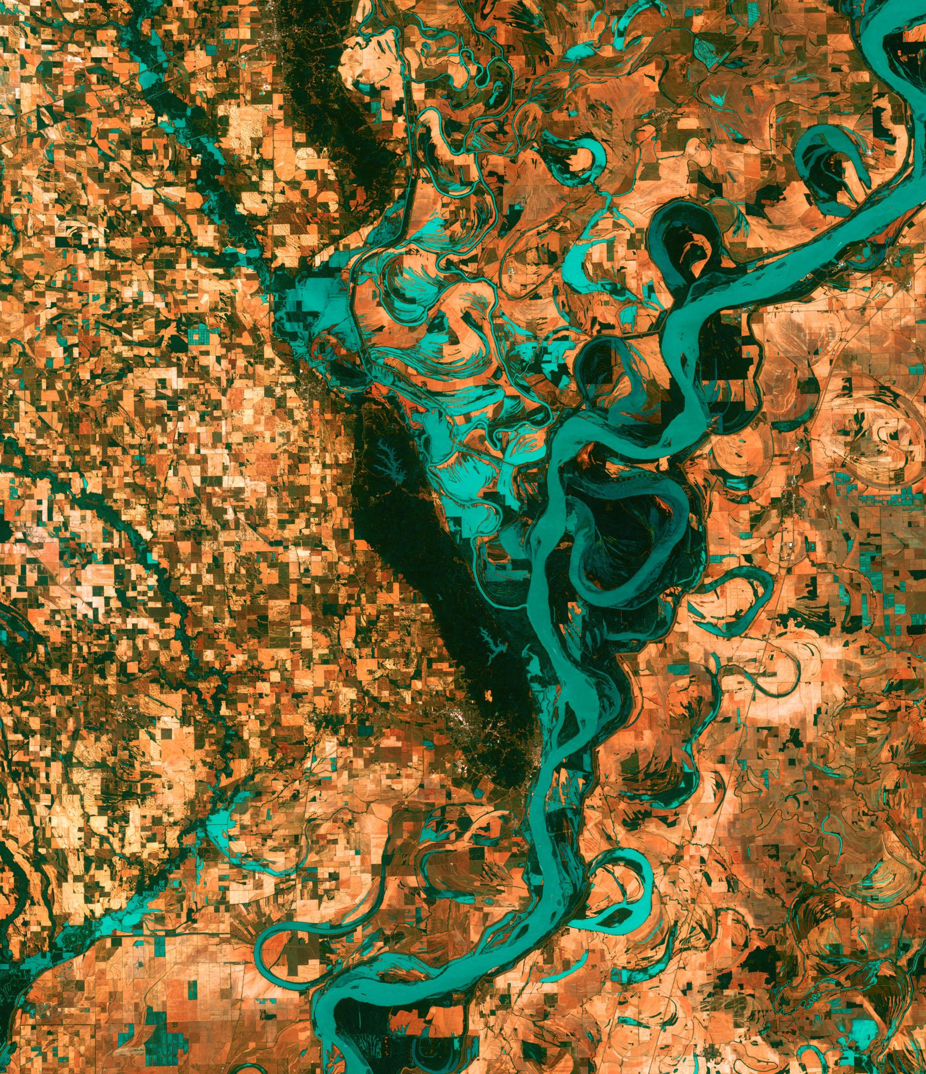
DEVELOP National Orientation (2021)
Module 10. Project Team

Slide 2
PROJECT TEAM
How DEVELOP Builds Teams
All DEVELOP projects are conducted by interdisciplinary teams
DEVELOP participants have:
Different academic backgrounds and work experience
Different levels of technical skills in GIS, remote sensing, & coding
Different capacity building goals
Different career stages
By The Way
Node Leads consider all of these factors when selecting DEVELOP teams!
We use personality assessments as a tool for introductory conversations, ice breakers to get to know each other, meet & greets with NPO and various guest speakers, and program-wide networking activities to engage the full DEVELOP team!

Slide 3
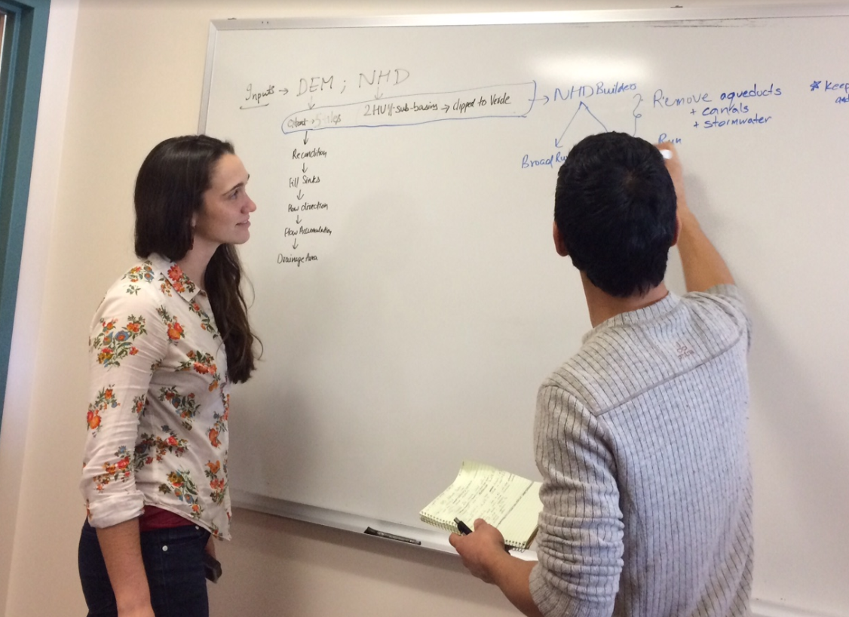
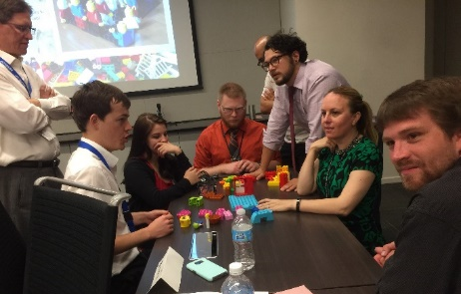
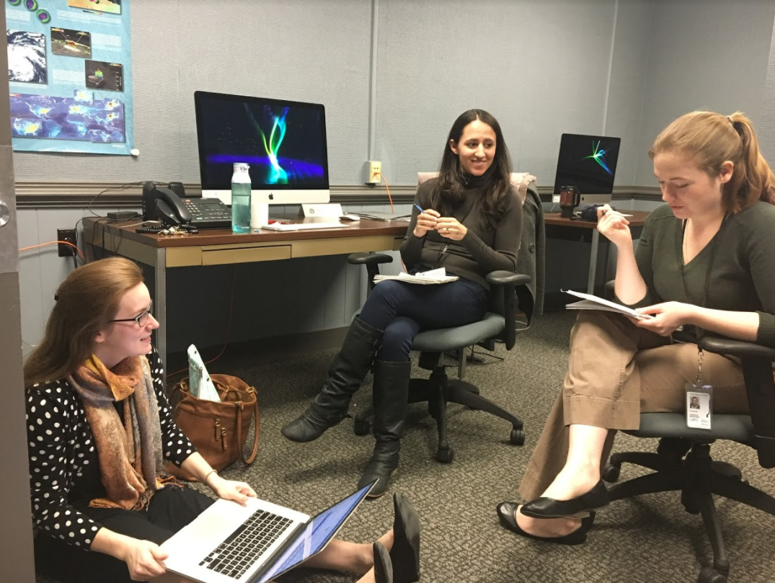
PROJECT TEAM
Communicating Across DEVELOP
At your node…. | With science advisors...
Talk with node leadership regularly. | Invite your advisors to team & partner meetings.
Include Fellows & team on all partner interactions (emails, calls, etc.). | Communicate regularly with advisors as their schedules allow.
Ask your node leadership for help if you need additional resources. | Ask advisors for help in all aspects of the project (including deliverable edits, methodology, & end products).
Inform your node leadership if you plan on undergoing the publication process. | Always exercise professional email & telecon etiquette when communicating with advisors.
Ask Fellows for help on tasks related to their Element responsibilities. | Include your advisors in email communication with project partners.

Slide 4
PROJECT TEAM
Conflict Resolution
Some Topics to Discuss with Your Team | How This Can Be Applied
Does your NASA 4D color match what you thought you would get? Why or why not? | Use this discussion to let your team members know that personality typing is a guide, not a verdict.
What are the strengths and weaknesses of each team member’s personality type? | Come prepared with some challenge scenarios related to the project and ask each team member how they might handle them (i.e. workload causing stress, collaborating across different work schedules, etc.).
If conflict arises, how would you try to mitigate it? | Again, come prepared with scenarios: a team member is making inappropriate comments, showing up to work late, etc.
By The Way
Communicate with your Lead about ANY personnel issues, no matter how minor. They need to be aware!

Slide 5
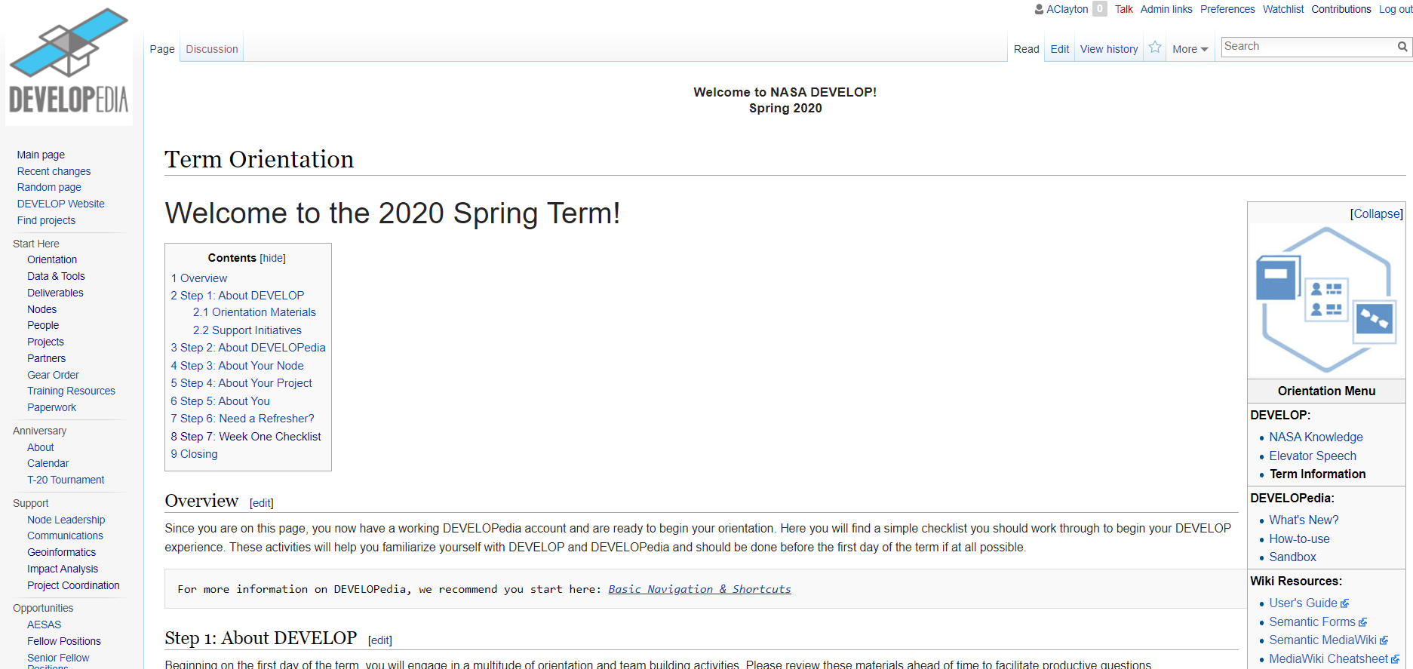
PROJECT TEAM
When in Doubt…
Google it
Look on DEVELOPedia
Look at past projects
Ask your team
Ask a Lead/Fellow
Ask your Science Advisor
Ask NPO
They are here to support you and ensure your success!

Slide 6
Project Team Duties & Responsibilities

Slide 7
PROJECT TEAM
By The Way
Project Leads are the main point of contact for project communication with multiple parties during the term.
Key Responsibilities
Key Things to Remember | Some Tips & Tricks
Time management | Make a schedule & keep files & tasks organized.
Managing project challenges | Be flexible & build in time to troubleshoot issues with your project methodology.
Communication | Maintain open and consistent communication with node leadership, NPO, science advisors & all partners.
End products & partner hand-off | Begin planning for hand-off & software release early in the term.

Slide 8
PROJECT TEAM
Deliverable Management
Deliverables communicate your project purpose, methodology, and results to a variety of audiences
Ensure that high-quality deliverables are created and submitted
Key Things to Remember | Some Tips & Tricks
Name files according to proper file nomenclature | YearTerm_NODE_DeliverableName_RD/FD_Version#
Follow deliverable template formatting | Reference DEVELOPedia for the deliverable templates & checklists.
Review deliverables before submission | Quality of writing, style, accuracy, etc. Incorporate feedback from Node leadership Address edits & comments from the PC team
Submit deliverables on time | Be mindful of deliverable deadlines.

Slide 9
PROJECT TEAM
Partner Engagement
DEVELOP projects are created to meet partners’ needs & build capacity.
Always be honest with your partners. Do not be afraid to give them updates (good or bad) or ask them for assistance.
Key Things to Remember | Some Tips & Tricks
Maintain consistency | Establish a regular schedule & follow through.
Keep node leadership informed | Include node leadership and your team on all partner communication (email & telecon).
Represent your team & DEVELOP at all times | Always maintain professional email and telecon etiquette.
Increase available data/resources | Ask for any data/resources that partners may have that could be useful. And ask early!

Slide 10
PROJECT TEAM
Remember: partners are the ones who will be using the projects results.
Managing Partner Expectations
2.
4.
Do not over commit on what you can accomplish or provide in one term.
1.
Ensure end products meet partner needs.
Maintain communication throughout the term.
Always follow through on promises.
3.

Slide 11
PROJECT TEAM
Partner Hand-Off
Clear, rehearsed, and prepared hand-offs are important to transition results and methods to end users
Best practices:
Talk with your project partners early on in the term about scheduling a hand-off.
Identify what type of hand-off will be most beneficial (feasible) for partners & the team.
Coordinate with all partners to ensure all interested parties can attend (keep in mind there may be differences in time zones).
Prepare a hand-off package of end products & deliverables.
Explain the Software Release process & timeline to partners in advance.
Follow up with your end users to receive feedback or answer any questions (especially on multi-term projects).

Slide 12
Project Leads

Slide 13
PROJECT TEAM
Leading Means…
Possess a clear vision of the future and be compelled by it.
Encourage people to share ideas, needs, perspectives, dreams, and desires.
Stand for, demonstrate, and portray what you believe.
Empower people with the authority to use their own skills and knowledge.
Evaluate the people who work with them and the performance of the team.
Inspire and motivate others with passion and example.
“When you include and acknowledge those in your corner, you propel yourself, your teammates, and your supporters to greater heights.”
- Simon Sinek

Slide 14
PROJECT TEAM
Project Lead Duties
Acts as the primary point of contact (POC) for the project – coordinates communication with node leadership, advisors, partners, & NPO
Ensure that the project team effectively completes and submits all deliverables to NPO by the assigned deadlines
Respond to edits, feedback, and questions from the Project Coordination team
Report progress and issues to your lead regularly
Foster a productive team dynamic and work environment
Empower team members to take on different elements of the project
Ensure compliance with all applicable SSAI, NASA, and DEVELOP rules, regulations, policies, and procedures
By The Way
All team members are expected to contribute equally to the project’s completion!

Slide 15
PROJECT TEAM
Team Management
It is important to know your team’s strengths and interests in the project
Consider activities and exercises for team members to get to know each other.
Hold ice breakers at the beginning of the term.
Continue having team activities throughout the term (lunches & outings!).
Understand team dynamics and delegate tasks accordingly.
Know team members’ personalities (NASA 4D and MBTI) and how they interact with others.
Identify the best ways to handle personnel issues when they arise.
Find out the individual goals & expectations of all team members.
Strike a balance between team members’ learning and productivity.
Learn team member objectives for their time with DEVELOP and beyond.

Slide 16
Thank You.
Joining the DEVELOP family means being part of NASA’s Legacy.
Learn it. Know it. Live it.

