Slide 1
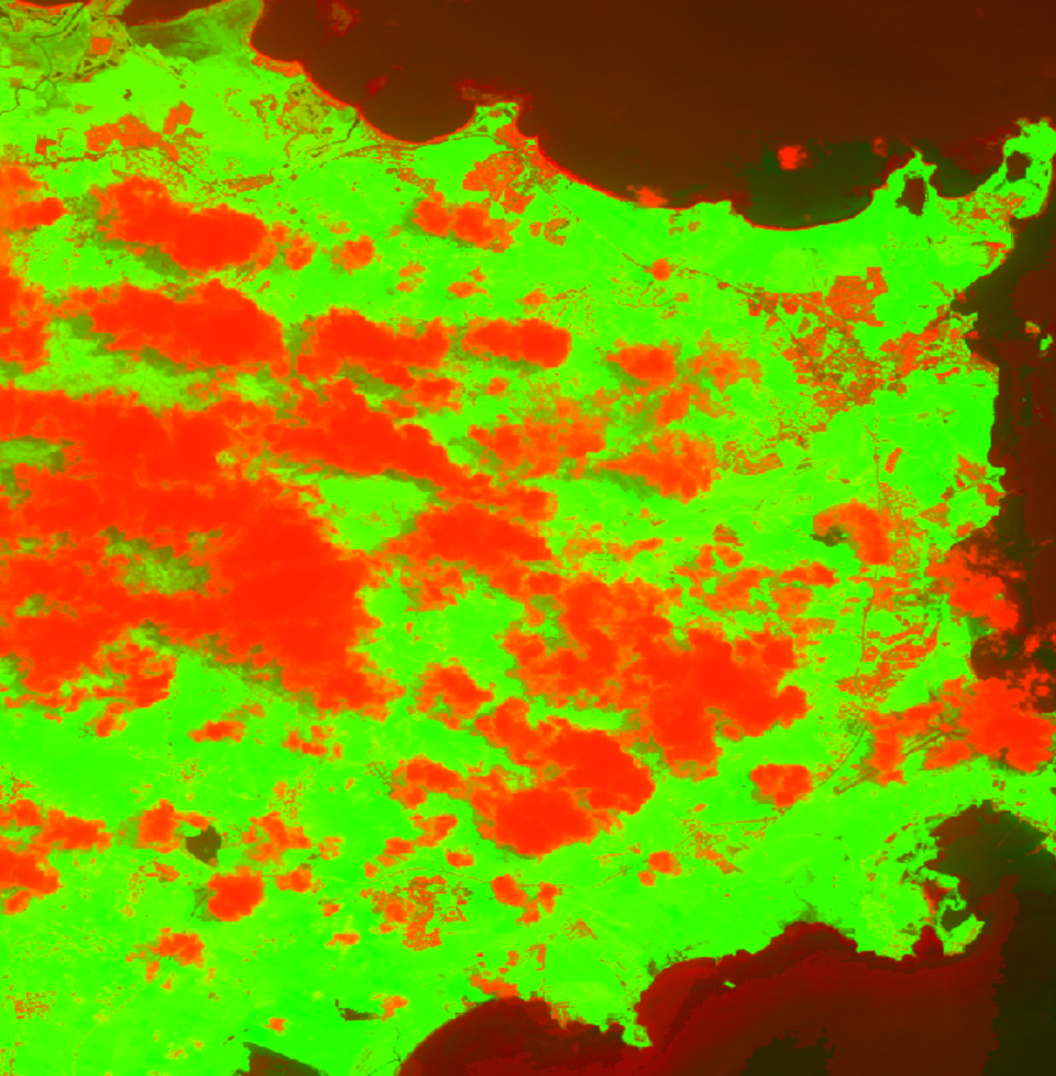
2018 Summer | Georgia – Athens
PUERTO RICO DISASTERS
Assessing changes in Cloud Dynamics in the Luquillo Tropical Montane Forest Using NASA Earth Observations and In Situ Measurements Following Defoliation from Hurricane Maria
Flavia Dias de Souza Moraes
Andrew Walz
Justin Bucher
Notes:
Hi, we are the Puerto Rico Disasters Team.
My name is Flavia Moraes, I am the Project Lead. I graduated from the Federal University of Rio Grande do Sul/Brazil with a Bachelor in Geography and in Journalism and am currently doing my PhD in Geography at the University of Georgia.
My name is Andrew Walz, I graduated from The University of Mary Washington with a Bachelors Degree in Geography and am currently a Masters Student at Clark University in GIS
My name is Justin Bucher, I graduated from UNC-Chapel Hill with a Bachelors in Geography and am currently studying Environmental Planning and Design at UGA.
Our tem is working to assess changes in cloud dynamics in the Luquillo Tropical Montane Forest, in Puerto Rico, pre- and post-Hurricane Maria.

Slide 2
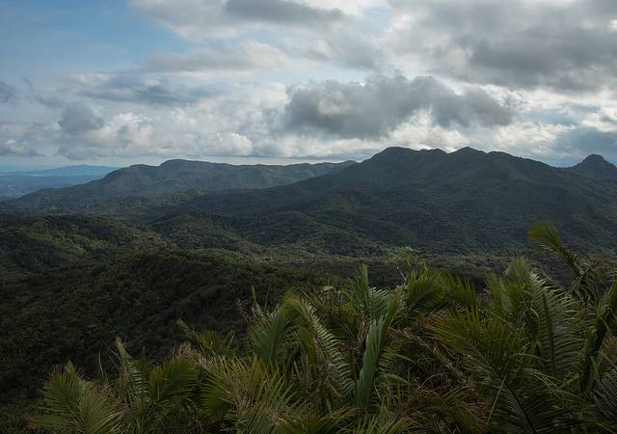
Study Area
Luquillo Mountains are located in the El Yunque National Forest, Puerto Rico
Tropical Montane Cloud Forests (TMCF)
Moisture dependent species
The peaks where the forest grows reaches 1,000 meters above sea level and are constantly covered by clouds
Orographic abundant rainfall
Atlantic Ocean
Photo Credit: Gary Potts/USFS IITF
N
0
20 km
Caribbean sea
El Yunque
Plains
Hills
Mountains
Image/Map Credit: Quiñones et al. 2018
Notes:
The Luquillo Mountains are located in the El Yunque National Forest, in Puerto Rico, which is the most biologically diverse forest in the United States’ Forest portfolio.
The horizontal distance from coastline to 1075-m elevation is only 10 km.
As eastern trade winds arrive from the Northeast containing warm moist air they meet the peaks of the Luquillo Mountains which reach up to 1,000 meters. As the air masses rise they cool and water condenses.
As a result, this forest is characterized by persistent cloud cover and it is designated as a Tropical Montane Cloud Forest (TMCF) where orographic precipitation plays an important role to preserve the moisture-dependent flora and fauna.
This cloud laden forest has become vitally important for the local water budget and the unique species which are present.
Images Source: https://data.fs.usda.gov/research/pubs/iitf/iitf_gtr_47_eng_highres.pdf
https://www.flickr.com/photos/101115103@N03/26208195223/in/album-72157667718953392/

Slide 3
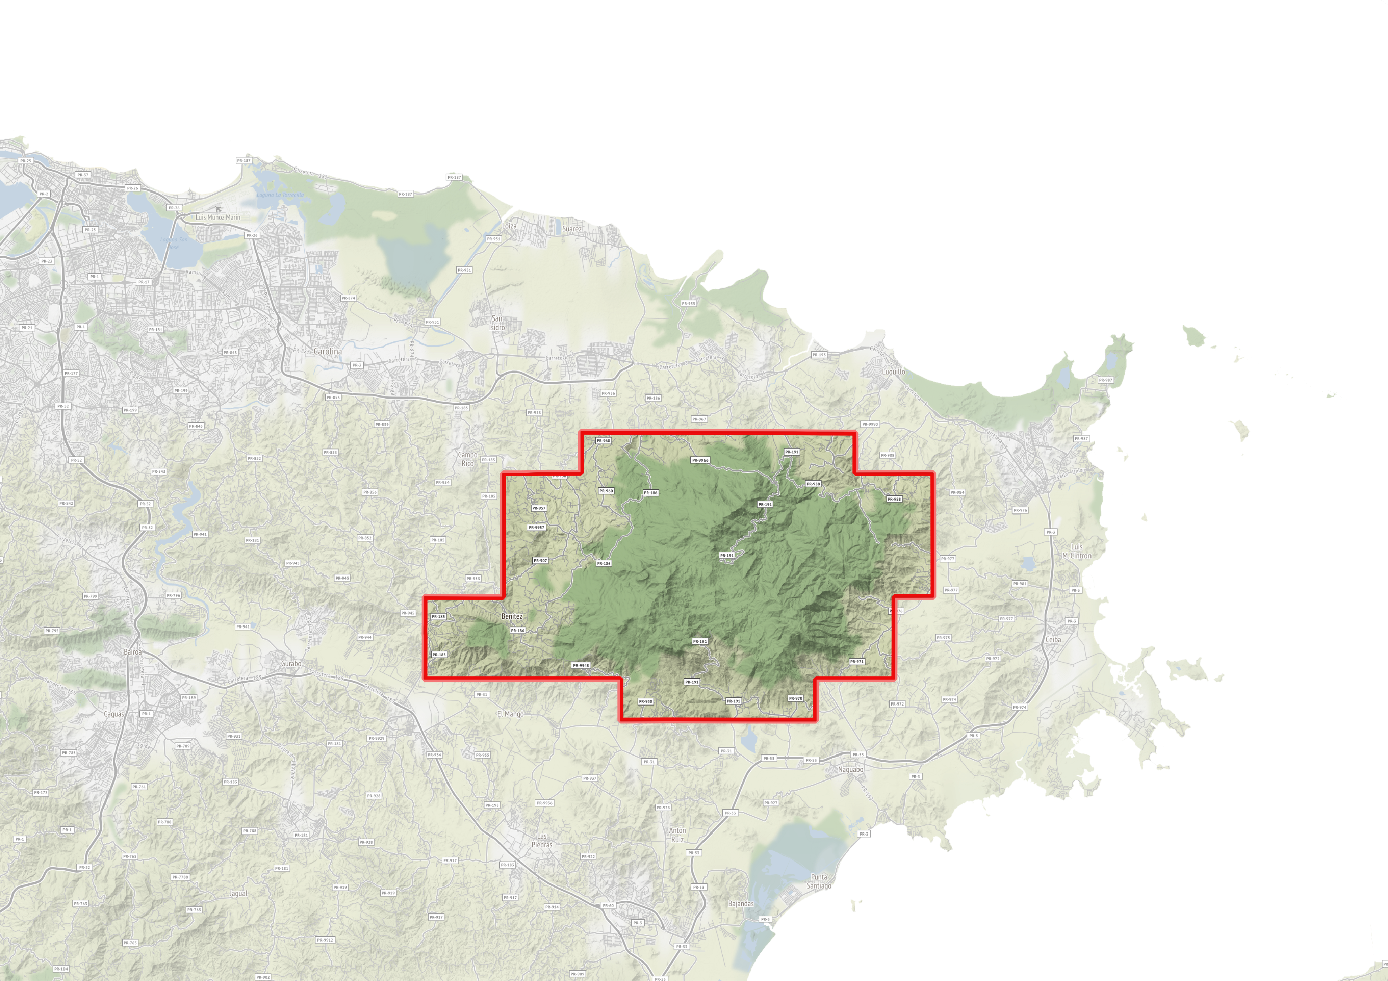
Community Concerns
Water
Biodiversity
Research & Recreation
Notes:
The Luquillo Mountains provide many important environmental and social services
*CLICK* - (arrow to water pops up)
On a typical day, over half of all water flowing from the forest is extracted for municipal use and human consumption.
Based on the cost paid by consumers, the water extracted from the streams that flow from the Luquillo Mountains is worth about $25 million per year
CLICK – (arrow to biodiversity pops up)
Also, the Luquillo Mountains’ unique environment provides habitat for many endangered and endemic species.
As one of the most biodiverse forests in the National Park System, it is extremely important that we understand how physical processes can affect this unique environment
CLICK – (arrow to research and recreation pops up)
Lastly, the El Yunque National forest is home to numerous research facilities and hosts a wide variety of research activities.
Tourism is also an increasingly important economic activity for Puerto Rico.
Image source: Map from - https://data.fs.usda.gov/research/pubs/iitf/iitf_gtr_47_eng_highres.pdf

Slide 4
Community Concerns
?
Notes:
However, in September of 2017, Hurricane Maria made landfall in Puerto Rico.
In addition to infrastructural damage suffered by Puerto Rico, the Luquillo Mountains experienced catastrophic defoliation and downed trees.
Due to the strong relationship between vegetation and cloud dynamics, as part of the water cycle, it is hypothesized that the defoliation caused by Maria will increase Cloud Base Height
(CLICK)
The rise in cloud base height could have serious implications for the local water budget as well as post-disaster forest recolonization by many unique, endemic species.
As shown in the graphic, post- Maria defoliation is assumed to raise cloud heights, but if so, by how much?
(CLICK)
Image source: Map from - https://data.fs.usda.gov/research/pubs/iitf/iitf_gtr_47_eng_highres.pdf

Slide 5
Partners
Photo Credit: Gary Potts_USFS IITF
US Department of Agriculture (USDA)
US Forest Service
International Institute of Tropical Forestry (IITF)
Notes:
For this project we are working with the US Forest Service, International Institute of Tropical Forestry, more specifically with the project leader Dr. Grizelle Gonzalez.
They have been monitoring cloud base height, since 2013, using ceilometer (in situ measurements), and we are helping them to understand changes in cloud dynamics by using NASA Earth Observations
Image Source:
Forest - https://www.flickr.com/photos/101115103@N03/35967722156/in/album-72157686433208325/
Logo -

Slide 6
Objectives
Determine changes in CBH pre- and post-Hurricane Maria
Analyze cloud spatial distribution change pre- and post-Hurricane Maria
Compare changes in cloud spatial distribution with changes in land cover pre- and post-Hurricane Maria
Provide the partners with products to better understand changes in CBH and cloud coverage pre- and post-Hurricane Maria
Photo Credit: Gary Potts_USFS IITF
Notes:
Our main objective is to analyze changes in cloud base height (CBH) and cloud coverage pre- and post-Hurricane Maria to analyze how the massive defoliation caused by Maria affected the cloud dynamics over the Luquillo Mountains in the El Yunque Forest.
Our end-products provide partners from the USFS with products that can better inform the park planning and management team about the impact Hurricane Maria had on cloud cover and CBH in the park. Furthermore, it will help the park staff to anticipate how future storms could impact cloud dynamics.
Image source: https://www.flickr.com/photos/101115103@N03/26678356255/in/album-72157667469973932/

Slide 7
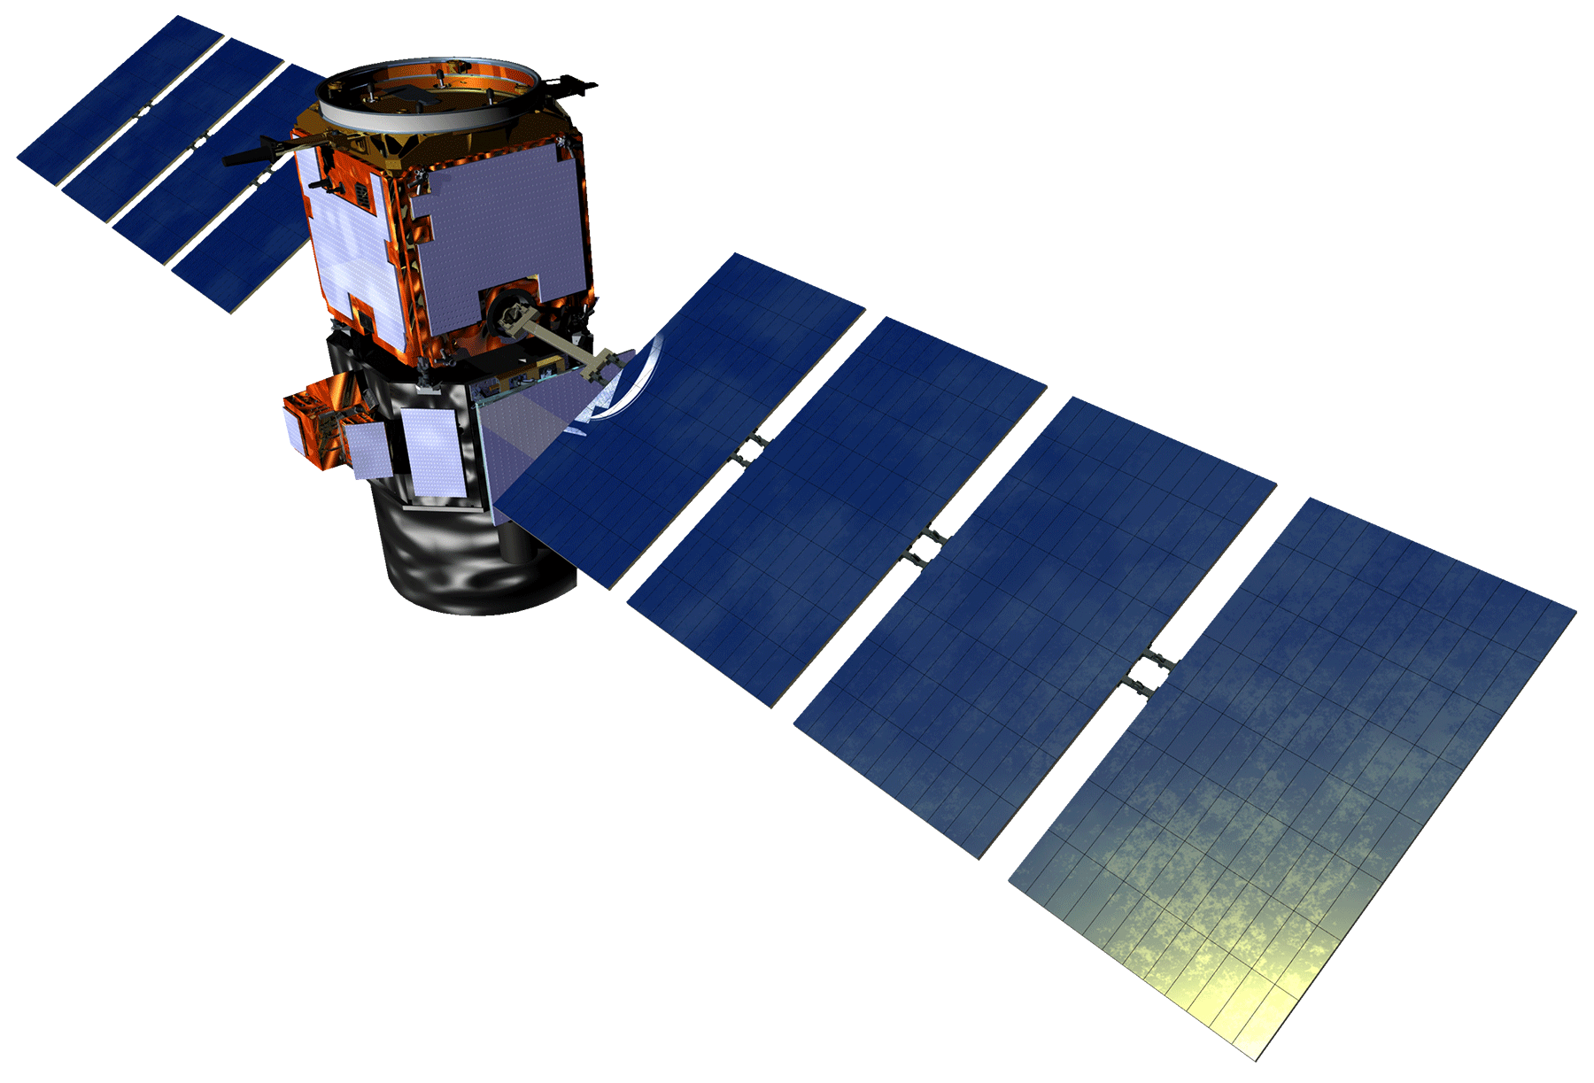
NASA Satellite/Sensors
CALIPSO/
CALIOP
Which Earth observing satellites are we using?
CALIPSO/CALIOP
Active LIDAR, passive infrared, and visible imager
Landsat 8
Operational Land Imager (OLI)
Thermal Infrared Sensor (TIRS)
In situ measurements:
Radiosonde data
Landsat 8
Image Credit: NASA
Notes:
(one clicks to show CALIPSO + Landsat 8)
(one clip shows CALIPSO description)
CALIPSO:
CALIPSO is part of the A-train satellite constellation
The product we are using is: Level 2, 333 meters, Cloud layer
Its primary role is “to study the role that clouds and aerosols play in regulating Earth’s weather, climate and air quality” (https://www.nasa.gov/mission_pages/calipso/mission/)
It will be particularly useful for this project because of its ability to penetrate clouds with its active LIDAR sensor
This will allow us to not only see where the clouds are but develop a profile of their characteristics, in particular the cloud base height
(one clicks to show Landsat 8 description)
Landsat 8:
Landsat 8 is the most recent iteration of the Landsat satellite program run through the USGS.
The satellite houses two different instruments, both of which were used in this project.
The first instrument is the Operational Land Imager, which is a multispectral sensor.
The second instrument is the Thermal Infrared Sensor (TIRS). This instrument captures thermal data and is useful for a wide range of applications, including identifying cloud cover in images, which is how it was used in
this project.
(one click shows In Situ Measurements used);
Radiosonde from San Juan, Puerto Rico, was used to calculate the theoretical cloud base height
Image Source: http://www.devpedia.developexchange.com/dp/index.php?title=List_of_Satellite_Pictures

Slide 8
Study Period
CALIPSO
Landsat 8
Dry Season
Early Rainfall Season
Midsummer Drought
CALIPSO
Landsat8
CALIPSO
Landsat8
Late Rainfall Season
2006
2007
2008
2009
2010
2011
2012
2013
2014
2015
2016
2017
2018
Hurricane
Maria
Notes:
The entirety of the project’s study period is from August 2006 - June 2018.
Because this project is concerned with the effects of Hurricane Maria, much of the data prior to the Maria’s landfall is included to establish pre-landfall conditions for comparative purposes.
Additionally, we account for seasonal variation pre-and post- Maria by comparing changes in cloud dynamics during two different time frames:
the Dry Season (Dec-Mar), in red
the Early Rainfall Season (Apr-Jun), in yellow
the Late Rainfall Season (Aug-Nov) and the Midsummer Drought (July) will be excluded of the analysis due to the fact that we do not have the data post-Maria to compare with pre-Maria data

Slide 9
Methodology
CALIPSO/CALIOP
Landsat 8 Surface Reflectance
Landsat 8 Raw Images
Input Data
Result
Tool
Ancillary Data
PyHDF
Google Earth Engine
Google Earth Engine
Comparison
Cloud Base Height
Cloud Coverage Heat Images
Cloud Free Composite NDVI Images
Vertical Cloud Profile
Horizontal Cloud Patterns
NDVI Coverage
Radiosonde data
ArcMap and QGIS
Cloud Coverage and NDVI Maps
Notes:
The Flowchart is broken into two main sections:
The left side of the flow chart is all of the methodology that pertains to the calculation of the vertical profile of the cloud cover
The right side of the flow chart is all of the methodology that pertains to the calculations of the horizontal patterns of the cloud cover
Flowchart Legend in Top Left Corner:
Double ended comparison arrow is in orange because it is also a potential analysis
Input data:
CALIPSO: Specifically the CALIOP lidar sensor located on the CALIPSO satellite
We will be using the level 2 cloud layer product
Landsat 8 surface reflectance is the atmospherically corrected Landsat 8 product available in Google Earth Engine
Landsat 8 raw images are the same images but not atmospherically corrected
Tools:
PyHDF is a python module that is used to read in and process HDF data, which is the format of CALIPSO data
Google Earth Engine is a platform that hosts a wide range of imagery. This imagery can then be processed on the platform and downloaded off the platform for use in subsequent processing or visualization outside of Google Earth Engine
Result:
Cloud Base Height
The cloud base height is the value taken from the Level 2 1/3 km Cloud layer.
Cloud Coverage “Heat Images”
This product is a collection of two images. These images represent the mean cloud cover score for pre and post Maria. The score is calculated where 1 is cloud covered and 0 is no cloud, thereby creating a range for each pixel between 1 and 0 across the collection of pre-hurricane images. The average value for each pixel in the scene is the cloud score for the pixel. This creates a map displaying the frequency of occurrence across the collection. This can be thought of as a heatmap of cloud coverage across the study period
Cloud Free Composite NDVI Images
This product is a collection of two images. One being the average NDVI value pre-hurricane Maria for each season and the other being the average post-hurricane Maria value. These images are then differenced via a series of methods in ArcMap and QGIS that you will see later in the presentation
Pre – Post = negative (increase), positive (decrease)
Cloud Coverage and NDVI Maps
These are a collection of maps and statistics derived from the maps to try and compare the presence of change in clouds and NDVI, thereby speaking to the potential relationship between vegetative health (of which NDVI is a proxy) and cloud coverage (the heat maps)

Slide 10
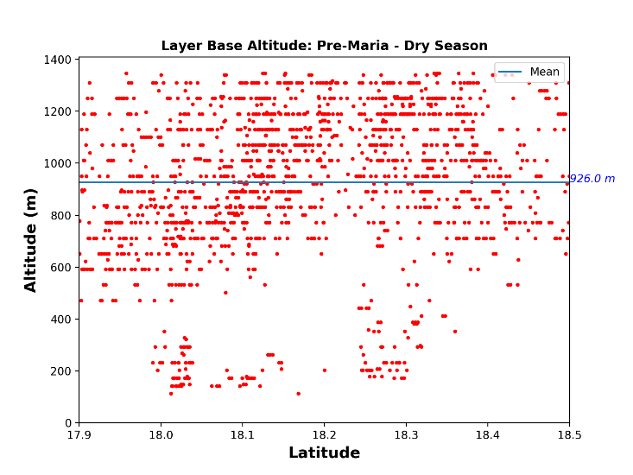
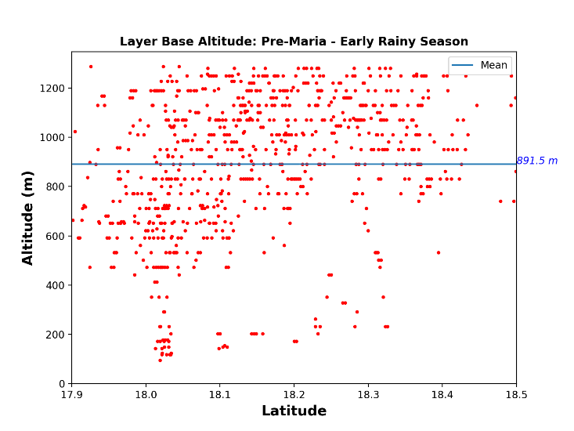
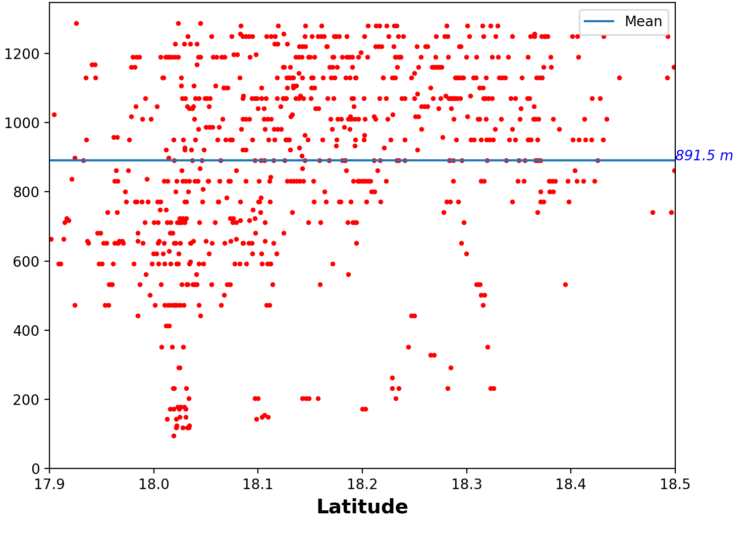
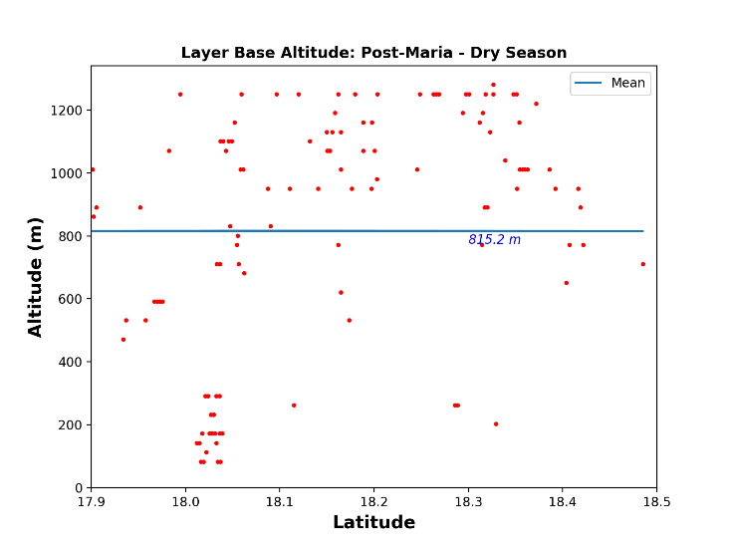
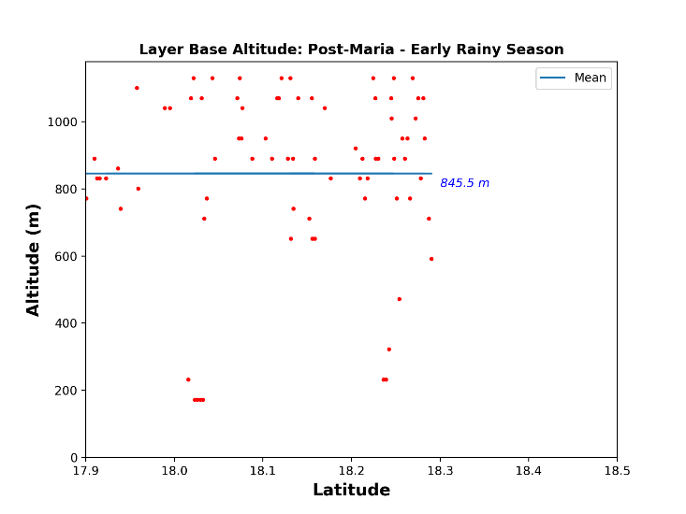
Results
~Extent of El Yunque Boundary
Layer Base Altitude: Pre-Maria –
Early Rain Season
Altitude (m)
Latitude
~Extent of Puerto Rico
Notes:
CLICK
Before diving completely into the results, lets review how we visualized and interpreted our results
*CLICK* First, we iterated through individual CALIPSO datasets and subset the data to the geographic extent of Puerto Rico
*CLICK* What we are looking at consists of a vertical profile of Cloud Base Height readings (indicated via the red dots)
*CLICK* the extent of the park is approximately located in this position.
After subsetting the data below the Trade Wind Inversion, which commonly serves to limit cloud formation above the temperature inversion (2,000 meters) we average the return of values that fell within the 1st quartile of readings to focus on the lower clouds.

Slide 11
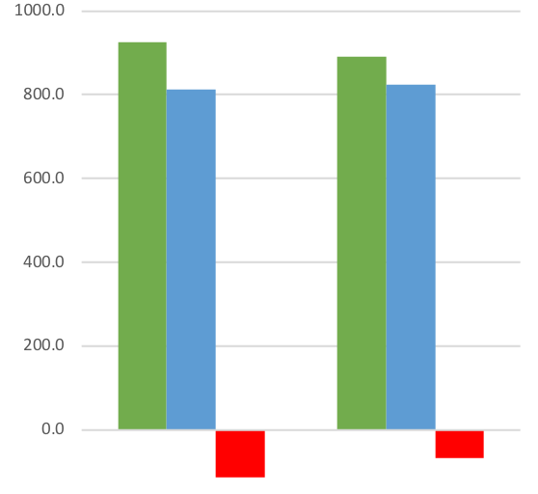
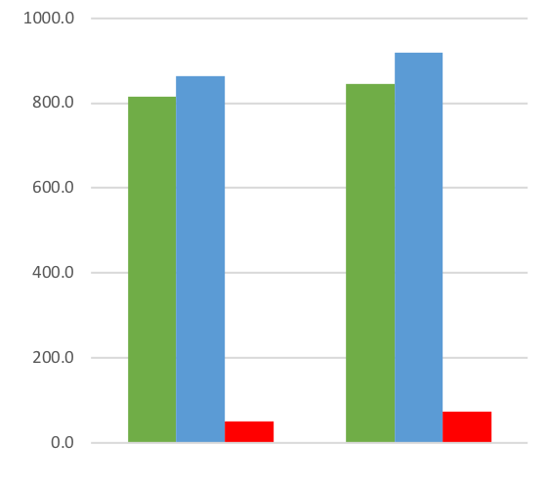
Pre-Maria: Jan. 2006 – Aug. 2017
Post-Maria: Sept. 2017 – June 2018
Average Cloud Base Height
Average Cloud Base Height
Altitude (m)
Altitude (m)
Dry Season
Early Rain Season
Dry Season
Early Rain Season
Avg. Values Below 1st Quartile | 926.0 m | 891.5 m
Theoretical CBH | 811.9 m | 824.6 m
Difference | -114.1 m | -66.9 m
Avg. Values Below 1st Quartile | 815.2 m | 845.5 m
Theoretical CBH | 864.5 m | 919.5 m
Difference | 49.4 m | 74.0 m
Notes:
Pre and Post Maria graphs are shown above, separated by season - Dry and Early Rain season were used for the pre/post comparisons due to data availability
The green bar represents CALIPSO derived CBH averages
The blue bar represents the average theoretical CBH - - derived via several atmospheric parameters from the radiosonde data (temperature, humidity, air pressure etc)
The red bar represents the difference between the two values (MLLCL – CALIPSO)
We found that the average CBH value DECREASED in altitude during the Dry and Early Rainy season AFTER Hurricane Maria according to our CALIPSO derived data
Explanation: this could be related to reduced surface roughness after Maria = less turbulence, convection occurring in lower atmosphere levels = lower clouds
Conversely, our calculated MLLCL values INCREASED in the months following Maria’s landfall
Explanation: atmosphere trying to increase the CBH, but land cover changes acting against that

Slide 12
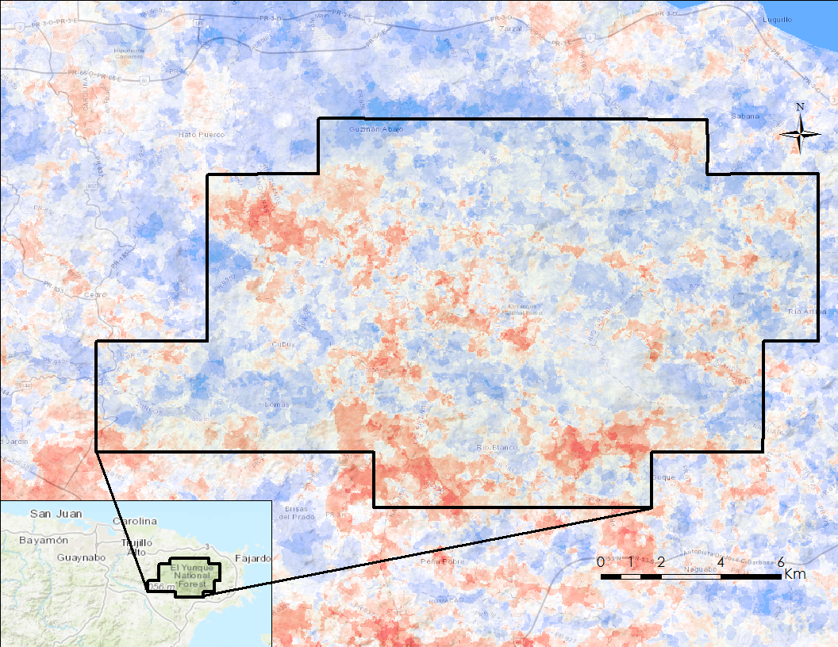
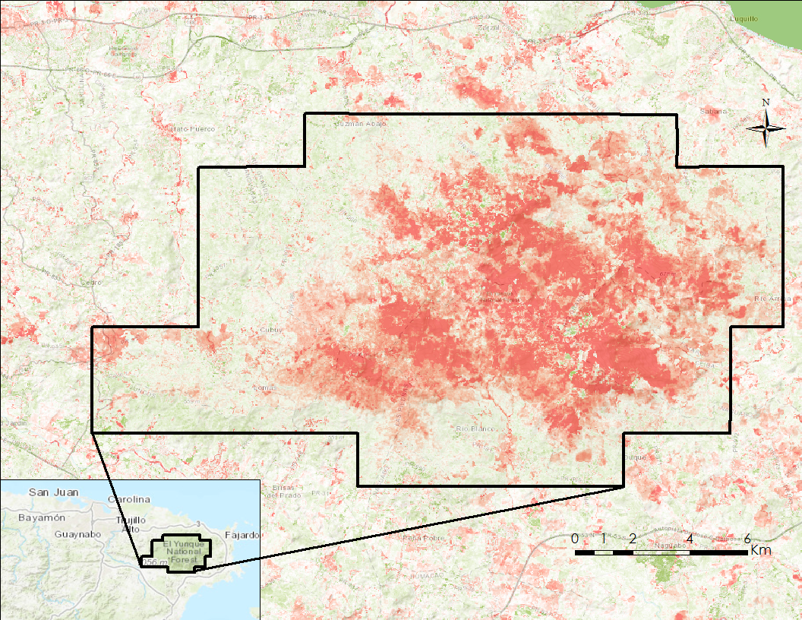
Results
Dry Season(Dec-Mar) cloud cover and NDVI intensity of change pre- and post-Hurricane Maria
Most Extreme Cloud Cover (-)
Most Extreme NDVI (-)
No Change
No Change
Most Extreme Cloud Cover (+)
Most Extreme NDVI (+)
Notes:
Map on the left:
The map on the left is a visualization of the intensity of change in cloud cover pre and post hurricane Maria during the Dry Season
The difference in cloud cover reveals a cloud cover increase (in blue) over some areas of the Luquillo Mountains and a cloud cover decrease (in red) occurring mainly over the lower land
Map on the right:
The map on the right is a visualization of the intensity of change in NDVI pre and post hurricane Maria during the Dry Season
We had been told by our science advisor that the reports from researchers on the ground in El Yunque indicated that areas to the west, and the peaks of the Luquillo mountains were the especially hard hit by the storm and our data seem to corroborate that (lower NDVI values in red).
This tracks with our expectations of seeing a decrease in NDVI due to defoliation and vegetation damage from Hurricane Maria, but it’s different from what we are expecting in relation to the cloud coverage over the same area.

Slide 13
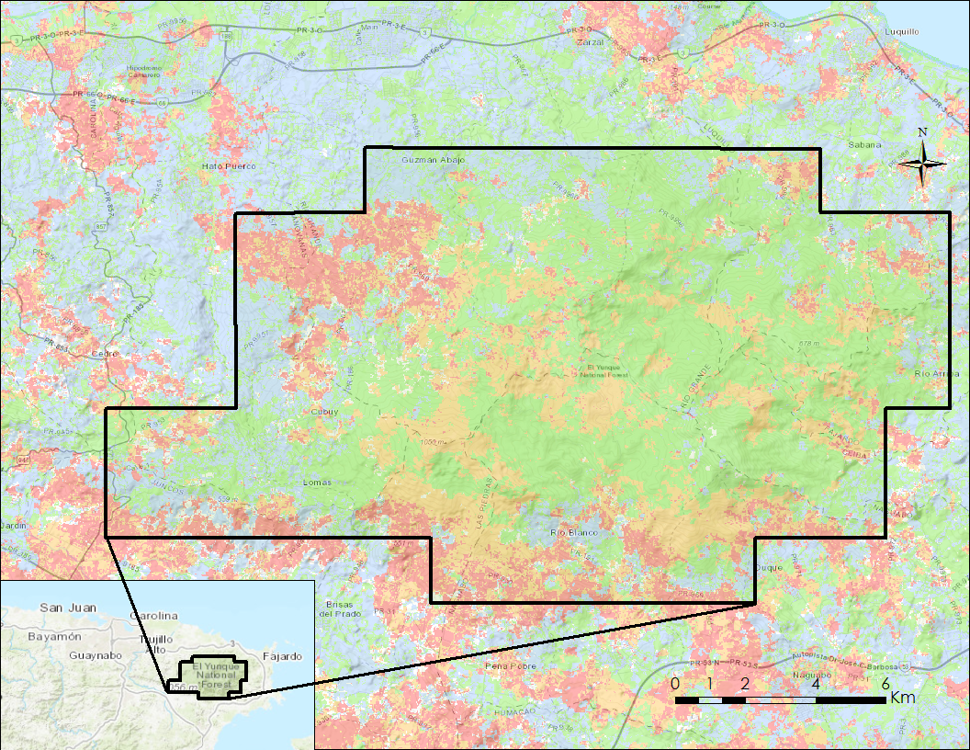
Results
NDVI and Cloud Cover (-)
Dry Season (Dec-Mar) cloud cover and NDVI difference pre- and post-Hurricane Maria
NDVI and Cloud Cover (+)
NDVI (-) and Cloud Cover (+)
NDVI (+) and Cloud Cover (-)
~69% of El Yunque had a decrease in NDVI pre and post Maria during Dry Season
Notes:
Map on the left:
The map displays the four outcomes that are possible with the NDVI and Cloud Cover pairing comparing the before and after hurricane Maria during the Dry Season
NDVI and Cloud Cover Decrease
NDVI and Cloud Cover Increase
NDVI increase and Cloud Cover Decrease
NDVI decrease and Cloud Cover Increase
This map shows that the area within the El Yunque national forest (within the black boundary) falls primarily within the two categories related to a decrease in NDVI (NDVI and Cloud Cover Decrease = yellow, NDVI Decrease and Cloud Cover increase = green)
Chart on the right:
The chart on the right displays the numerical breakdown of the percentage of total number of pixels that are in each respective category
Providing support to the visual conclusions, we see that roughly 69% of the total number of pixels belong to one of the two categories corresponding to NDVI decrease
The relationship between NDVI and cloud cover is different from what we have expected, since the majority is showing NDVI decrease and cloud cover increase after Maria during the Dry Season.
Explanation: This could be due to the changes in surface roughness (vegetation type), resulting in more effective orographic effect that can lift and condense the air mass in a lower altitude = more orographic clouds = increase in cloud coverage!
Dry season after Maria = is on average regarding the moisture availability (precipitable water), so changes in land cover due to hurricane can play the role to affect clouds

Slide 14
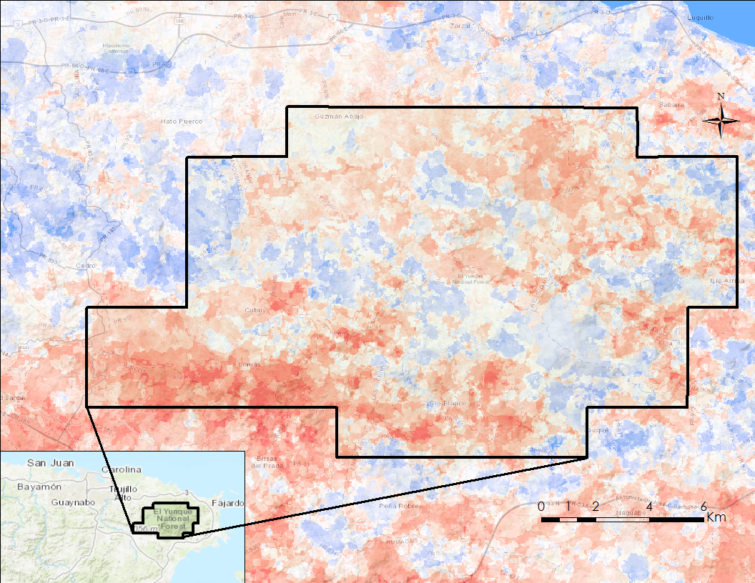
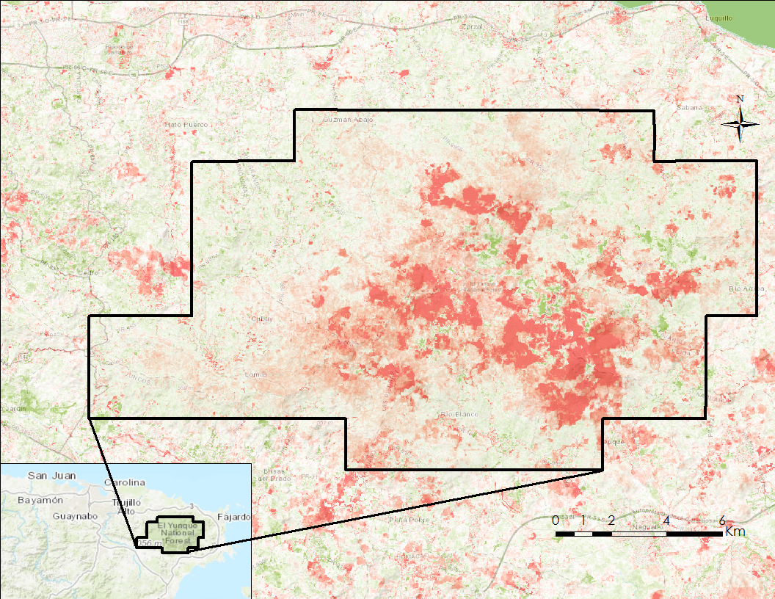
Results
Early Rain Season(Apr-Jun) cloud cover and NDVI changes pre- and post-Hurricane Maria
Most Extreme Cloud Cover (-)
Most Extreme NDVI (-)
No Change
No Change
Most Extreme Cloud Cover (+)
Most Extreme NDVI (+)
Notes:
Map on the left:
The map on the left is a visualization of the intensity of change in cloud cover pre and post hurricane Maria during the Early Rain Season
The difference in cloud cover reveals a cloud cover increase (in blue) over a few areas of the Luquillo Mountains and a cloud cover decrease (in red) occurring over the remaining area
Map on the right:
The map on the right is a visualization of the intensity of change in NDVI pre and post hurricane Maria during the Early Rain Season
Again, this agrees with the areas more affected by Hurricane Maria (west, and peaks of the Luquillo Mountains), but we can see that the vegetation here has already recovered much more than when compared to the previous season.

Slide 15
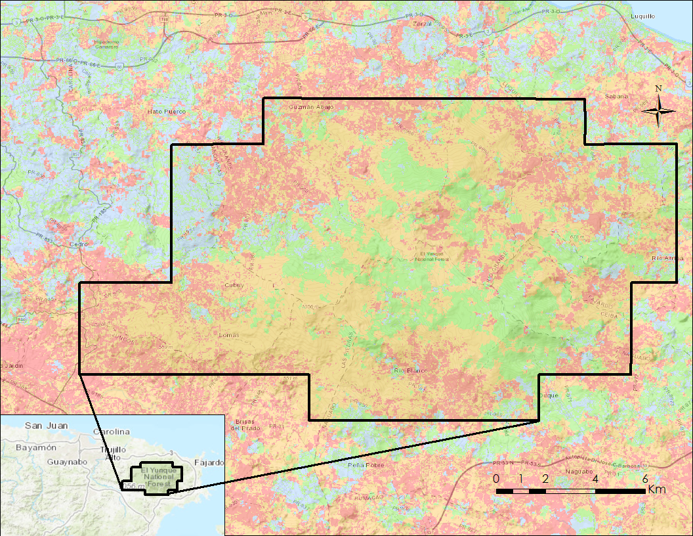
Results
NDVI and Cloud Cover (-)
Early Rain Season(Apr-Jun) cloud cover and NDVI difference pre- and post-Hurricane Maria
NDVI and Cloud Cover (+)
NDVI (-) and Cloud Cover (+)
NDVI (+) and Cloud Cover (-)
Notes:
Map on the left:
The map displays the four outcomes that are possible with the NDVI and Cloud Cover pairing comparing the before and after hurricane Maria during the Early Rain Season
NDVI and Cloud Cover Decrease
NDVI and Cloud Cover Increase
NDVI increase and Cloud Cover Decrease
NDVI decrease and Cloud Cover Increase
This map shows that the area within the El Yunque national forest (within the black boundary) falls primarily within the two categories related to a decrease in NDVI (NDVI and Cloud Cover Decrease = yellow, NDVI Decrease and Cloud Cover increase = green)
Chart on the right:
The chart on the right displays the numerical breakdown of the percentage of total number of pixels that are in each respective category
Providing support to the visual conclusions, we see that roughly 70% of the total number of pixels belong to one of the two categories corresponding to NDVI decrease
A difference between the results from the Early Rain Season and the Dry Season discussed before is we see much stronger evidence for a positive relationship between NDVI and cloud cover.
However, we still can see NDVI decrease and cloud cover increase occurring in the Luquillo Mountains (higher elevation), which can be related to the surface roughness and the more effective orographic effect, as mentioned before.
Additionally, it seems that during this rainy season the decrease in cloud coverage is surrounding the peaks of the Luquillo Mountains where we could not see drastic changes in NDVI post-Maria. So, it is probably not directly related to the land cover change.
We saw that the amount of moisture available at the atmosphere (precipitable water) was anomaly below the mean for this season = drier than normal ERS, which suggests that a larger scale mechanisms other than the hurricane

Slide 16
Conclusions
CBH Following Maria
NDVI and Cloud Cover Following Maria
Further Remarks
Cloud Base Height decreased in both the Dry and the Early Rain Season
Decreased surface roughness => less friction => faster winds encountering mountains => more efficient lifting => lower clouds
Increase in Theoretical CBH in both the Dry and the Early Rain Season
Partners can compare these results with their observational data set to review forest management strategies
NDVI decreased where expected in both the Dry and Early Rain Season (~70% of the area)
Cloud cover increased during the Dry Season(~60% of the area)
Decreased surface roughness = orographic effect
Cloud cover decreased during the Early Rain Season (~70% of the area)
Anomaly dry atmosphere = large scale mechanism
Concerns about data quality
CALIPSO
Low elevation clouds
Photo Credit: Gary Potts_USFS IITF
Notes:
CBH FOLLOWING HURRICANE MARIA
Our study indicates that large scale defoliation events could have a different impact over the Luquillo Mountains from what was suggested in previous studies using anecdotal data.
The USFS could use the CALIPSO data to review their main concerns about CBH increase after a catastrophic hurricane. This is because our results indicate that CBH can decrease after a massive defoliation event instead of increase as it was supposed.
NDVI AND CLOUD COVER RESPONSE FOLLOWING MARIA
NDVI decreases occurred in areas of the park that were most vulnerable to high winds and within the path of Maria (peaks of the Luquillo Mountains)
Increases in Cloud Cover during the Dry Season could have resulted from better orographic uplift due to decreased surface roughness = more cloud coverage
Decrease in Cloud Cover during the Early Rain Season could be related to large scale mechanisms other than hurricane or land cover change effects = much drier than normal season
FURTHER REMARKS
During the course of our project we encountered some difficulties that we would like to comment upon.
First, the CALIPSO dataset:
We found CALIPSO to be well suited to our needs to determine CBH, however we found the product does not lend itself to small-scale meteorological data analysis.
Furthermore, the geographic limits imposed by the satellite’s fixed path weakens any conclusions drawn to areas that lay outside of the path.
The El Yunque National park lies within 10km of the furthest path.
The product including the Opacity flag was available only until March 2018, does not allowing us to analyse the Early Rain Season changes after Maria
Secondly, we found it difficult determine a method to measure CBH for low lying clouds. While we did settle on a methodology that subset clouds based on the Trade Wind Inversion elevation (2000 m), we believe there could be a better methodology for the measurement of low-elevation clouds that should be better investigated
Image: https://www.flickr.com/photos/101115103@N03/35839109542/in/album-72157686433208325/

Slide 17
Future work
Correlate CBH changes with USGS precipitation records, MODIS Evapotranspiration, IITF Vaisala CL31 Ceilometer and USGS cloud monitoring camera
Compare Terra MODIS and Landsat 8 cloud masks results
Compare different CALIPSO products and their estimated CBH pre- and post-Maria
Notes:
We hope to correlate CBH changes with USGS precipitation records, MODIS Evapotranspiration, IITF Vaisala CL31 Ceilometer and USGS cloud monitoring camera
In addition, we will compare Terra MODIS and Landsat 8 cloud masks results.
Finally, we hope to compare different CALIPSO products and their estimated CBH pre- and post-Maria

Slide 18
Acknowledgements
Project Partners
Dr. Grizelle Gonzalez, Research Scientist, USDA, US Forest Service, International Institute of Tropical Forestry
Science Advisors
Dr. Thomas Mote, University of Georgia
Dr. Paul Miller, University of Georgia
Other Contributors
Caren Remillard, NASA DEVELOP Center Lead, Georgia – Athens
Martha Scholl, Research Hydrologist, USGS National Research Program
Robert A. Ryan, NASA Langley Research Center
Notes:
Thanks to our project partners, science advisors and other contributors

Slide 19
References
Dunion, J. P., & Velden, C. S. (2004). The impact of the Saharan air layer on Atlantic tropical cyclone activity. Bulletin of the American Meteorological Society, 85(3), 353-366.
Quiñones, Maya; Parés-Ramos, Isabel K.; Gould, William A.; Gonzalez, Grizelle; McGinley, Kathleen; Ríos, Pedro. 2018. El Yunque National Forest Atlas. Gen. Tech. Rep. IITF-GTR-47. San Juan, PR: U.S. Department of Agriculture, Forest Service, International Institute of Tropical Forestry. 63 p.
Schubert, W. H., Ciesielski, P. E., Lu, C., & Johnson, R. H. (1995). Dynamical adjustment of the trade wind inversion layer. Journal of the Atmospheric Sciences, 52(16), 2941-2952.
Van Beusekom, A. E., González, G., & Scholl, M. A. (2017). Analyzing cloud base at local and regional scales to understand tropical montane cloud forest vulnerability to climate change. Atmospheric Chemistry and Physics, 17(11), 7245.
Notes:
These are the references we have used
Thank you for your attention!
Any questions?

Slide 20
Additional Slides (will not appear on the slide show - to be kept “hidden” )

Slide 21
Google Earth Engine
Input Data
Result
Start Date Pre Maria
End Date Pre Maria
Start Date Post Maria
End Date Post Maria
Tool
Flow
Collection Code
El Yunque Boundary
Puerto Rico Scene Boundary
Image Scene Path & Row
Run the Image Difference Function
ee.ImageCollection.filter
Difference Image showing the difference between the mean “Before” image and mean “After” image
Export Image Collection
Image Collection for Start and End Dates
Clip the Image Collection to the El Yunque Boundary
Run Image Collection through the cloud cover function
Reclassify Images based on their difference value
Image Collection for Start and End Dates
Image Collection of cloud cover masks
Classified Images (NDVI Increase and Cloud Cover Decrease, etc.
Export Image Collection
Export Image Collection
Notes:
Google Earth Engine Methodology Takeaways:
The strength of Google Earth Engine is the ability to quickly and flexibly process a large time series analysis without having to physically hold any of the data used in the analysis
In this case we have created a methodology to allow the user to flexibly change the selection parameters for an image dataset and then do some basic geoprocessing and calculations across the entire dataset
Because we worked with six different time frames, this methodology had the advantage of being able to quickly change to our different time frames without having to change any of the subsequent code
Inputs:
Defined variables for the start date, end date, and code for the image collection
Import the El Yunque boundary file as an asset (Google Earth Engine term for uploading the shapfile into the workspace so it is accessible to the script)
These four pieces serve as the input for the ee.ImageCollection.filter code
Ee.ImageCollection.filter
This code will select only the images in the entire MODIS image collection that fall within the date range and intersect the el Yunque park Boundary
It is important to note that by selecting any image that intersects the El Yunque study area you have to ensure that you don't have images that do not entirely capture the study area
This is a potential problem for study areas that fall on multiple paths but in the case of El Yunque MODIS data this was not an issue
Image Collection intersecting El Yunque
This output is all of the images that meet the input criteria
In this case that means that all of the images in this collection fall in the user provided date range and intersect the park boundary
The actual number of images in the collection depended on the time frame we provided but ranged to anywhere from 165 images to 8 images in a collection
ImageCollection.map(clipFunction)
The ImageCollection.map(function) code is the particular method provided by Google earth Engine to iterate through an image collection
The inputs for this function are the image collection of El Yunque per the other provided parameters and the El Yunque Boundary
In this case we are mapping a function that takes in each image of the collection individually and clips it to the El Yunque Boundary
Image Collection Contained by El Yunque Boundary
This result is an image collection that is stored in a variable that subsequently contains only the clipped images
ImageCollection.map(ratioFunction)
This function will pass each image from the clipped image collection into a cloud ratio calculation
The function will then pass the cloud ratio values for each pixel in each image back to the variable created to store the function call
NDVI Values for Subset Image Collection
This image collection is a collection of images that only contain one band, which is a cloud ratio value band. What this shows is the cloud ratio value for each pixel in the entire collection
ImageCollection.sum().divide(collectionSize)
ImageCollection.mean () is a method provided by Google Earth Engine to gather the average
.divide is a function used for the division operation
The net result of this operation is to create the average e
This method is part of the reducer class of methods in Google Earth Engine that processes an image collection in some way to reduce the entire collection down to a single image
Single composite image of total NDVI values across the collection
This single composite image contains the summed values of the NDVI value for each pixel across the entire time frame

Slide 22
PyHDF
Start Date
End Date
El Yunque Boundary
MODIS Image Collection
Image Collection Contained by El Yunque
ImageCollection.map(ndviFunction)
Image Collection ofNDVI Values for the El Yunque subset
ee.ImageCollection.filter
ImageCollection.sum()
Image Collection Intersecting El Yunque
Single composite image of total NDVI values across the collection
ImageCollection.map(clipFunction)
El Yunque Boundary
Notes:
CALIPSO Processing and Analysis Takeaways:
Placeholder
Inputs:
HDF Files
Methods

