Slide 1
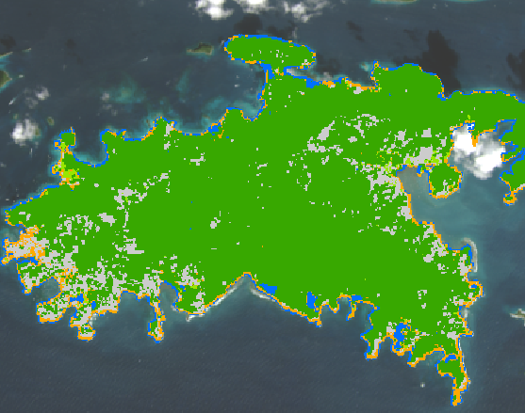
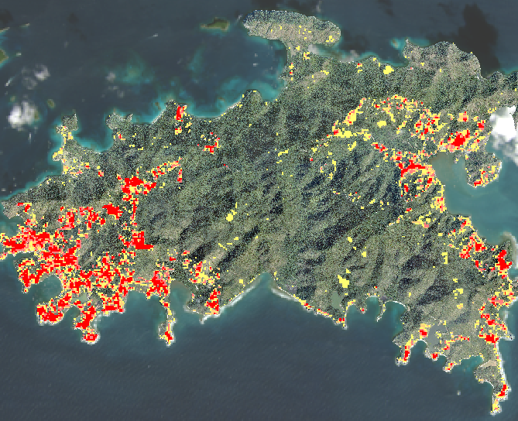
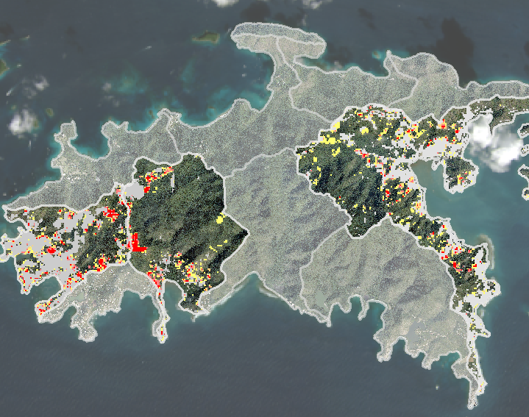
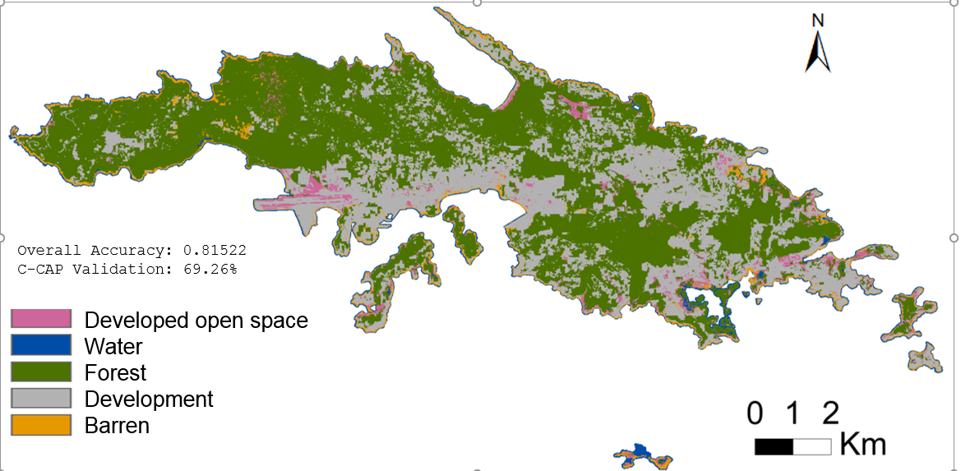

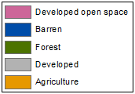
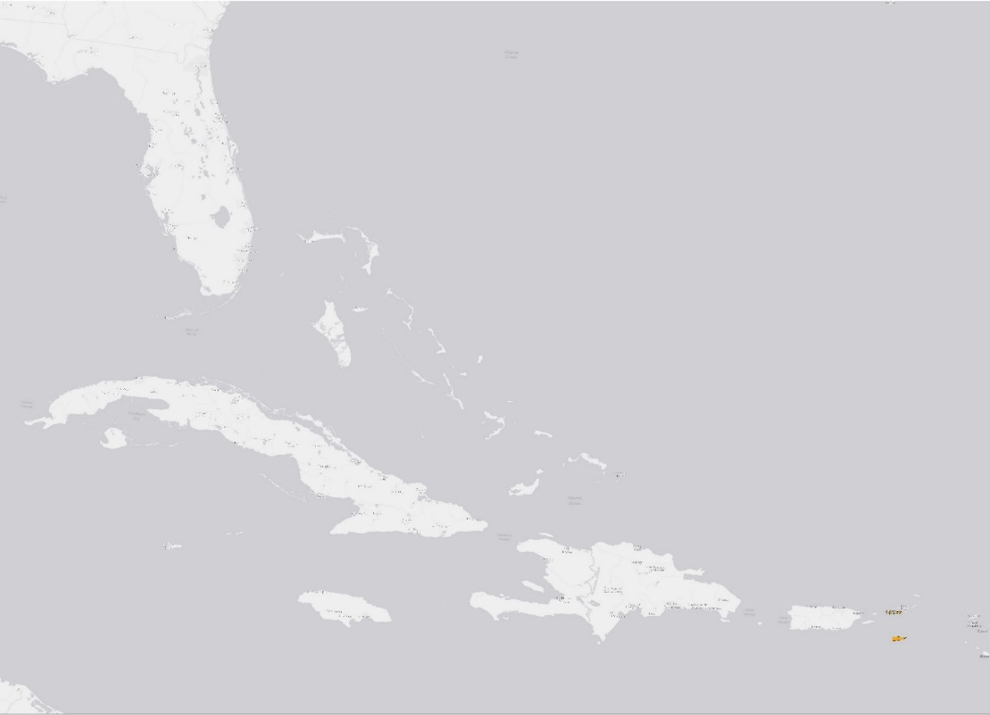
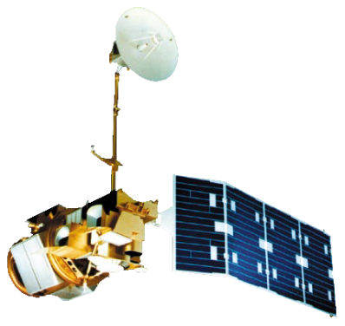
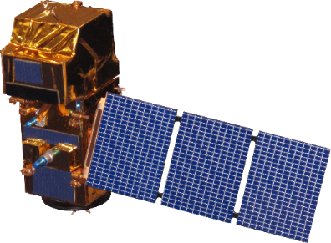

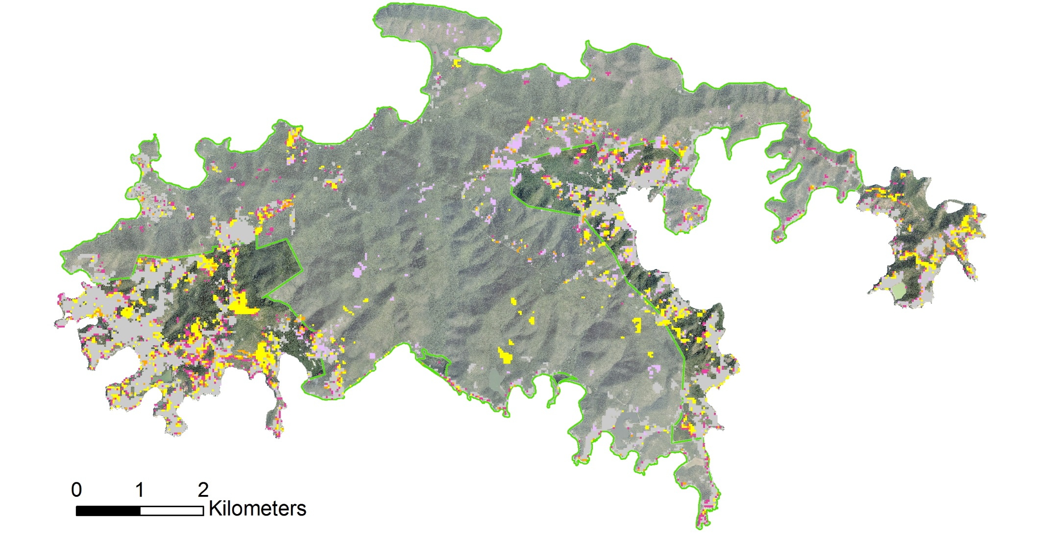
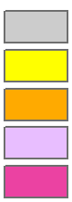
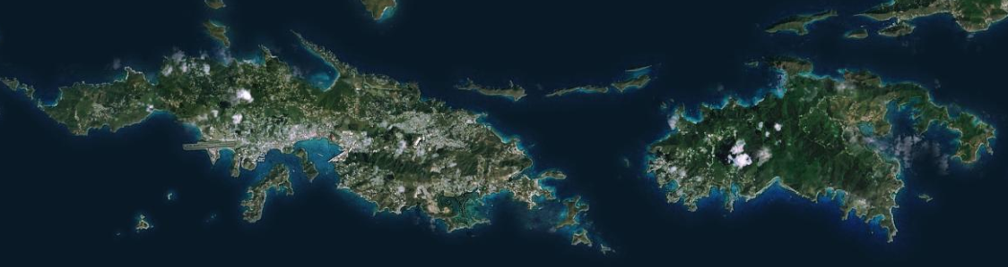


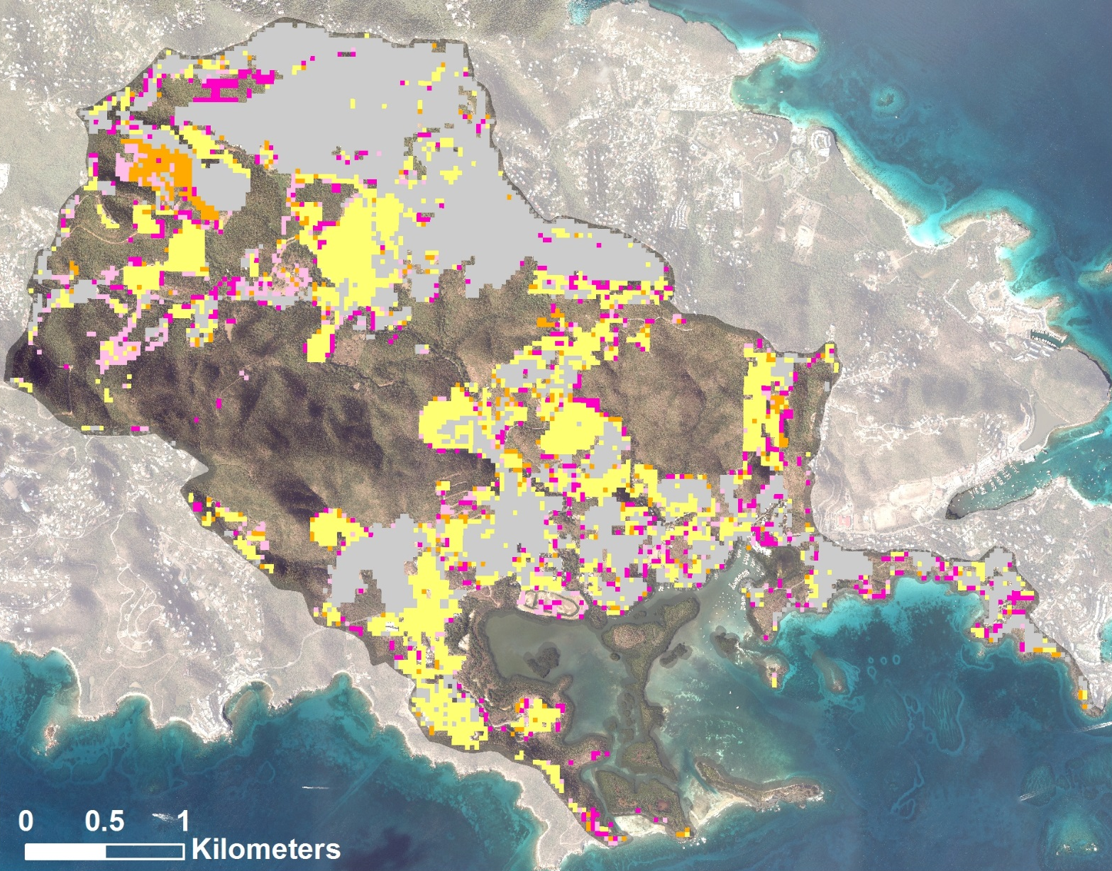




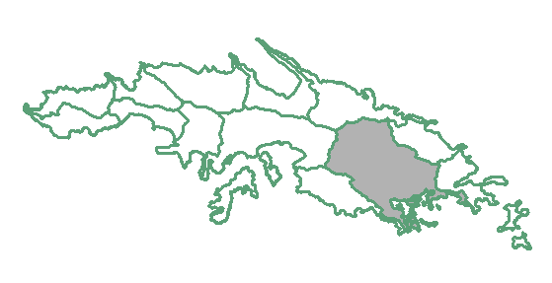
Using NASA Earth Observations to Monitor Land-use Change and Map At-risk Coastal Habitats in the US Virgin Islands
Abstract
Methodology
The United States Virgin Islands (USVI) are home to an array of diverse and stunning habitats. The beauty of the islands has continued to attract visitors and residents, which overtime has increased human development and impact. The resulting land-use change increases sediment loads and the flow of pollutants into surrounding nearshore environments such as coral reefs, mangroves, and seagrass beds. Coral reefs, the most diverse marine habitats on Earth, are particularly susceptible to these inputs. Compounded with regional climate-related processes such as rising ocean temperatures and acidification, future land-use change poses a formidable threat to the marine environment. Without a healthy environment, the USVI economy also becomes endangered because it is heavily supported by tourism and recreation. In order to assess land-use change in the USVI, we utilized Landsat 5 TM, Landsat 8 OLI and TIRS, and Sentinel-2 MSI data to map land-use and analyze land cover change dating back to 1985. The produced maps were analyzed by watershed boundaries to identify high priority nearshore environments that are likely to be at risk to from growing development. Our work will provide the USVI Department of Planning and Natural Resources, Division of Coastal Zone Management (CZM) with a tool to better understand land-use trends, identify at-risk coastal habitats, and strengthen existing knowledge of the link between land-use and coastal ecosystem health.
Created composite images on which to run supervised classifications for each year
Analyzed land use trends over time for each island
Analyzed trends by watershed boundaries to identify at-risk marine habitats
Objectives
Results
Analyze satellite imagery to fill gaps in current knowledge of historical land-use and land cover
Identify coastal zone areas that are at risk due to land-use change
Predict future land-use change trends using machine learning
Developed open space
Water
Forest
Development
Barren
Study Area
Earth Observations
Florida
Figure 1. Land-use classification of St. Thomas using 2016 Sentinel-2 Imagery.
Landsat 8 OLI
US Virgin Islands Ecological Forecasting
Cuba
Landsat 5 TM
Sentinel-2 MSI
Development year
Haiti
Dominican
Republic
Pre-1992
1992-2013
2014
2015
2016
Virgin Islands
National Park
Northern
U.S. Virgin Islands
St. Thomas
St. John
Figure 2. Yearly development on St. John. Most development has occurred mostly in coastal zones outside of the Virgin Islands National Park. Analysis was completed using classified Landsat 5, Landsat 8, and Sentinel-2 imagery.
Team Members
Jersey Bay Watershed
Rebecca Lehman
(Project Lead)
Bretton Alwood
Carrie Boyle
Erica Ta
Development year
Pre-1992
1992-2013
2014
2015
2016
Acknowledgements
Leslie Henderson – U.S. Virgin Islands Department of Planning and Natural Resources Coastal Zone Management
Pedro Nieves – U.S. Virgin Islands Department of Planning and Natural Resources Coastal Zone Management
Jean-Pierre Oriol – U.S. Virgin Islands Department of Planning and Natural Resources Coastal Zone Management
Dr. Juan Torres-Perez – Bay Area Environmental Research Institute
Dr. Liane Guild – NASA Ames Research Center
Dr. Marilyn Brandt – University of the Virgin Islands
Dr. Tyler Smith – University of the Virgin Islands
Jenna Williams – DEVELOP National Program, Ames Center Lead
John Dilger – DEVELOP National Program, Ames Assistant Center Lead
Dr. Adem Ali – College of Charleston
Dr. Joseph D. Ortiz – Kent State University
Figure 3. Yearly development in the Jersey Bay watershed on St. Thomas. Analysis was completed using classified Landsat 5, Landsat 8, and Sentinel-2 imagery.
Conclusions
Development intensity varies by watershed, which should be considered in the process of issuing permits for future development.
Long-term data are critical to seeing variation in distribution and intensity in development.
Landsat imagery does not provide the spatial resolution needed to quantify change on an island scale..
Project Partners
USVI Department of Planning and National Resources, Coastal Zone Management (CZM)
NASA Ames Research Center – Summer 2017

