Slide 1
Gulf of Mexico Health &
Air Quality
Utilizing NASA Earth observations to manage air quality and pollutants over the Gulf of Mexico
Amanda Clayton (Project Lead)
Lori Mandable

Slide 2
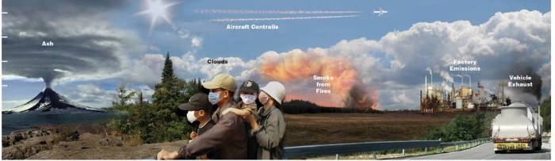
Community Concerns
12 km
9 km
6 km
3 km
-
-
-
-
Credit: NASA
Offshore oil and natural gas drilling in the GOM produces aerosol, nitrogen dioxide, and sulfur dioxide emissions
Affects onshore AQ, causing health and environmental impacts
Point data from individual platform and non-platform sources do not provide the regional coverage necessary to answer larger scale scientific questions
Notes:
Offshore oil and natural gas drilling in the Gulf of Mexico, on over 3,000 platforms, produces aerosols, nitrogen dioxide, and sulfur dioxide emissions. Emissions from offshore drilling can impact onshore air quality, causing health and environmental impacts. Emissions point data from individual platform and non-platform sources do not provide the regional coverage necessary to answer larger scale scientific questions.
Image Source: http://www.nasa.gov/content/goddard/cats-eyes-clouds-smoke-and-dust-from-the-space-station (Composite image created from photographs by Patrick Byrne, Carolyn Conner, Peggy Davis, Daneil Fogg, John Newman, Cyrus Reed, and Gayle Trautman)

Slide 3
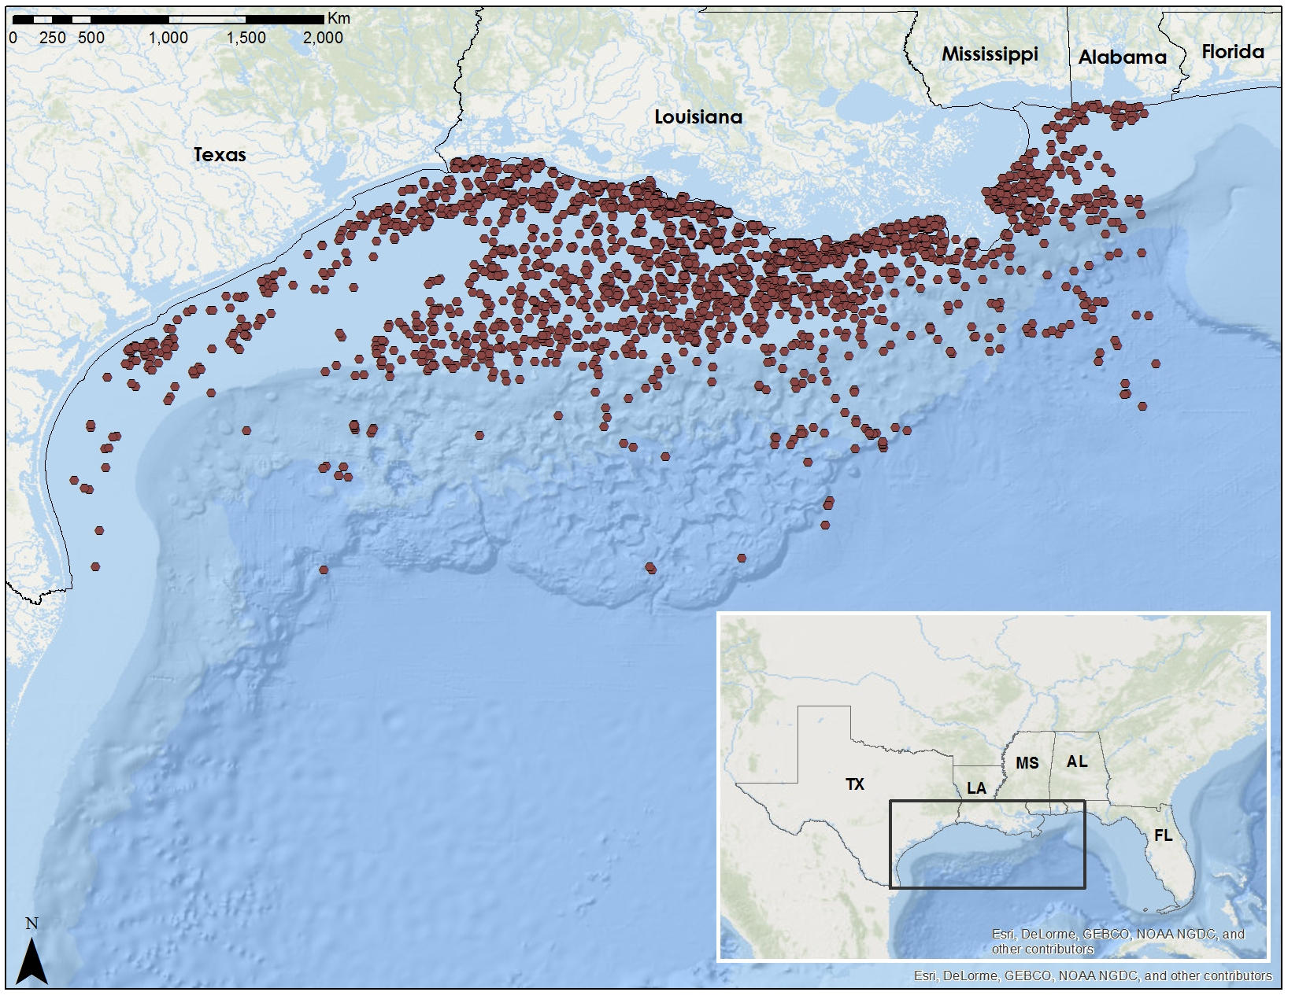
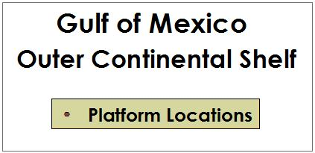
Study Area
Notes:
Our project focused on the Outer Continental Shelf (OCS) of the Gulf of Mexico including the onshore areas of Texas, Louisiana, Mississippi, and Alabama. The points on the map show oil and natural gas production platform locations from 2000 to 2015.
Base Map: Esri, DeLorme, GEBCO, NOAA NGDC, and other contributors

Slide 4


Objectives
Map and Analyze airborne pollutant concentrations of PM_{2.5}, NO₂, and SO₂ using NASA Earth observations
Determine correlations between pollutants and primary emission sources (BOEM and EPA)
Develop methodology for continuing emissions monitoring
Credit: BOEM
Notes:
Working with our partners at the Bureau of Ocean Energy Management, our project had three main objectives. First, to use NASA Earth observations to map and analyze airborne pollutant concentrations of aerosol PM2.5, nitrogen dioxide and sulfur dioxide trace gases. Second, to determine correlations between these pollutants and primary emissions sources by incorporating data from BOEM’s Gulfwide emission inventories and from EPA ground monitoring sites. Lastly, to develop a methodology that BOEM can use for continuing emissions monitoring.
Image Source: http://www.boem.gov/Sale-246/

Slide 5
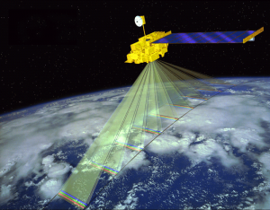
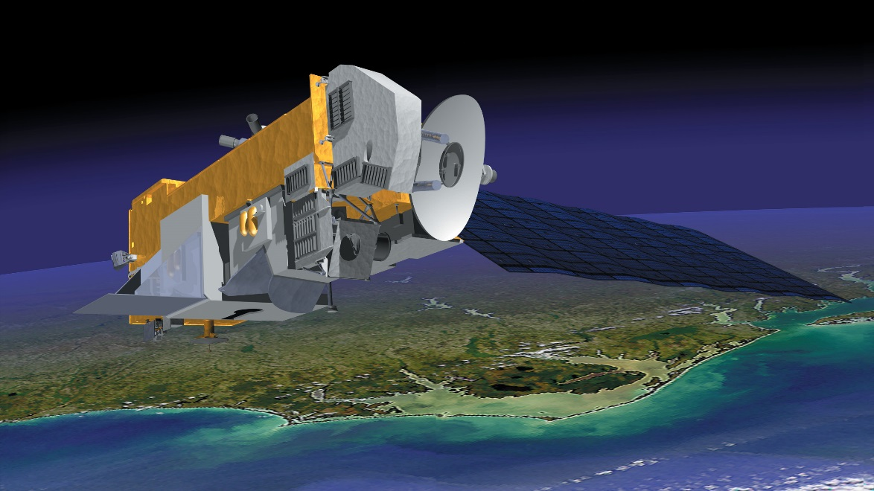
NASA Satellites & Sensors
Credit: NASA
Credit: NASA
Terra / MODIS
Aura / OMI
Aerosol Optical Depth (AOD)
Nitrogen Dioxide (NO₂)
Sulfur Dioxide (SO₂)
Notes:
We utilized MODIS data from the Terra satellite for satellite retrieval of aerosol optical depth, which serves as a proxy for PM_{2.5} emissions, and Aura’s OMI data for total column nitrogen dioxide (NO₂) and sulfur dioxide (SO₂).
Image Source: http://mynasadata.larc.nasa.gov/oyw/terra-celebrates-5000th-day-on-orbit/
Image Source: http://earthobservatory.nasa.gov/Features/Aura/

Slide 6
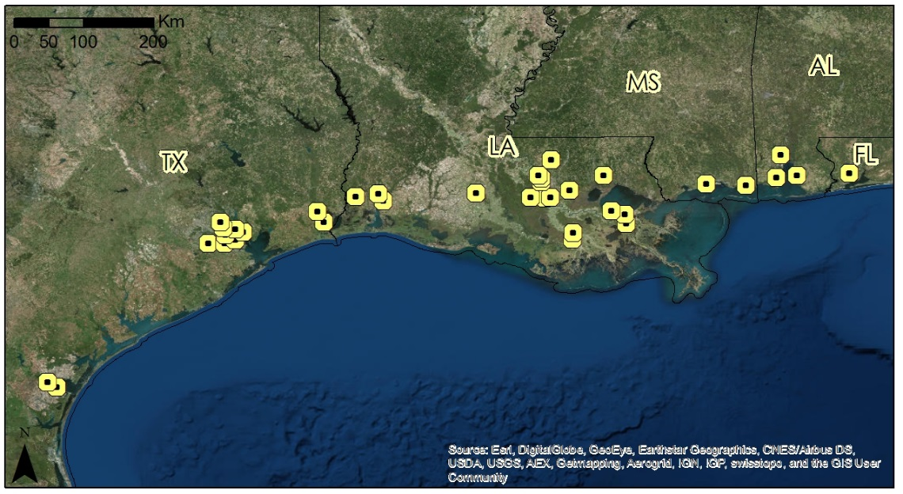

Methodology Overview
STEP 1
Examine Level 3 satellite data to determine local “hot spots”
STEP 2
Obtain Level 2 data for “hot spot” locations to analyze emission patterns
STEP 3
Compare and correlate Level 2 data analysis with in situ point data
Notes:
The first step in the process was to obtain and examine Level 3 satellite data products from Terra’s MODIS and Aura’s OMI sensors to determine local hot spots. Step 2 was to analyze higher resolution, Level 2 data to analyze emission patterns. And lastly, to compare and correlate the Level 2 data with in situ point data from BOEM and the EPA.

Slide 7
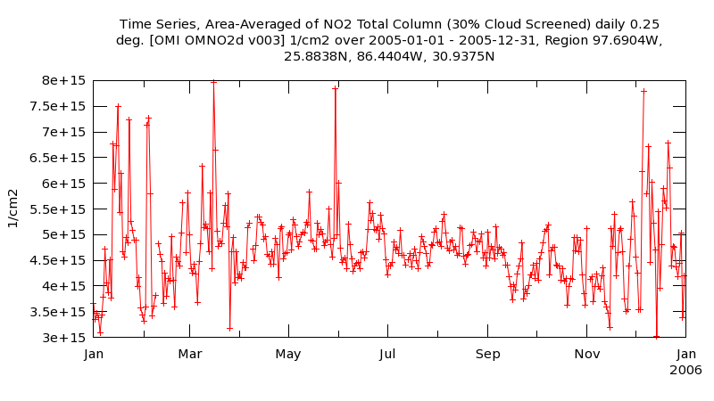
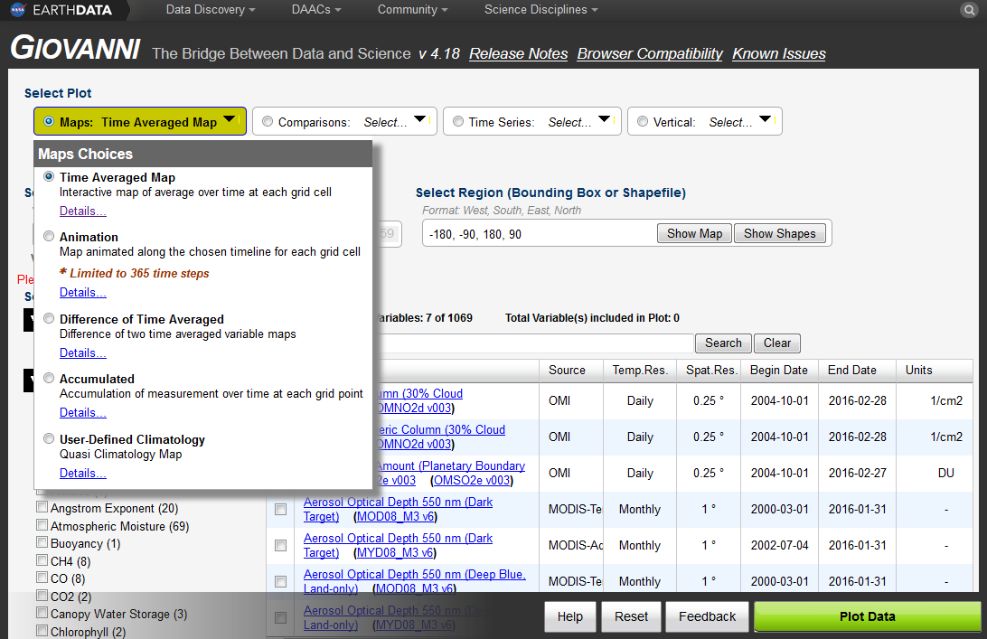
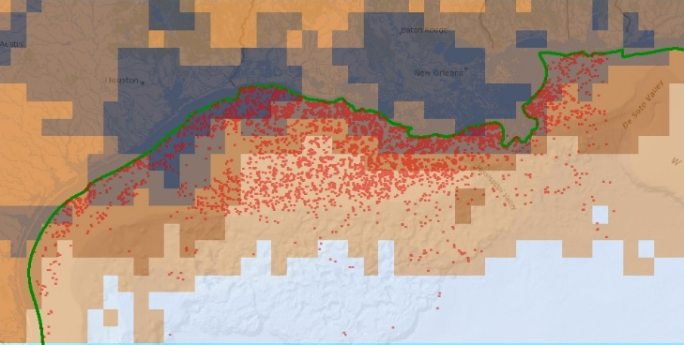
GIOVANNI
AREA - AVERAGED TIME SERIES
TIME – AVERAGED MAP
Notes:
We first looked at Level 3 data using NASA’s GIOVANNI online visualization and analysis tool that allows for easy access and analysis of Earth observing satellite data. Terra/MODIS provided Aerosol Optical Depth on a daily basis over a gridded area of 1 degree by 1 degree for the time series of 2005-2015. Aura/OMI provided the nitrogen dioxide and sulfur dioxide measurements on a daily basis over 0.25 degree by 0.25 degree gridded area for the same 2005-2015 time series.
For initial analysis, time series graphs illustrating the variation in pollutant level as well as time-averaged map products detailing locations of higher pollution were produced, then fed into ArcGIS, where areas of high pollution flagged as “hot spots.”

Slide 8
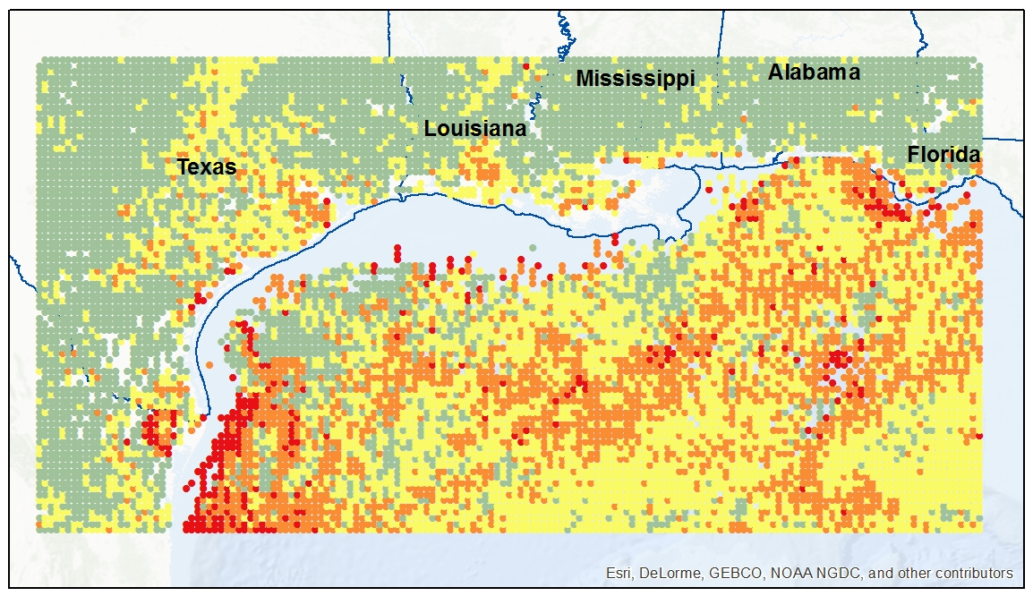
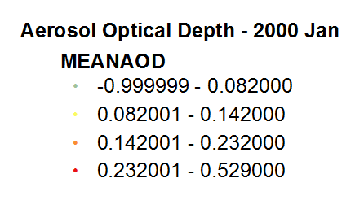
Level 2 Analysis
[In Progress]
SAMPLE IMAGE
Notes:
For areas identified as emitting high pollution values, Level 2 data was obtained at a spatial resolution of 0.1 degree by 0.1 degree (approximately 10 km) grids which was then analyzed, compared and correlated with point data provided by BOEM and EPA to determine relationships between emission values and air quality.

Slide 9
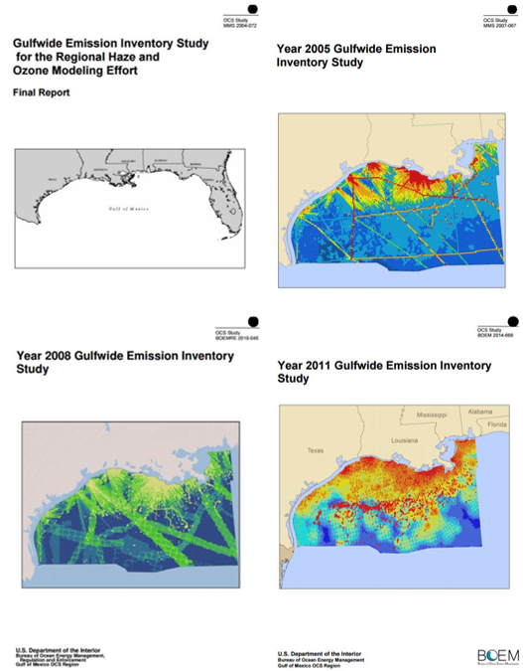
BOEM Emission Inventories
Monthly emission data from platform and non-platform point sources
Emission data parsed to specifically identify PM_{2.5}, NO_{x} and SO₂ sources
Data uploaded into ArcGIS for comparison and correlation with satellite data
Notes:
BOEM requires that oil and gas platform and non-platform sources in the Gulf of Mexico record monthly emissions measurements for a variety of criteria pollutants and greenhouse gasses including PM2.5, nitrogen oxides and sulfur dioxide. Examples of platform sources include diesel and natural gas engines, flares, and drilling equipment while non-platform sources include drilling rigs, pipe laying vessels, and helicopters. These monthly emissions data for the years 2000, 2005, 2008, and 2011 were stored in Microsoft Access database tables. These data were parsed by pollutant type and downloaded into Microsoft Excel for upload into ArcGIS, where it could be correlated with NASA satellite data.

Slide 10

EPA AirData
[In progress]
Notes:
In addition to the in situ data provided by BOEM, we downloaded emissions data from EPA onshore monitoring sites.

Slide 11
Results
[In progress]
Multiple slides
Time series and area averaged map visualizations

Slide 12
Conclusions
[In progress]

Slide 13
Advisors
Dr. Robert Levy, NASA GSFC
Dr. Pawan Gupta, NASA GSFC
Partners
Dr. Jose Hernandez, BOEM
Dr. Pawan Gupta, ARSET
Others
Dr. Bryan Duncan, NASA GSFC
Dr. Nickolay Krotkov, NASA GSFC
Dr. Lok Lamsal, NASA GSFC

