Slide 1
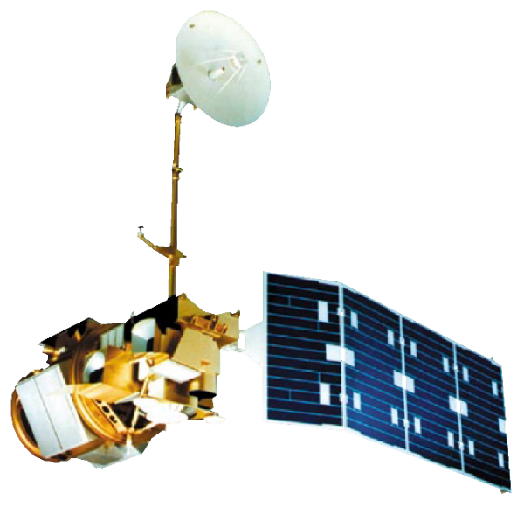
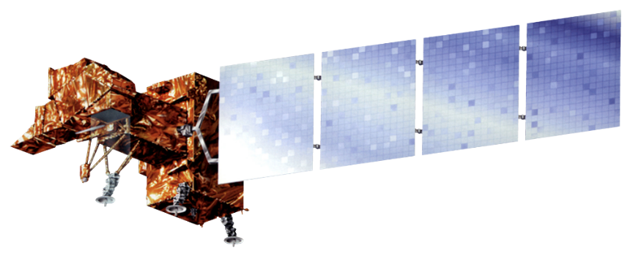

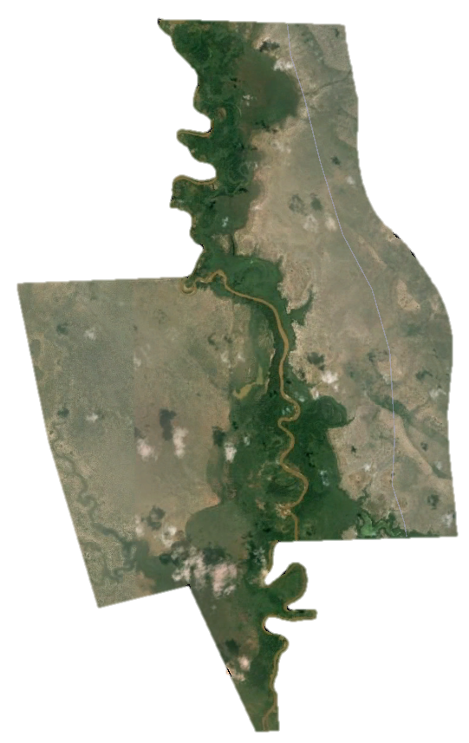
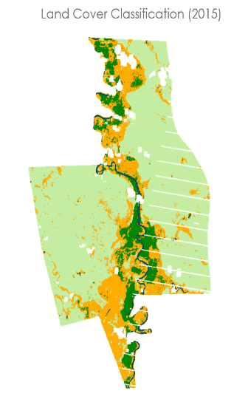
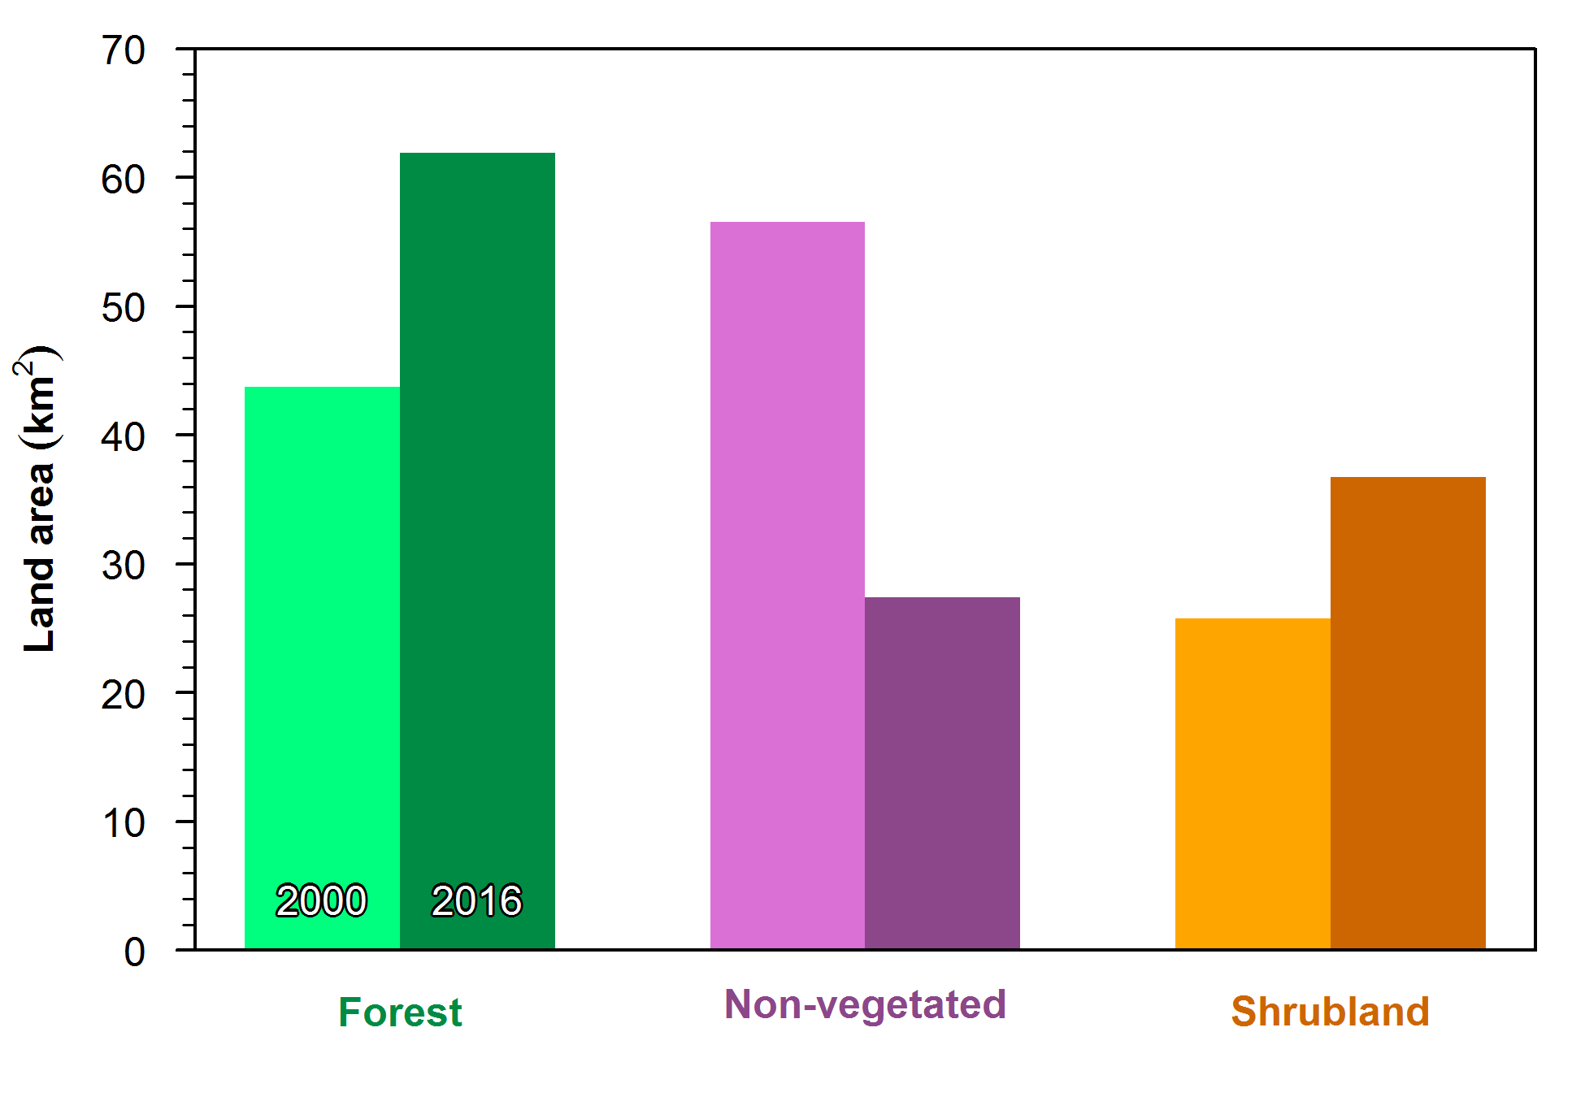
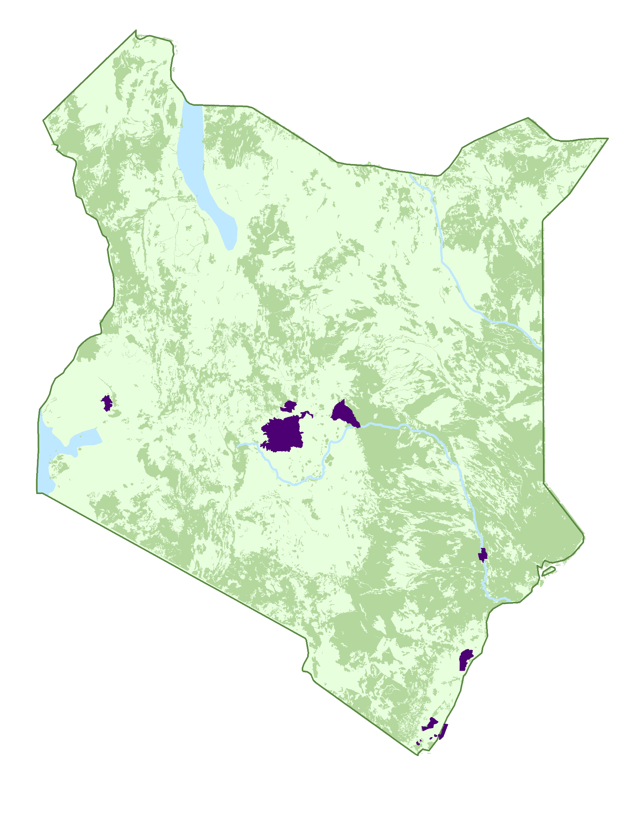
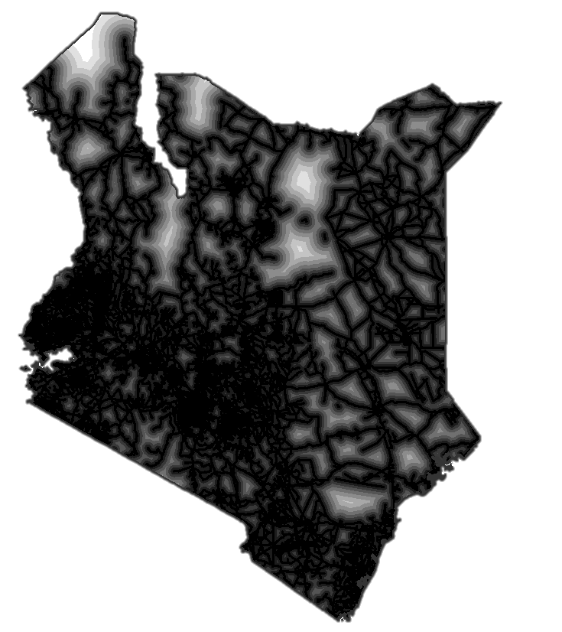
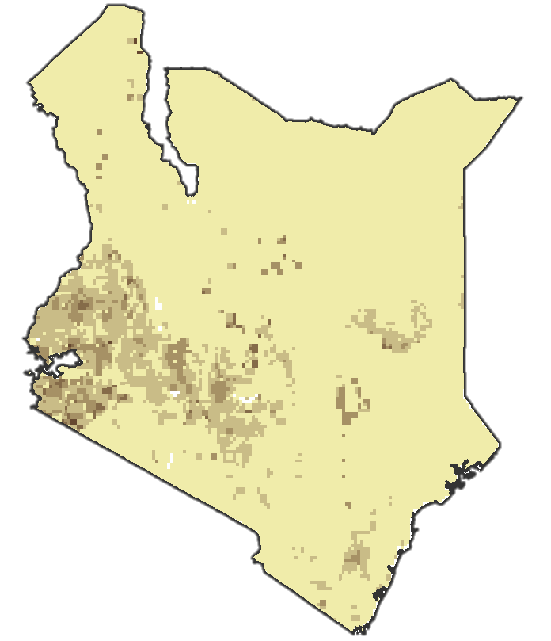
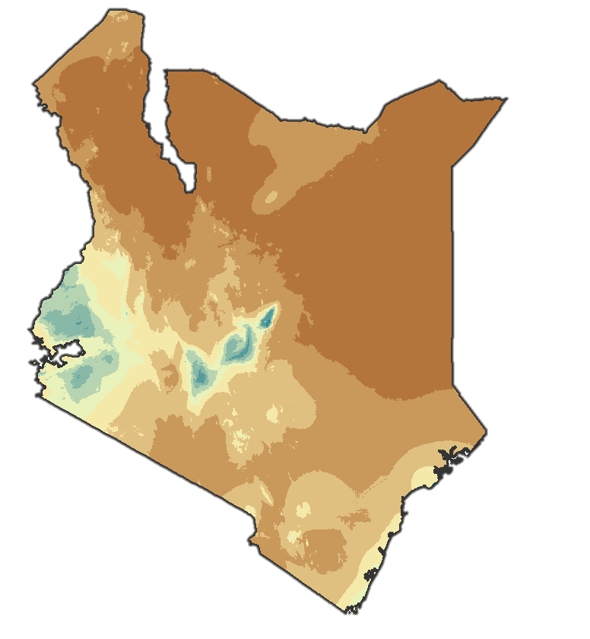
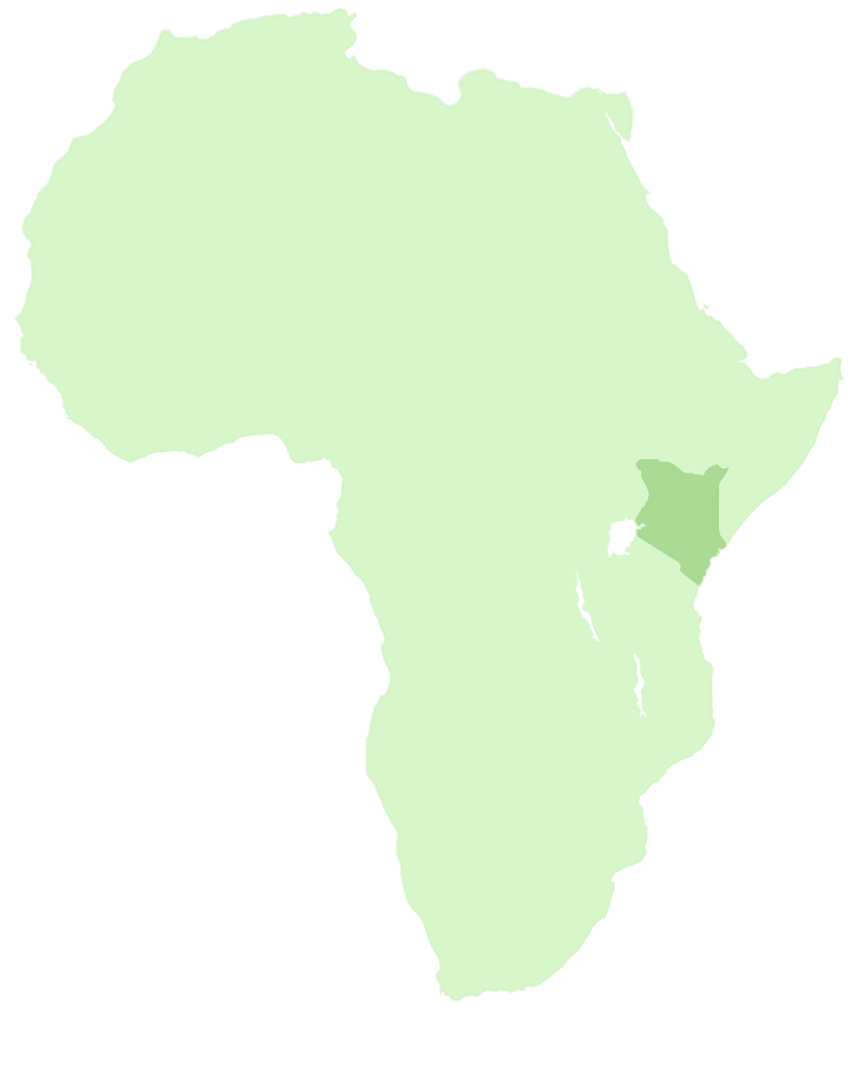
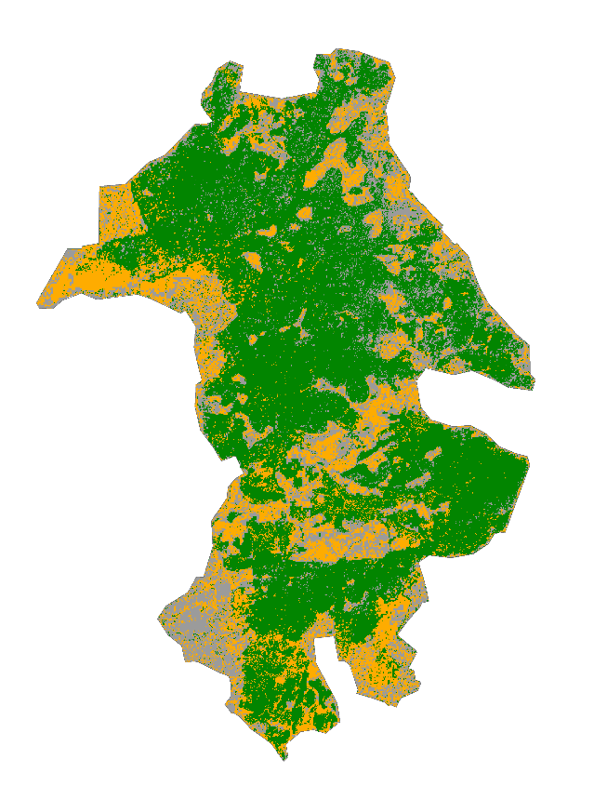
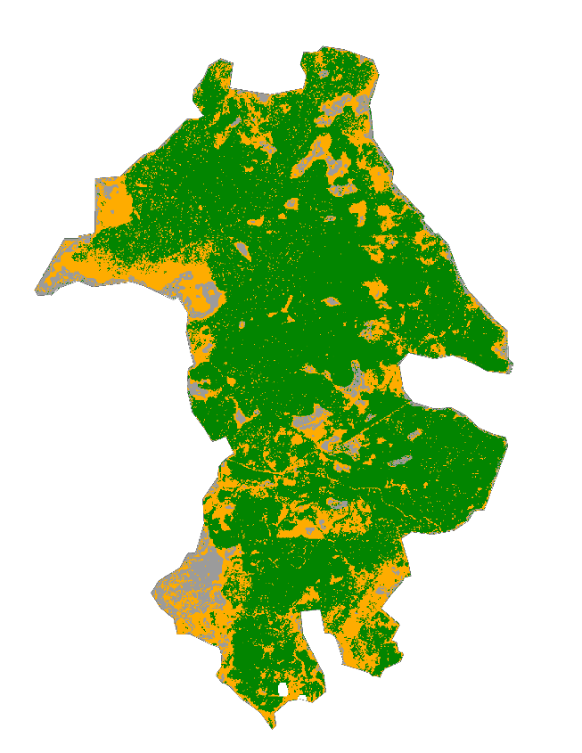
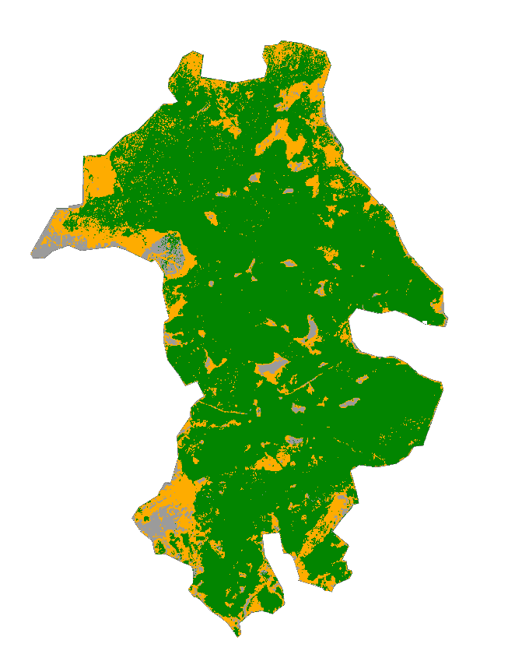
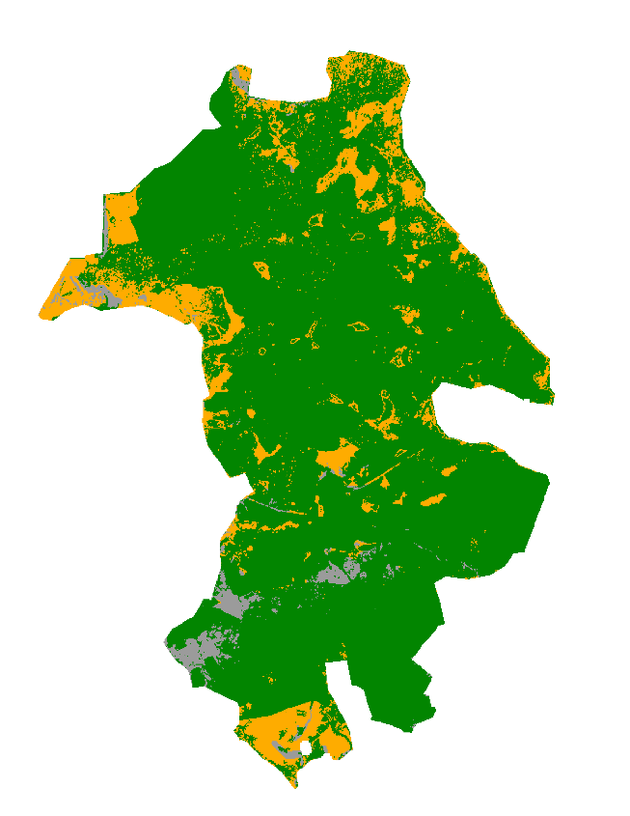
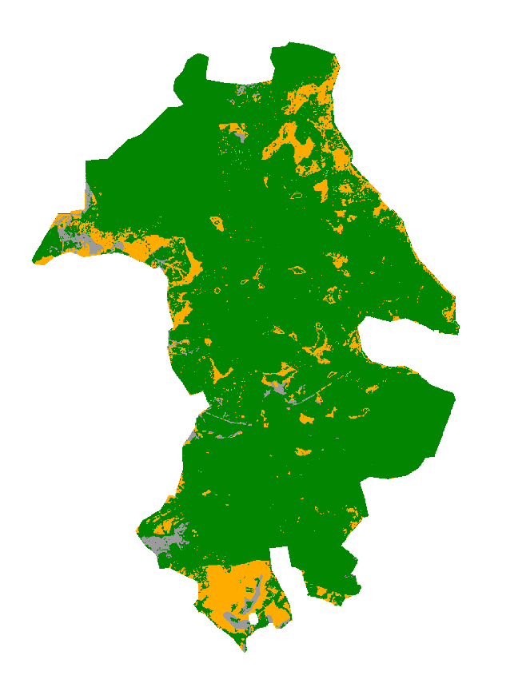

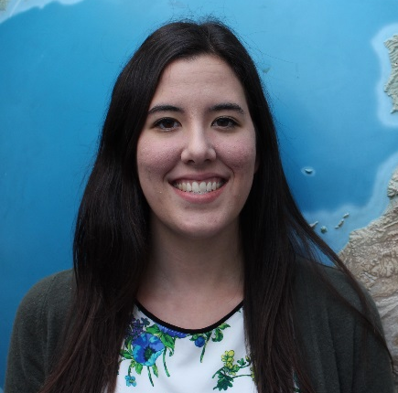
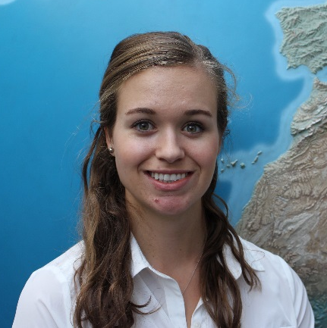
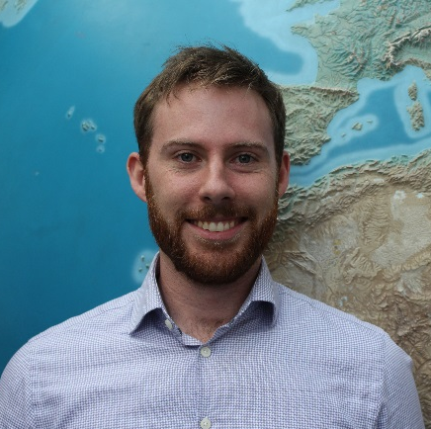
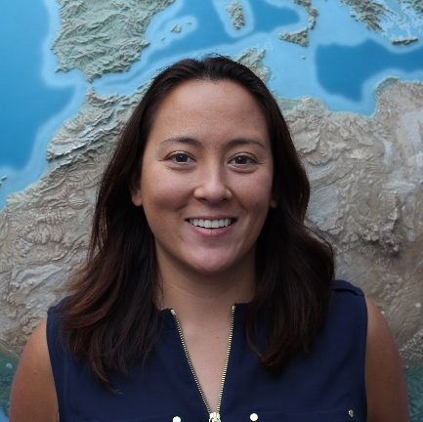
Estimating Carbon Sequestration Within Global Environment Facility Funded Protected Areas in Kenya to Aid Future Policy
Abstract
Objectives
Global deforestation continues to pose a major environmental problem that threatens biodiversity and increases the number of species facing extinction. In Kenya and worldwide, agriculture is the main driver of forest conversion. Each year, Kenya loses 12,000 hectares (ha) of forest out of its total 4.34 million ha. In order to increase forest cover and protect biodiversity, the Global Environment Facility (GEF) funded projects to establish 12 PAs within Kenya from 1995-2008. Currently, GEF utilizes a global dataset to track only change in forest cover in the PAs. Creating maps of past and forecasted above-ground carbon estimates will enable GEF to gain a better understanding of how the PAs are both conserving biodiversity and addressing climate change mitigation through carbon sequestration. Using Landsat 5 TM, Landsat 7 ETM+, and Landsat 8 OLI imagery from 1995-2016, land cover in each PA was classified to map past changes in forest cover and above-ground carbon stock. Additionally, these maps were processed with ancillary datasets in TerrSet Land Change Modeler to forecast above-ground carbon stocks for 2020 and 2030, given current deforestation rates. Final maps of past and forecasted above-ground carbon estimates will aid GEF in future policy and program decisions.
Estimate the amount of above-ground carbon stored in 14 protected areas established by GEF in Kenya
Forecast the amount of above-ground carbon sequestered in the protected areas in 2020 and 2030
Earth Observations
Landsat 5
Landsat 8
Landsat 7
Methodology
Study Area
Classify
Land Cover
Analyze
Change
Map land cover in each protected area for 1995, 2011, 2016
Quantify land cover gains and losses in each protected area
Satellite Image
Classified Image
Predict
Change
Evaluate Change
Quantify past and forecasted
forested area & estimate
carbon stores based on total forested area
Combine change maps, transition potential, and driver variables to predict land cover in 2020 and 2030
Above-ground Biomass
Carbon Fraction
Carbon Storage
Kenya Ecological Forecasting
Results
Kakamega Forest Reserve
2015
Projections:
2030
1999
2010
2020
Protected Areas
2010 Biomass Extent
Forest
Non-vegetated
Shrub
Conclusions
The 12 study areas are not experiencing rapid changes over the 15 - 20 year study period.
The low rate of change within protected areas is in stark contrast to the surrounding regions.
This methodology may be applied to other countries with GEF funding and help justify their 4,443 environmental grants worldwide.
Project Partner
The Global Environment Facility, Independent Evaluation Office
Acknowledgements
Team Members
Dr. Compton J. Tucker, NASA Goddard Space Flight Center
Dr. John Bolton, NASA Goddard Space Flight Center
Anupam Anand, Dr. Geeta Batra, & Dr. Juha Uitto, Global Environment Facility
Sean McCartney, SSAI/GSFC (DEVELOP)
Heather Mitchell, DEVELOP Volunteer
This material is based upon work supported by NASA through contract NNL11AA00B and cooperative agreement NNX14AB60A. Any mention of a commercial product, service, or activity in this material does not constitute NASA endorsement. Any opinions, findings, and conclusions or recommendations expressed in this material are those of the author(s) and do not necessarily reflect the views of the National Aeronautics and Space Administration and partner organizations.
Madeline Ruid
Team Lead
Erin Glennie
Perry Oddo
Alison Thieme
NASA Goddard Space Flight Center – Fall 2016

