Slide 1
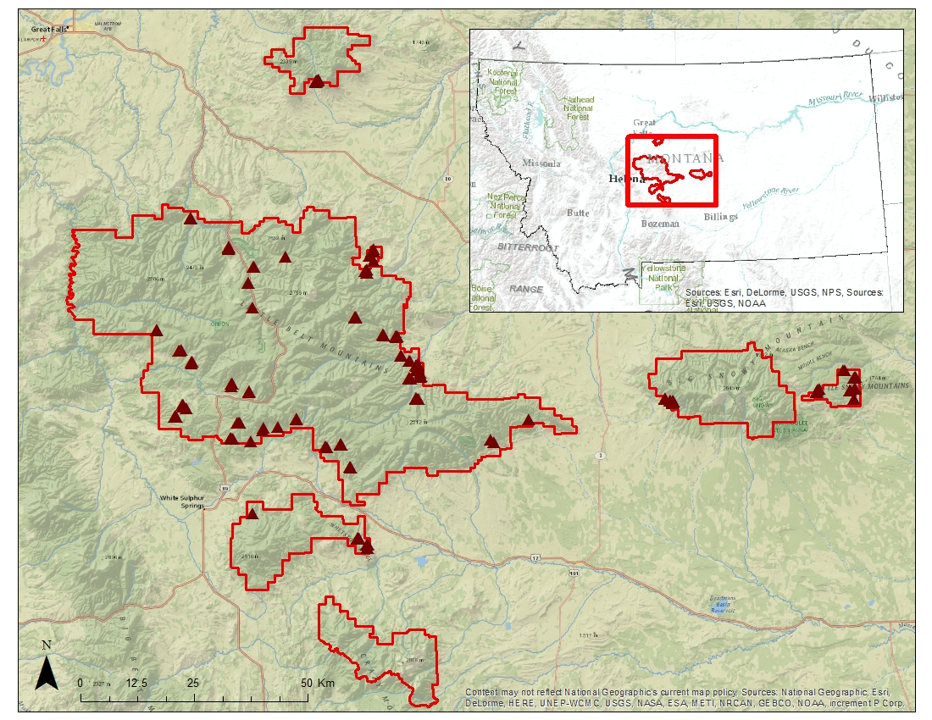
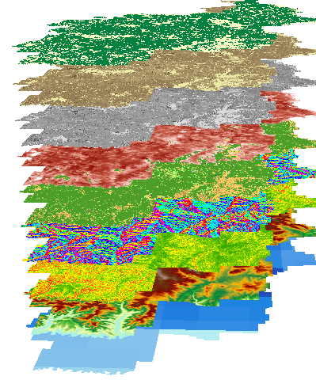

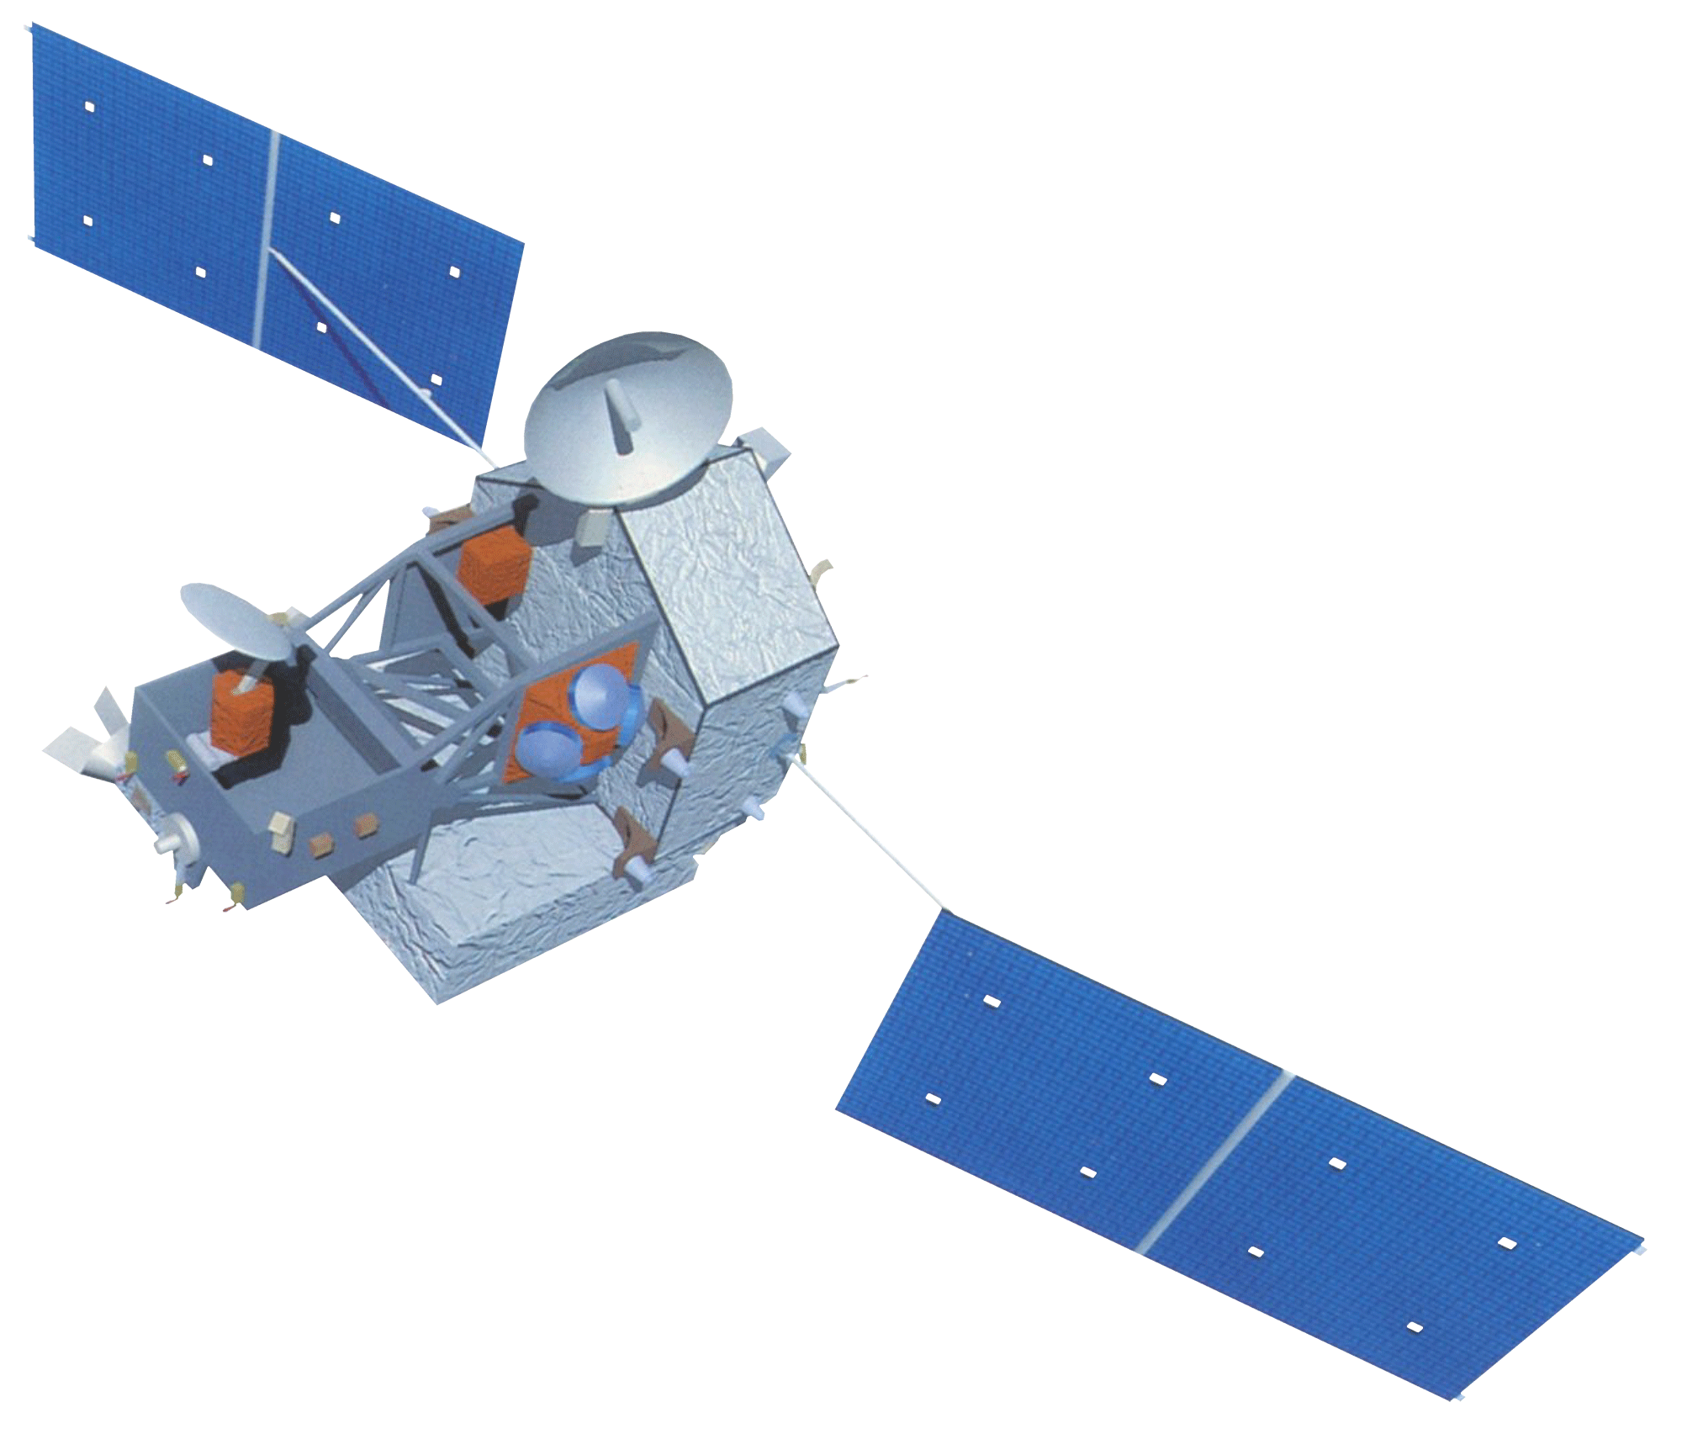
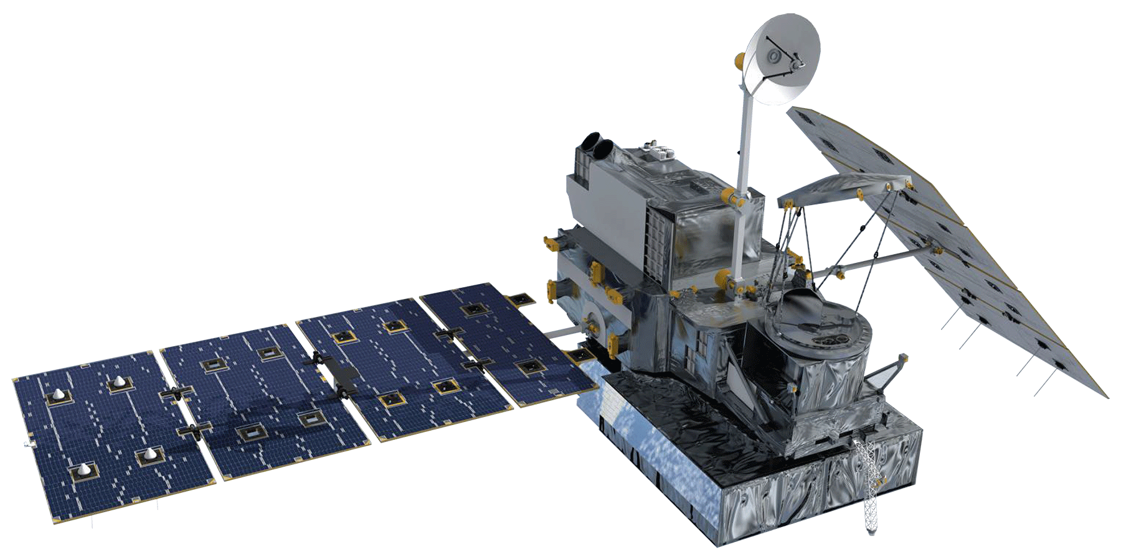
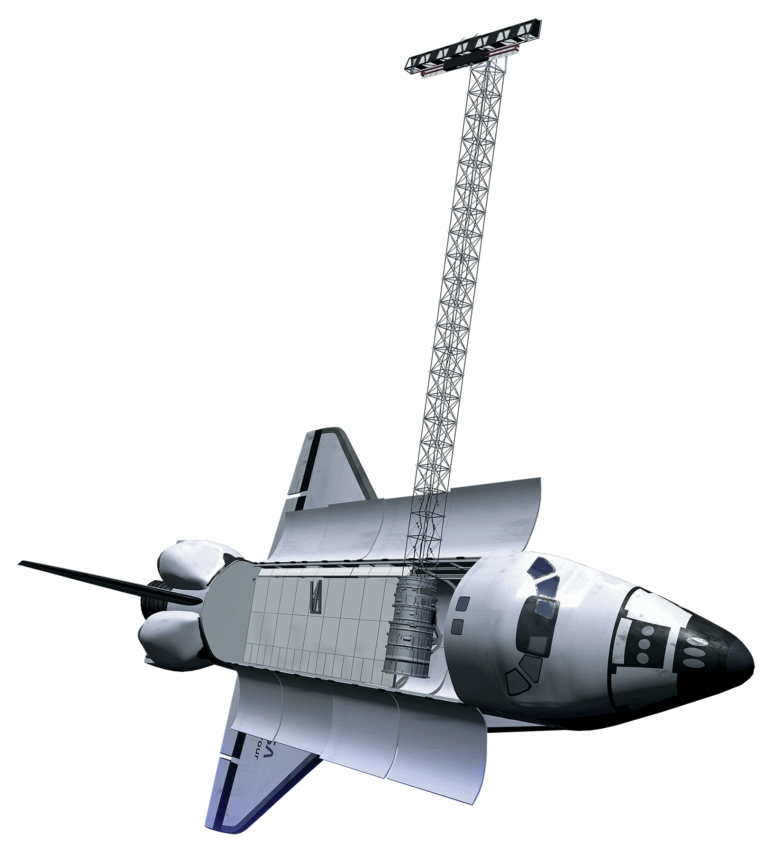

Montana Ecological Forecasting
Utilizing NASA Earth Observations to Forecast the Effects of Climate Change on Northern Goshawk Nesting Habitat
Erika Higa (Project Lead), Sean McCartney, Amanda Clayton
DEVELOP National Program at NASA Goddard Space Flight Center
Abstract
Objectives
Keep this blank for now.
Body text point size should be at least 24.
Caption text point size should be at least 16.
Feel free to rename, move, and resize sections as needed.
Use data from NASA Earth Observing Systems (EOS), along with ancillary data, as inputs for habitat suitability modeling to identify potential nesting habitat for the northern goshawk in the Lewis and Clark National Forest
Forecast the impacts on nesting habitat due to climate change and potential mountain pine beetles encroachment by the year 2050
Study Area
Methodology
Datasets
Data Processing
Analysis
Land Cover
Tree Canopy Cover
Tree Class Size
Basal Area
Vegetation Height
Aspect
Slope
DEM
Precipitation
Project Layers to NAD 1983 UTM 12N
Resample layers to 30m resolution
Clip to study area
Input Layers into Habitat Suitability Models
Maxent
Mahalanobis Typicality
BioMapper
Habitat Suitability Modeling
Lewis and Clark National Forest
Jefferson Division
Nest Sites
Earth Observations
Climate Change Models
Beijing Climate Center Climate System Model (BCC_CSM1.1)
Goddard Institute for Space Studies ModelE/Russell Model (GISS-E2-R)
Hadley Global Environment Model 2 - Earth System (HadGEM2-ES)
Mountain Pine Beetle outbreak data 2001-2014 [in progress]
Landsat 8
TRMM
Forecasting
GPM
SRTM
Results
Project Partners
Habitat Suitability Model
Forecasting
Dr. Nate Bickford (University of Nebraska at Kearney)
Oulu University, Finland
Victor Murphy (USDA Forest Service)
Acknowledgements
[input map here]
[in progress]
Dr. Ross Nelson (NASA Goddard Space Flight Center)
Dr. John Bolten (NASA Goddard Space Flight Center)
Laura Conway (Lewis and Clark National Forest)
Team Members
Conclusions
In Progress
Use bullets.
Use complete sentences with periods
Left to Right: Amanda Clayton, Sean McCartney, Erika Higa
NASA Goddard Space Flight Center

