Slide 1
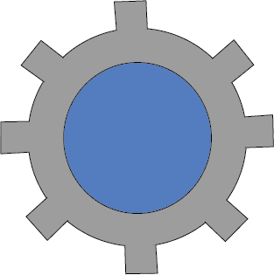
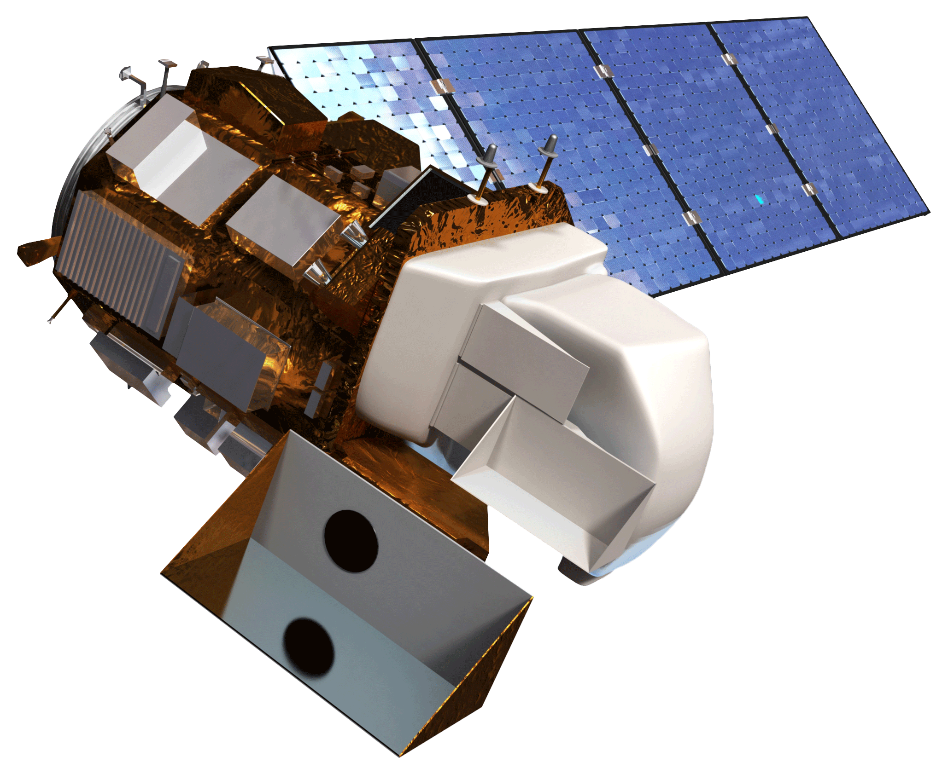
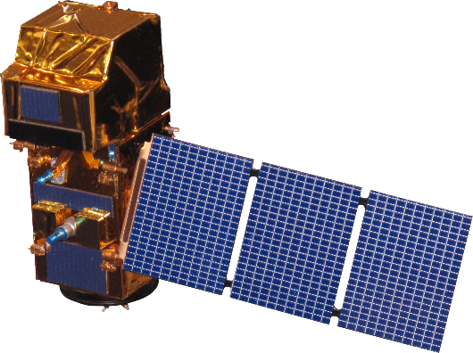
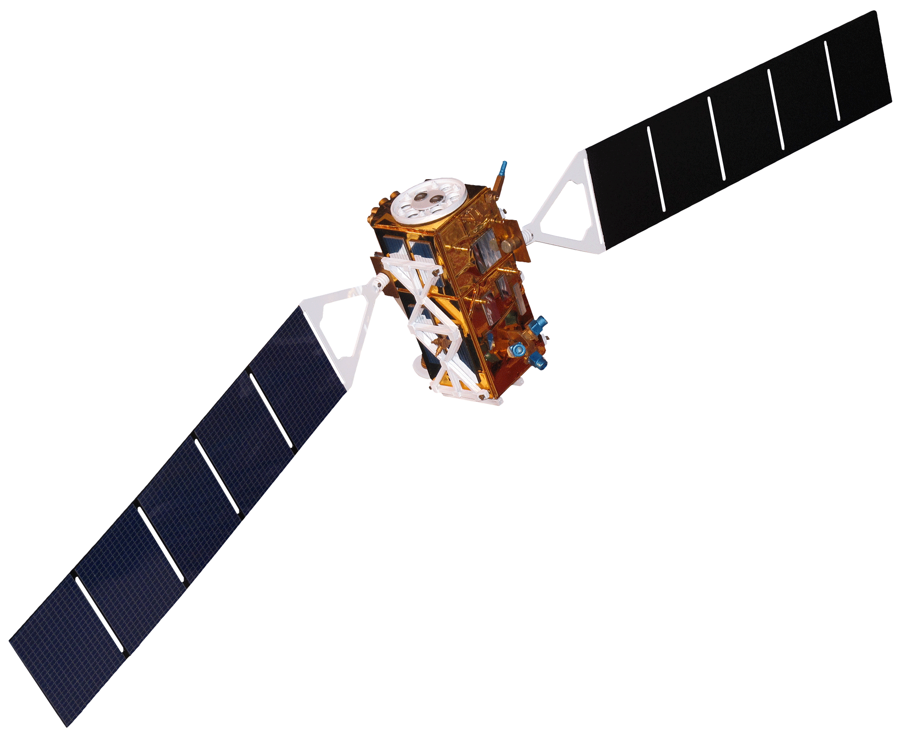
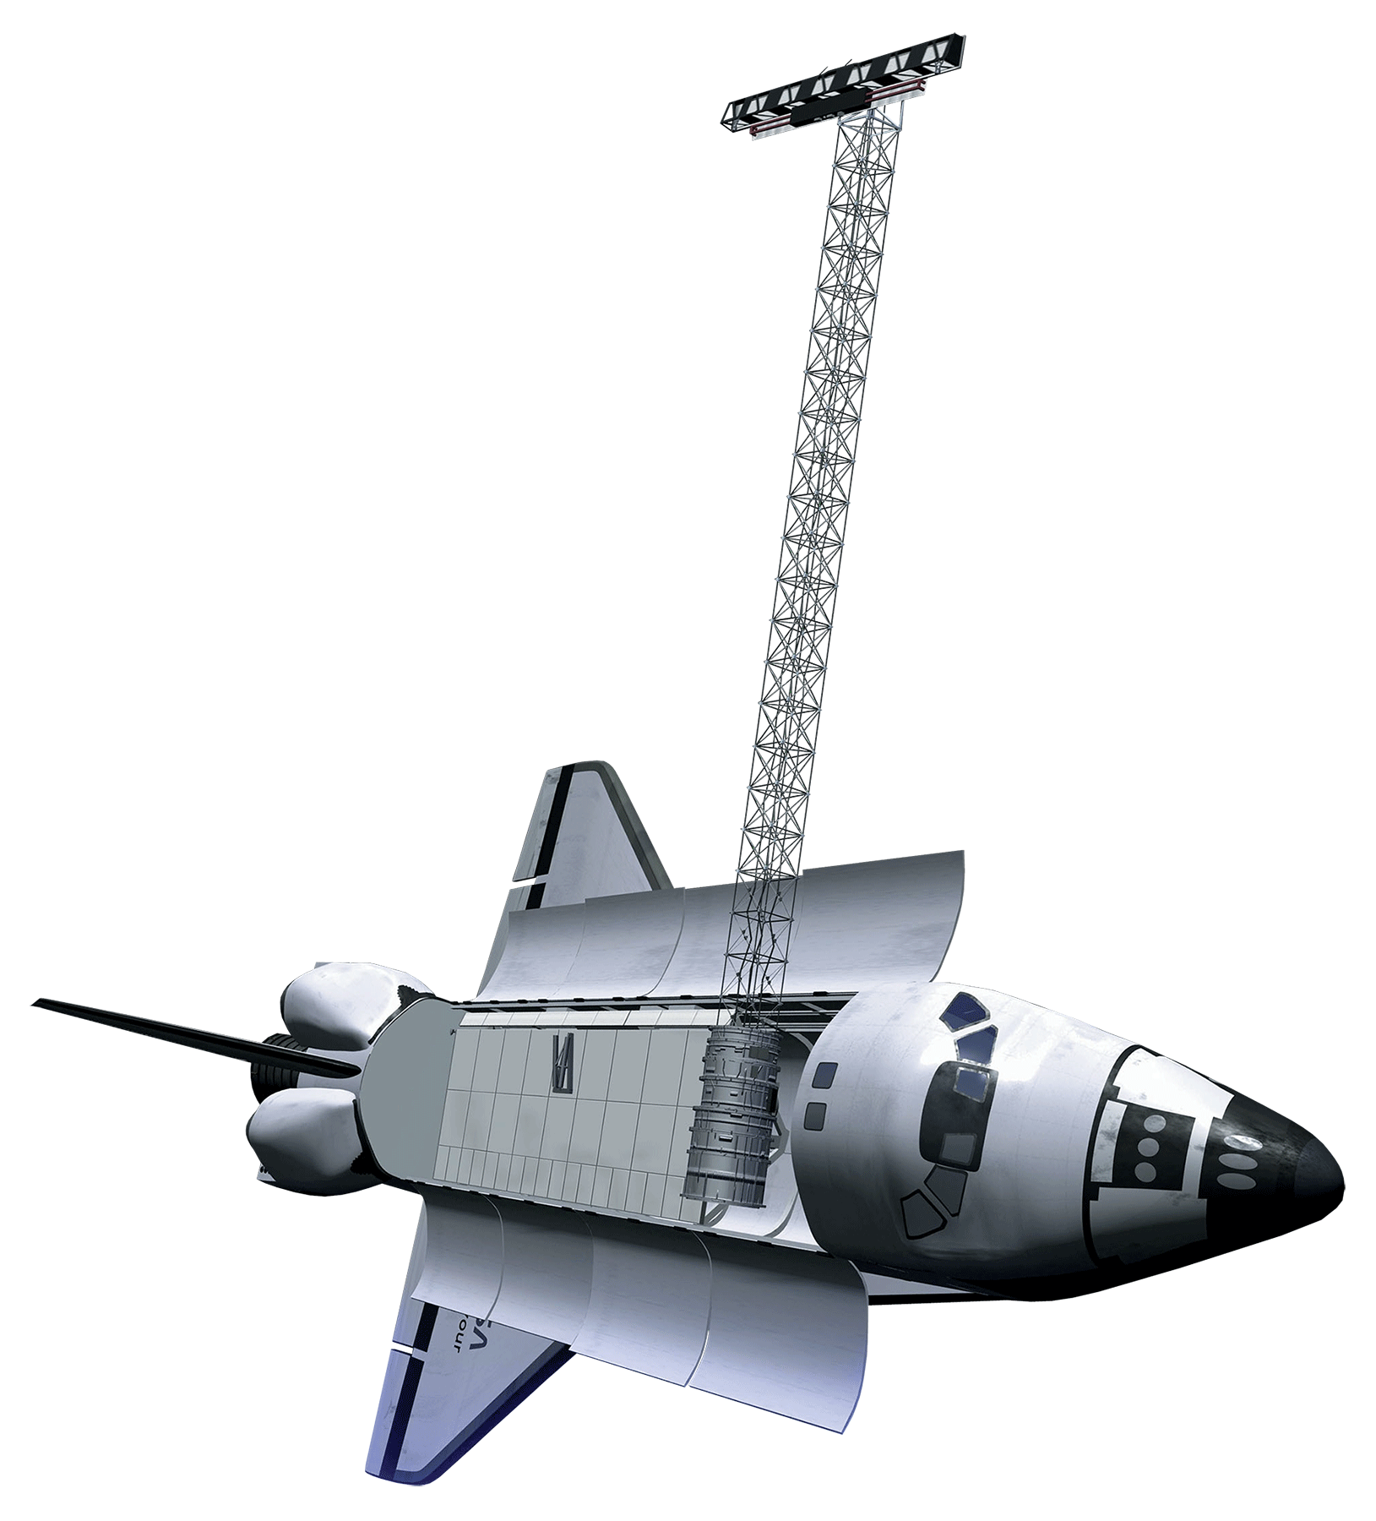
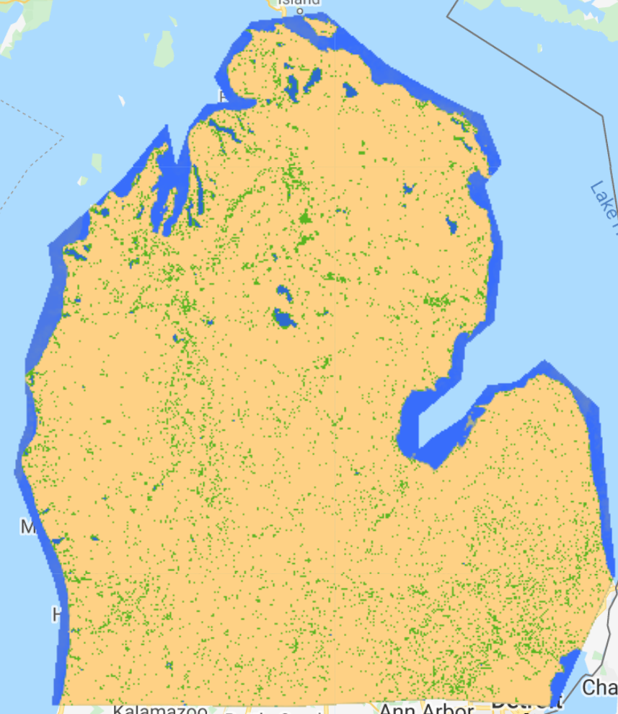
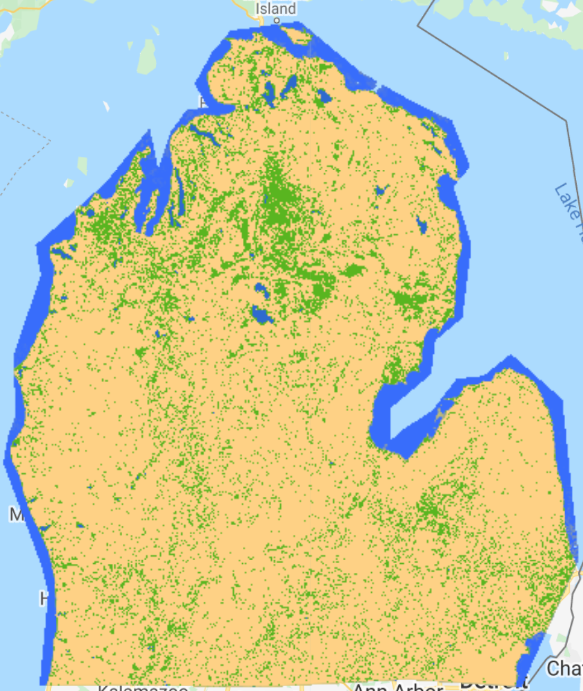
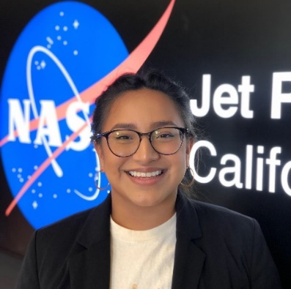
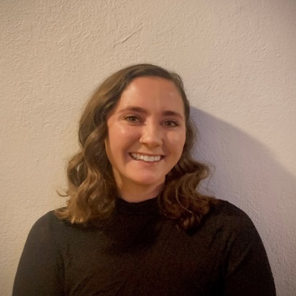
A Google Earth Engine Tool to Automate Wetland Extent Mapping Using Optical and Radar Satellite Sensors in the Great Lakes Basin for Wetland Management and Monitoring
Abstract
Objectives
Great Lakes Water Resources II
The Great Lakes Basin is one of the world’s largest freshwater ecosystems. The Basin harbors over 200,000 acres of wetlands. These wetlands provide a variety of environmental, ecological, and recreational functions to over 30 million people in the region. Some of these functions include improving water quality, mitigating flood impacts, providing wildlife habitat, and housing recreational activities. However, due to anthropogenic activities, habitat conversion and degradation threaten to disrupt or destroy remaining wetland ecosystems. Maps of wetland distribution based on ground surveys are costly and labor-intensive, prohibiting timely evaluations of wetland loss and gain. The Great Lakes Water Resources II team at the NASA Jet Propulsion Laboratory developed the Wetlands Extent Tool 2.0 (WET 2.0) in Google Earth Engine to automate mapping of wetland distribution in the Great Lakes Basin. The team partnered with the US Fish and Wildlife Service (USFWS), Environmental Protection Agency (EPA), Minnesota Department of Natural Resources (MDNR), the National Oceanic and Atmospheric Administration (NOAA), and Ducks Unlimited (DU). WET 2.0 incorporates Landsat 8 Operational Land Imager (OLI), Sentinel-1 C-band Synthetic Aperture Radar (C-SAR), and Sentinel-2 Multispectral Instrument (MSI) satellite data. WET 2.0 is trained to classify anywhere in the Great Lakes Basin. Utilizing a Random Forest classifier, WET 2.0 is capable of automatically mapping wetland extent in the entire Great Lakes Basin, achieving a mean overall accuracy of 80.12% when tested in Michigan. Findings and maps produced in WET 2.0 will enable our partners to identify areas of ecosystem degradation and wetland destruction in order to enact environmental practices and policy initiatives to maintain environmental and economic health in the area.
Classify and map wetlands extent and type in the entire Great Lakes Basin in WET 2.0
Develop a user interface for WET 2.0 that enables user-specified and user-drawn geometries for analysis
Improve accuracy and validation of wetland classification
Methodology: Wetland Extent Tool (WET) 2.0
Optical
Sentinel-2 MSI
Landsat 8 OLI
Radar
SRTM DEM
Sentinel-1 C-SAR
Ancillary
Field Data
Landcover
Pre-processing
Parameters
NDVI
MNDWI
TCGWD
DSWE
VV
VH
VV/VH
Acquisition & Correction
Google Earth Engine
Classification
Study Area
User Inputs
Area of Interest
Date Range
OUTPUT
Wetland
Extent
Map
Canada
Lakes
Earth Observations
Ontario
Quebec
Great Lakes
Basin
Minnesota
Wisconsin
Michigan
New York
0 400 800 1,200 mi
United States
of America
Ohio
Pennsylvania
Landsat 8 OLI
Sentinel-2 MSI
Sentinel-1 C-SAR
SRTM
Results
0 150 300 600 800 mi
Variable Importance in Random Forest Model
Random Forest Classifications: Northern Michigan
May – August 2019
September – December 2019
120 -
Upland
100 -
80 -
Open Water
Importance
60 -
Wetland
40 -
20 -
0 -
MNDWI
NDVI
TCWGD
VH
VV
VV/VH
DSWE
May – August Classification |  | Actual
 |  | Upland | Open Water | Wetland
Predicted | Upland | 27 | 6 | 481
 | Open Water | 0 | 1,037 | 6
 | Wetland | 2 | 58 | 617
September – December Classification |  | Actual
 |  | Upland | Open Water | Wetland
Predicted | Upland | 28 | 0 | 272
 | Open Water | 0 | 1,050 | 11
 | Wetland | 1 | 51 | 821
0 100 150 250 400 mi
Mean Overall Accuracy: 80.12%
Project Partners
Conclusions
US Fish and Wildlife Service, National Wetlands Inventory
Minnesota Department of Natural Resources
US Environmental Protection Agency, Office of Research and Development
Ducks Unlimited
University of Minnesota
Michigan Technological University
NOAA, Office for Coastal Management
Natural Resources Canada, Canada Centre for Mapping and Earth Observation, Canada Centre for Remote Sensing
We were able to classify Michigan with an average overall accuracy of 80.12%.
The model overestimated the wetland class, which was more evident during the Fall/Winter months in 2019.
The most important variables in the model were MNDWI and NDVI calculated with Sentinel-2. The least important variable was DSWE.
Acknowledgements
Team Members
We could like to acknowledge the following contributors:
Our science advisor Dr. Bruce Chapman (NASA Jet Propulsion Laboratory).
Our end user partners Megan Lang (FWS NWI), Jennifer Corcoran (MN DNR), Tom Hollenhorst (EPA), and Robb Macleod (DU).
Our collaborator partners Joe Knight (University of Minnesota), Brandon Krumwiede (NOAA), Laura Borgeau-Chavez (Michigan Technological University), and Brian Brisco (NRCan).
Node support Cecil Byles (NASA DEVELOP Fellow) and Benjamin Holt (NASA Jet Propulsion Laboratory).
Past contributors Erica O’Connor, Melissa Ferriter, Alice Lin, and Christopher Notto.
Vanessa Valenti
Project Lead
Erica Carcelén
Katie Lange
Nick Russo
This material contains modified Copernicus Sentinel data (2017-2019), processed by ESA.
California - JPL

