Slide 1

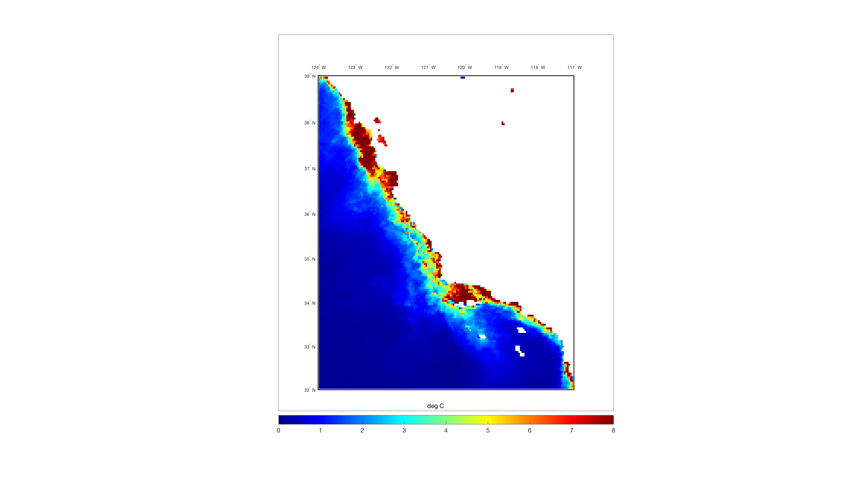
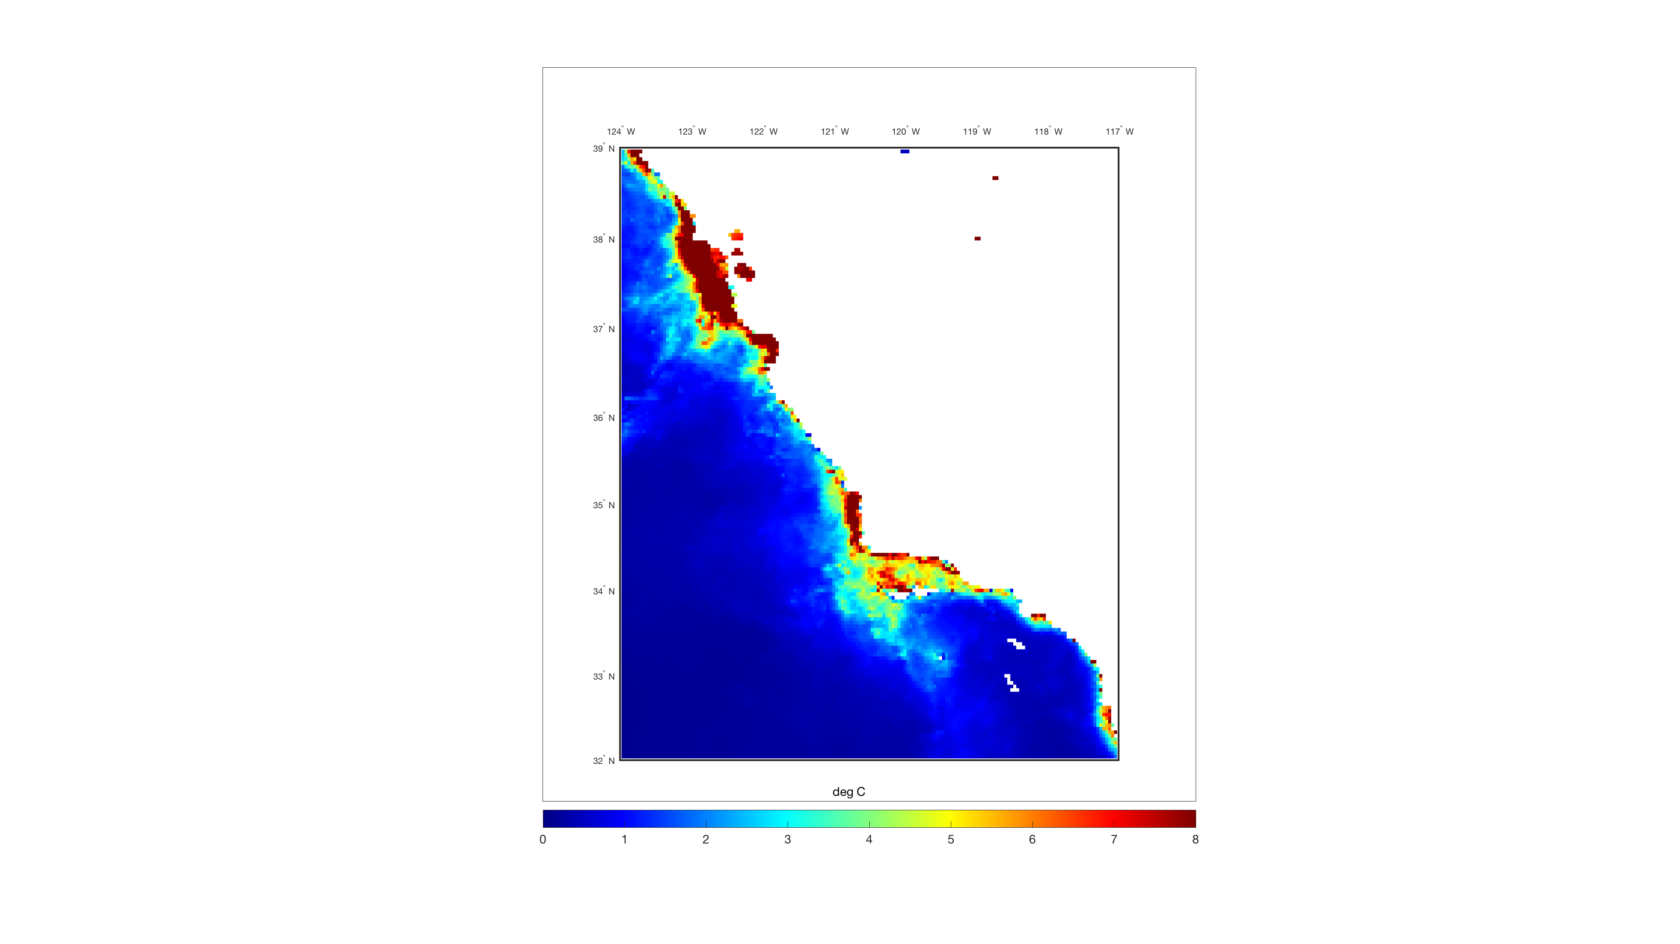
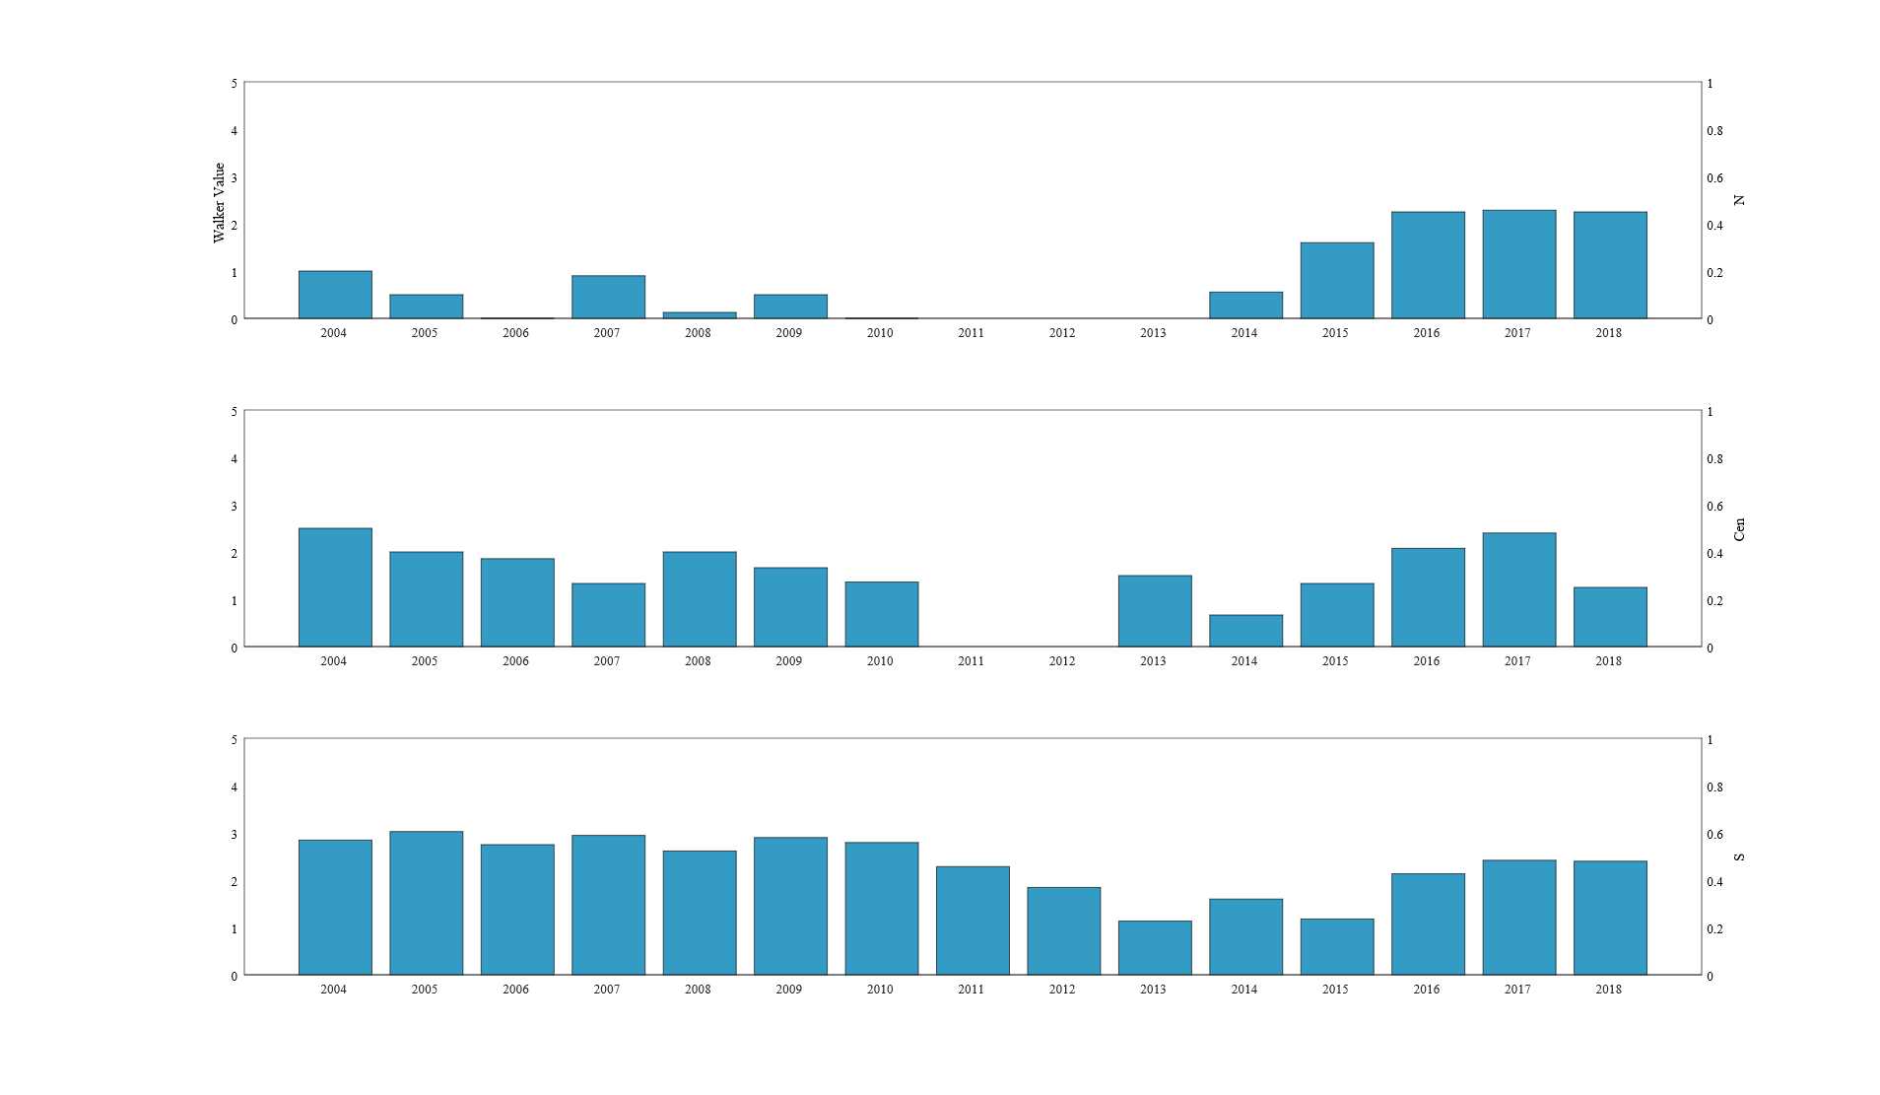
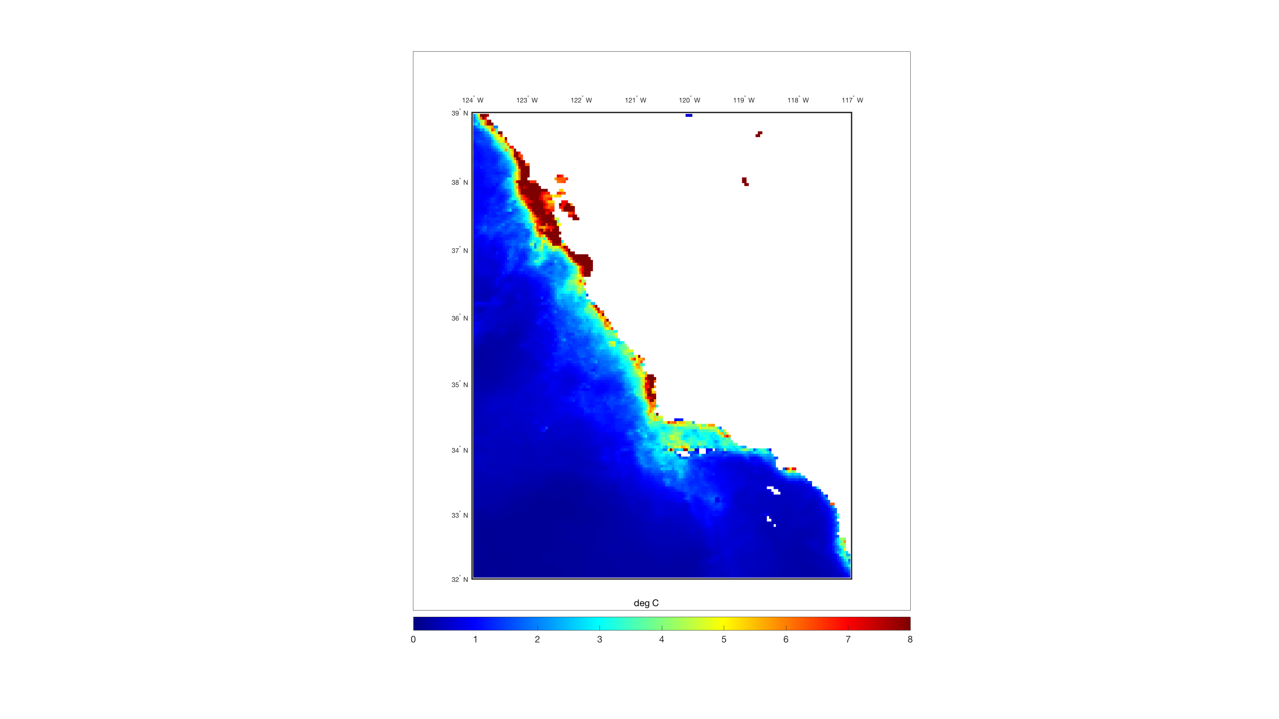
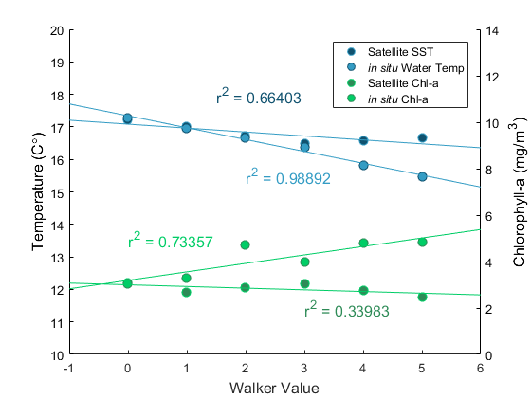
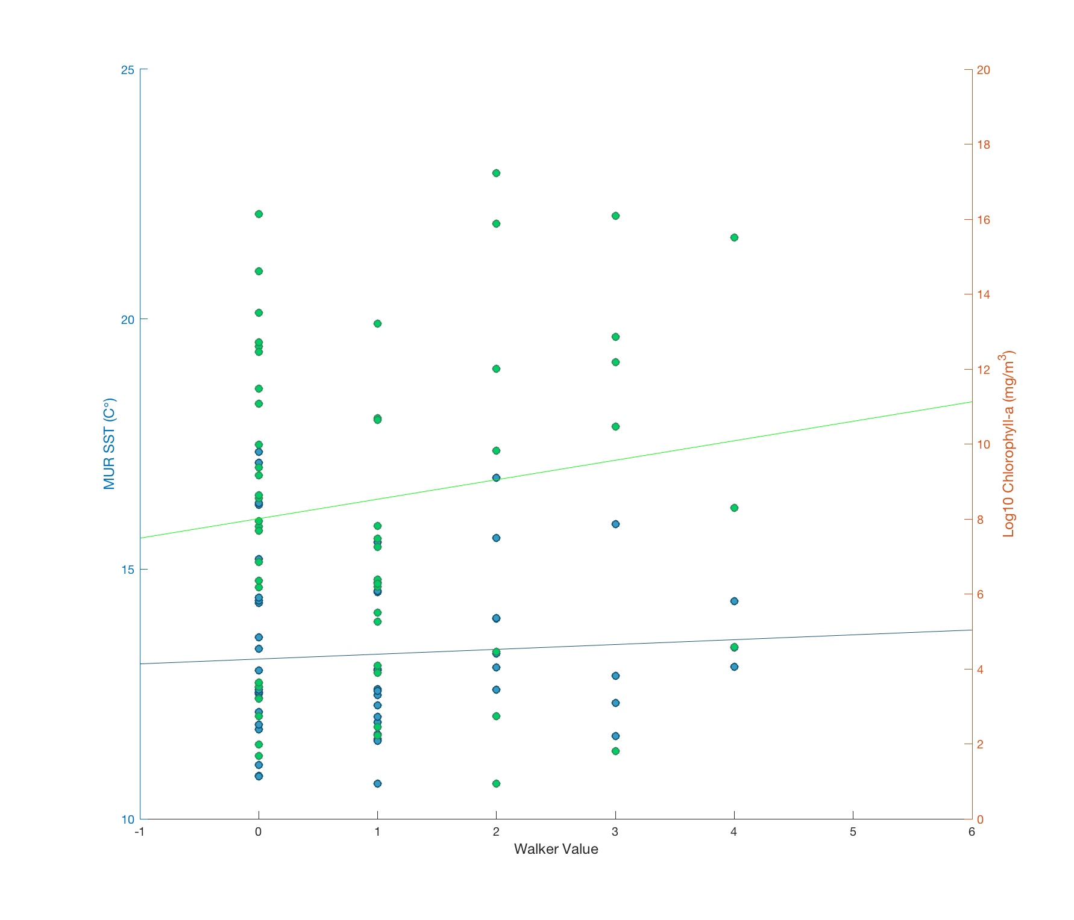
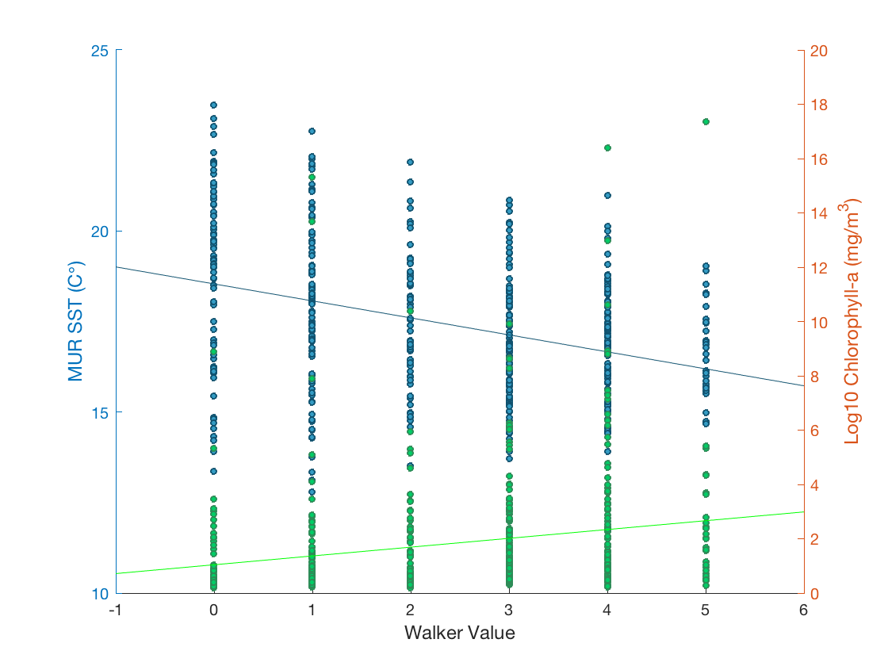
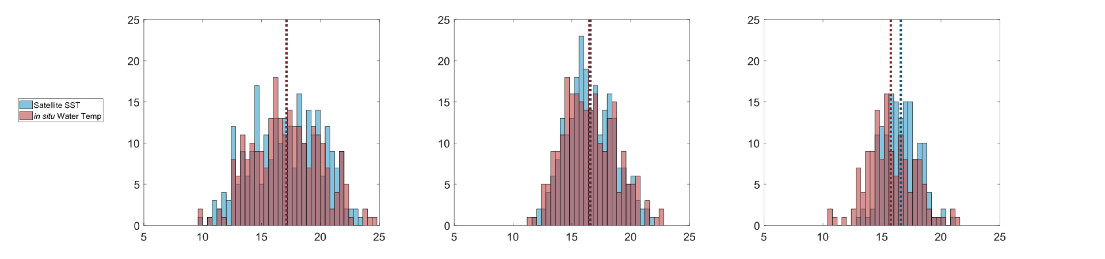



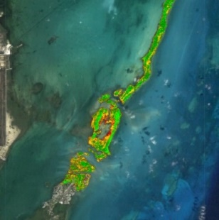


Predicting Grunion Migration Patterns and Spawning Areas in Response to Changes in California’s Oceans
Abstract
Methodology
The California grunion (Leuresthes tenuis) is a species of fish endemic to the California coastline that plays an important role in the marine food chain as a consumer of zooplankton and a food source for larger marine creatures. Grunion spawning events, commonly referred to as “grunion runs,” occur when the tide is highest during nights surrounding a new or full moon, allowing the fish to “run” up the beach to deposit and fertilize their eggs before returning to sea. These runs happen most frequently during the summer months along beaches in Los Angeles, Orange, and San Diego counties. However, spawning events documented over the last three decades in the San Francisco Bay suggest a pattern of northern migration caused by changes in ocean conditions and increased human beach activity. In collaboration with the Grunion Greeters Project and the California Department of Fish and Wildlife, the team evaluated oceanic environmental and ecological factors that affect grunion spawning patterns. Earth observation data products, including NASA Multi-scale Ultra-high Resolution Sea Surface Temperature (MUR SST) and Aqua Moderate Resolution Imaging Spectroradiometer (MODIS) chlorophyll-a (chl-a), were used to create time series of the California coastline and nearby Pacific Ocean from 2003 to 2018. Upwelling, sea surface current, air temperature, and harmful algal bloom (HAB) data were also considered to derive correlations between the above parameters and grunion spawning events. Analyzing how a changing ocean affects the California grunion will allow for more accurate predictive modeling of spawning behavior and will provide the knowledge base needed to protect this unique species.
2003
PREDICT grunion migration trends and patterns
In situ ocean
observation data
LOCATE
grunion run beaches
SST
Chl-a
TIME SERIES MAPS
CREATE
a tool that relates grunion runs and ocean conditions
In situ
grunion data
2018
Results
Objectives
2005
2017
2005
2017
5
4
3
2
1
Years (2004-2018)
124°W 123° 122° 121° 120° 119° 118° 117°
CREATE time series of satellite Earth Observations and ocean observation in situ data
COMPARE time series at different latitudes as well as calculate anomalies of ocean observation and satellite data to determine factors affecting grunion spawning patterns
DEVELOP a dynamic tool for the project partners to easily replicate methods for future satellite and in situ data
39 °N
38 °
37°
36 °
35 °
34 °
33 °
32 °
Northern
5
4
3
2
1
04 05 06 07 08 09 10 11 12 13 14 15 16 17 18
Walker Value
Central
5
4
3
2
1
04 05 06 07 08 09 10 11 12 13 14 15 16 17 18
Study Area
Southern
10 11 12 13 14 15 16 17 18 19 20
0 1 2 3 4 5 6 7 8
04 05 06 07 08 09 10 11 12 13 14 15 16 17 18
San Francisco
Spawning Sites
Figure 2. MUR SST data averaged over grunion spawning season (March to August)
Figure 3. Aqua MODIS chlorophyll-a data averaged over grunion spawning season (March to August)
Figure 4. Annual average Walker values (integer 0-5 representing grunion run size and intensity) by California region
Monterey
25
20
15
10
Northern
Central
Southern
R² = 0.0044
R² = 0.0193
R² = 0.1266
20
18
16
14
12
10
8
6
4
2
0
Satellite SST
In situ Water Temp
Satellite Chl-a
In situ Chl-a
R² = 0.0148
R² = 0.0180
R² = 0.0514
20
19
18
17
16
15
14
13
12
11
10
14
12
10
8
6
4
2
0
R² = 0.66403
MUR SST (°C)
Temperature (C°)
R² = 0.98892
Chlorophyll-a (mg/m³)
Santa Barbara
Ventura
Chlorophyll-a (mg/m³)
Malibu
Cabrillo
R² = 0.73357
Orange County
R² = 0.33983
Oceanside
0 1 2 3 4 5
San Diego
0 1 2 3 4 5
0 1 2 3 4 5
0 1 2 3 4 5
Walker value
Figure 1. Portion of the California coast encompassing grunion range, including beaches used in analysis (Northern: San Francisco, Monterey; Central: Santa Barbra, Ventura; Southern: Malibu, Cabrillo, Orange County, Oceanside, San Diego)
Walker Value
Walker Value
Walker Value
Figure 6. Compiled mean ocean temperatures and chlorophyll-a values by associated Walker values for entire study range
Figure 5. MUR SST versus Walker value overlaid with Aqua MODIS chlorophyll-a versus Walker value by region
Earth Observations
Project Partners
Figure 7. Frequency of grunion runs at given MUR SST (blue) and in situ water temperature (red) values, analyzed by run size (left: small (Walker 0-1), center: medium (Walker 2-3), right: large (Walker 4-5)
Grunion Greeters Project
California Department of Fish and Wildlife
25
20
15
10
5
0
Mean: 17.109 ºC
STD: 3.001 ºC
Mean: 17.113 ºC
STD: 2.869 ºC
25
20
15
10
5
0
Mean: 16.575 ºC
STD: 2.016 ºC
Mean: 16.482 ºC
STD: 2.240 ºC
25
20
15
10
5
0
Mean: 16.599 ºC
STD: 1.482 ºC
Mean: 15.748 ºC
STD: 2.056 ºC
Team Members
Frequency
Aqua
MODIS
EXAMPLE
5 10 15 20 25
5 10 15 20 25
5 10 15 20 25
Temperature (ºC)
Temperature (ºC)
Temperature (ºC)
Acknowledgements
Alexandra
Jones
Project Lead
Harrison
Knapp
Conclusions
Previous Contributors: Sol Kim & Ariana Nickmeyer (DEVELOP, California - JPL)
Benjamin Holt (NASA Jet Propulsion Laboratory, California Institute of Technology)
Dr. Karen Martin (The Grunion Greeters Project)
Loni Adams (California Department of Fish and Wildlife)
NASA Earth Observation satellite data and end products can be used to analyze oceanographic trends that correspond with grunion migration patterns.
The size of grunion spawning events have a negative correlation with increased coastal ocean temperatures, and a positive correlation with increased chlorophyll-a.
Changes in ocean conditions along the California coastline are likely driving northward grunion migration, with water and sea surface temperature having the strongest influence.
Annemarie
Peacock
Lael
Wakamatsu
Southern California Water Resources II
California – JPL | Summer 2018

