Slide 1
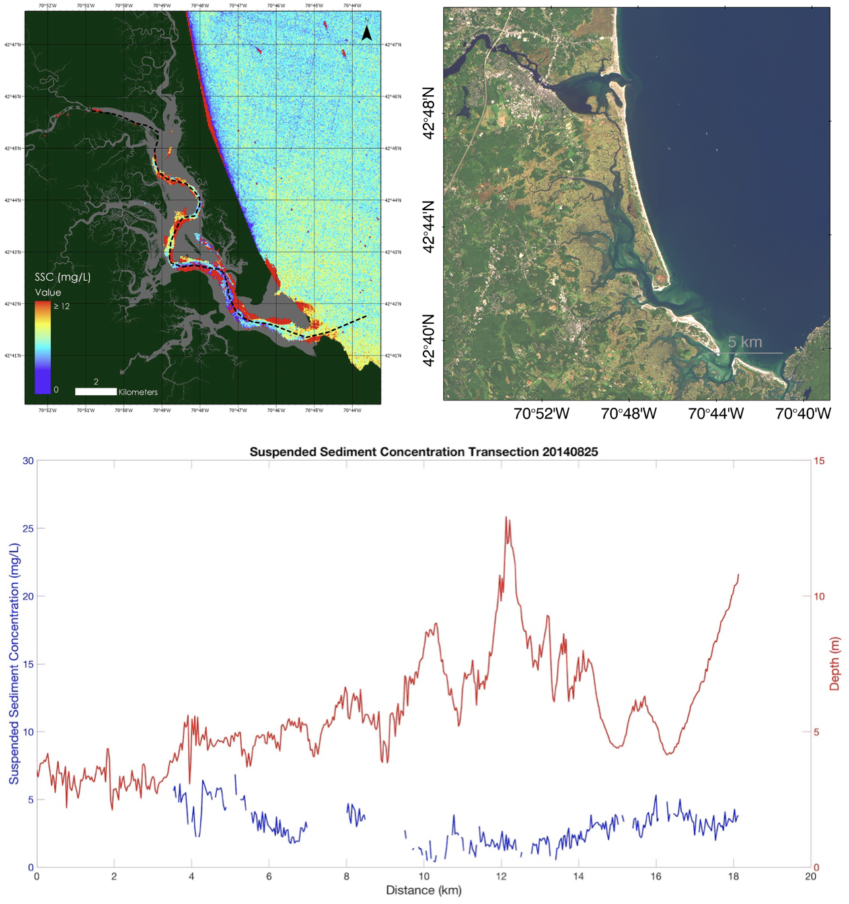
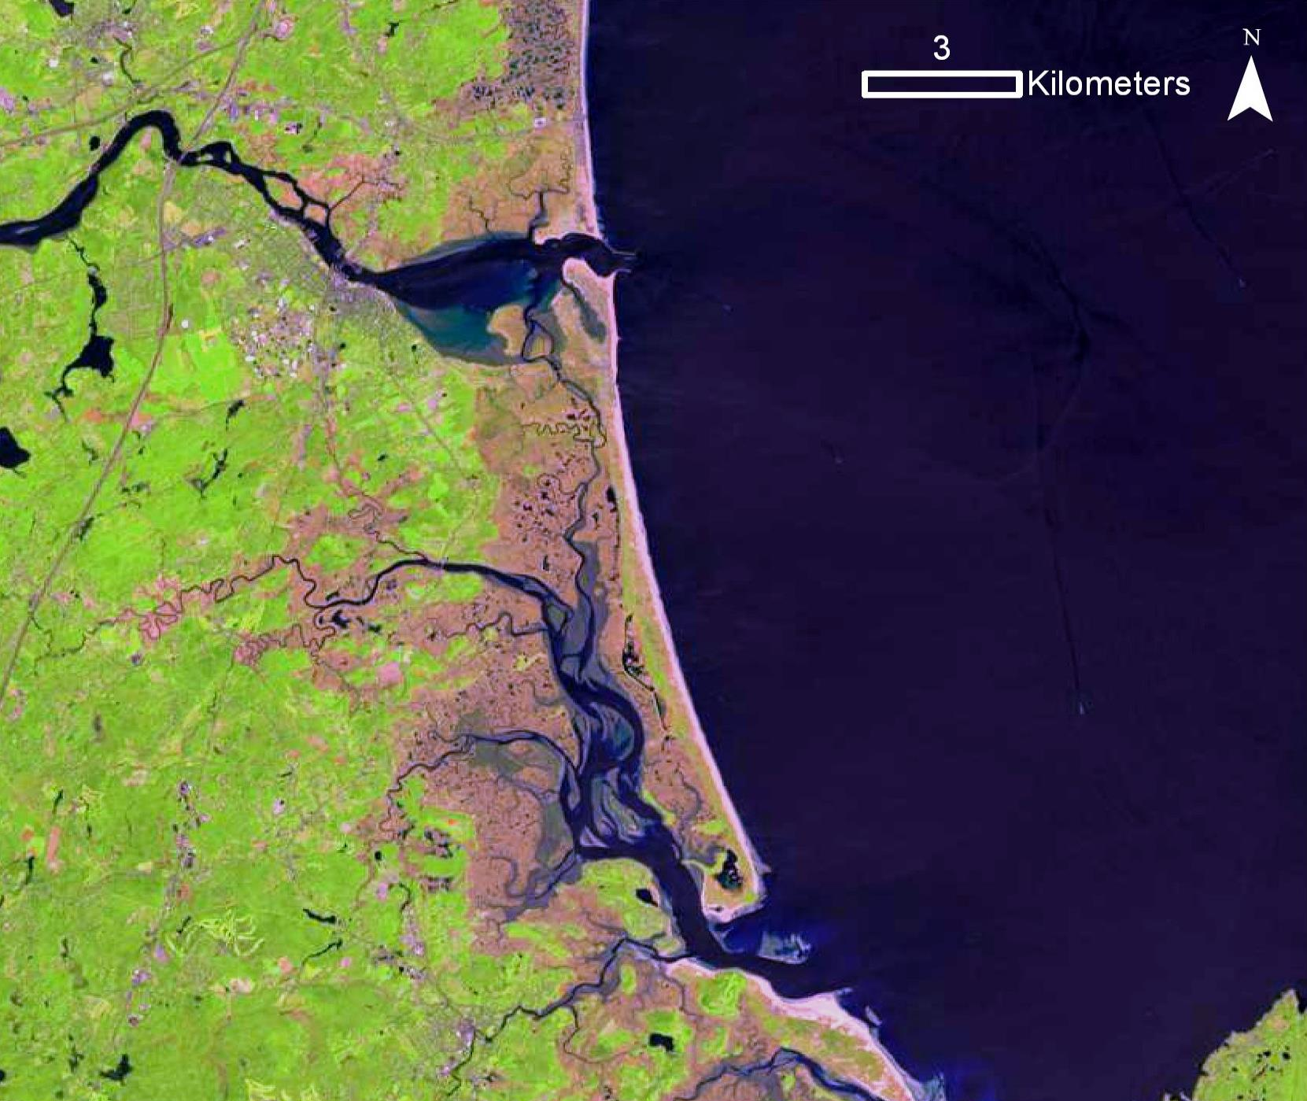
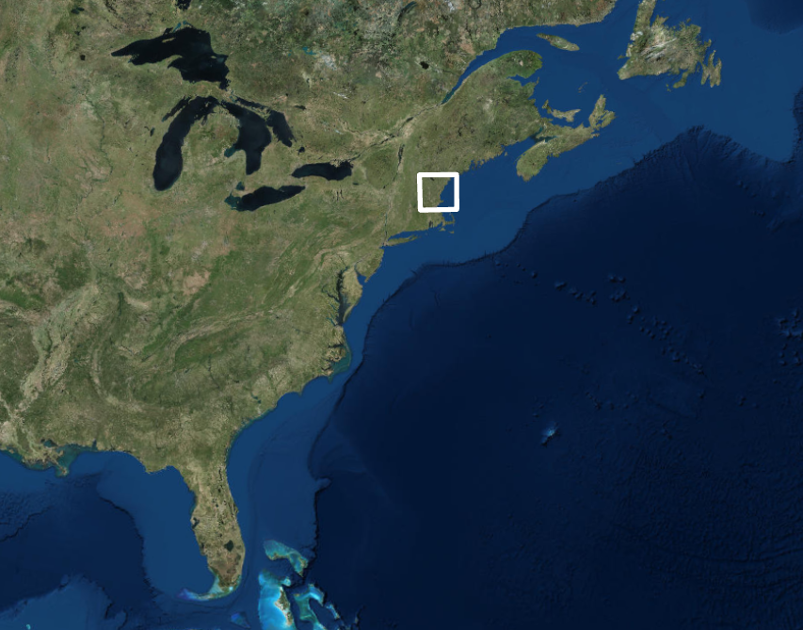
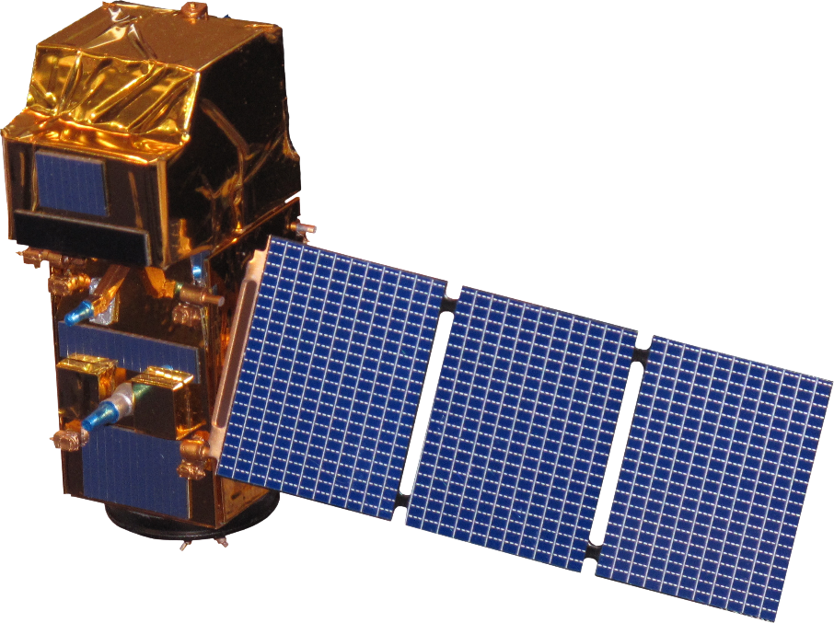
Utilizing NASA Earth Observations to Assess Marine Sediment Fluxes and Determine Marsh Vulnerability in the Plum Island Estuary
Abstract
Methodology
Salt marshes provide valuable ecosystem services, including protection from coastal storms, erosion control, carbon sequestration, improved water quality, and ecological diversity. Plum Island Estuary (PIE), the largest salt marsh in the northeast United States, is a two thousand year-old ecosystem located thirty-five miles north of Boston, Massachusetts. As sea level rises, the structure and health of this marshland ecosystem depends on sediment availability. Current research in the estuary, performed by the United States Geological Survey (USGS) and the Woods Hole Marine Biological Laboratory (MBL), uses point-measurements of sediment fluxes. However, these isolated data points can be misleading when attempting to understand system-wide changes. Landsat 8 Operational Land Imager (OLI) and Sentinel-2 MultiSpectral Instrument (MSI) imagery from 2013 to 2017 were compared to in situ data measurements. An algorithm was generated to calculate total suspended sediment concentration and distribution in the estuary. In dynamic ecosystems like salt marshes, utilizing remote sensing to quantify and visualize sediment supply assists end users in generating current and future vulnerability assessments of PIE to sea level rise.
Data Acquisition and Processing
Algorithm Development
Product Generation
In situ data
Satellite imagery (GloVis)
Atmospheric correction (ACOLITE)
An empirical algorithm based on in situ data
Polynomial regressions in R
SSC maps (ArcGIS Pro)
Distance vs. SSC graphs (SeaDAS and MATLAB)
Project Partners
United States Geological Survey (USGS), United States Fish and Wildlife Service (USFWS), and Plum Island Ecosystems Long Term Ecological Research Network (PIE LTER)
Objectives
Results
Landsat 8 – 08/25/2014
Develop an accurate methodology for estimating suspended sediment in PIE
Determine suspended sediment concentrations (SSC) from satellite imagery
Observe SSC along a transect in the estuary’s main channel
Generate a time-series from 2013 to 2017 of total suspended sediment
Study Area
Study Area
Suspended Sediment Concentration Transection 20140625
Atlantic Ocean
Gulf of Maine
Suspended Sediment Concentration (mg/L)
Depth (m)
Earth Observations
Distance (km)
Conclusions
Sentinel-2 MSI
In general, suspended sediment concentration decreases along the transect.
The applied algorithm is able to derive SSC from remote sensing data, but some of the results still show bottom effect.
Atmospheric corrections need to be refined in order to eliminate noise and negative impacts of aerosols.
Calculation of SSC in the Plum Island Estuary is feasible for areas deep enough to avoid issues with bottom reflectance.
Landsat 8 OLI
Acknowledgements
Team Members
Dr. Neil Ganju, Research Oceanographer, United States Geological Survey
Dr. Anne Giblin, Interim Director, Plum Island Ecosystems Long Term Ecological Research Network
Nancy Pau, Biologist, United States Fish and Wildlife Service
Dr. Sergio Fagherazzi, Professor, Boston University
Dr. Cedric Fichot, Assistant Professor, Boston University
Zachary Bengtsson
Project Lead
Bogumila Backiel
Ruizhe Guo
Sydney Neugebauer
Kimberly Johnson
Plum Island Estuary Water Resources
Massachusetts – Boston | Spring 2018

