Slide 1
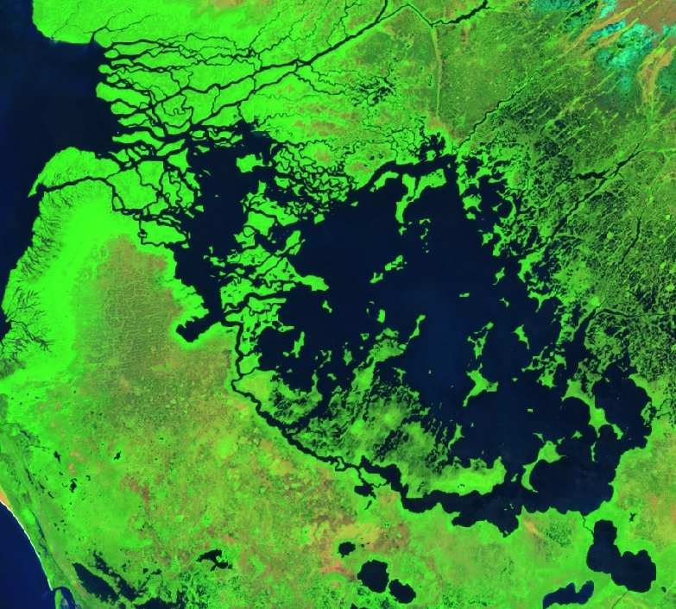
Donnie Kirk (Project Lead)
EVERGLADES ECOLOGICAL FORECASTING II
Amy Wolfe
Utilizing NASA Earth Observations to Enhance the Capabilities of Everglades National Park to Monitor and Predict Mangrove Extent to Aid Current Restoration Efforts
Adama Ba
Tyler Rhodes
Notes:
Image Credit: Google Earth Engine API
Introduction order: Tyler, Donnie, Adam
Adam will start off the introduction slide.
“As was previously stated, we are the Everglades Ecological Forecasting II project. Our objective for this project was to use NASA Earth Observations to Enhance the capabililties of the National Park Service to Monitor and Predict Mangrove extent to aid current restoration efforts. “

Slide 2
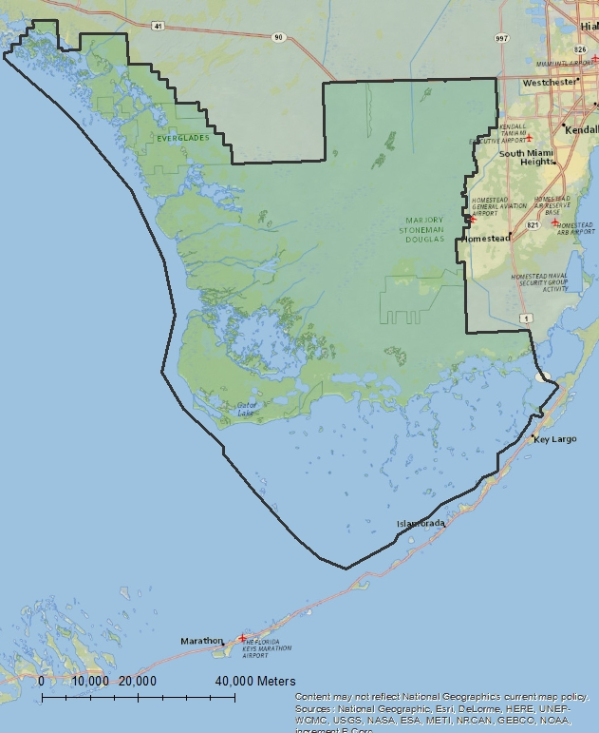
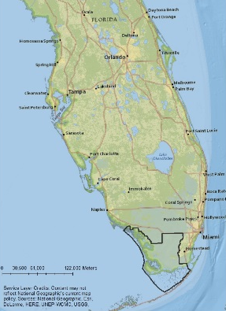
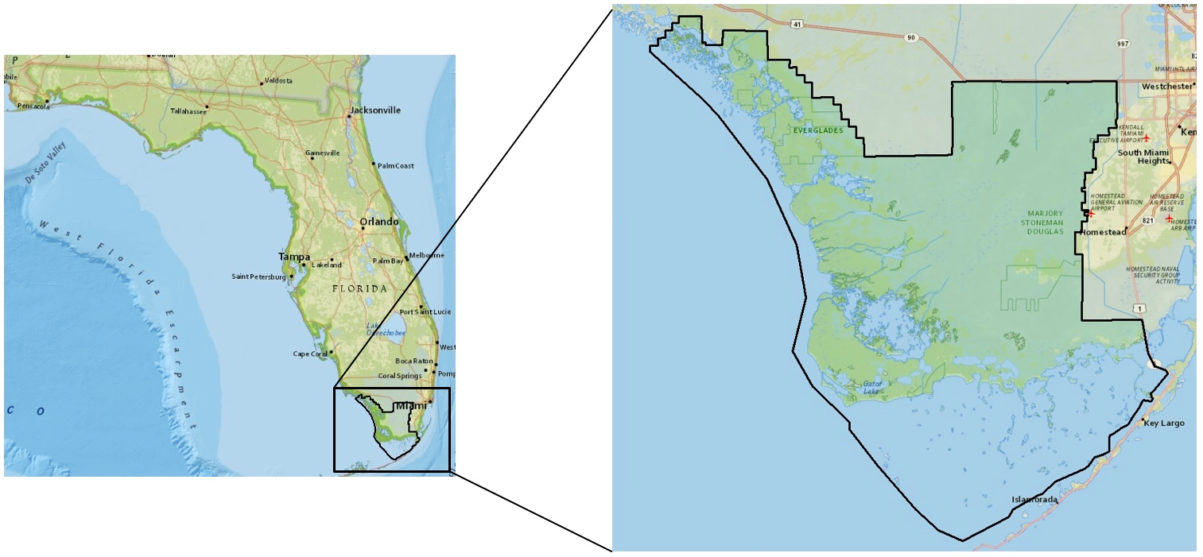
Study Area and Period
Everglades National Park
1.5 million acres on the southern tip of Florida
Stratified Random Sampling
To make similar projects comparable
Temporal Analysis
Dry Seasons
Everglades Park Boundary
Notes:
Adam**
Basemap – National Geographic Base Layer
Everglades Park boundaries provided by the project partner.
Our study area is located on the southern coastline of Florida within the Everglades National Park. We examined the Everglades National Park coastline by using a stratified random sampling technique. We are then going to do a seasonal analysis over a 25 year period by analyzing the dry seasons during these years.

Slide 3
Objectives
Use NASA Earth observations and Google Earth Engine API.
Create a methodology for mangrove monitoring.
Distinguish mangrove forests more accurately from other types of vegetation within the park.
Assess how this methodology can be used to address the targets of Agenda 2030 of United Nations Sustainable Development Goals (SDGs)
Image Credit : Pixbay.com
Notes:
Adam**
Image credit: https://pixabay.com/en/everglades-mangroves-bogs-73423/
Image source : TanjaC
“Our objectives for this term of the project was to fine tune the methodology from last term to more accurately delineate where mangroves were within the Everglades National Park. By creating this tool for the National Park Service, we were also attempting to meet some of the goals for the United Nations Sustainable Development Goals user summit.”

Slide 4
Sustainable Development Goals
Goal #15
Managing Forests Sustainably
Everglades National Park has experienced a 50% reduction in freshwater habitats.
Saltwater intrusion
Unsustainable water practices
Image Credit : United Nations Development Program
Notes:
Adam**
Image source: http://www.undp.org/content/undp/en/home/sustainable-development-goals.html
Image Credit: United Nations Development Program
Part of these goals center around sustainably managing forests, particularly goal # 15. The Everglades is reliant on freshwater resources as it is majority freshwater. Mangrove forests help regulate the saltwater that enters the park. However, mangroves are extending further in land as saltwater is intruding further in land. Understanding how this trend in the mangrove extent is changing with respect to freshwater restoration efforts can encourage park officials to make more informed decision making in future forest management practices.

Slide 5
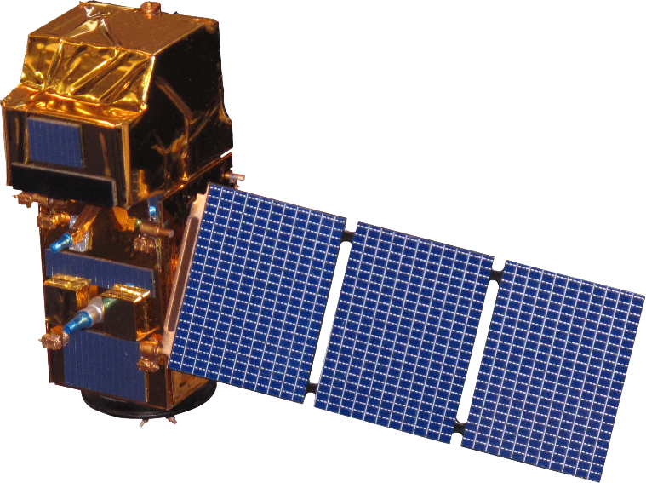
Satellites and Sensors
Landsat 7 ETM+
Landsat 5 TM
Sentinel-2
Landsat 8 OLI
Credit: Wikipedia Commons
Notes:
Donnie**
Image Source: https://commons.wikimedia.org/wiki/Category:Satellite_pictures_of_Florida#/media/File:ISS-42_Florida_in_the_United_States.jpg
Image Credit: Terry Virts
US Astronaut Terry Virts took this picture of Florida in the United States on Feb. 14, 2015 while he was on the International Space Station. Virts is a Flight Engineer with Expedition 42.
“We used Landsat 5 Thematic Mapper, Landsat 7 enhanced thematic mapper, and Landsat 8 Operational Land Imager to obtain satellite images for our study area and study period. Using the full suite of Landsat satellites allowed us to obtain imagery for a 25 year period from 1995 to 2015. “

Slide 6
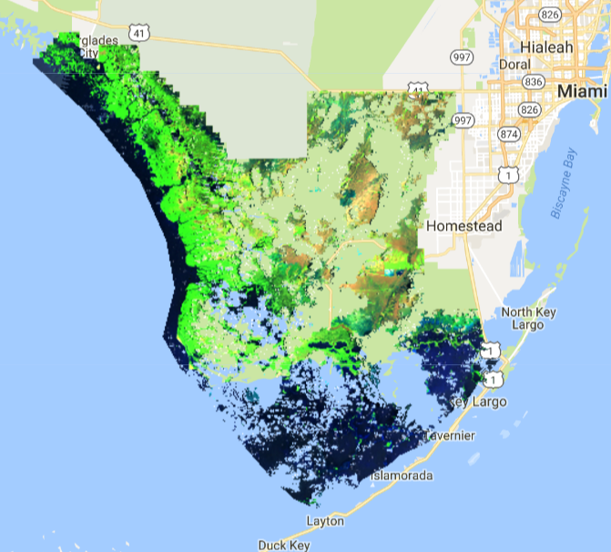
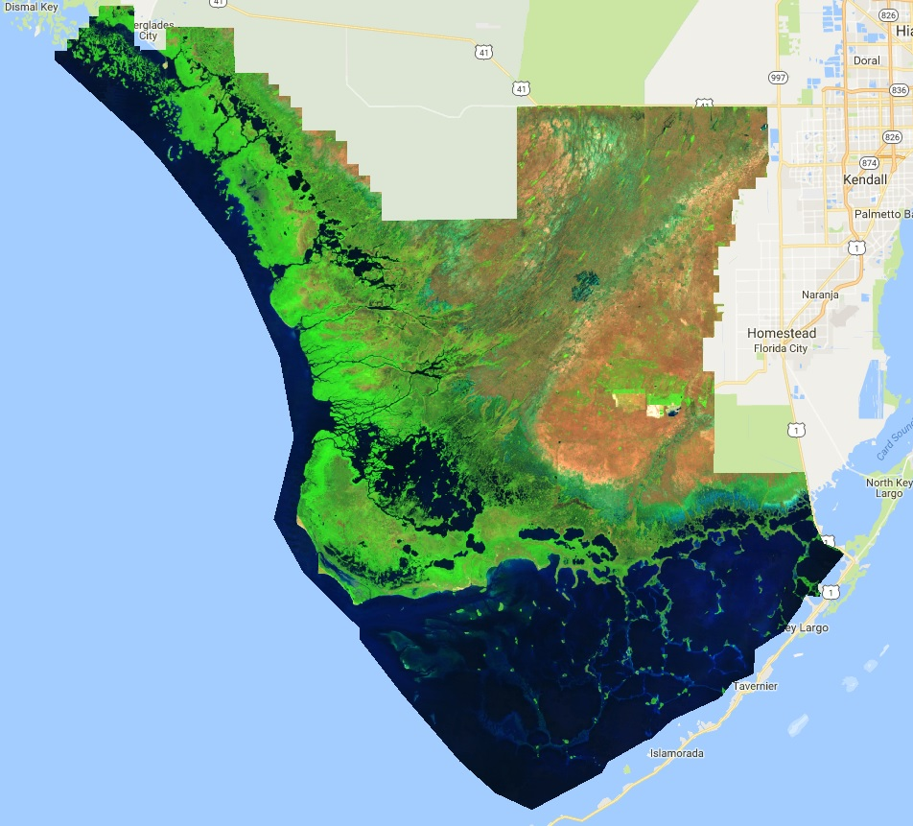
Methodology
Landsat 7
Landsat 5
Landsat 8
Notes:
Donnie**
Source: Google Earth Engine API
“We imported satellite imagery through Google Earth Engine’s API cloud based platform. This reduced the processing time because it allowed us to do all of the pre-processing and cloud removal within the same platform. Using a F-mask function within Google Earth Engine, the clouds were cut out of the images and aggregated over the dry season for each study year to produce a whole cloudless image. “

Slide 7
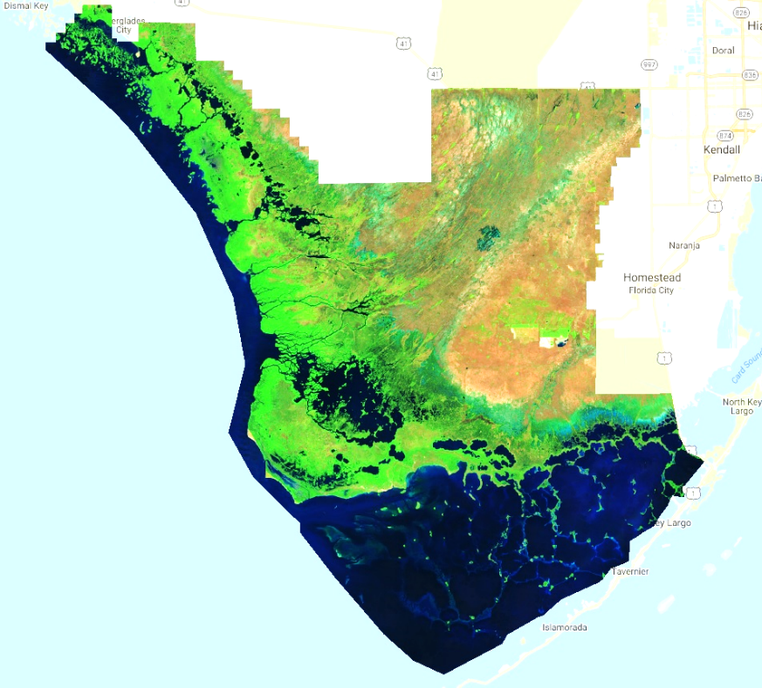
Methodology
Import Landsat TOA Images from GEE Archive
Cloud Mask Operation
Aggregate Cloud-Free Images
Random Forest Classification
Landsat 5
Landsat 8
Notes:
Donnie**
“So after we imported all of the images into Google Earth Engine and removed the pixels that exhibited clouds, we used a random forest classification process in order to delineate pixels that exhibited certain vegetation types.
This approach is known as supervised classification. We went into each study year and delineated each pixel that we were confident represented our 6 class types. These class types were water, mangrove forests, freshwater marsh, saltwater marsh and sawgrass prairie, shrubs and scrubs, and bare ground.

Slide 8
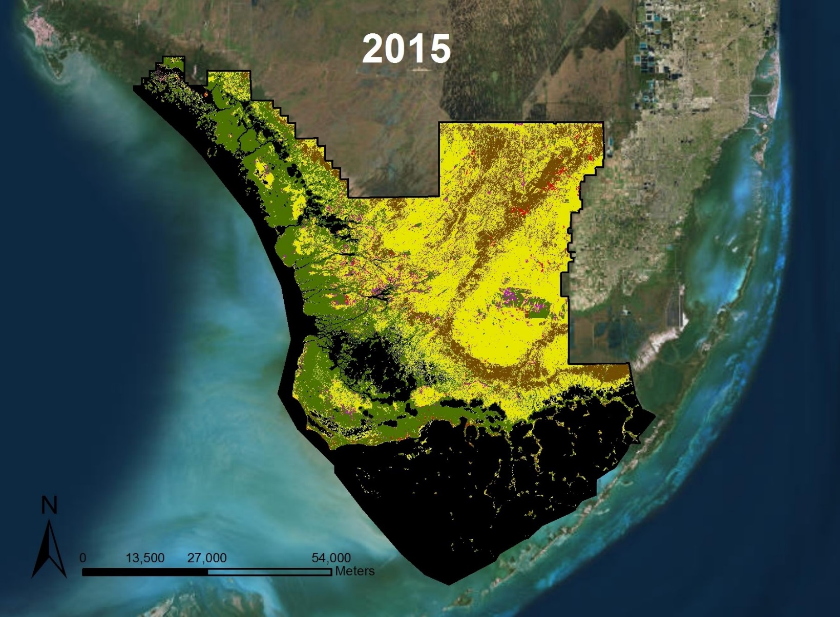
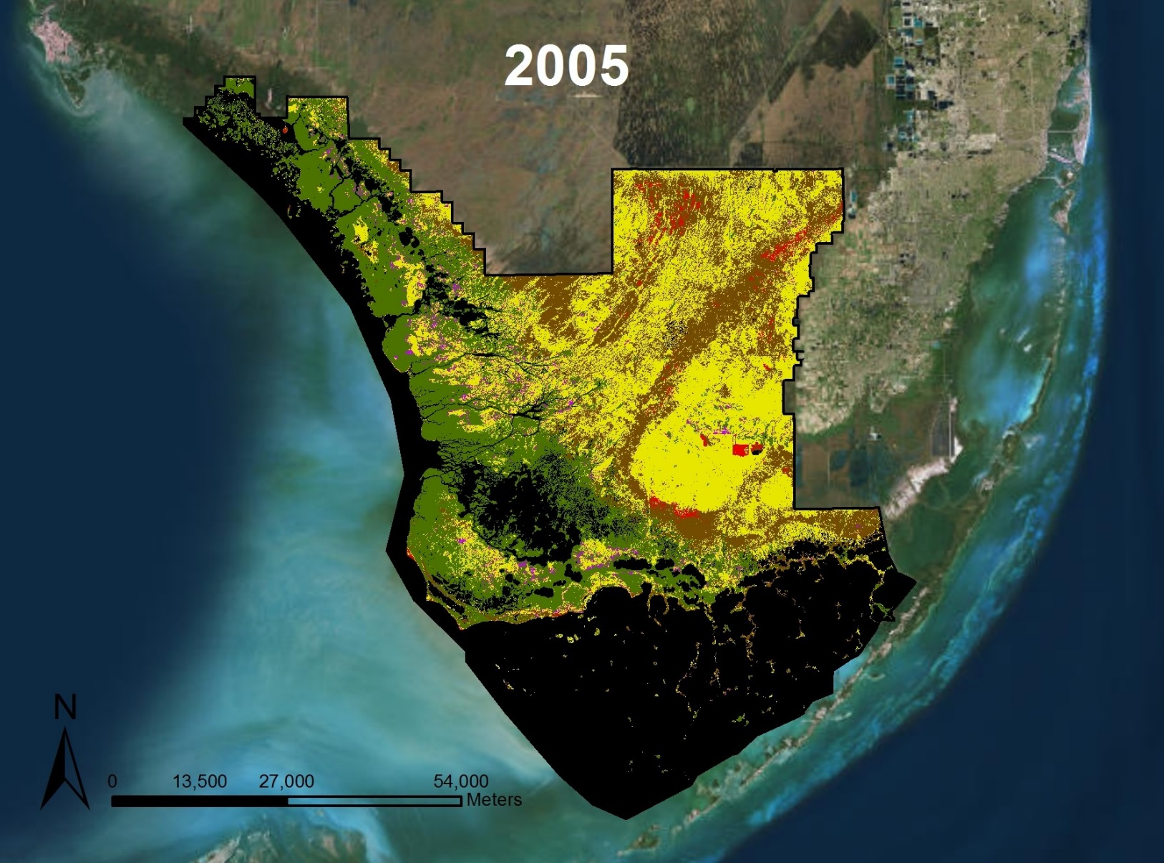
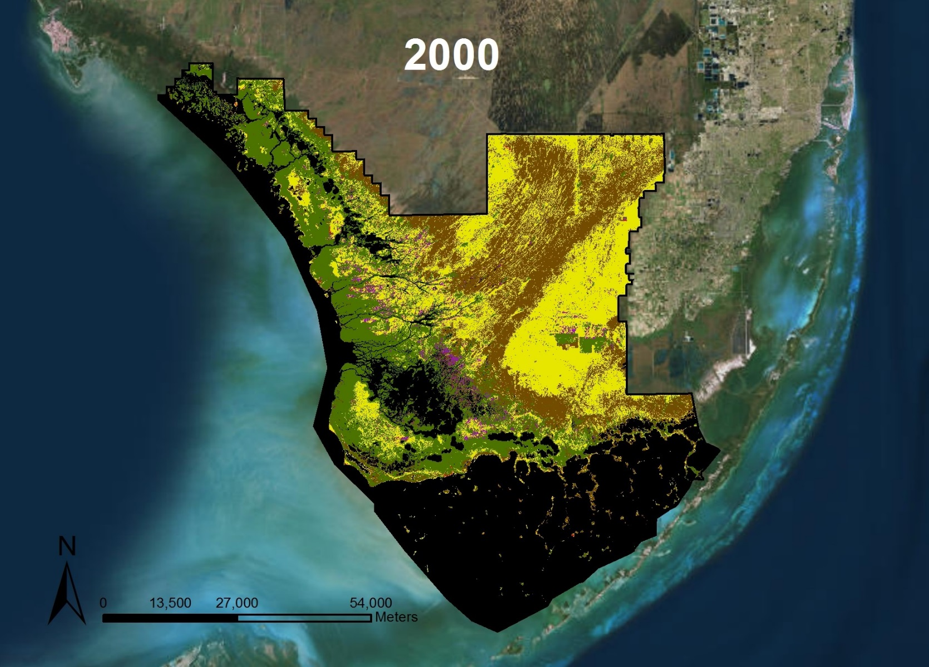
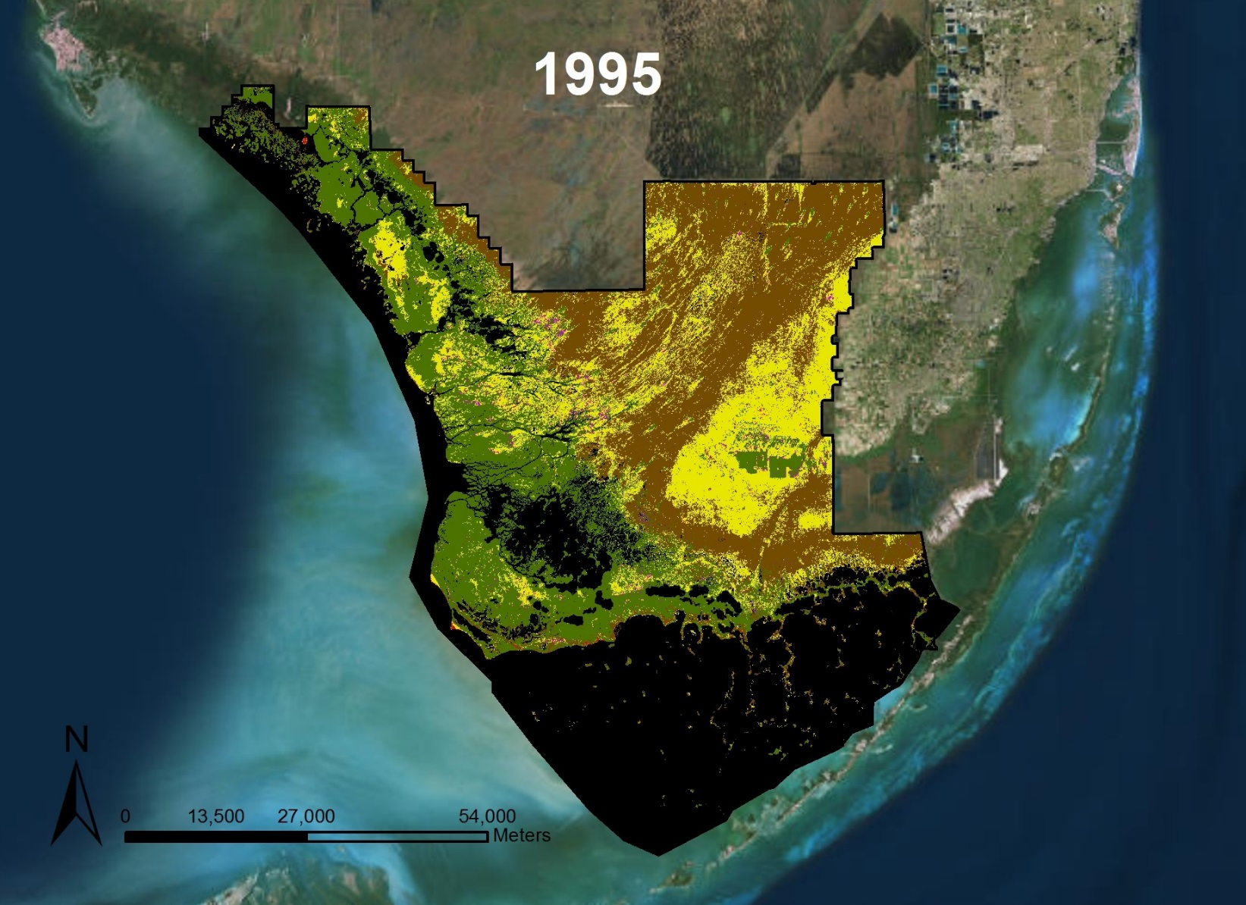
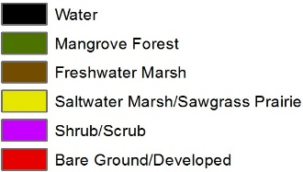
Methodology
Landsat 5
Landsat 8
Notes:
Donnie**
Within Google Earth Engine, we classified each pixel based on our own assumptions. To test the accuracy of this approach, we split up our training polygons and compared tested them against the remaining training polygons. We achieved an accuracy average of about 97%. These maps show our classification process from 1995 to 2015.

Slide 9
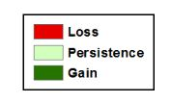
Results
1995 - 2000
2000 - 2005
2005 - 2010
2010 - 2015
2015 - 2016
Landsat 8
Notes:
Tyler**
To compare how the mangrove extent has changed over the years, we brought our classifications into TerrSet and performed a land change analysis within this software program. Our results show that mangroves are increasing further inland, which potentially means that the freshwater habitats of the Everglades are still declining.

Slide 10
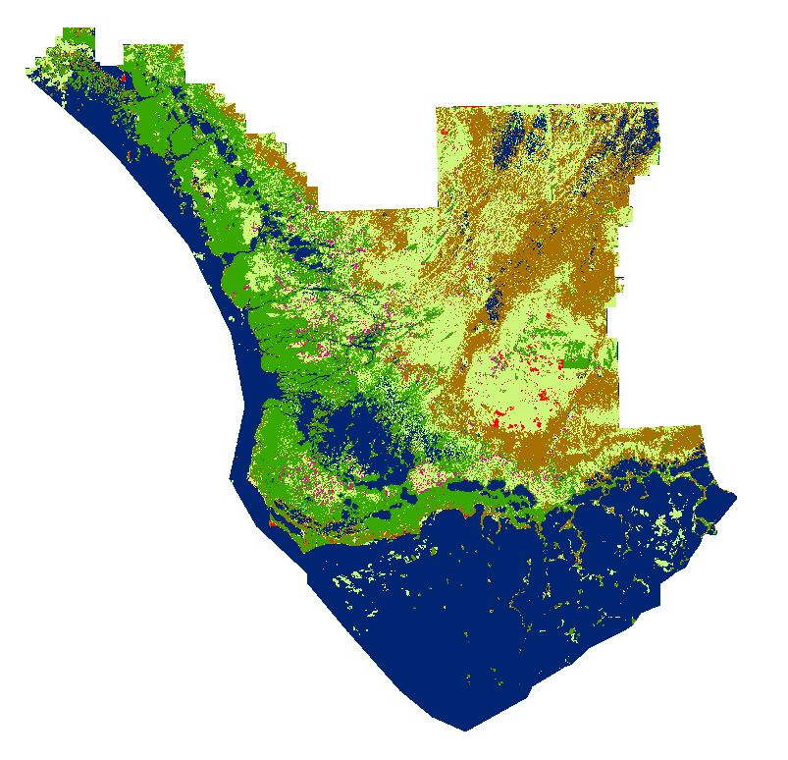
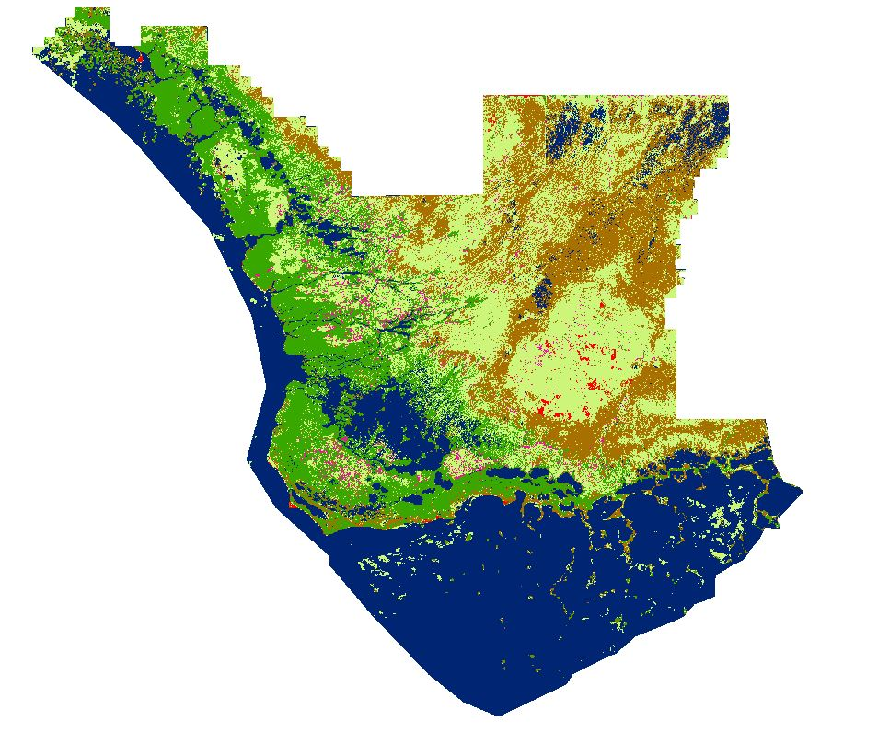
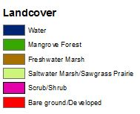
Results
2016
2030
Landsat 8
Notes:
Tyler**
We also forecasted to the year 2030 using our classification maps. However, we found that freshwater marshes were shown to increase with respect to the saltwater marshes, showing that water restoration efforts (if continuously done) can increase the freshwater habitats within the park.

Slide 11
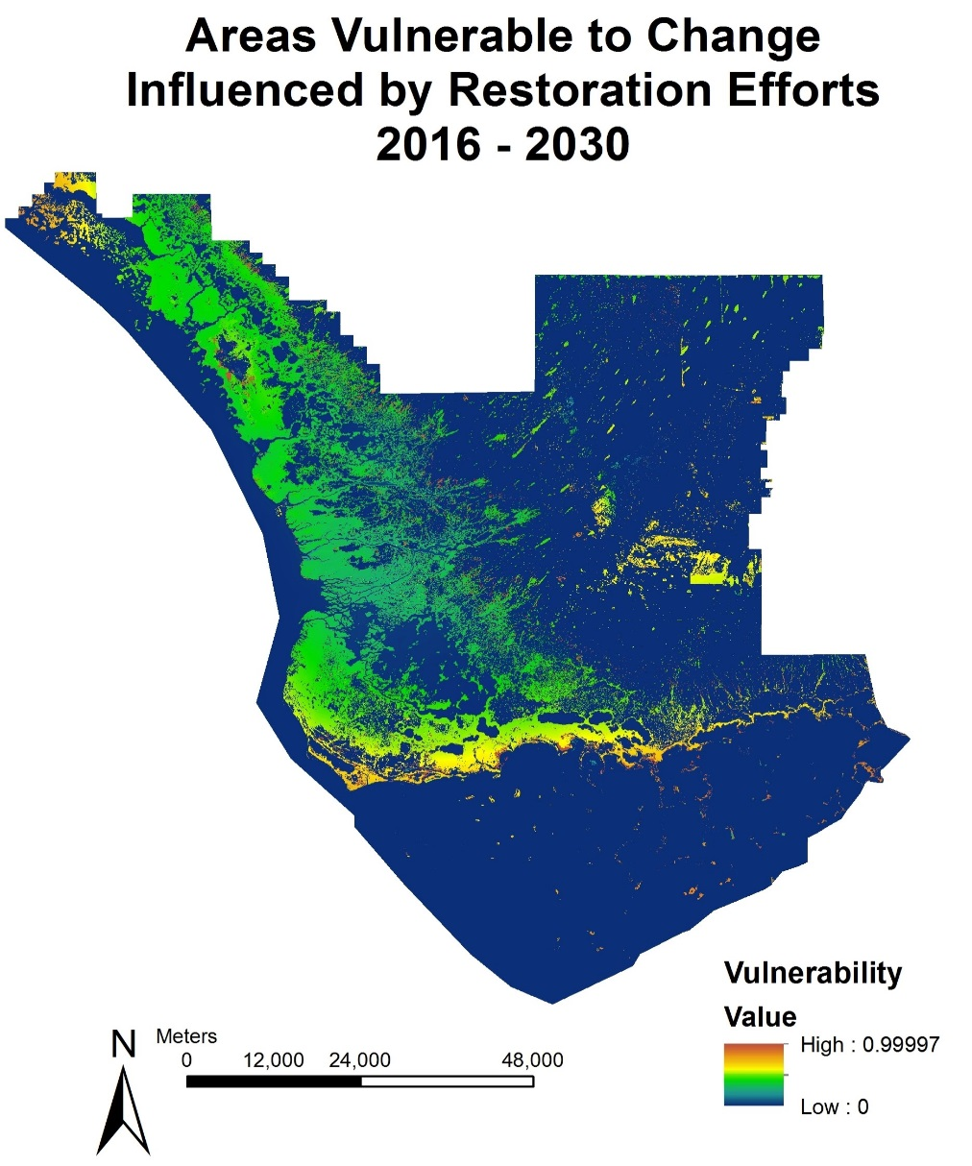
Conclusion
Mangrove extent is on a steady decline.
If restoration efforts are maintain, mangroves will push back towards the coastline.
These change analysis maps can be used to help the National Park Service establish mitigation initiatives for sustainably managing forests as freshwater is re-routed back into the park.
Landsat 8
Notes:
Tyler**
The general trend that we saw in this analysis was that the mangrove extent was decreasing and saltwater marshes and sawgrass prairies were increasing. This is indicative of the ecosystem as a whole changing in response to a changing climate and water restoration efforts made within the park. The National Park Service can now use this tool to sustainably manage forests within the park in order to contain the balance between saltwater and freshwater habitats.

Slide 12
A special thank you to our contributors for their time and assistance with this project
Advisors
Dr. Kenton Ross, NASA Langley Research Center
Dr. Marguerite Madden, University of Georgia
Dr. Sergio Bernardes, University of Georgia
Project Partners
Jed Redwine, National Park Service, Everglades National Park (ENP)
Dr. Hans-Peter Plag, Group on Earth Observations (GEO) Blue Planet Initiative (BPI) and Old Dominion University, Mitigation and Adaptation Research Institute (MARI)
Previous Contributors
Everglades Ecological Forecasting I Team
Notes:
Tyler**

