Slide 1
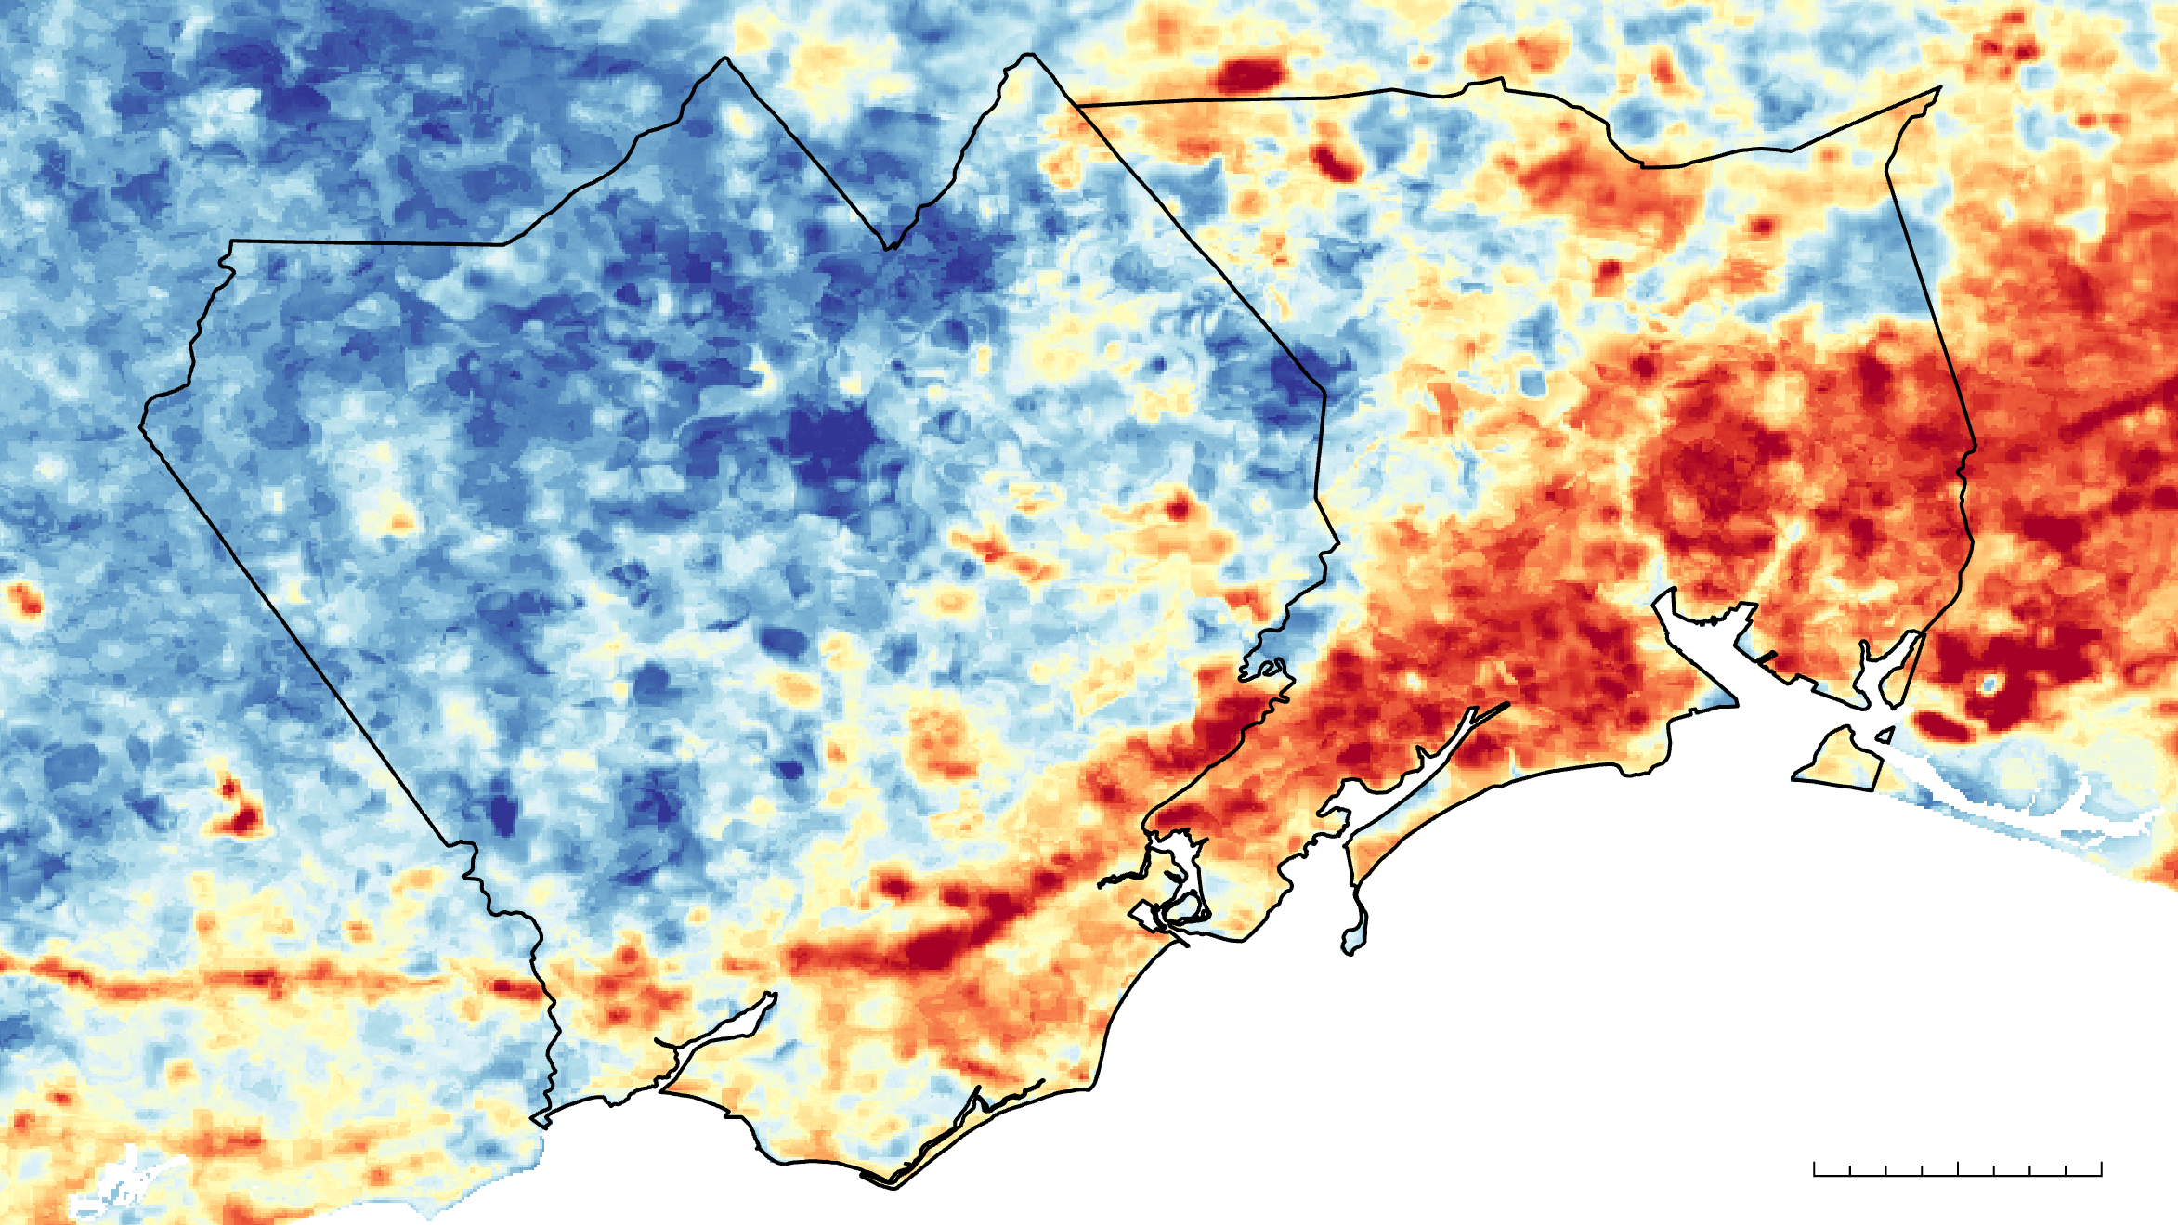
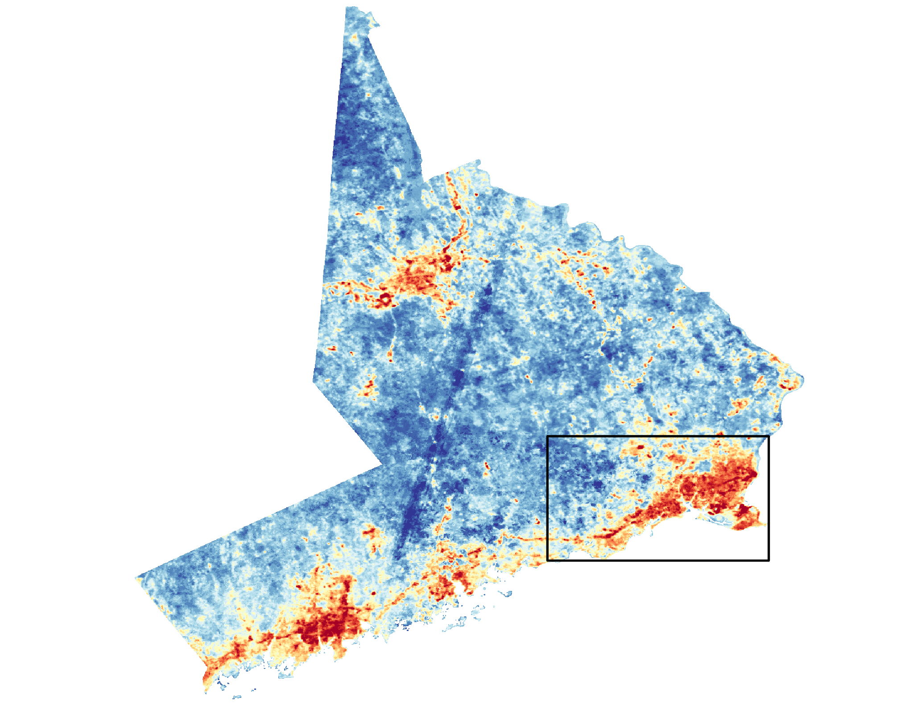
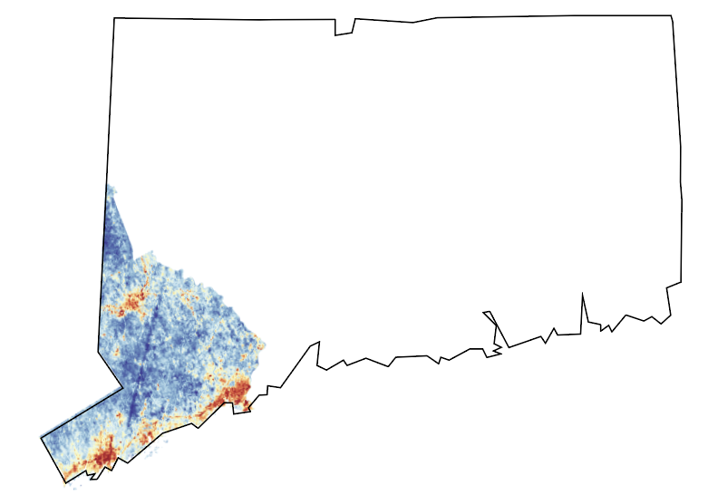
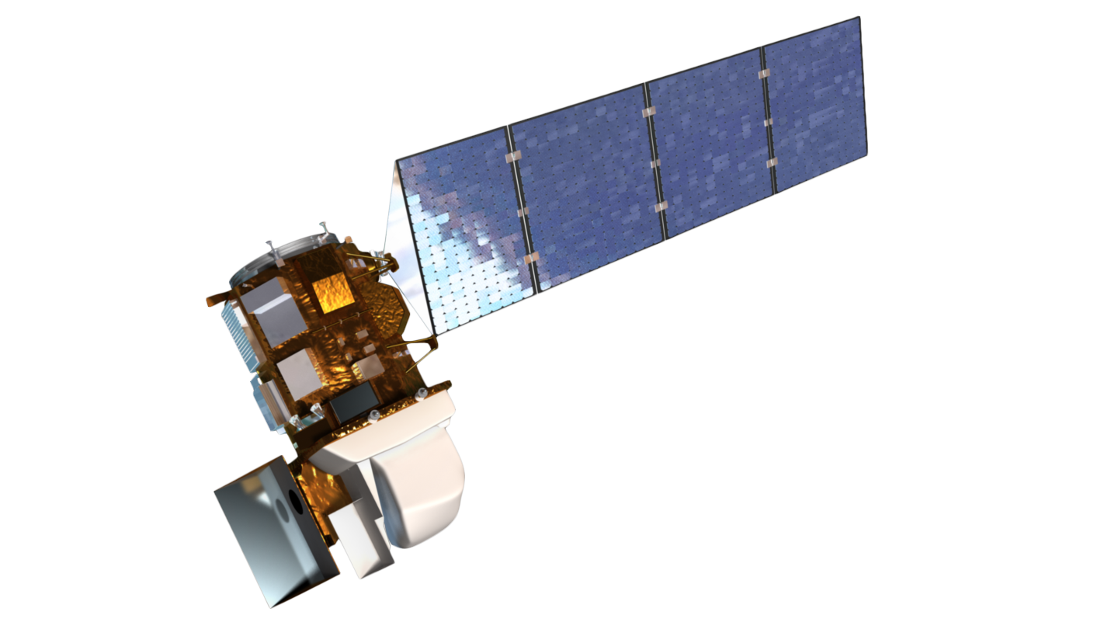
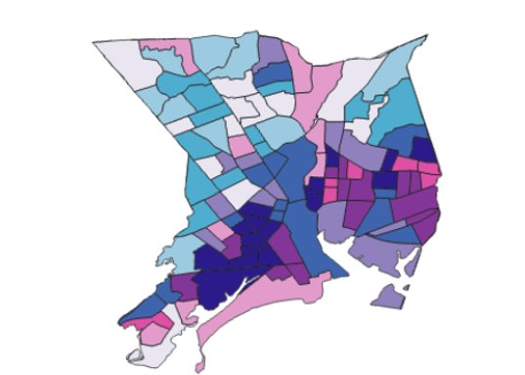
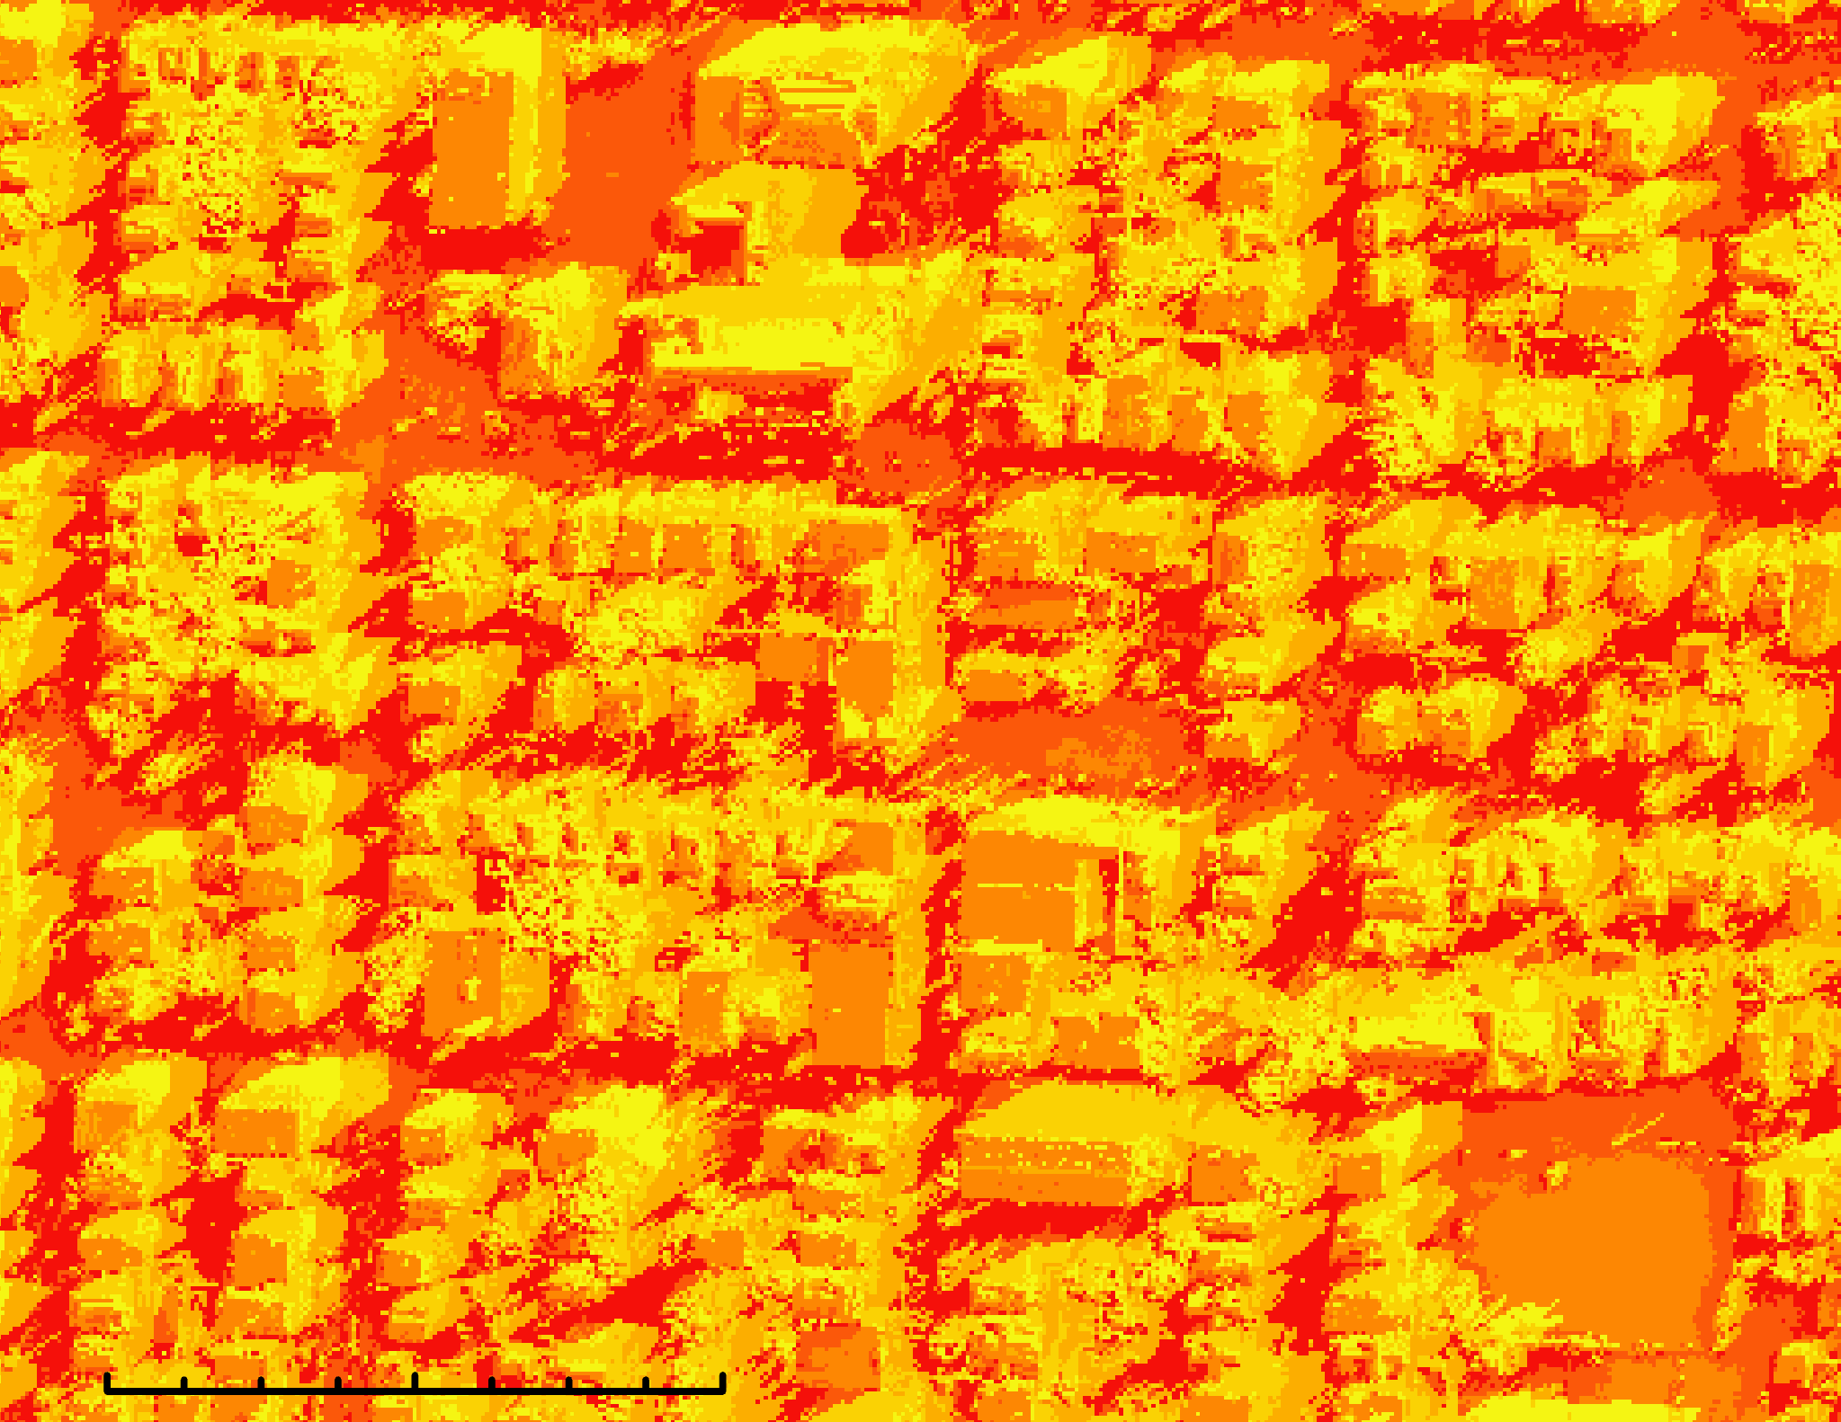
Bridgeport Urban Development
Leveraging NASA Earth Observations and Sociodemographic Data to Assess Urban Heat Vulnerability and Inform Cool Corridors in Bridgeport, Connecticut
Why does urban heat matter?
Due to Bridgeport's historic development patterns and impervious surfaces, its residents experience more intense heat than surrounding areas.
Causes health issues such as respiratory challenges and heat-related illnesses
Leads to greater energy use, burdening Connecticut communities which already pay some of the highest rates for electricity in the US
Fairfield County,
Connecticut
Bridgeport
Hotter
Town of Fairfield
Cooler
0
1
2 Miles
Bridgeport is up to 10°F warmer than the town of Fairfield
Heat Vulnerability Map for Bridgeport Connecticut
Landsat 8 TIRS
Landsat 9 TIRS
Mean Radiant Temperature Modeling in the East Side on 07/30/2022 at 14:30
Census Block Group
Temperature °F
Land Surface Temperature
Ogden St
89.1 – 98.4
High
Heat Vulnerability Score
98.4 – 100.0
Low
Low
High
100.0 – 148.2
148.2 – 152.7
Social Vulnerability Indicators used include a variety of socio-demographic and socio-economic census variables.
152.7 – 154.6
154.6 – 157.3
E Main St
Takeaways
Feasible to use NASA EO for Urban Heat Analysis
Thermal modeling is valuable for determining cooling interventions
0
250
500 feet
Parking Lot
Team Members
Acknowledgments
The team would like to thank everyone who made this project possible:
Science Advisors: Dr. Kenton Ross (NASA Langley Research Center), Dr. Xia Cai (NASA Langley Research Center)
Lead: Madison Arndt (Boston — Massachusetts)
Project Partners: Christina Smith (Groundwork Bridgeport), Andrei Harwell (Yale Urban Design Lab)
Silas Kirsch
Project Lead
John Hocknell
Maggie Roseto
Charlotte Tomlinson
Boston ─ Massachusetts | Spring 2024

