Slide 1
Colorado Front Range
Disasters
Understanding the Impact of Forest Management on the Cameron Peak and Calwood Fires
Neal Swayze, Christopher Choi, Garrett Knowlton, & Jorune Klisauskaite
Colorado – Fort Collins
Notes:
Intro slide:
This is Colorado Front Range Disaster's team for the Spring 2021 DEVELOP Term. For our project, we sought to understand the impact of forest management on the Cameron Peak and Calwood fires that occurred in late 2020.
The team consisted of Neal Swayze (Project Lead), Christopher Choi, Jorune Klisauskaite, and Garrett Knowlton. We were advised by Brian Woodward and Tony Vorster of the Natural Resources Ecology Lab at Colorado State University.

Slide 2
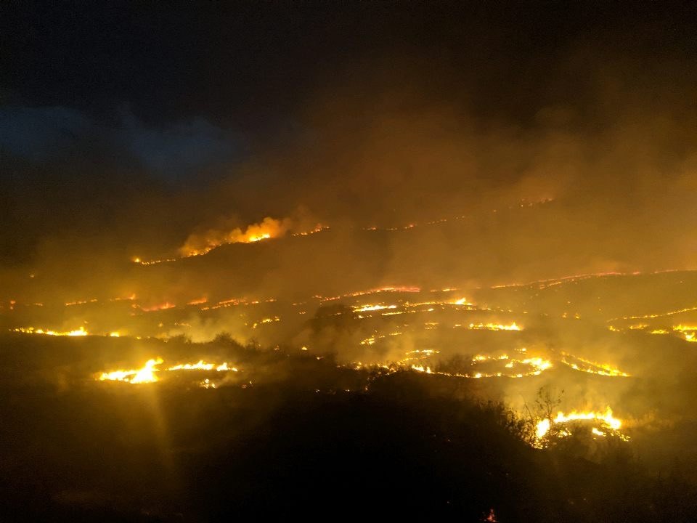
Outline
Background
Community Concerns
Project Partners
Project Objectives
Study Area and Period
Methods/Workflow
Results
Future Work
Image Credit: Mckinney, 2020
Notes:
A brief description of the flow of our presentation and what we will be discussing to the audience.
Image Credit: Seth Mckinney, "Provided by partners with permission to distribute"

Slide 3
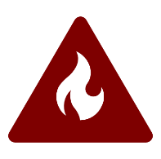
Background: Increasing Wildfire Activity Along Colorado Front Range
Climate Change
Reduced Snow & Precipitation
Drier Conditions
Increased Wildfire Activity
Notes:
​
Climate change is contributing to reduced snow and precipitation along the Colorado front range, and warming temperatures are also resulting in earlier spring snowmelt. The lack of precipitation paired with increasing temperatures early in the year is leading to fuels drying out earlier. Drier fuels paired with longer fire seasons are resulting in increased fire activity and intensity compared to historical trends.
Microsoft PowerPoint ClipArt

Slide 4
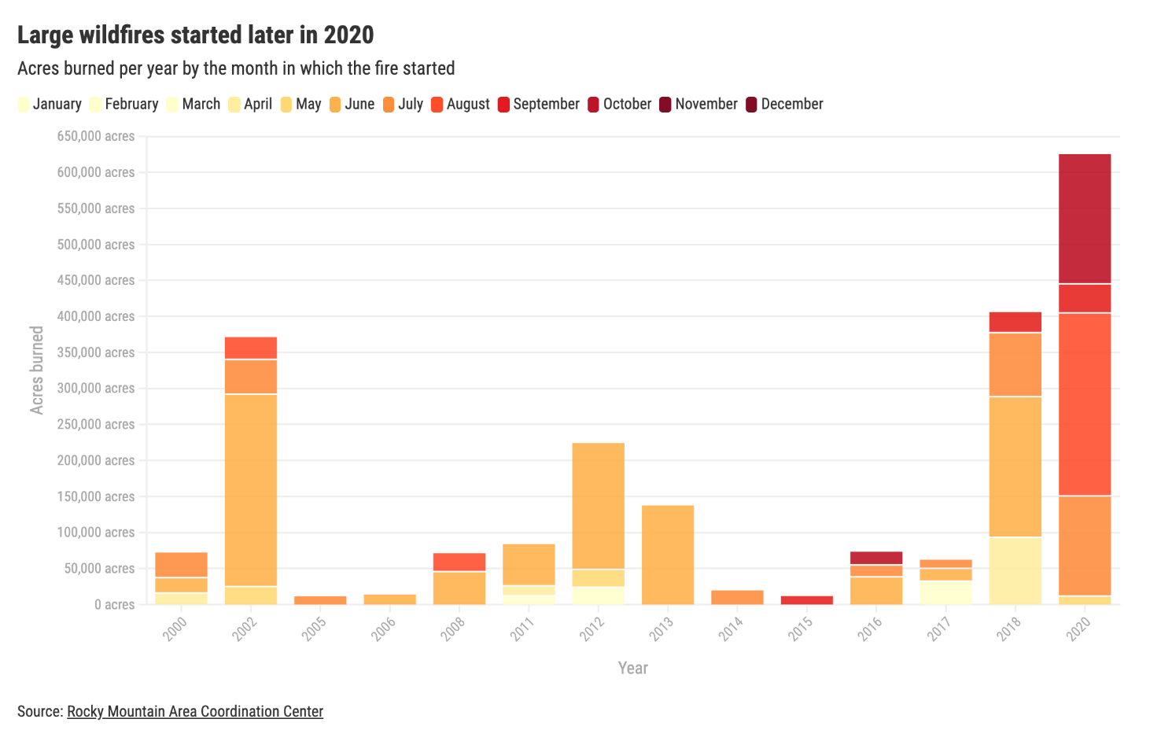
Wildfire Trends
Figure Credit: J. Ingold, 2020
Notes:
Jorune​
​
The East Troublesome and Cameron Peak fires were the largest fires ever recorded in Colorado history. Additionally, all three fires occurred late in the season, burning over 400,000 acres which has drawn serious attention. These fires have raised questions about the effectiveness of forest management over the last several decades for reducing wildfire risk.
​
Collective public concerns stem from the risks to ecosystem services, increased erosion, threats to the Wildland-Urban Interface, habitat loss (especially of species like the greenback cutthroat trout and Preble’s Mouse)​
​
There are also many more concerns such as financial costs of fighting the fires and restoring them post-fire and local air quality that impact vulnerable community health.
Figure Credit: J. Ingold, 2020

Slide 5
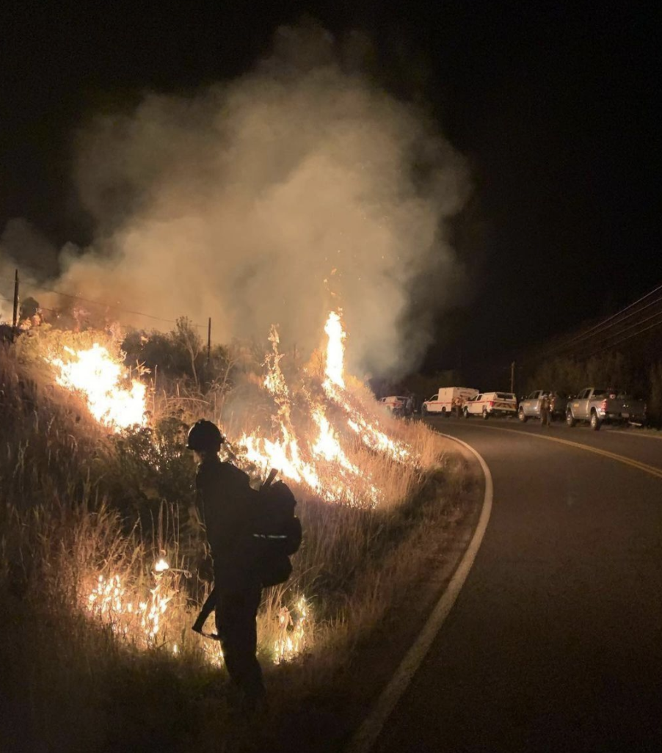
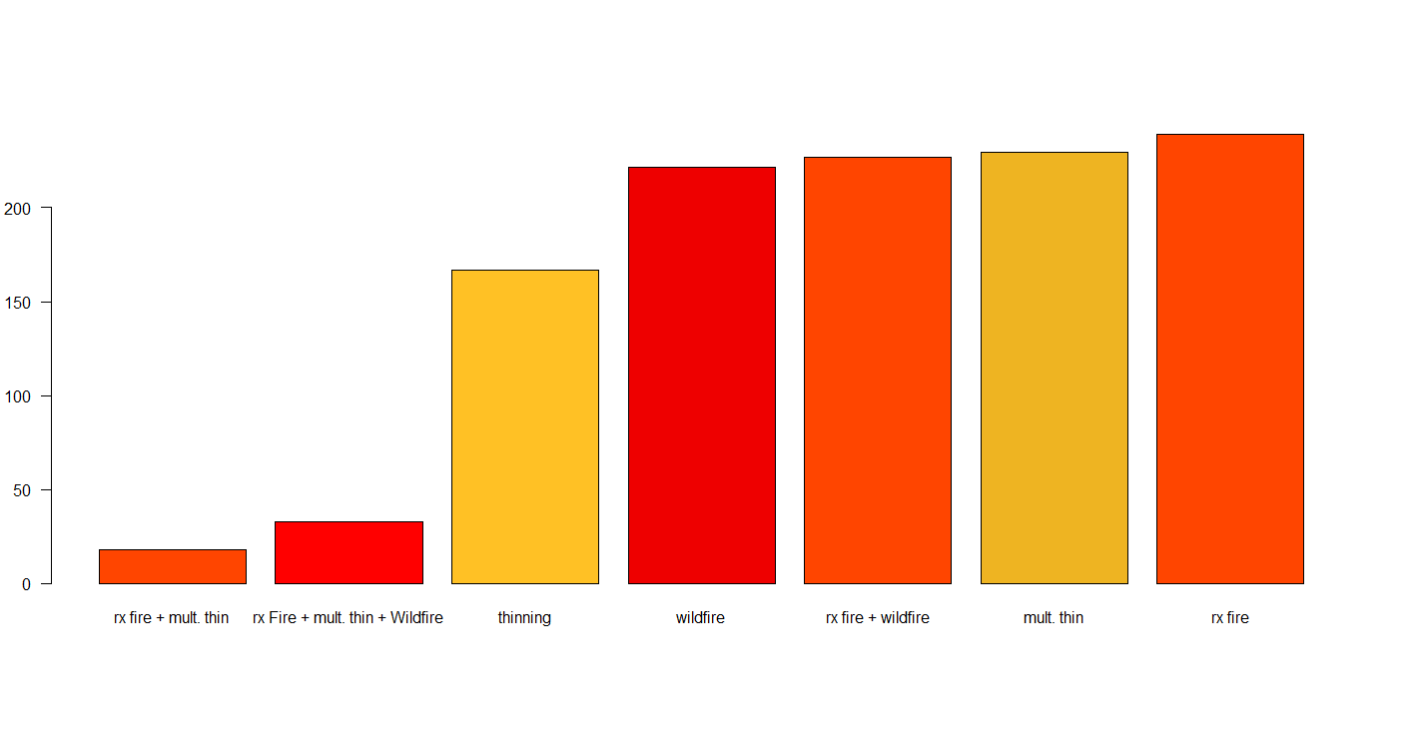
Forest Management
Most common treatment types
Thinning
Surface fuels treatments
Pile burning
Clearcuts
Calwood Fire Treatment Types
200
Image Credit: Texas Forest Service
Area in Hectares
150
100
50
Rx Fire &
Mult. Thin &
Wildfire
Wildfire
Rx Fire
Rx Fire &
Mult. Thin
Thinning
Mult. Thin
0
Rx Fire & Wildfire
Image Credit: National Parks Service and Bracewell
Image Credit: Beveridge, 2020
Notes:
Jorune​
Forest management comes in many shapes and sizes when it comes to reducing and rearranging forest fuels. These practices are designed to reduce burn severity and mitigate the associated risks of wildfire. The most common types of fuel treatments across the landscape are thinning, surface fuels treatment, pile burning, and clear-cut operations. The Rx in the graph describes “Prescribed Fires”. These treatments seek to remove fuel that allows wildfire to continue burning and spreading. By reducing fuel, burn severity and fire spread can be reduced.
Image Credit: Daniel Beveridge, "Provided by partners with permission to distribute"

Slide 6
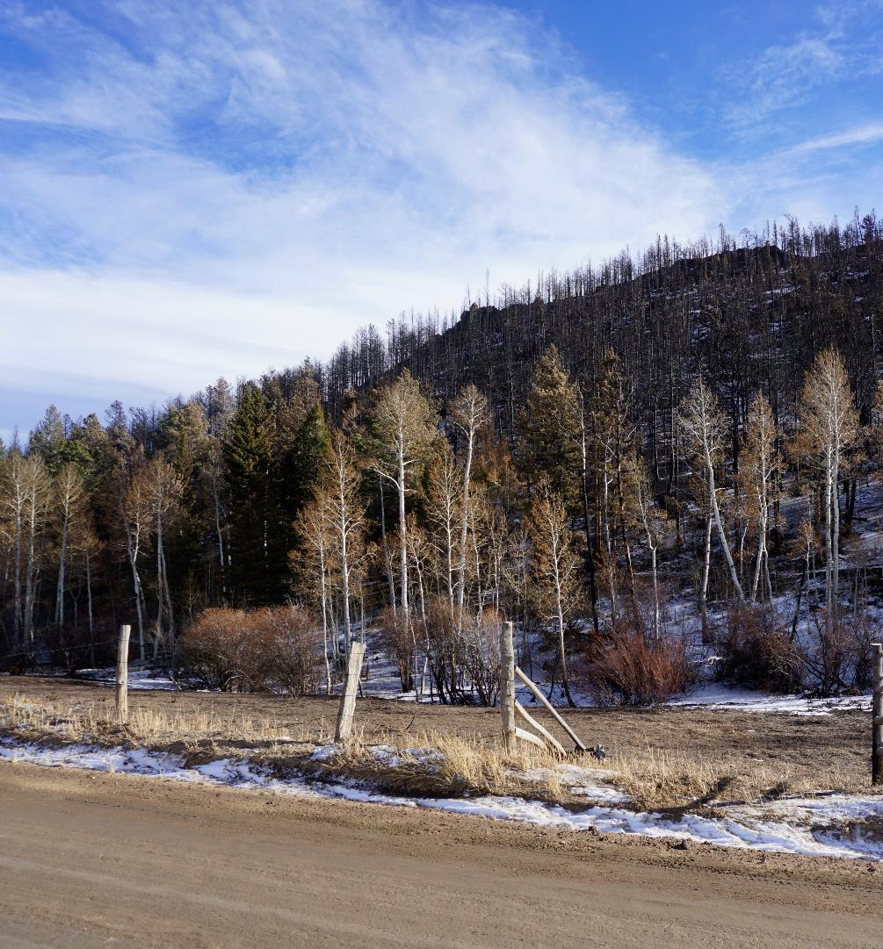
Project Partners
End Users
Coalition for the Poudre River Watershed
Daniel Bowker
Ben Delatour Boy Scout Ranch
Robert Sturtevant
Colorado Forest Restoration Institute
Dr. Michael Caggiano
The Nature Conservancy, Colorado Chapter
Rob Addington
Colorado State Forest Service
Daniel Beveridge
Collaborator
Colorado State University
Dr. Wade Tinkham
Image Credit: Neal Swayze
Notes:
Our project partners consist of the Coalition for the Poudre River Watershed, TNC – Colorado, the Ben Delatour Boy Scout Ranch, Colorado State Forest Service, Colorado Forest Restoration Institute, and Colorado State University. We were advised by Brian Woodward and Tony Vorster at the Natural Resource Ecology Laboratory at Colorado State University.
Image Credit: Swayze, N. (2020). DEVELOP Team

Slide 7
Project Objectives
1. Map
2. Create
3. Explore
4. Communicate
Sort various historical treatments to create a forest combined dataset
Map burn severity for the Cameron Peak and Calwood Fires
Explore relationships between burn severity and forest treatments
Share project results with a StoryMap to project partners
Notes:
I am going to briefly review our objectives for this project: ​
​
(((Click)))​
​
First, we want to create maps of burn severity for the Cameron Peak and Calwood fires​
​
(((CLICK)))​
​
Second, we want to model relationships between burn severity and forest treatments​
​
(((CLICK))) ​
​
Third, we create a story map to communicate our results to project partners and community stakeholders.

Slide 8
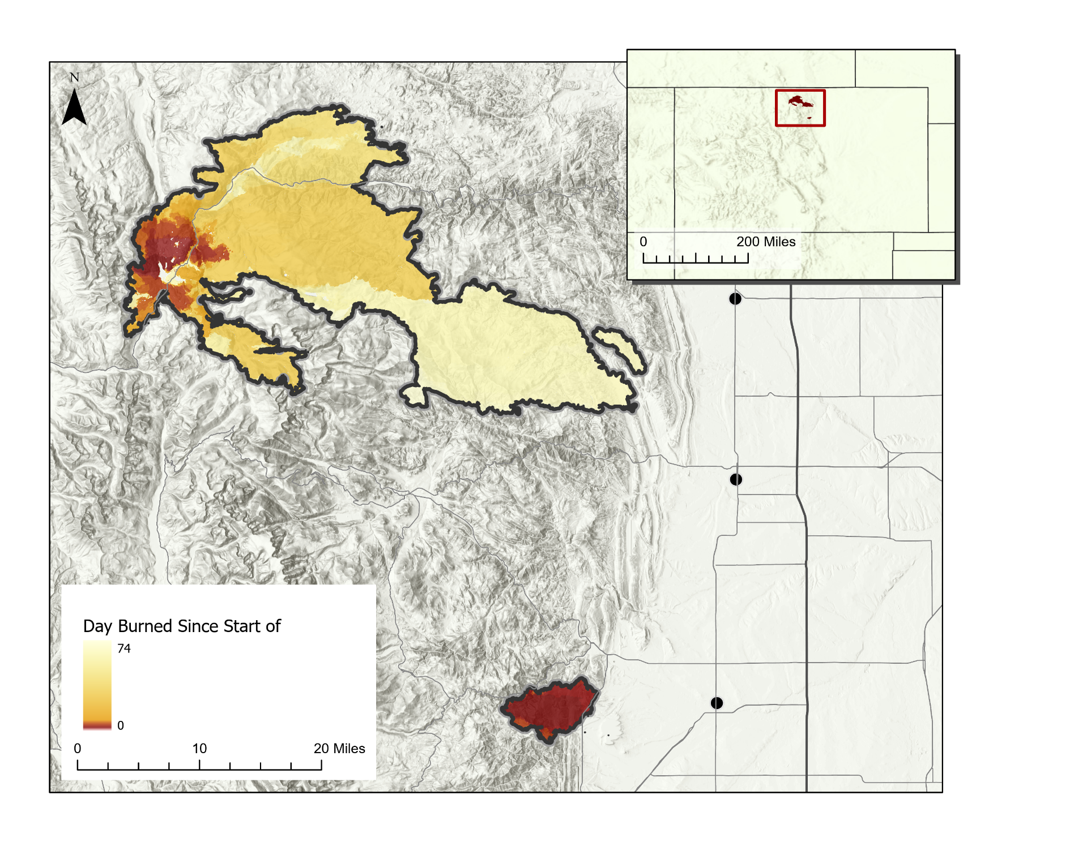
Study Area/Time Period
Study Period​: August-December 2020
Colorado
Cameron Peak Fire
August 13-December 2, 2020
Largest fire in CO history - 208,913 acres
Cameron Peak
Fort Collins
Loveland
Calwood Fire
October 17-November 14, 2020
Burned 10,106 acres
Fire Progression
CalWood
Day burned since start of fire
Longmont
Notes:
Neal
Our study is focused on three Colorado fires that burned in 2020: the Cameron Peak, East Troublesome, and Calwood fires.
The Cameron Peak fire was the longest burning fire, burning from August to December of 2020 (112 days!), and it was the largest fire in Colorado history burning over 200,000 thousand acres.
Calwood was a smaller fire that burned just over 10,000 acres and was in close proximity to the towns of Longmont and Boulder, gaining lots of interest from the local community.
These fires occurred late in the typical fire season, and they were largely driven by high winds and fuel loading, with some really windy days that reached up to 70mph. There were also multiple snow events that occurred during these fires, so there are multiple factors that played into how they spread and how large these fires got.
On the right, our study area map displays a difference normalized burn ratio index applied to Sentinel-2 MSI imagery for the two fires.
-----------------------------------------------------------
Credits
Map basemap - Esri

Slide 9
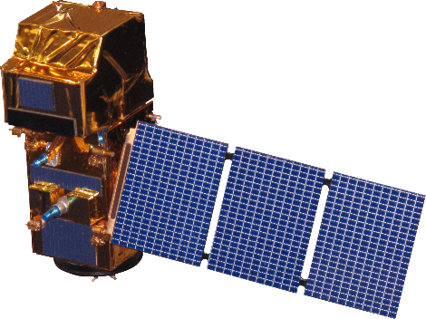
Satellites/Sensors Used
Sentinel-2
MultiSpectral Imager (MSI)
Map burn severity indices
Landsat 8
Operational Land Imager (OLI)
Create Forest Structure & Disturbance predictor variables
Shuttle Radar Topography Mission (SRTM)
Topographic Variables
Image Credit: NASA, ESA
Notes:
Chris
For our Data Collection we used the imagery from 3 satellites. Landsat and Sentinel provided imagery to map burn severity. SRTM provided elevation data to calculate a range of topographic variables, such as slope and aspect. All the imagery was accessed and processed in Google Earth Engine.
Images:
Sentinel-2 MSI: ESA
Landsat-8 OLI: NASA
SRTM: NASA
Images were retrieved from DEVELOPedia.

Slide 10
Methodology: Overview
Map Burn Severity
(Difference Normalized Burn Ratio [dNBR], Relative Difference Normalized Burn Ratio [RdNBR], Relativized Burn Ratio [RBR])
Compare Burn Severity Maps to Field Data
Satellite Image Selection
Explore relationships between treatment type and burn severity
Model relationships using RandomForest algorithm
Field Data
Standardize Historical Treatment Data
Treatment Data
Extract Predictor Variables from treatment areas
Predictor Variables
Notes:
We wanted to briefly go over our methods that we plan on using for the project. ​
​
(((CLICK)))​
​
First, we acquired all our images using Google Earth Engine and we retrieved our other data from partners: ​
​
We tested two approaches for mapping burn severity, manual image selection and automated image selection. We are also currently generating several ecological and topographic variables, and we are still organizing all our partner treatment data. ​
​
(((CLICK)))​
​
We mapped burn severity using the difference normalized burn ratio (dNBR), relative difference normalized burn ratio (RdNBR), and relativized burn ratio (RBR). We will then extract our ecological and topographic data for the given treatment areas​
​
(((CLICK)))​
​
Following, we then will validate our burn severity maps using the Colorado State Forest Service soil burn severity plots. ​
​
(((CLICK)​
​
Next, our plan is to model correlations between burn severity and treatment type, ecological variables, and topographic variables using random forest regressions​
​
(((CLICK))) ​
​
These models will help us better understand the relationships between treatment type and burn severity for the Cameron Peak and Calwood fires. ​
​

Slide 11
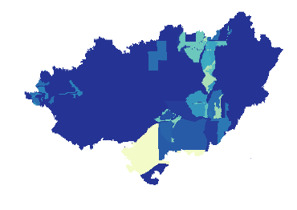
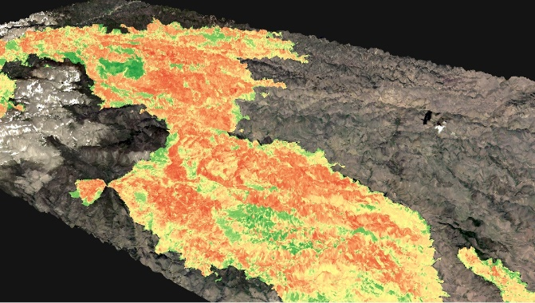
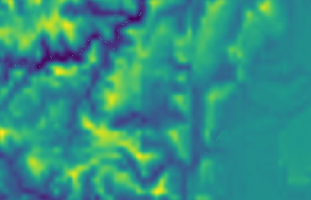
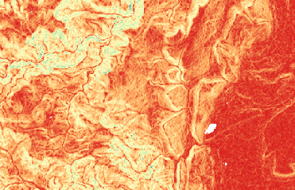
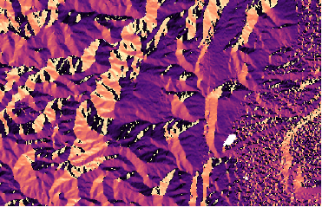
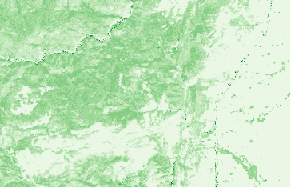
Methods: Modeling Relationships between Burn Severity and Treatment type
Map Burn Severity:
dNBR
RBR
RdNBR
Predictor Variables:
Treatment Type
Forest Structure
Topographic
Disturbance
Analysis:
Random Forest Modeling
Summary Statistics
Treatment
mTPI
Slope
Aspect
Veg Height
Notes:
Chris
In the first part of our project to map burn severity, we will first create a burn severity index by combining the data from a range of burn ratios and indexes. After initial discussions with project partners, it was highlighted that the change in canopy cover over the burned areas was also an important measurement for them to understand burn severity.
Using this burn severity index, we will apply it to our three burn areas, then identify forest treatment areas within the three burn areas.
In the second part of the project, we will measure the burn severity, climatological, and topographic characteristics of different treated areas, as well as non-treated areas. Using a random forest model, we will aim to determine relationships and the effectiveness of different treatments and burn severity under a variety different geographic situations.
Image credits: DEVELOP Team Generated in Google Earth Engine from Sentinel-2 MSI imagery

Slide 12
Methods: Burn Severity Mapping
Difference Normalized Burn Ratio (DNBR)
Pre NBR – Post NBR
Normalized Burn Ratio (NBR)
Pre-Fire (2019) RGB
Pre-Fire NBR
NIR – SWIR
NIR + SWIR
DNBR
Post-Fire (2020) RGB
Post-Fire NBR
Notes:
We wanted to also briefly explain the methods that we used for mapping burn severity. ​
​
(((Click)))​
​
For the manual image selection method, we selected pre (2019) and post (2020) fire images for Calwood fire. These images were selected to have low cloud and snow cover.
(((Click)))​
Next, we applied the normalized burn ratio equation to the Near Infrared and Shortwave infrared bands of these images
(((Click)))​
This generated both a pre and post NBR image for the Calwood fire
(((Click)))​
Finally, we subtracted the values of the pre – image from the post image to generate a difference normalized burn ratio index, which helps detect changes after a fire.
DEVELOP Team Generated in Google Earth Engine from Sentinel - 2 MSI imagery

Slide 13
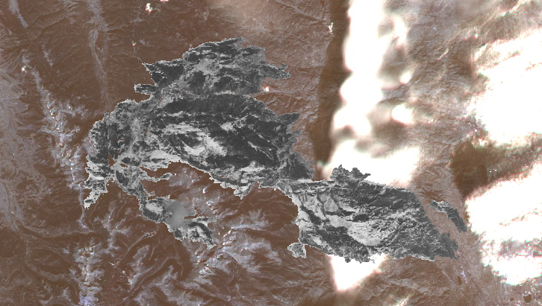
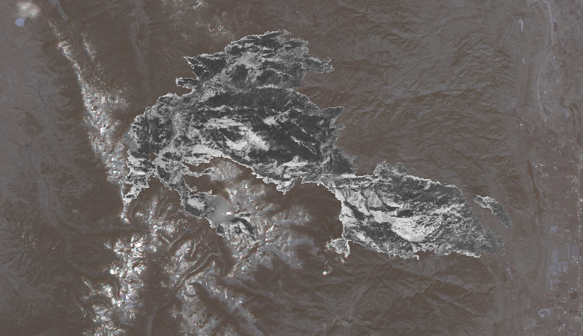
Methods: Manual Image Selection Method
West Image:
10/12/2020
Select pre (2019) and post (2020) cloudless (<15%) and snowless images
Method was compared to: Automated Compositing Method (Parks et al. 2018)
Mosaic selected images
East Image:
12/22/2020
Calculate NBR, dNBR, RBR, and RdNBR
Notes:
We wanted to also briefly explain the methods that we used for mapping burn severity. ​
​
(((Click)))​
​
For the manual image selection method, we selected pre (2019) and post (2020) fire images for the Cameron Peak and Calwood fires. These images were selected to have low cloud and snow cover. Calwood was easy because the fire was smaller, and we were able to find two suitable images with no snow or cloud cover that covered the whole fire.​
​
Cameron peak was a little different. Since the fire burned for 112 days, we had some issues finding snow free and cloud free images for mapping the entire fire. We decided to split the fire into two sections (East and West) with different pre and post fire dates for each half to avoid snow.​
DEVELOP Team Generated in Google Earth Engine from Sentinel-2 MSI imagery
​
(((CLICK)))​
​
After we picked out suitable images, we then masked out water, and mosaicked the selected images together. We then calculated NBR, dNBR, RBR, and RdNBR for the mosaicked images. ​
​
(((CLICK))))​
​
We also investigated an automated pixel compositing method for mapping burn severity for both fires. While an automated burn severity mapping method sounds really nice, we found that the method wasn’t very good at selecting pixels when there was a lot of snow cover. Overall, we didn’t like the results and decided to stick with the manual image selection method for both fires. ​
​
Image credits: DEVELOP Team Generated in Google Earth Engine from Sentinel - 2 MSI imagery

Slide 14
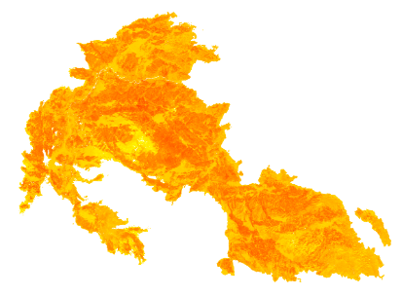
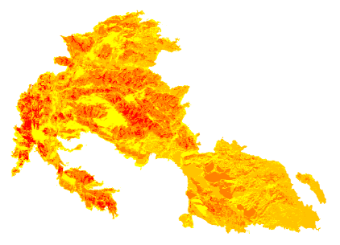
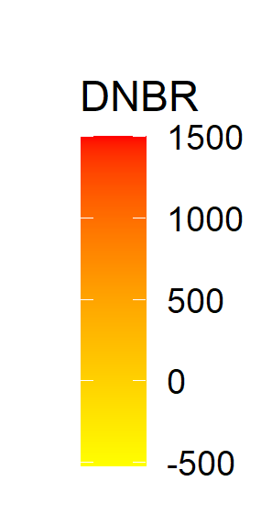
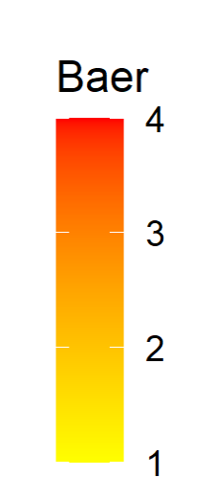
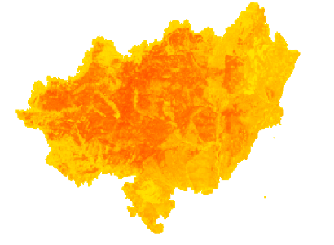
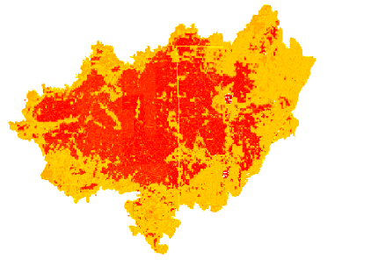
Burn Severity Results
Cameron Peak Fire
1000
dNBR
BAER Burn Severity
750
dNBR
500
250
0
Cameron Peak Fire
800
RBR
600
400
200
0
dNBR
BAER Burn Severity
4000
3000
RdNBR
2000
Calwood Fire
1000
0
Low
Mod
High
Low Mod
Mod High
Notes:
Here are our three different burn severity rasters for both the Cameron peak and Calwood fires, these all explain burn severity slightly differently. As you can see, our maps were similar to the Burned Area Emergency Response (BAER) burn severity maps on the right, and we are pretty happy with our results. ​
​
These different burn severity metrics all describe different components of burn severity
DEVELOP Team Generated in Google Earth Engine from Sentinel - 2 MSI imagery

Slide 15
Methods: Predictor Variable Generation
LandTrendr
Disturbance
Variables
Forest Treatment
Variables
Ecological
Variables
Topographic
Variables
Total: 43 Predictor variables
Notes:
We used various predictor variables for our model. This included fuel treatment, ecological, topographic, and LandTrendr Disturbance variables.
From left to right we have snippets of treatment type, forest cover, elevation, and greatest disturbance variables used in this study. However, there were many other variables that we assessed in our modeling.
Image credits: DEVELOP Team Generated in Google Earth Engine from Sentinel-2 MSI imagery

Slide 16
Methods: Predictor Variable Generation
Forest Treatment Variables
Treatment Size
Treatment Age
Type of Treatment
Topographic Variables
Slope
Aspect
Elevation
Landform
Physio Diversity
Topographic Diversity
Topographic position index
Topographic wetness index
Northness
Eastness
Continuous Heat-Isolation Load Index (CHILI)
Multi-scale Topographic Position Index (mTPI)
Topographic Solar-Radiation Index (TRASP)
Ecological Variables
Canopy Height
Canopy Bulk Density
Canopy Base Height
National Veg. Classification
Fuel Veg. Cover
Fuel Veg. Type
Fuel Characteristic Class
Fuel Vegetation Height
Existing Fuel Type
LandTrendr Disturbance Variables
Magnitude of greatest disturbance
Year of disturbance
Recovery magnitude
Notes:
We used various predictor variables for our model. This included
forest treatment variables (e.g., as type of treatment, age of treatment, and treatment size)
LandTrendr Disturbance Variables (e.g., as magnitude of greatest disturbance and year of disturbance)
ecological variables (e.g., canopy cover, canopy height and fuel types)
Topographic variables (e.g., as elevation, slope, aspect, and landform)
This slide covers all of the predictor variables that we included in our model. These categories cover: forest treatments, landtrendr (disturbance), ecological variables from LANDFIRE, and topographic variables.
** Don't spend too much time here, just showing what we included**

Slide 17
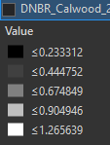
Methods: Stratifying Points
0
1
2Km
Forest Treatment
Rx Fire
Rx Fire + Multiple Thinnings
Rx Fire + Multiple Thinnings + Wildfire
Wildfire
Rx Fire + Wildfire
Thinning
Multiple Thinning
Other Treatments
Stratified Points
Notes:
We sampled all the variables across our study areas using randomly placed stratified points treated and untreated areas.
Here we see where the largest treatment areas by area are across where the Calwood fire burned and the points we sampled at.

Slide 18
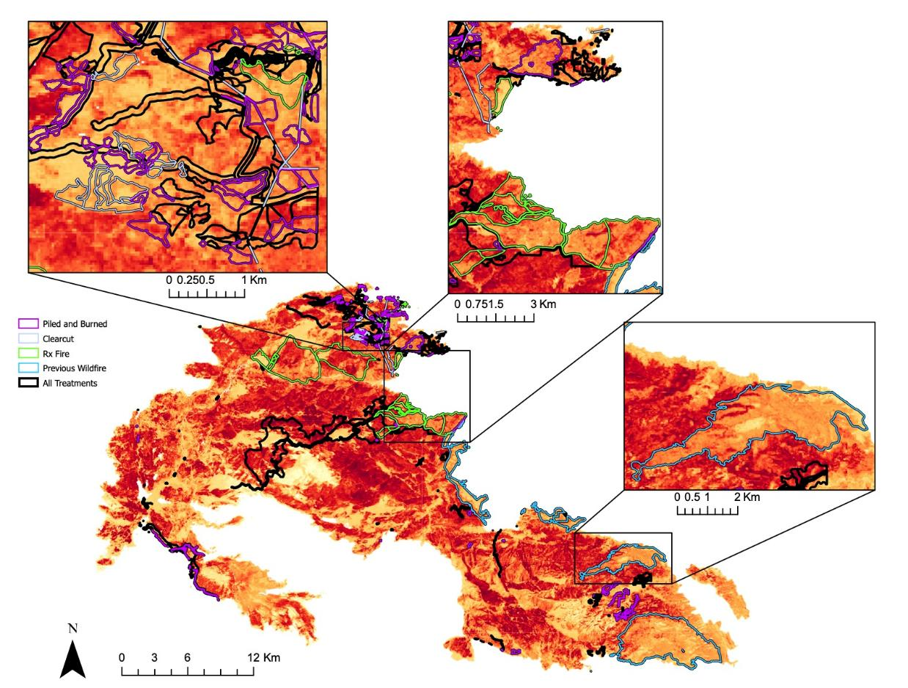
Results: Visual Comparison
0
1 Km
0
3 Km
dNBR
1403
-913
0
2Km
Piled & Burned
Clearcut
Rx Fire
Wildfire
N
All Treatments
0
12 Km
Notes:
This map visualizes the different treatment categories alongside a burn severity for the Cameron Peak fire.
There are many categories and combinations of treatments that occurred, however this map visualizes a few that stood out to the team.
You can see that inside some of these polygons, it appears that the treatments may have led to lower burn severity. There are other factors that could have caused this trend, that we seek to understand with our data analysis and modeling, but we thought that these visualizations were important.
DEVELOP Team Generated in Google Earth Engine from Sentinel - 2 MSI imagery

Slide 19
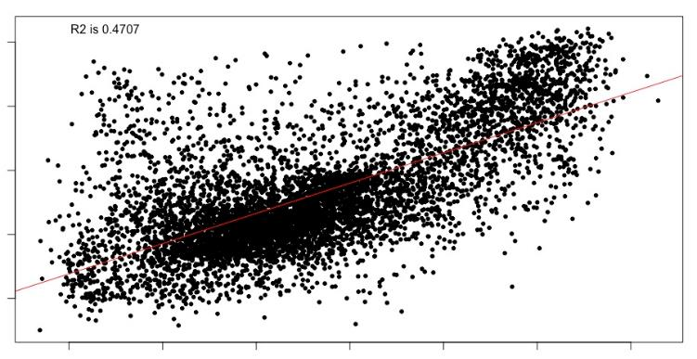
Results: Random Forest
Predicted vs Observed Burn Severity
Calwood Fire
1000
R^2 = 0.4707
800
Forest Canopy Cover
600
Predicted
Treatment Class
400
Aspect
200
Canopy Base Height
0
200
400
600
800
1000
1200
Observed
Veg. Type
Most Important Predictor Variables
1 | Forest Canopy Cover
2 | Treatment Class
3 | Aspect
Duration Disturbance
50
100
150
200
% Inc RMSE
Notes:
For the Calwood fire, we ran a preliminary random forest regression keeping the top 6 predictors.
The preliminary results from random forest suggested that Forest canopy cover, treatment class, aspect, canopy base height, vegetation type, and duration disturbance were the top predictors for predicting DNBR burn severity
The overall R^2 was low (.4707), but it was interesting to see that treatment class was a significant predictor.
Our most significant predictor was forest canopy cover.

Slide 20
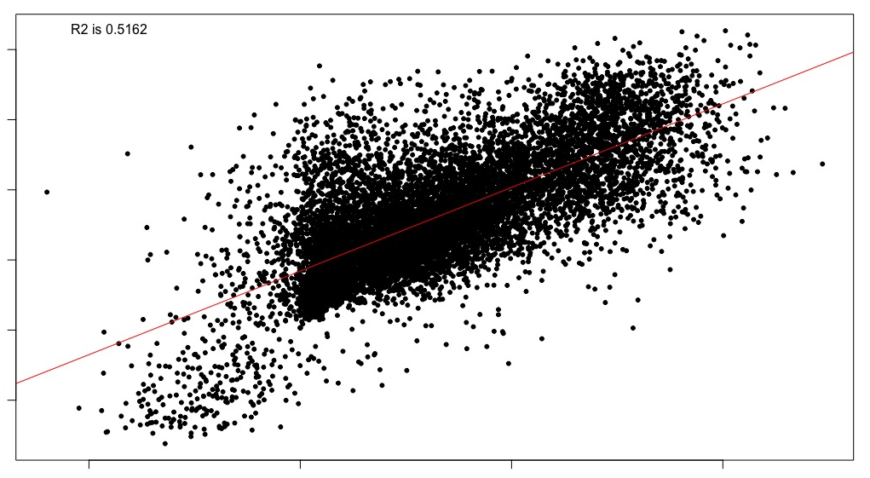
Results: Random Forest
Predicted vs Observed Burn Severity
Cameron Peak Fire
800
R^2 = 0.5162
600
Elevation
400
Predicted
200
Treatment Class
0
CHILI
-200
Canopy Bulk Density
-500
0
500
1000
Observed
Eastness
Most Important Predictor Variables
1 | Elevation
2 | Treatment Class
3 | Chili
Biophysical Settings
150
200
250
300
%IncRMSE
Notes:
For the Cameron Peak fire, we also ran a preliminary random forest regression keeping the top 6 predictors.
The preliminary results from random forest suggested that Elevation, Treatment Class, Chili, Canopy Bulk Density, Eastness, and Biophysical Settings were the top 6 predictors for explaining burn DNBR burn severity.
The overall R^2 was low (.5162), but it was interesting to see that treatment class was a significant predictor, and the overall regression results were slightly higher than for Calwood.
Our most significant predictor was Elevation, which is in line with previous studies investigating drivers of wildfire.

Slide 21
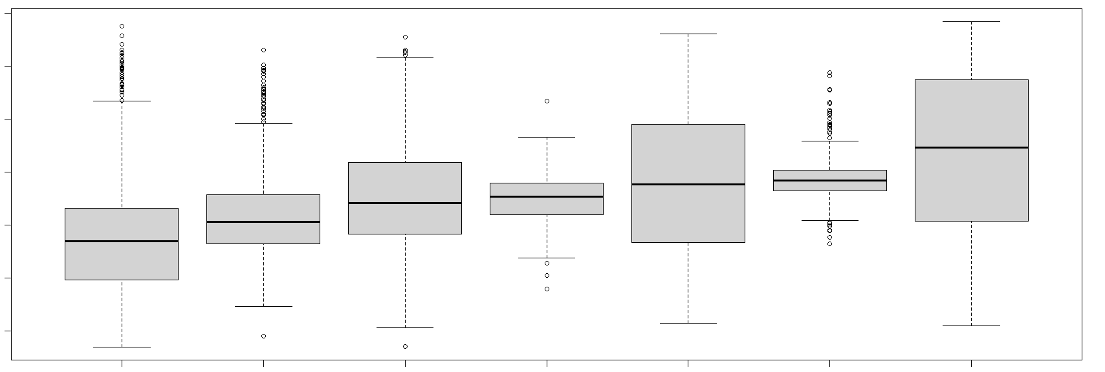
Results: Burn Severity vs Treatment Type
Treatment Type vs Burn Severity – dNBR Calwood Fire
1200
1000
800
dNBR
600
400
200
0
Wildfire
Rx + Wildfire
Rx Fire
Thinning
Multi-Thinning
Rx Fire + Multi-Thinning
Rx Fire + Multi-Thinning + Wildfire
Notes:
We also looked at trends between treatment type and burn severity for the two fires. For Calwood, we saw similar variation in burn severity across the 7 classes of treatment types.
Overall, the general trends showed fire combination treatments having the lowest average burn severity, and the thinning combination treatments having the highest burn severity.
These trends are preliminary though, and more analysis is necessary to determine if these trends are statistically significant.

Slide 22
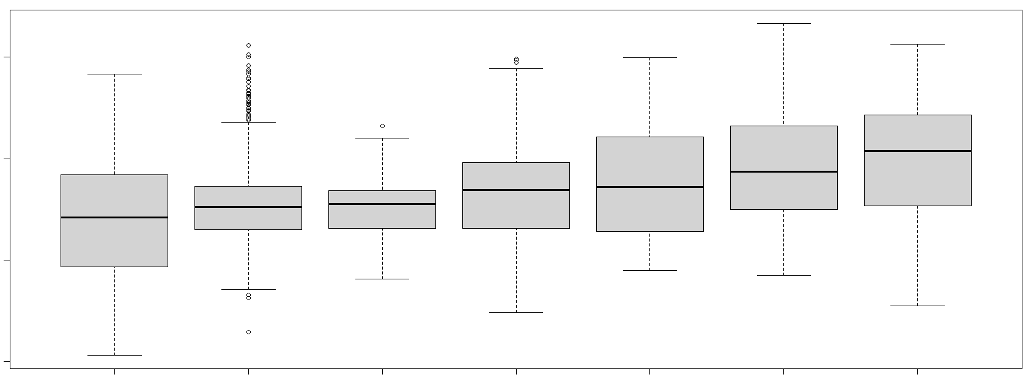
Results: Burn Severity vs Treatment Type
Treatment Type vs Burn Severity – dNBR Cameron Peak Fire
1000
500
dNBR
0
-500
Wildfire
Rx Fire
Thinning
Pile Burn
Pile Burn + Thin
Multi-Thinning
Multi-Thinning + Wildfire
Notes:
For Cameron Peak, we saw similar variation in burn severity across the 7 classes of treatment types compared to Calwood
Overall, the general trends varied a bit more than at Calwood, where burn severity did not have a distinctive trend between fire-based treatments and thinning based treatments
These trends are preliminary, and more analysis is necessary to determine if these trends are statistically significant.

Slide 23
Main Takeaways
Products
Organized treatment database
Complex treatments – challenges
Visual comparisons
RandomForest Results
Findings
Late season burn severity mapping is challenging
Topographic variables are important
Notes:
Our primary products from this project included a compiled, organized treatment database which can be used for future study of the two fires. This was a very time intensive and challenging task, as many of the treatments overlapped and created many unique features. We also produced visual comparisons of comparisons between burn severity and treatment type.
Our random forest results are preliminary and will require further investigation with more complex analysis. Overall, we found that mapping burn severity late in the season is really challenging, since snow makes finding good satellite images hard. We also found that topographic variables were important predictors for mapping burn severity, which aligns with the findings of previous studies.

Slide 24
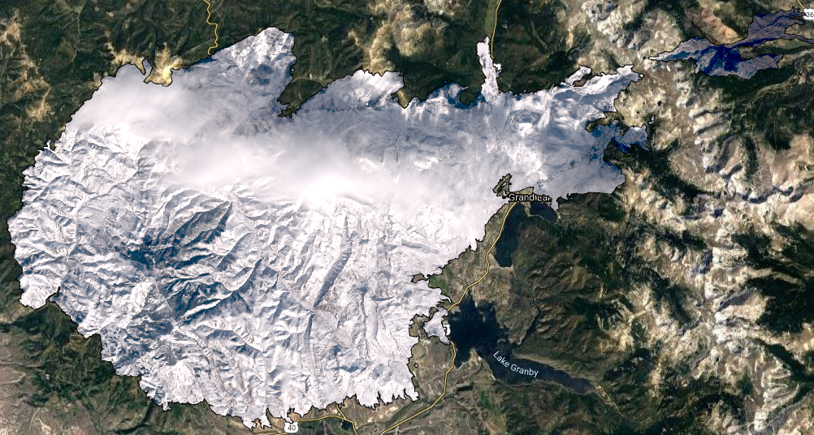
Future Work
Field validation is critically important
Re-mapping with available imagery
More focused analysis on different variables
Replicating methods for East Troublesome with snow-free imagery
Expanding on modeling approaches
Better understand burn severity drivers
Different types of regression
Notes:
As we wrapped up the project, we had several discussions about what’s next with this work. We found that field validation is critically important and will be needed to further assess the accuracy of burn severity maps made in this project. Additionally, as new imagery becomes available, mapping burn severity will have less challenges especially with snow cover which we ran into in our manual image selections. Because of early snow that helped extinguish the East Troublesome fire, we were unable to find post-fire imagery that allowed us to create a NBR calculation and create a map of burn severity. However, with spring and summer just around the corner, clear images with minimal or no snow will be able to be gathered and our methods can replicated for the East Troublesome fire. Finally, there is a lot to explore with this project and there are many other relationships to assess in the future.
Image credits: DEVELOP Team Generated in Google Earth Engine

Slide 25
Partners​
​Daniel Bowker, CPRW ​
Rob Addington, TNC ​
Robert Sturtevant, Ben Delatour Boy Scout Ranch​
Daniel Beveridge, CSFS ​
Dr. Michael Caggiano, CFRI​
Dr. Wade Tinkham, CSU​
​
Science Advisors​
​Dr. Paul Evangelista, NREL​
Dr. Tony Vorster, M.S., NREL​
Brian Woodward, M.S., NREL​
Nick Young, M.S., NREL​
Dr. Catherine Jarnevich, U.S. Geological Survey
Special Thanks To​
​Scott Cunningham, NASA DEVELOP Colorado Node Fellow​
Jillian LaRoe, U.S. Geological Survey​
Camille Stevens-Rumann, FRS – CFRI​
Stephanie Mueller, CFRI​
Kelsey Newton, CFRI​
Sarah Osborne, CSFS​
Amanda West, CSFS
Notes:
We would like to thank all our advisors and partners who made this project possible through their guidance and support with providing data, advice, and edits.

