Slide 1
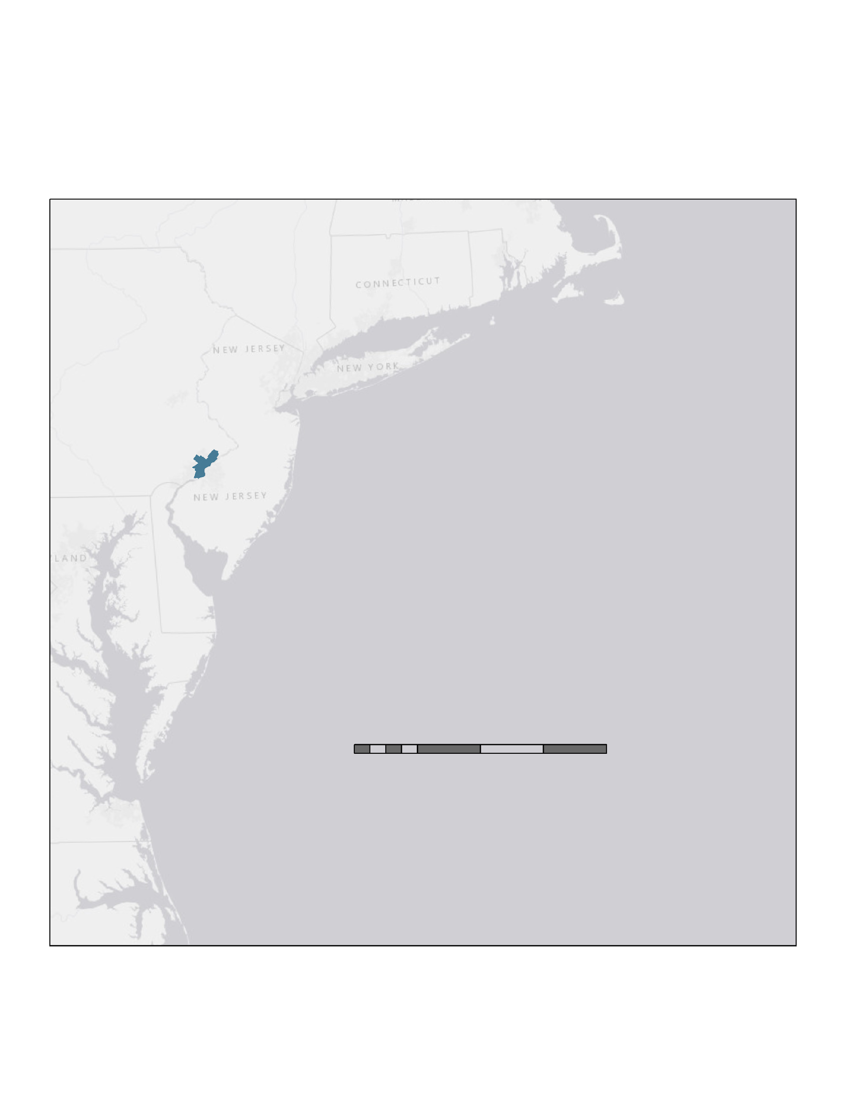

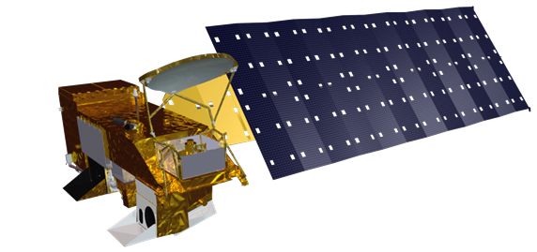
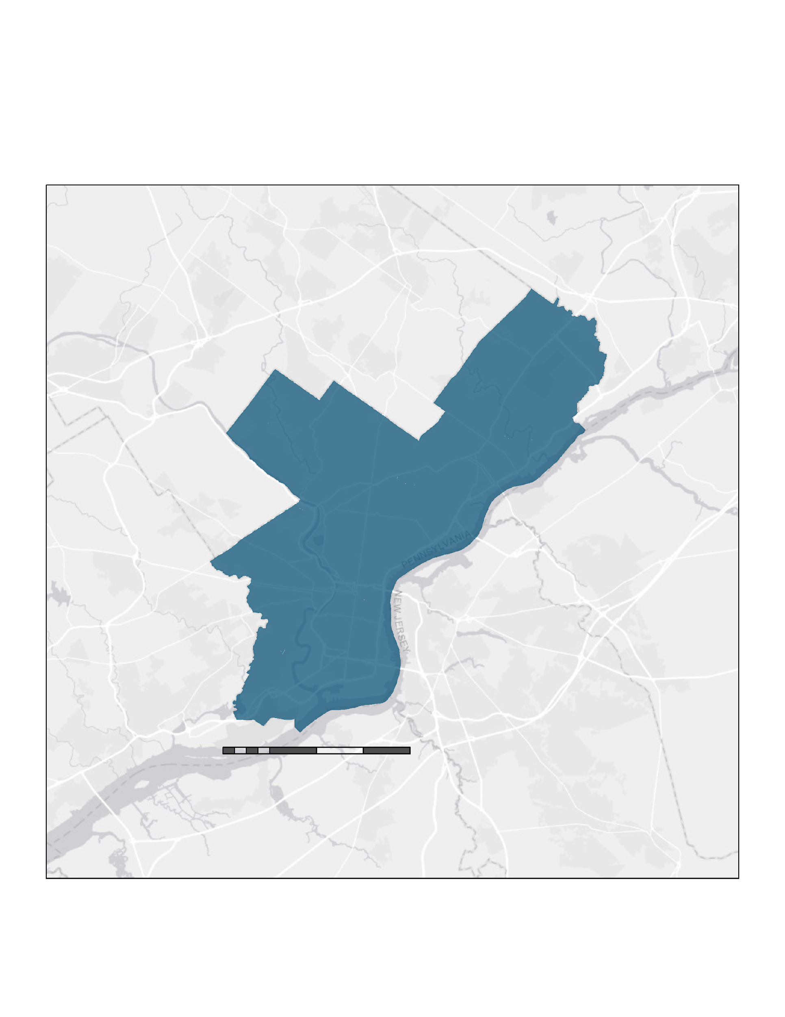
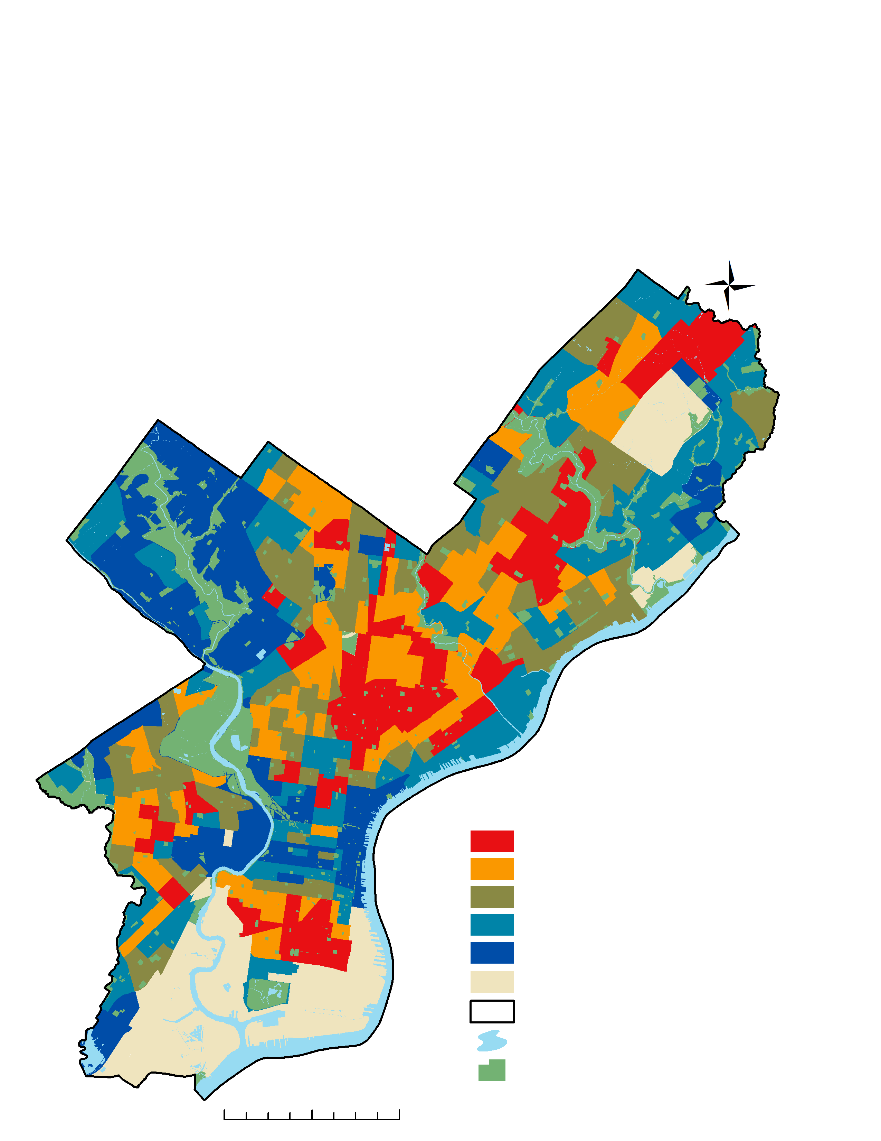
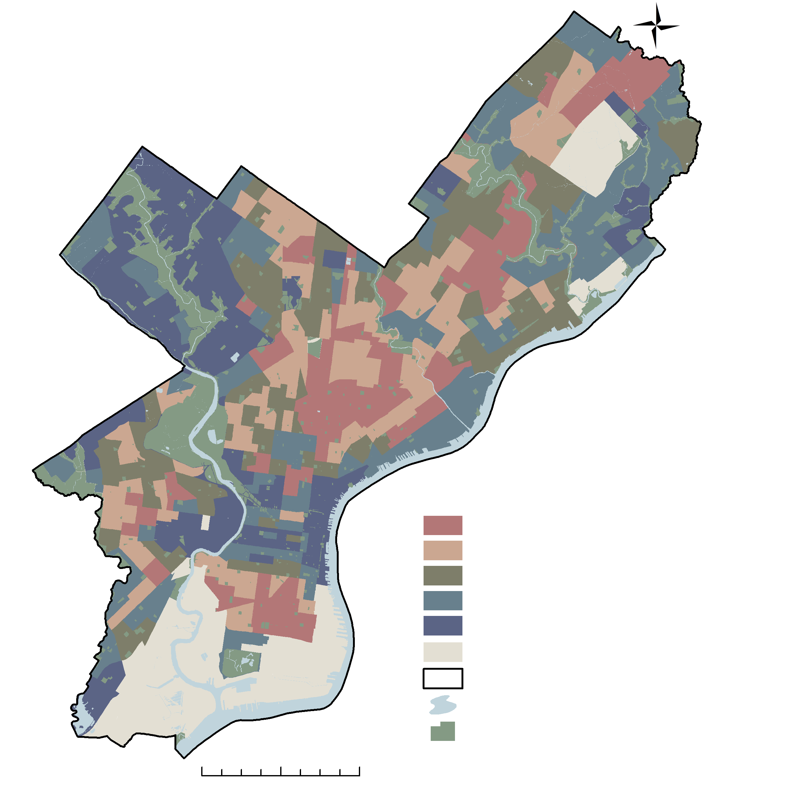


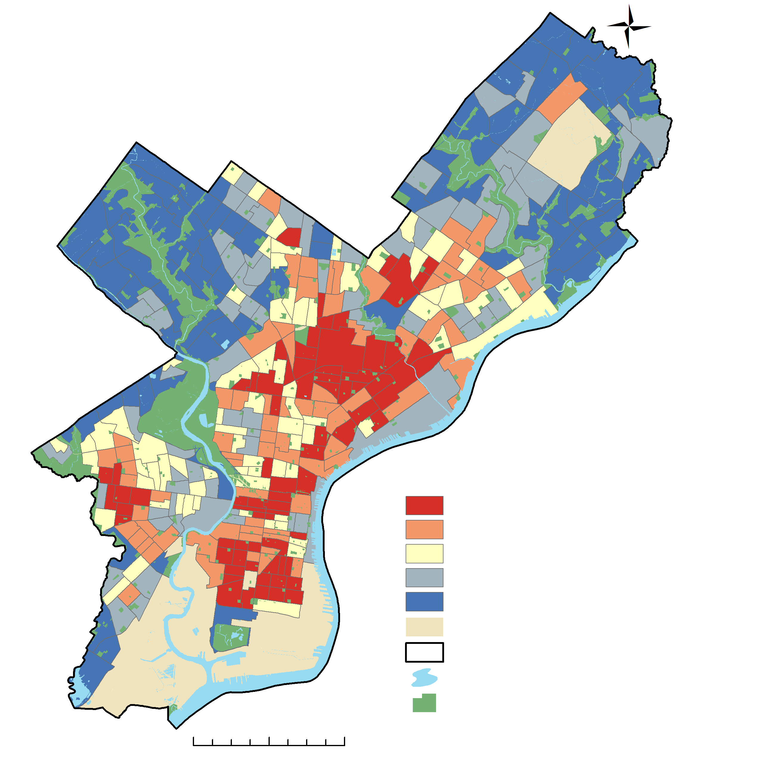
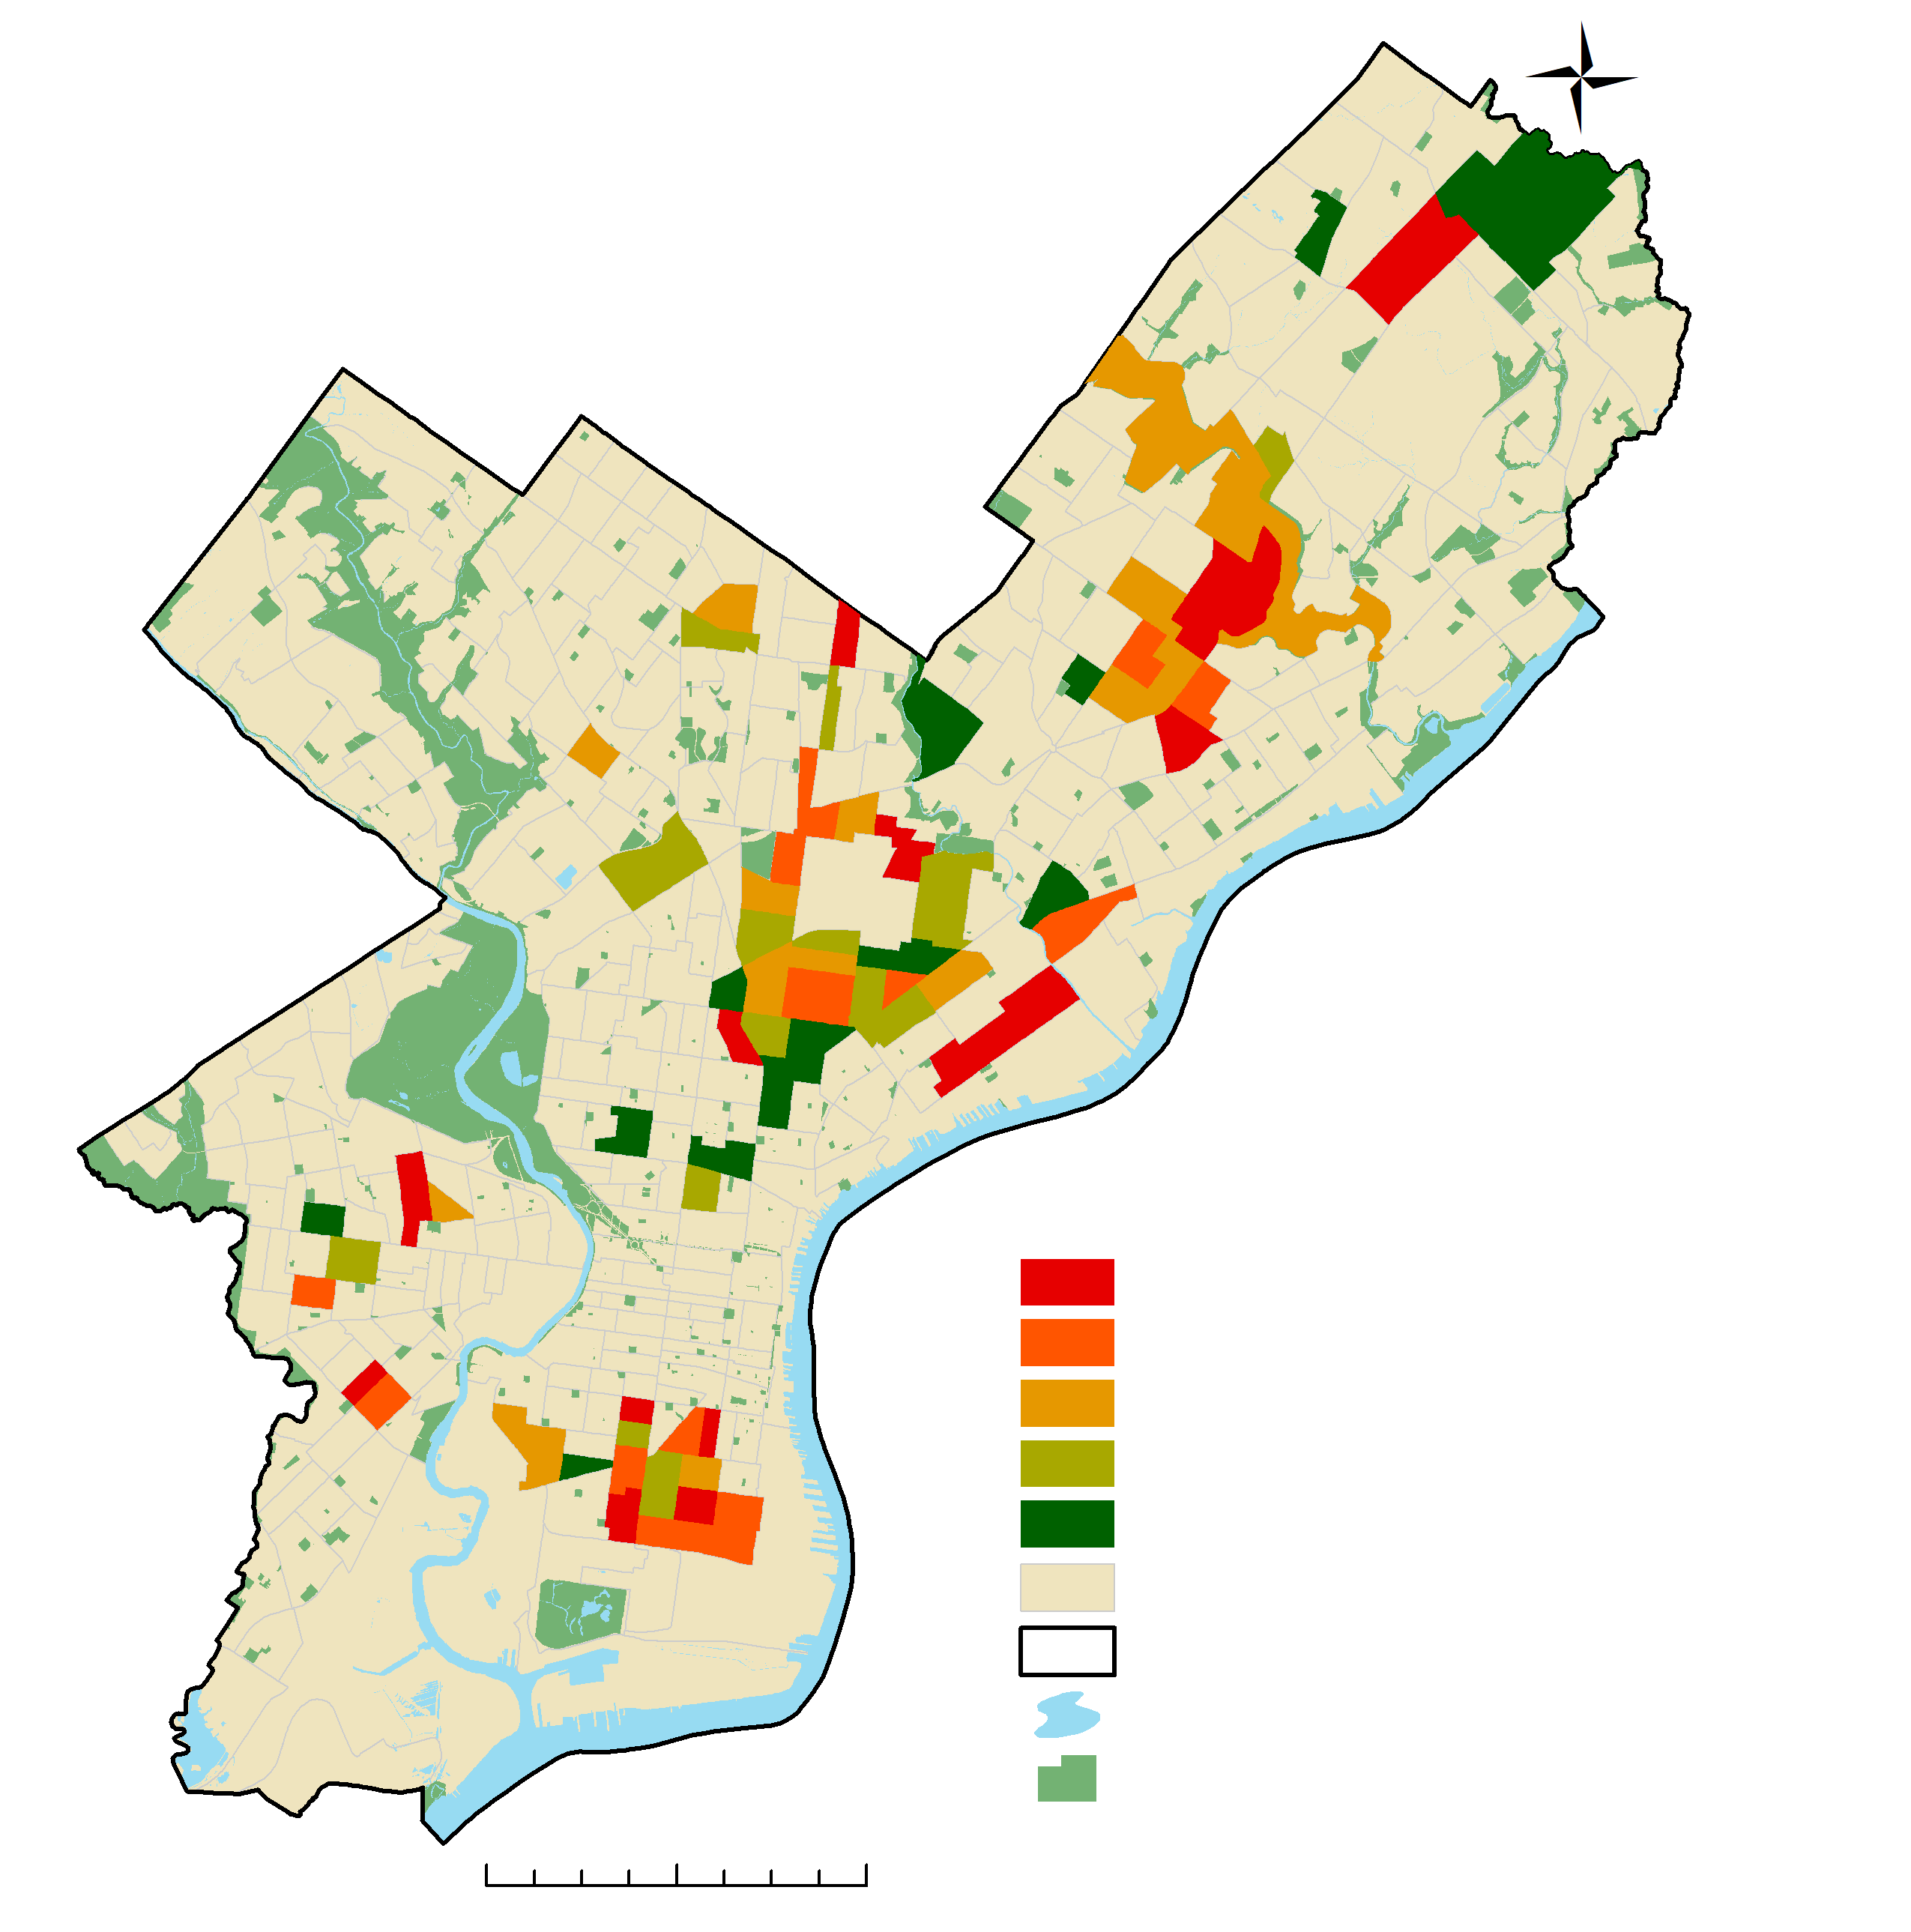





Assessing Land Surface Temperature, Vegetation Cover, and Compounding Vulnerability Factors to Identify High Priority Areas for Cooling Initiatives in Philadelphia, Pennsylvania
Abstract
Objectives
Philadelphia Health & Air Quality
Heat is the leading cause of weather-related deaths in the US, with heat-related hospitalizations increasing by 2-5% between 2001-2010. In Philadelphia alone, 137 heat-related deaths were recorded between 2010-2018, while a total of 18 daily temperature records have been set since 2010. Temperature is relatively higher in cities compared to rural areas, a phenomenon known as the urban heat island effect. This effect exaggerates daytime maximum temperatures and nighttime heat retention in urban areas, which increases heat exposure in urban environments and especially impacts vulnerable populations. Vulnerability to heat-related illnesses is determined by a combination of risk factors, such as demographics, socioeconomic status, and preexisting health conditions. This project supported the Philadelphia Department of Public Health and Office of Sustainability by identifying priority areas for cooling interventions, such as heat danger educational outreach and urban tree planting. The team developed heat vulnerability scores for each census tract within Philadelphia. Remotely sensed land surface temperature, normalized difference vegetation index, normalized difference built-up index, normalized difference water index, and albedo data were calculated from Aqua Moderate Resolution Imaging Spectroradiometer and Landsat 8 Operational Land Imager/Thermal Infrared Sensor instruments. These variables were weighted against socioeconomic variables and preexisting health conditions using a principal component analysis. A total of 74 census tracts clustered were identified as high-risk areas for heat-related illnesses. 15 of these census tracts also had very low tree density (lower 20th percentile) and should be targeted for tree planting initiatives. The findings of this project will help target interventions to mitigate heat-related health issues and improve the overall wellness of Philadelphia residents.
Assess heat vulnerability within Philadelphia based on socioeconomic data, health data, and environmental factors derived from Earth observations
Identify priority areas for heat mitigation and resilience-building strategies through principal component analysis
Provide Heat Vulnerability Index map to be made available to the public
Highlight tree planting initiative opportunities in vulnerable census tracts
Study Area
Earth Observations
Philadelphia, Pennsylvania, US
Study Period:
Summer 2017-2019
Landsat 8 OLI/TIRS
Aqua MODIS
Daytime LST
Albedo
NDVI
NDBI
NDWI
Nighttime LST
Methodology
0 40 80 120 160 miles
0 2 4 6 8 miles
Retrieve Data
Aggregate Pixels
PCA
HVI
Street Trees
Socioeconomic data, health data, and Earth observations
Median across time &
mean by census tract
Principal Component Analysis – summarize data patterns into key components
Heat Vulnerability Index from select principal components
Priority map of street trees based on HVI and street tree density
Variables
Components
Results
Land Surface Temperature
Heat Vulnerability Index
Street Tree Priority Areas
Difference from Mean (◦F)
By Census Tract
Trees per 100 yards of Street
4.492 to 10.881
2.057 to 4.491
-0.567 to 2.056
-5.191 to -0.568
-18.727 to -4.192
No Data
City of Philadelphia
Water
Parks
Very High
High
Medium
Low
Very Low
No Data
City of Philadelphia
Water
Parks
0.46 to 1.34
1.35 to 1.80
1.81 to 2.57
2.58 to 4.19
4.20 to 9.90
HVI<Very High
City of Philadelphia
Water
Parks
0 2 4 miles
0 2 4 miles
0 2 4 miles
Conclusions
Project Partners
The highest heat exposure in Philadelphia is in densely populated residential areas.
4 principal components (PC1 – socioeconomic factors and chronic health conditions, PC2 – heat exposure and satellite-derived environmental variables, PC3 – age and age related illness, PC4 – socio-cultural drivers of heat vulnerability) explain 80% of variance in data.
74 census tracts with very high HVI would benefit most from resilience building and cooling interventions
15 census tracts would benefit most from tree planting initiatives
Philadelphia Department of Public Health
City of Philadelphia, Office of Sustainability
Acknowledgements
Team Members
NASA DEVELOP:
Dr. David Hondula - Science
Advisor, Arizona State University
Crystal Wespestad - NASA DEVELOP Fellow/Lead
Partners:
Philadelphia Department of Public Health: Jason Hammer, Jessica Caum, & Alexandra Skula
City of Philadelphia, Office of Sustainability: Saleem Chapman
Brandy Nisbet-Wilcox
Project Lead
Samuel Meltzer
Spencer Nelson
Charlotte Wagner
Arizona - Tempe

