Slide 1
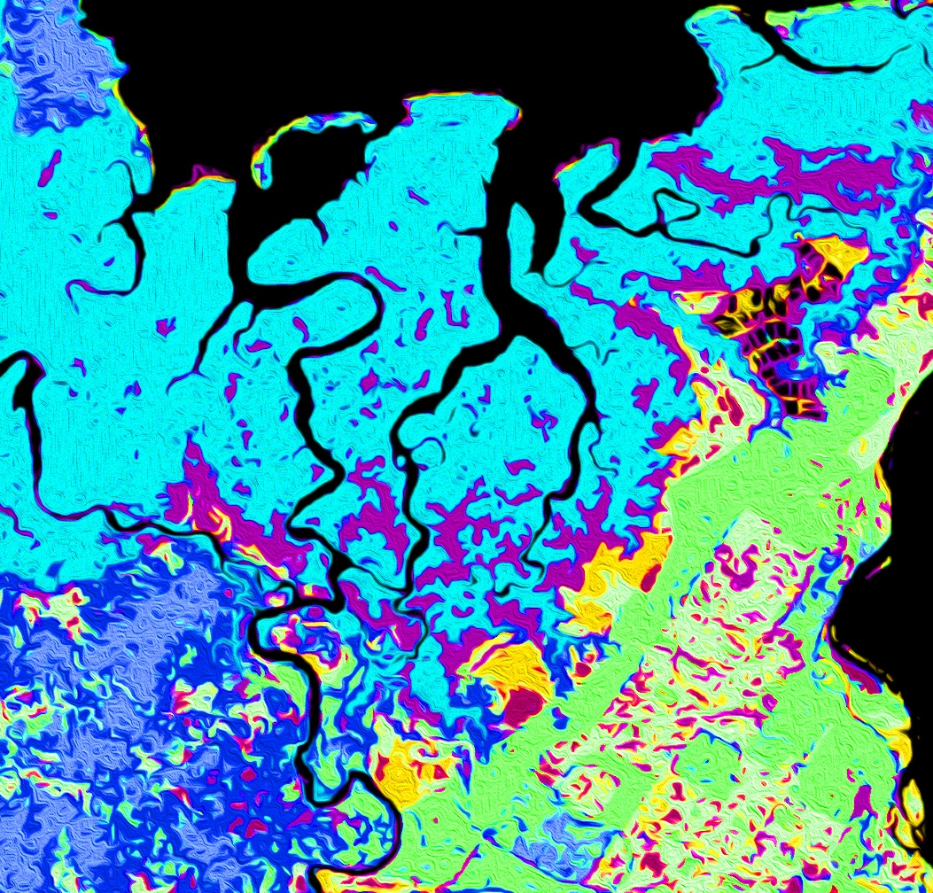
TALAMANCA-OSA ECOLOGICAL FORECASTING II
Assessing Habitat Suitability and Human-Jaguar Conflict Areas to Identify Potential Jaguar Corridors Connecting La Amistad and Corcovado National Parks in Costa Rica
Samuel Furey
Olivia Landry
Samantha Trust
Iris Fynn
Georgia – Athens| Summer 2019
Notes:
Hi, my name is ………...
We are the Talamanca-Osa Ecological Forecasting II Team.
Introduce our backgrounds.

Slide 2
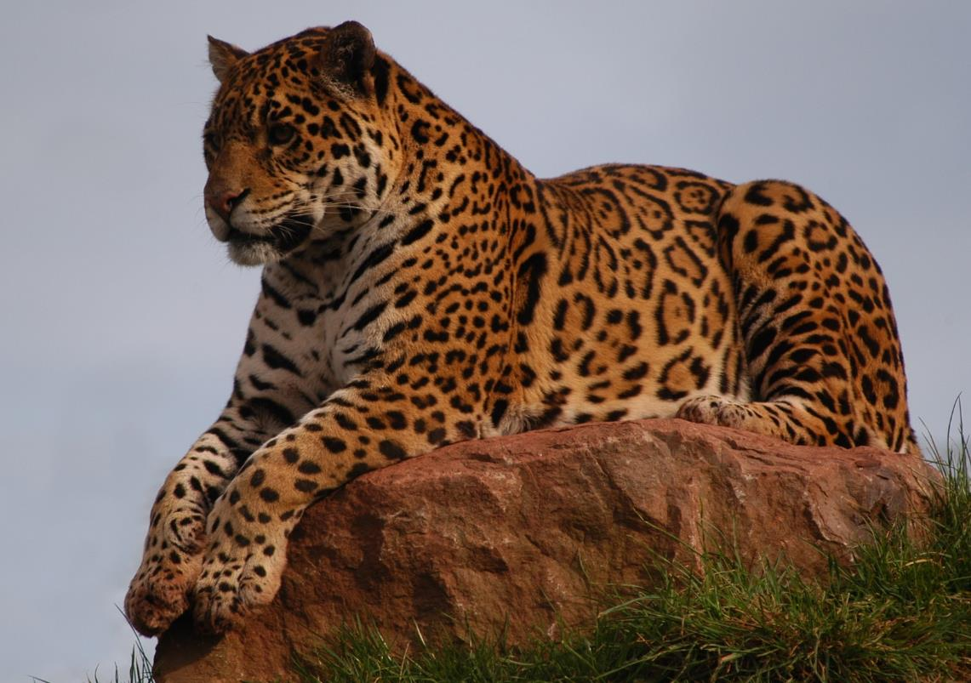
Background
Jaguars listed as Near Threatened on the International Union for Conservation of Nature (IUCN) Red List
Endangered throughout Costa Rica
Two isolated populations:
Talamanca Mountains
Osa Peninsula
Corridor connects national parks and links habitat fragments
Credit: Edward Quick
Notes:
Jaguars, also known as, Panthera onca, are currently endangered in Costa Rica due to habitat fragmentation from decades of deforestation and agricultural development. In the southern Puntarenas province, there are two existing, yet isolated populations of jaguars in different national parks.
If this species has any chance of survival, their habitats need to be expanded and connected. Our project focused on creating a wildlife corridor by connecting forest fragments to allow these two populations to reconnect.
Image Credit: Edward Quick
Image Source: Unsplash, https://unsplash.com/photos/fOwbUzvySOw, royalty free

Slide 3
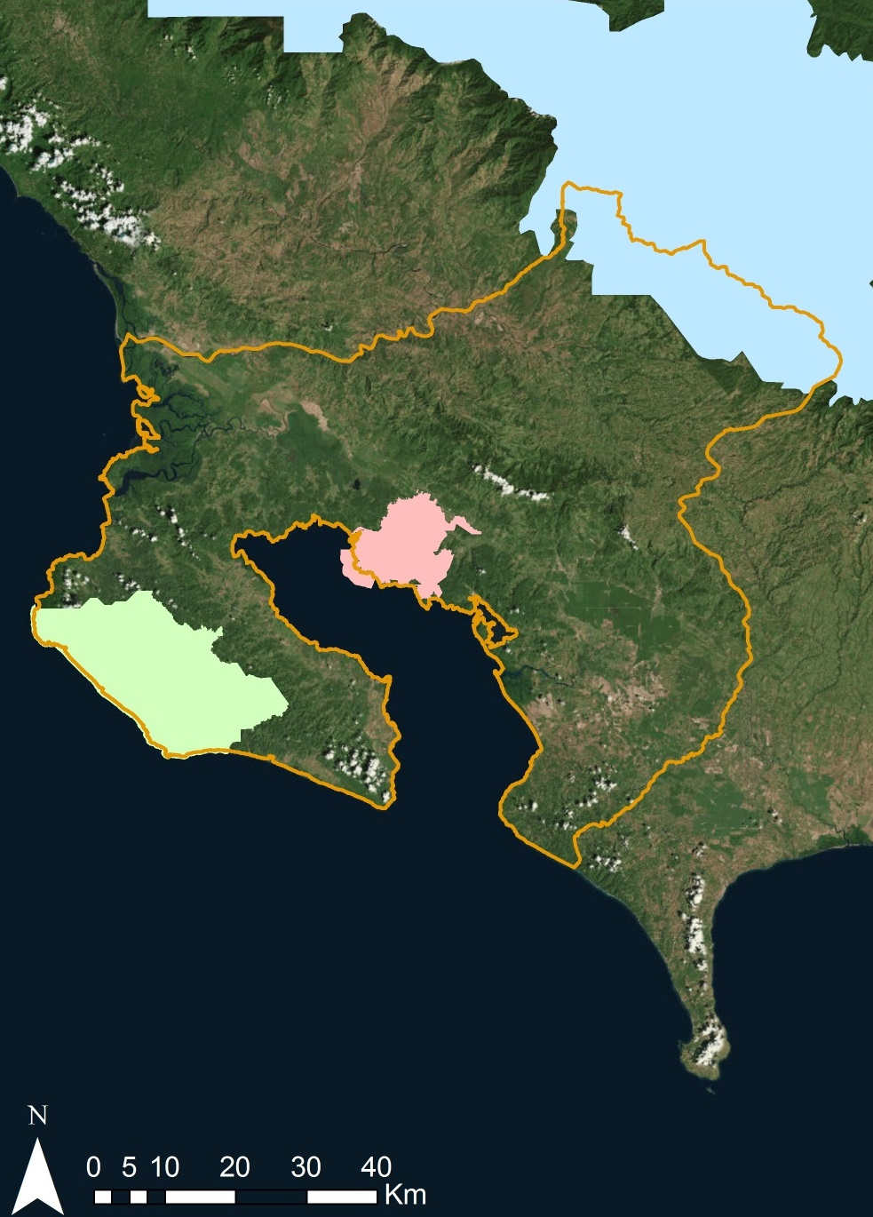
Study Area
Costa
Rica
Study area encompasses 5382 km² including the Talamanca Mountains and the Osa Peninsula
La Amistad International Peace Park
Piedras Blancas National Park
Corcovado National Park
Study Period: January 1987 to June 2019, Forecasting to 2030
0 5 10 20 40
Km
Study area
Corcovado National Park
Piedras Blancas National Park
La Amistad National Park
N
Notes:
Our study area includes three national parks: La Amistad International Peace Park highlighted in blue, Corcovado National Park highlighted in green, and Piedras Blancas National Park highlighted in pink. Our main goal was to locate optimal corridors between La Amistad and Corcovado, based on historic land use and land cover data from January 1987 through June 2019, in conjunction with additional datasets.

Slide 4
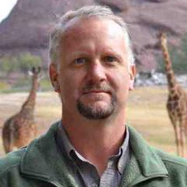
Partners
Arizona Center for Nature Conservation – Phoenix Zoo
Osa Conservation
Dr. Jan Schipper | Field Conservation Research Director
Annie Johnson | Research Assistants
Chelsey Tellez
Kyli Denton
Kinley Ragan
Credit: Arizona Center
for Nature Conservation
Hilary Brumberg | Healthy Rivers Program Coordinator
Credit: Osa Conservation
Credit: Isabelle Juskova
Notes:
To provide expertise about jaguars and conditions in Costa Rica, we collaborated with two non-profit organizations, the Arizona Center for Nature Conservation based in Phoenix, Arizona and Osa Conservation, based in Costa Rica. These organizations are working to promote educational outreach and wildlife friendly agriculture and to establish a jaguar monitoring system using a network of camera traps.
Image Credit: Arizona Center for Nature Conservation, given permission by partner
Image Credit: Osa Conservation, given permission by partner
Image Credit: Isabelle Juskova
Image Source: https://unsplash.com/photos/xotmnyN3gdc, Royalty-free

Slide 5
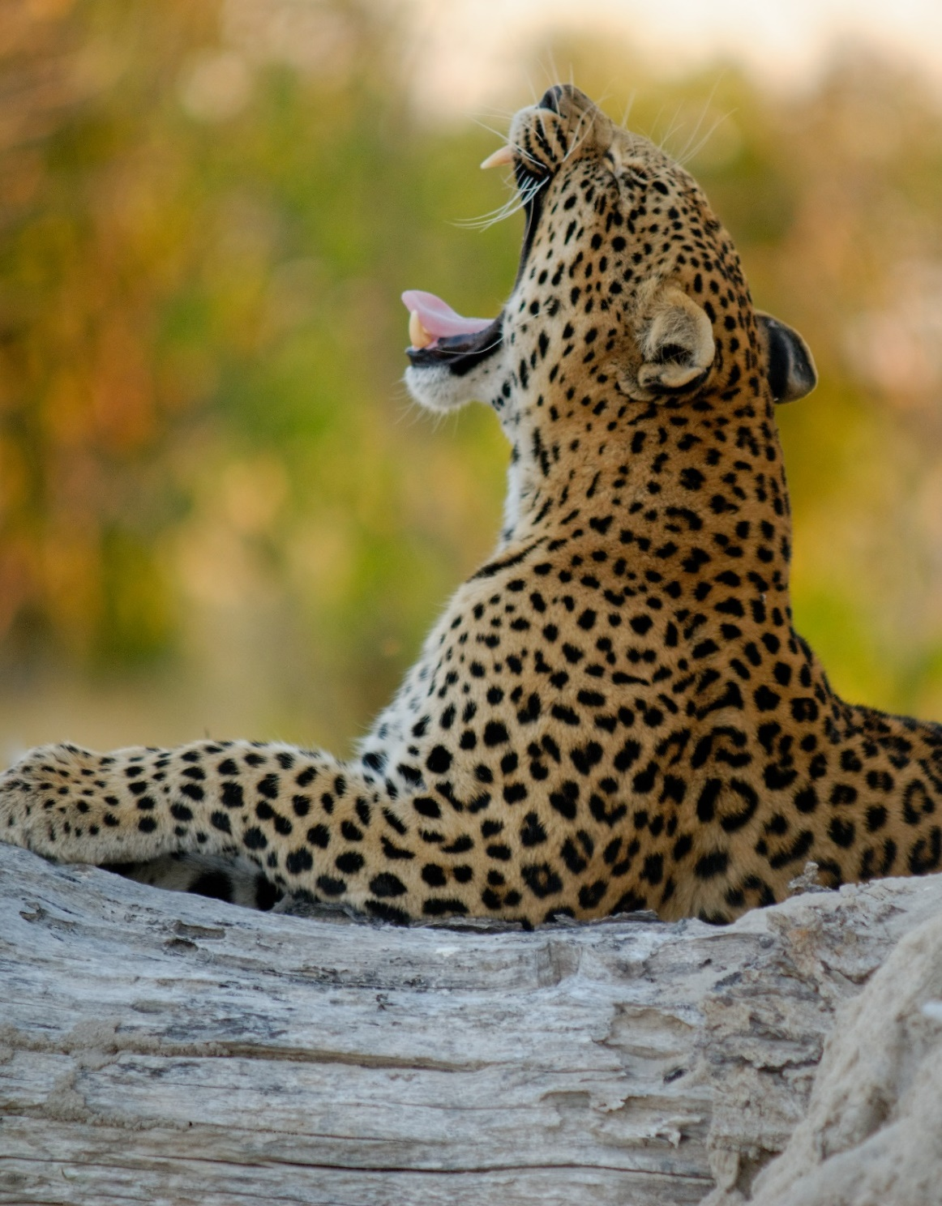
Community Concerns
Jaguar Habitats & Population: Crops like pineapple and African oil palm plantations act as barriers to movement. Only an estimated 12 jaguars remain in Corcovado National Park.
Human–Jaguar Conflicts: Decreased habitat size drives jaguars closer to humans, increasing the likelihood of human-jaguar conflict and retaliatory hunting.
Ecosystem Health: Since jaguars are an apex predator and keystone species, the reduced number of individuals causes a negative trophic cascade.
Credit: Colin Watts
Notes:
Some community concerns include deforestation, urbanization and agricultural development which fragment habitats and act as barriers to jaguar movement. Due to the decreased habitat size, jaguars and humans are forced together more often, leading to hunting and retaliatory killings. As an apex predator and keystone species, the death of jaguars causes a negative trophic cascade, greatly affecting species like, the agouti and the white lipped peccary.
Image Credit: Colin Watts
Retrieved from https://unsplash.com/photos/0b3VIVMgkNs Royalty-free

Slide 6
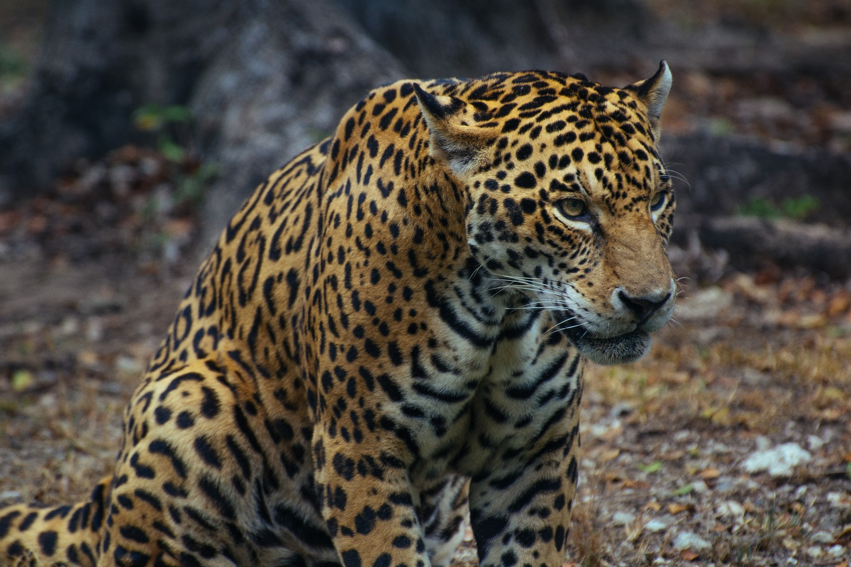
Objectives
Conduct historical land use and land cover analyses (1987 and 1997)
Forecast land use and land cover classifications to year 2030
Create a human-jaguar conflict risk map based on environmental and human use factors
Model corridors to aid jaguar movement between Costa Rica’s La Amistad International Peace Park and Corcovado National Park
Credit: Adolfo Felix
Notes:
Our first objective was to continue land use and land cover analyses started in term one, using historical data from 1987 and 1997 to project land use and land cover to the year 2030. We also created a map based on environmental and human use factors that highlighted areas of conflict between humans and jaguars, particularly areas where jaguars are at a higher risk of being killed.
Finally, we used those maps, in conjunction with other environmental inputs, to model potential corridors between protected lands to aid jaguar movement.
Image Credit: Adolfo Felix
Retrieved From: Unsplash, https://unsplash.com/photos/CLjJLym3Xks, Royalty Free

Slide 7
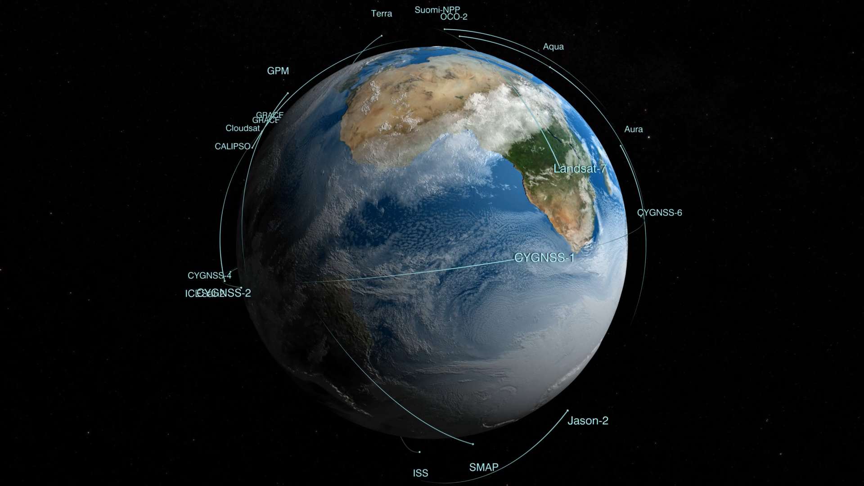
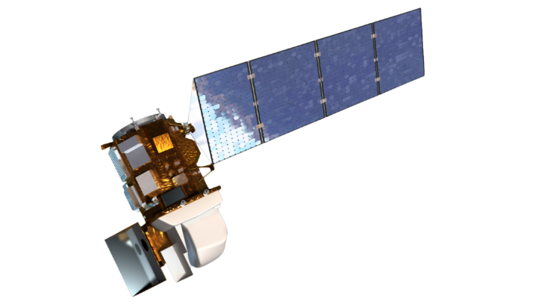
Terra Advanced Spaceborne Thermal Emission and Reflection Radiometer (ASTER)
Landsat 5 Thematic Mapper (TM)
Credit: Planet
NASA Satellites and Sensors
Landsat 8 Operational Land Imager (OLI)
Notes:
We used three NASA Earth observations in our analyses: Landsat 5 Thematic Mapper and Landsat 8 Operational Land Imager to classify land use and land cover. These classifications were verified using high temporal and spatial resolution data from PlanetScope. In addition, Terra ASTER was used for elevation inputs for our human-jaguar conflict map and potential corridor map.
Image Credit: http://www.devpedia.developexchange.com/dp/index.php?title=List_of_Satellite_Pictures

Slide 8
Methodology
Landsat 5 TM
1987 1997
GEE
Land Use and Land Cover Maps
Landsat 8 OLI
Planetscope
2018 2019
Transition Potential Maps
Land Change Modeler
TerrSet
2030 Land Use and Land Cover Map
Ancillary Datasets
Terra ASTER Digital Elevation Model
Jaguar Corridor Suitability Map
Human-Jaguar Conflict Risk Map
1999 to 2011
Notes:
Using Google Earth Engine, we analyzed Landsat 5 and 8 data to evaluate changes in land use and land cover from 1987 through 2019.
With TerrSet Land Change Modeler, we used maps from 1987 and 1997 to forecast to 2019. By comparing our forecasted 2019 land use map to the actual 2019 map produced by last term, we were able to create a confidence interval for forecasting.
Then using the 1987 and 2019 maps, we projected land use to the year 2030 with the given confidence. Once we had this, we included several other input rasters, like elevation, slope, and distance to roads and settlements, to create a human-jaguar conflict risk map.
Finally, we used Linkage Mapper to map an optimal corridor between projected 2030 forest fragments, using least cost paths.

Slide 9
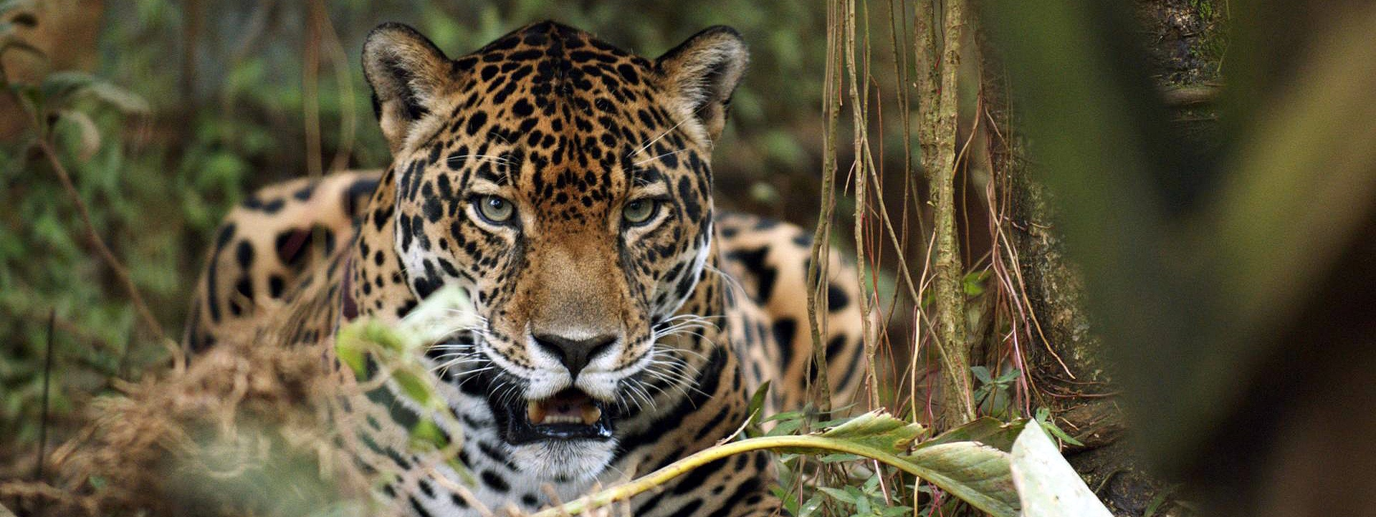
Results
Credit: Arizona Center for Nature Conservation
Notes:
Next, we’ll talk about results!!
Image Credit: Arizona Center for Nature Conservation, Permission from Partner

Slide 10
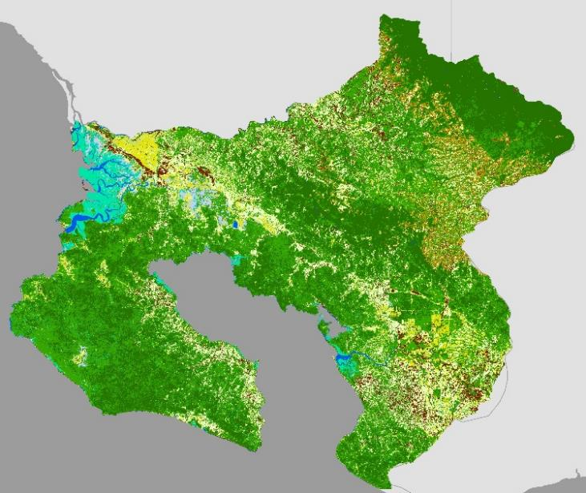
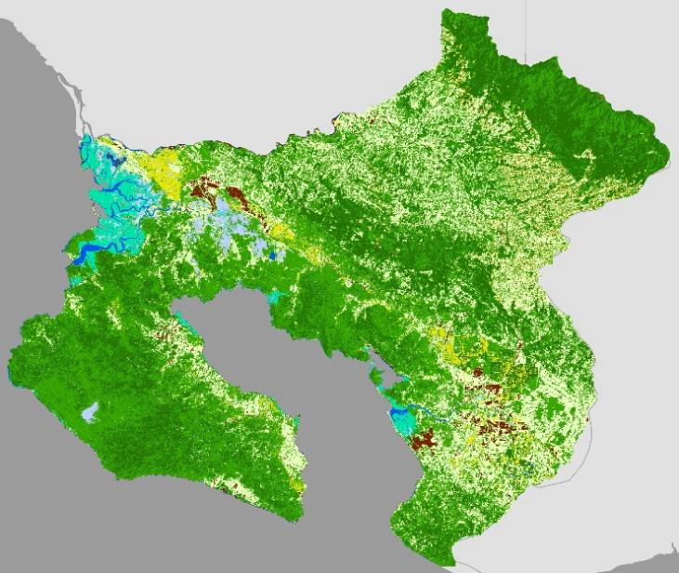
Historical Land Use and Land Cover
Coffee
Exposed Soil/Urban
Grassland/Pasture
Mangrove
Wetland
Palm Plantation
Páramos
Primary Forest
Secondary Forest
Water
N
0 10 20 40
N
Km
0 10 20 40
Km
Land Use & Land Cover 1987
Land Use & Land Cover 1997
Notes:
From 1987 to 1997, palm plantations and exposed soil/urban decreased by 1.31 percent and 3.63 percent respectively, while grassland/pasture increased by 8.40 percent. African oil palms are replanted every 25 to 30 years. In preparation for planting, non-productive stands are cleared and left fallow, or are ploughed for the sewing of a legume cover crop to fix Nitrogen in the soil 1997 could have been a replanting year, this would account for the observed decrease in African oil palm and exposed soil and an increase in grasslands (planted legumes) occurring around the Inter-American Highway. which aligns with 2012 through 2019 trends in palm plantation expansion. Aligning with current 2019 trends, historical palm plantations are expanding around the Inter-American Highway.
Consequently, primary forest also decreased from 1987 to 1997 by 6.08 percent. This reduction could be accounted to the clearing of lands for palm plantations before environmental policies like Forest Law 7575 of 1996 were enacted.

Slide 11
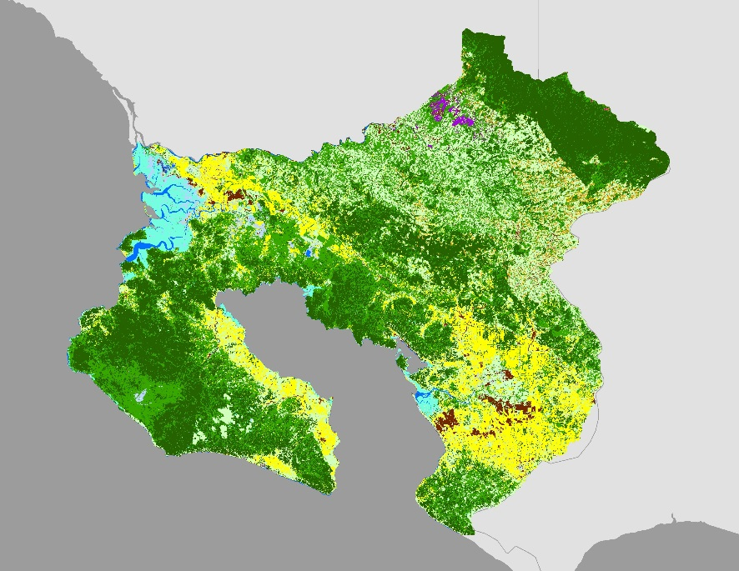
Projected 2030 Land Use and Land Cover
Coffee
Exposed Soil/Urban
Grassland/Pasture
Mangrove
Wetland
Palm Plantation
Páramos
Pineapple
Primary Forest
Secondary Forest
Water
N
0 10 20 40
Km
Projected Land Use & Land Cover 2030
Notes:
From 2019 to 2030, we expect to see palm plantations continuously expand around the Inter-American Highway and the northern Osa Peninsula, along the gulf. Consequently, we expect to see a significant reduction of secondary forests in the northern Osa region as it is being replaced with oil palm.
Grasslands and pastures and primary forest seem to remain constant throughout the study region.

Slide 12
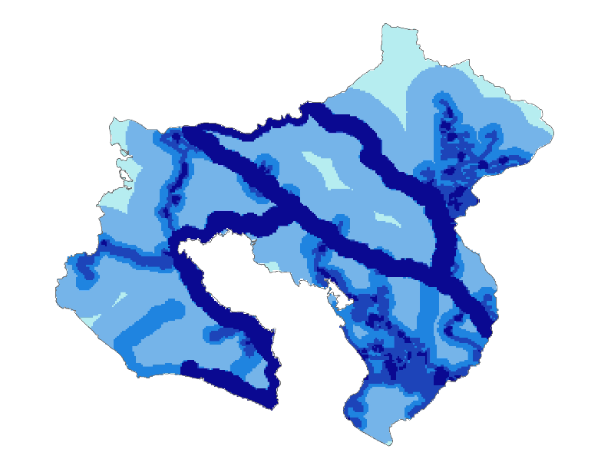
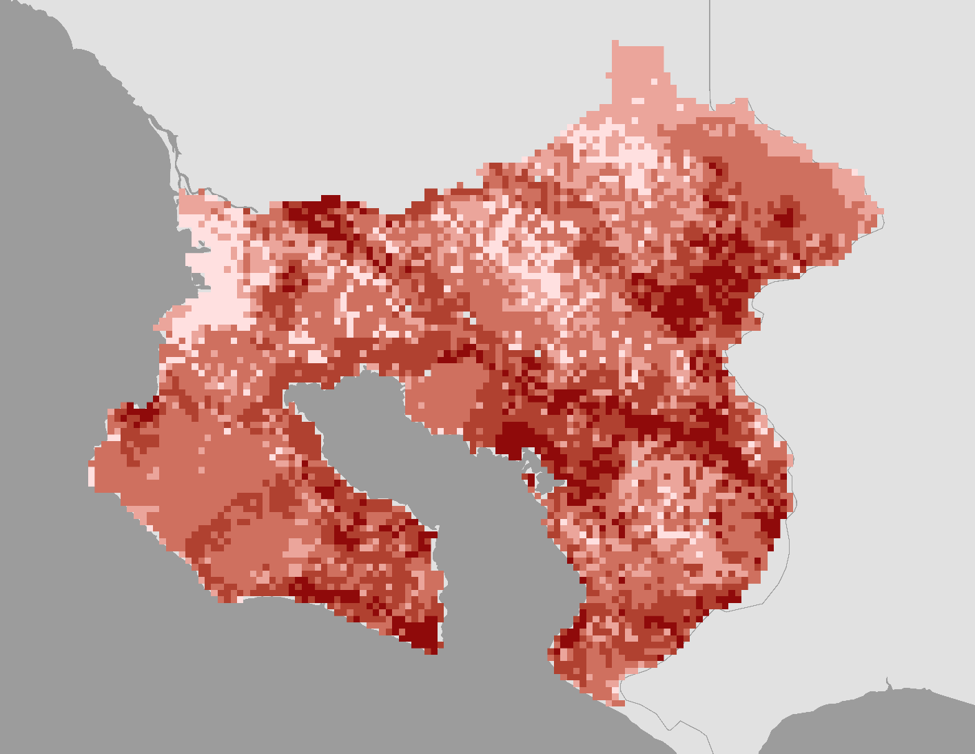
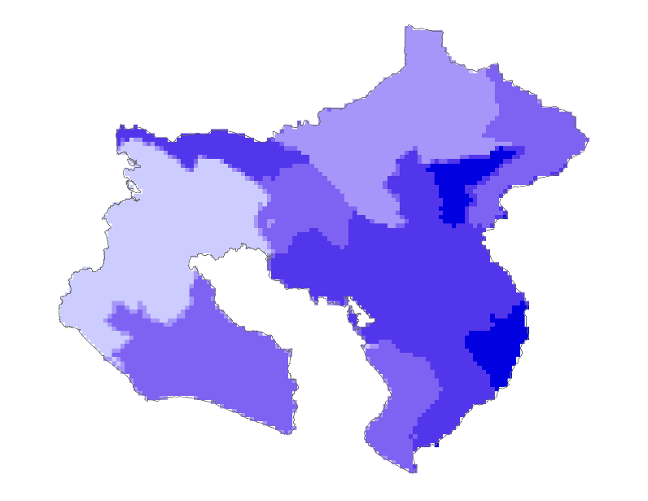
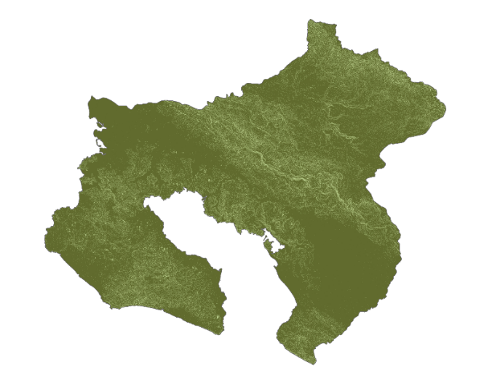
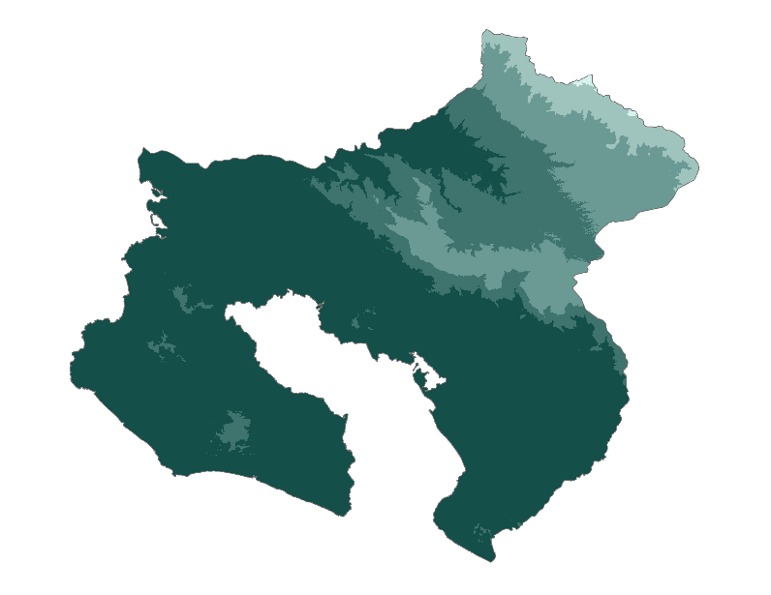
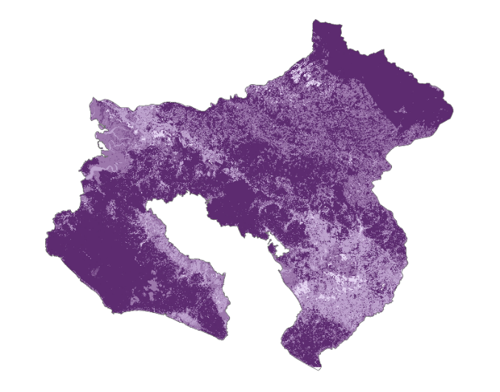
Projected 2030 Human-Jaguar Risk Assessment
Low Risk
N
Moderately Low Risk
Moderate Risk
Moderately High Risk
0 10 20 40
Very High Risk
Km
Reclassified Risk Value Rasters
Human-Jaguar Conflict Risk Assessment
Notes:
To calculate risk of human-jaguar conflict, we used ancillary datasets, including distance to cities, distance to roads, human population count, slope, elevation, and land use and land cover from 2030 as inputs. Based on discussions with our partners, each of the 6 rasters shown on the left were reclassified and assigned risk values on a scale of 1-5, 5 being highest risk of conflict. Each raster was then assigned a weight of influence using the raster calculator to achieve the map shown on the right. The resulting map shows that areas of higher risk are those closer to roads and human settlements. Areas of very high and moderate risk make up about 15% of the study area, while the majority of the study area is of moderate risk at 66%.

Slide 13
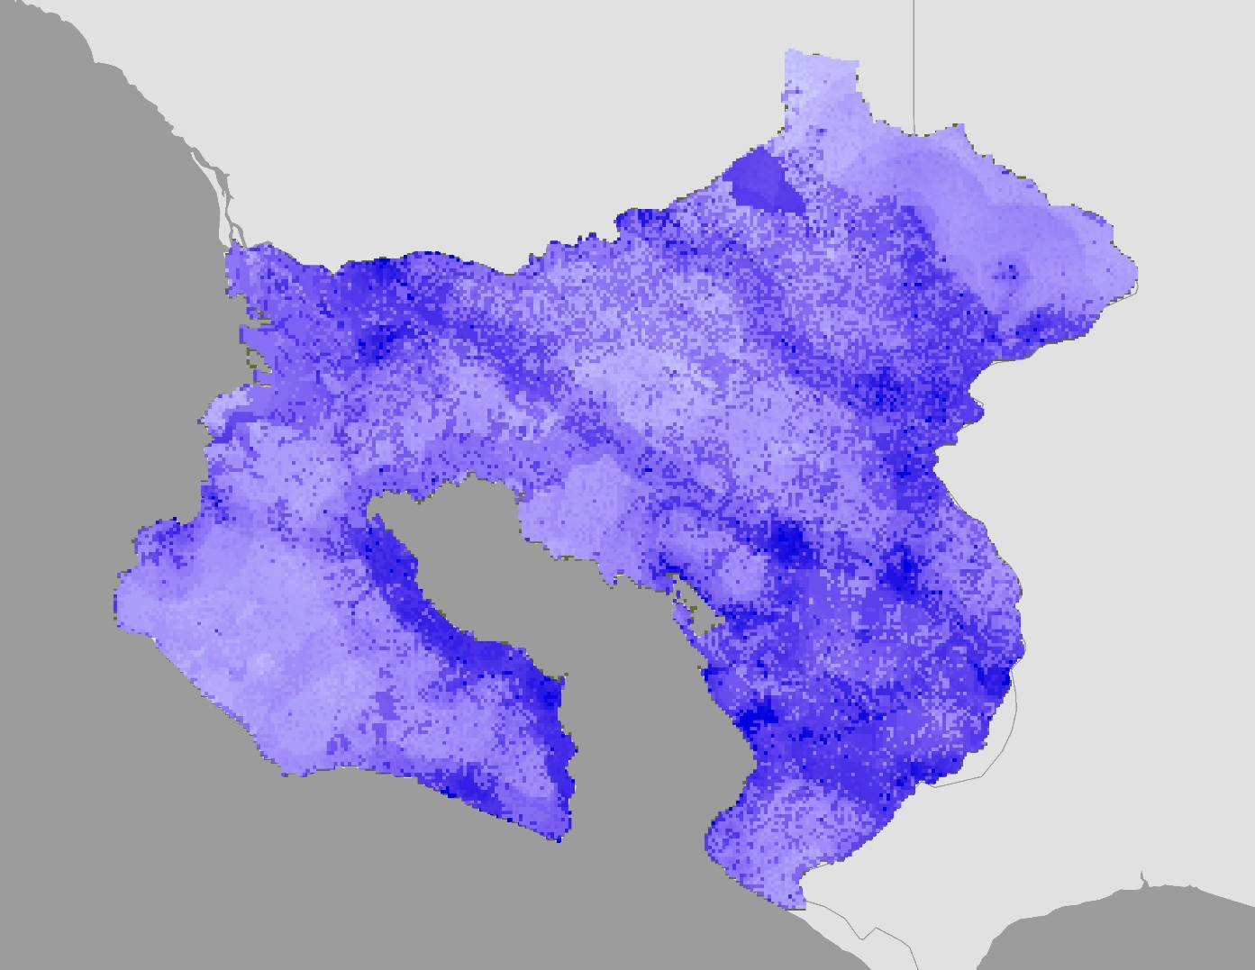
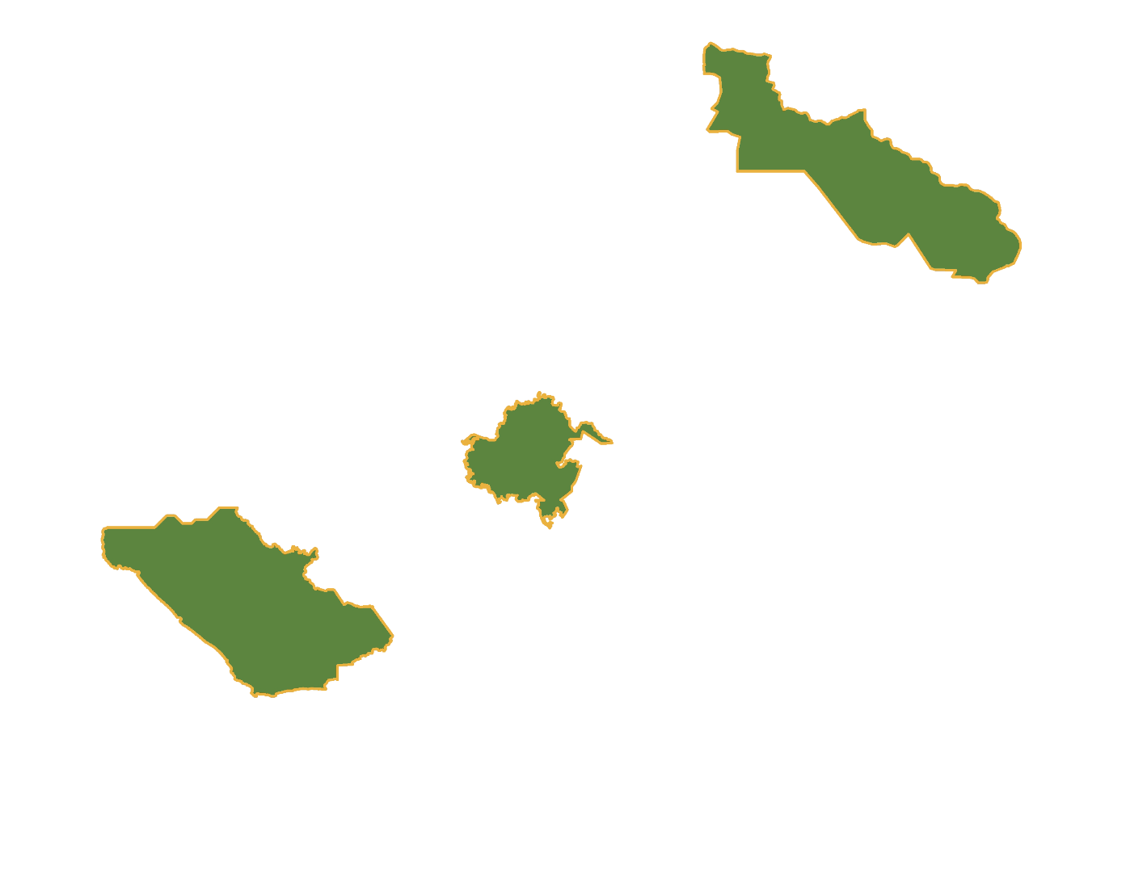
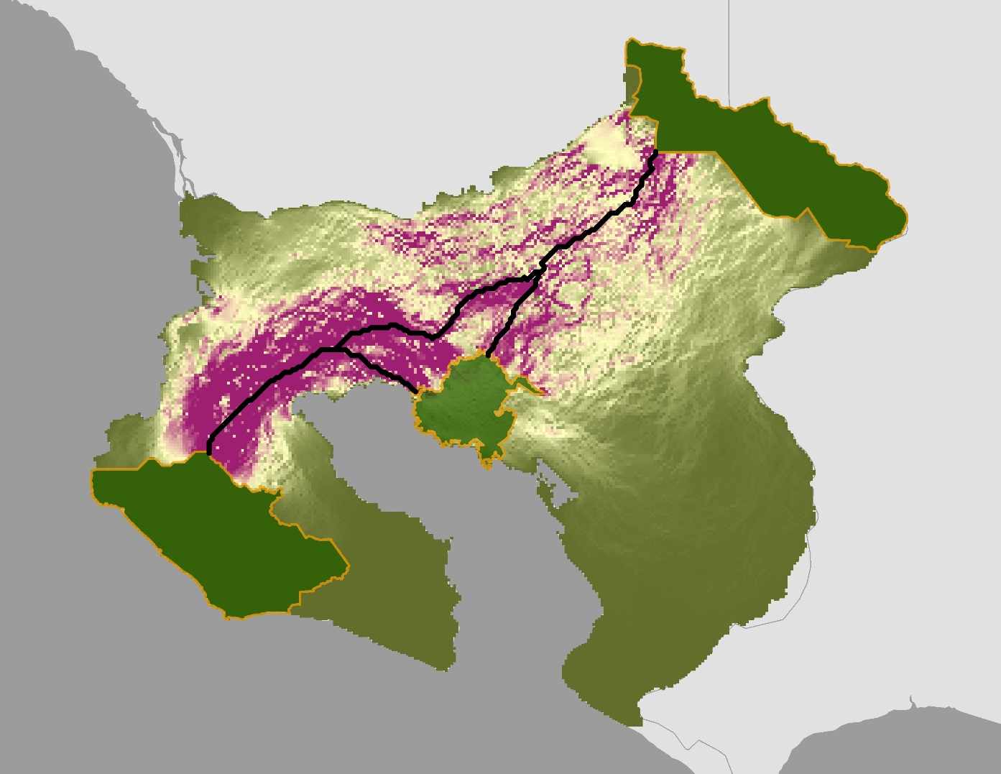
Corridor Connecting La Amistad and Corcovado National Parks
Low Resistance
N
National Parks
N
Moderately Low Resistance
Proposed Corridor
Moderate Resistance
Most Optimal
Moderately High Resistance
0 10 20 40
0 10 20 40
Very High Resistance
Km
Least Optimal
Km
Notes:
Using a similar approach of assigning values and weights, we created a resistance raster to be used as an input to Linkage Mapper.
From Linkage Mapper, we created a map connecting the parks with a least cost path, avoiding areas of pineapple and palm plantations, which are complete barriers to movement. After building the network and mapping linkages, we used pinchpoint mapper to map the flow of current through the resistance raster layer. The resulting layer, in shades of pink, yellow and green, indicate multiple diffuse pathways to connect the habitat cores, rather than one single least-cost path. Magenta shows higher levels of current allowed to flow through the layer, indicating a more optimal corridor, while the yellow and green indicate less optimal pathways for facilitating jaguar movement.

Slide 14
Errors and Uncertainties
When using TerrSet Land Change Modeler the future changes used during forecasting are assumed to change at the same rate as change in the historical data provided
Legend categories must be identical in both land cover dates in order to project accurately
Pineapple was not forecasted to 2030 as it was non existent in our study area in 1987
Credit: Arizona Center for Nature Conservation
Notes:
Unfortunately, there were several errors and uncertainties we came across during our analyses.
One being, the inaccuracy of the rate of change; the rate of change was based on the historical data inputs provided. Therefore, the amount of change between 1987 and 2030 is based on the notion that change happens to the same extent and at the same pace as the changes between 1987 and 1997. This provides uncertainty in our final forecasted 2030 result as final land cover categories may not represent the full extent to which each category changed. Additionally, legend categories must be identical in both historical inputs so land cover that was non existent in an earlier date will not be included in a later date and vice versa.
This applies to the classification and forecasting of pineapple and it is therefore not as accurate as it could be.
Image Credit: Arizona Center for Nature Conservation, given permission by partner

Slide 15
Conclusions
Between 2019 and 2030
Palm plantation will increase by 3.7%, with a slight increase around the Pan-American Highway and a significant increase in the northern Osa region.
Secondary forest will decrease by 4.3% as it is replaced with palm plantations in the northern Osa, encroaching on Corcovado
There is a projected higher human-jaguar conflict risk around the Pan-American Highway and in populated areas, specifically in Playa Pan Dulce, Pavones, Puerto Jiménez, Golfito, Paso Canoas and San Vito.
Corridors modeled in Linkage Mapper showed two potential corridors through the Buenos Aires Canton area
Credit: Arizona Center for Nature Conservation
Notes:
Between 2019 and 2030, palm plantations are expected to increase by 3.7% due to the global demand and economically valuable traits of oil palm.
We also expect to see a decrease in secondary forest on the Osa Peninsula due to these expanding palm plantations.
From our human-jaguar conflict risk assessment, we verified that risk is higher around major roads, like the Pan-American and Inter-American Highways, and highly developed areas.
Lastly, Linkage Mapper was effective in identifying a least cost path between parks to ensure mobility of jaguars.
Image Credit: Arizona Center for Nature Conservation, given permission by partner

Slide 16
Future Work
Forecast using historical data in addition to more recent land use and land cover data
Later work should incorporate the use of Fragstats metrics in identifying patterns and relationships between the land cover types.
Model potential jaguar corridors and risk assessments using jaguar prey availability data
Credit: Osa Conservation
Notes:
Combined use of Fragstats and Linkage Mapper in ArcGIS will be useful in both recognizing the importance of habitat patterns to jaguar population distributions and how these landscape patterns interact.
Prey availability is the biggest driver in jaguar presence. Adding a prey distribution map as a risk assessment and corridor model input would help increase overall accuracy. This could be done by through extensive ground survey work and the expansion of the Osa-wide camera trap network to the northern region.
Image Credit: Osa Conservation, given permission by partner

Slide 17
Acknowledgements
Science Advisors – University of Georgia
Dr. Marguerite Madden, Director – Center for Geospatial Research
Dr. Steve Padgett-Vazquez, University of Georgia
Contributors
Osa Peninsula Water Resources II Team
Talamanca-Osa Ecological Forecasting I Team
GA – Athens Node Leadership
Shelby Ingram, Acting Center Lead/Project Coordination Fellow
Project Partners
Arizona Center for Nature Conservation
Dr. Jan Schipper, Field Conservation Research Director
Annie Johnson, Chelsey Tellez, Kyli Danton and Kinley Ragan, Field Conservation Research Assistants
Osa Conservation
Hilary Brumberg, Healthy Rivers Program Coordinator
Notes:
We are grateful to our project partners, research director Dr. Jan Schipper and his research assistants at the Arizona Center for Nature Conservation – Phoenix Zoo, as well as, Hilary Brumberg at Osa Conservation.
We would also like to thank Dr. Marguerite Madden, Dr. Steve Padgett-Vazquez, Dr. Sergio Bernardes, and Shelby Ingram whose knowledge and expertise were instrumental throughout our study.

Slide 18
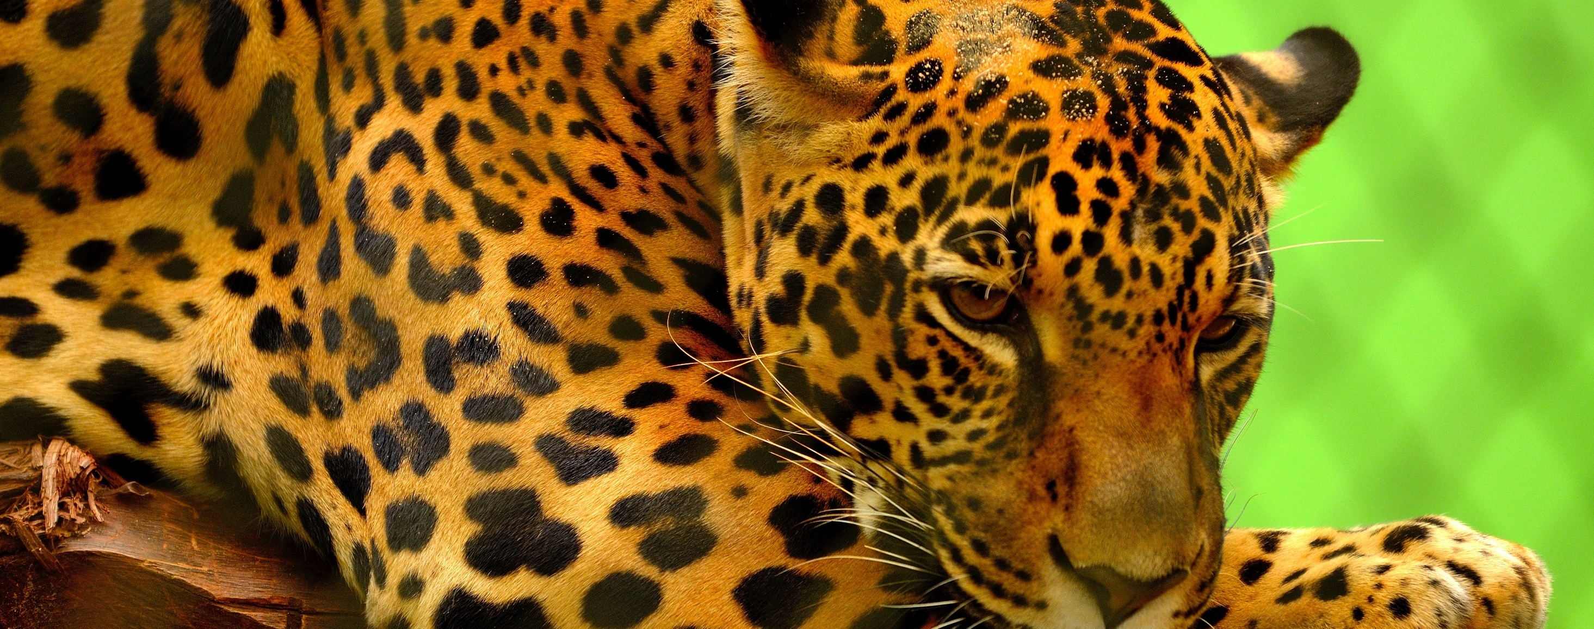
Questions?
Credit: Osa Conservation
Credit: Arizona Center for Nature Conservation
Credit: Flickr
Notes:
Image Credit: https://www.pexels.com/photo/leopard-on-brown-log-155164/, royalty fee

Slide 19
Appendices
Appendix A
Surface reflectance bands and wavelengths used to calculate NDVI and EVI
Appendix B
Equations used to calculate NDBI, NDMI, NDWI, TCB, TCG, TCW
Appendix C
Partner and literature sources for elevation cut offs for land use and land cover classification
Appendix D
Transition Potential Maps used for TerrSet
Appendix E
Values and weights assigned for human-jaguar conflict risk map
Appendix F
Values and weights assigned for resistance raster used as an input for Linkage Mapper
Appendix G
Cantones (poltical districts) within Study Area

Slide 20
Appendix A
Table A1
Surface reflectance bands and wavelengths used to calculate NDVI and EVI
Surface Reflectance | Landsat 5 TM |  | Landsat 8 OLI
 | Band | Wavelength (μm) | Band | Wavelength (μm)
Blue | 1 | 0.45 - 0.52 | 2 | 0.452 - 0.512
Red | 3 | 0.63 - 0.69 | 4 | 0.636 - 0.673
NIR | 4 | 0.77 - 0.90 | 5 | 0.851 - 0.879

Slide 21
Appendix B
Normalized Difference Built Index (NDBI)
$\text{ND}\text{BI}\text{ = }\frac{\text{SWIR} \text{−} \text{NIR}}{\text{SWIR}\text{ + }\text{NIR}}$
Tasseled Cap Brightness (TCB)
$\text{TCB}\text{= (0.2043}\text{∗}\text{BLUE}\text{)+(0.4158}\text{∗}\text{GREEN}\text{)+(0.5524 }\text{∗} \text{RED}\text{)+(0.5741 }\text{∗} \text{NIR}\text{)+(0.3124 }\text{∗} \text{SWIR}\text{1)+(0.2303 }\text{∗} \text{SWIR}\text{2})$
Normalized Difference Moisture Index (NDMI)
$\text{NDMI}\text{ = }\frac{\text{NIR} \text{−} \text{SWIR}}{\text{NIR}\text{ + }\text{SWIR}}$
Tasseled Cap Greenness (TCG)
$$\text{TC}\text{G}\text{=(}\text{−}\text{0.1603}\text{∗}\text{BLUE}\text{)+(0.2819}\text{∗}\text{GREEN}\text{)+(}\text{−}\text{0.4934}\text{∗}\text{RED}\text{)+(0.7940}\text{∗}\text{NIR}\text{)}$$
$\text{+(}\text{−}\text{0.0002}\text{∗}\text{SWIR}\text{1)+(}\text{−}\text{0.1446 }\text{∗} \text{SWIR}\text{2)}$
Tasseled Cap Wetness (TCW)
$\text{TC}\text{W}\text{= (0.0315}\text{∗}\text{BLUE}\text{)+(0.2021}\text{∗}\text{GREEN}\text{)+(0.3102}\text{∗}\text{RED}\text{)+ (0.1594}\text{∗}\text{NIR}\text{)+(}\text{−}\text{0.6806}\text{∗}\text{SWIR}\text{1)+(}\text{−}\text{0.6109}\text{∗}\text{SWIR}\text{2)}$
Normalized Difference Water Index (NDWI)
$\text{NDWI}\text{ = }\frac{\text{Green} \text{−} \text{NIR}}{\text{Green}\text{ + }\text{NIR}}$
Equations used to calculate NDBI, NDMI, NDWI, TCB, TCG, TCW

Slide 22
Appendix C
Table C1
Partner and literature sources for elevation cut offs for land use and land cover classification
Class | Elevation Restrictions in Code | Elevation Range from Literature | Partner Source | Literature Source
Grassland/Pasture | Less than 2000 m | ~1500 m | Dr. Jan Schipper | Holl & Quiros-Nietzen 1999
Paramos | Greater than 2000 m | 3100 to 3300 m | Dr. Jan Schipper | Kappelle & Horn 2016
Coffee | Greater than 870 m | 1000 to 1300 m | Dr. Jan Schipper | Avelino et al. 2005
Mangrove | Less than 500 m | less than 200 m | Jiménez, J. A. 2016 | Jiménez, J. A. 2016
Melina/Teak on the Osa Peninsula | Less than 120 m | N/A | Hilary Brumberg | N/A
Wetland | Less than 500 m | less than 200 m | Jiménez, J. A. 2016 | Jiménez, J. A. 2016

Slide 23
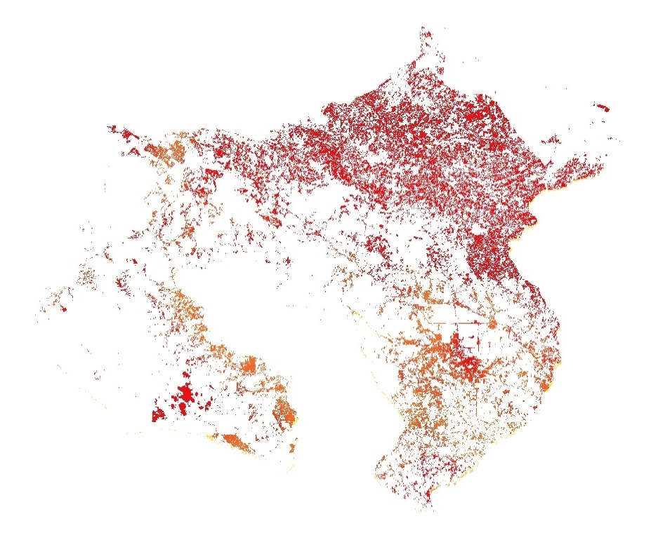
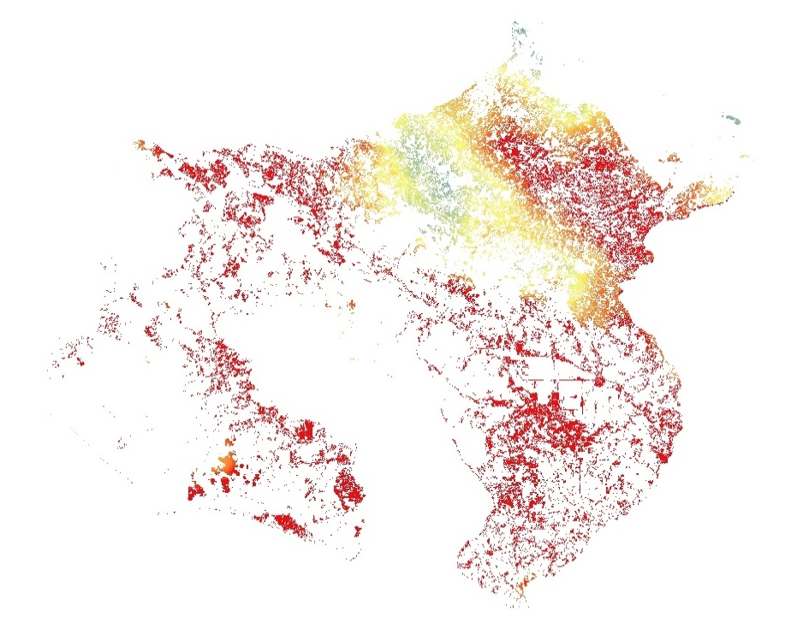
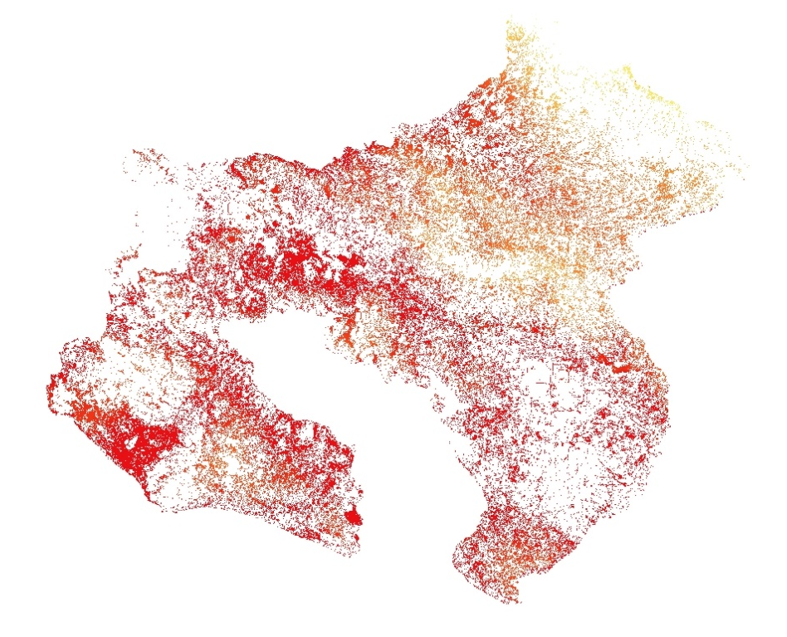
Appendix D
Percent
Change
N
Percent
Change
N
Percent
Change
N
99%
0 10 20 40
99%
0 10 20 40
99%
0 10 20 40
0%
Km
0%
Km
0%
Km
Transition from Grassland/Pasture to Exposed Soil/Urban
Transition from Grassland/Pasture to Palm Plantation
Transition from Secondary Forest to Grassland/Pasture
Figure D1. Transition Potential Maps used for TerrSet

Slide 24
Appendix E
Elevation (m) | Suitability Value (0-3, 3 being most suitable)
0-1000 | 3
1000-2000 | 2
2000-3000 | 1
>3000 | 1
Land Cover Type | Suitability Value (1-5, 5 being most suitable for jaguars)
Pineapple | 1
Palm Plantation | 2
Mangrove | 3
Water | 2
Grassland/Pasture | 3
Exposed Soil/Urban | 1
Primary Forests | 5
Secondary Forests | 5
Wetland | 4
Coffee | 4
Paramos | 1
Bivariate Key Values (based on distance and size of settlement) | Risk Value (1-5, 5 being highest risk of conflict with humans)
0 | 1
1 | 1
2 | 2
3 | 3
4 | 4
5 | 5
6 | 5
Slope (degrees) | Suitability Value (0-3, 3 being most suitable)
0-15 | 3
15-30 | 2
30-45 | 1
>45 | 0
Bivariate Key Values (based on distance and size of road) | Risk Value (1-5, 5 being highest risk of conflict with humans)
0 | 1
1 | 1
2 | 2
3 | 3
4 | 4
5 | 5
6 | 5
Pop. Count (persons/sq. km) | Risk Value (0-3, 3 having highest risk)
0 | 0
0-5 | 1
5-25 | 2
25-150 | 3
Tables E1- E7. Values and weights assigned for human-jaguar conflict risk map
Layer Name | Weight of Influence (%, must add to 100)
Slope | 10
Elevation | 10
LULC | 30
Population | 10
Cities | 20
Roads | 20

Slide 25
Appendix F
Elevation (m) | Resistance Value (1-10, 10 being highest resistance to movement of jaguars)
0-1000 | 0
1000-2000 | 2
2000-3000 | 6
>3000 | 10
Land Cover Type | Resistance Value (1-10, 10 being highest resistance to movement of jaguars)
Pineapple | 10
Palm Plantation | 6
Mangrove | 5
Water | 9
Grassland/Pasture | 5
Exposed Soil/Urban | 10
Primary Forests | 0
Secondary Forests | 1
Wetland | 3
Coffee | 4
Paramos | 10
Bivariate Key Values (based on distance and size of settlement) | Resistance Value (1-10, 10 being highest resistance to movement of jaguars)
0 | 0
1 | 2
2 | 4
3 | 6
4 | 8
5 | 10
6 | 10
Slope (degrees) | Resistance Value (1-10, 10 being highest resistance to movement of jaguars)
0-15 | 0
15-30 | 2
30-45 | 5
45-60 | 7
>60 | 10
Bivariate Key Values (based on distance and size road) | Resistance Value (1-10, 10 being highest resistance to movement of jaguars)
0 | 0
1 | 2
2 | 4
3 | 6
4 | 8
5 | 10
6 | 10
Distance to River (km) | Resistance Value (1-10, 10 being highest resistance to movement of jaguars)
0-.5km | 0
.5-1km | 1
1-2km | 2
2-4km | 3
4-8km | 4
8-16km | 5
>32km | 5
Tables F1- F7. Values and weights assigned for resistance raster used as an input for Linkage Mapper
Layer Name | Weight of Influence (%, must add to 100)
Slope | 5
Elevation | 5
LULC | 40
Distance to Rivers | 10
Cities | 20
Roads | 20

Slide 26
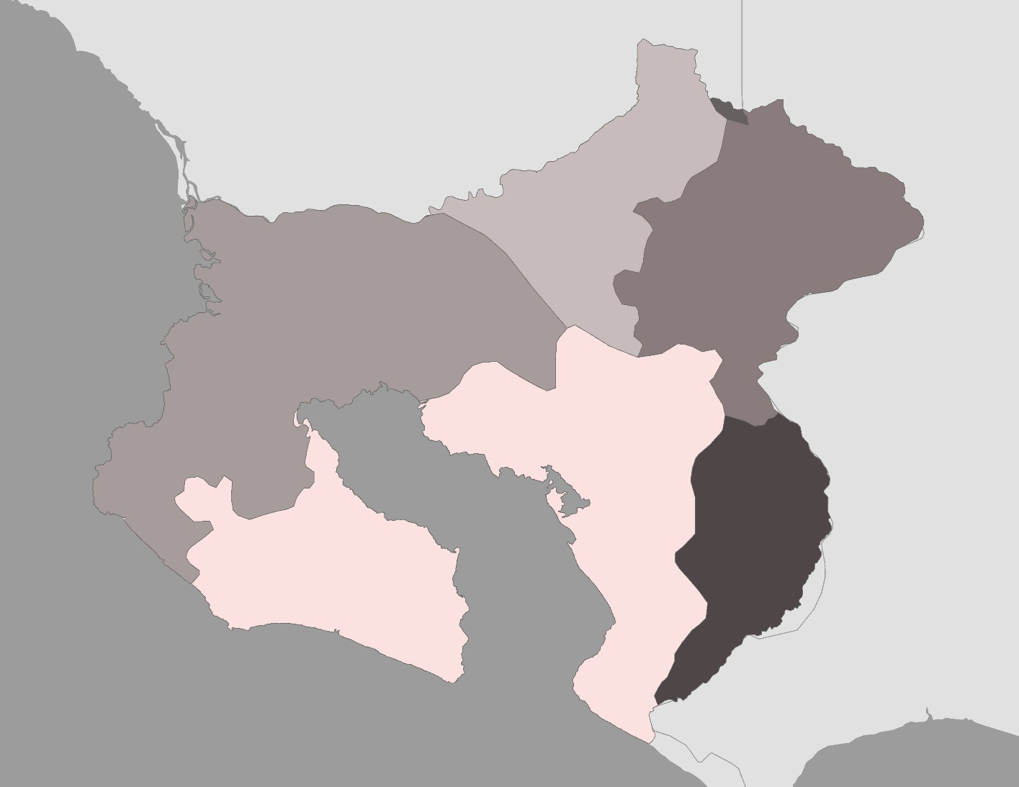
Appendix G
Osa
Golfito
Coto Brus
N
Buenos Aires
Talamanca
Corredores
0 10 20 40
Km
Figure G1. Cantones (political districts) of Study Area

