Slide 1
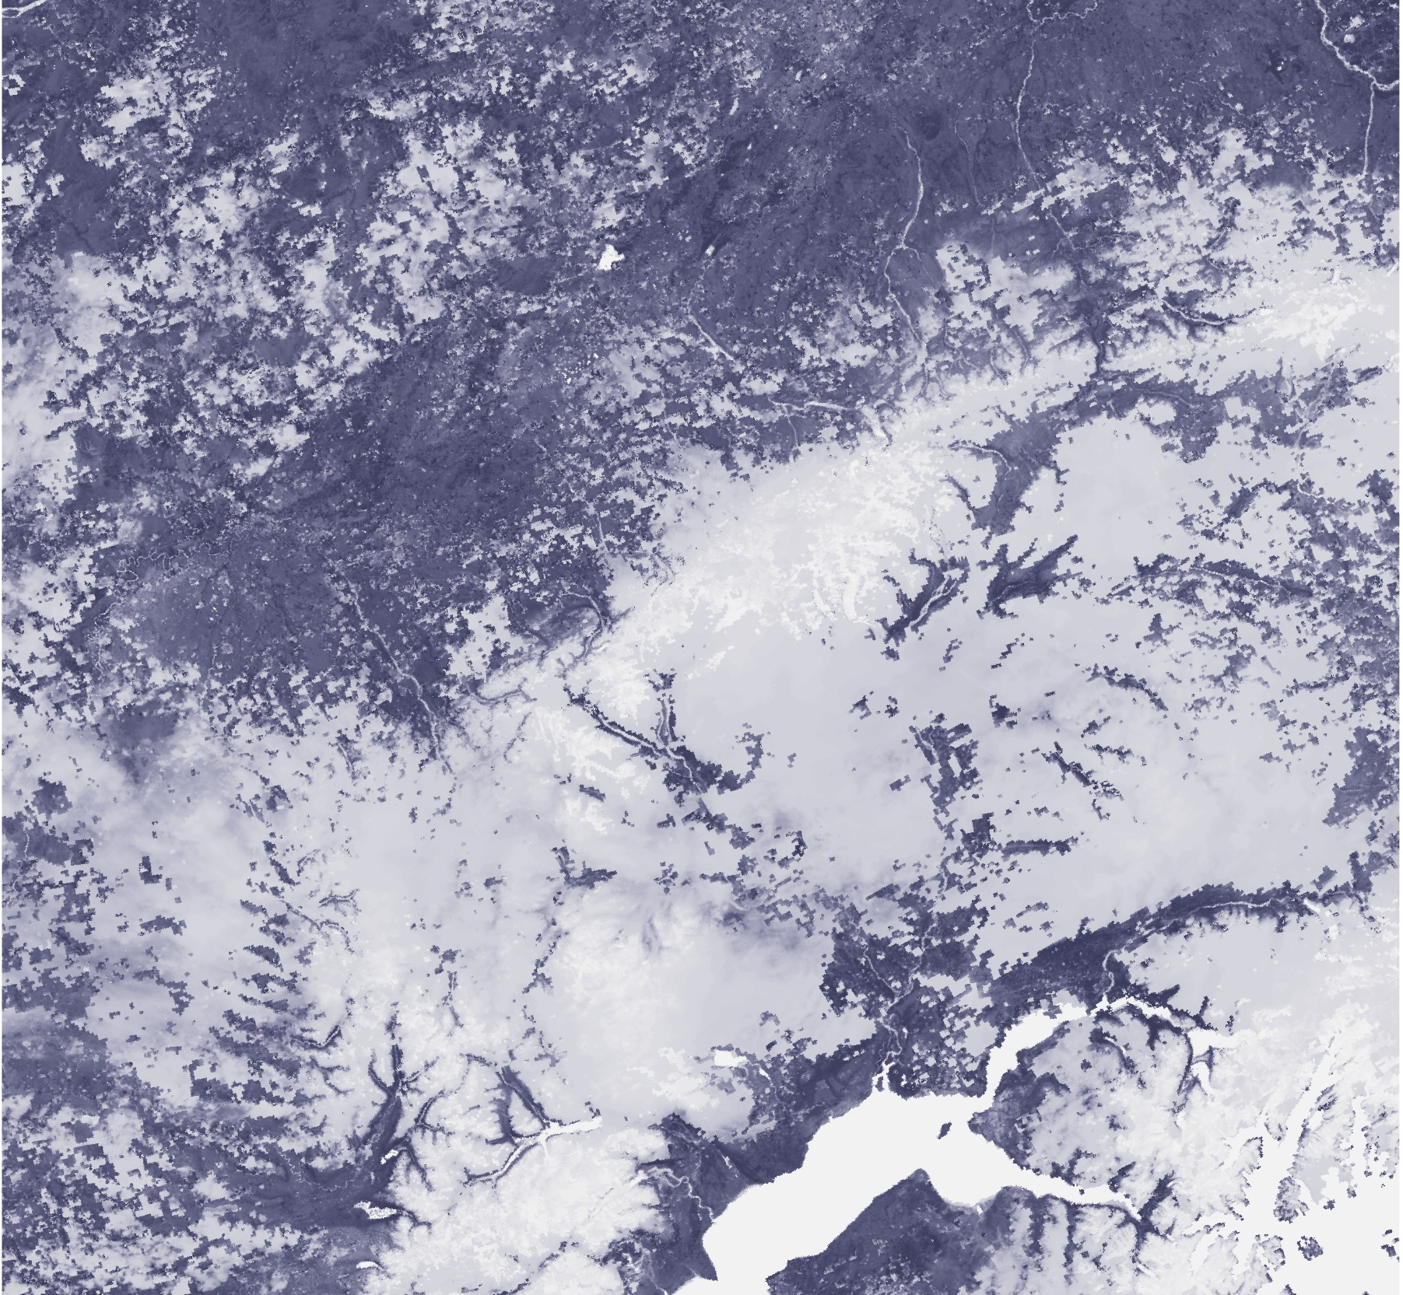
ALASKA DISASTERS
Evaluating the Atmosphere-Land Exchange Inverse Evaporative Stress Index for the Alaskan Environment to Determine Wildfire Likelihood
Christine Evans
Brianna Santallana
Ryan Marshman
Alabama – Marshall | Spring 2019

Slide 2
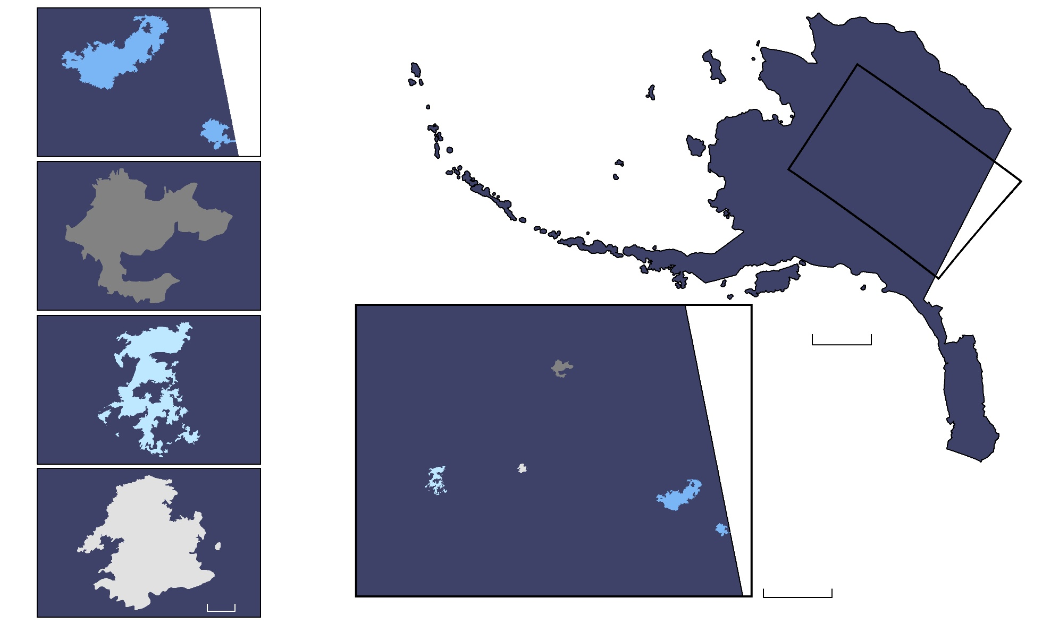
OVERVIEW
Study Area: Alaska
Study Period:
2004/2005/2015/2018
(April to September)
Taylor Complex
Fire Case Studies:
  2004: Taylor Complex
  1,305,705 acres
  2005: Nelson Mountain
  242,688 acres
  2015: Big Creek Two
  315,918 acres
  2018: Zitziana River
  71,942 acres
Nelson Mountain
300 mi
Big Creek Two
Zitziana River
100 mi
20 mi
Notes:
This project covers the state of Alaska, focusing on areas within the “Burn Belt” regions with travels through the interior of the state. The study period is defined by 3 very active fire seasons, including the largest fire season of 2004, second and third largest fire seasons of 2005 and 2015, and ends with a relatively less active fire season in 2018.
Image Credit: MSFC Alaska Disasters team

Slide 3
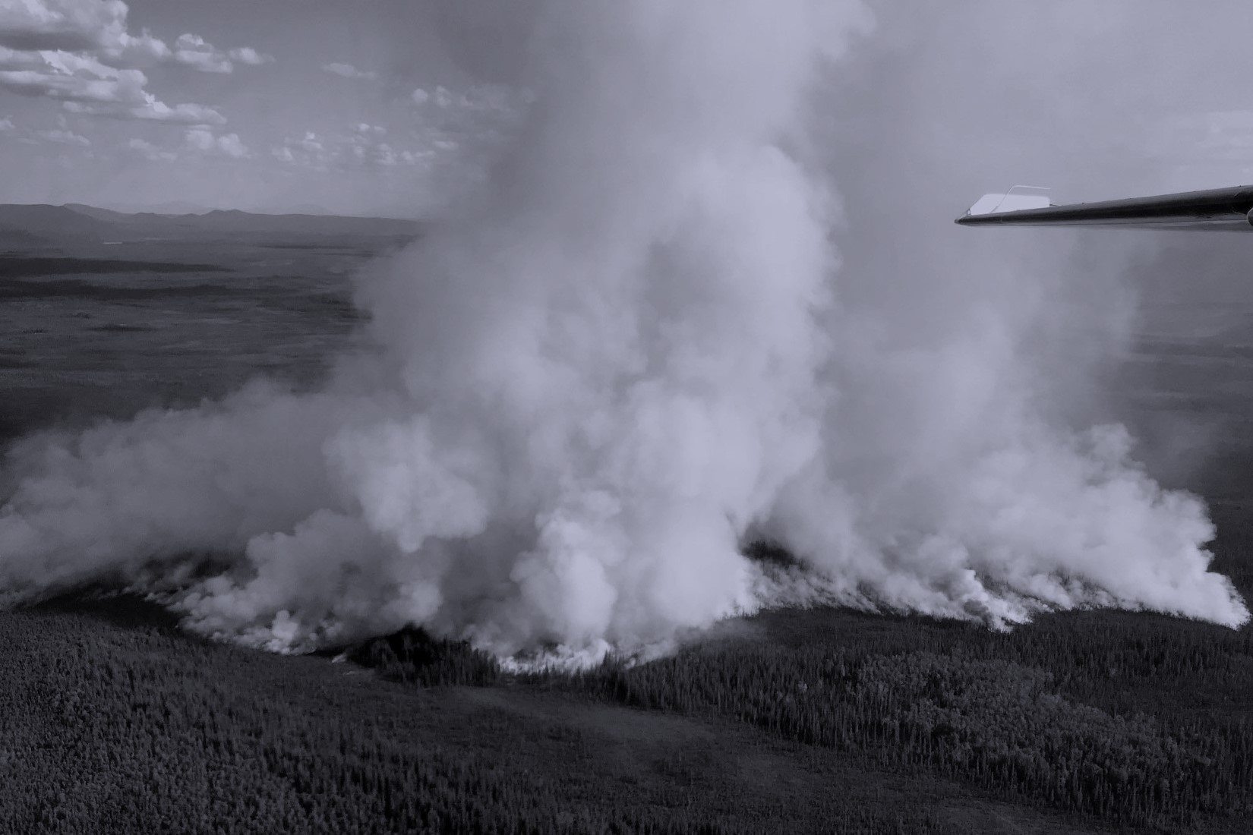
COMMUNITY CONCERNS
Environmental changes are increasing the frequency and intensity of wildfires
Wildfires destroy homes and wildlife habitat as well as release harmful pollutants
Areas experiencing vegetation stress contribute to or spread these wildfires
Current vegetation stress products cannot be directly applied to the high latitudes of Alaska
Image Credit: Alaska Fire Science Consortium
Notes:
Image source: Alaska Fire Science Consortium (provided by partners and given permission to use)
Some community concerns that drive this project are that environmental changes, such as increasing global temperatures, are increasing the frequency and intensity of wildfires experienced by the state. These wildfires destroy homes and wildlife habitat, as well as release harmful pollutants into the atmosphere.
The increase in temperatures and decreases in precipitation are contributing to areas experiencing vegetation stress and are making the land more likely to contribute to the spread of wildfires.
While vegetation stress products exist, they cannot be directly applied to the high latitudes of Alaska due to the low solar azimuth angle; thus it is important to continue evaluating different methods such as the ALEXI model, which is the goal of this project.

Slide 4
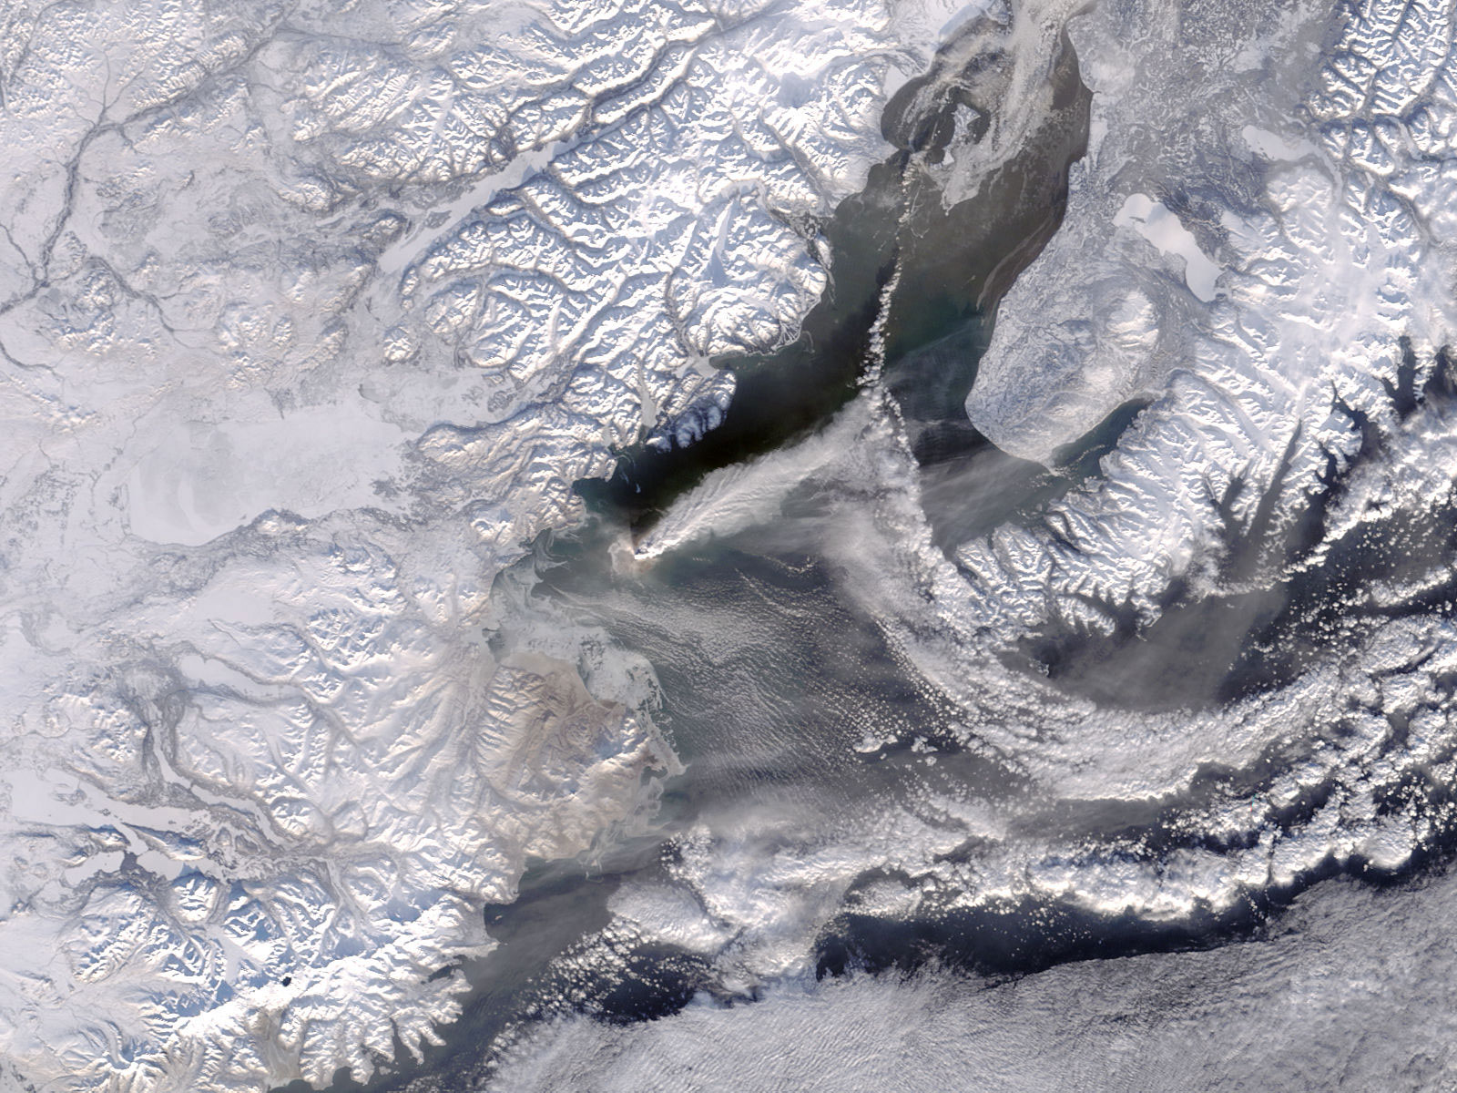
OBJECTIVES
Utilize MODIS and VIIRS sensors to introduce improved methods of evaluating vegetation stress and determining wildfire likelihood in Alaska
Evaluate the Atmosphere-Land Exchange Inverse(ALEXI) Evaporative Stress Index (ESI) product and determine if it provides lead time over other drought indices when applied to the Alaskan environment
Identify areas throughout Alaska that are prone to drought and wildfires
Image Credits: NASA
Notes:
Image Credits: https://earthobservatory.nasa.gov/images/15936/eruption-on-augustine-island-Alaska (public domain)
The objectives for this project are to utilize NASA Earth observations to introduce improved methods of evaluating vegetation stress and determining wildfire likelihood,
evaluate and calibrate the ALEXI ESI product when applied to the Alaskan environment by determining appropriate parameters and identify areas throughout Alaska that are prone to drought and wildfires

Slide 5
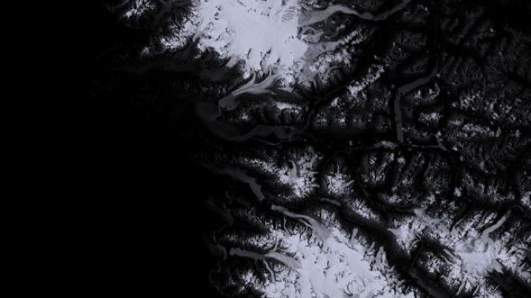
PARTNERS
Alaska Interagency Coordination Center (AICC)
Alaska Fire Science Consortium (AFSC)
NASA Short-term Prediction Research and Transition Center (SPoRT)
Image Credit: Landsat 8 OLI
Notes:
Image Credit: Map created by team member in ArcMap
The team partnered with three organizations during this project. The first is our end-user: The Alaska Interagency Coordination Center (AICC), who serves as the logistics support and predictive service for all state and federal agencies involved in wildfire management. We also collaborated with the Alaska Fire Science Consortium, who work to promote communication between wildfire scientists and the state’s wildfire managers, as well as with the NASA Short-term Prediction Research and Transition Center (SPoRT) who created the data model that will be utilized for this project.

Slide 6
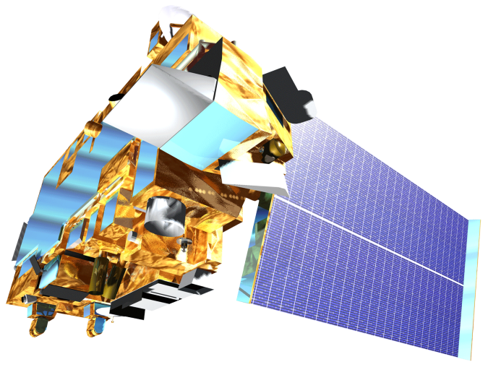

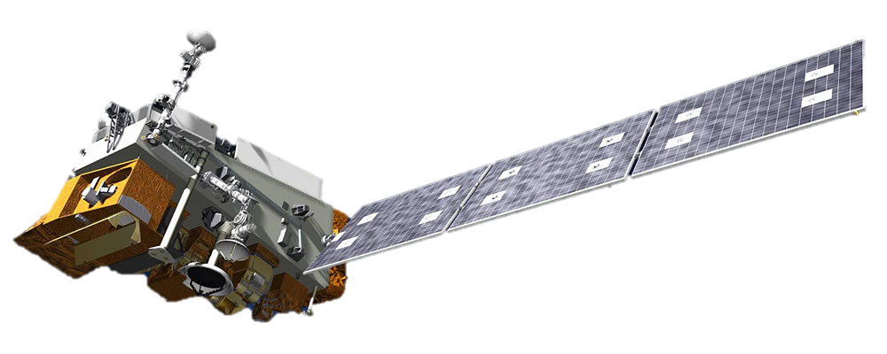
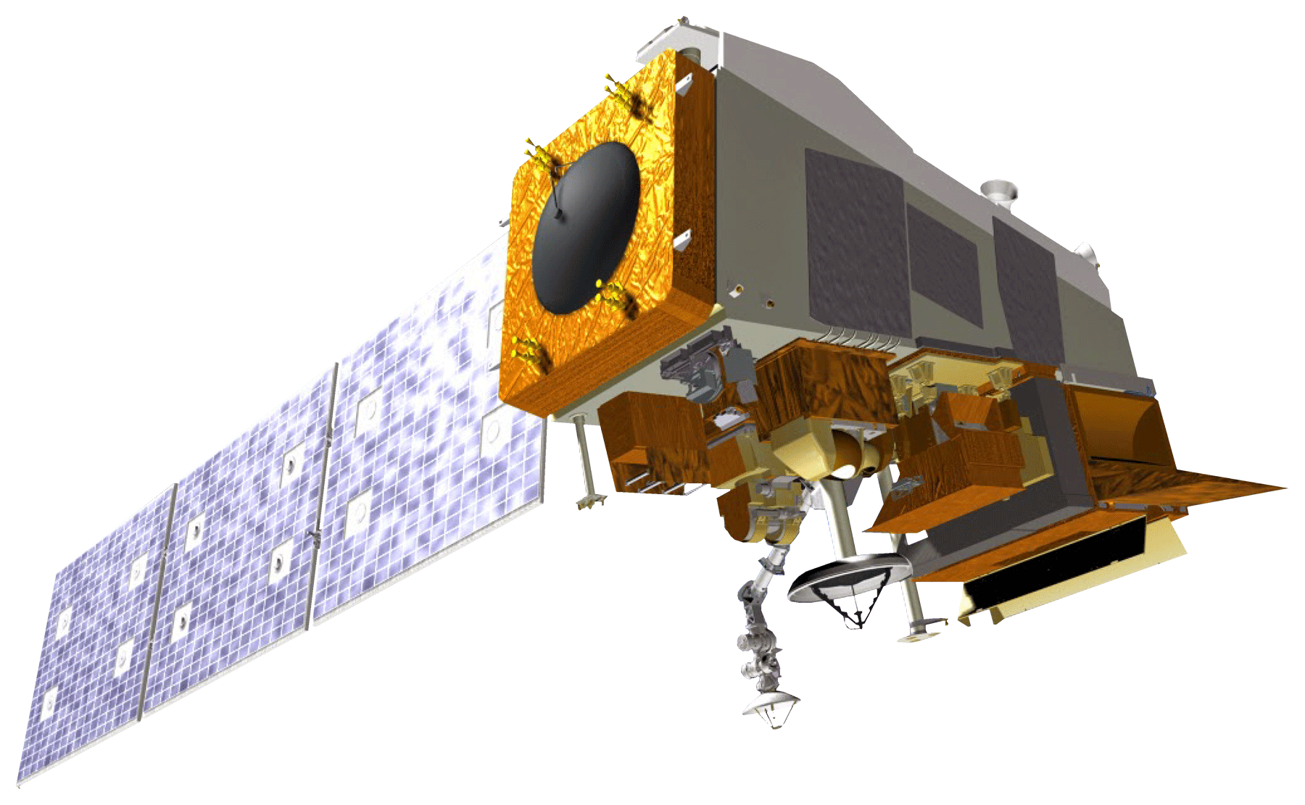
EARTH OBSERVATIONS
Aqua MODIS
  Land surface temperature
  Green vegetation cover
  Land cover
Terra MODIS
  Land surface temperature
  Green vegetation cover
Suomi NPP VIIRS
  Land surface temperature
NOAA-20 VIIRS
  Land surface temperature
Image
Credits:
NASA
Notes:
Four Earth observations were used including Aqua MODIS, Terra MODIS, Suomi NPP VIIRS and NOAA 20 VIIRS. The data from these satellites are incorporated into the ALEXI ESI model outputs, which will be discussed in later slides. We also utilized the Aqua/Terra MODIS to identify green vegetation cover.
Image Credits: NASA (Public Domain)

Slide 7
METHODOLOGY
Data Acquisition
Data Processing
Data Analysis
End Products
Aqua/Terra MODIS-derived NDVI
ALEXI ESI
US Drought Monitor Data
Canadian Fire Weather Index (CFWI)
NDVI Calculation
  Mean
  Standard Deviation
  Anomaly
CFWI
  Reclassify
Drought Monitor
  Reclassify
Visual Comparisons
Pearson’s Correlation Coefficient -Spatial Correlation
Accuracy Assessment -Confusion Matrix
ALEXI ESI Comparative Analysis
Canadian Fire Weather Indices Comparative Analysis
ArcGIS Online Story Map
Notes:
The team worked to create three end products for our partners. The first is the ALEXI ESI Comparative Analysis. To do this we utilized the MODIS-derived NDVI, ALEXI ESI , and Us Drought Monitor data. After some data manipulations in ArcMap and Excel, we were able to visual compare the three datasets, as well as compute from statistical analyses to determine the data’s spatial correlation and accuracy. For the Canadian Fire Weather Indices Comparative Analysis, we utilized the ALEXI ESI data and Canadian Fire Weather Index data and performed an accuracy assessment to determine the accuracy of the ALEXI ESI. Finally, to promote communication of our project as a whole, but also the use of NASA Earth observations, the team created an ArcGIS Online Story Map

Slide 8
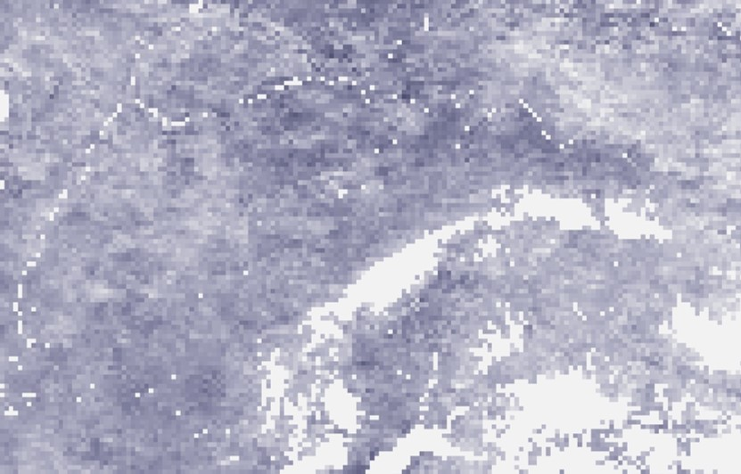
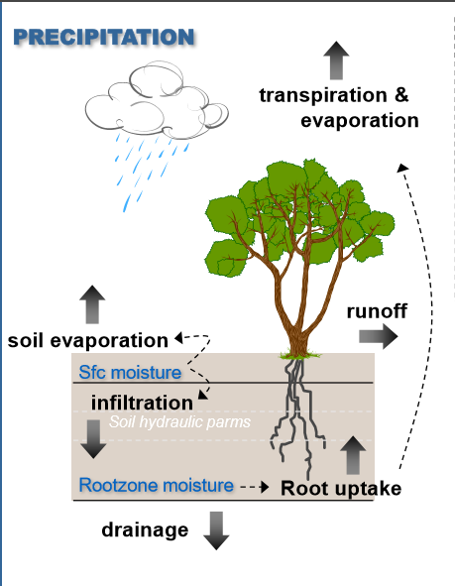
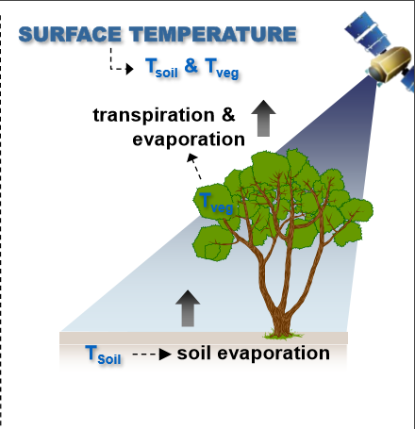
ALEXI ESI
Atmosphere-Land Exchange Inverse Evaporative Stress Index
Generated by the NASA Short-term Prediction Research and Transition Center
Uses the rise in land surface temperature to compute evapotranspiration
Image Credits: NASA
Notes:
Background Image Source: Map of ALEXI ESI output, created by team member in ArcMap
Alexi model source: https://ntrs.nasa.gov/archive/nasa/casi.ntrs.nasa.gov/20180008809.pdf (NASA Public Domain)
The ALEXI ESI product is generated by NASA SPoRT and works by Inferring the surface energy budget using the rise in land surface temperature to calculate evapotranspiration. Our project compares the ESI product to other indices to determine whether or not the Alexi model can provide lead time in detecting areas of vegetation stress. Detecting stress earlier can help our partners in detecting areas that are vulnerable to wildfires.

Slide 9
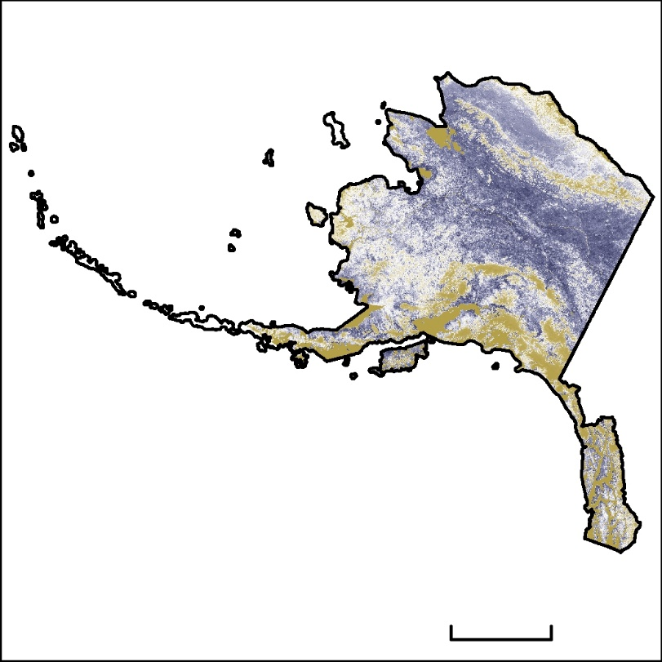
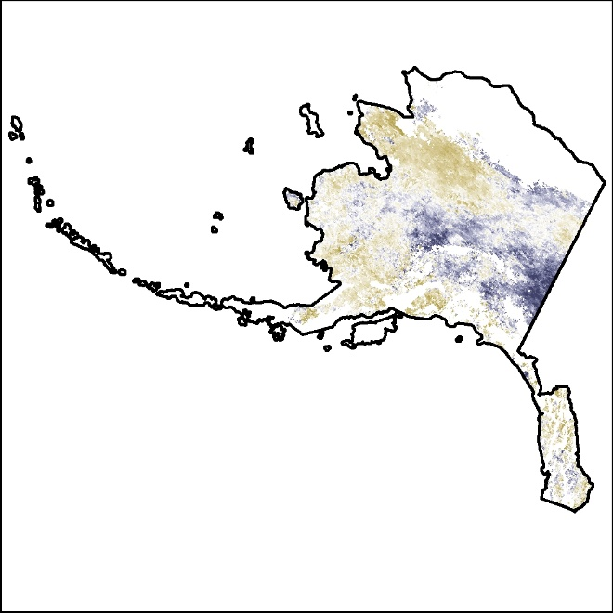
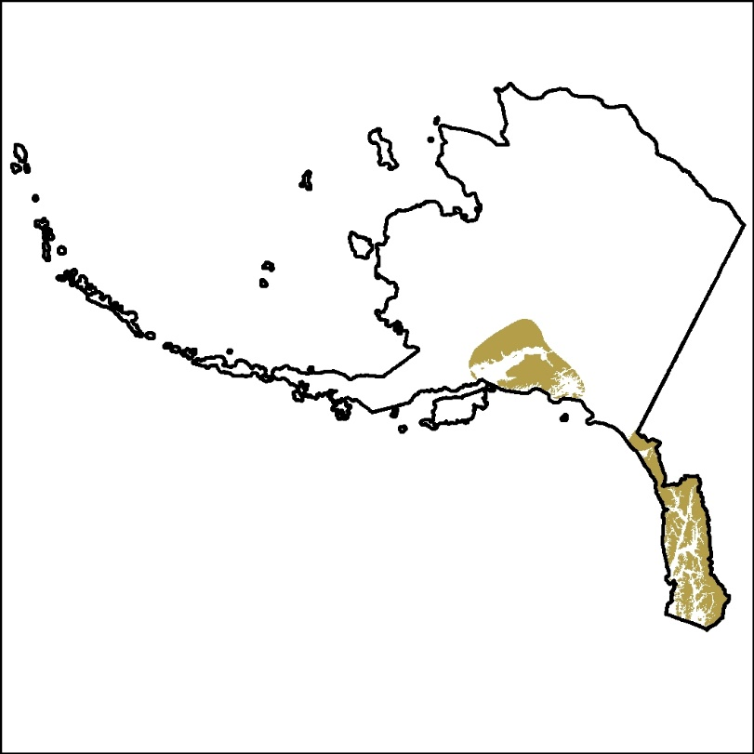
INTERCOMPARISON OF INDICES
NDVI
ESI
High: 4
High: 4
US Drought Monitor
Classification
Low: -4
300 mi
Low: -4
Drought
MODIS-derived Normalized Difference Vegetation Index (NDVI)
ALEXI ESI
USDA US Drought Monitor
Notes:
Map Sources: Drought Monitor data, NDVI, and ALEXI ESI data mapped out in ArcMap by team member
Our first end product focuses on comparing the ALEXI ESI model to the MODIS derived NDVI and the USDA US Drought Monitor. For the ESI to NDVI comparison, the data was formatted as standard deviations from the average. The ESI data was downloaded in this format while the NDVI’s anomalies were calculated for the comparison. For the ESI to USDM comparison, ESI percentage data was used alongside the USDM to classify areas as having drought or no drought. ESI percentage values from 0 to 1 indicate drought while values from -1 to 0 indicate no drought. For the USDM categories D1-4 were classified as drought while D0 was no drought

Slide 10
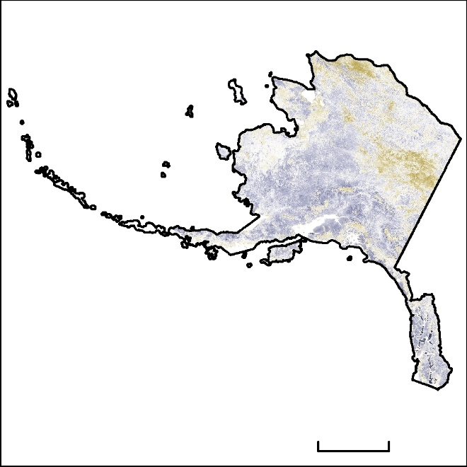
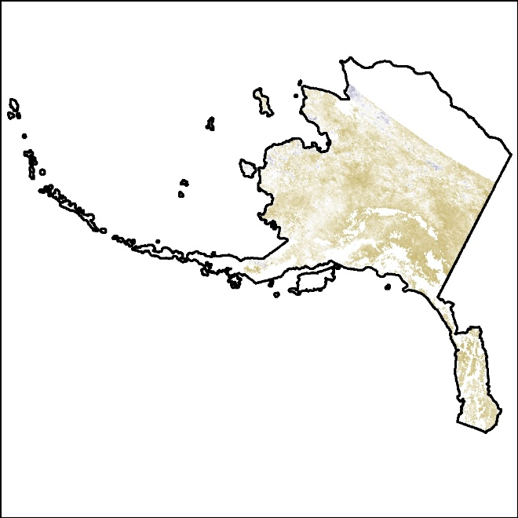
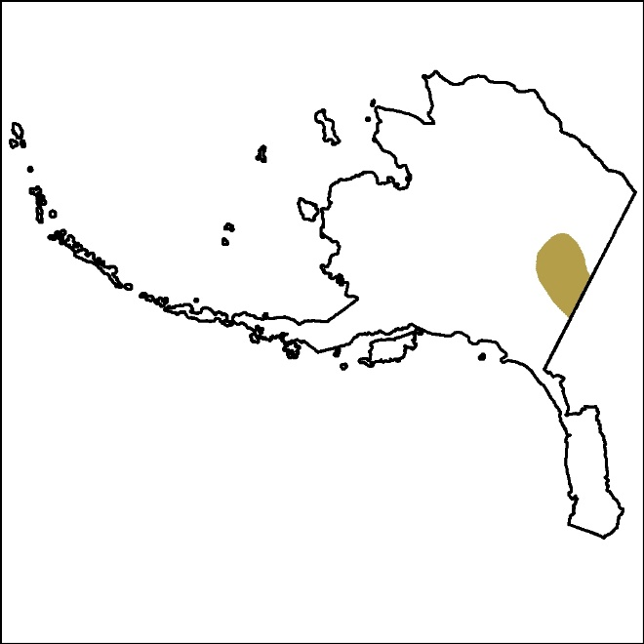
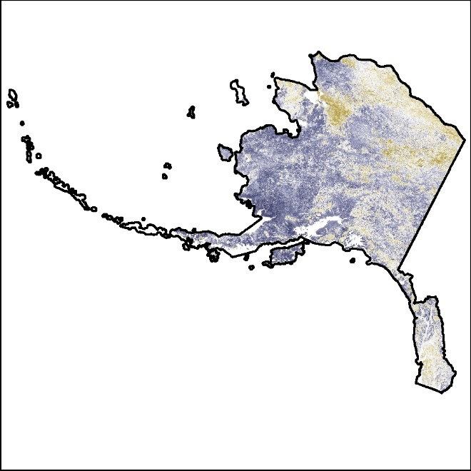
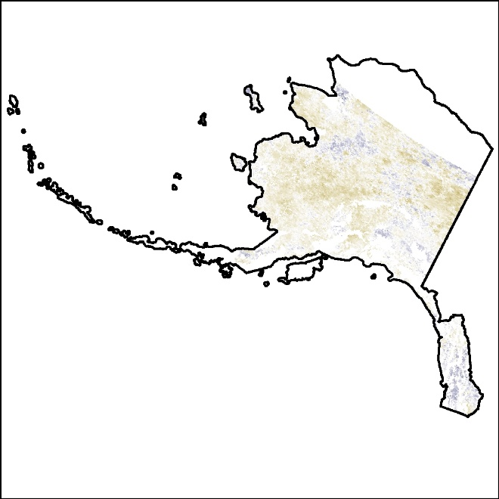
RESULTS – ALEXI ESI VISUAL COMPARISON
2004
June to July
Drought Monitor
NDVI Anomaly
ESI
NDVI
US Drought Monitor
High: 4
High: 4
ESI
Classification
300 miles
Low: -4
Low: -4
Drought
2005
June to July
Values from the same locations for ALEXI ESI, NDVI, and the drought monitor data were compared to highlight their similarities and differences
NDVI
ESI
Notes:
Map Sources: Drought Monitor data, NDVI, and ALEXI ESI data mapped out in ArcMap by team member
Shown here are the comparisons for the peaks of the 2004 and 05 fire seasons. For both the NDVI and the ESI, high values are shown in purple while low values are shown in gold. The high values for the NDVI represent areas of above average green vegetation while low values represent areas with below average green vegetation cover. The high values areas for the ESI represent above average vegetation health and soil moisture while low value areas represent below average vegetation stress and soil moisture content. The USDM was separated into areas of drought and no drought, with the gold color representing areas of drought. There is no drought image for 2005 as there was no recorded drought for that year.

Slide 11
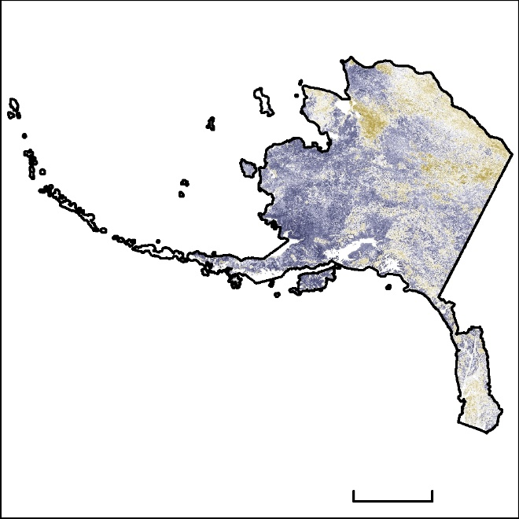
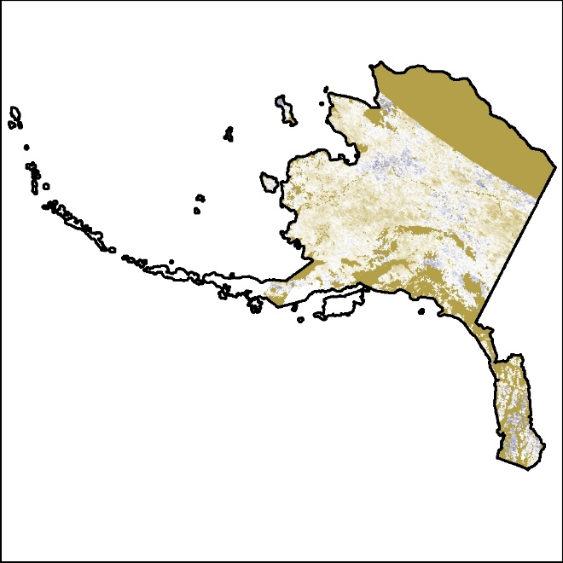
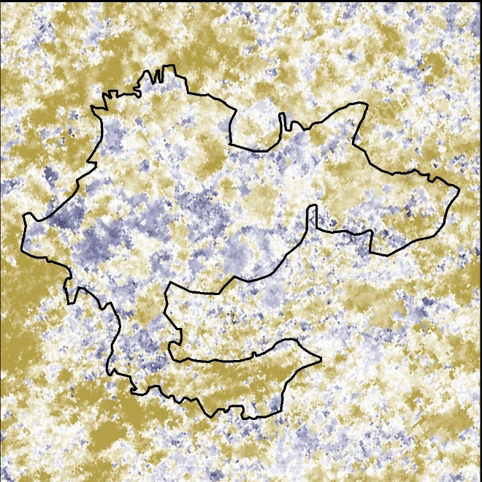
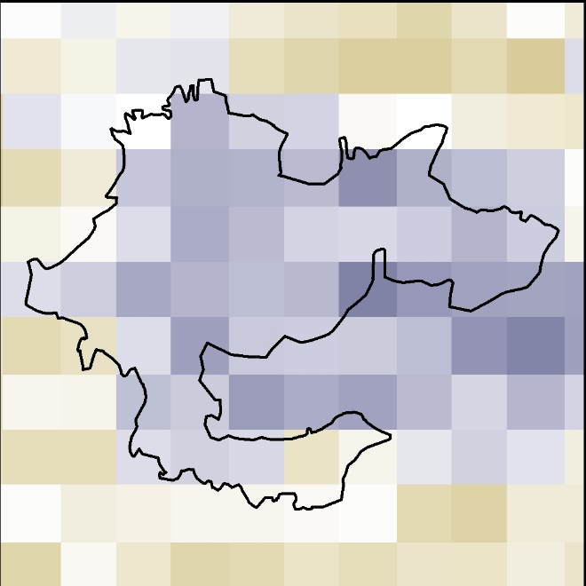
RESULTS – ALEXI ESI VISUAL COMPARISON
2005
June to July
NDVI anomalies were calculated by determining the mean NDVI for each month range from 2000-2018, then subtracting the mean from the month range in question and dividing by the standard deviation
NDVI Anomaly
ESI
NDVI
High: 4
High: 4
ESI
300 mi
Low: -4
Low: -4
Nelson
Mountain
Fire
Nelson Mountain
Fire Extent
2 mi
0
Notes:
Map Sources: Drought Monitor data, NDVI, and ALEXI ESI data mapped out in ArcMap by team member
The team first calculated the NDVI anomalies by determining the mean NDVI for each month range from 2000-2018, as well as its standard deviation. Then we computed the anomaly by subtracting the mean from the month range in question and dividing by the standard deviation. This was done for a more accurate comparison to the ESI data since the output of the ALEXI model is in anomalies.

Slide 12
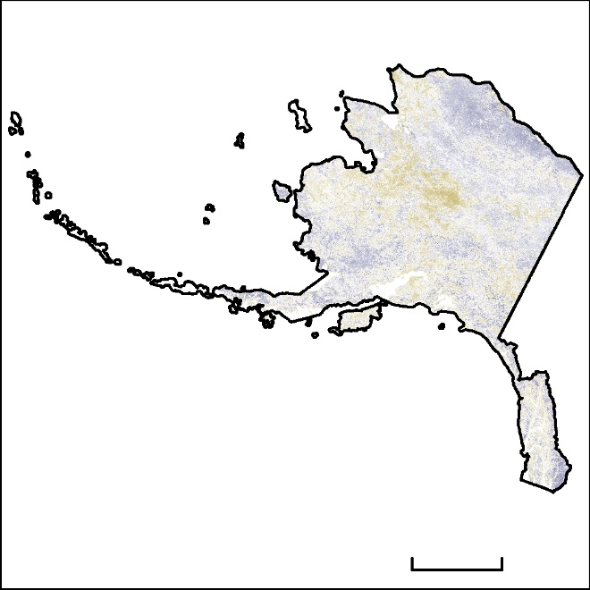
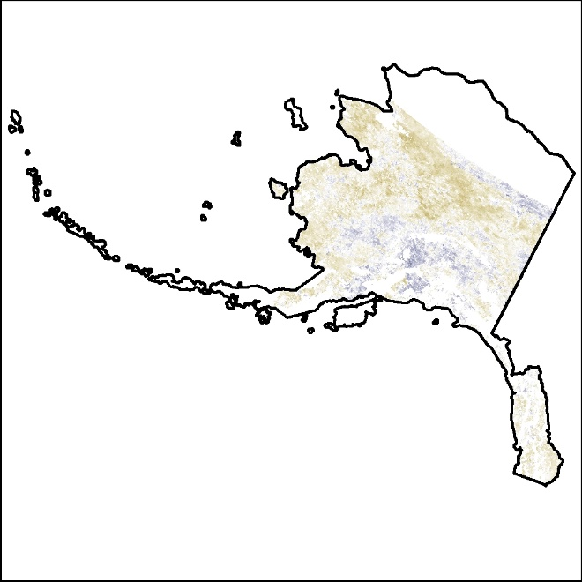
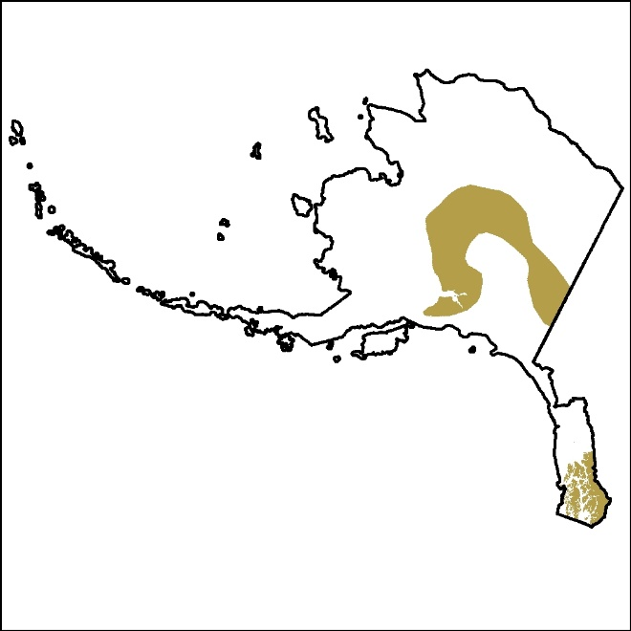
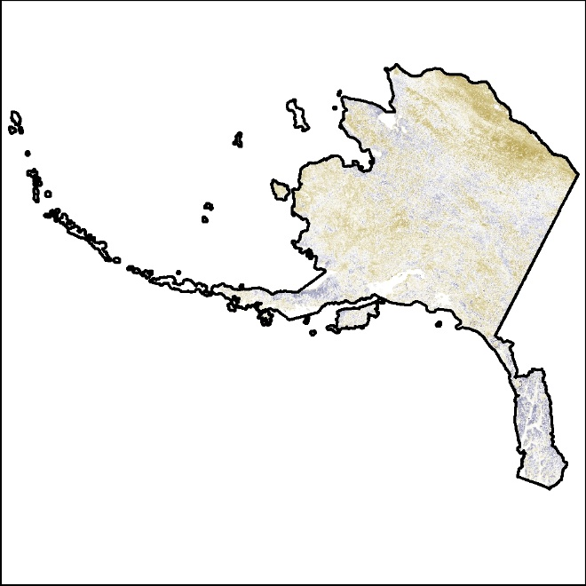
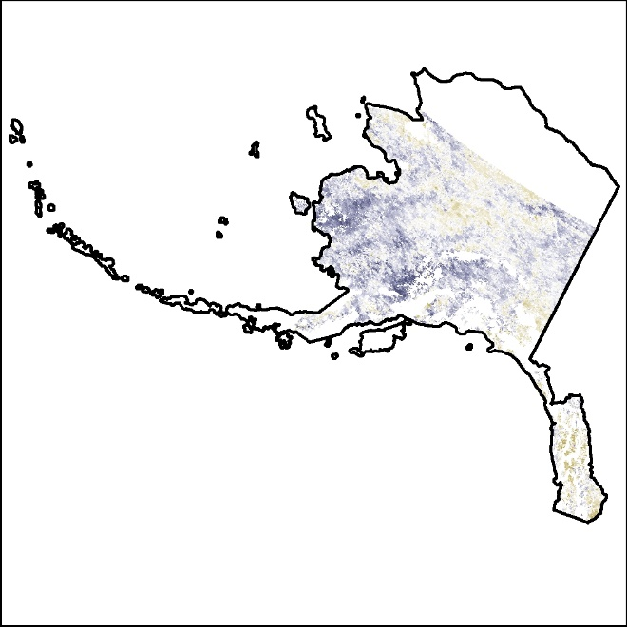
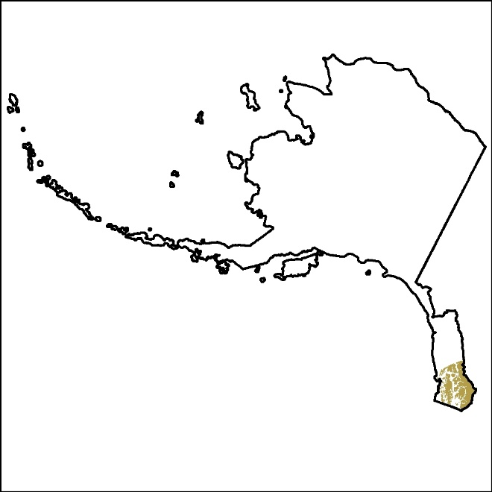
RESULTS – ALEXI ESI VISUAL COMPARISON
2015
June to July
Drought Monitor
NDVI Anomaly
ESI
US Drought Monitor
NDVI
High: 4
High: 4
ESI
Classification
300 mi
Drought
Low: -4
Low: -4
2018
June to July
Drought Monitor
NDVI
ESI
Notes:
Map Sources: Drought Monitor data, NDVI, and ALEXI ESI data mapped out in ArcMap by team member
The team compared the NDVI, ESI, and Drought monitor for 2015 and 2018 as well.

Slide 13
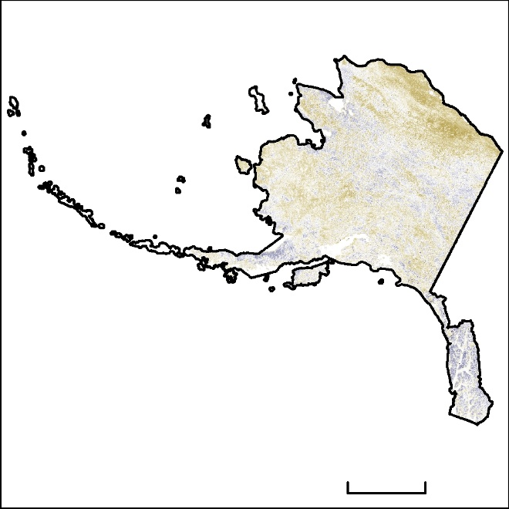
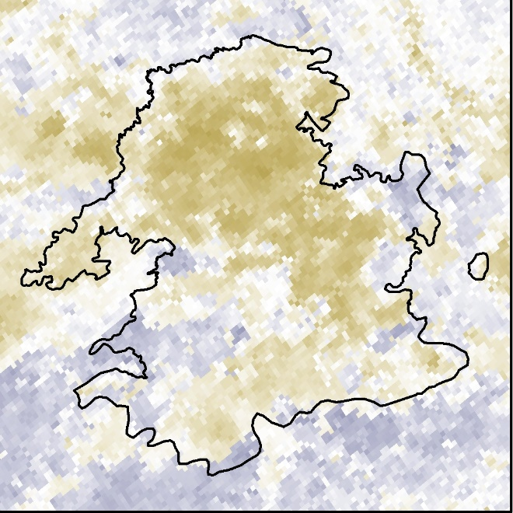
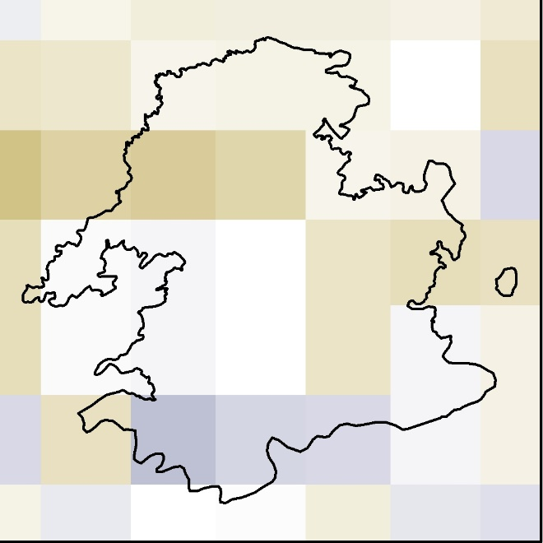
RESULTS – ALEXI ESI VISUAL COMPARISON
2018
June to July
Drought Monitor
NDVI Anomaly
ESI
US Drought Monitor
NDVI
High: 4
High: 4
ESI
Classification
300 mi
Low: -4
Drought
Low: -4
Zitziana
River
Fire
NDVI
Zitziana River
Fire Extent
ESI
2 mi
0
Notes:
Map Sources: Drought Monitor data, NDVI, and ALEXI ESI data mapped out in ArcMap by team member
The Zitziana River Fire was the largest fire of 2018. Though there was no drought in the the area of the fire, both the ESI and NDVI indicate vegetation stress here. Stressed vegetation acts as fuel for fire.

Slide 14
RESULTS – ALEXI ESI COMPARATIVE ANALYSIS with NDVI
June to July
Pearson’s Correlation
R | R²
-0.130 | 0.017
Pearson’s Correlation
R | R²
-0.100 | 0.010
Pearson’s Correlation
R | R²
0.036 | 0.001
Pearson’s Correlation
R | R²
-0.153 | 0.023
2004
2005
2015
2018
Notes:
To quantitatively evaluate our data, we created a layer of points within the border of the state of alaska, and extracted the values at these points for both the ESI and the NDVI data. Exporting that data to excel, we were able to graphically plot these data sets and compute pearson’s correlation values for each set. Values for this analysis range from 1 to -1, with 1 meaning positive correlation, -1 meaning negative correlation, and 0 meaning no correlation. As you can see from our computations, there was little correlation between the data.

Slide 15
RESULTS – ALEXI ESI COMPARATIVE ANALYSIS with DROUGHT MONITOR
June to July Confusion Matrix | ALEXI ESI (not stressed) | ALEXI ESI (stressed)
2004 - Drought Monitor (not stressed) | 6,407 | 0
2004 - Drought Monitor (stressed) | 309 | 0
2015 - Drought Monitor (not stressed) | 9,182 | 7
2015 - Drought Monitor (stressed) | 3,015 | 0
2018 - Drought Monitor (not stressed) | 1,054 | 2
2018 - Drought Monitor (stressed) | 666 | 1
Comparison between USDA Drought Monitor drought classifications and ALEXI ESI percentages
Computed a confusion matrix to identify if the ALEXI ESI product is accurate against the USDA drought classification
No drought during 2005
 | Overall Accuracy | Producer’s Accuracy | User’s Accuracy
2004 | 0.9540 | 0.9540 | 1
2015 | 0.7524 | 0.7528 | 0.999
2018 | 0.6123 | 0.6128 | 0.998
Notes:
For the comparative analysis between the ALEXI ESI product and Drought Monitor Classification, the team computed an accuracy assessment to determine the ALEXI ESI accuracy against the USDA Drought Monitor Classifications. The Drought Monitor classifications range from 0 (abnormally dry) to 4 (severe drought). The classes 1-4 were combined into one “Drought” class and these areas were plotted against the ALEXI ESI values to identify if the ALEXI ESI identified stress vegetation within the drought class perimeters.

Slide 16
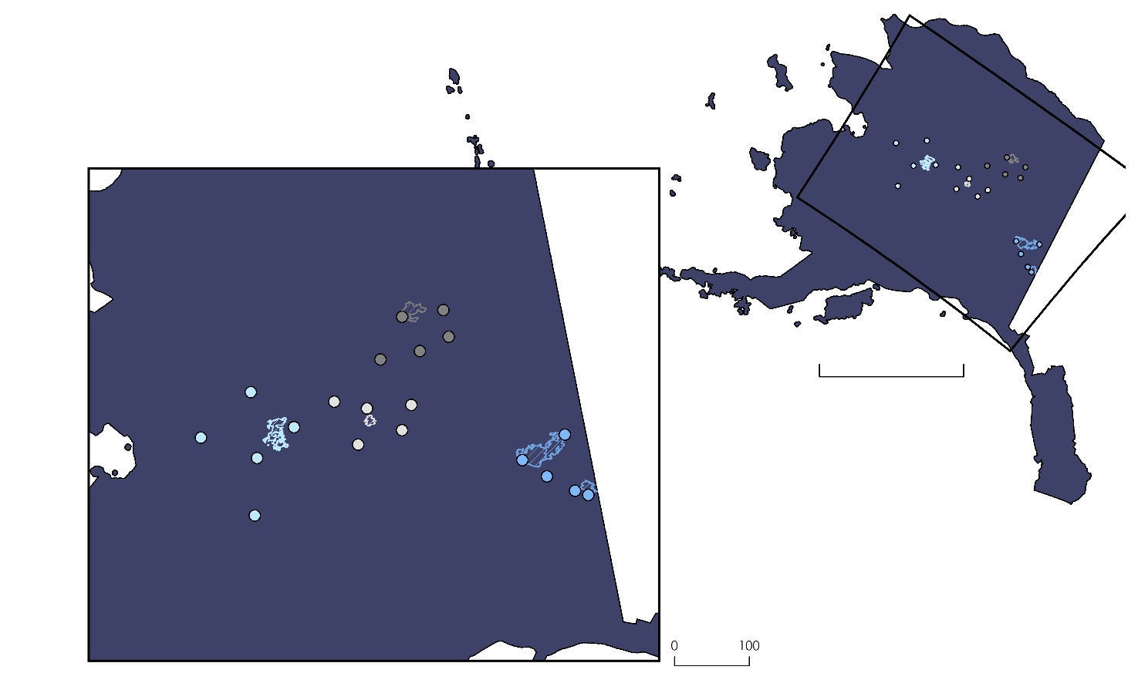

RESULTS – CFWI COMPARATIVE ANALYSIS
Comparison between CFWI fire intensity classification and ALEXI ESI percentages
Identified 5 fire management stations closest to the fire extent
Computed a confusion matrix to identify if the ALEXI ESI product is accurate against the CFWI
2018 Fire Stations
2015 Fire Stations
2005 Fire Stations
2004 Fire Stations
 | Overall Accuracy | Producer’s Accuracy | User’s Accuracy
2004 | 1 | 1 | 1
2005 | 0.7143 | 0.6667 | 1
2015 | 0.7143 | 0.6000 | 1
2018 | 1 | 1 | 1
300 mi
Big Creek Two Fire
Nelson Mountain Fire
Zitziana River Fire
Taylor Complex Fire
100 mi

Slide 17
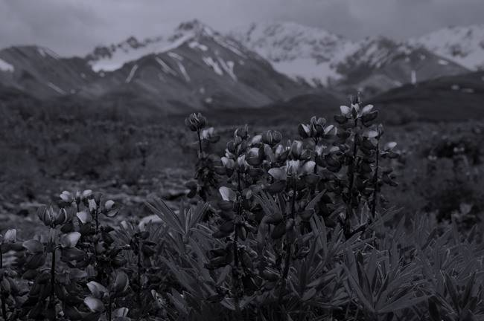
CONCLUSIONS
    The ALEXI ESI had a low correlation to the MODIS-derived NDVI products, which demonstrates that the ALEXI ESI product may be detecting stress in green vegetation, providing increased lead time in wildfire detection.
    The ALEXI ESI had an overall accuracy of 61% when compared to the USDA Drought Monitor classification areas during June to July 2018.
    The ALEXI ESI had an overall accuracy of 72% in 2015 when compared to the CFWI.
Image Credit: National Park Service
Notes:
Image Credit: https://www.nps.gov/im/vmi-dena.htm (public domain)
In conclusion, the team determined that the ALEXI ESI had a low correlation to the MODIS-derived NDVI products, which demonstrates that the ALEXI ESI product is detecting stress in green vegetation, providing increase lead time in wildfire detection, the ALEXI ESI had an overall accuracy of 61% when compared to the USDA Drought Monitor classification areas during June – July 2018, and the ALEXI ESI --------------- when compared to the Canadian Fire Weather Indices.

Slide 18
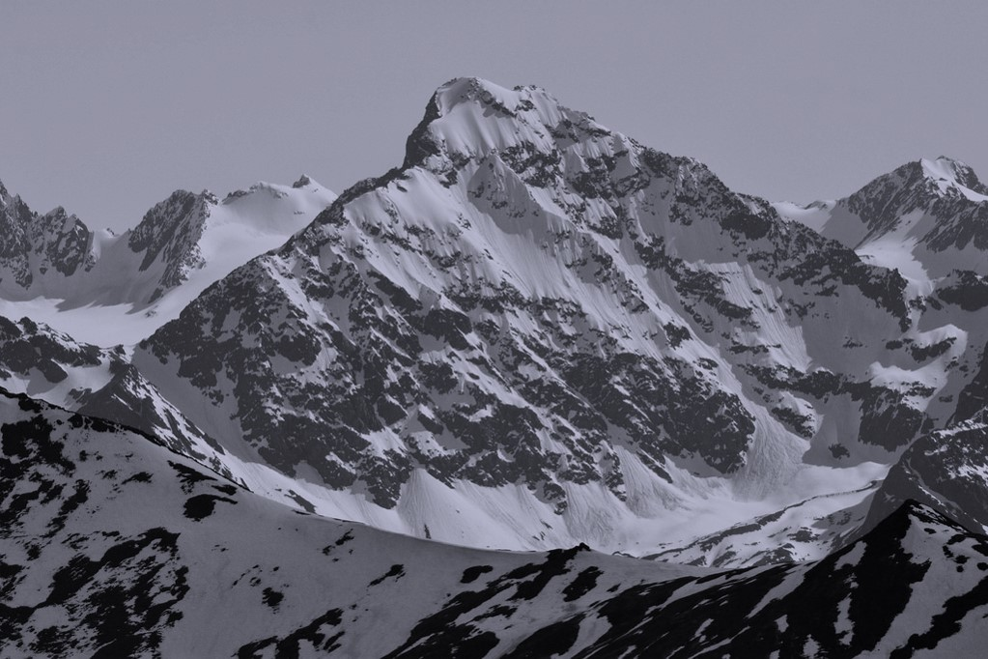
LIMITATIONS
No data for ALEXI ESI in the higher latitudes of Alaska
“Abnormally Dry” classifications of the USDA Drought Monitor were not included in the reclass step for comparing the ALEXI ESI to the drought areas
Date ranges did not overlap exactly between the three datasets
Image Credit: Paxson Woelber on Flickr
Notes:
https://www.flickr.com/photos/paxson_woelber/27829537851 (CC BY 2.0)
Some of the limitations the team experienced are that there were no data areas for ALEXI ESI product in the higher latitudes of Alaska, the “Abnormally Dry” classifications of the USDA Drought Monitor were not included in the reclass step for comparing the ALEXI ESI to the drought areas which could have altered the accuracy assessment of the ALEXI ESI and the date ranges did not overlap exactly between the three datasets

Slide 19
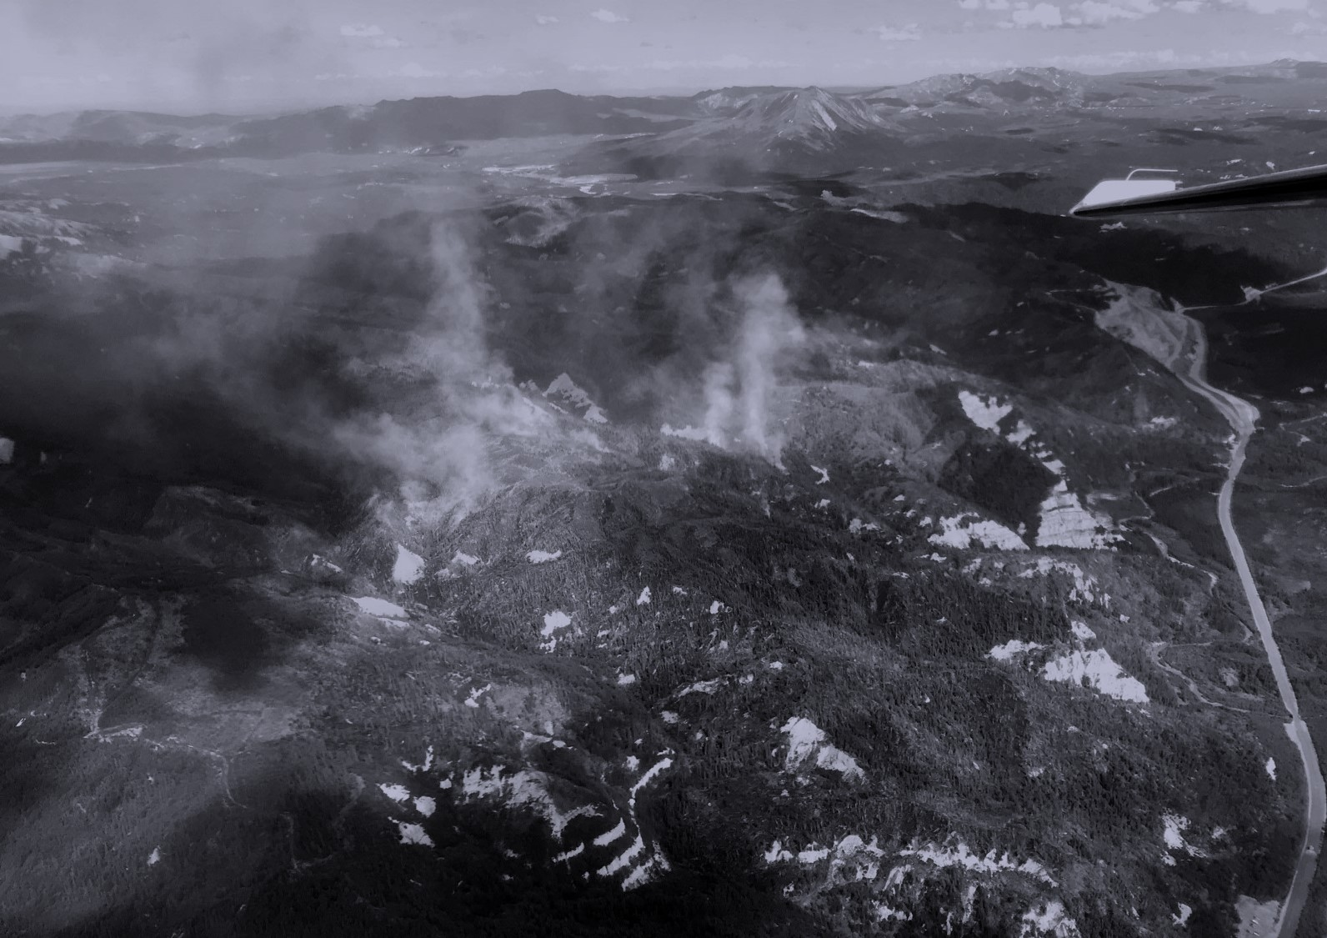
FUTURE WORK
Incorporate the “Abnormally Dry” Drought Monitor classification areas and recalculate the accuracy assessment
Incorporate lightning data for a further analysis into wildfire occurrence
Compare ALEXI ESI to different vegetation indices
Image Credit: Alaska Fire Science Consortium
Notes:
Image Source: Alaska Fire Science Consortium (provided by partners and given permission to use)
Some future work the team is interested in is to incorporated the abnormally dry classification areas and recalculate the accuracy assessment to identify if this corresponds better with the ALEXI ESI data, incorporate lightning data to further analyze the occurrence and spread of wildfires, and identify various vegetation indices that could be compared to the ALEXI ESI product.

Slide 20
Heidi Strader, Alaska Interagency Coordination Center (End User)
Alison York, Alaska Fire Science Consortium (Collaborator)
Robert Ziel, Alaska Fire Science Consortium (Collaborator)
Dr. Chris Schultz, NASA Short-term Prediction Research and Transition Center (SPoRT) (Collaborator)
Dr. Chris Hain, NASA Short-term Prediction Research and Transition Center (SPoRT) (Collaborator)
Dr. Jeffrey Luvall, NASA Marshall Space Flight Center (Science Advisor)
Dr. Robert Griffin, University of Alabama Huntsville (Science Advisor)
Maggi Klug, University of Alabama in Huntsville (Mentor)
Leigh Sinclair, University of Alabama in Huntsville, Information Technology and Systems Center(Mentor)
Helen Baldwin, University of Alabama in Huntsville (Mentor)
Madison Murphy, NASA DEVELOP Alabama – Marshall Node (Center Lead)
Kathrene Garcia, NASA DEVELOP Alabama – Marshall Node (Communications Fellow)

Slide 21

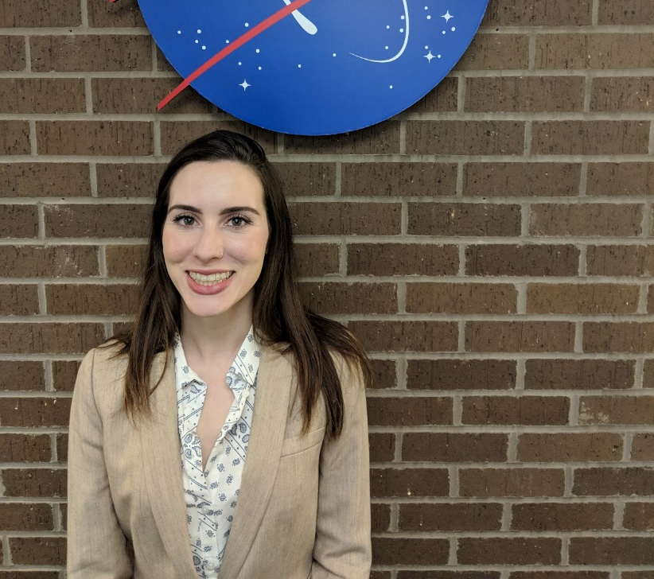

PROJECT TEAM
Christine Evans - Project Lead
Brianna Santallana
Ryan Marshman

