Slide 1
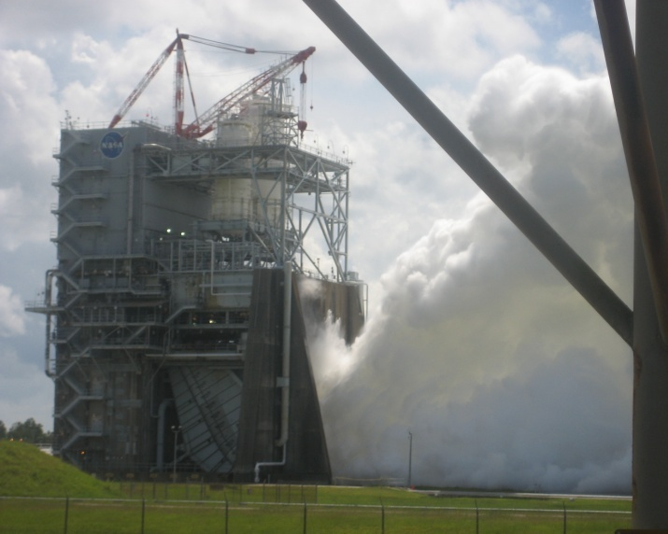
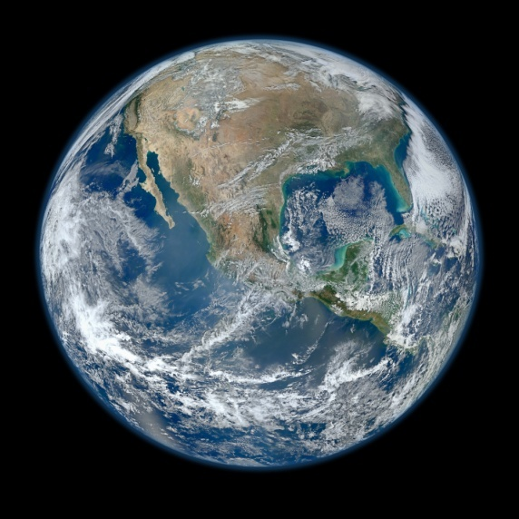
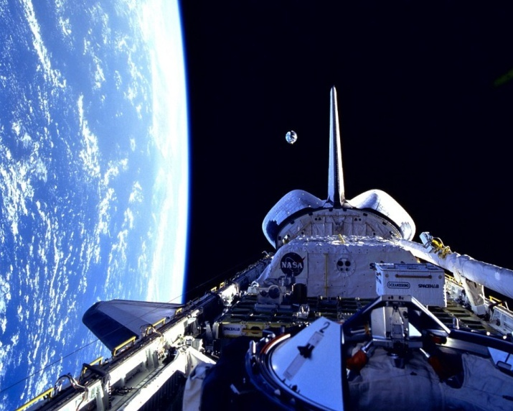
DEVELOP National Program
About NASA & DEVELOP:
History, organization, Personnel

Slide 2
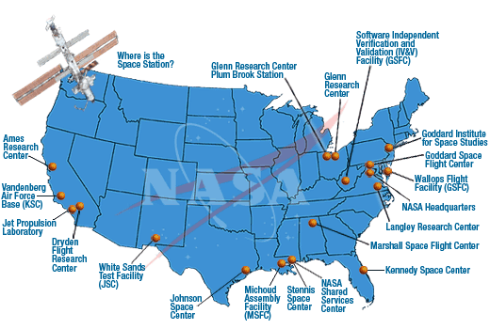
History
NASA History
"An Act to provide for research into the problems of flight within and outside the Earth's atmosphere, and for other purposes." With this simple preamble, the US Congress and President Dwight D. Eisenhower established the National Aeronautics and Space Administration (NASA) on July 29, 1958.
NASA began operations on October 1, 1958, absorbing into itself the earlier National Advisory Committee for Aeronautics (NACA) intact: 8,000 employees, an annual budget of $100 million, three major research laboratories - Langley Aeronautical Laboratory, Ames Aeronautical Laboratory, and Lewis Flight Propulsion Laboratory - and two smaller test facilities.
DEVELOP History
In 1998, three interns at NASA Langley Research Center co-authored the white paper “Practical Applications of Remote Sensing” (Bauer et al., 1998). At that time, the Digital Earth Initiative, a federal interagency project dedicated to creating a virtual representation of the Earth to further human understanding of the world, was piloting an effort to increase public access to federal information about the Earth and the environment. A proposal combining NASA’s Digital Earth Initiative and the students’ paper advocated the formation of a program, and in 1999 DEVELOP was officially formed. Beginning in 2001, new offices were established across the country and expansion has continued to today. DEVELOP is always looking for new opportunities to expand the DEVELOP network and those benefiting from DEVELOP activities.

Slide 3
Where DEVELOP Fits @ NASA
NASA Administrator
Associate Administrator
Mission Directorates
Human Exploration and Operations
Space Technology
Mission Support
Aeronautics Research
Science
Joint Agency Satellite Div.
Heliophysics Division
Earth Science Division
Planetary Science Div.
Astrophysics Division
Applied Sciences Program
Capacity Building Program
You Are Here!
DEVELOP National Program

Slide 4
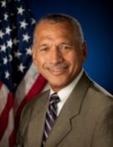
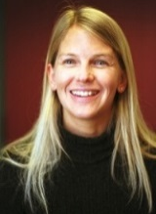
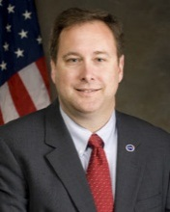

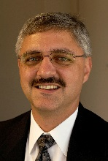
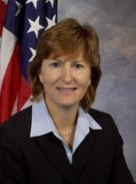
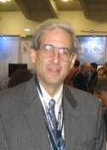
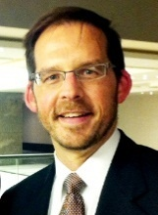
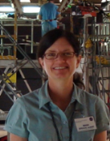
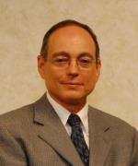
NASA Chain of Command
NASA Administrator
Charles F. Bolden, Jr.
Deputy Administrator
Dava Newman, Ph.D.
Associate Administrator
Robert M. Lightfoot, Jr.
Charles Bolden
Dr. Dava Newman
Robert Lightfoot
Associate Deputy Administrator
Lesa Roe
Science Mission Directorate
Geoff Yoder
Earth Science Division
Mike Freilich, Ph.D.
Lesa
Roe
Geoff Yoder
Dr. Mike Freilich
Applied Sciences Program
Lawrence Friedl
Capacity Building Program
Nancy Searby, Ph.D.
DEVELOP National Program
Mike Ruiz
Lawrence Friedl
Dr. Nancy Searby
Mike
Ruiz
NASA Organization Chart: http://www.nasa.gov/about/org_index.html#.VBNBWvldWbM

Slide 5
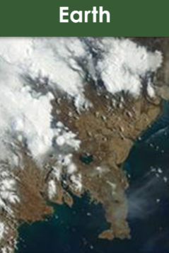
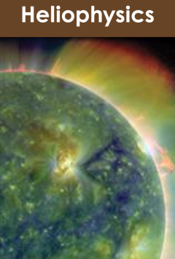
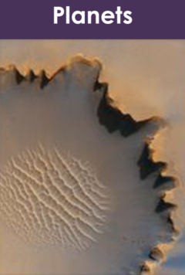
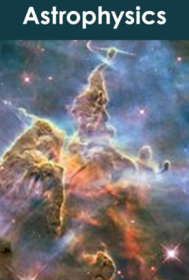
Science Mission Directorate
“Exploring near… and far… for the benefit of all.”
NASA leads the nation on a great journey of discovery, seeking new knowledge and understanding of our planet Earth, our Sun and solar system, and the universe out to its farthest reaches and back to its earliest moments of existence. NASA's Science Mission Directorate (SMD) and the nation's science community use space observatories to conduct scientific studies of the Earth from space to visit and return samples from other bodies in the solar system, and to peer out into our Galaxy and beyond.
Earth
Heliophysics
Planets
Astrophysics
NASA Science Mission Directorate Website: http://science.nasa.gov/

Slide 6
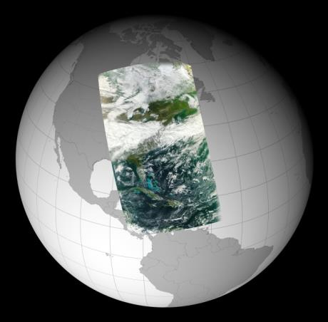
Earth Science Division
“Advancing Earth System Science to meet the challenges of climate and environmental change.”
Earth is a complex, dynamic system we do not yet fully understand, and like the human body, is comprised of diverse components that interact in complex ways. Our planet is changing on all spatial and temporal scales. The purpose of NASA's Earth science program is to develop a scientific understanding of Earth's system and its response to natural or human-induced changes, and to improve prediction of climate, weather, and natural hazards.
Research Encompasses:
The global atmosphere
The global oceans including sea ice
Land surfaces including snow and ice
Ecosystems
Interactions among the atmosphere, oceans, land and ecosystems, including humans
NASA Earth Science Division Website: http://science.nasa.gov/earth-science/

Slide 7

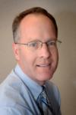
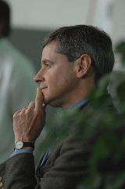
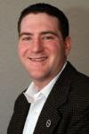
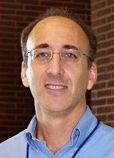
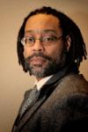
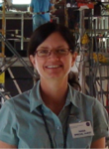

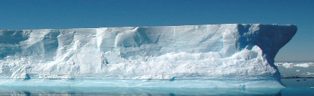
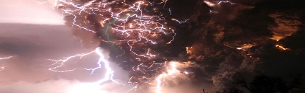
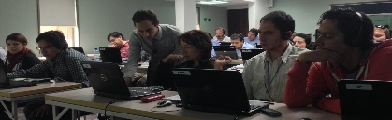


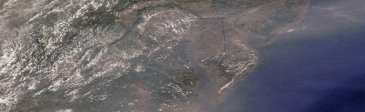
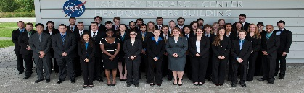
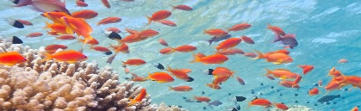
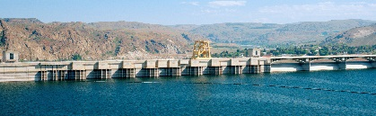

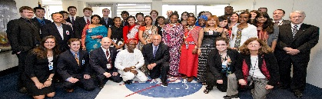
Applied Sciences Program
“Discovering Innovative & Practical Applications of NASA Earth Science”
Lawrence Friedl
Director
Partner with public and private organizations
Discover innovative NASA Earth science applications
Support environmental decision-making activities
Demonstrate practical benefits of NASA Earth science
Help improve the quality of life and strengthen the economy
ASP Program Managers (NASA HQ)
Brad Doorn
Water
Woody Turner
Eco
John Haynes
Health/AQ
David Green
Disasters
Lucien Cox
Operations
Manager
Nancy Searby
Capacity
Building
National Application Areas + Capacity Building Elements
Agriculture
Climate
Disasters
ARSET
Eco Forecasting
Energy
Health & AQ
DEVELOP
Oceans
Water Resources
Weather
SERVIR
Applied Sciences Program Website: www.nasa.gov/applied-sciences

Slide 8

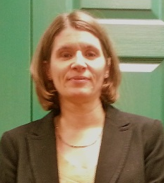
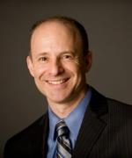
ASP’s Capacity Building Program
Nancy Searby
Program Manager
Engages current and future decision makers in a spectrum of activities to improve skills and capabilities in the United States and developing countries to access and apply NASA Earth science.
Three elements: ARSET, DEVELOP, SERVIR
(GOMI recently graduated)
CBP Element Leads
Ana Prados
ARSET
NASA Goddard
Mike Ruiz
DEVELOP
NASA Langley
Dan Irwin
SERVIR
NASA Marshall
ARSET
Online and hands-on NASA remote sensing training
DEVELOP
Dual workforce capacity building using collaborative feasibility projects
SERVIR
Building international capacity in
developing countries

Slide 9
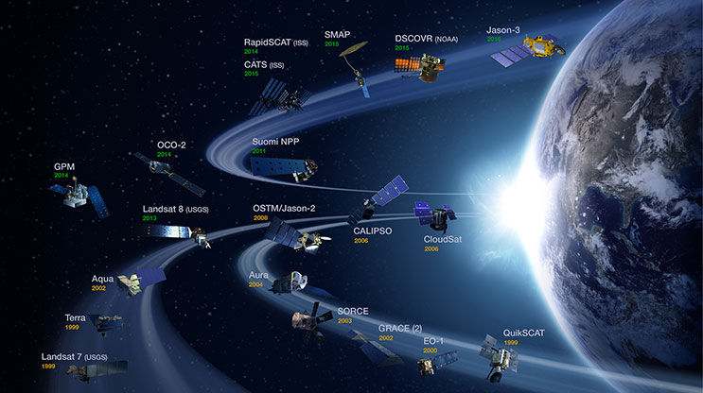
NASA Earth Observing Satellites
NASA Earth observations include a coordinated series of 17 polar-orbiting and low
inclination satellites for long-term global observations.

Slide 10
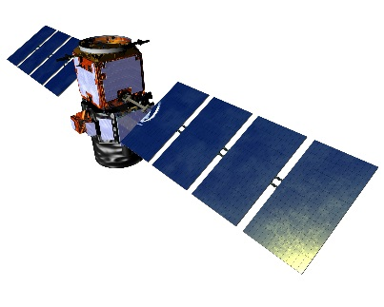
EO v. EOS
NASA Earth observations: umbrella term used that includes all airborne and flight missions that study the Earth.
Current NASA Satellite Missions:
NASA’s Earth Observing System (EOS): EOS is a subset of the full suite of NASA Earth observing missions focused on long-term global observations of the land surface, biosphere, solid Earth, atmosphere, and oceans to improve understanding of the Earth as an integrated system.
Only use this term when speaking exclusively to the below missions:
Current EOS Missions:
Aqua
Aura
Landsat 7
Landsat 8
OSTM/Jason-2
QuikSCAT
SORCE
Terra
Aqua
Aura
CALIPSO
CloudSat
EO-1
GPM
GRACE
Jason-3
Landsat 7
Landsat 8
OSTM/Jason-2
OCO-2
QuikSCAT
SORCE
SMAP
Suomi NPP
Terra
NASA Earth Science Missions: www.nasa.gov/missions/current/index.html

Slide 11
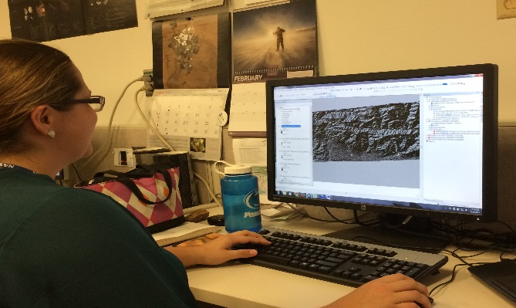
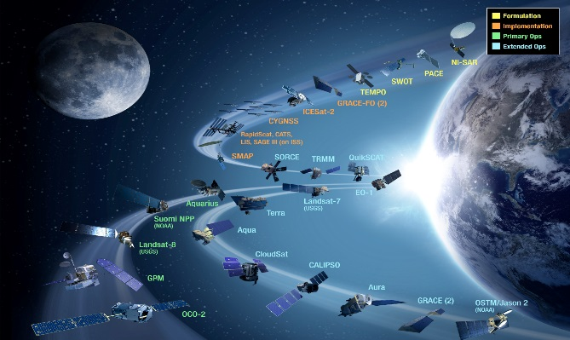
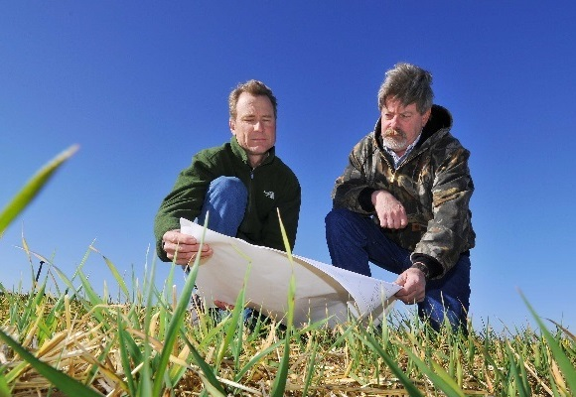
CBP’s DEVELOP National Program
“Shaping the future by integrating Earth observations into global decision making.”
Participants + Earth Observations + Decision Makers
DEVELOP bridges the gap between NASA Earth Science and society, building capacity in both its participants and end-user organizations
to better prepare them to handle the environmental challenges
that face society.
Capacity Building : www.nasa.gov/applied-sciences/capacitybuilding

Slide 12
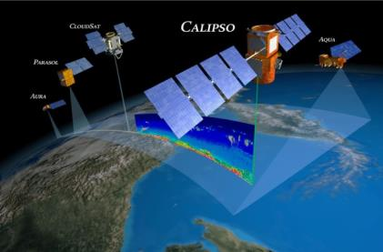
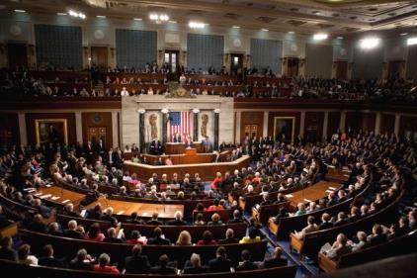
The DEVELOP Elevator Speech
So what is DEVELOP?
DEVELOP, part of NASA’s Applied Sciences Program, addresses environmental and public policy issues by conducting interdisciplinary feasibility projects that apply the lens of NASA Earth observations to community concerns around the globe. Bridging the gap between NASA Earth Science and society, DEVELOP builds capacity in both participants and partner organizations to better prepare them to address the challenges that face our society and future generations. With the competitive nature and growing societal role of science and technology in today’s global workplace, DEVELOP is fostering an adept corps of tomorrow’s scientists and leaders.
NASA’s Applied Sciences’
DEVELOP National Program
Measurements
and Predictions
Communities
DEVELOP’s Website: http://develop.larc.nasa.gov

Slide 13
DEVELOP’s Mission, Vision & Core Values
MISSION
VISION
Integrating NASA Earth observations
with society to foster future innovation and cultivate the professionals of tomorrow by addressing diverse environmental issues today.
Shaping the future by integrating Earth observations into global decision making.
COLLABORATION
Cultivating teamwork, multi-disciplinary solutions, and open communication to bridge the gap between science and society
INNOVATION
Fostering rapid feasibility projects to harness ingenuity and demonstrate the applications of Earth science
PASSION
Pursuing all endeavors with energy, excitement, and enthusiasm to sustain a high level of excellence and respect
DISCOVERY
Exploring the potential of NASA’s investment in Earth science to make the extraordinary possible

Slide 14
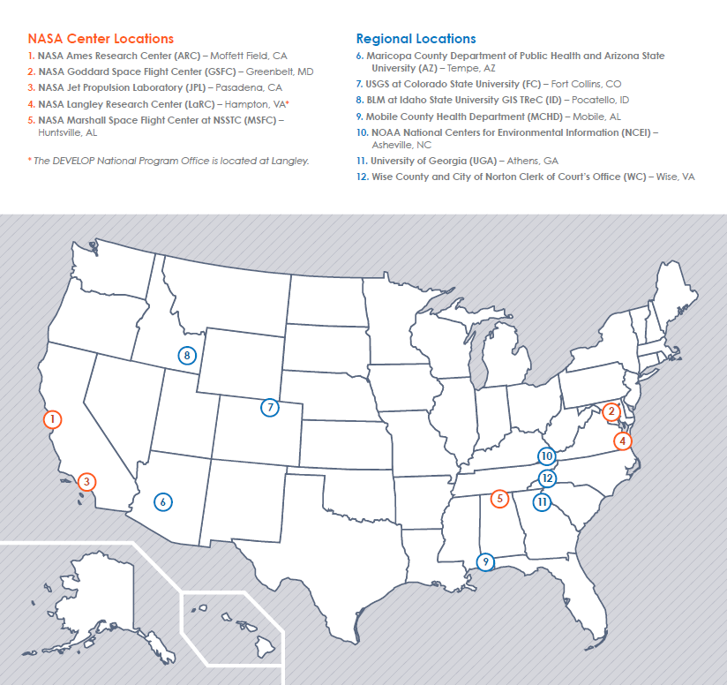
DEVELOP Locations
NASA Center Locations
Can only accept US citizens (exception: MSFC)
Contracted through SSAI, Inc.
Regional Locations
Can accept foreign nationals (exception: NCEI)
Contracted through Wise County, VA

Slide 15
DEVELOP Chain of Command
NPO
National Level
Center Lead
Science Advisor
Mentor
Center Level
Assistant Center Lead
Fellow
Office Level
Project Lead
Project Level
Project Team
Team Level

Slide 16
National POCs
DEVELOP
NPO
Karen Allsbrook
Lauren Childs-Gleason
Lindsay Rogers
Dr. Kenton Ross
Mike Ruiz
Jennifer Tindell
Sr Fellows & Post Doc
Georgina Crepps
Tiffani Miller
Carrie Kelley
Jordan Vaa
Dr. Katie Moore
DEVELOP
Fellows
Ryan Avery (LaRC)
Sean Cameron (UGA)
Sarah Carroll (FC)
Amanda Clayton (LaRC)
Dash Cruz (MSFC)
Elaina Gonsoroski (MCHD)
Erika Higa (JPL)
Aubrey Hilte (WC)
Sol Kim (JPL)
Kelly Meehan (NCEI)
Christie Stevens (WC)
Alison Thieme (GSFC)
Caitlin Toner (ID)
Jenna Williams (ARC)
DEVELOP Node Leadership
Goddard
Sean McCartney (CL)
Alison Thieme (ACL)
Idaho
Courtney Ohr (CL)
Caitlin Toner (ACL)
JPL
Nick Rousseau (CL)
Erika Higa (ACL)
Langley
Emily Gotschalk (CL)
Tyler Rhodes (ACL)
Marshall
Maggi Klug (CL)
Dash Cruz (ACL)
Mobile
Tyler Lynn (CL)
Elaina Gonsoroski (ACL)
NOAA NCEI
Alec Courtright (CL)
Kelly Meehan (ACL)
UGA
Caren Remillard (CL)
Sean Cameron (ACL)
Wise County
Michael Brooke (CL)
Kimberly Berry (ACL)
Ames
Brittany Zajic(CL)
Jenna Williams (ACL)
Arizona
Lance Watkins (CL)
Fort Collins
Brian Woodward (CL

Slide 17

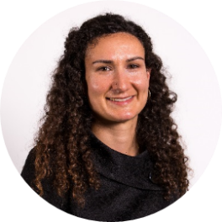
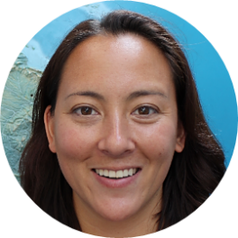
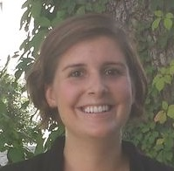



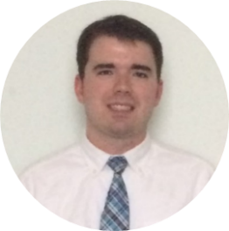
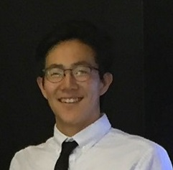


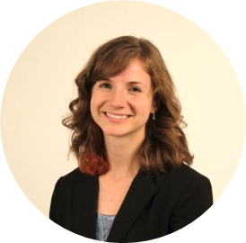
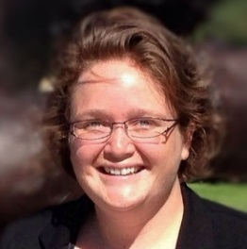
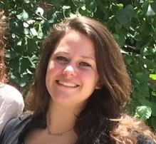

FY17 Fellows Class
What is a DEVELOP Fellow?
A recent college graduate who spends one year with DEVELOP growing both personally and professionally, and contributing to the program as a whole. Each Fellow serves in a dual-role, splitting their time between their node and NPO-related tasks.
Kelly Meehan
Geo (NCEI)
Allison Thieme
Geo (GSFC)
Elaina Gonsoroski
IA (MCHD)
Dash Cruz
IA (MSFC)
Sarah Carroll
IA (FC)
Ryan Avery
PC/Geo (LaRC)
Sean Cameron
PC (UGA)
Sol Kim
Geo/Mission Apps (JPL)
Erika Higa
Geo (JPL)
Caitlin Tonner Comm (ID)
Christie Stevens
Comm (WC)
Jenna Williams
Comm (ARC)
Aubrey Hilte
PC (WC)
Amanda Clayton PC (LaRC)

Slide 18
Question? Contact…
Karen: contracts, payroll, status reports/invoices, schedule adjustments, online app system, travel, SSAI
Lauren: projects, deadlines, conferences, telecons, Fellow class, CL position competition, publications, international activities, state/local government activities, partner engagement, project hand-offs, media interactions, Wise County
Georgina: Impact Analysis Team-related items, tracking metrics, indicators, socioeconomic impact analysis, PSI, participant surveys, alumni survey
Carrie: Communications Team-related items, graphic design support, social media, newsletter, VPS, video help, recruiting, military engagement, recruiting, outreach activities, Campus Ambassador Corps, print materials
Tiffani: Project Coordination Team-related items, EOX micro journal, publications, deliverables, using the national telecon line
Katie: Geoinformatics Team-related items, software release authority, programming/coding
Jordan: IT Team-related items, DEVELOPedia, DEVELOP website, DEVELOP Exchange, software, hardware
Topics Not Listed Here: ANYONE! We love answering questions and will direct you to the right person if we can’t answer ☺

Slide 19

THANK YOU!
Joining the DEVELOP family means being part of NASA’s Legacy.
Learn it. Know it. Live it.

