Slide 1
Alto Orinoco Health & Air Quality
Utilizing NASA Earth Observations to Locate Remote Yanomami Villages in the Alto Orinoco Municipality for Targeted Elimination of River Blindness Disease
Amanda Rumsey (Project Lead)
Rajkishan Rajappan (Project Lead)
Sara Amirazodi
(Project Lead)
Kyle Sowder
Zachary Tate
Timothy Larson
Annabel White
Notes:
Intro: Hello we are here to talk about the Alto Orinoco Health and Air Quality project which used satellite imagery to locate remote Yanomami Villages in the Alto Orinoco Municipality for Targeted Elimination of Rive Blindness Disease. This project was brought to the DEVELOP program through direct contact between Administrator Charles Bolden and former President Jimmy Cater.

Slide 2
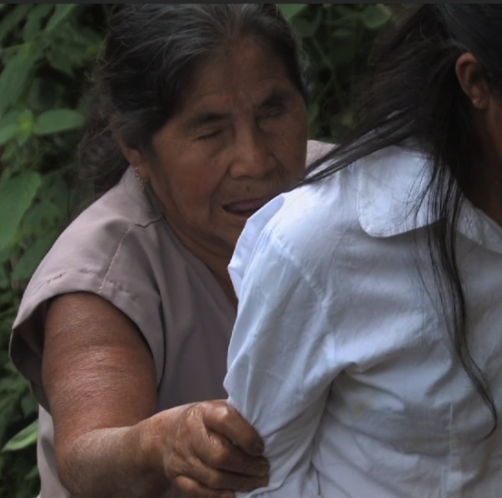
Community Concerns
What is Onchocerciasis or River Blindness Disease?
  Neglected Tropical Disease
  Caused by a parasitic worm, Onchocera volvulus
  Transmitted through the bite of a black fly
Source: The Carter Center
  Symptoms include itching, rashes, skin discoloration, visual impairment and blindness
Why Is Eradication Important?
  Disease reinforces poverty cycle by impacting quality of life, ability to work, and ability to visually learn survival skills and cultural practices
Notes:
Onchocerciasis or river blindness disease is one of 17 neglected tropical disease worldwide. It is caused by a vector born parasite and is transmitted through the bite of black flies that breed near water. Symptoms of river blindness disease include itching, rashing, skin discoloration, visual impairment and blindness.

Slide 3
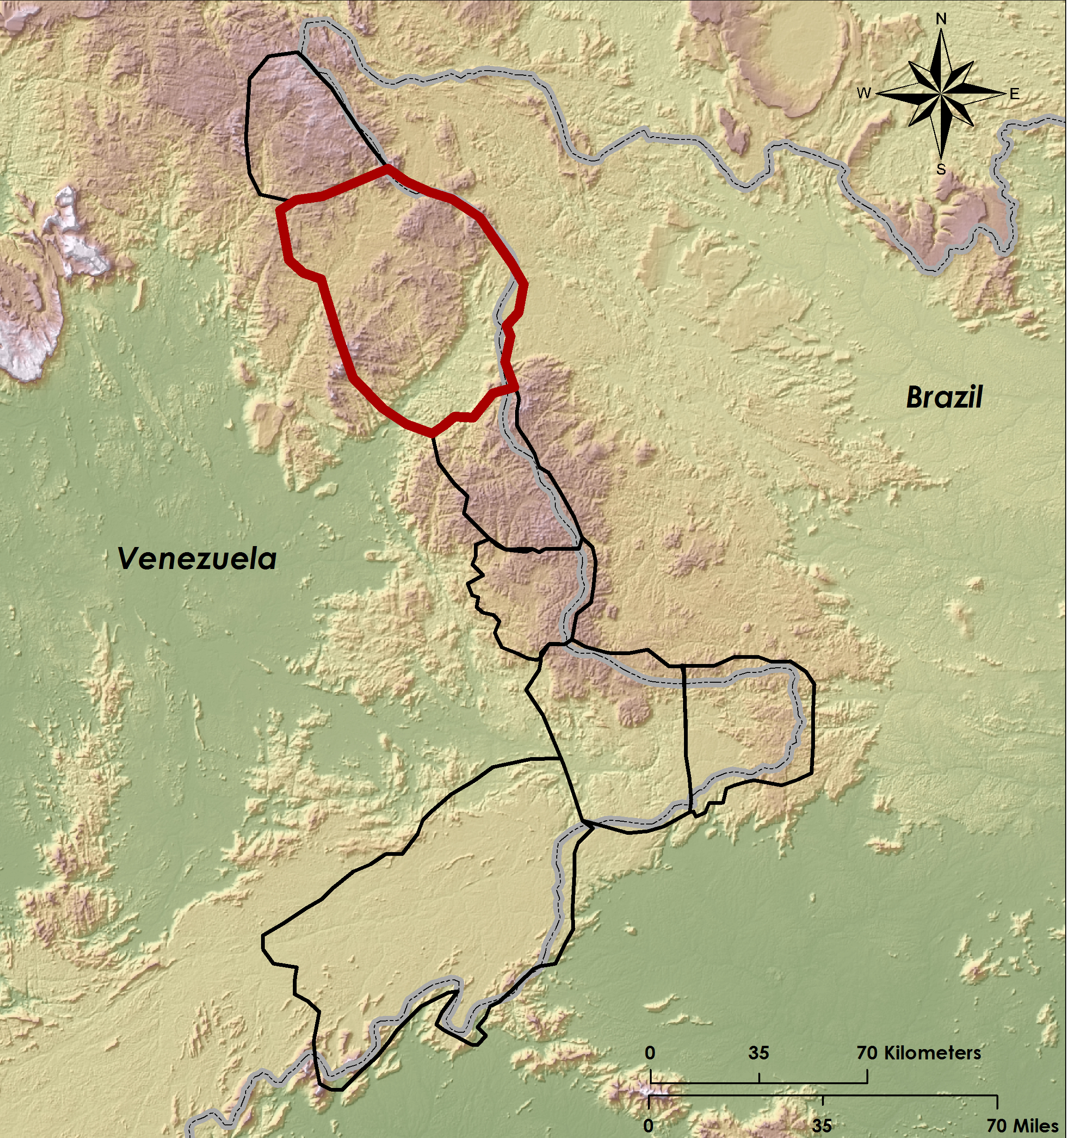
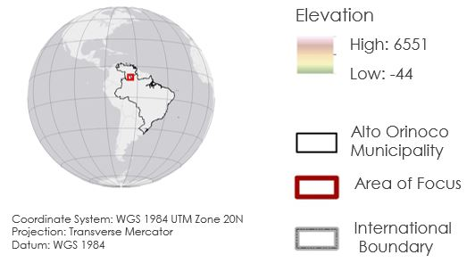
Community Concerns
Who is at Risk?
  Endemic to 13 sub-regions of Brazil, Ecuador, Guatemala, Mexico, Venezuela, and Colombia
  The Alto Orinoco Municipality is one of the last remaining active transmission zones
  122,282 people within the Alto Orinoco region are at risk
  20,500 people within the Alto Orinoco region need treatment
Notes:
Today river blindness is endemic to 13 sub-regions of Latin America. Through the efforts of The Cater Center’s Onchcerciasis Elimination Program for the Americas, 11 of the 13 endemic areas have interrupted transmission of river blindness disease through health education and semiannual distribution of Mectizan. The Alto Orinoco municipality in Venezuela is one of the last remaining transmission zone for river blindness and is inhabited by indigenous Yanomami tribes. Within this region over 122,000 people are at risk for the disease and 20,500 people are currently seeking treatment for the disease.

Slide 4
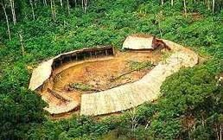
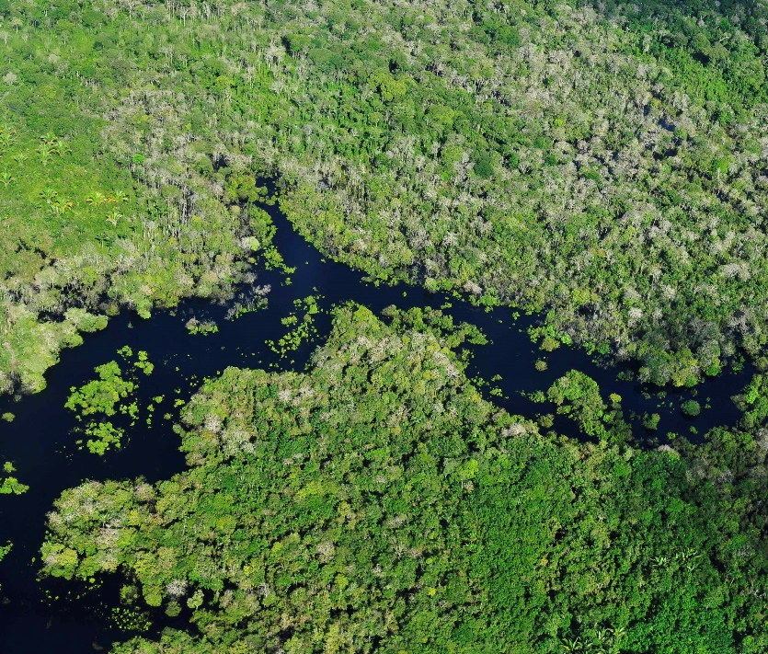
Community Concerns
What are the Current Limitations to Providing Treatment?
  Densely forested terrain
  Political boundaries
  Government policies
  Remote locations of villages
  Migratory nature of Yanomami
Source: Wikipedia User Zeljko
Source: Flickr User CIAT
Notes:
The Carter Center has been working to provide treatment to Yanomami tribes that inhabit the Alto Orinoco municipality, but entry into the region is hindered by densely forested terrain, political boundaries and policies. The remote locations and migratory patterns of the Yanomami tribe also present challenges in accessing the area for the effective distribution of treatment .

Slide 5
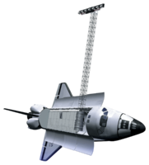
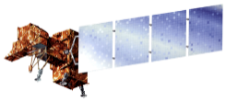


Objectives
Use NASA Earth observations and DigitalGlobe data to locate remote Yanomami villages
Convey locations and physical characteristics of villages to The Carter Center in usable format
Develop a suitability model to assist The Carter Center in future village identification efforts
Notes:
The goals of this study are to convey the locations and physical characteristics of villages to the The Carter Center and to create a suitability model.
Villages will be located within the Alto Orinoco Study region seen to the right. The study area covers the Alto Orinoco Municipality of Venezuela and was split up into 7 “at risk” sub regions outlined by the Carter Center. We will be looking at all 7 sub regions with an emphasis on region 2 due to the regions recent exponential village growth.

Slide 6
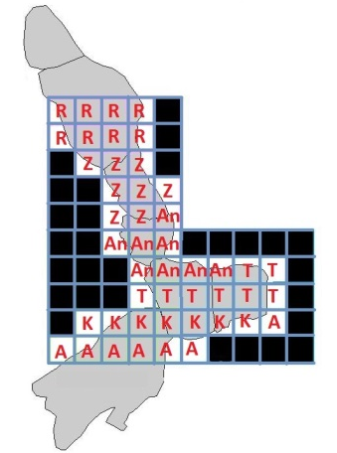
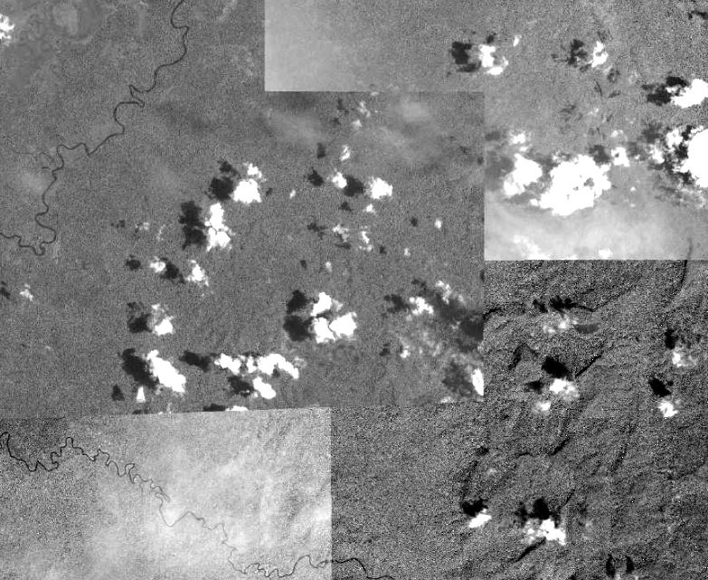
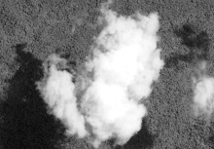
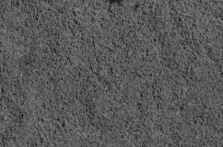
Methodology
Step 1 and 2
Step 3
Step 4
Notes:
To Identify the Yanomami Villages, the study area was dissected into 46 sub regions and each team member was assigned 7 to 8 sub regions to visually inspect. Each person visually inspected their assigned sub regions on a pixel by pixel basis using high resolution digital globe cloud free mosaics. Because the Alto Orinoco region is an extremely cloudy subtropical region, not all clouds were eliminated during the mosaicking process. If a cloud was present in the mosaic, raw digital globe data from another data was substituted in.
The study area was dissected into 46 grids
Each team member was assigned 7-8 grids to visually inspect
Each grid was inspected on a pixel-by-pixel basis using a high resolution cloud-free DigitalGlobe mosaic
If a cloud was present in the cloud-free mosaic, raw imagery from another date was substituted in

Slide 7
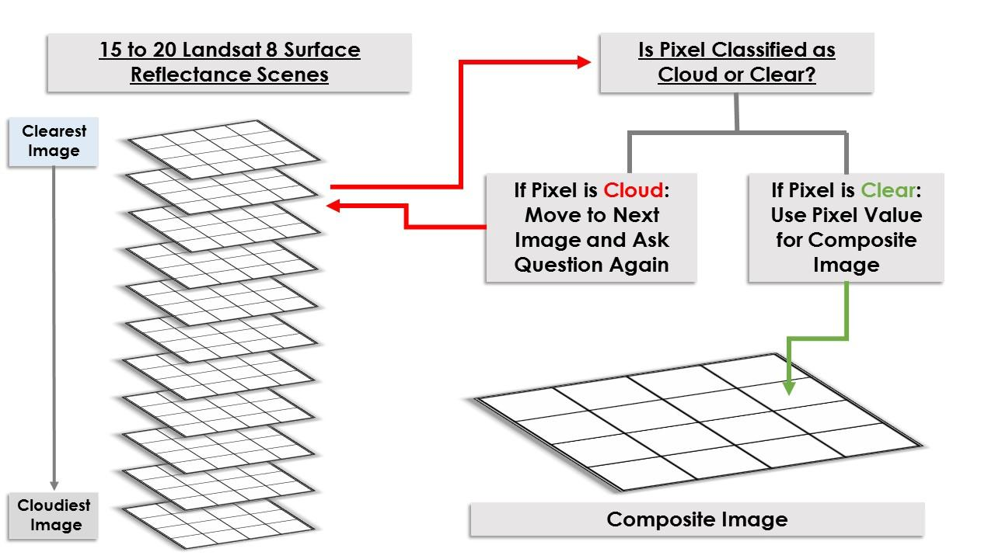
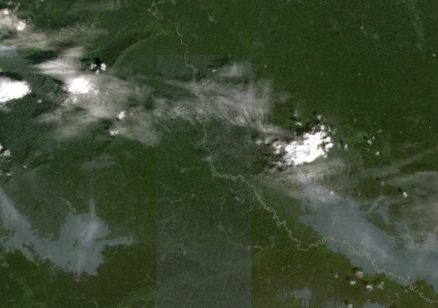
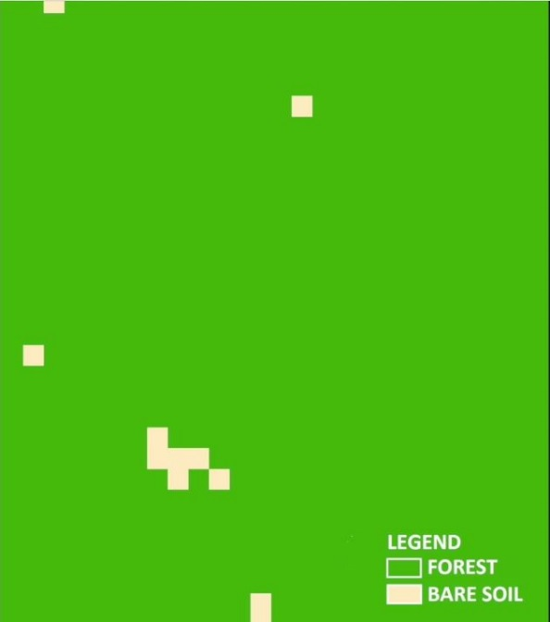
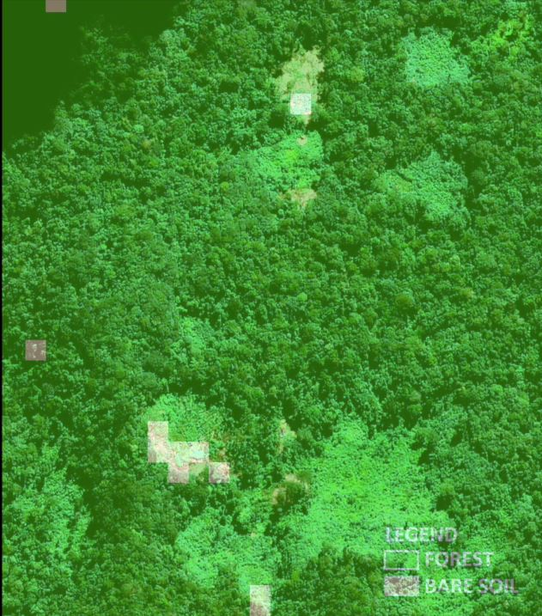
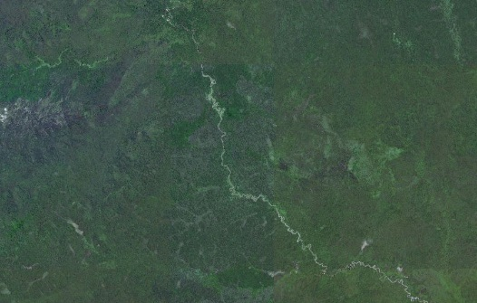
Methodology
Unsupervised K-means Classification
Pixel-by-Pixel Compositing Technique
K-means Unsupervised Classification
Compositing Results
Overlaid on High Resolution Data
Notes:
30 Meter Resolution Landsat 8 surface reflectance products were then used as a cross-checking tool. Landsat 8 surface reflectance scenes covering our study area that were acquired from 2013 to 2015 were combined using a cloud masking pixel-by-pixel compositing technique to derive a cloud free image of the study area. An unsupervised k-means classification was then performed on the cloud free composite to produce a binary “forest Non forest” layer. The “forest non forest layer” was overlaid onto the high resolution imagery, and areas that were classified as “non forest” were manually double checked for villages.

Slide 8
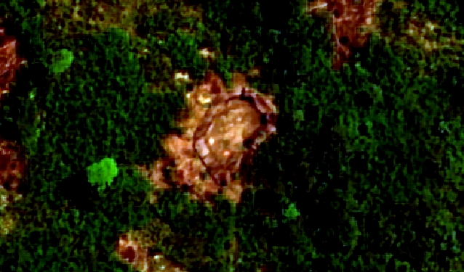
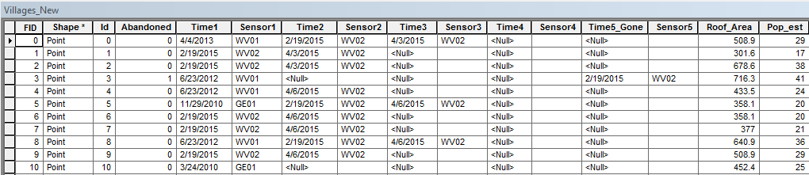
Methodology
Attributes
  Village ID
  Roof area
  Population estimate
  Temporal information
  Sensor information
  Abandoned date
Source: DigitalGlobe
Notes:
When a village was identified, the village were marked with a point vector. Village ID, village diameter, number of huts, temporal history, sensor history, and current population estimates were then recorded in the attribute table.

Slide 9
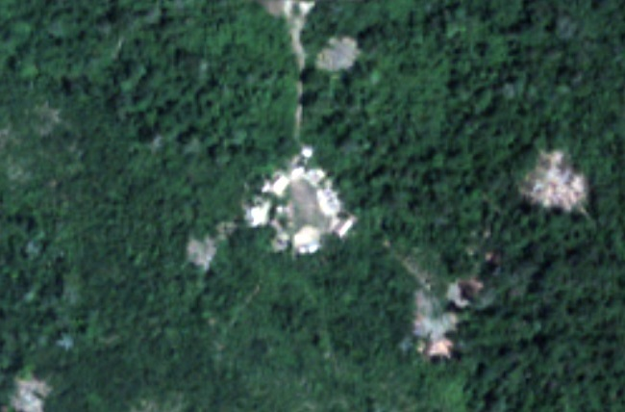
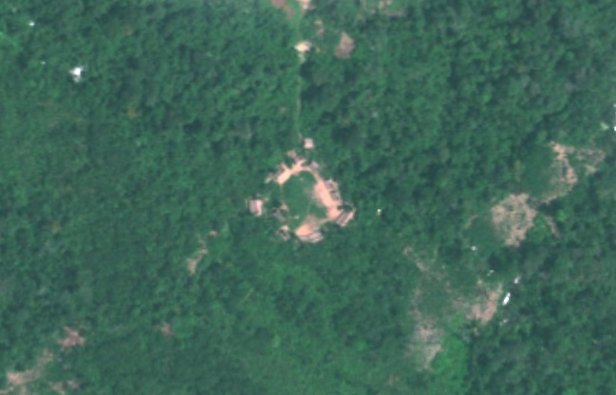
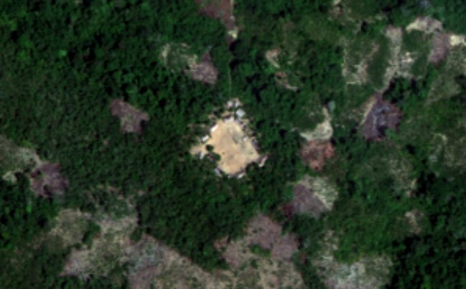
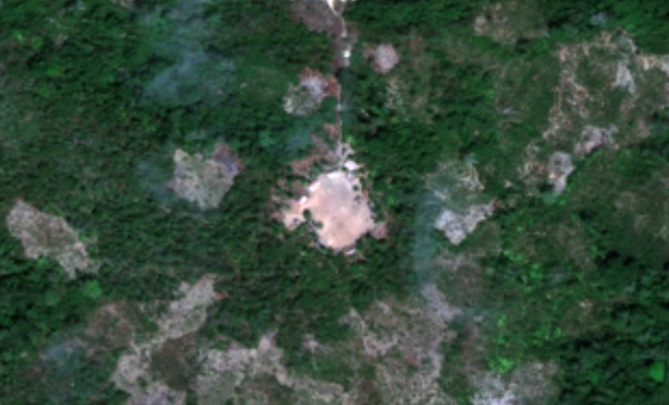
Villages
2009
2010
2014
2015
Notes:
~Villages were confirmed visually using the most recent available high resolution data. In many locations we had more than one high-resolution dataset, spanning a time range as far back as 2007. This allowed us to build temporal attributes for villages going as far back as the could be confirmed with the available data we had. The data was not uniform in its spatial extent or temporal extent, so in some cases the most recent imagery available to us was from 2008, while in others, up to 2015. Also, in a few cases we found villages that appeared in prior imagery but were abandoned in the most recent data; so we also added these to the database to provide to our end user. Other attributes were measured such as the roof area, which allowed us to implement a crude population estimation method that assigns an average amount of living space per person at 17.4m2, based on another study conducted in another region of the Amazon.
****100 m accuracy for location of villages. It was shown in different images from different dates that the village locations are shifted 0-100m

Slide 10
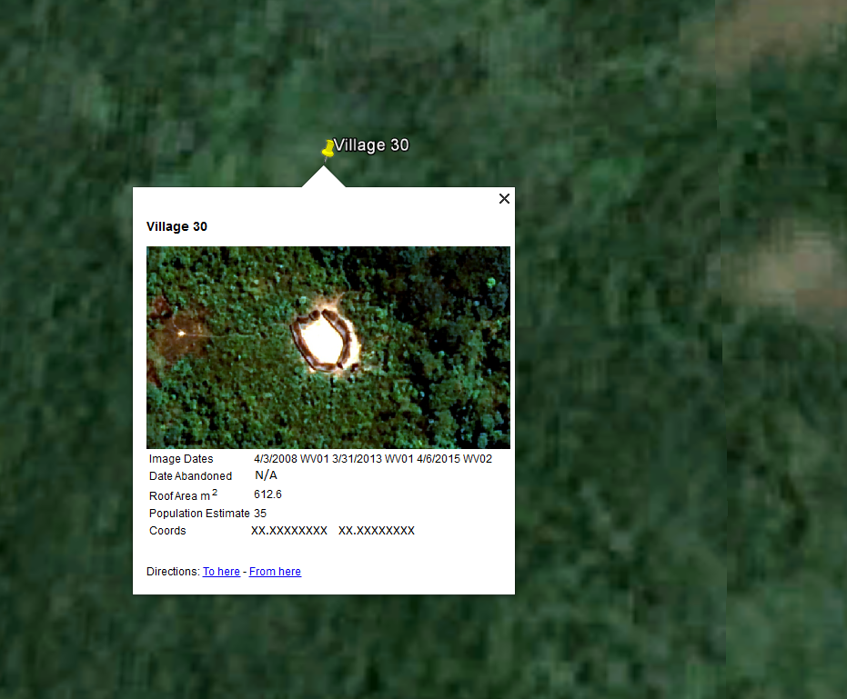
Notes:
Data will be provided to our end user in shapefile, KML, and spreadsheet formats; The KML was chosen in order to provide a useful format that can be utilized by less-experienced GIS users through Google Earth. We demonstrated this to our end user and it was very well received. Each village placemark contains a thumbnail image, dates and sensor where the village was visible, the date when the village appeared abandoned (if applicable), roof area, population estimate, and coordinates. The KML file that can be navigated in Google Earth. This way the end user can easily access the information for each of the villages without needing complicated spatial analysis software such as ArcGIS.

Slide 11
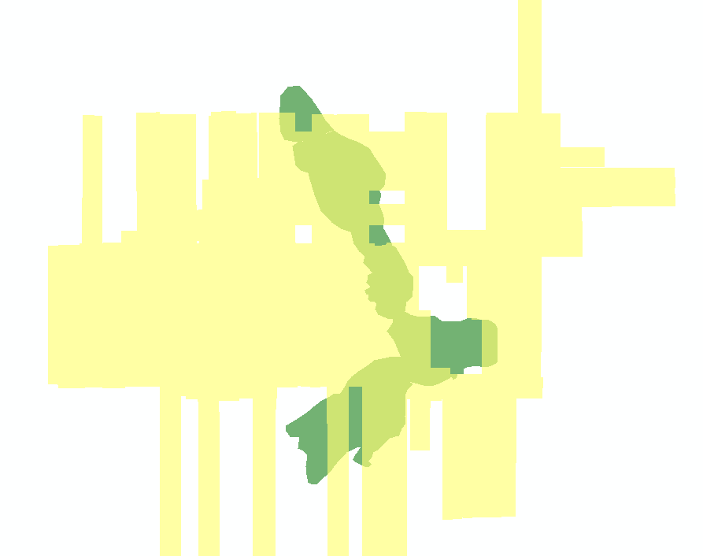
High Resolution Coverage
Notes:
Biases in the village dataset include:
Missing gaps in high resolution data
+-100 yard accuracy due to orthographic corrections
Villages cant be seen because they are under permanent cloud

Slide 12
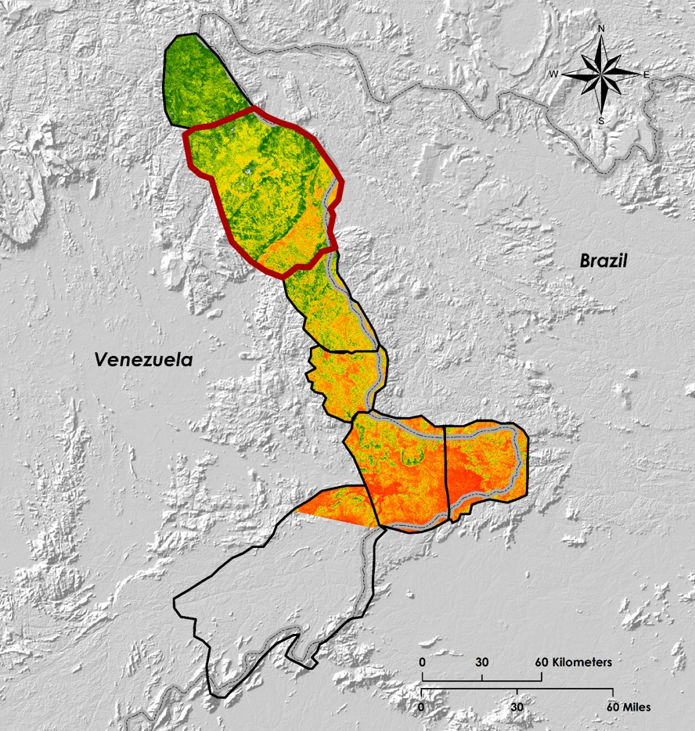
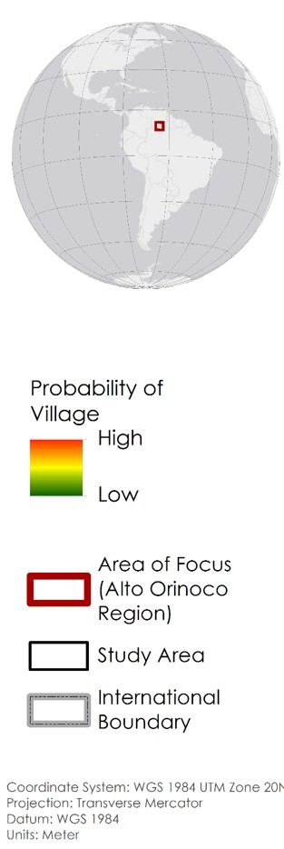
Additional Study at MSFC:
Suitability Model
Inputs
village samples and environmental conditions and locations
Outputs
a probably score for village existence
Notes:
Additional work that was being performed on this project at MSFC was a habitat suitability model. This model took our observations and village locations, as well as other environmental parameters and output a probability of a village being located there. This information will be useful to The Carter Center in their future efforts of eradicating river blindness disease and continuing treatment to these remote villages that have shown to be mobile in nature.

Slide 13
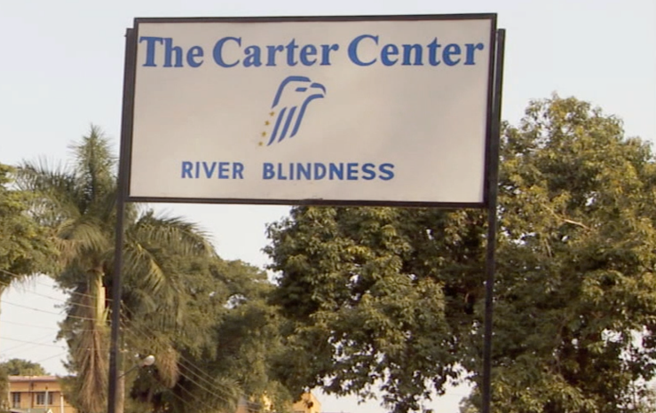
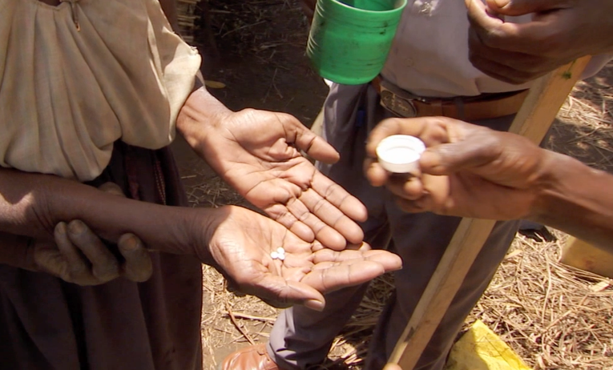
What’s Next?
The Carter Center will send public health workers to the region in the next 2-4 months
Public health workers will provide health education and distribute Mectizan
Source: The Carter Center
Source: The Carter Center
Notes:
In the near future, The Carter Center will be sending medical aid to the Alto Orinoco Municipality of Venezuela. They will be working with the Venezuelan government to deliver treatment to each remote village in order to help eradicate the disease from the area.

Slide 14
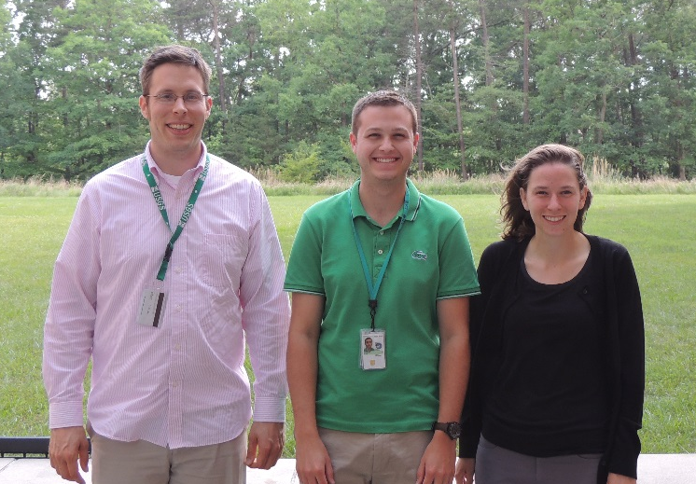
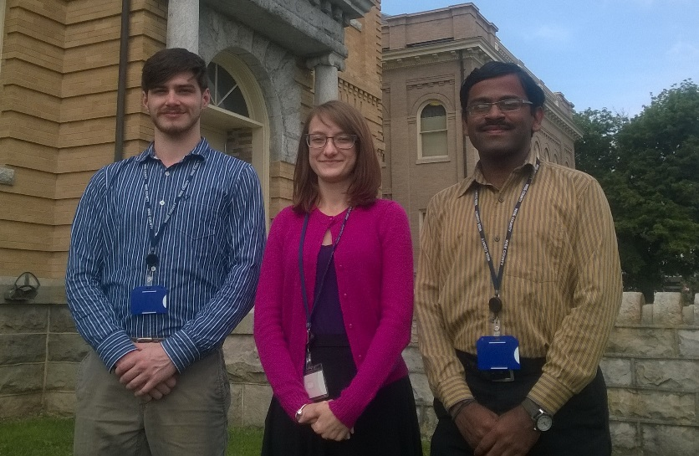
Advisors
Dr. Jim Tucker, GSFC
Dr. John Bolten, GSFC
Partners
Dr. Frank Richards, The Carter Center
Lindsay Rakers, The Carter Center
GSFC: Timothy Larson, Kyle Sowder, Amanda Rumsey
Others
Katie Melocik, GSFC
WC: Zachary Tate, Annabel White, Rajkishan Rajappan
Notes:
Rajkishan Rajappan
Kyle Sowder
Timothy Larson
Zachary Tate
Annabel White
Sara Amirazodi

