Slide 1
South Africa Ecological Forecasting
Understanding Landscape Changes in Elephant Habitat within the Kruger National Park through NASA Earth Observing Systems
Andrea Presotto (University of Georgia), Ashley Dupont (University of Georgia), Christine Brady (University of Georgia), and Kirstin Valdes (University of Georgia)

Slide 2
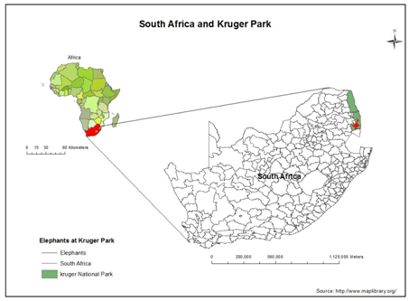
Study Area
Kruger National Park
Located in northeast South Africa (Mpumalanga and Limpopo)
Park Area: 8,000 mi²/ 20, 720 km²
Altitude: 200 m - 840 m
Rainfall: 450 - 500 mm
One of the world’s largest wildlife sanctuaries
13 major vegetation types
850 animal species
Figure 1. South Africa, Kruger National Park, and study area.

Slide 3
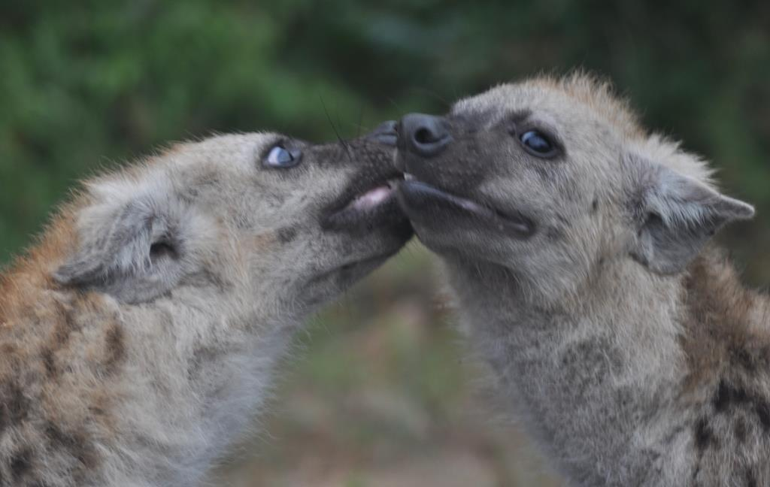
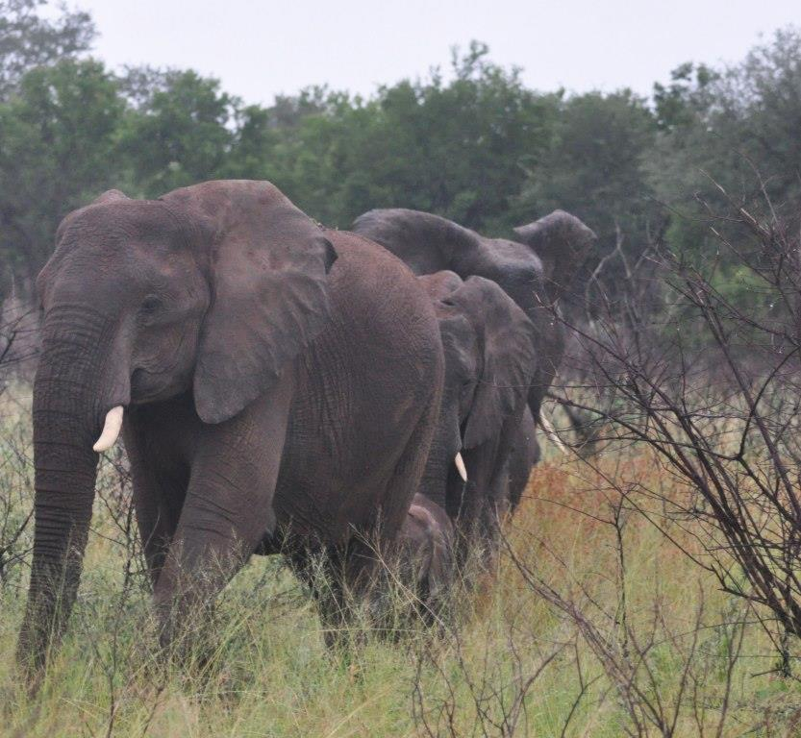
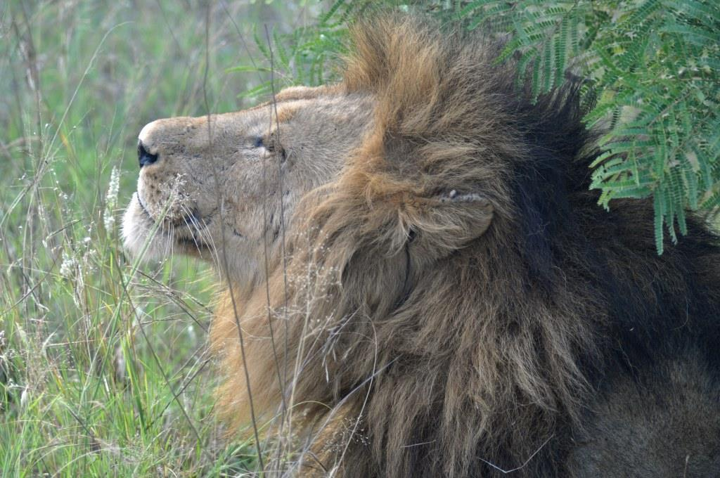
Community Concerns
Kruger National Park is currently experiencing landscape change from woodland to grassland habitat
As suitable vegetation grows scarce, park rangers have observed elephants stripping bark and branches from trees to feed
Male elephants, or bulls, have been observed attacking and pushing over trees, most of which are unable to recover
Both elephant foraging activities and aggressive behavior may be contributing to the landscape change
Photos by Andrea Presotto

Slide 4
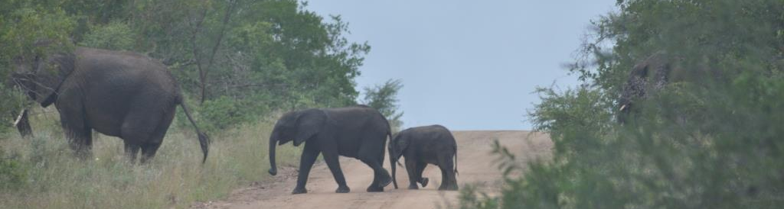
Objectives
Develop time series maps to provide end user with rate of woodland degradation
Create habitat sustainability model to illustrate current areas of elephant habitat and identification of potential areas for future use
Compare results of pixel-based and object-based classification to improve understanding of advantages and disadvantages of each method
Photo by Andrea Presotto

Slide 5
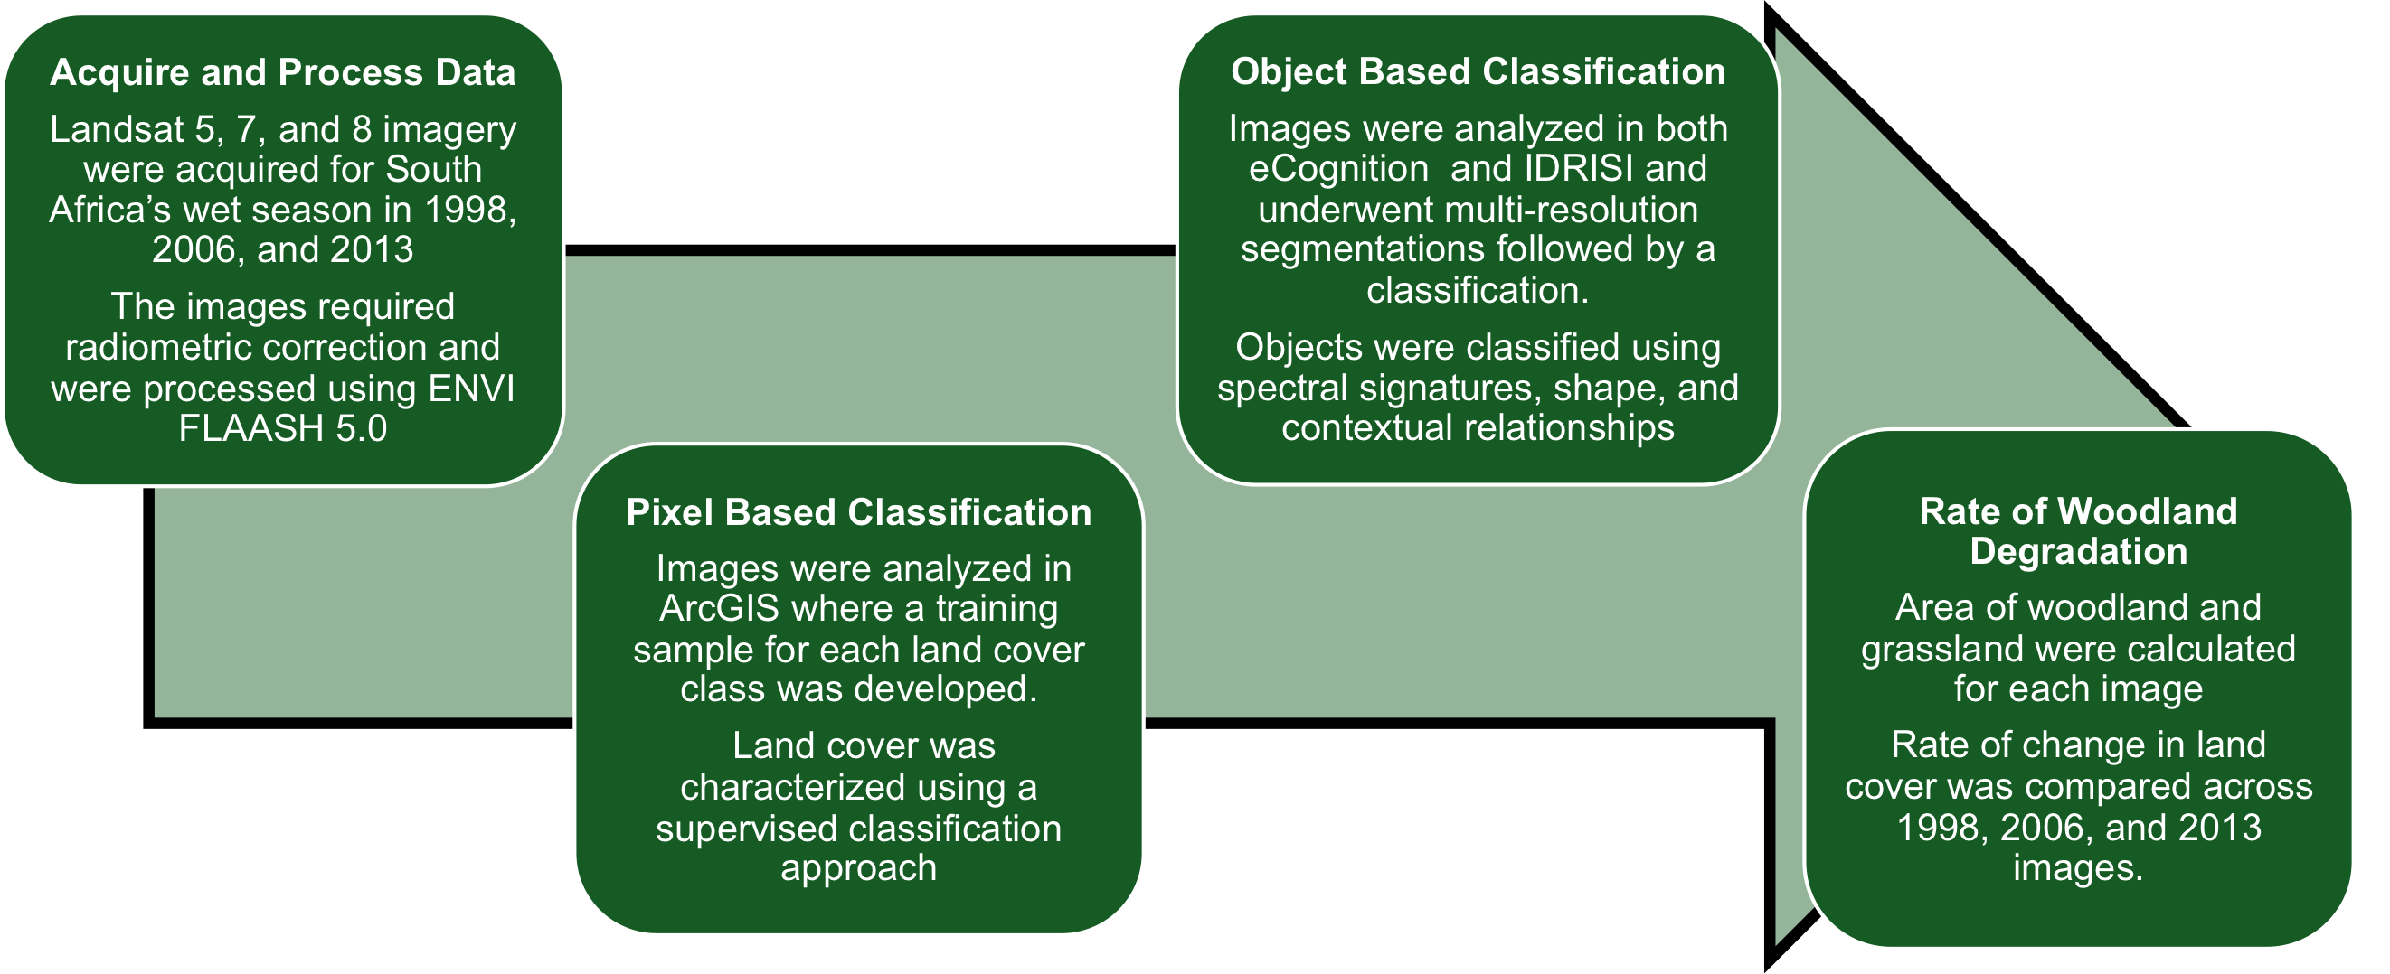
Methods
Figure 2. Methodology

Slide 6
Methods: Classification
Land Cover Class | Color | Definition
Grassland |  | Identified by lower and taller grass
Mixed Vegetation |  | Identified shrubs and sparse trees smaller than 10 m
Woodland |  | Identified by tree density and with trees taller or equal 10 m
Bare soil |  | Identified by absence of foliage
Water |  | Consists of perennial rivers, streams, and lakes.
Burn Scar |  | Consists of landscape that has been burned via controlled fire
Cloud |  | Consists of areas of cloud cover
Shadow |  | Consists of areas blocked by cloud cover
Methods

Slide 7
Results: Pixel-based Classification
Pixel based classification depicts a steady increase in bare soil and mixed vegetation from 1998 to 2013 (classification results, bottom right).
From 2006-2013, there was an increase in woodland habitat.
Figure 3. Pixel Based Classification results depicting overall change from woodland to grassland and mixed vegetation from 1998 to 2013. Analysis run in ArcGIS.

Slide 8
Results: Pixel-based Classification
 | Percentage of Study Area
Land Cover | 1998 | 2006 | 2013
Woodland | 51.76% | 29.14% | 41.31%
Mixed Vegetation | 17.39% | 20.59% | 39.74%
Grassland | 21.47% | 42.64% | 3.06%
Bare Soil | 2.89% | 6.20% | 12.81%
Water | 0.37% | 0.28% | 0.60%
Burn Scar | N/A | 1.16% | 2.48%
Cloud/Shadow | 6.12% | N/A | N/A
Figure 4. Pixel-based classification results depicting percentage of land cover change from 1998 to 2013. Marked increase in mixed vegetation and bare soil.

Slide 9
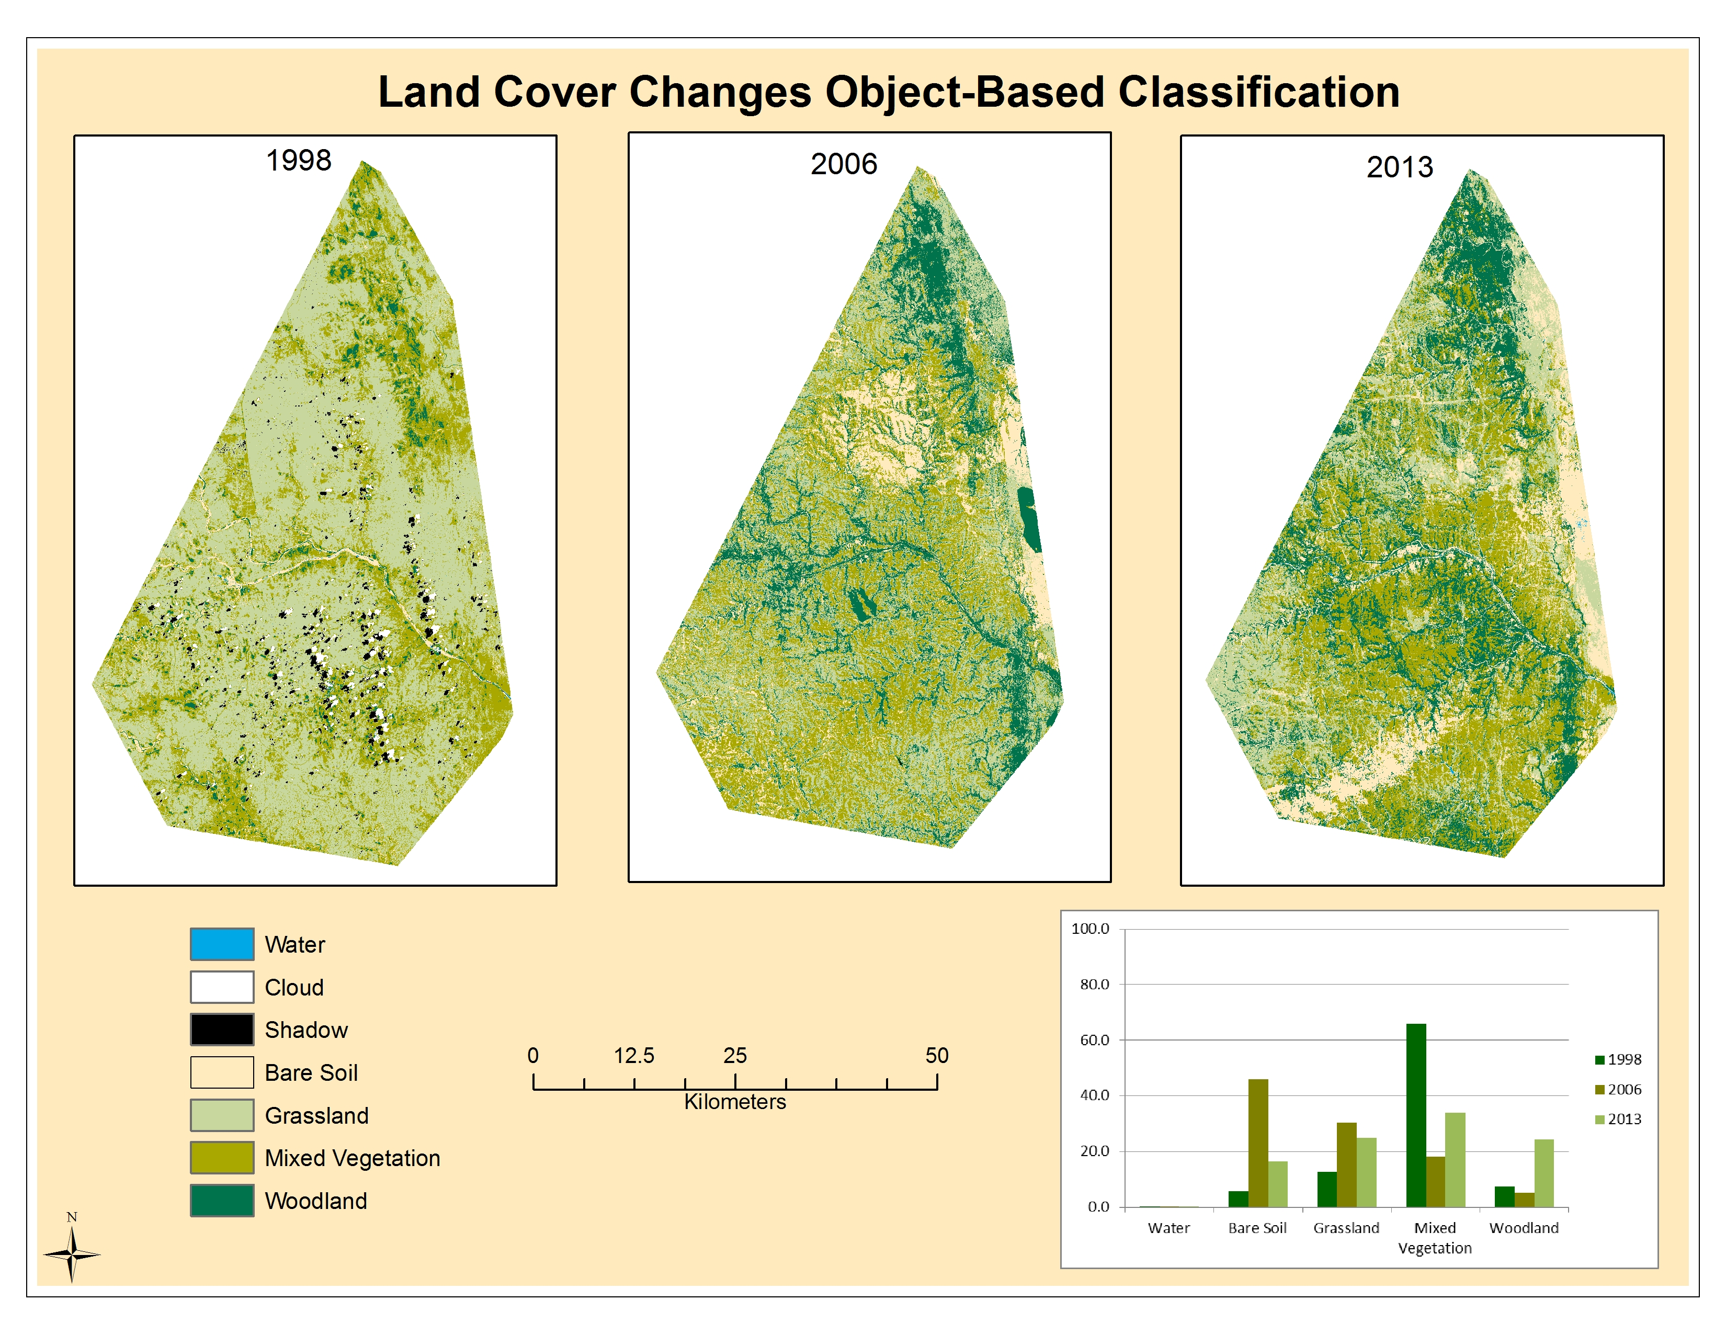
Results: Object-based Classification
Due to poor quality of Landsat 5 images, grassland was over classified in 1998 leading to a poor object based classification.
Trends in grassland habitat show a steady increase, with an over classification of this class in 2006.
Other land cover classes tended to be erratic and showed no trend over the 16-year study period.
Figure 5. Object-based classification results depicting increases in woodland habitat from 1998 to 2013. Analysis run in IDRISI.

Slide 10
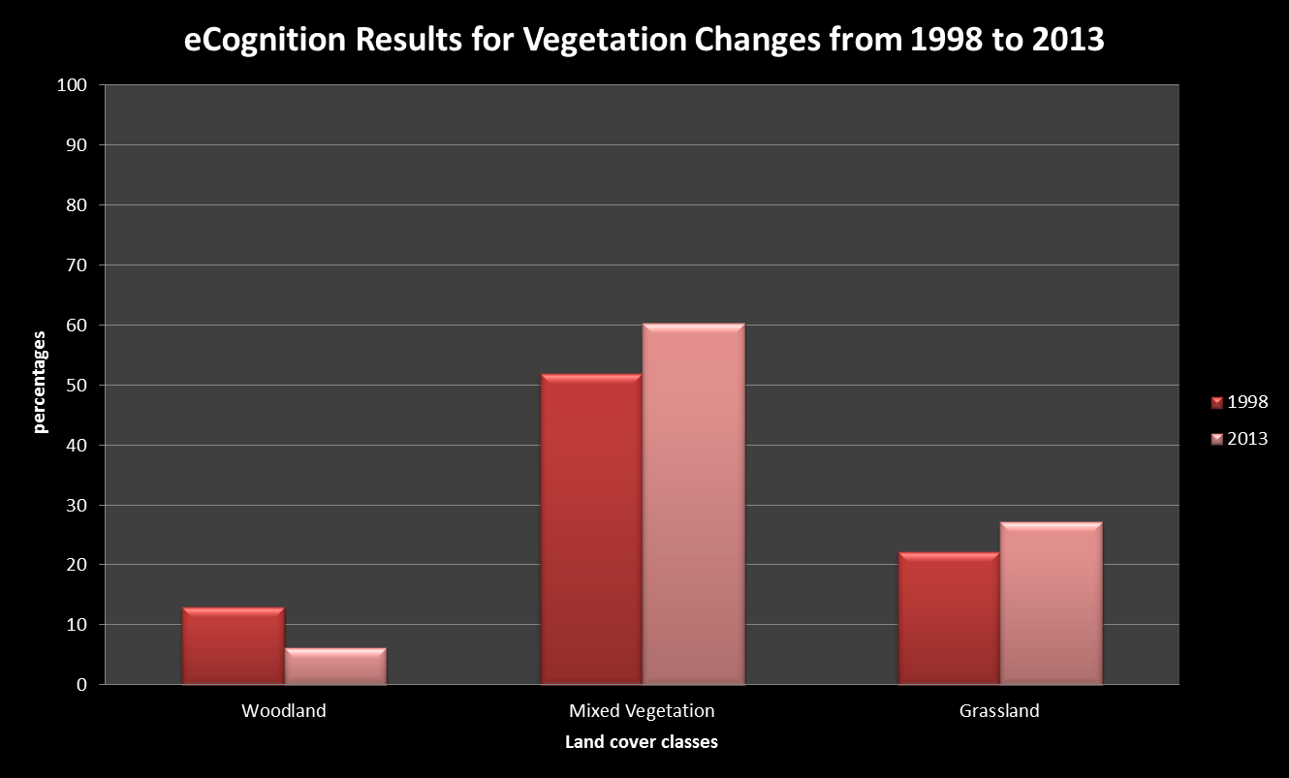
Results: Object-based Classification
1998
2013
Figure 6. Object based classification results using eCognition software shows a decrease in woodland and increases in mixed and grassland vegetation from 1998-2013. Left: Classified Landsat 5 and 8 images. Upper: eCognition statistical analysis showing increased land cover percentages of mixed and grassland vegetation.

Slide 11
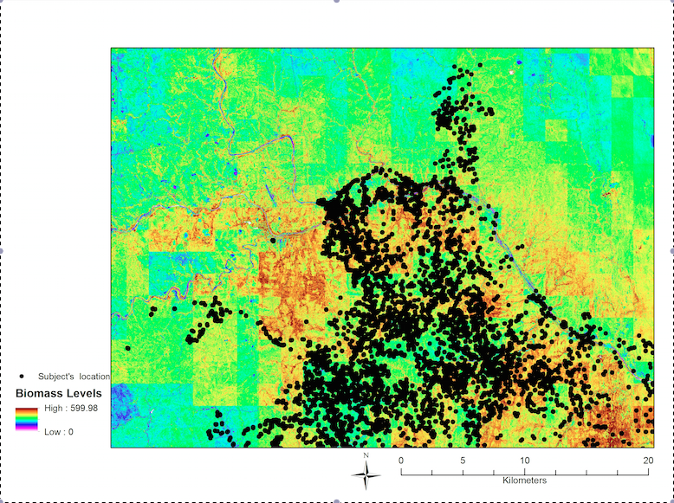
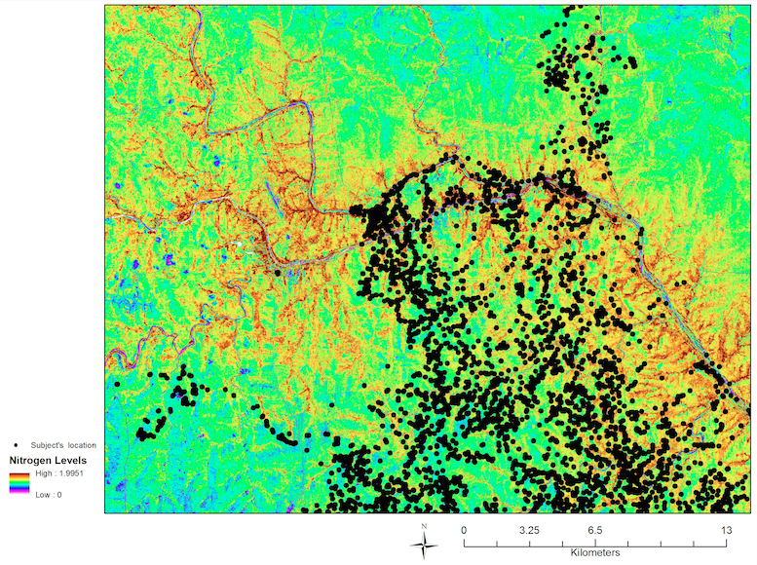
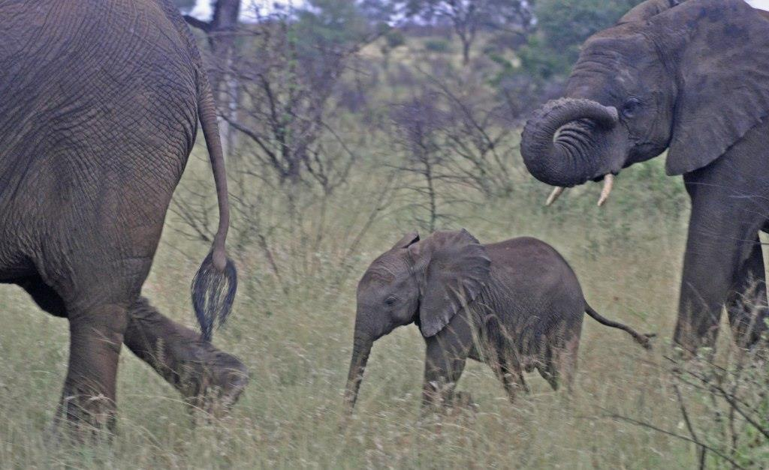
Results: Habitat Suitability Model
Biomass Levels (2010) over Elephant Study Area
Nitrogen Levels (2010) over Elephant Study Area
Figure 7. Biomass level map showing areas of high and low biomass within the study area.
Figure 8. Nitrogen level map showing areas of high and low nitrogen within the study area.
Photo by Andrea Presotto

Slide 12
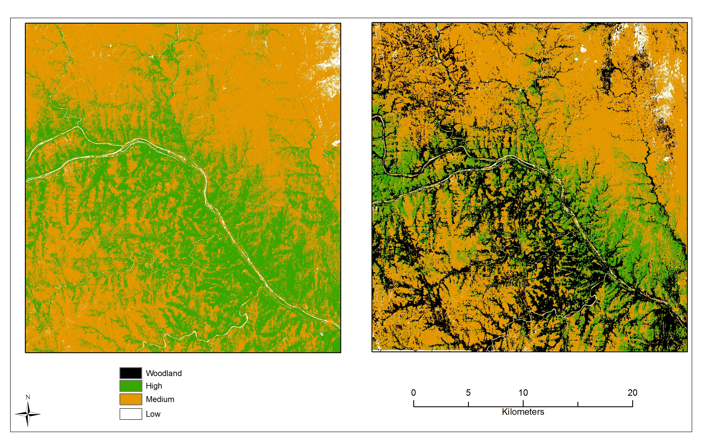
Results: Habitat Suitability Model
Figure 9. Combined GIS model (nitrogen and biomass) and 2013 object based classification. Model shows that overlap between woodland habitats and those with biomass fall in the same area.

Slide 13
Acknowledgements
Dr. Marguerite Madden, University of Georgia
Dr. Richard Fayrer-Hosken, University of Georgia
Steve Padgett-Vasquez, University of Georgia
Caren Remillard, University of Georgia

