Slide 1
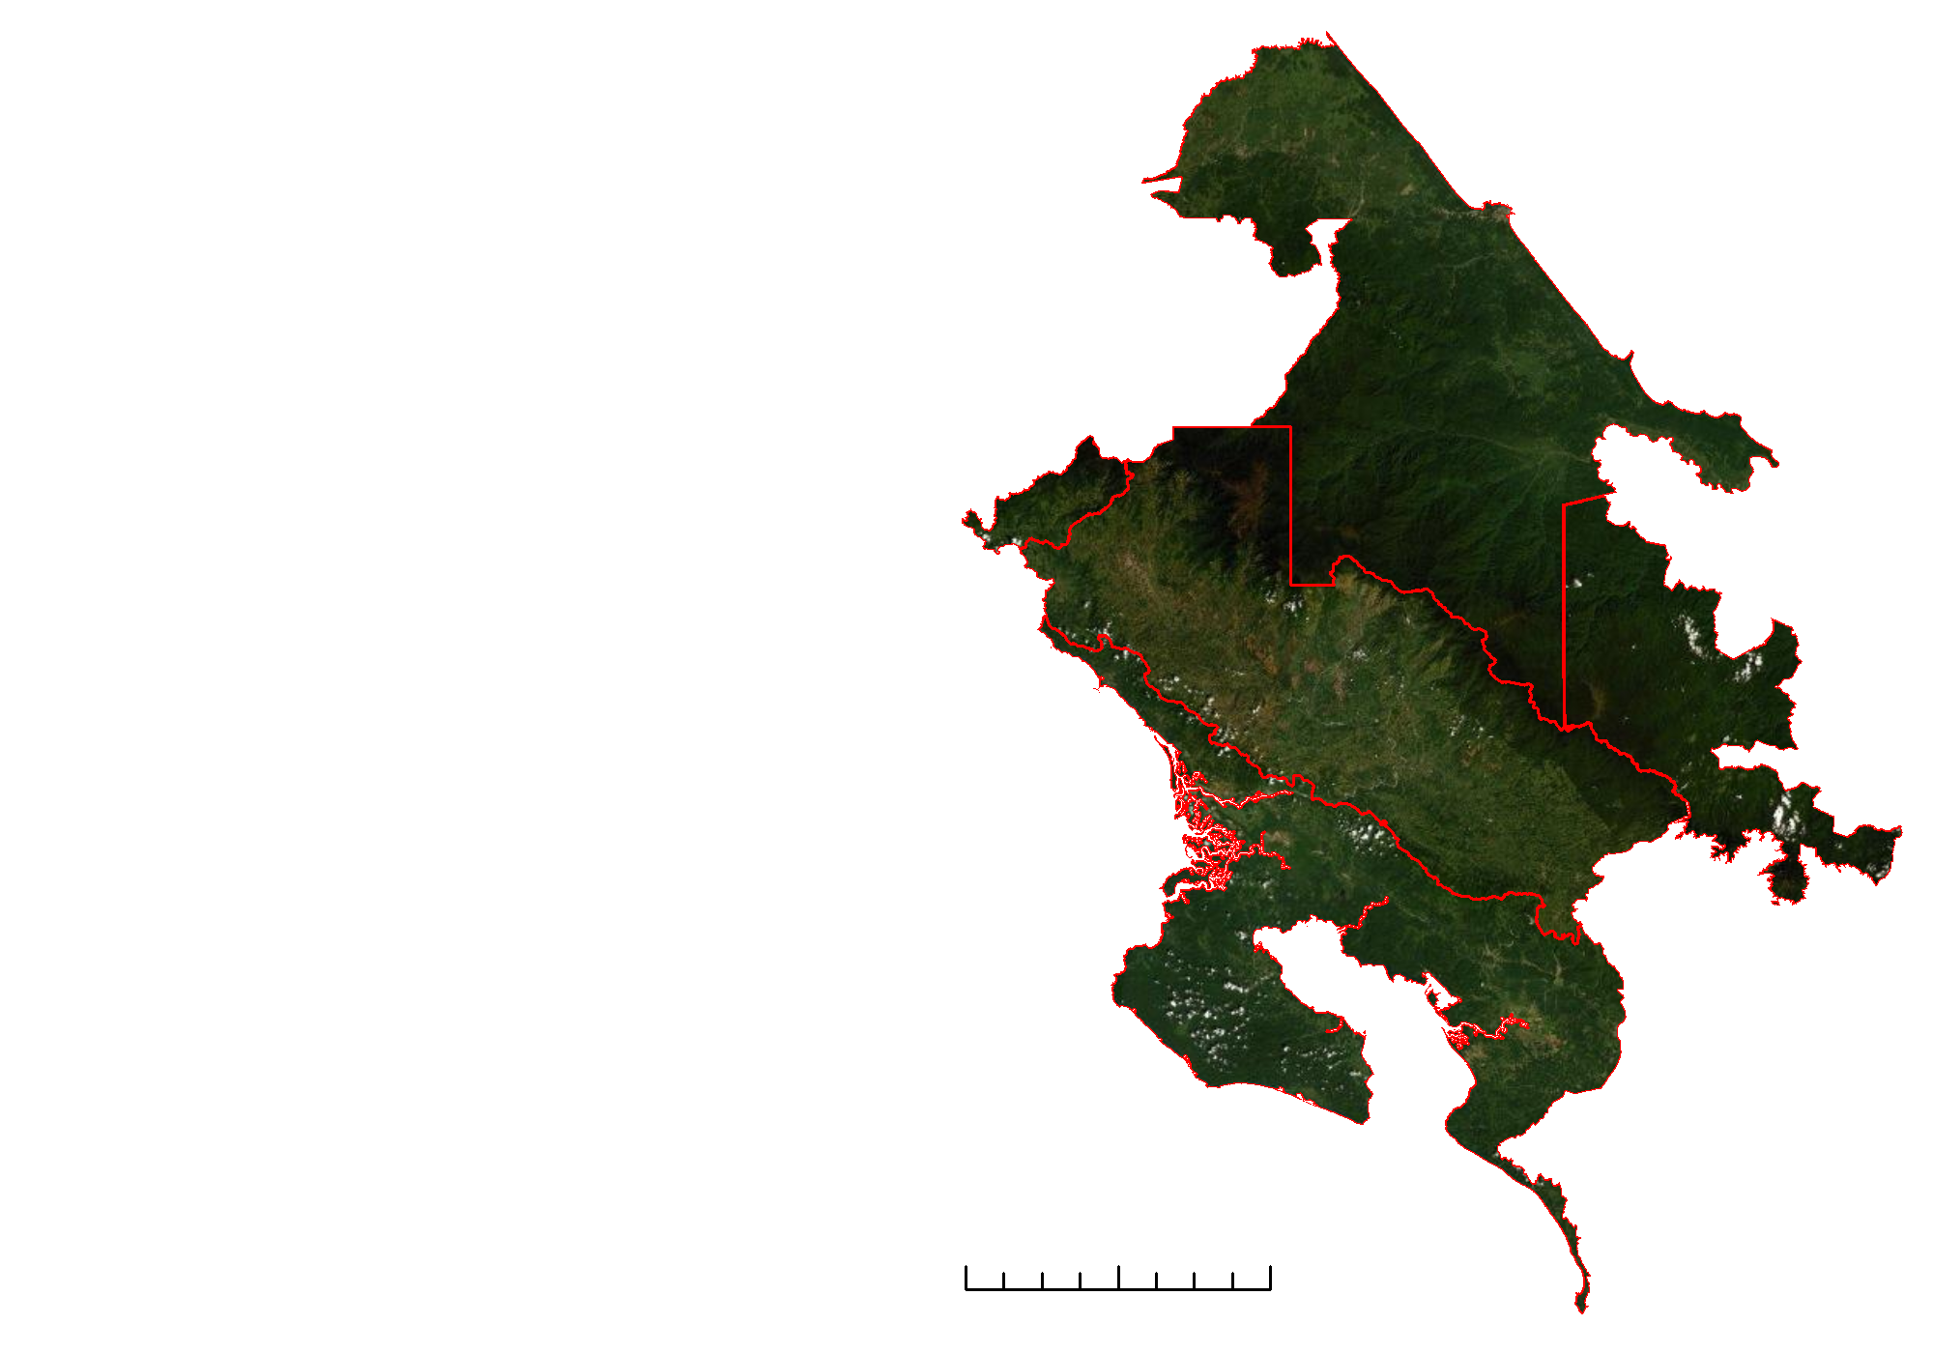
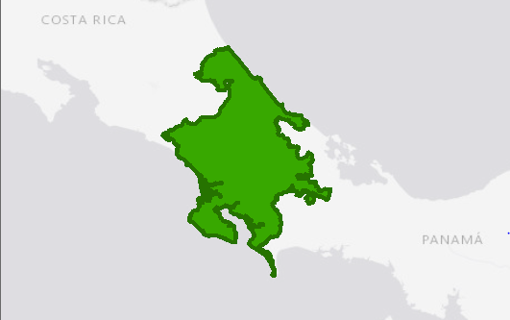
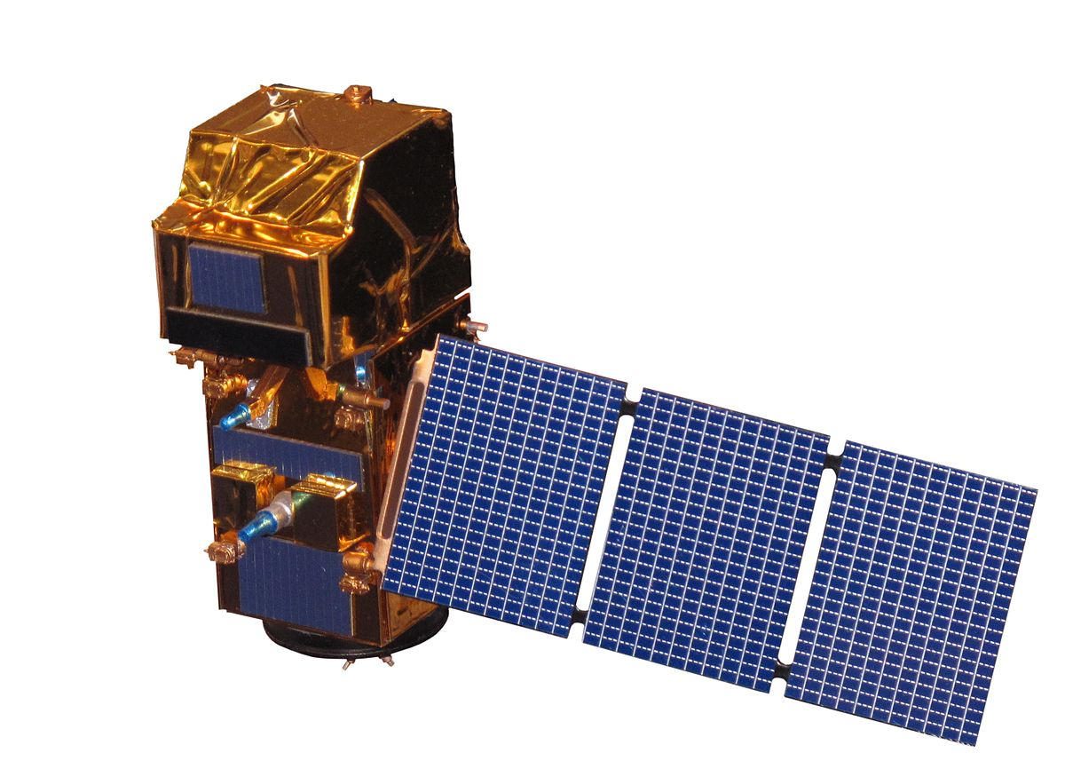
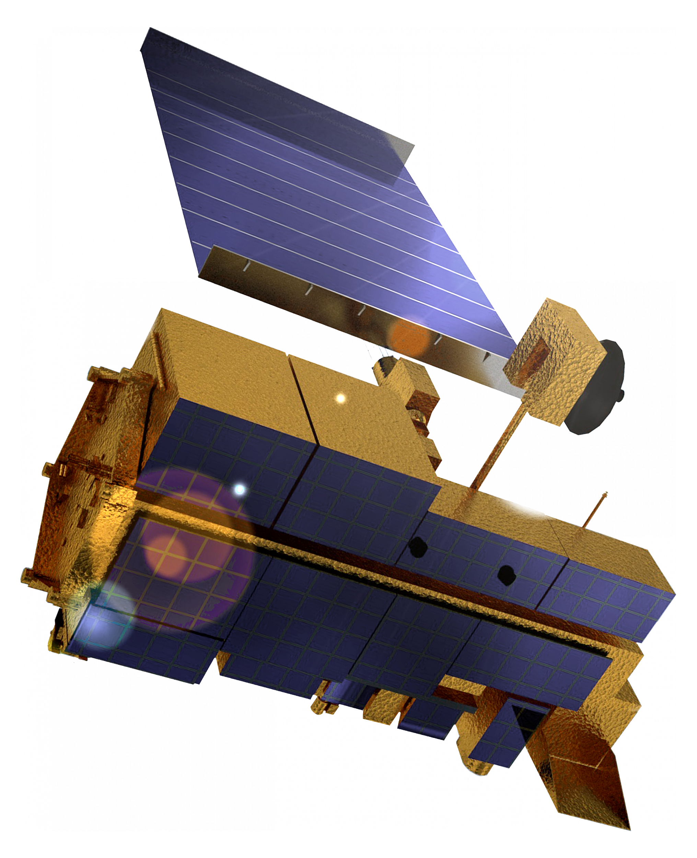
Identifying Current and Future Areas of Environmental Concern in La Amistad International Park to Inform Resource Management
Abstract
Study Area
Costa Rica & Panama Ecological Forecasting II
Seven percent of all scientifically known life forms lie within the 202,230 square miles of Central America, making this area ecologically unique and increasing the need for environmental management. The Mesoamerican Biological Corridor forms a conservation partnership throughout Central America to establish a forested corridor of over 600 protected areas. Although conservation programs exist, deforestation still afflicts the area, putting strain on these diverse ecosystems. La Amistad International Park in southern Costa Rica and northern Panama in particular faces conflicting land use changes. Expanding agricultural development and urbanization, combined with concern over indigenous land rights, have raised questions about the implementation of sustainability goals and communication strategies within the region. To help address these issues, the NASA DEVELOP Costa Rica & Panama Ecological Forecasting II team continued a partnership with the Ministry of Environment and Energy in Costa Rica and the National Environmental Authority in Panama. The team created a Land Use Conflict Identification Strategy (LUCIS) model based on land cover maps for 2019 and 2029 that were created in term I using imagery from Landsat 8 Operational Land Imager (OLI). With partner input, the team applied weights to different objectives and combined suitability maps to identify areas of potential biodiversity conflict. Additionally, the team created a Short-term Forest Change (SFTC) Tool using Terra Moderate Resolution Imaging Spectroradiometer, Landsat 8 OLI, and Sentinel-2 Multispectral Instrument to help the partners identify areas of immediate, major forest changes. The LUCIS model indicated higher agricultural growth when compared to the ecological category.
N
La Amistad Caribe
La Amistad Panama
Osa
La Amistad Pacifico
La Amistad Panama
Study Area
Osa
Study Area boundaries
0
25
50
Kilometers
Objectives
Results
Use NASA Earth observations to identify and forecast potential conflict areas in land conservation
Produce Land Use Conflict Identification Strategy (LUCIS) maps that will provide partners with information on areas of immediate and future biodiversity concern
Apply methods from Hansen Global Forest Change and past DEVELOP projects to create a Short-term Forest Change (SFTC) Tool that will allow partners to monitor major forest changes in the corridor
N
N
Methodology
Results
Original Data
Processing & Analysis
High
High
Roads
Project &
Clip
Raster data
Reclassify
Suitability maps per objective
Medium
Medium
Forest cover
Low
Low
Pastures
0
20
40
80
kilometers
0
20
40
80
kilometers
Protected areas
Weighted Overlay
2019 Conflict Map for Costa Rica
2029 Conflict Map for Costa Rica
Palm plantation
Vector data
Suitability map per goal
Conclusions
Pineapple plantation
In Costa Rica’s Osa and Caribbean regions, 19.5% of the study area is high conflict and 52.4% is low conflict for the year 2019.
For the 2029 conflict map of Costa Rica, 12% of the study area is of high conflict, and less than 1% of the study area is low conflict.
The central and northern regions of the Costa Rican study area have the greatest conflict between ecological and agricultural suitability in 2029.
Flood areas
Euclidean Distance
Raster Calculator
Conflict maps
Urban areas
Earth Observations
Project Partners
Landsat 8 OLI
30 m resolution
16-day cycle
Ministry of Environment and Energy, National Center for Geoenvironmental Information (Costa Rica)
National Environmental Authority (Panama)
Acknowledgements
Sentinel-2 MSI
10-60 m resolution
5-day cycle
Terra MODIS
250 m resolution
1-day cycle
Rafael Monge Vargas | Ministry of Environment and Energy, Costa Rica
Roney Samaniego | National Environmental Authority of Panama
Dr. Marguerite Madden | University of Georgia Center for Geospatial Research
Dr. Sergio Bernardes | University of Georgia Center for Geospatial Research
Shelby Ingram | NASA DEVELOP Georgia – Athens Node
Dr. Steve Padgett-Vasquez | NASA DEVELOP National Program
Molly Azami |NASA DEVELOP Costa Rica & Panama Ecological Forecasting
Kara Bisonette |NASA DEVELOP Costa Rica & Panama Ecological Forecasting
Masha Khoadee |NASA DEVELOP Costa Rica & Panama Ecological Forecasting
Zachary Leslie |NASA DEVELOP Costa Rica & Panama Ecological Forecasting
Ellen Delgado | Universidad Nacional Toribio Rodrigues de Mendoza de Amazonas
Austin Stone | University of Georgia
This material contains modified Copernicus Sentinel data (2019) processed by ESA.
.
.
Team Members
Kate Markham
Project Lead
Teodora Mitroi
Sharifa Karwandyar
Eder Hernandez
Georgia – Athens

