Slide 1
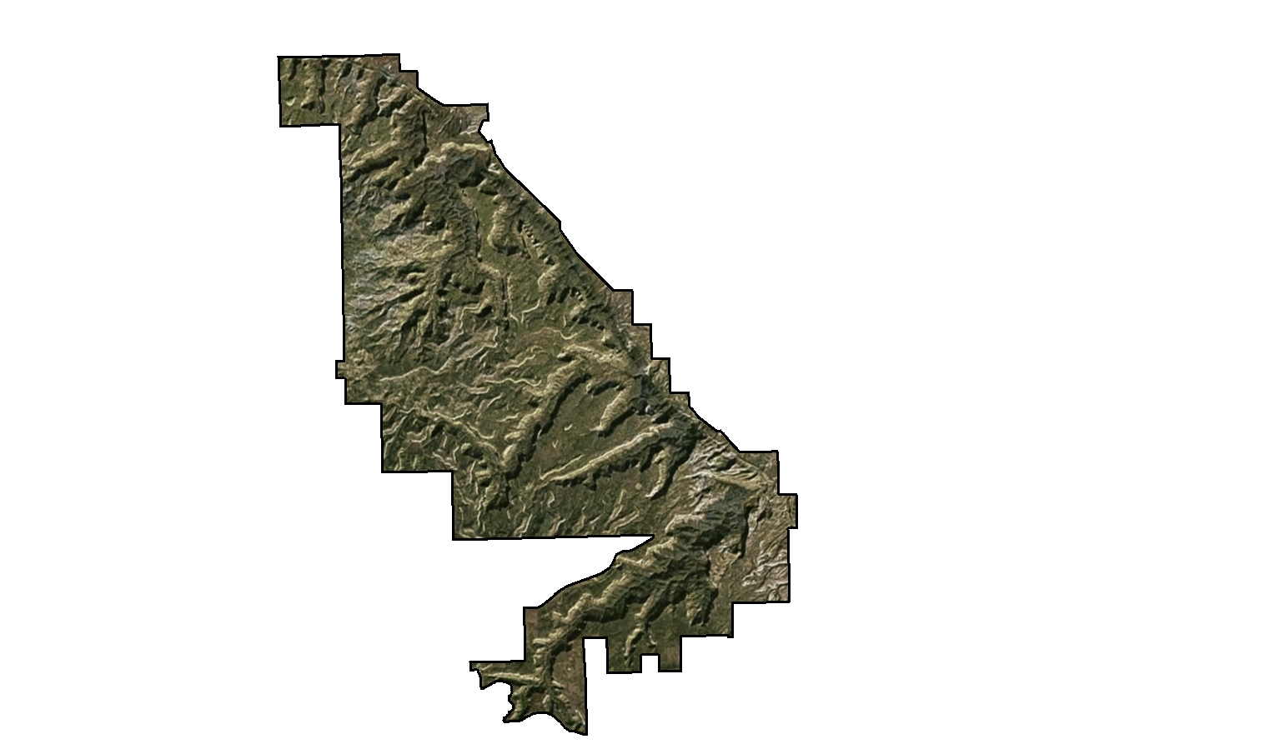
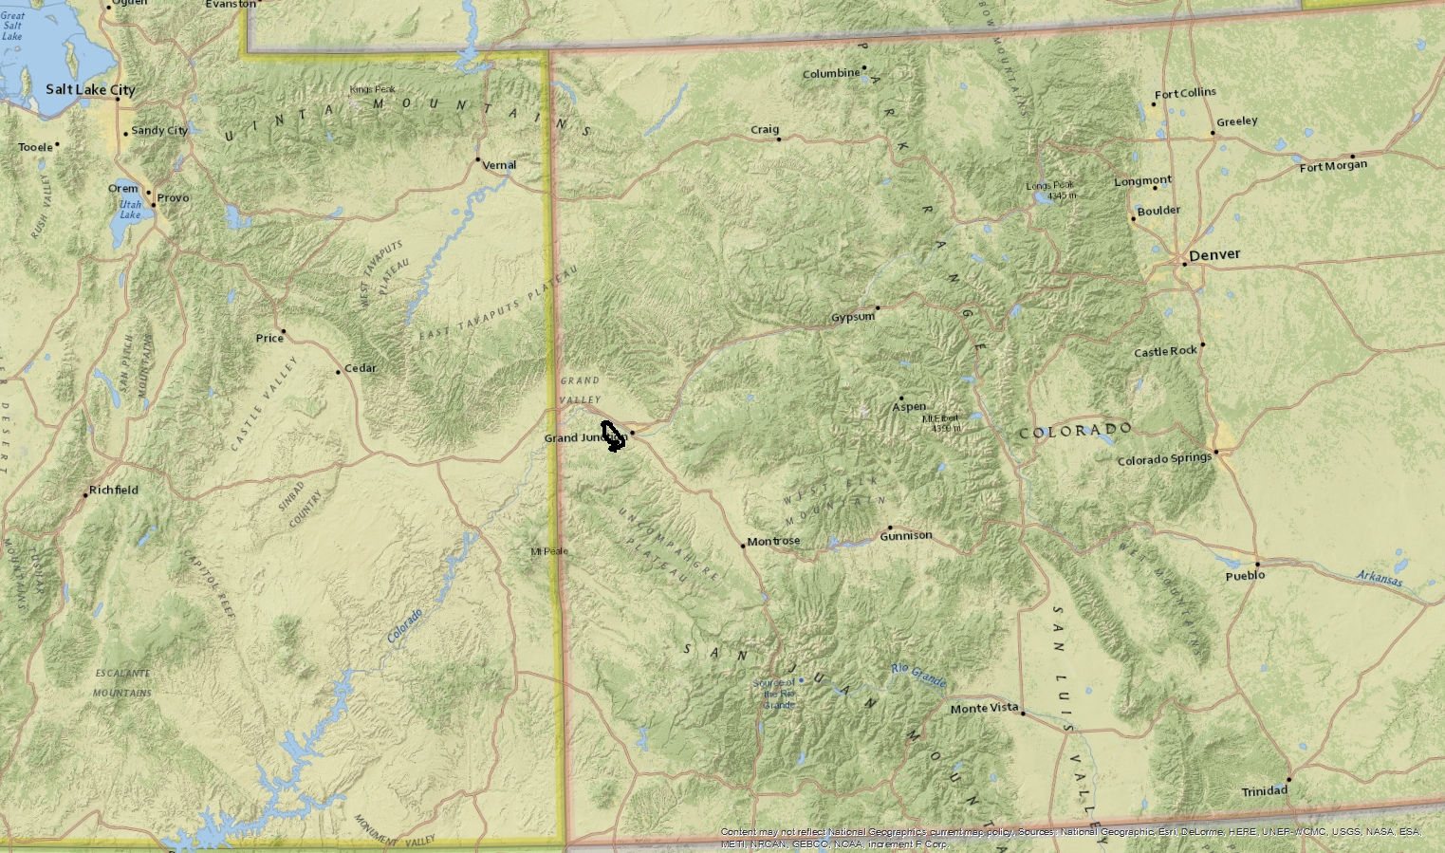

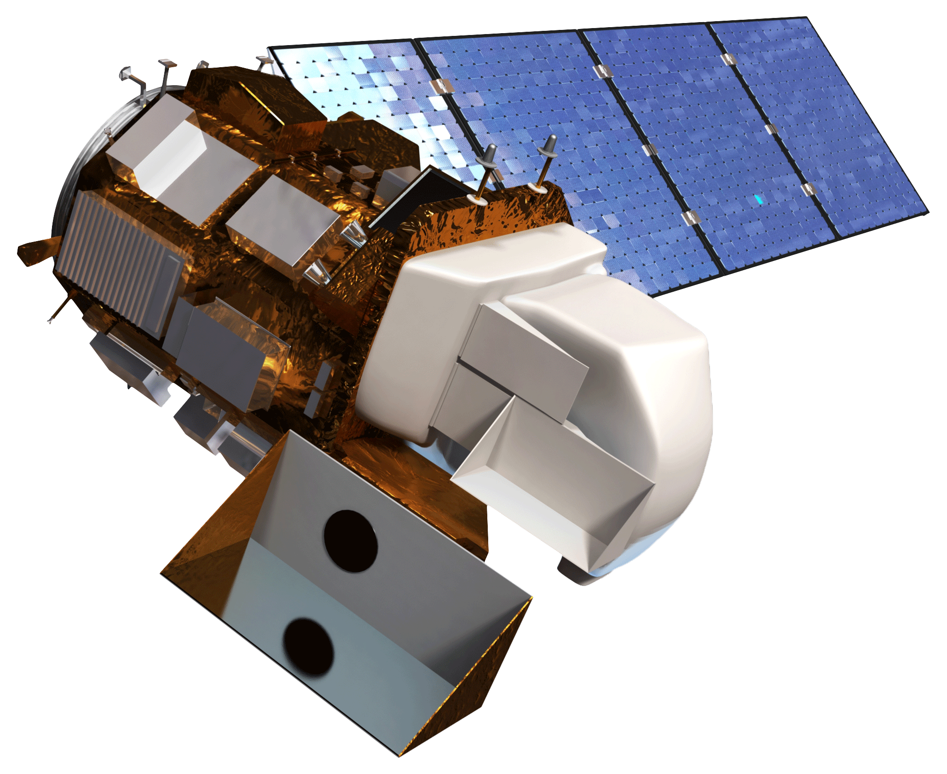


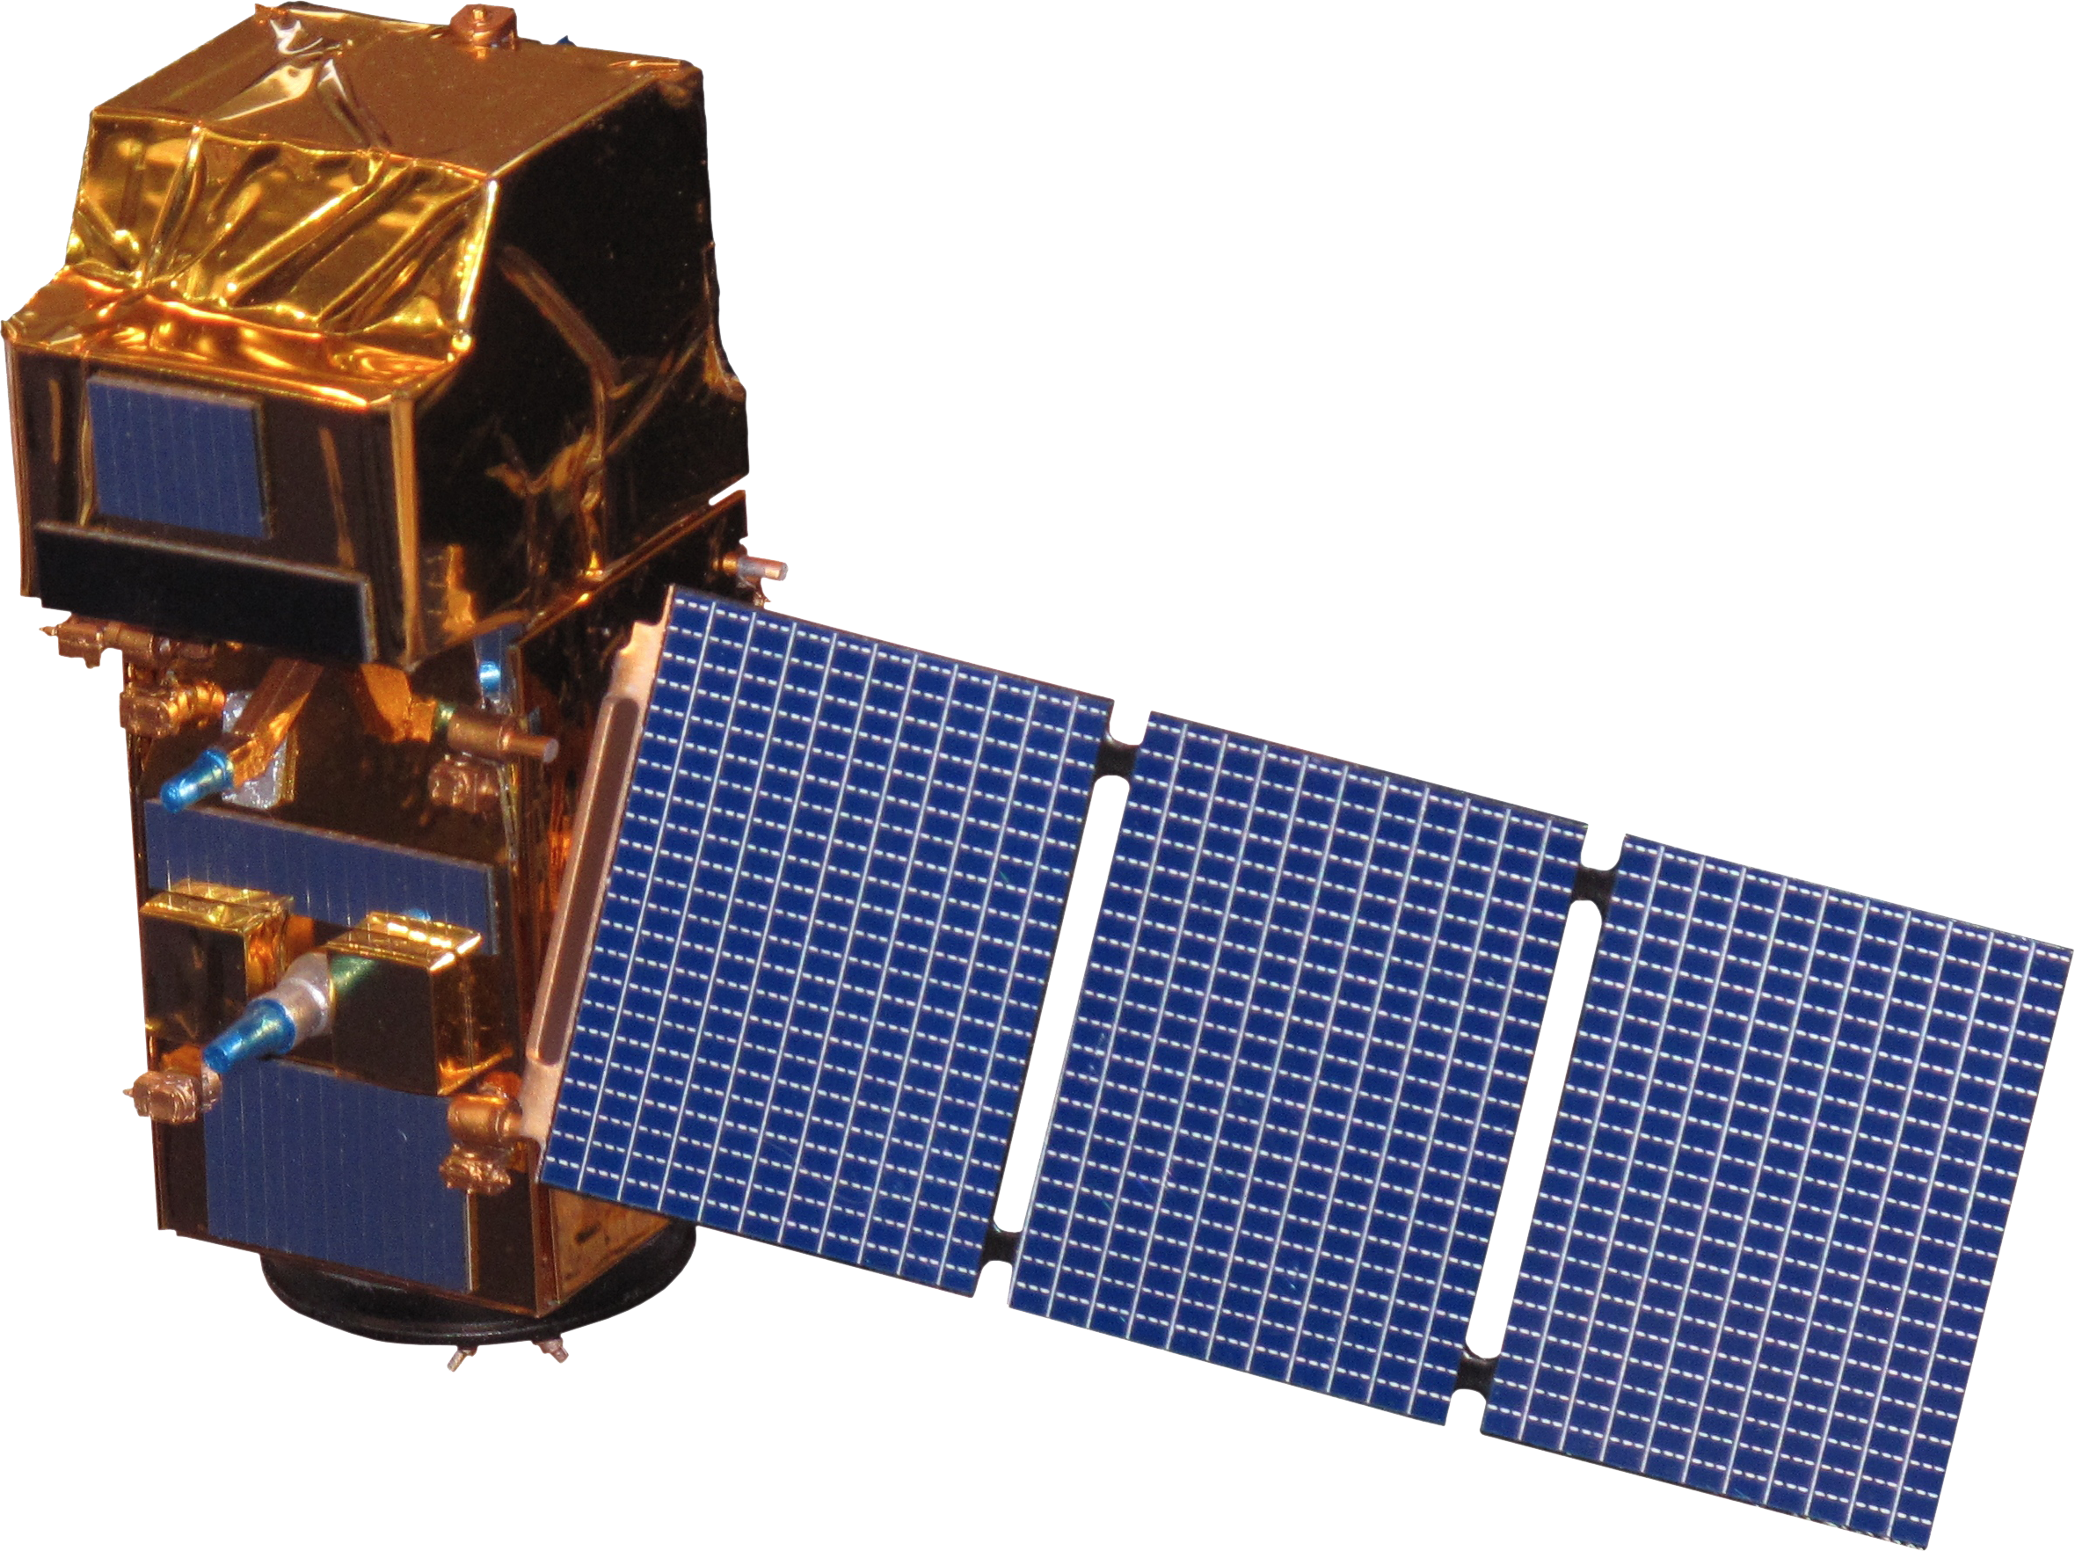

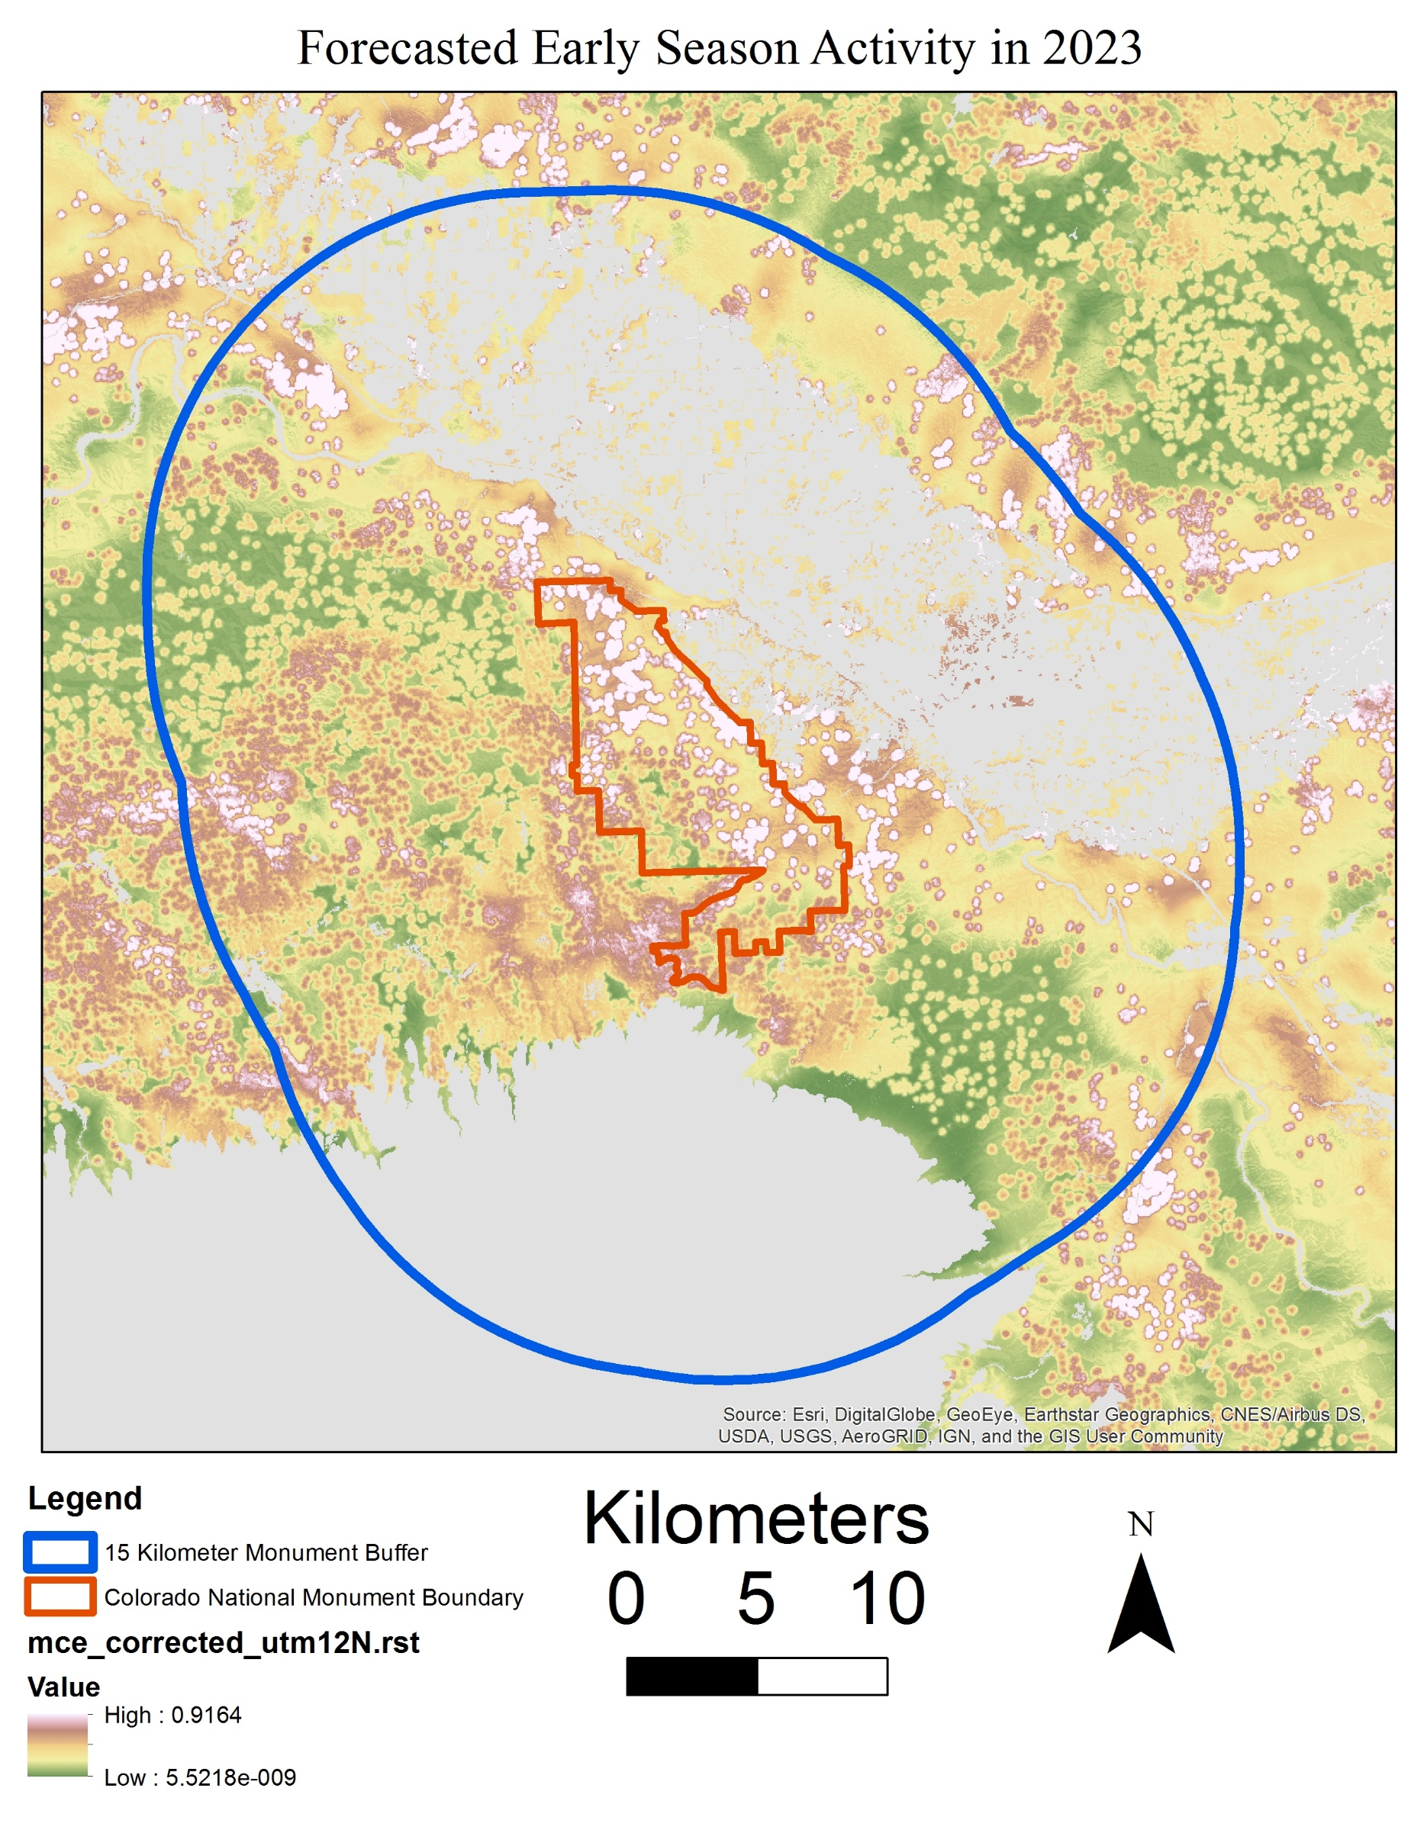
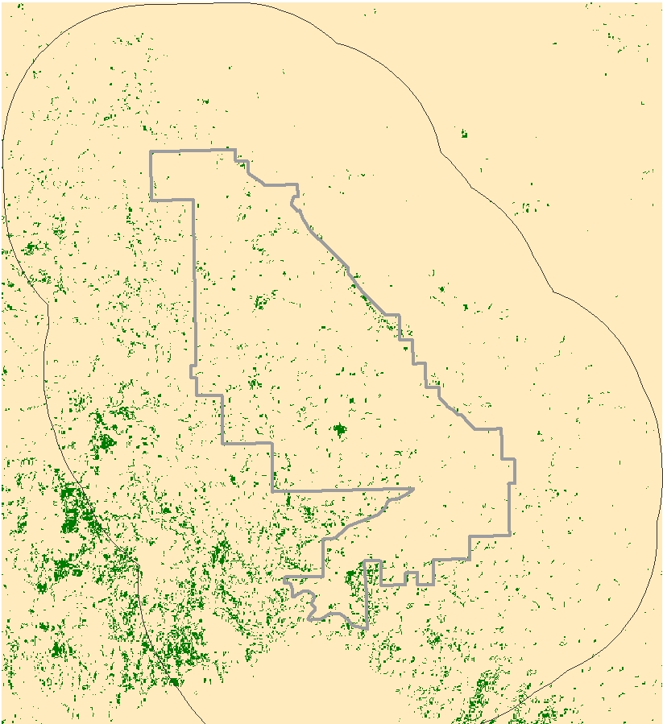
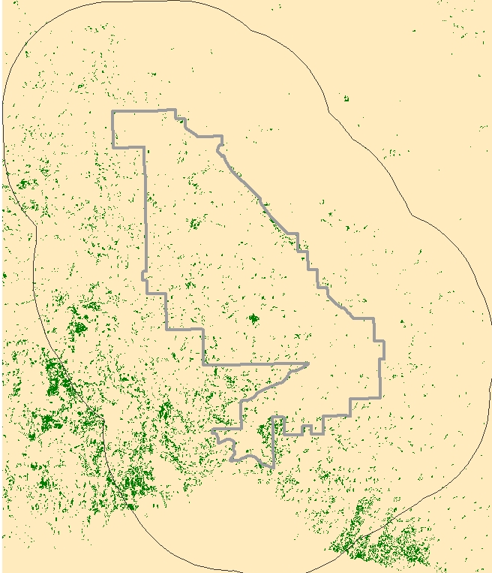
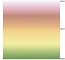
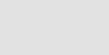





Identifying Early Season Invasives for Monitoring and Management in the Colorado National Monument
Abstract
Study Area
Bromus tectorum, otherwise known as cheatgrass, is an invasive grass from Europe that has increased its presence all over the world by out-competing native grasses due to its adaptability and lifecycle. During the end of its life cycle, typically occurring in the summer, its flammable remains often create the conditions for forest fires to start early in the season. This alters native wildlife’s previous response to wildfires and increases the overall frequency of fires. As a result, cheatgrass often disrupts the necessary recovery time for native wildlife after habitat destruction. This NASA DEVELOP project utilized Landsat 5 TM, Landsat 8 OLI and TIRS, Terra MODIS, and Sentinel-2 MSI data to study the spread of cheatgrass throughout the Colorado National Monument and the surrounding area to determine locations at risk of being invaded by cheatgrass. The results of the study included historical and current cheatgrass population maps, multi-criteria evaluation (MCE), MCE analysis, and forecasted cheatgrass spread. The MCE analysis assessed the factors and constraints that contribute to the vulnerability to cheatgrass invasion. The results from this project will assist the National Park Service in improving their monitoring and management efforts and help contribute to the prevention of cheatgrass in Colorado National Monument.
Include a map that has easily readable text and a legend. Including the study period is optional.
For ALL images – make sure all text is legible and add legends separately (so they can be moved or resized). If text is not editable, a team member must be available to make changes with a very short turn-around time (hours, not days) after submission.
Objectives
Evaluate the vulnerability of the landscape to cheatgrass invasion
Create historic and current distribution maps of cheatgrass
Identify cheatgrass movement during the study period and near future
Generate a forecast map for cheatgrass distribution
Project Partners
Earth Observations
Methodology
Determined peak and dieoff period using AppEEARs
Gathered images from Earth Explorer using these dates
Created NDVI of cheatgrass for 2008-2017
Created map showing historical trends
Created map showing the areas at risk of invasion
Collected ancillary data from USGS, USDA, US Census, and NPS
Determined current distributions
Identified factors that cause cheatgrass growth
Landsat 8 OLI & TIRS
Landsat 5 TM
Colorado National Monument Ecological Forecasting
Sentinel-2 MSI
Aqua MODIS
Results
Multi-Criteria Evaluation to Cheatgrass Invasion
2017 Locations vs. Predicted 2023 Locations
2017
2023
Factors used to Assess Vulnerability to Cheatgrass Invasion:
High: 0.92
Low: 5.5e-8
3 Mile Border Around Park
Colorado National Monument Boundaries
Predicted Early-Season Activity Locations
Hydrographic Features
Early Season Activity
Developed Area
Elevation
Aspect
Roads
Crops
Team Members
Masked-Out Area
Conclusions
There are several areas of concentrated early season activity to the southwest of the park.
Not all early season activity detected by satellite imagery is cheatgrass. Ground Truthing is needed to confirm that cheatgrass is present in that area.
Early Season Activity can skip years. There are multiple cases where an area went 2-4 years in between cheatgrass blooms.
The MCE shows that the areas of greatest vulnerability to invasion are located slightly east and southwest of the park.
Three forecasting scenarios were conducted for the analysis, with the 2023 image, shown above, representing the high scenario of a 4% annual growth rate.
Zachary Peloquin
Project Lead
James Ficklin
Kayla Rini
Owen Cox
Acknowledgements
Thank you to Ann Rodman and Molly Murphy from the National Park Service, Dr. Deborah Kennard of Colorado Mesa University, Dr. Kenton Ross, and the amazing DEVELOP support team for their help and collaboration.
NASA Langley Research Center – 2017 Summer

