Slide 1
Los Angeles Health & Air Quality
If your team has fewer than four authors you can change the format to move the names to the center, as long as the text stays lined up.
Please do not place an image on this slide.
Delete this text box.
Identifying Urban Emission Patterns in the Los Angeles Megacity
Talha Rafiq (Project Lead)
Isis Frausto-Vicencio
Valerie Carranza

Slide 2
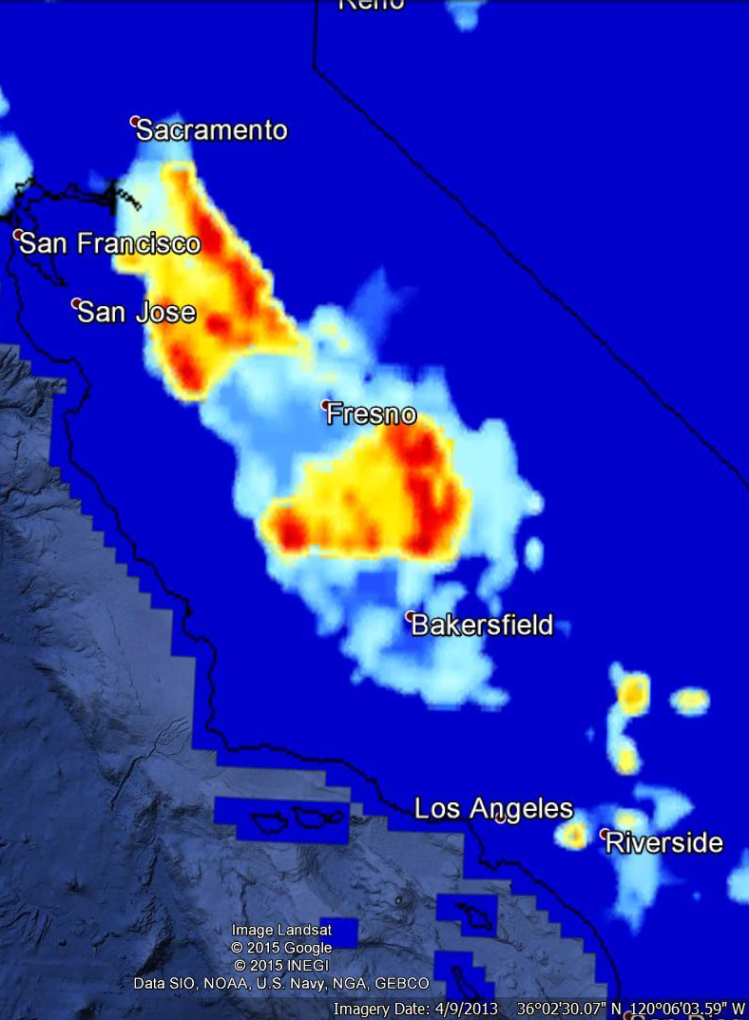
Summary
Introduction
Megacities & GHG
Why study Los Angeles?
Methane emission sources
Methods
GIS Data Collection
Analyze Emission Sectors
Develop GHG spatial representation
Evaluate with NASA Earth Observation Data
Results & Conclusion
IN PROGRESS

Slide 3
Background & Significance
Cities around the world produce roughly 70% of anthropogenic GHG emissions (Kort et al. 2012).
CH4 is more potent than CO2, but not as strictly regulated and not as well-understood in megacities
Effective policies need more precise quantification and identification of methane sources
Previous research studies comaBottom-up & Top-down methods don’t agree
Notes:
Intro

Slide 4
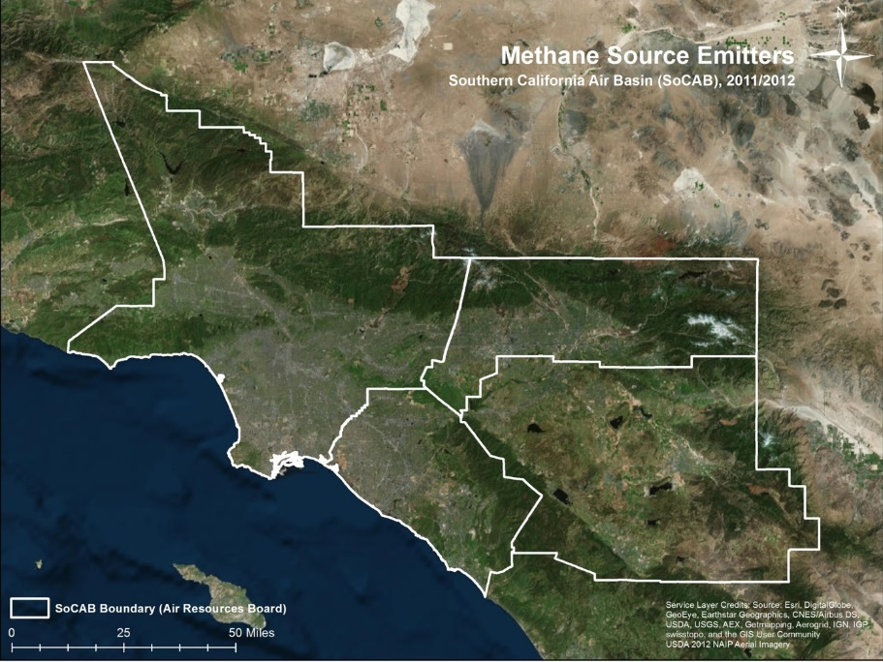
Objectives
Develop a raster-based spatial representation of CH₄ emissions in the SoCAB region
Calculate emission factors for top CH₄ producing sectors
Compare our method with Top-down Earth observations
Study area: South Coast Air Basin (SoCAB)
Notes:
Intro
Top Methane sources in SoCAB
Landfills
Natural gas
Wastewater treatment
Livestock – dairy farms
Petroleum

Slide 5
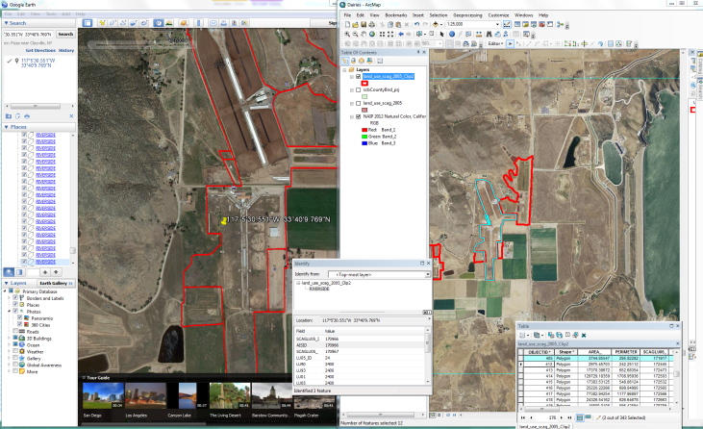
GIS Data Collection
Processing & Validation

Slide 6
3.
Research & Rank of CH₄ Emission Sectors
Methodology
CARB 2012 | Statewide
Rank | Source | Statewide Total (Gg CH₄/year)
1 | Livestock-Dairy | 73,175
2 | Landfills | 7,973
3 | Natural Gas | 2,354
4 | Wastewater Treatment Plants | 1,665
5 | Oil wells | 1,037
CALGEM 2012 | SoCAB
Rank | Source | SoCAB total (Gg CH₄/year)
1 | Landfills | 171.3
2 | Natural Gas | 87.4
3 | Wastewater Treatment Plants | 56.3
4 | Livestock-Dairy | 77.3
5 | Petroleum | 7.9
Image Credit: Monet
Notes:
Develop and Analysis
Cite: http://blog.archisnapper.com/wp-content/uploads/architect-field-report.jpg
Image Source: http://commons.wikimedia.org/wiki/File:Claude_Monet_-_The_Magpie_-_Google_Art_Project.jpg

Slide 7
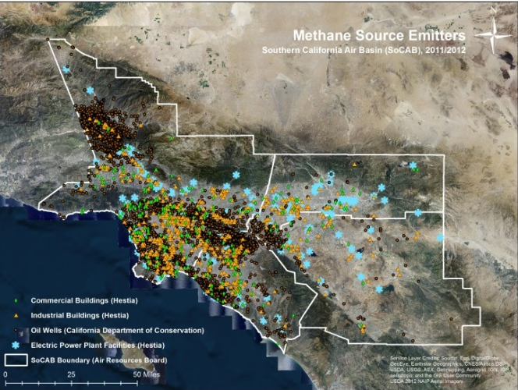
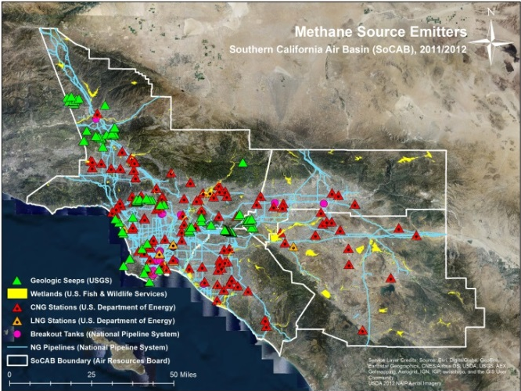
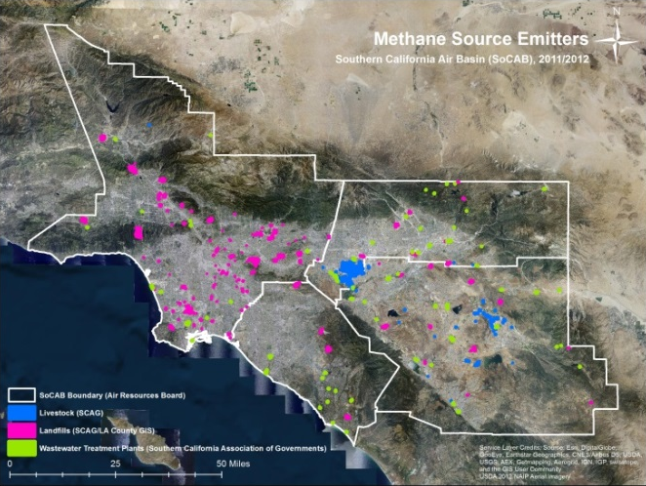
Results
INSERT FINAL MAP

Slide 8
Image Credit: Monet
General Guidelines III
Include speaker notes for each slide (see below).
Include a visual on each slide, if possible.
Arrange content to minimize white space.
Notes:
These notes should be thorough enough for someone not familiar with the project to clearly present the material.
Image Source: http://commons.wikimedia.org/wiki/File:Claude_Monet_-_The_Magpie_-_Google_Art_Project.jpg

Slide 9
Maps & Logos
Maps
Import the legend separately.
Make sure all text is legible and editable.
Cite base layer source in speaker notes.
Logos
US Federal logos only.
No state, NGO, local and or international government logos, or software logos.

Slide 10
Photos & Figures I
You may only use images taken by your team, provided by your partners (as long as you have permission from them), from a Federal Agency, from the new DEVELOP stock imagery collection on DEVELOP’s Flickr page, or Creative Commons images.
Obtain a media release form from all people in photos that your team has taken — no children!
All image sources should be cited using a consistent format and should be visible on the slide.

Slide 11
Photos & Figures II
Please do not include the image URL in the source text box but rather place it in the notes section below.
If you use a border for your images include it on all photographs to keep your presentation consistent.
Keep all images and text boxes editable, including individual elements of flowcharts.
Background images are discouraged. If you use one, make sure that your text remains clear and legible.

Slide 12
Acknowledgements
List advisors, partners, and others who have contributed in any way to the project.
If your project is a multi-term one, acknowledge past contributors.
Choose one of the two following slides as an acknowledgements page. Feel free to modify them as needed to fit your content.
Image Credit: Monet
Notes:
Image Source: http://commons.wikimedia.org/wiki/File:Claude_Monet_-_The_Magpie_-_Google_Art_Project.jpg

Slide 13
Advisors
Kristal Verhulst, Ph.D. (NASA Jet Propulsion Laboratory)​
Francesca Hopkins, Ph.D. (NASA Jet Propulsion Laboratory)​
Preeti Rao, Ph.D. (NASA Jet Propulsion Laboratory)
Partners
California Air Resources Board (CARB), End-User/Collaborator,
POC: Abhilash Vijayan (Manager: Greenhouse Gas Technology & Field Testing Section)
Others

