Slide 1


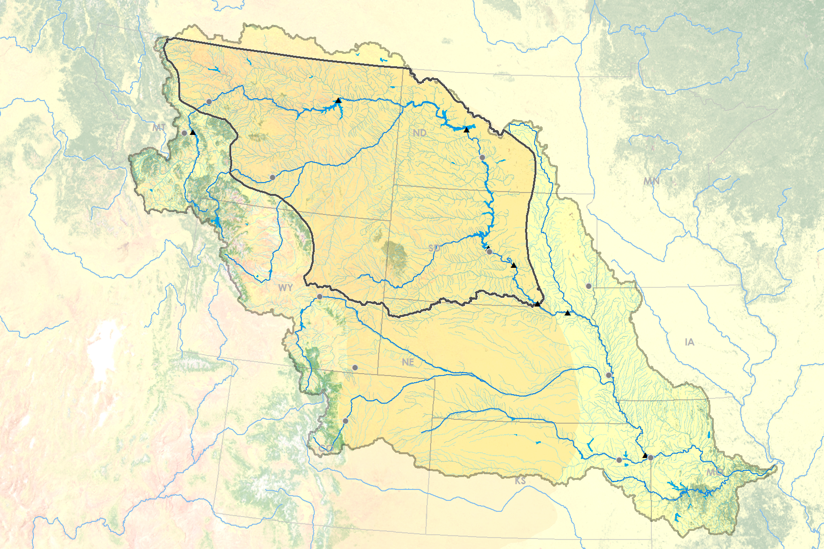
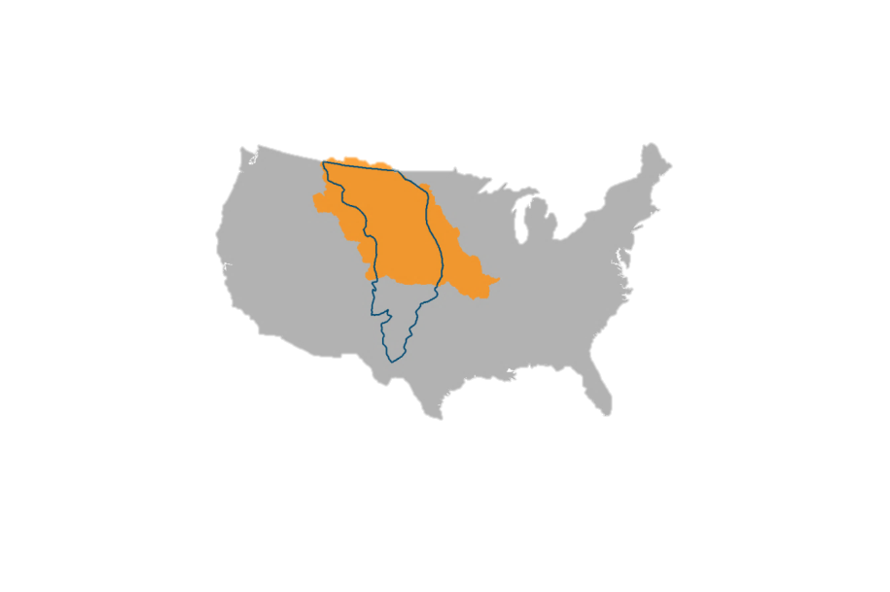
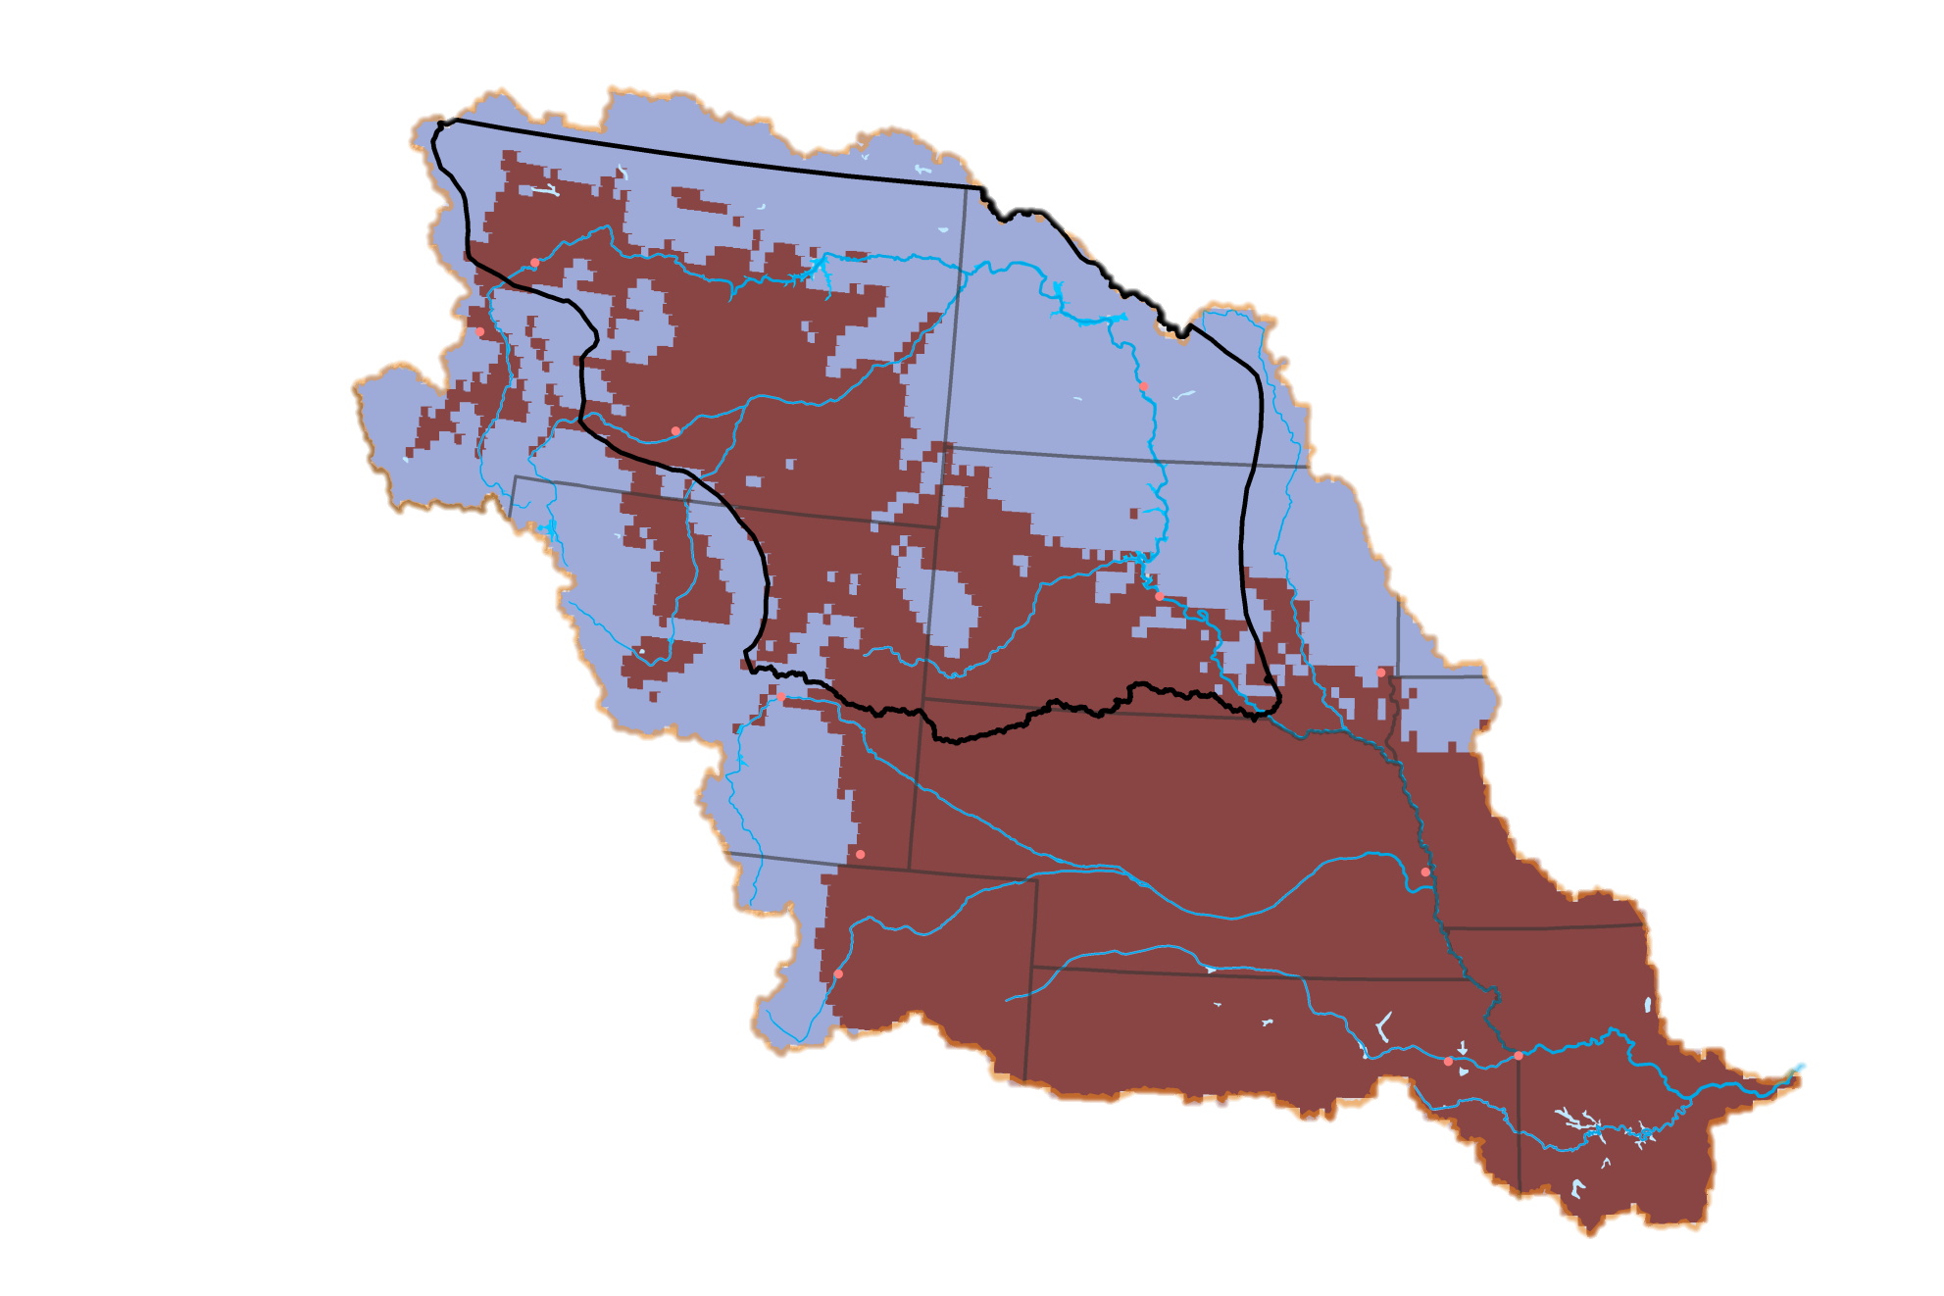
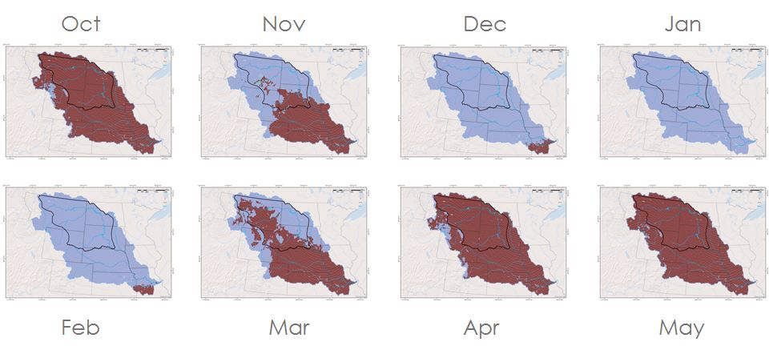
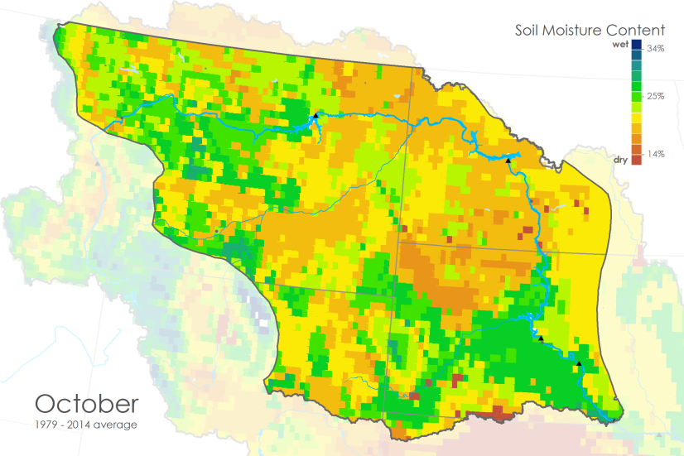
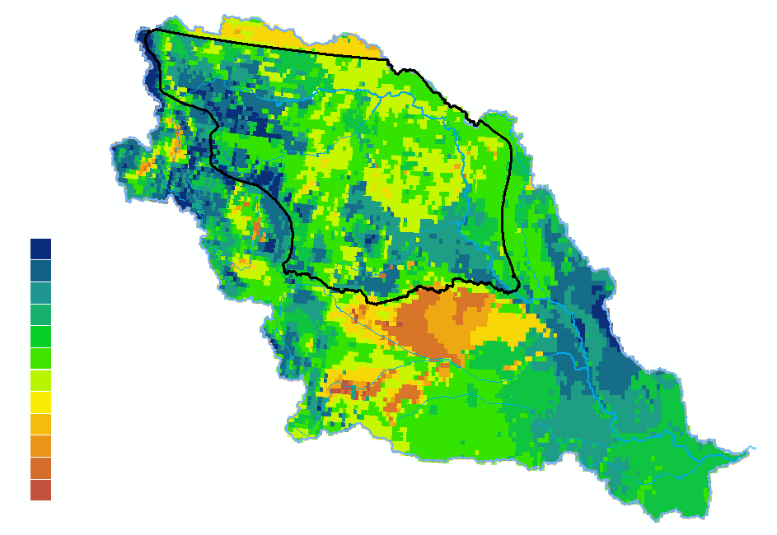
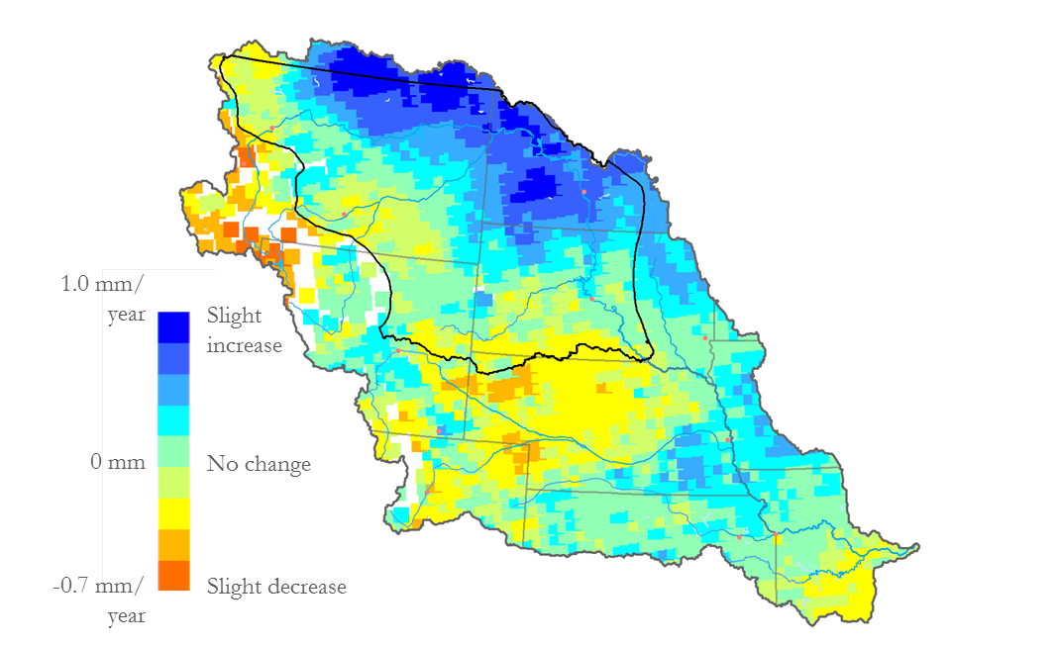

Missouri River Climate
Understanding Runoff in the Missouri River Basin Using NASA and NOAA Satellite Observations for Improved River System Management and Decision Support
Emily Sturdivant (Project Lead), Alec Courtright, Nancy Barnhardt, and Sam Swanson
DEVELOP National Program at NOAA National Centers of Environmental Information
Abstract
Objectives
Earth Observations
The Missouri River’s highly variable discharge directly affects livelihoods in six states. The U.S. Army Corps of Engineers (USACE) manages six dams for purposes including flood mitigation, irrigation, hydropower needs. Management decisions impact local residents, businesses, and ecosystems, which rely on accurate forecasting of river flows. However, environmental variables such as soil moisture, snowpack, and soil temperature have an unquantified influence on river run-off. In particular, the Northern Plains region of the upper basin is not adequately covered by ground monitoring stations, resulting in a data-poor region and an incomplete understanding of the driving variables of run-off.
Climatologies were created for each variable and mapped as 35-year averages. In the Upper Basin Plains focus region, snow water equivalent and soil moisture show increasing trends over the 35-year period. There are consistent differences in timing of soil freeze and thaw along an east to west gradient. These results will aid the USACE management team in their informed water management and communication with basin residents.
1
Detect historic and present soil temperature, soil moisture, and snow water equivalents through a combination of NASA and NOAA Earth observations, Climate Data Records, modeled data, and in situ data.
North American Land Data Assimilation System (NLDAS) –GOES satellite
Defense Meteorological Satellite Program (DMSP) – GlobSnow: European Space Agency
2
Document normal and anomalous conditions for Northern Plains region.
3
Exploratory Analyses of the association between these driver variables and USGS stream discharge.
Project Partners
Study Area
United States Army Corps of Engineers: Kevin Grode, Missouri Basin Water Management Reservoir Regulation Team Lead
NOAA Regional Climate Services Director: Doug Kluck, Central Region Climate Services Director
South Dakota State University: Dr. Dennis Todey, South Dakota State Climatologist
Great Falls
Canyon Ferry
Fort Peck
Parque Nacional Natural (PNN) Tayrona
Helena
Upper Basin Plains Focus Region
Garrison
Bismarck
Billings
Northern Great Plains
Oahe
Pierre
Big Bend
Sioux Falls
Casper
Fort Randall
Gavins Point
Results
Cheyenne
Denver
Omaha
Methodology
3. Analysis
Topeka
Kansas City
Monthly Soil Freezing Climatology 1979-2015: March
2. Processing
1. Data
Soil Temperature
Focus area average temperature
1979-2015 average monthly soil freeze/thaw per pixel.
Monthly climatologies
Focus area first, last, and duration of frozen soil months
Soil Temperature
Oct
Nov
Dec
Jan
Not Frozen
Data Acquisition
Frozen
Soil Moisture
Monthly and yearly averages of soil moisture content
Oct
Apr
May
Frozen or unfrozen soil across the MRB. The eastern plains freeze and thaw at a different rate during transition months.
Snow Water Equivalent
Feb
Mar
Monthly climatologies
Focus area averages per month and year
Anomalous years
Monthly Soil Moisture Content Climatology 1979-2015: February
Max SWE by pixel since 1979
Average max SWE by month and year
Soil Moisture Content
Very wet
34%
Very dry
25%
Conclusions
14%
Soil Moisture
Very wet
October
46 kg/m²
Plains snow has a slight increasing trend from 1979 to 2012. Soil moisture averaged across the plains of the upper basin also shows an similar trend up to 2015. These are both consistent with climate models that predict increasing precipitation in winter months at northern latitudes.
In 2015, we expect slightly less snow and average soil moisture in the plains of the upper basin based on historical patterns in years with strong El Niño.
1979 – 2014 average
Monthly climatologies
Focus area maximums and average maximums
Anomalous years
Average
27 kg/m²
Very dry
9 kg/m²
Average soil moisture content for that particular area. February has the highest soil moisture content of the year.
Trend in Average Maximum SWE: 1979-2012
Within the upper basin, the lower elevation eastern plains, east of Fort Peck and the Black Hills, freeze earlier and thaw later than the western plains.
Team Members
Acknowledgements
1.0 mm/
year
0 mm/year
-0.7 mm/year
Slight
Increase
No change
Slight Decrease
Snow Water Equivalent
We would like to thank our Center Lead Jessica Sutton and our science advisor DeWayne Cecil for all of their help and guidance throughout this project.
We would also like to acknowledge:
Carrie Vuyovich: Cold Regions Research and Engineering Laboratory USACE
Rocky Bilotta, Anthony Arguez, Jesse E. Bell, Ethan Shepherd: NOAA NCEI
Ned Gardiner: NOAA NCEI
Michael Kruk: NOAA NCEI
and everyone else at NCEI who gave us guidance along the way.
Increasing and decreasing snow water equivalent per year since 1979. In the Northern Plains, some regions have seen an average increase of 1 mm of maximum SWE per year.
NOAA National Center for Environmental Information
Notes:
Seasonal soil temperature changes occur at different rates on an East to West gradient based on elevation. Within the upper Missouri River basin the plains region East of the Rocky Mountains and the Black Hills of South Dakota cools more quickly in the fall and heats more slowly in the spring.

