Slide 1
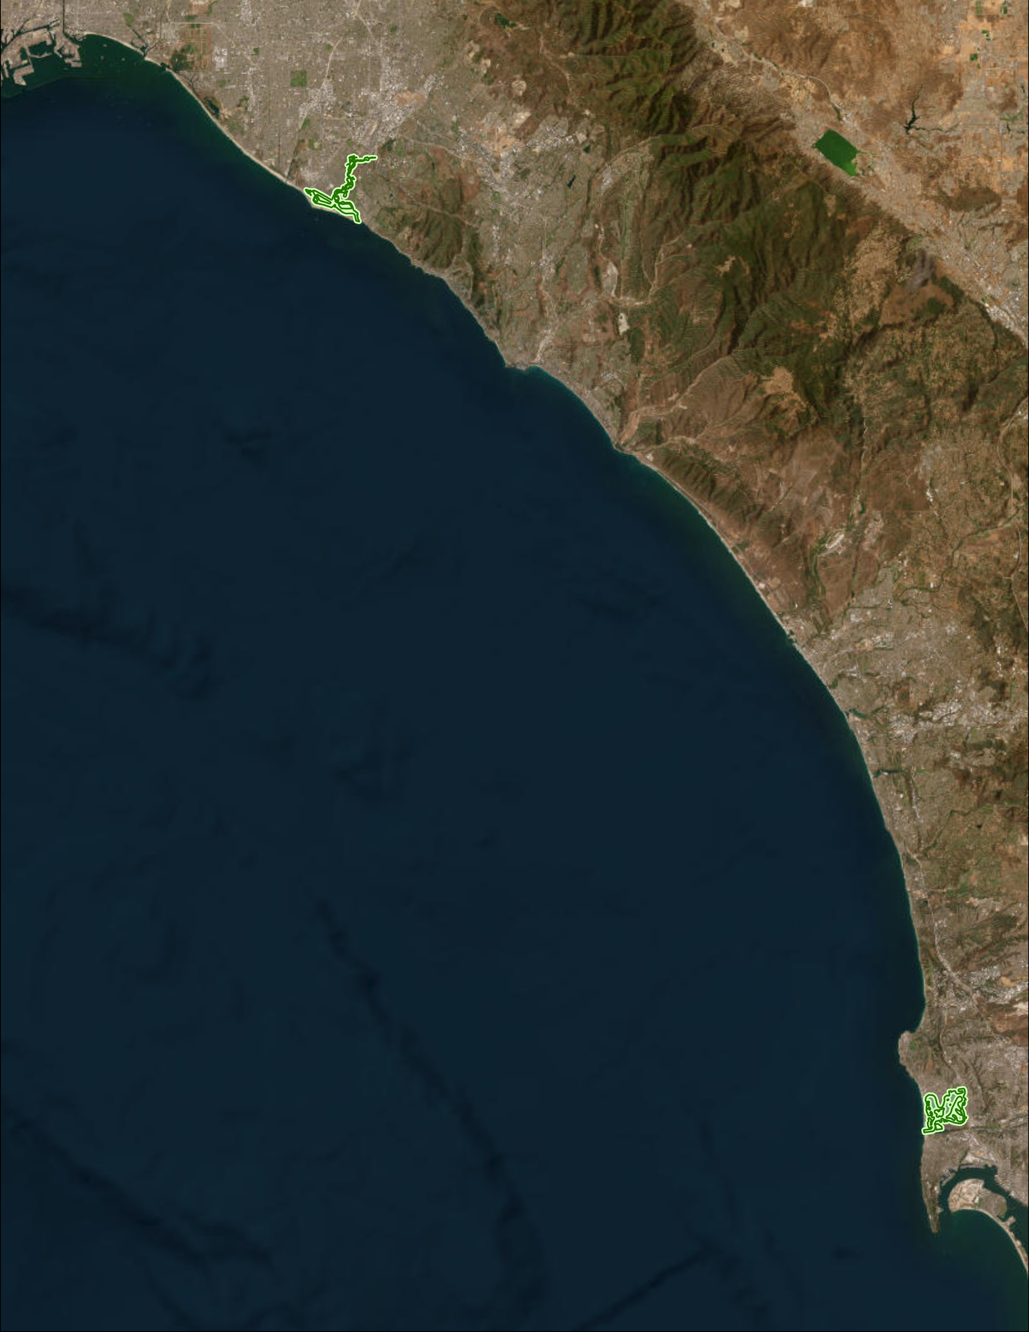
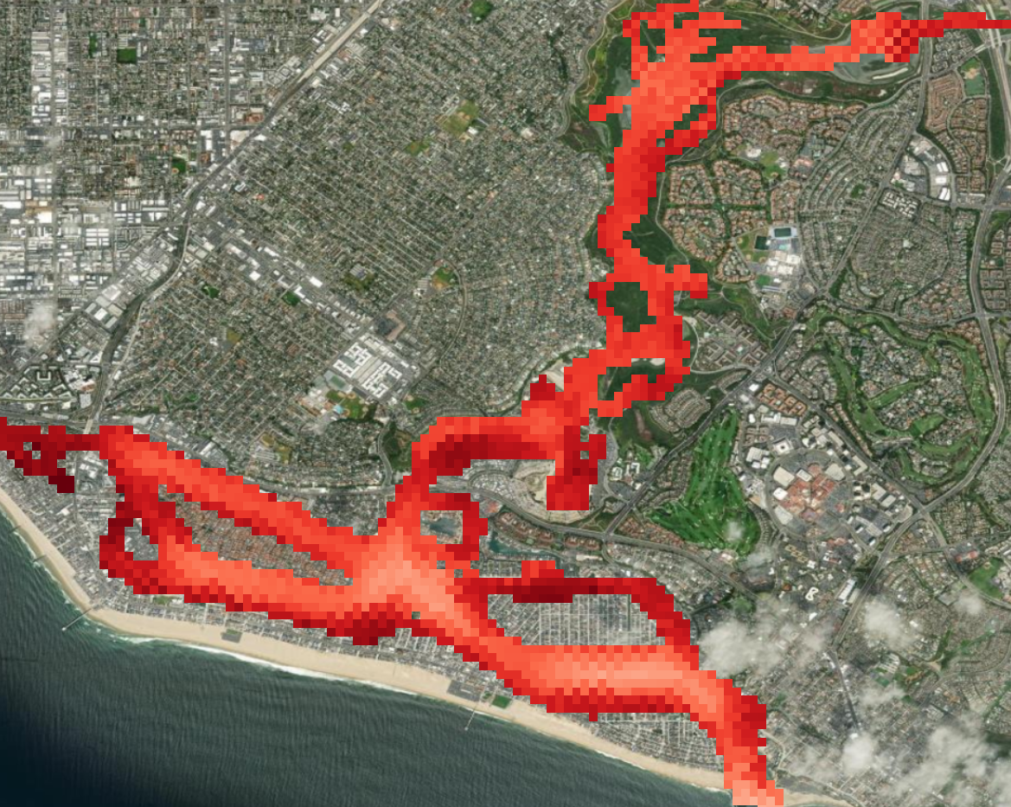
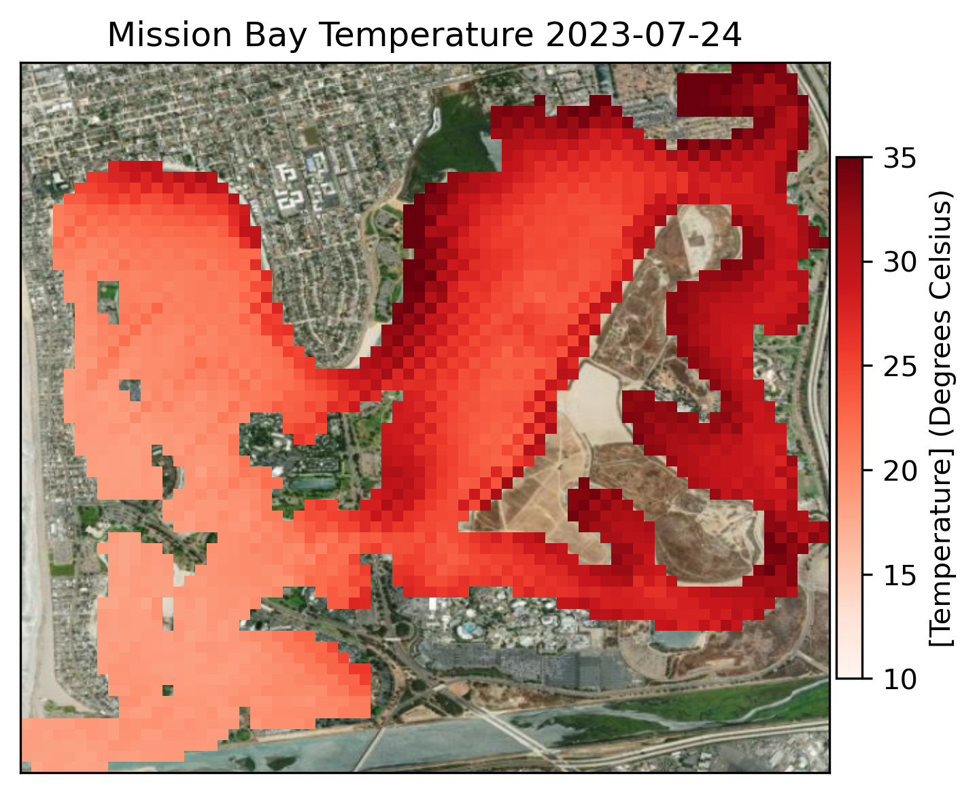
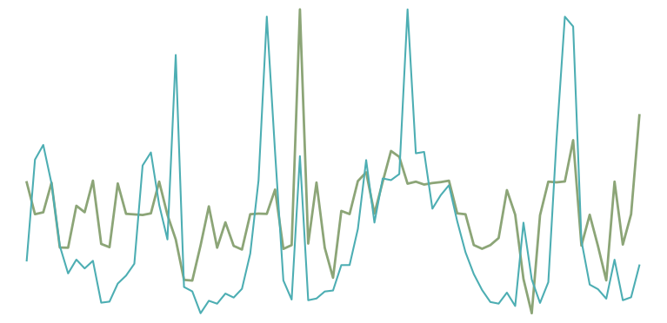
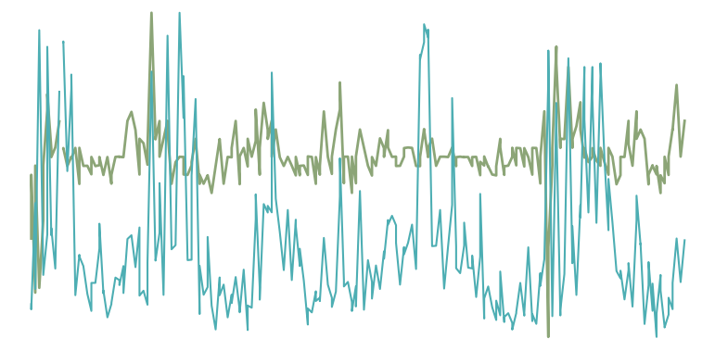
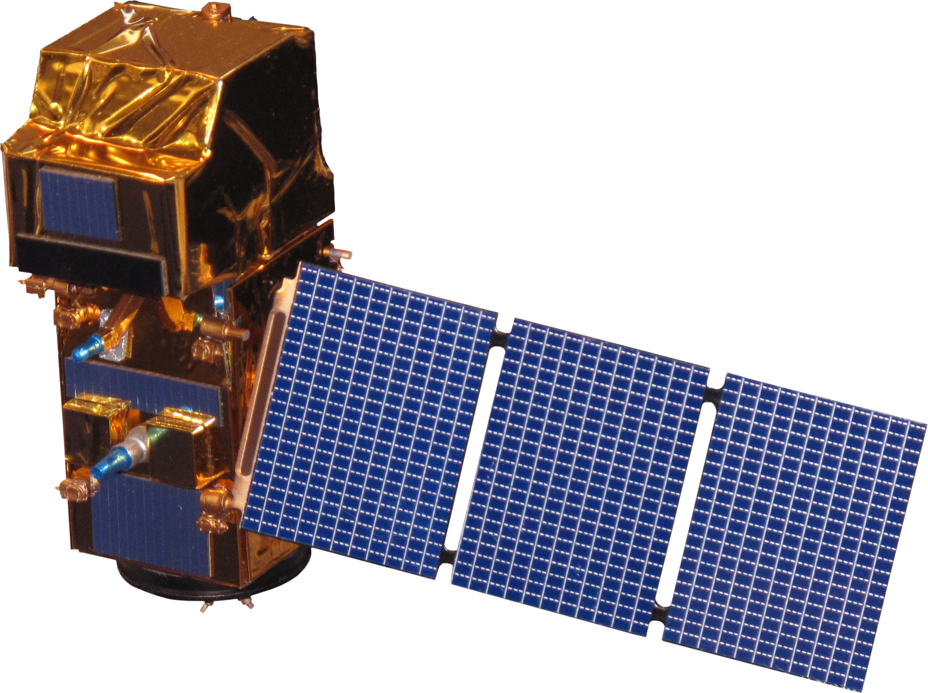
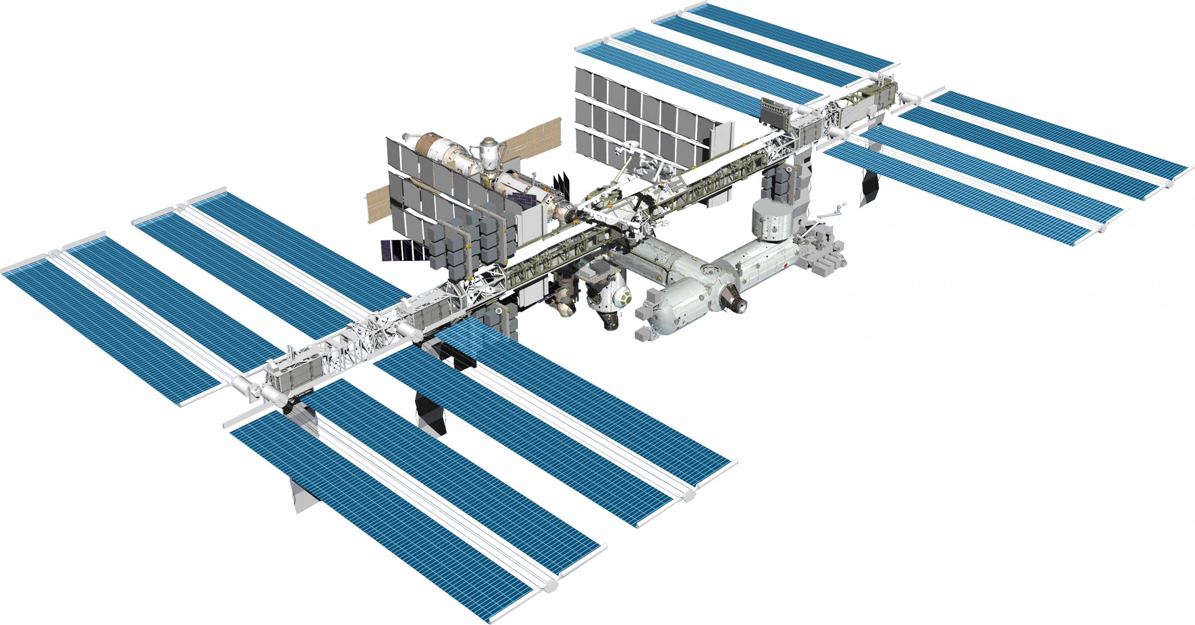
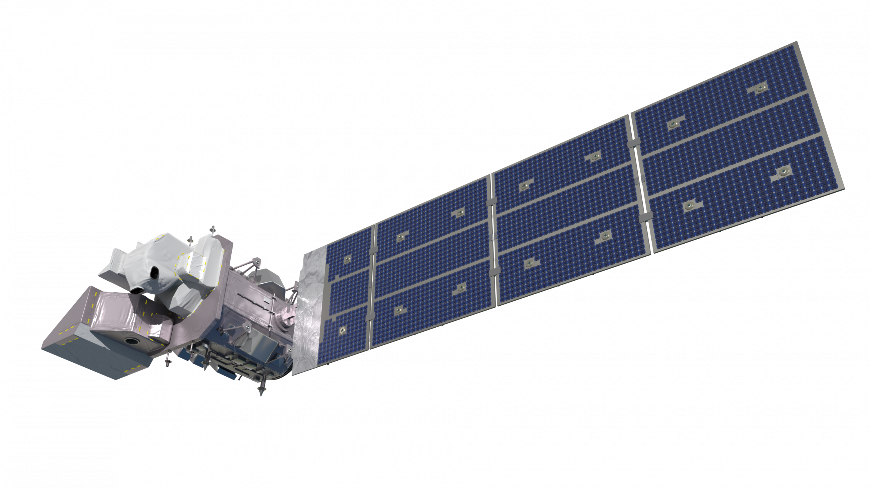
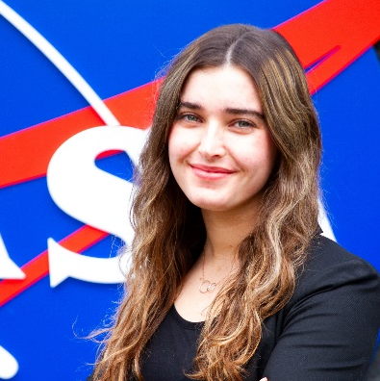
Southern California Water Resources
Using NASA Earth Observations to Monitor Seagrass Extent and Water Quality Parameters in Southern California
Project Synopsis
Methodology
Study Area
0
500
Eelgrass (Zostera marina) is a species of submerged aquatic vegetation (SAV) found in shallow bays and estuaries with soft seafloors. Eelgrass is recognized for providing ecosystem benefits such as carbon sequestration, sediment stabilization, water clarification, and fish and wildlife habitats. However, eelgrass is impacted by both marine and terrestrial threats associated with climate change. In this project, we worked with the Southern California Coastal Water Research Project (SCCWRP), the National Oceanic and Atmospheric Administration’s National Marine Fisheries Service, and the State of California San Diego Regional Water Quality Control Board to investigate water quality parameters (ie., chlorophyll-a concentration, sea surface temperature, and turbidity) associated with eelgrass in Newport bay and Mission Bay, California. The team used Landsat 8 Operational Land Imager (OLI) and Thermal Infrared Sensor (TIRS) Surface Reflectance Tier 1, Landsat 9 OLI-2/TIRS-2 Surface Reflectance Tier 1, Sentinel-2 MultiSpectral Instrument (MSI), and ECOsystem Spaceborne Thermal Radiometer Experiment on Space Station (ECOSTRESS) land surface temperature and cloud mask to create a time series of these water quality parameters from 2019-2023. We found that the parameters followed cyclical, seasonal patterns with turbidity and sea surface temperature peaking in the summer. We did not find that the parameters had changed significantly over longer time periods. These results will be used in a model developed by SCCWRP to assess eelgrass ecosystem health and predict ecosystem occupancy in the future.
1,000
Select Imagery
Accuracy assessment
Miles
Mask clouds and land
Create time series charts
Newport Bay, CA
Objectives
Calculate water quality parameters
Create animations
Mission Bay, CA
Investigate the limitations of remote sensing data when examining submerged aquatic vegetation bounds and water quality parameters
Create outputs for partners and land managers to utilize in a model to better understand ecosystem health
Determine the most accurate algorithms and programs for processing raw satellite imagery in aquatic settings
Understand how water quality in areas with SAV changes spatially and temporally
Study Areas
Basemap citation: ESRI, NASA, NGA, USGS, FEMA, Earthstar Geographics, SanGIS, California State Parks
Results
Surface Temperature: Sentinel-2
Turbidity and Chlorophyll-a: Landsat 8 & 9
Newport Bay 2023-04-02
Mission Bay 2023-07-24
35
17
Mission Bay
5
16
4
30
15
3
Chlorophyll-a (mg/$m^{2}$)
Turbidity (FNU)
14
2
25
13
1
Temperature (Celsius)
2019
2020
2021
2022
2023
Date
Turbidity (FNU)
20
Newport Bay
Chlorophyll-a (mg/$m^{2}$)
16
6
15
14
5
4
Chlorophyll-a (mg/$m^{2}$)
Turbidity (FNU)
10
12
3
Basemap Credit: Esri, DigitalGlobe, GeoEye, i-cubed, USDA FSA, USGS, AEX, Getmapping, Aerogrid, IGN, IGP, swisstopo, and the GIS User Community
10
2
0
2019
2020
2021
2022
2023
1
Conclusions
Date
Earth Observations
Turbidity and surface temperature showed cyclical change with peaks in the summer.
There were no identifiable patterns Chlorophyll-a over time.
We recommend choosing bodies of water with eelgrass no deeper than 2 meters with high water clarity for eelgrass extent mapping. In addition, using the highest possible resolution imagery will yield more accurate results.
The accuracy assessment of turbidity in Newport Bay produced a root mean square error of 2.25 for both Landsat 8 & 9 and Sentinel-2.
Landsat 8 OLI & TIRS
Sentinel-2 MSI
ISS ECOSTRESS
Landsat 9 OLI-2 & TIRS-2
Project Partners
Team Members
Southern California Coastal Water Research Project
NOAA, National Marine Fisheries Service, West Coast Region
San Diego Regional Water Quality Control Board
Acknowledgements
Katya Beener
Project Lead
Caroline Baumann
Nelly Perez
Gwenyth Greco
We would like to thank our science advisors Dr. Christiana Ade, and Dr. Adriana Parra Ruiz, and Benjamin Holt for their guidance. Additionally, we would like to thank Michael Pazmino and Jane Zugarek for assisting us through our DEVELOP term.
JPL | Spring 2024

