Slide 1
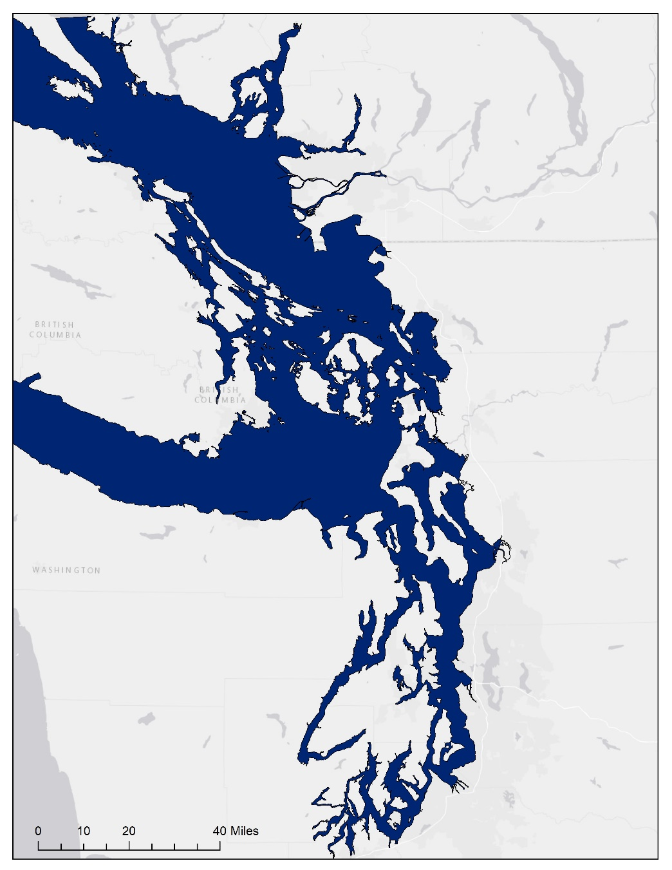
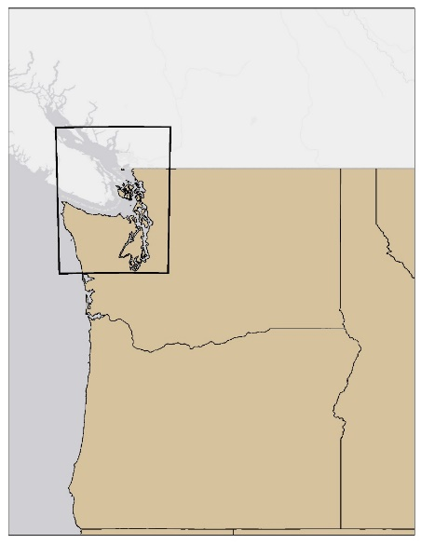
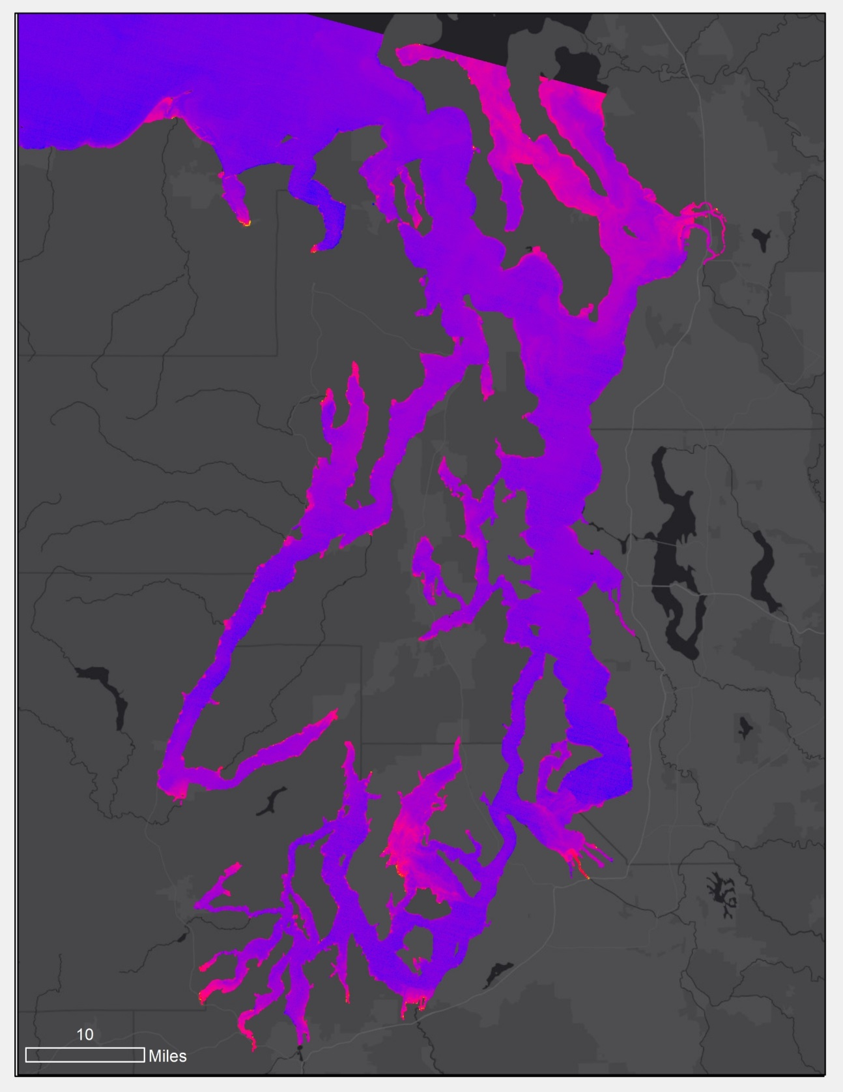
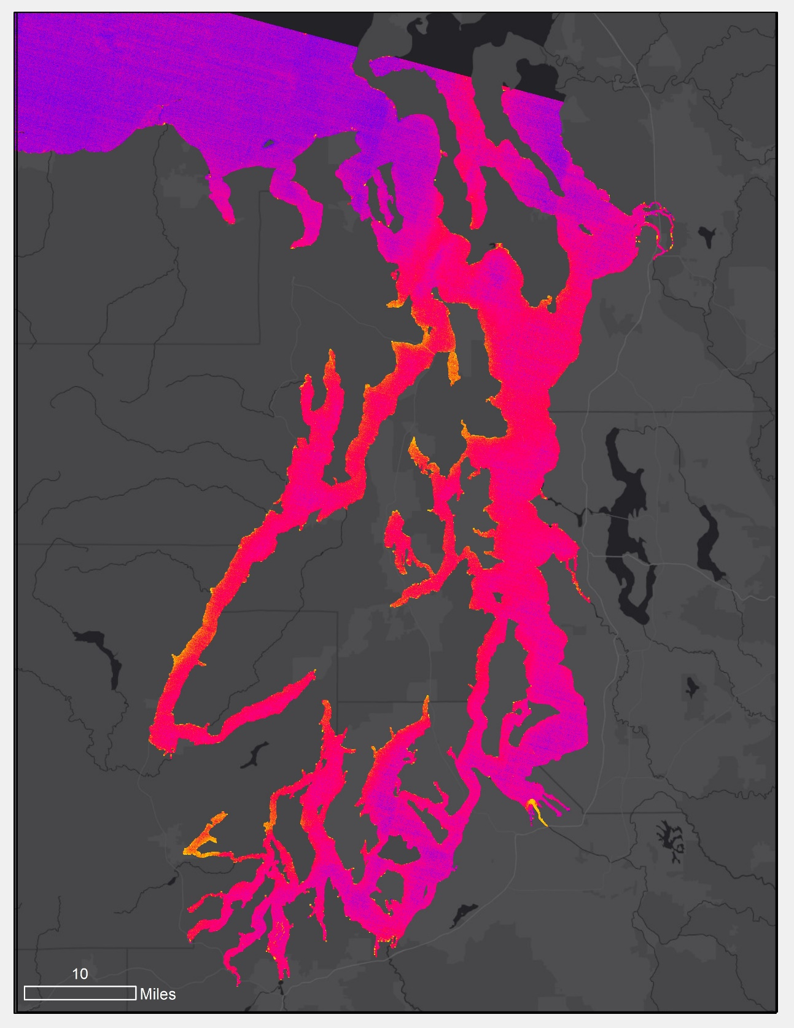
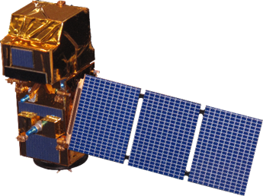




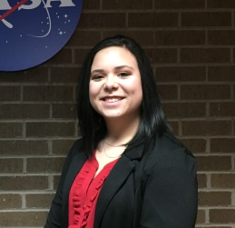
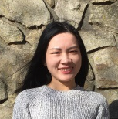
Evaluating Methods for Identifying and Monitoring Factors in the Puget Sound that Indicate Eutrophication and Hypoxia
Abstract
Methodology
Dissolved oxygen levels have been declining in the Puget Sound since 2000 due to eutrophication, resulting in Harmful Algal Bloom (HAB) events which negatively impact water quality and wildlife in the area. Therefore, analyzing and identifying eutrophication and hypoxic events is integral to water quality control and watershed management. The Puget Sound Water Resources team partnered with the Pacific States Marine Fisheries Commission (PSMFC) Habitat Program to test methods for monitoring water quality using remote sensing. The team tested multiple algorithms utilizing Landsat 8 OLI and Sentinel-2 MSI data to detect turbidity and chlorophyll concentrations. Results will assist the PSMFC Habitat Program to fill geographic and temporal data gaps and to enhance local decision-making practices and management of water resources.
Data
ACOLITE Processing
Statistical Analysis
End Products
  Landsat 8 OLI
  Sentinel-2 MSI
  In situ measurements
  Landsat 8 OLI: 2 Chlorophyll algorithms, 5 turbidity algorithms
  Sentinel-2 MSI: 4 Chlorophyll algorithms, 5 turbidity algorithms
Objectives
  Pearson Correlation
  Analysis of Variance (ANOVA)
  Tukey’s HSD Analysis
Provide the PSMFC with a resource to bridge spatial gaps in in situ data by assessing the suitability of 9 algorithms utilizing Sentinel-2 MSI and Landsat 8 OLI data processed using ACOLITE to identify indicators of HAB events within the Puget Sound
Aid project partners in enhancing water quality management by identifying areas that are historically prone to development of HABs
  Chlorophyll & Turbidity Time Series Analysis
  Buoy Interpolation & ACOLITE Analysis Maps
  ACOLITE Tutorial
Study Area
Project Partner
Pacific States Marine Fisheries Commission Habitat Program
Results
Bellingham
Canada
Chlorophyll Concentration
Turbidity
Mt Vernon
WA
Puget Sound
OR
ID
Seattle
Earth Observations
Chlorophyll Concentration
Derived from CHL_OC2 (ug/L)
Turbidity Levels derived from T_DOGLIOTTI_NIR (NTU)
High: 6
High: 50
Low: 0
Low: 0
Sentinel-2 MSI
Landsat 8 OLI
Conclusions
Scenes analyzed within the study period illustrated coastal and inlet areas, for example Skagit Bay and Tacoma Inlet, as repeatedly having relatively higher chlorophyll concentrations and turbidity and may need further monitoring for eutrophication and HABs.
The algorithms used within ACOLITE to determine chlorophyll concentration produced statistically similar results according to Tukey’s honest significance test.
The majority of algorithms used within ACOLITE to determine turbidity produced statistically similar results according to Tukey’s honest significance test.
Landsat 8 OLI and Sentinel-2 MSI imagery processed through ACOLITE had low correlation with in situ data and thus are not the most ideal for monitoring eutrophication and HABs in the Puget Sound.
Acknowledgements
Team Members
Dr. Jeffrey Luvall (NASA Marshall Space Flight Center)
Dr. Robert Griffin (University of Alabama in Huntsville)
Dr. Juan L. Torres-Pérez (Bay Area Environmental Research Institute, NASA Ames Research Center)
Leigh Sinclair (University of Alabama in Huntsville/ Information Technology and Systems Center)
Maggi Klug (University of Alabama in Huntsville)
Fran Recht (Pacific States Marine Fisheries Commission, Habitat Program Manager)
Benjamin Page (NASA SERVIR)
Emily Kinkle
Project Lead
Helen Baldwin
Christine Evans
Yu Han
Puget Sound Water Resources
Alabama – Marshall | Spring 2018

