Slide 1
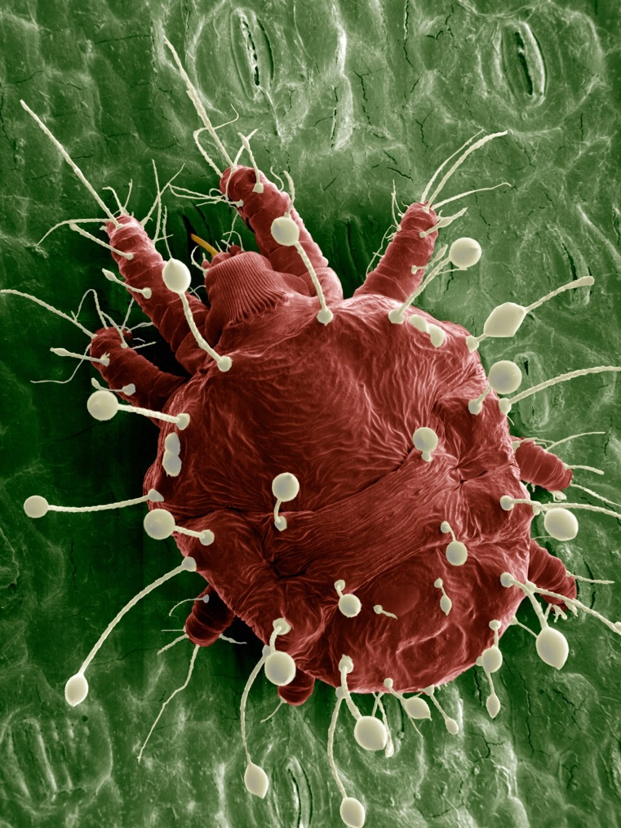
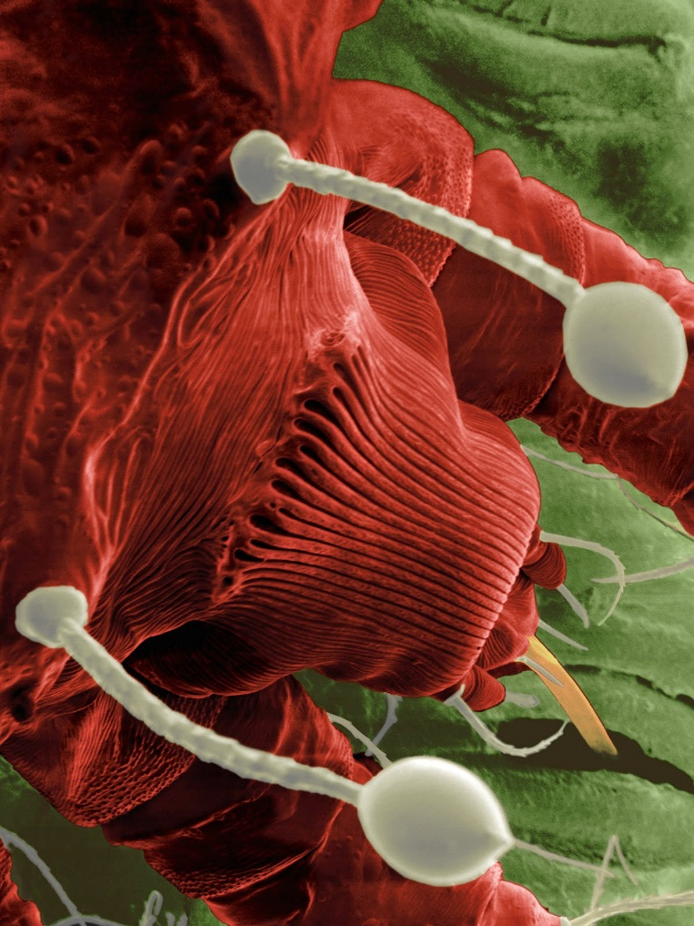
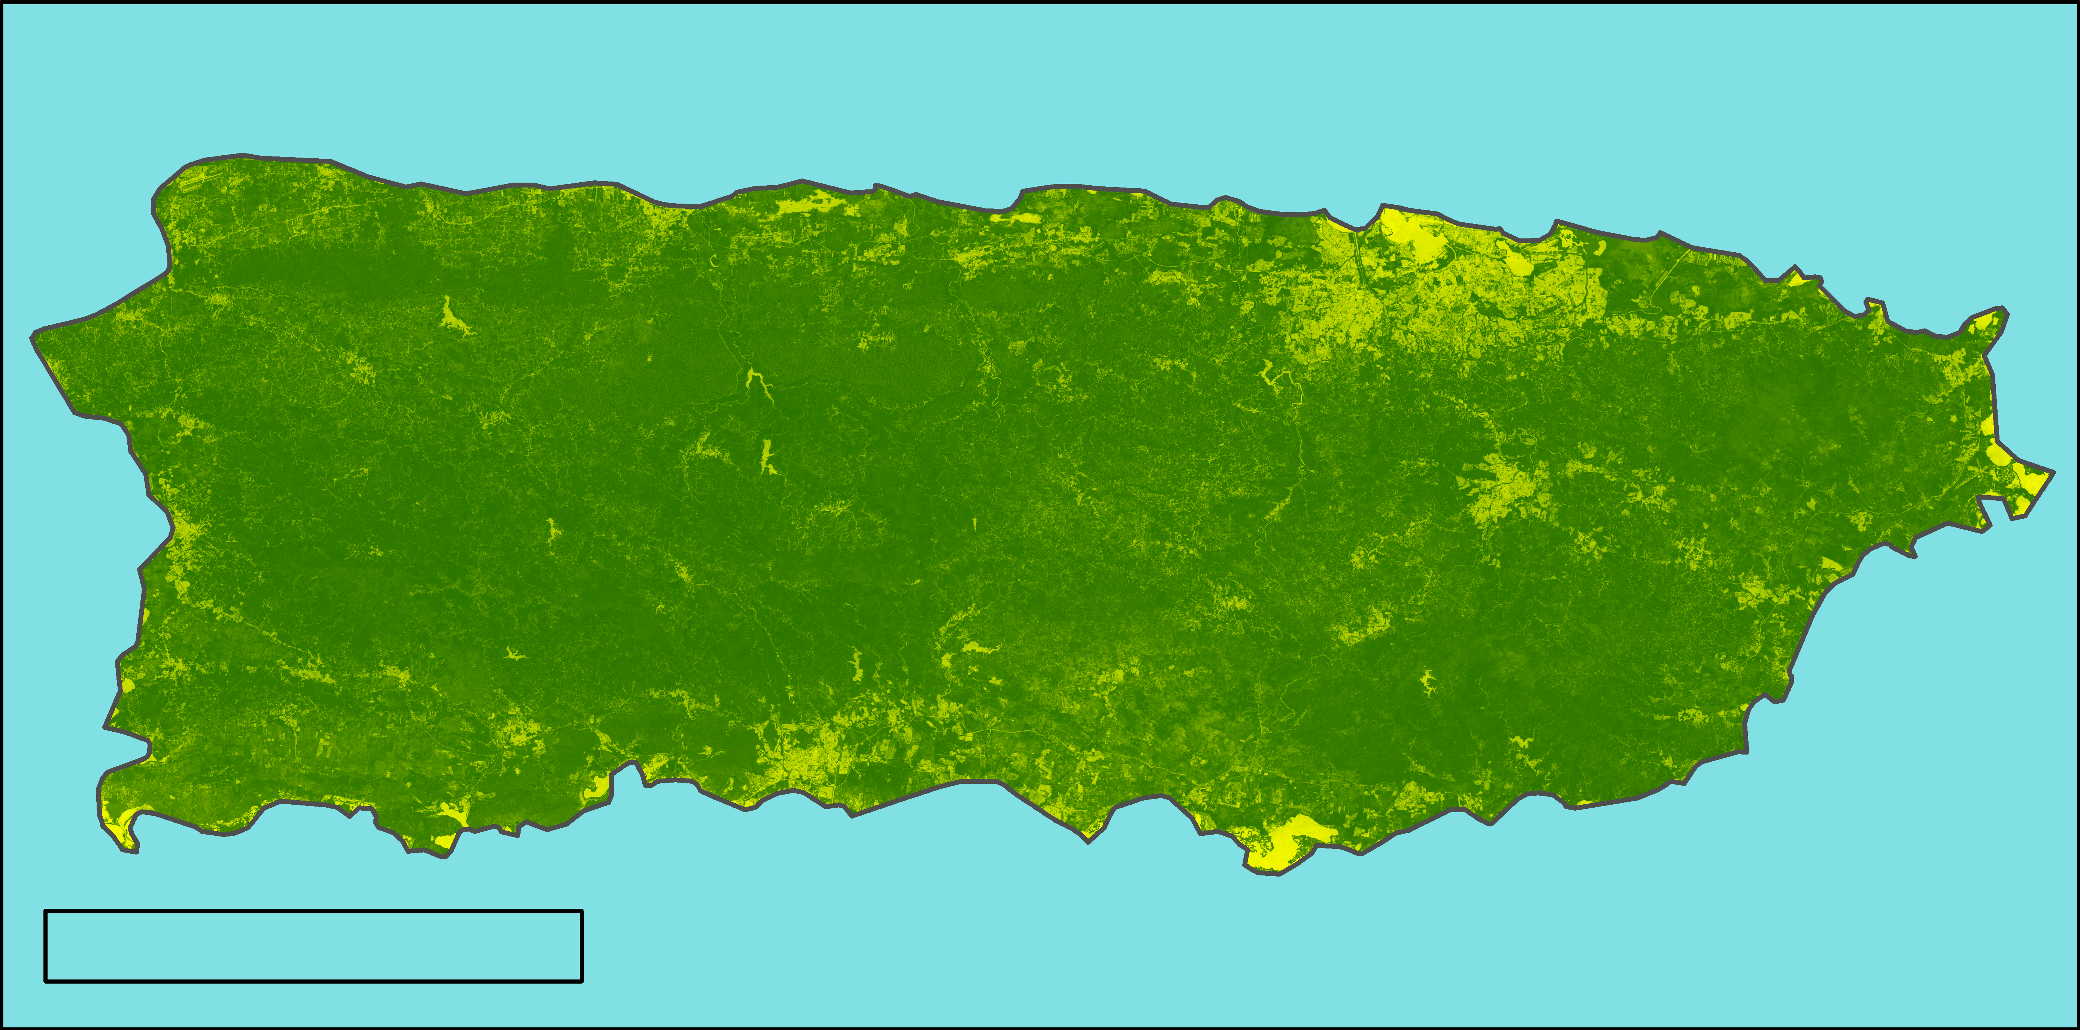
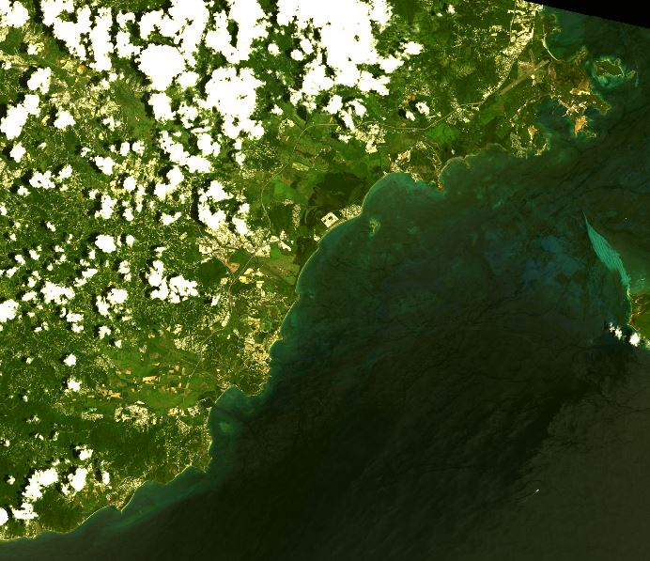
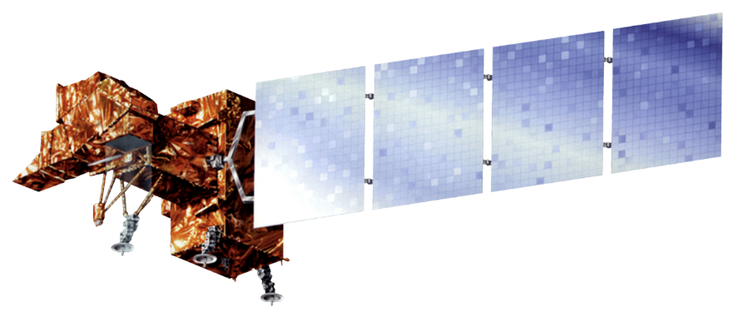

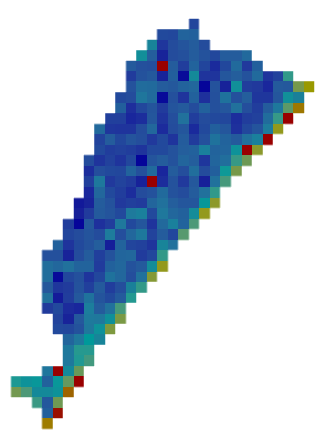
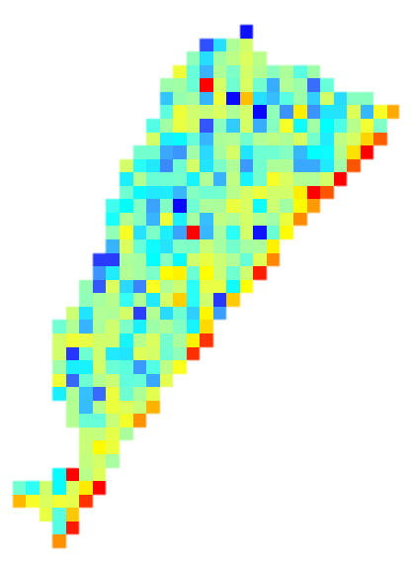
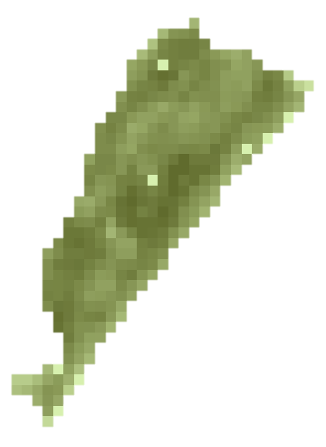
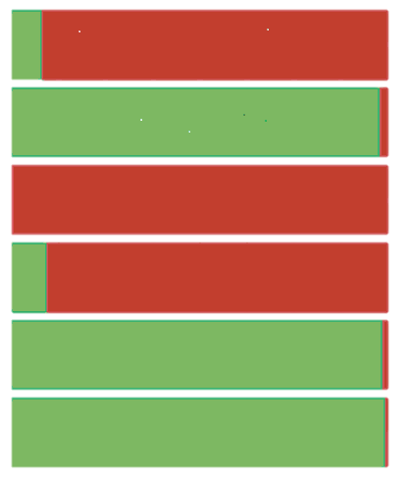
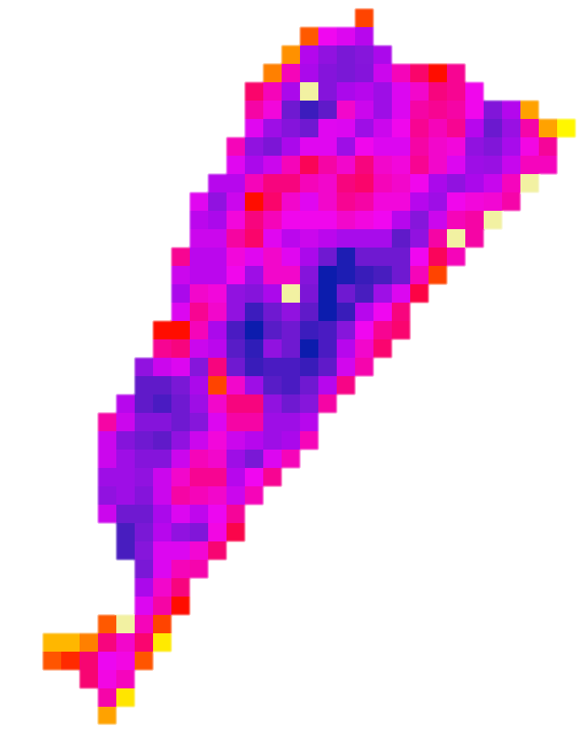
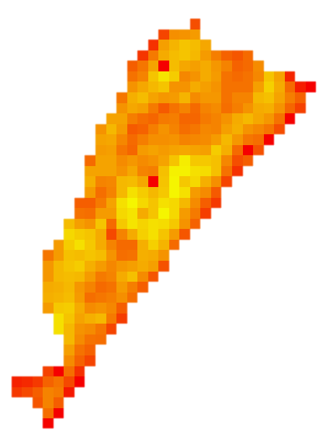
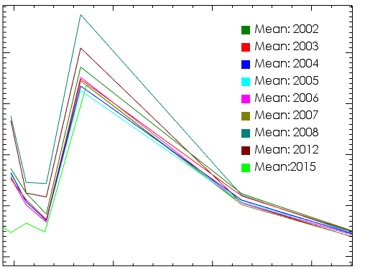
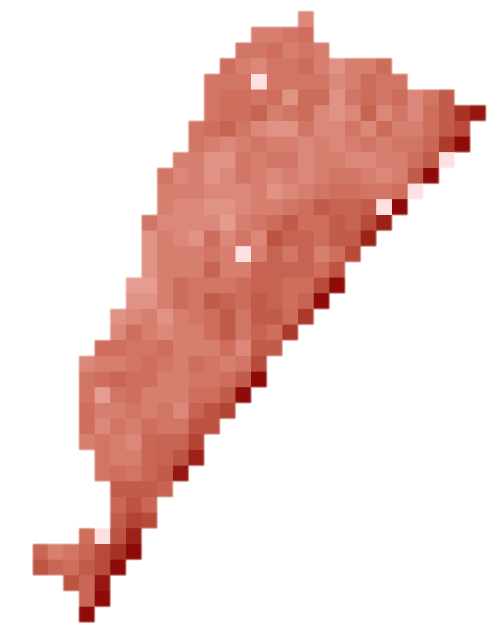
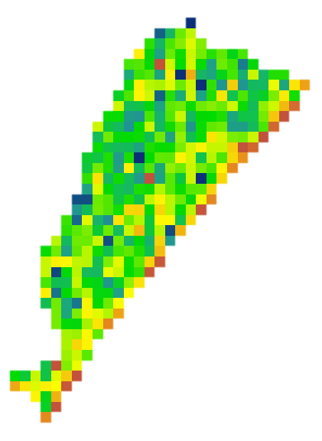
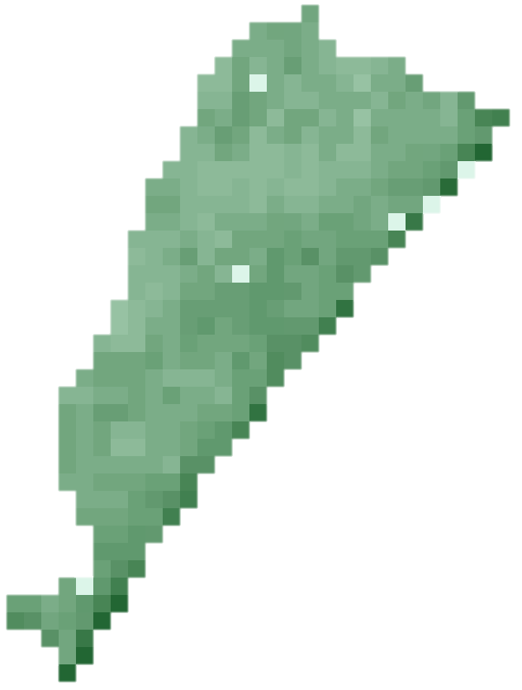
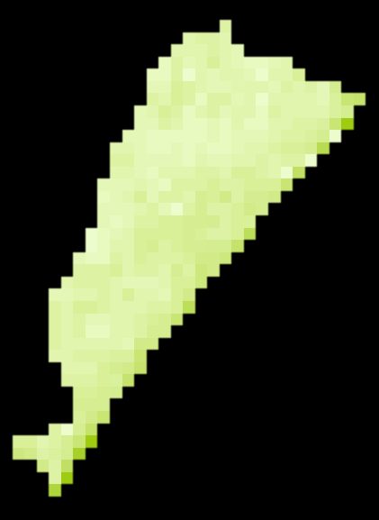

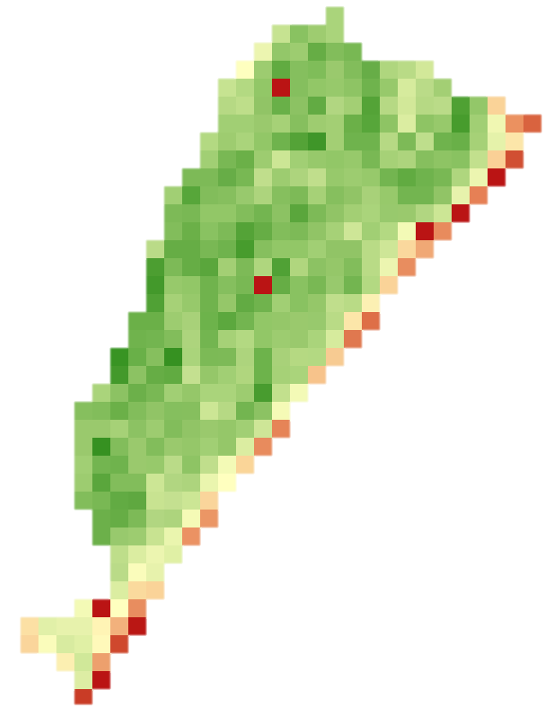
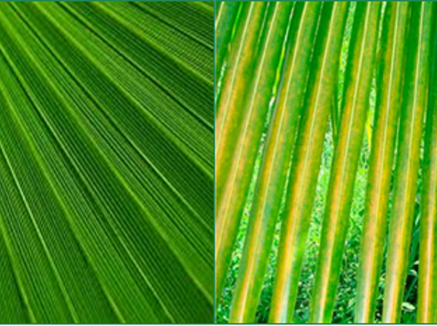






Utilizing NASA Earth Observations to Map the Spread
of the Red Palm Mite, Raoiella indica Hirst, in Puerto Rico,
for Detection, Management, and Conservation
Abstract
Objectives
The rapid spread of the red palm mite, Raoiella indica Hirst, has devastated coconut palm, banana, and plantain crops throughout the Americas and the Caribbean since its introduction into the hemisphere in 2003. Red palm mites use specialized mouthparts to feed via the stomata on plant hosts’ leaves, resulting in accelerated water loss, decreased crop yield, and a characteristic pattern of leaf yellowing and senescence that can be remotely detected using multispectral imagery and calculated spectral vegetation indices from Landsat 7 Enhanced Thematic Mapper Plus (ETM+), Landsat 8 Operational Land Imager (OLI), Earth Observing-1 (EO-1) Hyperion, and IKONOS platforms, and aerial imagery. In conjunction with the United States Department of Agriculture (USDA) Agricultural Resource Service (ARS) and the University of Puerto Rico, the distribution of red palm mite infestation in Puerto Rico was tracked from 2002 to 2016, and maps were produced showing the geographic spread of the red palm mite infestation during this time. The high adaptability of red palm mites to multiple plant hosts, adverse environmental conditions, and diverse dispersal pathways, plus the absence of known biotic countermeasures, makes the mite an urgent environmental and economic threat throughout Southeast Asia, Oceania, and the Americas. Understanding past red palm mite invasions will help to prevent its spread into proximal agricultural areas and limit exposure and resulting crop destruction. The tracking methodology and tools established here can be applied to other geographical areas in an effort to mitigate current mite infestations and to monitor and prevent probable future invasions.
Create historical maps of red palm mite distribution in Puerto Rico from 2002 to 2016.
Provide improved knowledge of the geographic spread of red palm mite and the environmental and social factors that contribute to red palm mite invasions.
Develop tracking methodology that can be passed on to partners and used to understand or prevent future invasions.
Study Area
United States
50 km
Normalized Difference Vegetation Index
High : 1
Cuba
Low : -1
Source: USDA ARS
Hispaniola
Pacific Ocean
Methodology
Service Layer Credits: Sources: Esri, USGS, NOAA
Puerto Rico
Landsat Imagery of in situ Palm Locations
Earth Observations
Landsat 8
Puerto Rico Agriculture
Landsat 7
Results
Decision Tree Output for Palm Infestation
Spectral Signatures in
Humacao Nature Preserve
Prediction:
Healthy
Damaged
Mean: 2002
Mean: 2003
Mean: 2004
Mean: 2005
Mean: 2006
Mean: 2007
Mean: 2008
Mean: 2012
Mean: 2015
2015
Vegetation Indices
and
Spectral Bands
4,000
2008*
3,000
2007
Scaled Data Value
2004*
2,000
2003
1,000
2002
0.5
1.0
1.5
2.0
0
25
50
75
100
Wavelength (μm)
Percent Predicted
Supervised Classification
Conclusions
* Years not used for training classifier
Within Puerto Rico, the red palm mite infestation began in 2006 and quickly spread. By 2008, all regions of the island showed signs of infestation in preferred host plants.
Classifiers, including Random Forest and Neural Network, were unable to consistently predict infestation across years using medium spatial resolution data. Spectral signatures of infestation sites were inconsistent and reflected broader weather patterns.
Future tracking of red palm mite infestations should include use of higher resolution imagery or of larger coconut palm plantations as in situ training sites.
Team Members
Acknowledgements
Project Partner
Dr. John Bolten, NASA
Dr. Michael Cosh, USDA ARS
Dr. Ron Ochoa, USDA ARS
Dr. Jose Carlos Rodrigues, University of Puerto Rico
Sara Lubkin
Project Lead
Julia Marrs
Sean McCartney
Alison Thieme
Any opinions, findings, and conclusions or recommendations expressed in this material are those of the author(s) and do not necessarily reflect the views of the National Aeronautics and Space Administration. This material is based upon work supported by NASA through contract NNL11AA00B and cooperative agreement NNX14AB60A.
NASA Goddard Space Flight Center – Summer 2016

