Slide 1
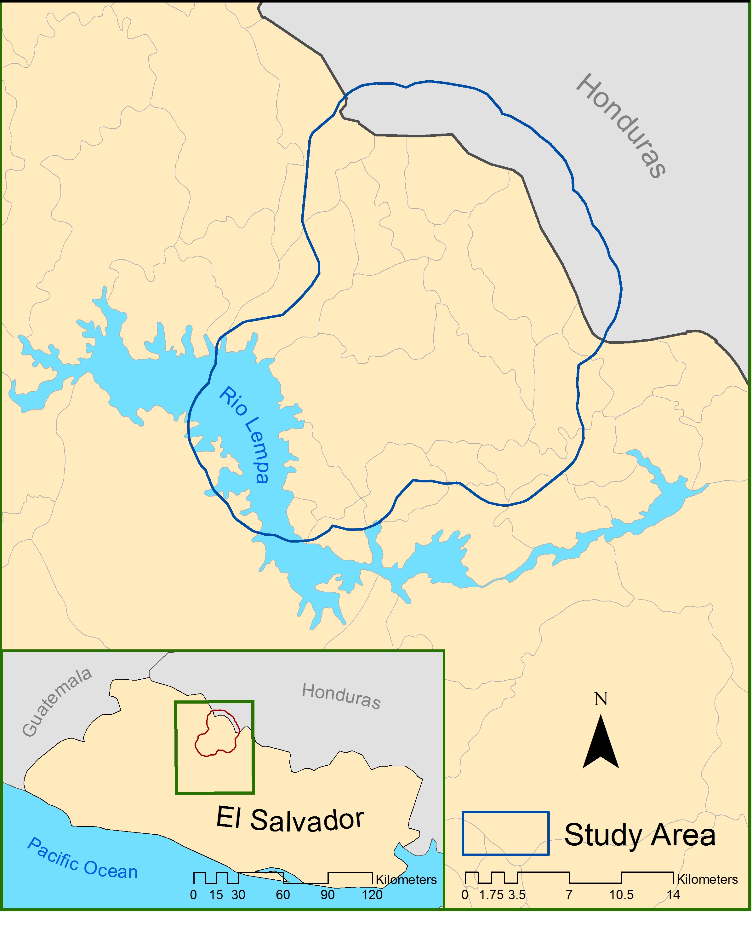
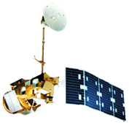
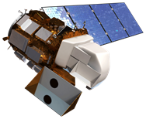
El Salvador Ecological Forecasting
Utilizing NASA Earth Observations to Develop a Historically Based Trajectory of
Deforestation and Degradation in El Salvador
Courtney Duquette, Clarence Kimbrell, Susannah Miller, Jordan Ped (Project Lead), Stephen Zimmerman
NASA DEVELOP National Program at NASA Langley Research Center
Abstract
Objectives
Study Area
Keep this blank for now.
Body text point size should be at least 24.
Caption text point size should be at least 16.
Feel free to rename, move, and resize sections as needed.
Land Use/Land Cover (LULC) delineating dominant tree species, agriculture and pastoral plots, and urban development
Regional Forest Inventory (RFI) highlighting forest extent, distinction between primary and secondary forests, percent forest cover, and distribution of biomass
Forecasting model of tree cover to see which are more susceptible to deforestation and degradation
La Moncomunidad La Montañona, Chalatenango, El Salvador
Methodology
DATA ACQUISITION
ABES Project field survey
DATA PROCESSING
END PRODUCT
Landsat Scenes are clipped using python in ArcGIS.
DATA ANALYSIS
LandTrendr -- Forecasting Model
Data from MARN
Un/Supervised classification
(LULC). Forest mask & RIF
LULC Time Series: 2014, 2010,
1995 & 1986
QuickBird and RapidEye
imagery are resampled in ArcGIS
to fit resolution of Hansen and Landsat data
RFI accuracy checked with field surveys, RapidEye, and Hansen data
Earth Observations
Landsat CDR 4, 5, & 8
Resampled (30 m) QuickBird imagery is utilized to “validate” Hansen data at the regional scale
Landsat 4-5
Landsat 8
Hansen dataset is clipped to QuickBird extant.
Hansen Global or PALSAR
Results
Conclusions
Use images.
Make sure that it has some sort of flow, that it makes sense. Show your results in a logical order.
No bullets.
Use bullets.
Use complete sentences with periods.
Team Members
Acknowledgements
Project Partners
Use a professional-looking photo.
Individual headshots are ok, if they aren’t pixelated and are all the same size.
Include a caption that states the team members’ names.
Dr. Kenton Ross
NASA DEVELOP National Program
Colorado Agriculture
NASA DEVELOP, Fort Collins, Colorado, Summer 2015
Collaborator:
The Earth Institute, Columbia University (ABES Project)
POC: Dr. Sean Smukler & Sean Kearney
End Users:
La Mancomunidad La Montañona, Chalatenango
POC: Arnulfo Alberto
Ministerio de Medio Ambiente y Recursos Naturales (MARN)
POC: Giovanni Molina

