Slide 1
Amazonia
Disasters
Assessing Methods for Gold Mining-Related Deforestation Detection in Amazonia Using NASA Earth Observations
Caley Feemster, Paxton LaJoie, Marco Vallejos, Perren Wright
Alabama – Marshall
Notes:
Speaker: Paxton
Introducing the project / team
"We've been working with Asociación Para La Conservación De La Cuenca Amazónica for the past nine weeks through MSFC to assess methods for tracking gold-mining related deforestation in Amazonia..."

Slide 2
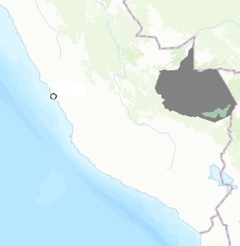
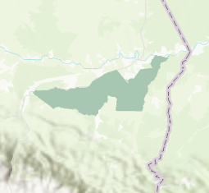
STUDY AREA
Study Period: January 2019-June 2020
Study Area: Madre De Dios, Peru
Tambopata National Reserve
Landscape
Rich biodiversity
Large rivers
Interoceanic Highway
Madre De Dios
Peru
Tambopata National Reserve
km
N
0
.0625
.125
.250
.375
.500
Notes:
Speaker: Caley
Our study area is the Madre de Dios region of Peru's Amazonia from January 2019 to June 2020.
We are focusing on this location due to its proximity to the Tambopata National Reserve, the rich local biodiversity, and large rivers.
This region is also home to major illegal gold mining sites such as La Pampa, which sparked the initial monitoring and reform acts by Peru's government.

Slide 3
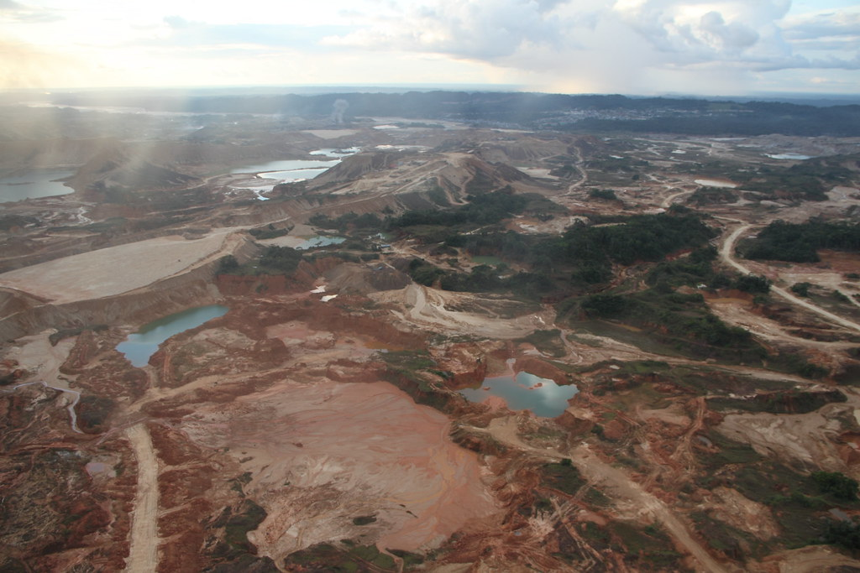
BACKGROUND
Artisanal and Small-Scale Gold Mining (ASGM)
Since 2009, more than 1,000 km² of rainforest in Madre de Dios has been cleared by illegal mining activities.
Gold extraction relies on bonding gold deposits with mercury, leaving behind toxic pollution from retention ponds.
Operation Mercury
National declaration of martial law to enforce restrictions on small-scale mining operations.
Image credit: Presidencia del Consejo de Ministros
Notes:
Speaker: Marco
The issue of illegal mining is complex, as the Peruvian government must balance their native biodiversity health, natural resource management, the health of local indigenous communities, and the economic interests of the nation's people.
The small-scale mining operations consist of slash and burn techniques to clear the forested landscape, followed by mass amounts of water mixed with mercury pumped into the ground to flush out gold deposits. When the gold rises, the mercury is removed from the gold and left behind to pollute the newly deforested and flooded landscape.
Mercury contamination is present in the air, water, and soil—harming local communities for generations.
There are increasing risks of the illegal miners coming into contact with local farmers and indigenous communities as they expand their mining operations throughout Madre de Dios' forests.
Operation Mercury: in February 2019, approximately 1,200 Peruvian police officers were sent into the La Pampa mining site to cease operations and enforce national efforts against the illegal mining.
Image credit: "Madre de Dios operativo de interdicción contra la minería ilegal" by Presidencia del Consejo de Ministros is licensed with CC BY-NC-SA 2.0. To view a copy of this license, visit https://creativecommons.org/licenses/by-nc-sa/2.0/
https://www.flickr.com/photos/prensapcm/14063657785/in/album-72157644425802645/

Slide 4
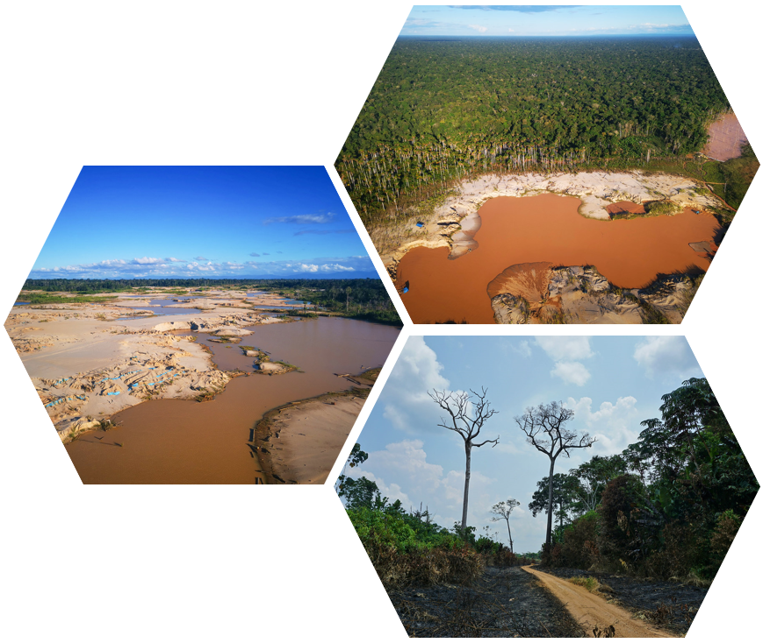
COMMUNITY CONCERNS
Mercury contamination in soil and freshwater resources
Compromising indigenous water resources
Ruining local agricultural plots
Loss of wildlife habitat
Public funds being diverted to combat mining
Image credit: Ministerio de Defensa del Peru, CIFOR
Notes:
Speaker: Marco
Madre de Dios is a biodiversity hotspot, and local communities still heavily utilize traditional methods of resource acquisition from the rainforest and its species.
Because mining involves clearcutting and burning trees, as well as flooding the landscape, many species are displaced, and resources are ruined. The flooded soil is filled with mining wastes, making it hazardous and unusable for farming.
Mercury contamination in the soil, water, and air also pose a massive threat to the health of communities in the area.
Madre de Dios operativo de interdicción contra la minería ilegal" by Presidencia del Consejo de Ministros is licensed with CC BY-NC-SA 2.0. To view a copy of this license, visit https://creativecommons.org/licenses/by-nc-sa/2.0/
https://www.flickr.com/photos/92793865@N07/40799022833
CIFOR, https://www.flickr.com/photos/45423546@N07/31199847008
Ministerio de Defensa del Peru, https://www.flickr.com/photos/ministeriodedefensaperu/46848900975/in/album-72157678049191007/

Slide 5
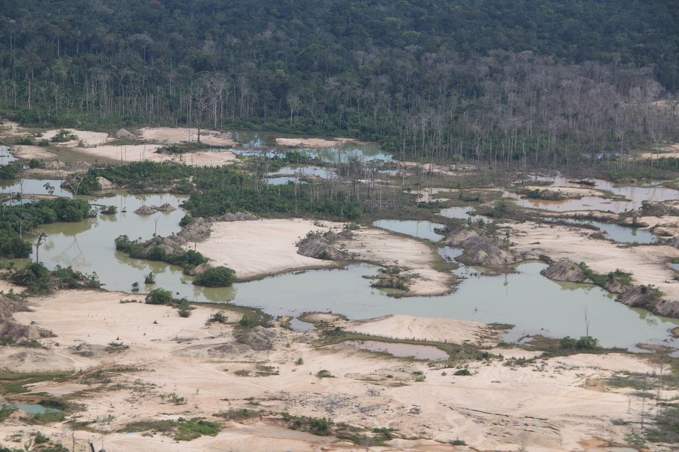
PARTNERS
The Asociación para la Conservación de la Cuenca Amazónica (ACCA)
Andean Amazon Conservation
Monitoring of the Andean Amazon Project (MAAP Project)
Identifying deforestation in real-time
NASA SERVIR
NASA & U.S Agency for International Development (USAID)
Earth observations for environmental decision-making in developing countries
Image credit: Presidencia del Consejo de Ministros
Notes:
Speaker: Caley
Our partner organization, The Asociación para la Conservación de la Cuenca Amazónica (ACCA), is an Amazonian conservation organization working to preserve South America's Amazon rainforest.
ACCA has been working on addressing the illegal mining issue, including their Monitoring of the Andean Amazon Project (MAAP Project) utilizing remote sensing methods to identify and monitor mining activity throughout the region.
We are also supported by NASA SERVIR, a joint venture between NASA and the U.S. Agency for International Development (USAID) that utilizes earth monitoring and mapping technologies to evaluate ecological threats and respond to disasters in nations worldwide.
Image credit: Presidencia del Consejo de Ministros, https://www.flickr.com/photos/74492578@N04/14040535976 is licensed with CC BY-NC-ND 2.0. To view a copy of this license, visit https://creativecommons.org/licenses/by-nc-nd/2.0/

Slide 6
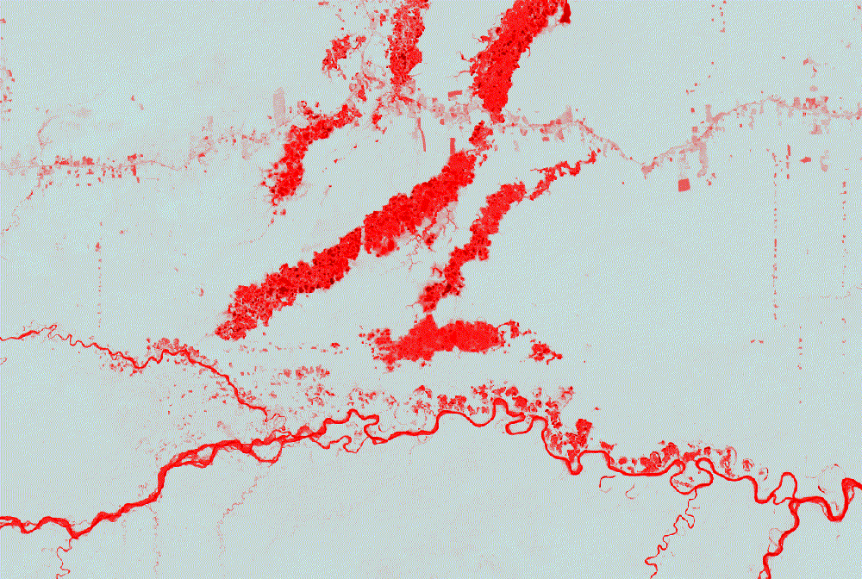
OBJECTIVE: ASSESS CHANGE DETECTION
Assess the performance of a change detection algorithm
Create a new sampling methodology
Stratified Random Sampling
Incorporating Landsat-8
Improve overall accuracy of ACCA's change monitoring app
Timelapse of mining scars in Madre de Dios, Peru
Visualized in Google Earth Engine using NDVI on Landsat 8 Tier 1 Surface Reflectance Imagery
Notes:
Speaker: Perren
Initial efforts by ACCA to aid Peru's national effort to halt illegal gold mining included the development of a Google Earth Engine app identifying new mining activity on a monthly basis. This processing was based on spectral unmixing analysis to monitor changes in photosynthetic vegetation to map and monitor deforestation in the region. This process proved accurate for detecting deforestation, but not specifically identifying deforestation caused by mining activity, which is what we aimed to refine.
To improve the initial change detection app, we needed to develop a new sampling methodology for generating sample points to test the algorithm against high resolution ground-truth imagery.
Perren will describe the objectives set forth by the team in relation to our partner's end goals and explain how each of these efforts (q-test, sampling, accuracy assessment) are significant. This will be less in-depth than the methodology slide but will give an overview of our goals to the audience and offer explanations of these terms.
Note: we may develop flowchart to better describe objective.

Slide 7
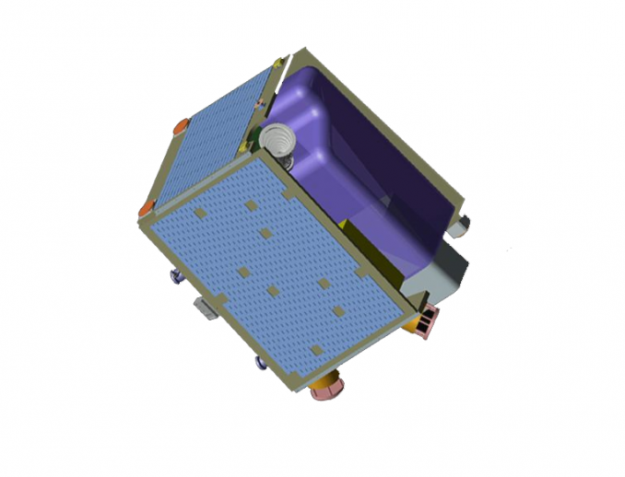
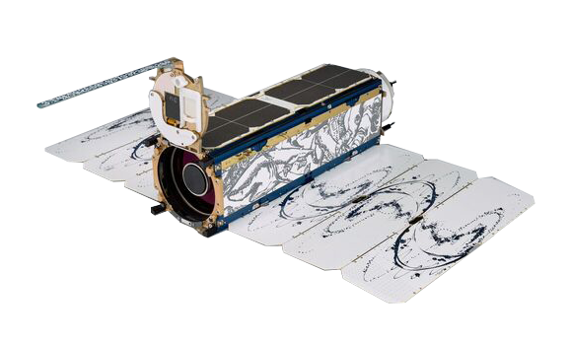
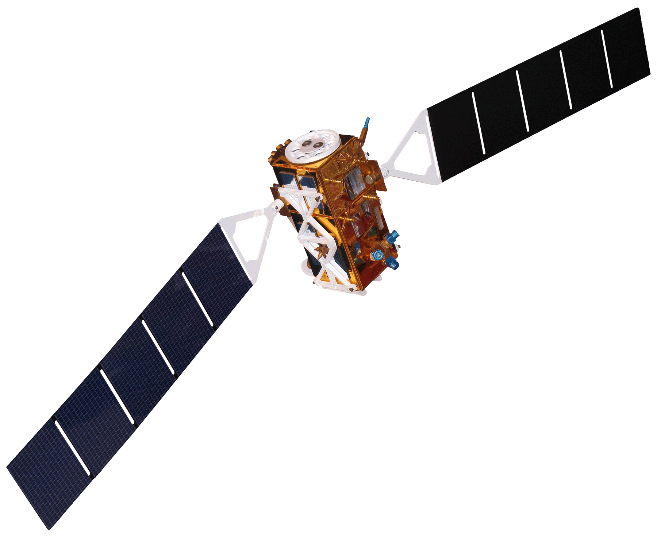
EARTH OBSERVATIONS
Landsat 8 Operational Land Imager (OLI) Tier 1 Surface Reflectance Imagery
Sentinel-1 Synthetic Aperture Radar (SAR)
PlanetScope 3.7-meter resolution RGB imagery
RapidEye 5-meter resolution RGB imagery
Landsat 8
RapidEye
PlanetScope
Sentinel-1
Image credits: NASA, ESA, Planet
Notes:
Speaker: Paxton
ACCA initially completed their change detection classification using Sentinel-1 SAR data and sampling for accuracy assessment using PlanetScope and RapidEye hosted through Collect Earth Online.
To ensure we utilized NASA data, we incorporated Landsat-8 surface reflectance imagery to support our sampling for reference data to be used in the accuracy assessment.
PlanetScope and RapidEye were useful because of their very high spatial resolution for ground truth accuracy, while Landsat 8 allowed us to incorporate SWIR bands for assessing soil and vegetation moisture.
Note: may refine this slide into a flowchart to better display the uses of each mission & its respective imagery. We will also be removing the backgrounds in the satellite images to save space.
Credit: Sentinel-1 ESA: Attribution-ShareAlike 2.0 France (CC BY-SA 2.0 FR) https://creativecommons.org/licenses/by-sa/2.0/fr/deed.en; PlanetScope: https://spacedata.copernicus.eu/planetscope; RapidEye: https://earth.esa.int/eogateway/missions/rapideye

Slide 8
METHODOLOGY
Sampled Data
In situ data
Landcover Classification
Change Detection Framework
Stratified Random Sampling
Landsat 8
Google Earth Engine
Collect Earth Online
Planet
NDFI
Analysis
Omnibus Q-Test
Accuracy Assessments
Notes:
Speaker: Paxton
As briefly covered in the Objectives section, our work included utilizing the Omnibus Q-Test, developing a sampling methodology, and completing accuracy assessments.
Our sampling methodology began by using ACCA’s change detection app based on Sentinel-1 SAR data, the team conducted stratified random sampling and assigned varying strata weights based on land cover class size. This process allowed for representative samples of each landcover class while maintaining random sampling. ACCA indicated a need to improve both spatial and temporal accuracy within their classification and required approximately 18 months of recent imagery to be assessed. To meet partner needs, the team used aggregated image sets for each month spanning January 2019 to June 2020 to enable accuracy assessment of both change within monthly time frames and change specifically caused by mining activity.
With these new samples, we validated their classification against high-resolution imagery (PlanetScope and RapidEye) in Collect Earth Online, before bringing these samples back into GEE to assess the accuracy through the omnibus Q-test and confusion matrices. NDFI was used in Collect Earth Online to track deforestation changes.
Note: we plan to revise this chart into something much more appealing and likely break down these steps across multiple slides.

Slide 9
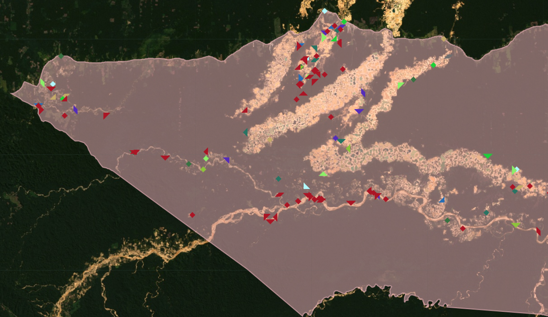
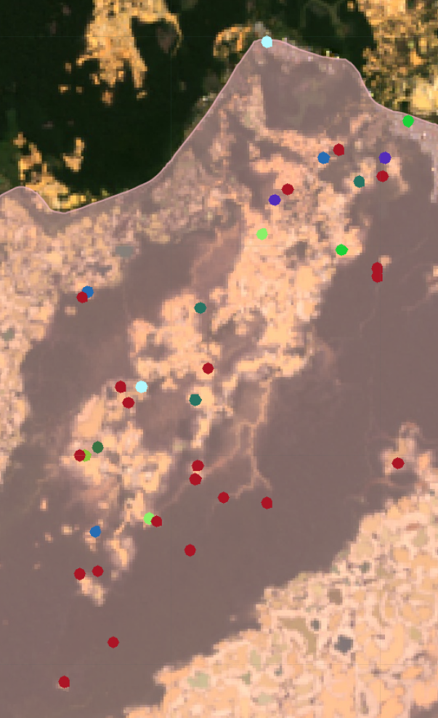
STRATIFIED RANDOM SAMPLING
Notes:
Speaker: Perren
To gather representative samples of our study area, we decided to use stratified random sampling to collect approximately 1,000 points across the study area.
These points were based on Q-Test identified change throughout the 18-month study period, and each sample color represents changes from the aggregated monthly imagery.
A lot of our change points fell in known mining areas, as well as along the major river.
Not shown are the no-change points, which largely represented the continuous forest landcover class.

Slide 10
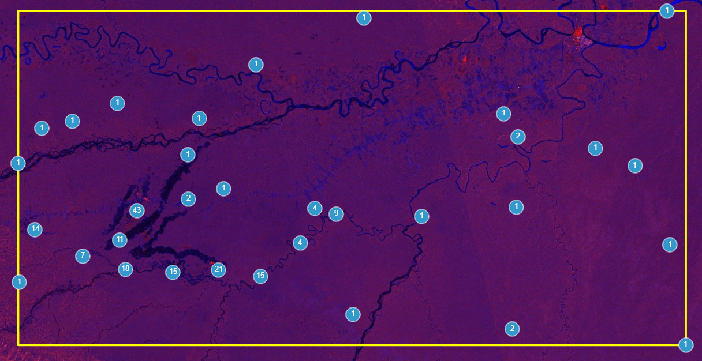
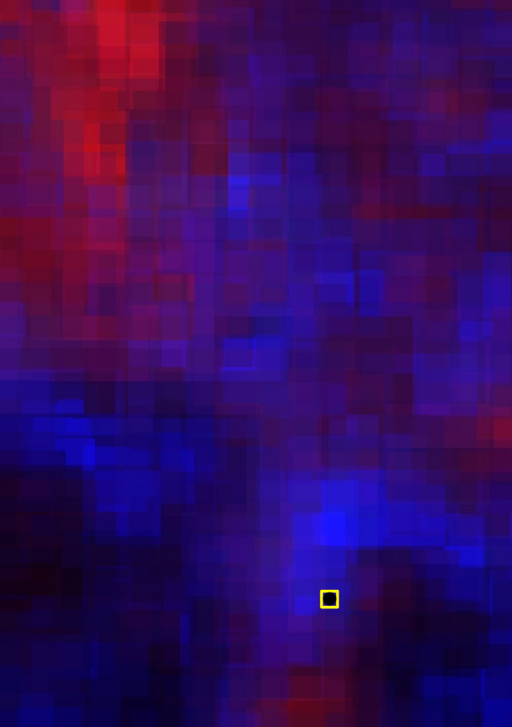
SAMPLING REFERENCE DATA
Collect Earth Online was used to identify areas of land change
Assessed plots using Sentinel-1, PlanetScope, and Landsat 8
Normalized Difference Flood Index for identifying deforestation
Notes:
Speaker: Caley
We then imported our points into Collect Earth Online; where we utilized Planet monthly imagery, Landsat 8 RGB bands, and Sentinel-1 SAR data to assess change.
Deforestation was measured through the use of a degradation tool calculating NDFI from Landsat and SAR data.
SAR data was especially useful as Peru has a 5-month rainy season and imagery was often difficult to assess.

Slide 11
RESULTS (CHANGE DETECTION)
Omnibus Q-test outputted a raster image where 1,050 points were generated as a random stratified sample
150 points for the no change class
50 points for each subsequent month of change
556 points were identified as no change
494 points were identified as change
19% of change points were identified as mining
40
RESULTS (Q-TEST)
30
Mining
No Change
Other
20
10
0
Mar ‘19
Aug ‘19
Jan‘20
Jun‘20
12
8
4
0
No Change
Mar ‘19
Aug ‘19
Jan‘20
Jun‘20
Notes:
Speaker: Perren
The q-test processed monthly-aggregated SAR data to track changes across the 18-month study period. From this, we produced our 1000+ samples, and processed them through CEO.
Of these points, approximately half were classified as "no change", while 494 were identified as change.
19% of the change points were mining
The variance predicted vs actual change went up over time

Slide 12
RESULTS (ACCURACY)
Overall Change
The Q-test method had 4 false positives compared to our data
The Q-test method had 391 false negatives compared to our data
The Producer’s Accuracy[1- false positives over total positives] was 99% for detecting No Change
The User’s Accuracy [1-false negatives over total percentage] was 97% for detecting No Change
1.2
1
0.8
0.6
0.4
0.2
0
No Change
Change
Producer’s Accuracy
User’s Accuracy
Notes:
Speaker: Perren
We had very low user accuracy in the change category, as we were able to recognize points that were classified as change but were instead due to algal blooms or agricultural crop cover change. We determined that the change algorithm was too sensitive and detected spectral changes did not reflect actual landcover change.
We also had a lot of false negatives, points that were identified as changes but were not.

Slide 13
SAMPLING RESULTS
Monthly Accuracy
1
0.8
0.6
0.4
0.2
0
No Change
Mar ‘19
Aug ‘19
Nov ‘19
Feb ‘20
Apr ‘20
Producer’s Accuracy
User’s Accuracy
Notes:
Speaker: Perren
This is the visualization of our data for each specific month
We can see no data for January 2019, because this was the start of our study period and we did not access imagery from December 2018 to reference if change had occurred at some point in January. There is notably also high producer's accuracy in May 2019, which may be attributed to high clarity imagery in the middle of Peru's dry season. We also found that imagery in the rainy season, primarily in December 2019, nearly always contained too much interference to adequately attribute change that may have happened in this month.

Slide 14
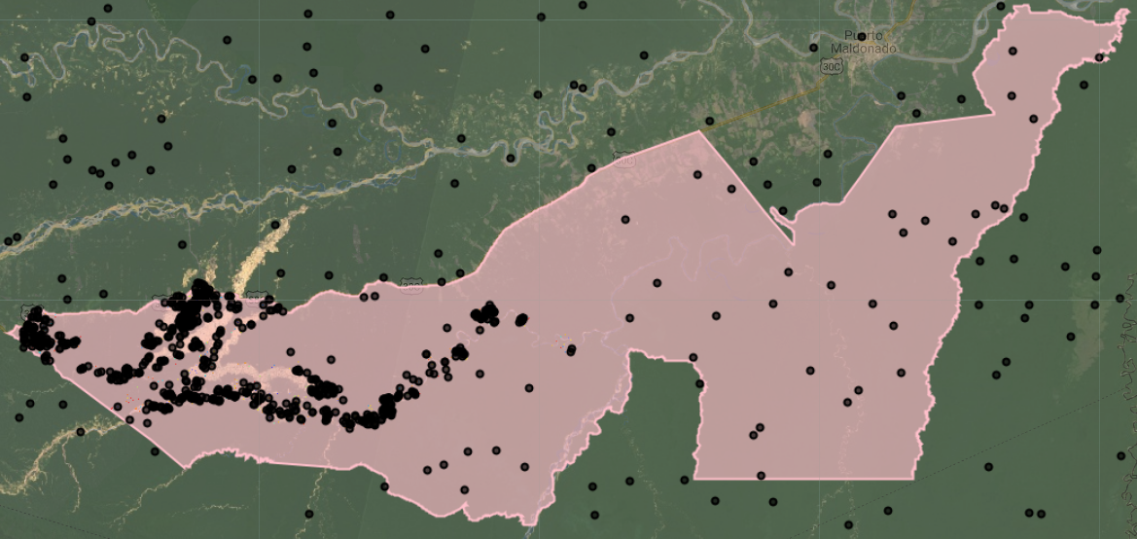
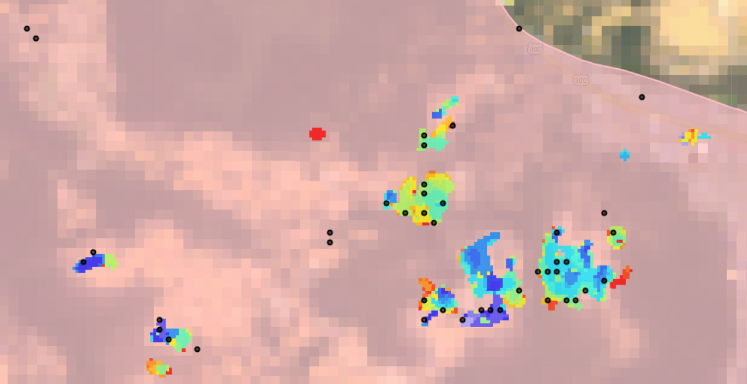
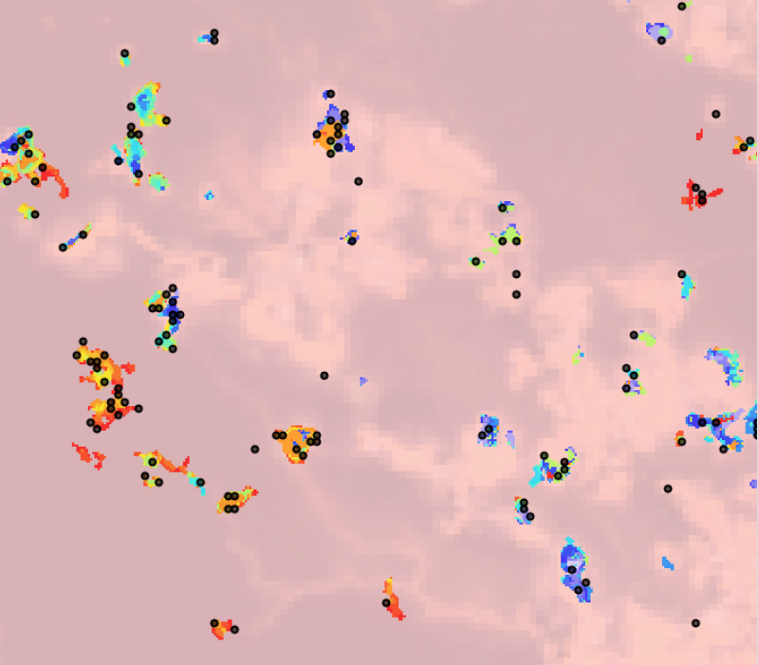
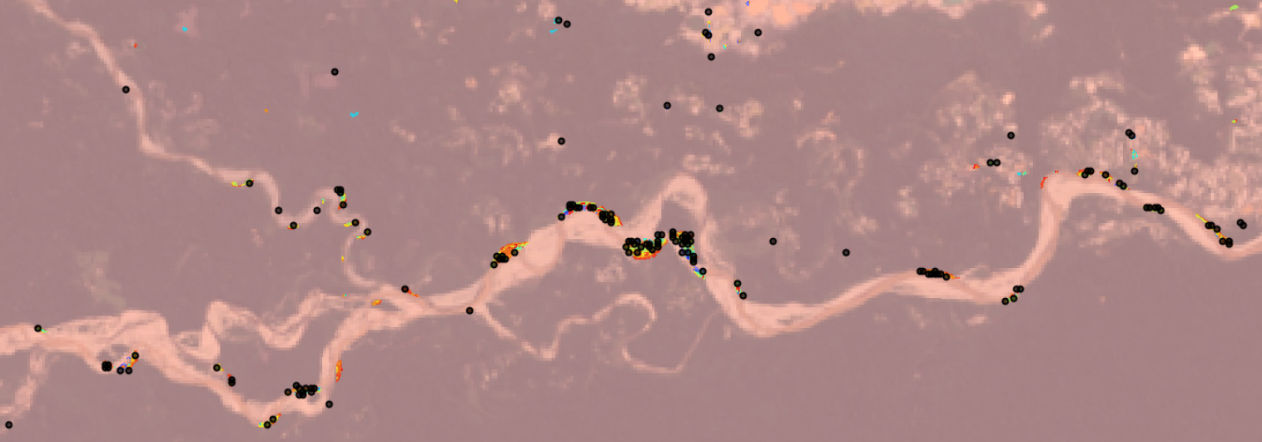
REFINING CHANGE DETECTION
Notes:
Speaker: Paxton
Post-sampling, we decided it would be useful to run a sieve filter over the SAR change map and exclude change that had been recorded at a single-pixel level. This change was likely due to speckling and contributed to our low user's accuracy. We found that a significant portion of our samples had been highlighting single-pixel changes, which should be excluded in the future.
We also realized that we made an error in our GEE sampling, and collected samples in and around our study area, as opposed to only in our study area, also creating issues.
Areas of consistent change, visualized above in multicolored polygons, were largely concentrated in known mining areas and around the main river. While a fair number of pixels coincided with the change areas, there were considerable samples that ultimately represented single-pixel changes.

Slide 15
CONCLUSIONS
1
Low Accuracy: Our consistently low accuracies across the study period indicates flawed temporal sampling methodology; not an error with the Q-Test algorithm.
2
Sensitivity to Change: The sampling algorithm identified areas of change that did not reflect differences in landcover and needs to be refined.
3
Minimum Mapping Units: Change identified can be attributed to speckling and poor imagery, pre-processing did not include filtering for single-pixel changes.
Notes:
Speaker: Marco
This slide will focus on our interpretation of our methodology and results. This will include our thoughts on the process and our decision-making, including the inclusion of Landsat-8 imagery and aggregating the imagery by month. We found that the algorithm would have benefitted from further pre-processing, including adjusting the thresholds for recognizing change.

Slide 16
FUTURE WORK
1
More sample points: Compile more sample points to provide additional training to the model
2
Use daily images: Daily images could be used over monthly composites to provide more accurate detection of when the change occurred
3
Assess misclassification time period: Assess how many months off the misclassifications are to see if there is a common time span of misclassification
Notes:
Speaker: Caley
One of the major components of our accuracy assessment portion of the project was identifying considerations for future refinement efforts. We have a lot of ideas for different pre-processing before running the algorithm, and different image transforms / statistical measures that may help increase the algorithm's land classification accuracy. Here we will discuss our recommendations, and future work that ACCA can do with our contributions to continue supporting Operation Mercury. This includes the three recommendations above—as most of our sources of error concerned the temporal components of the analysis.

Slide 17
Questions

Slide 18
Dr. Jeffery Luvall (NASA Marshall Space Flight Center)
Dr. Robert Griffin (The University of Alabama in Huntsville)
Kelsey Herndon (NASA SERVIR Science Coordination Office)
Andréa Puzzi Nicolau (NASA SERVIR Science Coordination Office)
John Dilger (Spatial Informatics Group)
A.R. Williams (DEVELOP Fellow at Marshall Space Flight Center)
Christine Evans (The University of Alabama in Huntsville)
Helen Baldwin (NASA SERVIR Science Coordination Office)
Madison Murphy (Optimal GEO)
This material contains modified Copernicus Sentinel data (2019, 2020), processed by ESA.

Slide 19
Backup Slide

Slide 20
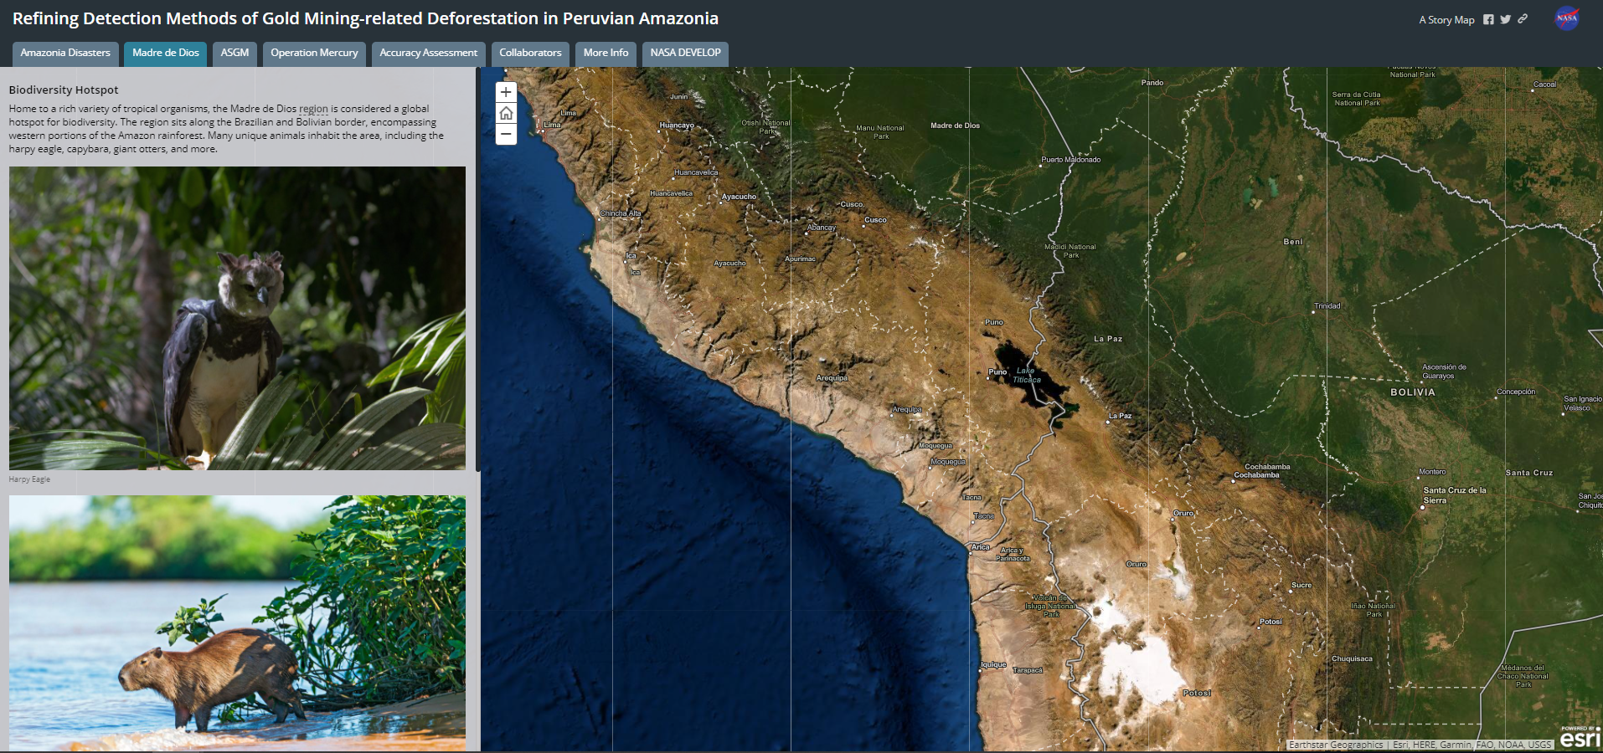
AGOL StoryMap
Notes:
To communicate the results of this project, the team produced a creative communication tool via the public facing StoryMap in ArcGIS Online.

