Slide 1
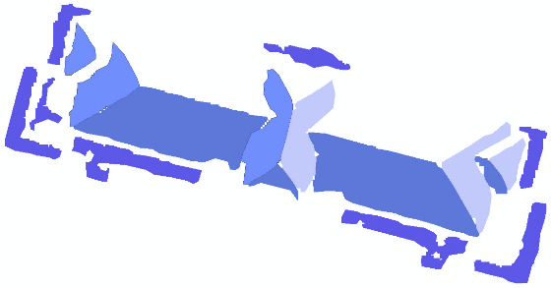
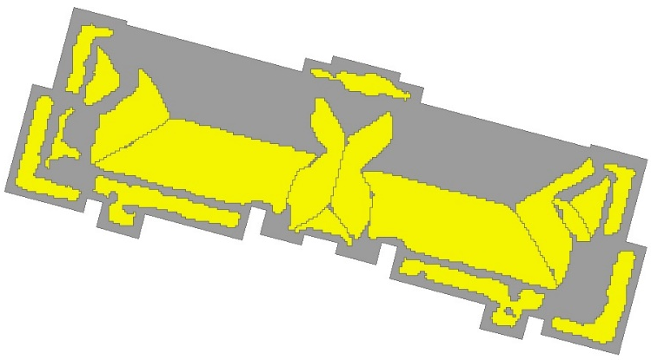
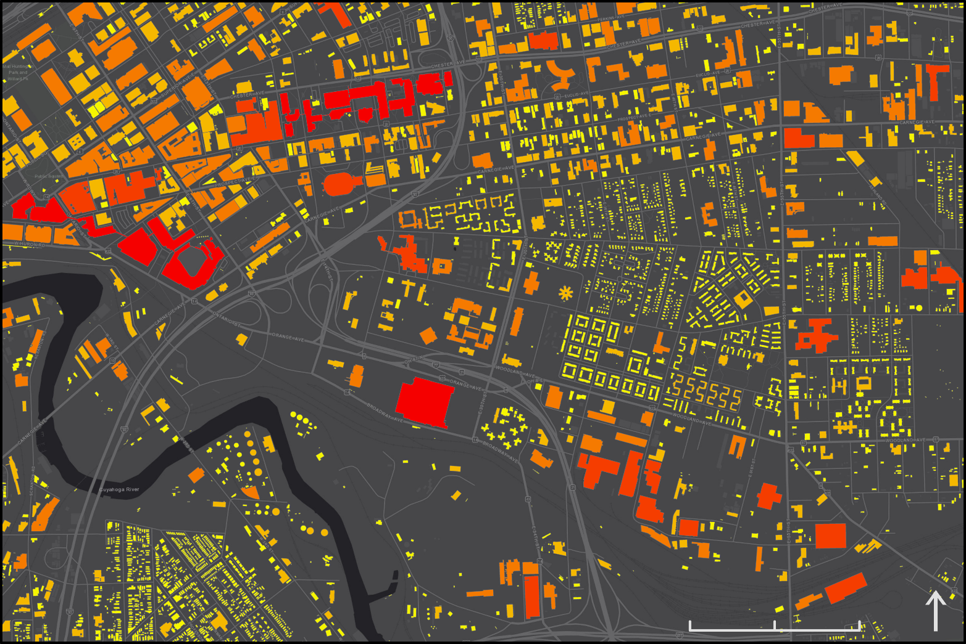
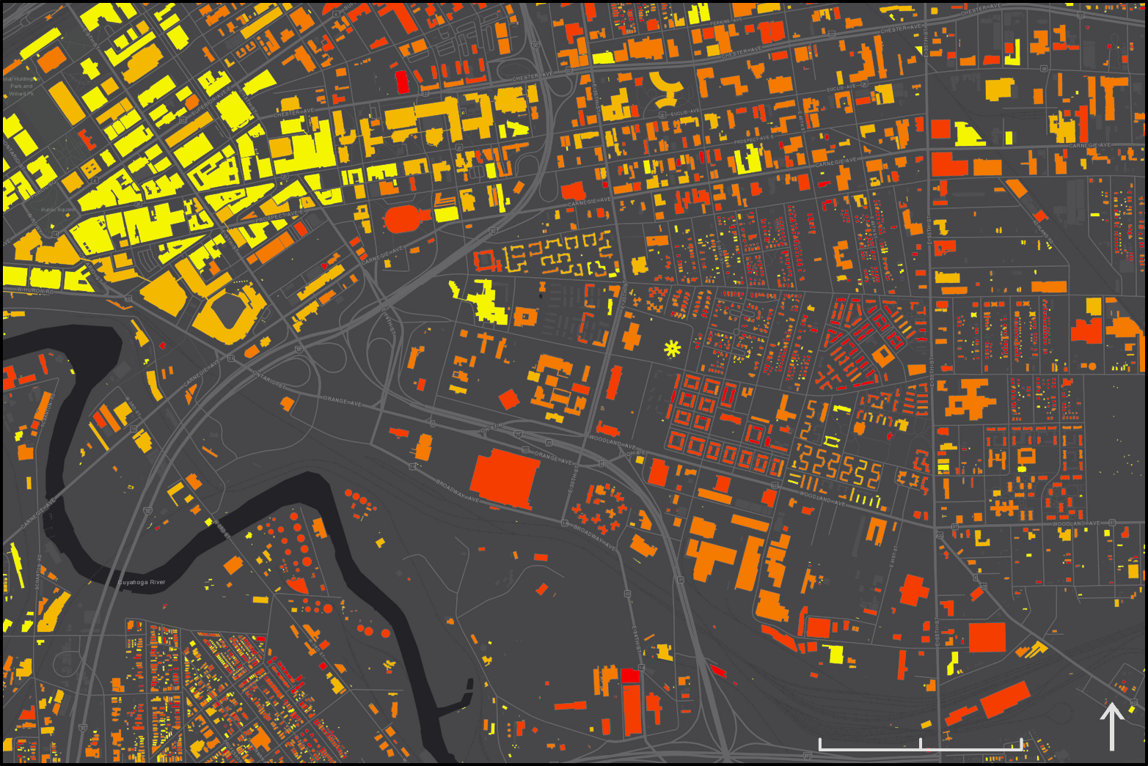
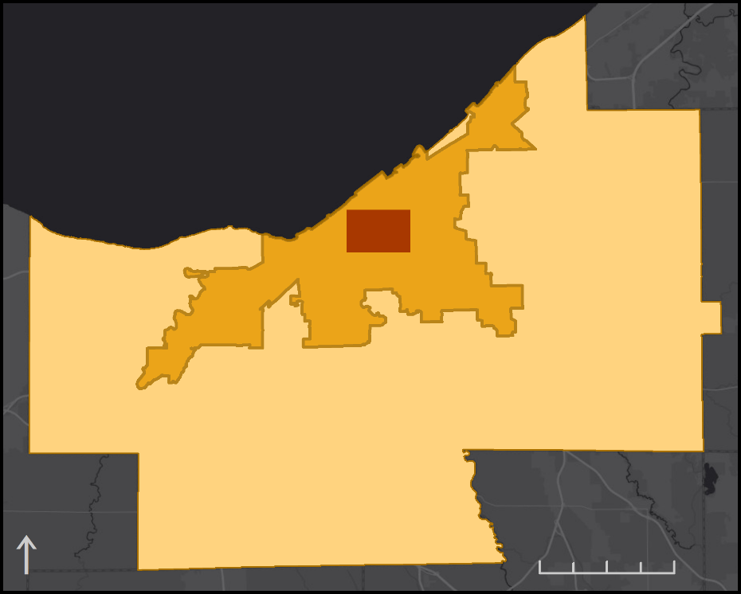
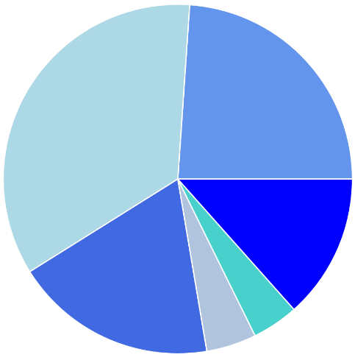
Restructuring the Energy Balance in Ohio by Quantifying Energy Loss and Solar Potential Using NASA Earth Observation and LiDAR
Abstract
Methodology
Ohio Energy
Cities around the globe are adopting clean energy technologies to ensure sustainable development and address the impacts of a changing climate. The City of Cleveland and Cuyahoga County in Ohio have committed to 100% renewable energy by 2035 and 2050, respectively. To help them achieve their clean energy goals, we created a method for generating a solar power potential map and an estimation of potential kilowatt hours within viable locations. Our team used NASA Prediction of Worldwide Energy Resources (POWER) data generated from the CERES and MODIS satellite instruments to estimate incoming solar irradiation and the effects of clouds and aerosols. The main determining factors in identifying areas with high solar potential were shadowing, aspect, and irradiation values dependent on tilt angle. Our methods are an improvement over existing solar potential estimation tool analyses because we used a high resolution (1ft) digital surface model derived from LiDAR data, which allowed for detailed shading, slope, and aspect modeling, and because we adjusted irradiance according to roof slope rather than assuming a horizontal surface irradiation. Additionally, we calculated solar potential per individual roof segment, thereby avoiding an overestimate from inclusion of unsuitable rooftop locations. Results showed that downtown test areas had appreciable solar potential losses due to shadowing from nearby buildings, but there is still significant potential for solar energy generation when kilowatt hours are calculated for viable areas. These methods have the capacity to be applied to the entire county and to other regions seeking to efficiently utilize solar energy.
We generated a new method to automatically identify roof segments for solar power production. With these data we calculated the potential annual energy production per building.
Solar irradiation by tilt (NASA POWER)
X
Annual sun exposure
X
Surface area corrected for slope
Modeled solar energy potential
Generated polygons of roof segments based on slope and aspect, eliminating north-facing and steep (>60º)
Calculated energy production efficiency and total energy potential per building
Objectives
Results
Evaluate average annual solar insolation potential in Cuyahoga County and the City of Cleveland using LiDAR and NASA Earth observations
Estimate average annual energy generation potential for selected rooftop segments
Identify socioeconomic and land use attributes for buildings with high solar potential
Total Solar Energy per Building
(amount of energy produced)
Solar Energy Normalized by Surface Area
(efficiency of production | energy divided by area)
Study Area
Lake Erie
0 0.25 0.5
0 0.25 0.5
mi
mi
Test Area
0 – 10 10 – 30 30 – 100 100 – 300 300 – 660 Total Energy (MWh/yr)
0 – 2 2 – 3 3 – 5 5 – 10 10 – 738
Normalized by Area (kWh/yr・ft²)
Cleveland
x10⁵
Cumulative Sum of Solar Energy for 2945 Buildings Ordered Most to Least Productive
Total Potential Solar Energy By Land Use
0.8
0.4
0.0
Commercial
Residential
(1-2 Family)
Cumulative Solar Energy (MWh/yr)
~94,000 MWh
560 buildings
35%
Industrial
24%
Cuyahoga County
Residential (Multi-Family)
13%
0 3 6
0 1000 2000 3000
19%
Other
Institutional
mi
Building Count
5%
4%
Earth Observations & Products
Conclusions
This method is a useful tool for determining high priority buildings for solar panel installation and will help Cuyahoga County and the City of Cleveland achieve their 100% renewable energy goals.
Within the study area, 85% of the total potential energy could be generated by the 560 top-producing buildings.
This model can be adapted to multiple locations by altering parameters for local solar installation practices and irradiation data.
SRTM
NASA Prediction of Worldwide Energy Resources
Project Partners
Acknowledgements
City of Cleveland, Office of Sustainability
Cuyahoga County, Department of Sustainability
NASA DEVELOP:
Dr. Nicholas B. Rajkovich – Science Advisor, University of Buffalo
Dr. Dave Hondula – Science Advisor, Arizona State University
Erika Higa – Center Lead
Megan Seeley – Geoinformatics Fellow
NASA POWER:
Dr. Paul Stackhouse Jr. – Senior Research Scientist and Principal Investigator
A. Jason Barnett – Geospatial and Technology Developer
Brian Tisdale – Booz-Allen and Hamilton, Inc.
Partners:
Mike Foley – Department of Sustainability Director
Dan Meaney – Cuyahoga County Planning Commission Manager
Anand Natarajan – Mayor’s Office of Sustainability Energy Manager
Elizabeth Lehman – Mayor’s Office of Sustainability Energy Analyst
Solar Panel Experts:
Robert Martens – Better Together Solar President/CEO
Al Frasz – Dovetail Solar and Wind President
Team Members
Hannah Besso
Project Lead
Yiyi He
Crystal Wespestad
Sihang Chen
Arizona – Tempe | Summer 2019

