Slide 1
Website & Booklet Imagery Spring 2019
Project Short Title
DEVELOP Node Name (Ex. Virginia – Langley)

Slide 2
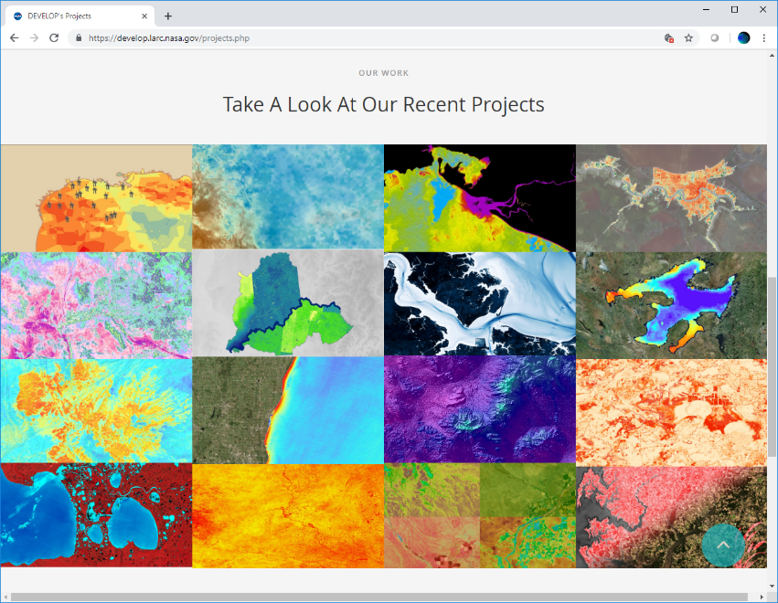
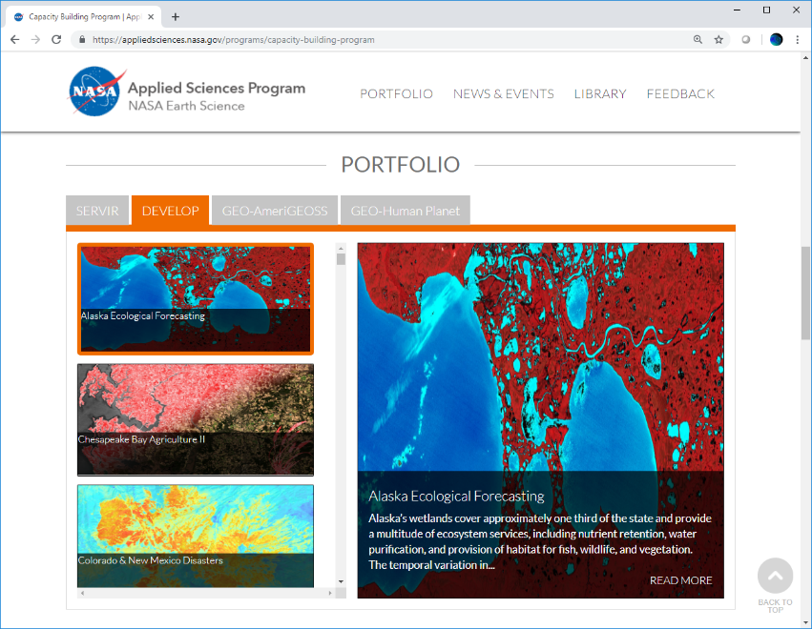
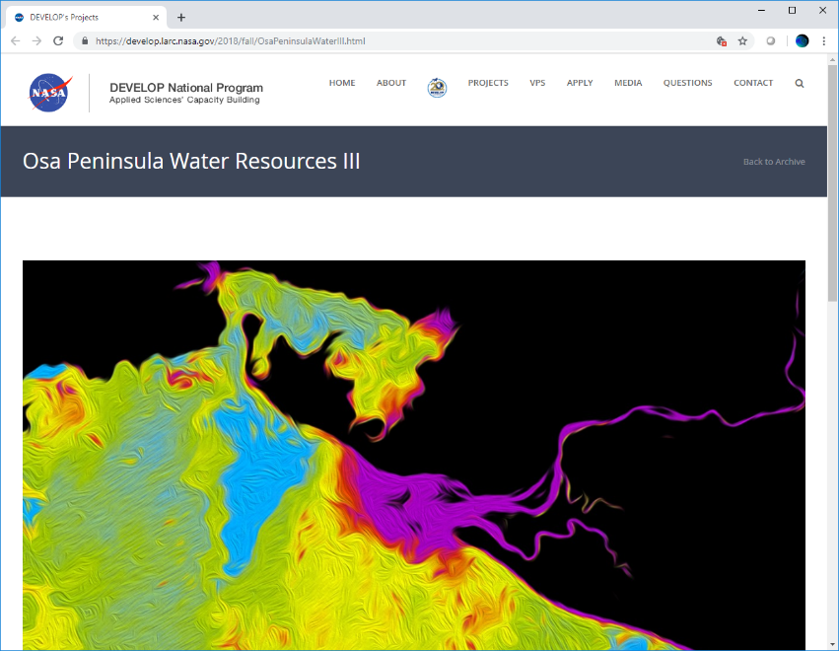
Web/Booklet Image: Purpose & Overview
This image should be an attractive, processed image of your study area that will be used to represent the project. This image will be used as a cover image on the project page of the DEVELOP website, the project’s close-out presentation image, the project image on NASA’s Applied Sciences eBooks website, a Summer Booklet image, and imagery that can be used by DEVELOP’s communications team for future publications and promotional materials.
Delete this slide before submission.

Slide 3
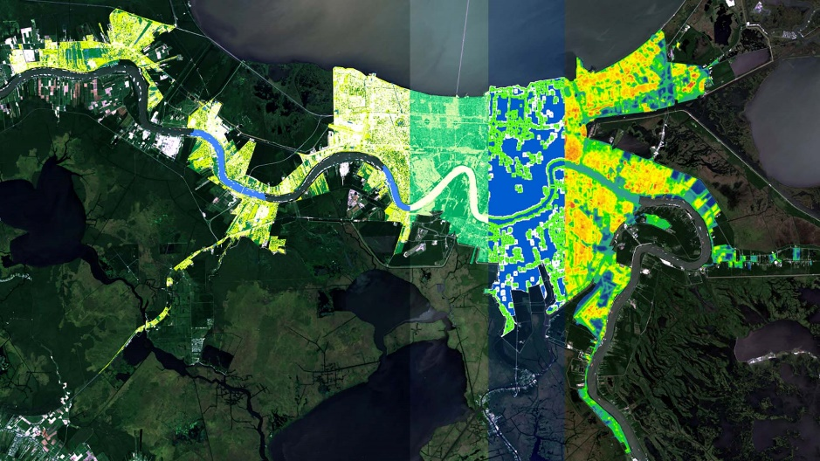
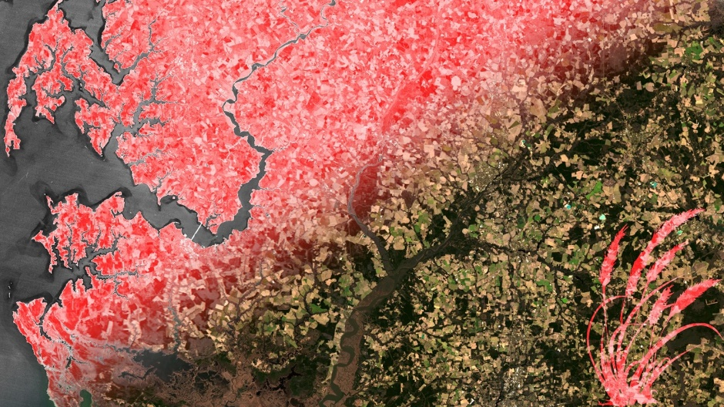
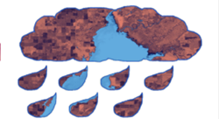
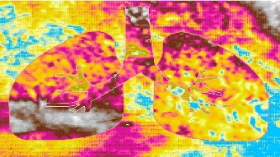
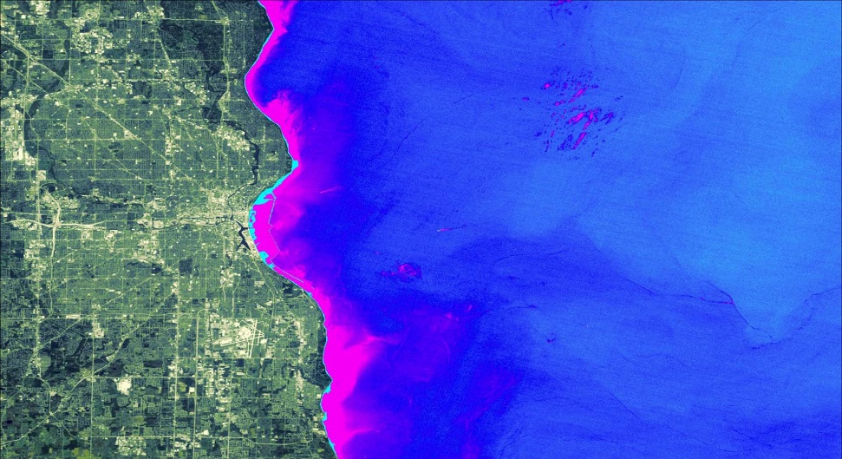
Web/Booklet Image: Requirements
High-resolution: 1920 x 1080 (300+ dpi), landscape orientation
You can use an online resizer like this one → http://resizeimage.net/
Saved as a JPEG or PNG
At least one image provided is derived from recent data (2018-2019)
The entire frame is filled with imagery, meaning absolutely NO white space
Cannot be clipped to a shape or large, clip art style overlays
Delete this slide before submission.
https://develop.larc.nasa.gov/projects.php

Slide 4
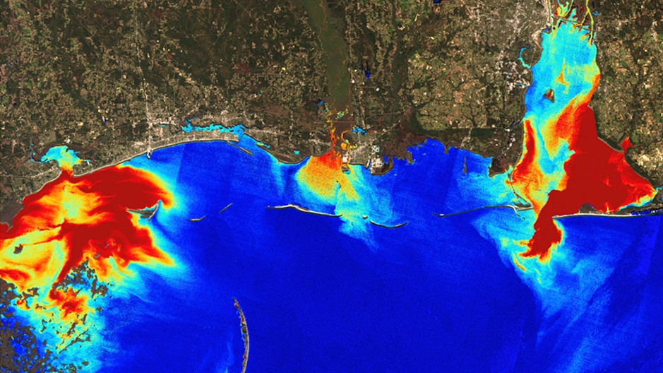
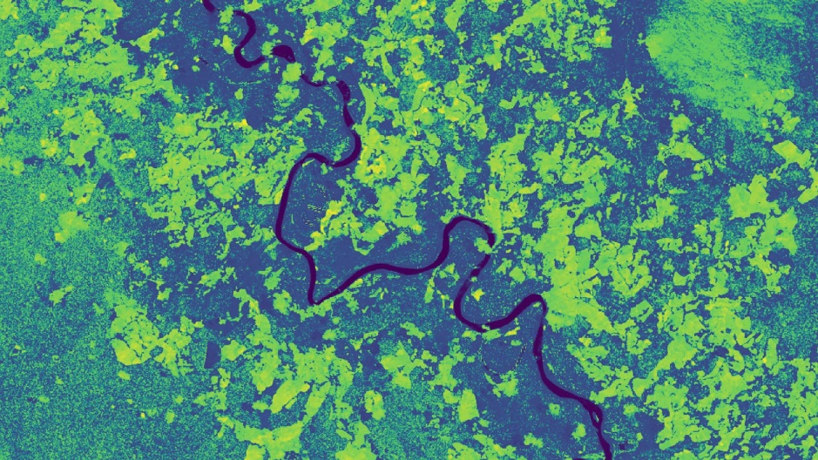
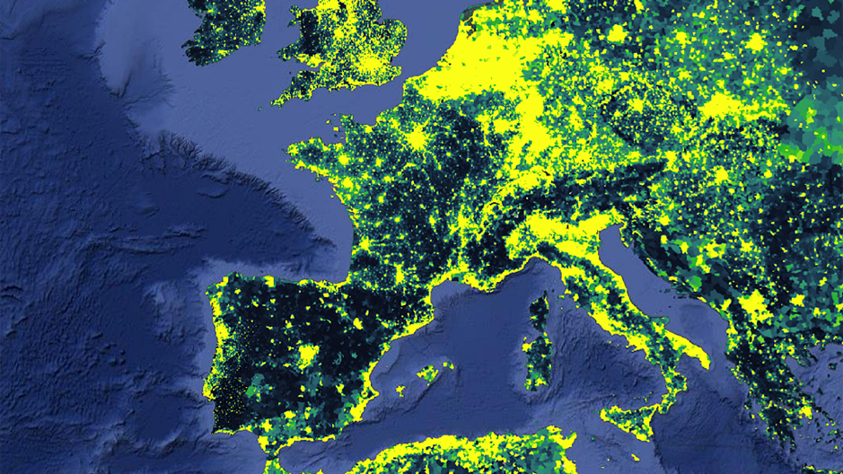
Web/Booklet Image: Requirements
Image is derived from NASA sensor data
Not from an outside source
Not a photograph of the team or a landscape
Why? DEVELOP is a NASA-funded program that is focused on highlighting NASA data applications.
Exception: NC projects can use CDR data if necessary
Some kind of processing has taken place
The team actually created the image
Not just a raw satellite image or simple re-order of spectral bands (false color composite)
Including non-NASA data along with NASA data in the creation of your image is fine, but you can’t include a map or diagram someone else made.
Delete this slide before submission.

Slide 5
Web/Booklet Image: Captions
Questions to answer:
What satellite & sensor do the data come from?
What is the date(s) of data?
What is the data showing? (i.e. precip, turbidity, land cover, etc.)
Where is the image?
What is the general interpretation and/or analysis of data
What does the color scale represent?
Not so great captions:
“Las Cruces Heat”
“CERES data overlaid on a solar site development suitability map.”
“Segmented tree canopies colorized by heights, showing stem density within the study area.”
“Slope raster embedded with bison image.”
Delete this slide before submission.

Slide 6
Web/Booklet Image: Captions
Here are some example Website Image captions:
“NDVI-processed imagery using 2017 Landsat 8 OLI data, blended with true color band combination (4, 3, 2). The Eastern shore of Maryland, located in the Chesapeake Bay, is displayed. Lighter shades of red indicate less healthy vegetation and darker shades indicate healthier vegetation. Less healthy vegetation indicates areas where local stakeholders should divert more resources.”
Link: https://develop.larc.nasa.gov/2018/fall/ChesapeakeBayAgII.html
“Mean GPM IMERG daily precipitation (2017-2018), processed Sentinel-1 C-Band SAR imagery (2018), and NDWI calculated using Landsat 8 OLI imagery (2017-2018) reflected for the Ohio River Basin within Kentucky, Illinois, and Indiana. High mean precipitation is in blue, water detected in NDWI is in blue, and processed Sentinel-1 imagery removes speckle and noise. Focusing on land represented by deep blue hues allows emergency teams to know where flooding may occur.”
Link: https://develop.larc.nasa.gov/2018/fall/OhioRiverValleyTI.html
Delete this slide before submission.

Slide 7
Delete this box and place image here.
In the case you’d like to submit more than one image, duplicate this slide.
Project Short Title Here
Caption: Make sure to include what NASA satellite/sensor and date from which the image is derived. You should also include what the image is (EX: NDVI) and how it can be used for decision making. 75 word limit.
Metadata Tags: List any keywords or project participant names that you would like to be included in the photo’s metadata.

