Slide 1
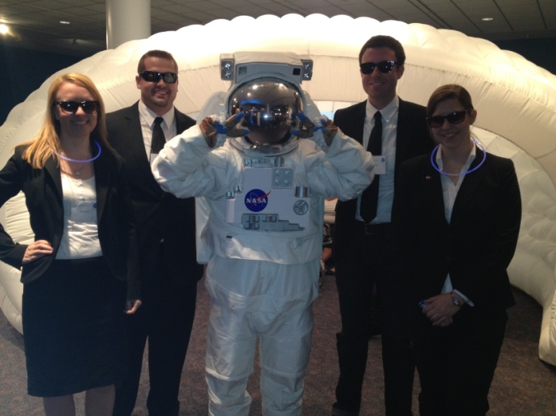
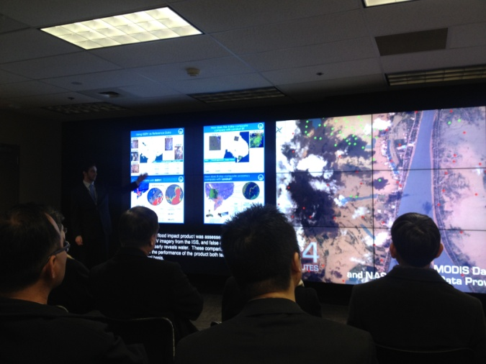
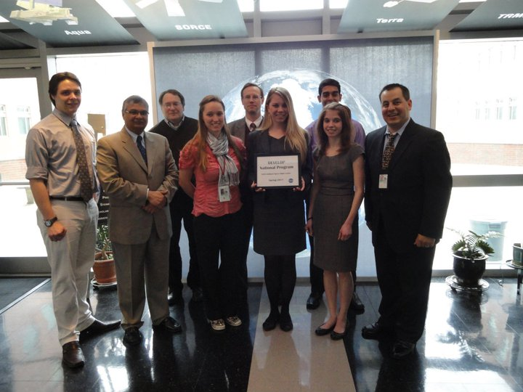
DEVELOP National Program
Participant Expectations :
General Guidelines & Best Practices

Slide 2

Handbook
Provides participants with the policies and procedures of DEVELOP, as well as an overview of NASA’s Applied Sciences & Capacity Building elements, rules of conduct, operational guidelines, information about deliverables and resources available.
Read the handbook and fill out and sign the signature pages your first day in the office. Your Center Lead will collect and return the following forms to NPO:
Statement of Understanding & Agreement
Media Release
Drug Free Work Place and Sexual Harassment
Non-disclosure Agreement
Patent, Copyright & Intellectual Property Agreement
Travelers’ Responsibility Agreement
Emergency Contact Information
The handbook is the best resource for information,
if you have a question - check there first!

Slide 3
General Guidelines & Expectations
Be on time for work!
Attend meetings and lectures as directed.
DEVELOP is a drug-free workplace.
Harassment of any type will not be tolerated.
Have an open mind. Do not discriminate; learn from people who differ from you.
Be mindful of those around you, your actions and other’s property - you represent the DEVELOP Program and your team’s location.
ALL research is the property of DEVELOP.
You must have permission from your Center Lead and NPO BEFORE submitting or presenting your project anywhere.
Be flexible, changes will occur! Learn to expect the unexpected!

Slide 4
Individual Responsibilities
DEVELOP participants are expected to follow rules and regulations of their team’s location, their sponsoring grant organization, and DEVELOP.
Respect yourself, everyone else, and property belonging to other people. Do not steal or damage materials.
Demonstrate integrity. Never plagiarize; it is punishable by law.
Act fairly and promote harmony in the work place by showing common courtesy to other participants.
Encourage a positive working environment; profanity and lewdness are not permitted.
The nature of the DEVELOP Program necessitates that each participant be willing to accept tasks that arise unexpectedly.
Maintain a positive attitude. A person’s productivity is directly affected by the attitudes of the people around them, so striving for a positive outlook in the work place is of the utmost importance.
Abide by the dress code
Have fun and learn! ☺

Slide 5



DEVELOP’s Signature Dress Code
Business Casual:
  Pants: Khakis or slacks
  Skirts: Appropriate business skirts at/near knee length
  Dresses: Appropriate length (at/near knee) dresses, no spaghetti straps
  Shirt: Collared shirts, polo shirts, blouses, sweaters
  Shoes: Dress shoes (no sandals, no sneakers, no flip flops)
  Accessories & Make Up: Be conservative
Formal Presentations:
Formal Suits (Dark Colored - Black, Navy, Gray) & Dress Shoes
  Dress Code Don’ts:
  Jeans, tennis/running shoes (except on designated days)
  Pants that droop and display underwear
  Shorts
  Shirks shorter than 3 inches above the knee when seated
  Halter tops or exposed midriffs
  Revealing, too tight clothing
  Shirt straps narrower than 2 inches wide
  Sweat pants, sweatshirts, T-shirts
  Attire with vulgar, violent or explicit language or images
  Multiple body piercings, hats, bandanas, etc.
  No flip-flops of any kind
  Unkempt attire

Slide 6

Cell Phone Usage
Ringers should be set to silent or vibrate during work hours
Cell phone usage should be kept to a minimum, including texting
Personal phone calls should be made during lunch or before/after work

Slide 7
Use of Government Equipment (@NASA)
US Government computers are for authorized users only
It is NASA's policy to permit limited personal use of Government office equipment, including information technology (IT)
The limited personal use of Government office equipment by NASA employees and contractors shall not interfere with official business, violate existing laws, and should involve only minimal additional expense to the Government
Unauthorized use of the computer accounts and computer resources to which you are granted access is a violation of Federal Law; constitutes theft; and is punishable by law
Misuse of assigned accounts and accessing others' accounts without authorization is strictly forbidden
Failure to abide by these provisions may constitute grounds for termination of access privileges, administrative action, as well as civil or criminal prosecution
NASA 2540.1G & NPR 2810.1A: http://insidenasa.nasa.gov/ocio/policy/policy_direct/index.html

Slide 8
Privacy
Expect NO privacy when using a government computer.
Strict computer use policy in effect - every keystroke is stored, every NASA email is public domain.
NASA Policy:
NASA employees and contractors do not have a right to expect privacy while using Government office equipment at any time, including accessing the Internet and using email.
The Government maintains call details and network access records to monitor telephone activity and Internet access.
The Government also employs monitoring tools to track system performance and improper usage.
This applies to those emailing a NASA email as well.
NASA 2540.1G & NPR 2810.1A: http://insidenasa.nasa.gov/ocio/policy/policy_direct/index.html

Slide 9
Computer Usage
Online Policies:
Used for official purposes only, meaning absolutely no games, commercial radio or music/video downloads.
No Facebook, Twitter, etc. unless it’s for DEVELOP purposes!
Due to center-wide bandwidth considerations, streaming audio and video are prohibited unless for official business (project related is ok).
Limited personal emails are acceptable as long as they do not interfere with work.
Be mindful of the websites you visit and links you click on.
Be aware and careful of phishing attempts.
Software:
Installation of legally licensed software is permitted if the software is necessary to complete your project - but you must have approval from your Center Lead.
Do not make copies of proprietary software.
If you have questions regarding permissibility of software, please contact your Center Lead or IT POC.

Slide 10




Social Media
Facebook: www.facebook.com/developnationalprogram
Twitter: http://twitter.com/#!/nasa_develop
YouTube Channel: www.youtube.com/user/NASADEVELOP
Google+: http://ow.ly/auqy8
LinkedIn: www.linkedin.com/groups?gid=4343498&trk=group-name
Watch time spent on social media. If you are going to be on there you
should probably be on the DEVELOP pages writing nice things!

Slide 11
Communication
The Project Lead is the main point of contact to science advisors and project end-users/contacts
  Emails
  Telephone calls
  Meetings
Each team has access to a phone. If the phone rings, answer it with something like “DEVELOP Program, this is <name>. How may I help you?”
Emails relating to DEVELOP business or to NASA personnel must be approved by your Center Lead or DEVELOP NPO before they are sent outside of DEVELOP
CC the Center Leads when sending project related emails
Take advantage of - and seek out - opportunities!
Remember, your experience is what YOU make of it!

Slide 12
Payments & Taxes
Participants are paid on a step scale based on education level
  In order for a participant to qualify for the next step pay rate, the individual must be currently taking classes or graduated at that grade level
    Example, a participant who finishes their sophomore year in the spring is only eligible to move to the next pay step in the fall once he/she begins taking junior level classes
Taxes are NOT withheld from participants’ consulting checks
  It is the participant’s responsibility to pay any taxes if and when they are due, so it is wise to familiarize yourself with IRS and state specific guidelines regarding independent consultants and consult a tax specialist regarding your tax situation.
  One exception: Foreign nationals who are from countries that do not have a tax treaty with the United States will see an automatic 30% of their payment withheld by their funding organization and sent to the IRS.
    To see which countries have tax treaties with the US visit this website - www.irs.gov/publications/p519/ar02.html#en_US_2013_publink1000222821.

Slide 13
Travel
Any travel funded by the DEVELOP Program will be coordinated through the DEVELOP NPO. Travel is a privilege and must or originate from the NPO.
Travel Process:
  If a location finds a conference or meeting they are interested in attending, a request for travel must be submitted to the DEVELOP NPO - A template for the request for travel is available, including description, proposed attendees, and justification for the travel
  The NPO will assess merit of the event and funds available
  If approved to attend as a DEVELOP representative, travel requests must be submitted for the travel to be approved by the funding contract
  Once approved, travel arrangements (if needed) will be made by NPO and reimbursements will be processed upon the travelers’ return
Note: All proposed conference travel must be input into the NASA Conference Tracking System by the NPO and gain approvals from Langley and NASA HQ. NASA has a 50-person limit at conferences. Some large conferences, like AGU Fall Meeting, have waivers allowing for more to attend; however, attendance is still limited by NASA HQ.

Slide 14
Dealing w/Personnel Issues
Things will arise!
#1 – don’t put anything in writing. Should a personnel issue arise, immediately and verbally communicate the situation up the chain
Do not send emails about the situation - remember that NASA emails are NOT private
Maintain a positive work environment where participants feel comfortable coming to you with issues they are having with other DEVELOPers
If someone up the chain is the issue, skip that link in the chain
If you need counseling for how to respond to a specific situation talk to NPO
You or the person having the issue can also drop a note in the anonymous dropbox (use notepad) (http://developexchange.com/dropbox.html)
NPO
Center Lead
Project Lead
Team Member

Slide 15
Dealing w/Personnel Issues
If you need counseling for how to respond to a specific situation call NPO.
You can (and should) inform mentors/advisors regarding any issues, however they cannot make decisions regarding action. That must come from your contracting organization’s representative.
SSAI-Contracted Participants
Wise-Contracted Participants
Karen Allsbrook
757.864.1276
Lauren Childs-Gleason
757.864.4204
Center Lead
Center Lead
Project Lead
Project Lead
Team Member
Team Member
Again - Do NOT send emails about personnel issues. Call!

Slide 16
Performance Reviews & Exit Survey
Performance Review
DEVELOP’s main objective is to assist participants in developing both professionally and personally. Part of this process is giving feedback in performance reviews at the middle and end of the term. Please consider this process constructive and take any feedback as goal for improvement.
Midterm Review - typically weeks 5 or 6
End of Term Review - typically weeks 9 or 10
National Exit Survey
This is an online survey that we ask all participants to take. It is DEVELOP’s performance review and allows for a national perspective on the program, leadership, and advisors. It helps DEVELOP evolve and improve and we value your input greatly!
Timeline: Link shared in week 9, to be completed before August 6th

Slide 17
Annual Alumni Survey
A recent development for the program has been the establishment of an annual survey to assess the impact of DEVELOP, enhance the network of alumni engaged with the program, and assess the career fields that participants progress into. DEVELOP looks forward to surveying you in the near future!
Before you leave this term, please make sure that DEVELOP has the best email address to reach you. The survey goes out every June.
The Alumni Survey Provides:
Metrics for reporting to NASA HQ
Indicators for DEVELOP’s Results Framework
“Success Stories” for newsletters and other highlight activities
Method for signing up to receive The DEVELOPer Newsletter
Information to invite alumni to special events

Slide 18
Reapplication & Eligibility
Participants:
Term: 10-weeks
Classifications: 1) Currently enrolled, 2) Recent Graduate, 3) Early or Transitioning Career Professional
Eligibility Requirements: 18+, able to provide personal transportation to and from DEVELOP location, strong interest in Earth science and remote sensing, U.S. citizenship is required to apply to DEVELOP locations at NASA Centers
Reapplication Eligibility:
  Currently Enrolled: As long as enrolled
  Recent Graduates & Early/Transitioning Career Professionals: up to 4 terms within 2 years
Fellows:
Term: One year
Eligibility Requirements: Recent college graduate, participation in at least one summer term with DEVELOP (two or more terms preferable), ability to begin in September
Reapplication Eligibility: Not eligible to serve as a Fellow again, can apply for Senior Fellow position or if enrolls in a degree program, can reapply as a currently enrolled participant
Senior Fellows:
Term: One year award, renewable for up to three years
Eligibility Requirements: college graduate, previous DEVELOP Fellow or Center Leadership, U.S. citizenship required
Reapplication Eligibility: up to three years reapplying as a Senior Fellow

Slide 19
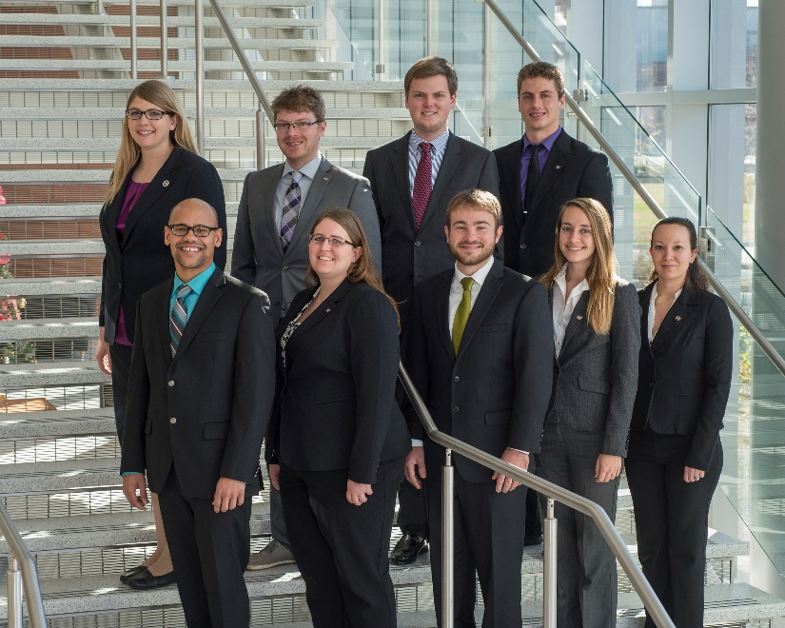
FY16 Fellow Class
What is a DEVELOP Fellow?
A recent college graduate who spends one year with DEVELOP growing personally and professionally while contributing to the program as a whole and their node. The position serves in a dual-role by splitting their time between their node and NPO-related tasks.
Fellow Term: Sept 8, 2015 to Sept 2, 2016
Eligibility Requirements:
  Recent college graduate w/minimum 3.0 cumulative GPA
  Participation in at least one summer term with DEVELOP (two or more terms preferable; one of which must be a summer)
  Ability to begin September 8 with the class of Fellows

Slide 20
FY16 Fellow Class Logistics
Awarded term is a 12-month period: 9/8/2015 – 9/2/2016
Not eligible for renewal after the year
Performance reviews take place during interims following each term (spring, summer, fall)
May be located at any DEVELOP location
Fellow positions are considered consultants and will not be offered health or other employment related benefits
Fellow positions split their time supporting NPO (25-50%) and their node (50-75%)
Fellow rate will be a $2.00/hr increase above the base pay scale (dependent on degree held)
Selections are made by NPO with inputs and agreement from the node the Fellow would be located at

Slide 21
FY16 Fellow Class Positions
Projects Coordination Fellow: Proposal writing/review, support project execution and deliverable collection/review, assist planning/preparation for close-outs, partner engagement, project and partner tracking/archiving, Project Strength Index assessments
Geoinformatics Fellow: Provide GIS/RS support to national teams, create/teach GIS/RS tutorials, tool scripting in Python and other languages, highlight capabilities of NASA Earth observations
Impact Analysis Fellow: Socioeconomic impact analyses, programmatic impact analyses, Equal Futures reporting, DEVELOP partner history/analyses, military engagement tracking, survey creation/management, monitoring baselines
Communications Fellow: Publications writing/review, DEVELOP micro journal support, social media, VPS management, video creation, The DEVELOPer newsletter, recruiting activities, Campus Ambassador Corps
Graphic Design Fellow: creation of print materials (brochures, annual reports, project booklets, bookmarks, recruiting flyers, newsletter, etc.), branding activities, template creation, website imagery, support SD with design projects
Information Technology Fellow: Website management/programming, manage hardware/software, limited IT support for all national teams, maintain DEVELOP Exchange/servers, DEVELOPedia [Additional Requirement: US Citizenship]

Slide 22
FY16 Fellow Class Application Timeline
Talk to Node Leadership & Review Positions
Interested individuals should begin talking to their Center Lead and advisor(s)/mentor(s) to discuss what the node responsibilities for a Fellow at a specific location would be (i.e. Assistant Center Lead).
Review the DEVELOPedia page and familiarize yourself with the positions and responsibilities.
Download the Application from DEVELOPedia
The application will be available on DEVELOPedia - download the file and complete. Direct any questions to Lauren or Karen.
Application Submission (Deadline: 11:59pm Eastern on 6/26)
Candidates submit application by emailing to Lauren.M.Childs@nasa.gov & Karen.N.Allsbrook@nasa.gov
Application Review & Interviews
Applications will be reviewed and top candidates will be selected for interviews, which will be jointly conducted by NPO and node leadership (6/26-7/14).
Final Selections
Final selections announced via email (7/17)
Formal announcement of Fellow class at NASA HQ Showcase (7/30)

Slide 23
Tips For Success
Be flexible
Stay organized
Have an open mind and a positive attitude
Know when things are due
Keep track of files
Be ready to present what you are doing at the drop of a hat
Two heads are always better than one - collaborate!
Go above and beyond
Get to know your team
Network Network Network - it’s all about who you know
Use this opportunity to build up your resume with new skills
“Whether you think you can or whether you think you can't, you're right.”
-- Henry Ford --

Slide 24
Important Things To Note
DEVELOP IS part of NASA’s Applied Sciences Program
DEVELOP is NOT part of NASA’s Office of Education
  NASA’s internships/activities have been consolidated and/or eliminated – DEVELOP is not one of those/part of that consolidation.
DEVELOP is very different from NASA’s internship opportunities in the way we approach projects, focus on teamwork, the level of responsibility and authority given to participants, the opportunities we provide, and the individuals and organizations we network with. Enjoy it while you are here!
NASA restricted travel under sequestration, meaning that new guidelines are in place to gain approval for travel. Travel is a privilege!

Slide 25

THANK YOU!
Have a Great Term!

