Slide 1
Idaho Disasters III
Using Landsat Earth Observations to Identify Increased Fire Susceptibility Due to Invasion of Cheatgrass (Bromus tectorum)
Jeff May (Project Lead)
Zachary Simpson
Jenna Williams
Notes:
The Idaho Disasters III project is a continuation of work that began during the Fall 2014 DEVELOP term. Throughout the life of this project, the Idaho Disasters team has studied the relationships that exist between wildland fire and the environment and some of the primary drivers that are changing wildfire regimes. This term, the Idaho Disasters III team applied work from the previous two terms to create a fuel model with the goal of identifying the distribution of invasive species, Bromus tectorum, more commonly referred to as cheatgrass. This loathsome winter annual is responsible for the expansion of wildfire throughout the great basin, and is largely responsible for ecosystem change in the semi-arid savanna regions of southeast Idaho.

Slide 2
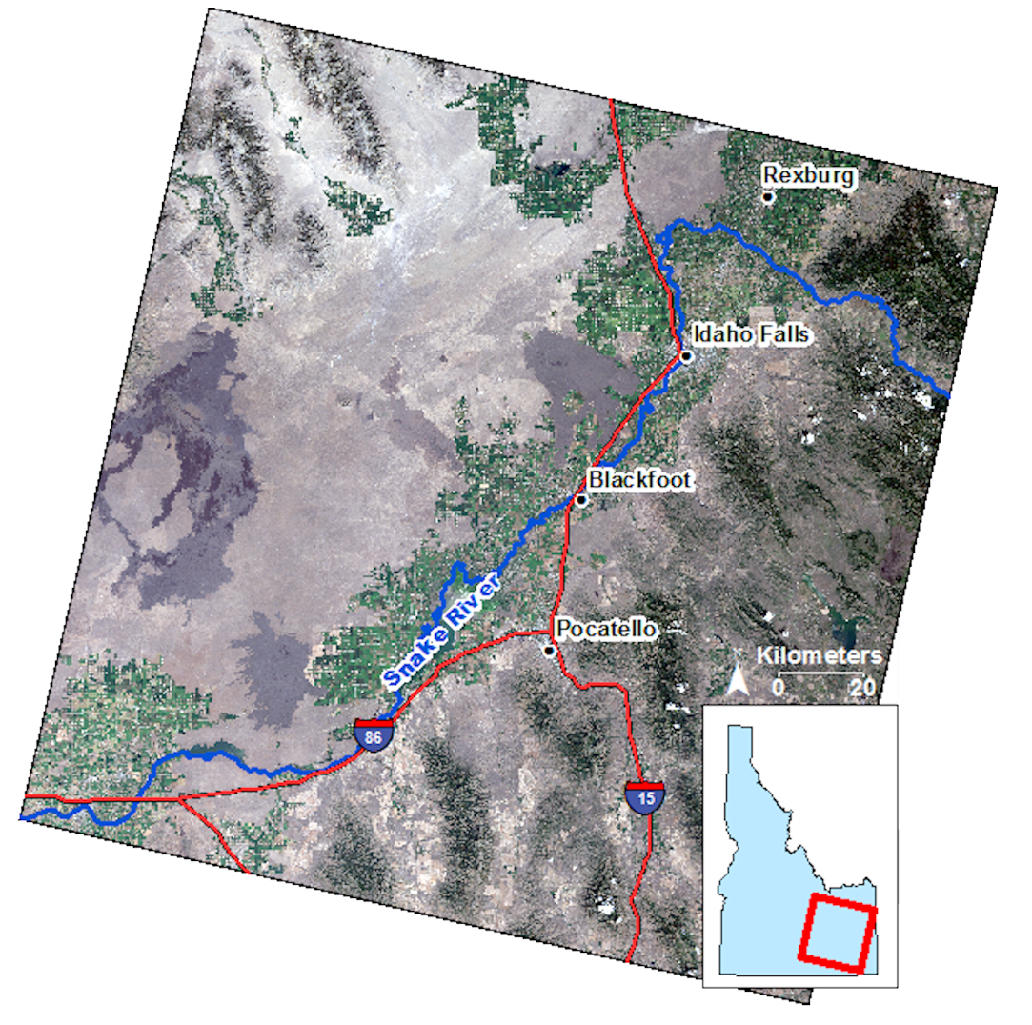
Project Overview
Study area
SE Idaho WRS-2 Path 39 row 30
Study period
March-June 2013, 2014 & 2015
NASA satellites/sensors used
Landsat 8 Operational Land Imagery (OLI)
Notes:
The study area for this project, captured by Landast WRS2 path 39 row 30, is comprised of semi-arid, sagebrush/herbaceous rangelands throughout the Snake River Plains and montane forest regions further southeast. Human municipalities exist along the Snake River where agricultural activity dominates the populated regions. The study period covered the seasonal transition from spring to summer in order to capture early cheatgrass phenology.

Slide 3
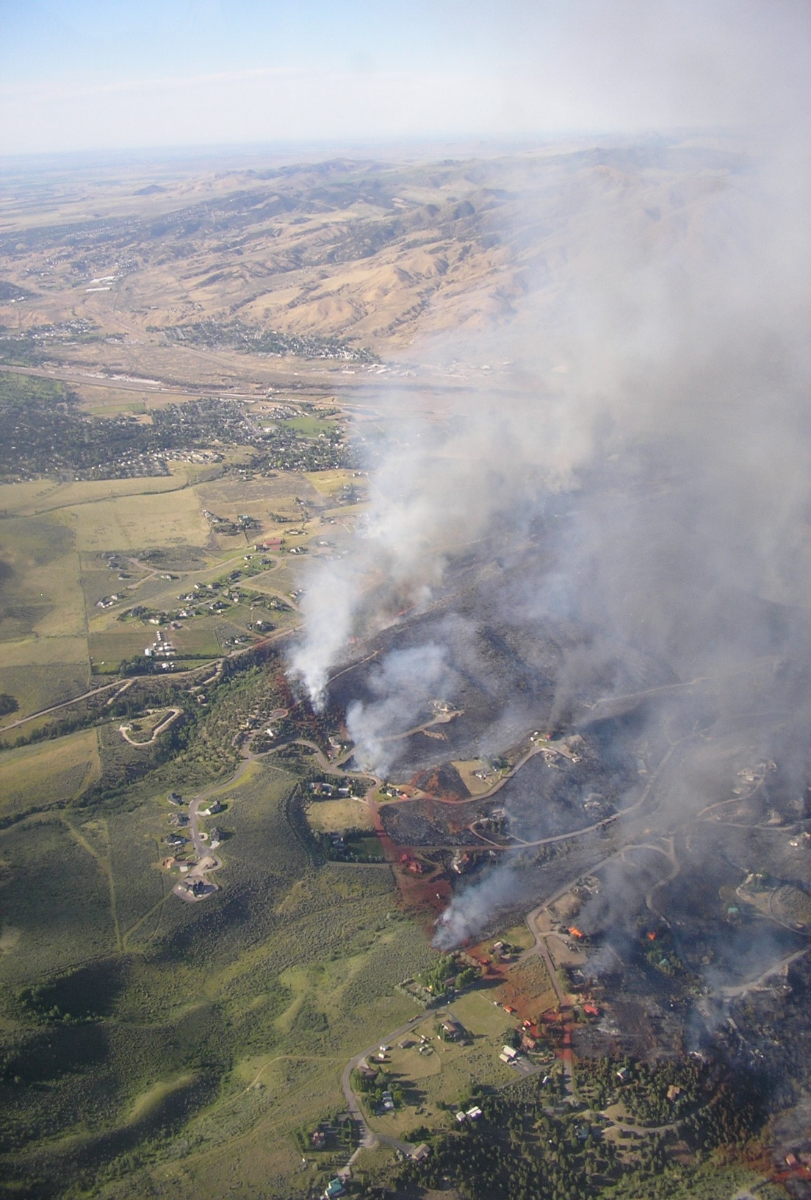
Objectives
Create a vegetation map that can be used to improve fire susceptibility models
Create a fire susceptibility map using vegetation mapping results
Benefit end-users by identifying high fire susceptibility areas
Credit: Greg Haxby
Notes:
The objectives of this study are twofold. The first being the creation of a fuel model that accurately identifies areas with higher concentrations of cheatgrass. Many believe that cheatgrass along with seasonal weather patterns play a large role in the increase in wildfire frequency. Because cheatgrass responds to climate change rapidly if a fire ignites cheatgrass dominated areas will burn quicker and spread faster leaving behind disturbed areas where cheatgrass can quickly invade and establish. Our second objective was to create a fire susceptibility model from the fuel model that will help land managers locate areas that are more combustible based on vegetation type.
Image used with permission by Greg Haxby (BLM)

Slide 4
Credit: Ryan Howerton
Community Concerns
The 2012 Charlotte Fire cost Idaho $211 million dollars in fire suppression expenditures.
In Idaho, climate change, wildfire, and invasive species have created a positive feedback environment leading to increased wildfire frequency and duration.
Expanded wildfire regimes significantly alter semi-arid savanna ecosystems.
Notes:
The Charlotte fire was one of the most economically impacting wildfires that southeast Idaho had seen in decades. Suppression expenditures and lost property resulting from this fire totaled 9.5 million dollars. This fire destroyed 66 homes, 96 buildings in total and caused the evacuation of 5,688 people. The justification for mapping fire susceptibility is to identify communities-at-risk throughout the wildland urban interface and mitigate this risk. Wildfire disturbance can also alter entire ecosystems and further promote invasive species leading negative consequences for semi-arid ecosystem if not appropriately monitored and controlled.
Wildfire coupled with the presence of cheatgrass creates a positive feedback cycle which further promotes the expansion of cheatgrass, wildfire frequency, and wildfire season duration. These three factors are to blame for the rapid degradation and change in Idaho’s rangelands, rapidly changing the sagebrush dominated region, to grasslands dominated by invasive and aggressive species. This change affects critical habitats of endangered species including the Greater Sage Grouse, the migration patterns of range-roaming ungulates, and grazing operations on public lands.
Image used with permission by Ryan Howerton (GIS TReC)

Slide 5
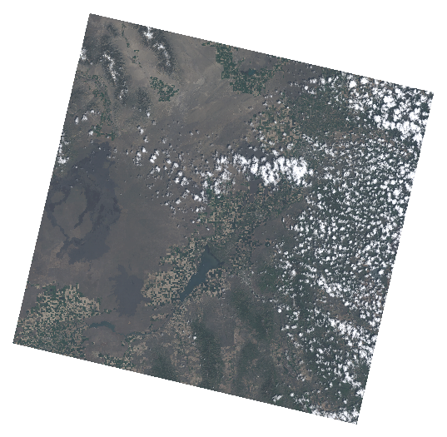
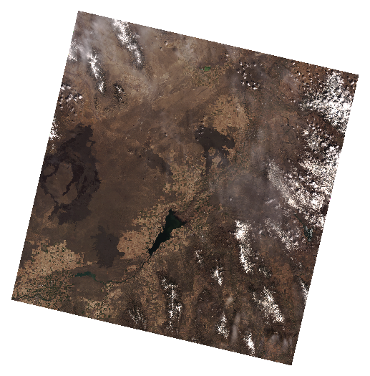
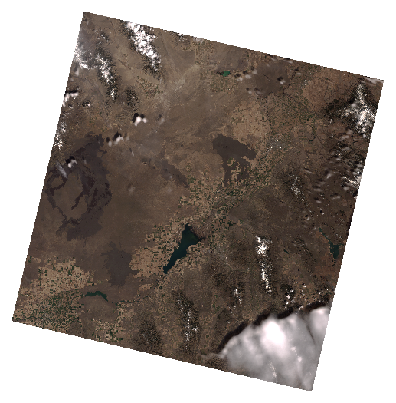
Methodology
Image Selection
2013
2014
2015
Criteria for image selection and Pheno-Calc
Base Temperature of 35 ° F
Growing Degree Day (GDD) of 400 with 10% tolerance
Less than 20% cloud cover
Notes:
We downloaded 23 images from the USGS Landsat 8 Operational Land Imager that comprised the complete growing season for this region for 2013, 14, 15. Phenoloical synchronization of satellite images make for stronger analysis. To accomplish this we analyzed historic meterologigal data from the Bureau of Reclamation’s AgriMet weather system. Using Pheno-calc a software developed at the GIS Training Research Center we evaluated minimum and maximum air temperature along with daily precipitation to determine the growing degree days in each year.

Slide 6
Methodology
Image Selection
Closest Phonologically Similar Days |  |  | Closest Landsat days to Phenology Days
Year | Julian Day | GDD | Julian Day | GDD
2013 | 125 | 406.435 | 135 | 652.385
2014 | 107 | 403.71 | 106 | 390.11
2015 | 103 | 406.25 | 109 | 466.55
Notes:
A GDD of 400 was determined to be most conducive to early cheatgrass growth. We then identified which Landsat 8 images available to us were phonologically similar or closest to the days of peek green up. These days were May 15, 2013, May 16, 2014, and April 19th, 2015

Slide 7
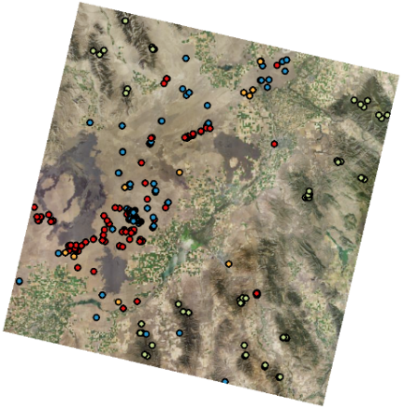
Methodology
Classification site creation
Classification sites were created using;
2013 NAIP imagery with a .5m resolution
2015 UoG ground truth observations
Cheatgrass points from Cliton et al., 2010
Field observations collected by ISU GIS TReC staff during summer months of 2014 and 2015
Vegetation Type | Number of Points
Bare Ground | 61
Cheatgrass | 124
Sagebrush/ Herbaceous | 149
Montane Forest | 63
Notes:
Once we had the imagery selected our next step was to create classification sites. To help delineate vegetation dominance in the study area we determined four land cover classes; Bare ground, sagebrush/ herbaceous, montane forest, and cheatgrass. 397 classification sites were created from;
2013 NAIP imagery with a .5 meter resolution
2010 Cheatgrass points from a study that used remote sensing and a time based series analysis to detect cheatgrass phenology
And in-situ data from the University of Georgia, ISU GIS TReC staff, and the BLM

Slide 8
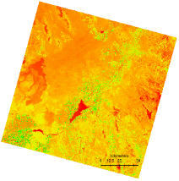
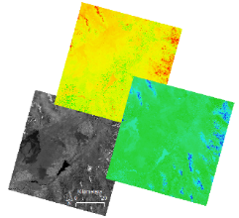
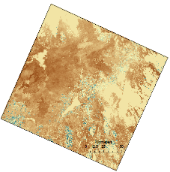
Methodology
Image Processing
mSAVI2 and TCT derived using IDIRISI TerrSet VegIndex Modules
NDBSI = (TM6 − TM5)/(TM6 + TM5+0.001)*
Modified Soil-Adjusted Vegetation Index | Tasseled Cap Transformation | Normalized Differenced Bare Soil Index
*Baraldi et al., 2006
Notes:
Three spectral indices were derived from the Landsat 8 imagery. The modified soil adjusted vegetation index (mSAVI2), and Krauth and Thomson’s Tasseled Cap Transformation which provides brightness, wetness, and greenness values to in image classification, and the Normalized Differenced Bare Soil Index (NDBSI). Unlike NDVI, mSAVI2 is not as sensitive to reflectance of bare-ground, making it an appropriate index to use given the sparsely vegetated nature of Idaho rangelands. NDVI has been observed to produce erroneously high values in areas where no vegetation exists, such as the basaltic lava flows at Craters of the Moon, and Hell’s Half Acre. Also the bare soil Index was used to differentiate areas that exposed a high level if bare ground. This is important due to the scarcity of vegetation that occurs within the Snake River Plain. Finally, to provide a generalized view of the vegetation that we were interested in, a mask was applied to the imagery that removes clouds, water, cultivated and uncultivated agricultural fields, and urbanized areas so these values did not interfere with naturally occurring vegetation.

Slide 9
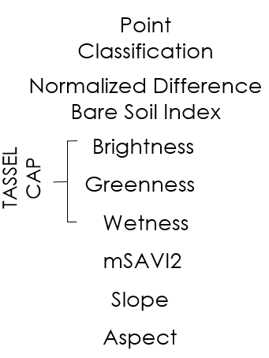
Methodology
Classification Tree Analysis
Notes:
Once the vegetation indices were derived, they were combined with 30m slope and aspect and input to IDRISI TerrSet’s Classification Tree Analysis module, or CTA. CTA is a nonparametric statistically based, supervised, classification method that uses machine based learning algorithms to determine which of the input data is most useful in performing the classification, disregarding any inputs that do not help differentiate between the designated classes. 60% of the classification points described were used to train the decision-tree model, and 40% were reserved for independent validation of the results.

Slide 10
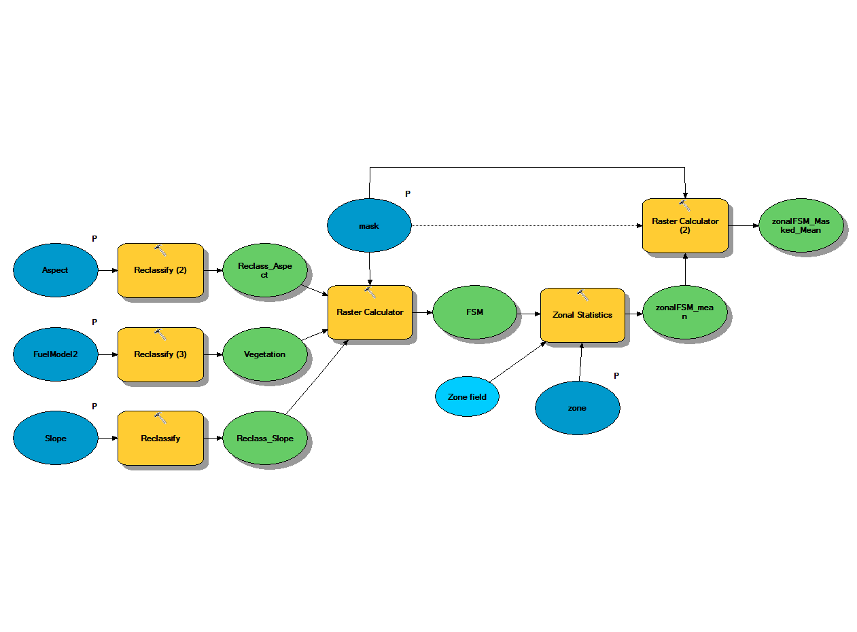
Methodology
Fire Susceptibility Model
Fire Susceptibility Model based on fuel model and topography.
Notes:
The fuel model derived from CTA was used as input to a fire susceptibility model that examines fuel, slope and aspect to identify areas with higher susceptibility to fire. This model weighted inputs from aspect, giving lower values to northerly facing slopes and higher values to areas with a southerly facing slopes. Slope was given values that reflected increases in slope by increased weight, however flat areas were given medium weight because they generally receive constant sunlight. The fuel model classes were assigned values that ranged from low (bare ground) to sagebrush, alpine forest and cheatgrass given the most weight due to its extremely combustible nature.

Slide 11
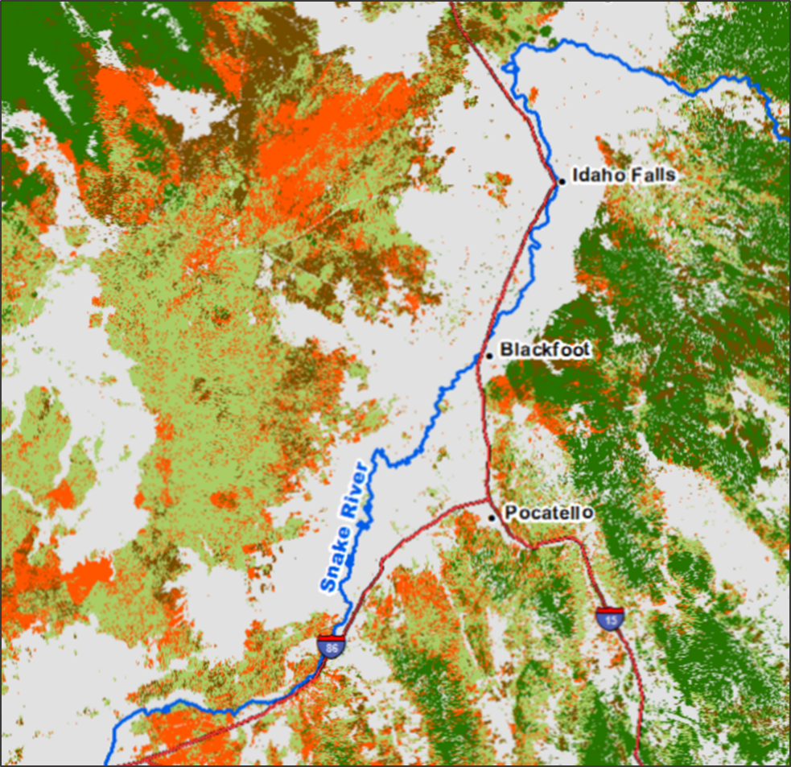
Classification
Results
Fuel Model
Output from Classification
Tree analysis
Cheatgrass was discriminated using
its unique phenology characteristics
Mask
Cheatgrass
Bare Ground
Montane Forest
Sagebrush/
Herbaceous
Notes:
Interpretation of the CTA results reveal an accurate representation of SE Idaho land cover based on prior knowledge of the region and known land cover distribution. By leveraging the enhanced radiometric resolution of, Landsat 8 imagery, taken at a time when cheatgrass is actively photosynthesizing, while native vegetation is not, allowed for successful delineation of this species.

Slide 12
Classification Results
Accuracy Assessment
Error Matrix Analysis – CTA Results
 | Sagebrush/ Herbaceous | Cheat grass | Bare ground | Montane Forest | Total | ErrorC
Sagebrush/Herbaceous | 45 | 8 | 2 | 3 | 58 | 0.22
Cheatgrass | 8 | 33 | 2 | 1 | 44 | 0.25
Bare ground | 4 | 5 | 20 | 1 | 30 | 0.33
Montane Forest | 3 | 4 | 0 | 20 | 27 | 0.26
Total | 60 | 50 | 24 | 25 | 159
Error0 | 0.25 | 0.34 | 0.17 | 0.2 |  | 0.26
Kappa coefficient: 0.64
Notes:
Accuracy for the fuel distribution model is 74% with a kappa coefficient 0f .64. We can conclude that our fuel model is reliable and can therefore be used in the decision making process. Sagebrush classification was the most accurate with a user’s accuracy 78% while bare ground classification was the least accurate with a User’s accuracy of 67%

Slide 13
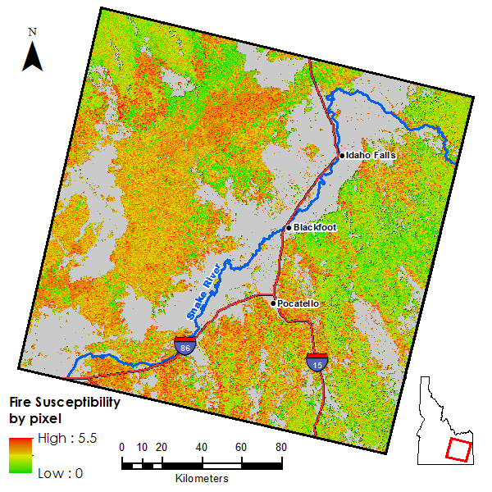
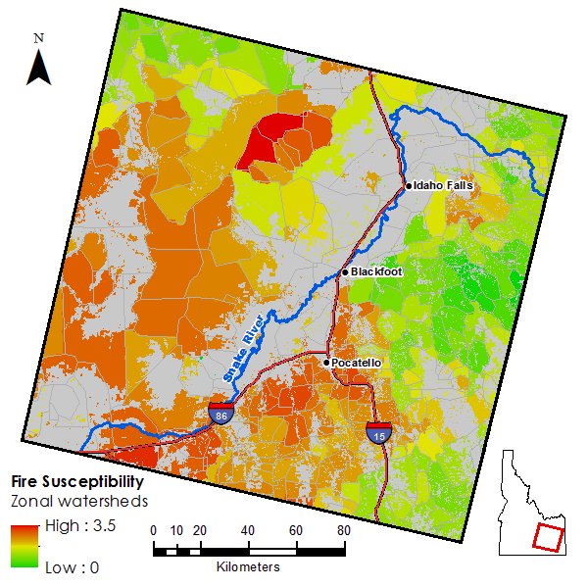
Fire Susceptibility
Results
*image mask applied where grey
Notes:
The results of the fire susceptibility model are shown here with green being used to identify areas with low fire susceptibility, and areas of high fire susceptibility shown as red. On the left, fire susceptibility is represented on a pixel-by-pixel basis while the image on the right indicates which region watersheds (HUC 6) are most susceptible to fire. The zonal mean was used to calculate fire susceptibility for each watershed.

Slide 14
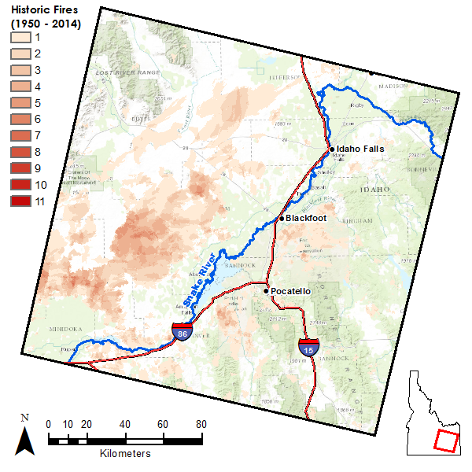
Fire Susceptibility
Accuracy Assessment
Notes:
The correlation matrix to the right, displays a value of 1 for the fire susceptibility results and 2 for the historic fires dataset. When the raw pixel value was compared with historic wildfire occurrence, it produced a Pearson correlation coefficient of 0.61. This suggest that there is a strong relationship between wildfire susceptibility and reoccurrence.

Slide 15
Conclusions
Species specific classification can be successful when the target species is phonologically distinct from surrounding vegetation types.
Fire susceptibility maps can help identify communities-at-risk along the wildland urban interface.
Results lend toward classifying fire susceptibility, identifying and mitigating fire risk, estimating general land health, and monitoring the expanse of invasive species
Reflectance from bare ground and sub-pixel mixing continues to be problematic for medium resolution land cover classification.
Notes:
This study demonstrates that it is possible to identify specific species contributing to increasing wildfire occurrence using Landsat 8 operational land imager imagery when that species has phenological characteristics that are different than native vegetation. The results of this study may be used to identify communities at risk along the WUI interface. Help plan or support proposed fuel load reduction projects in areas that are more susceptible to wildfire and can be used to identify and mitigate fire risk, make assessments about general land health, as well as monitoring the spread of cheatgrass. The methods described here can be improved by introducing a larger number ground truth data to aid in the creation of classification sites, improving the classification model.
In future projects leveraging higher resolution imagery or hyperspectral data for the purpose of applying spectral-unmixing method should be considered because bareground reflectance and sub-pixel mixing continue to be problematic when using remote sensing products with medium resolution.

Slide 16
Advisors
Keith Weber (ISU)
Mark Carroll (GSFC)
John Schnase (GSFC)
Partners
Mike Kuyper (BLM)
Michelle Mavers (BLM)
Collin Homer (USGS)
Past Contributors
Kiersten Newtoff (DEVELOP), Kyle Sowder (DEVELOP), Andrea Boddenberg (DEVELOP), Katherine Bradford (DEVELOP), Eric Smith (DEVELOP)
Others
Ryan Howerton (ISU)
Notes:
We would like to acknowledge the following people who have contributed to this project in a variety of way.

