Slide 1
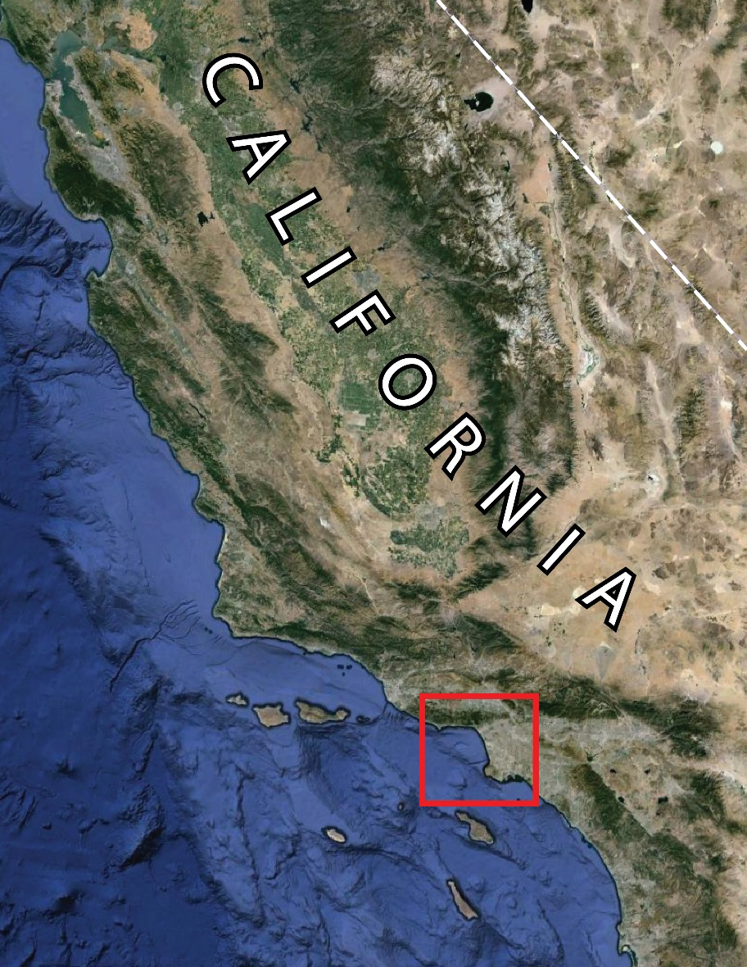
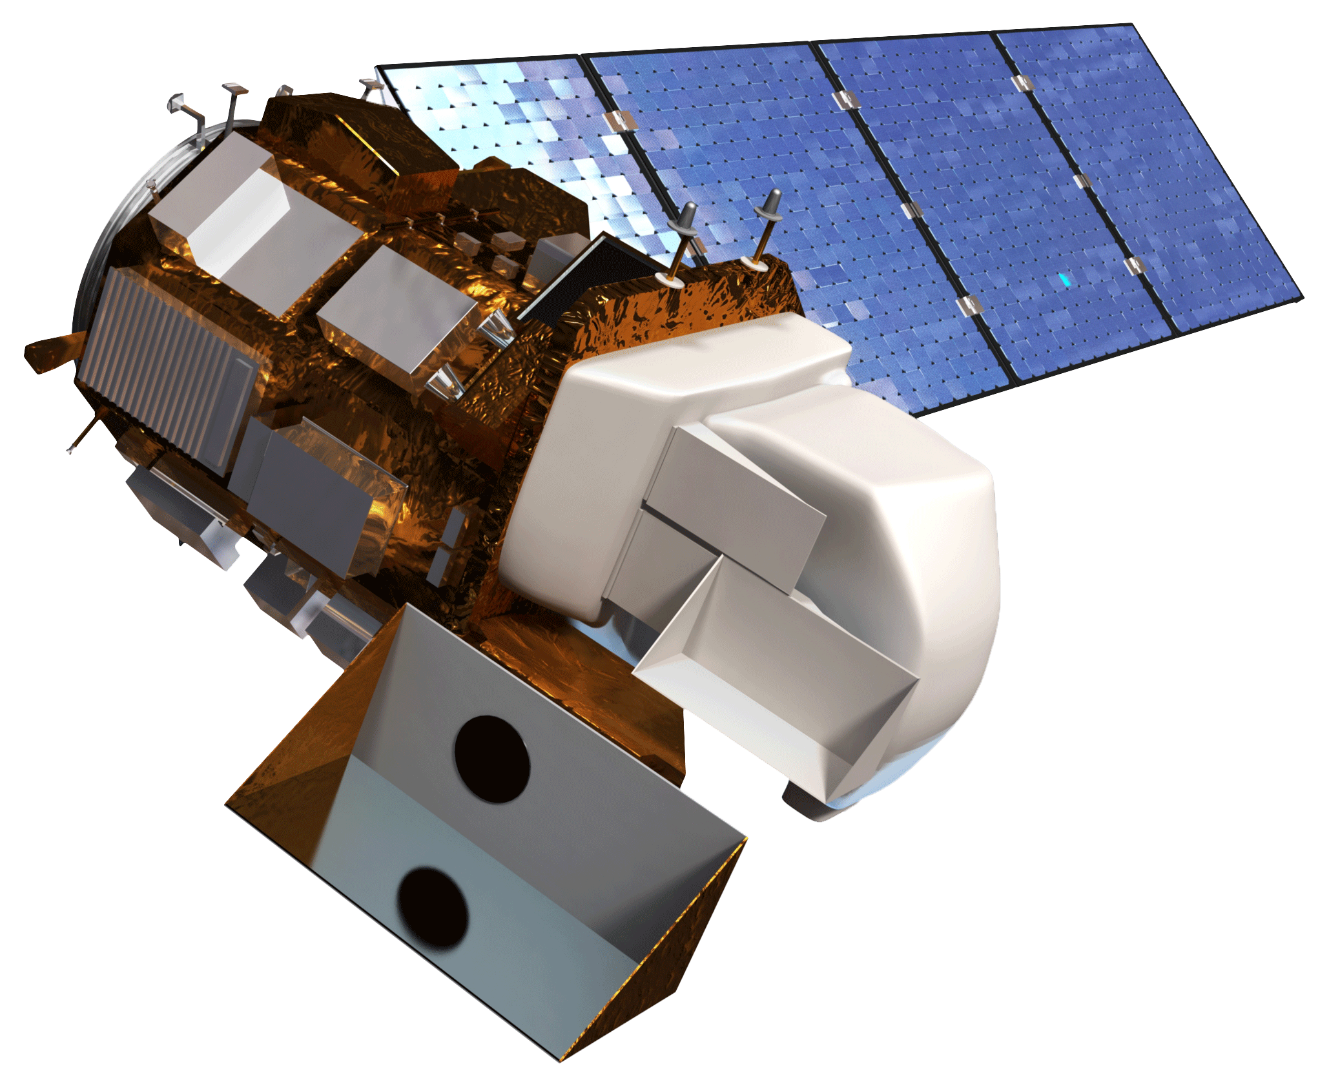
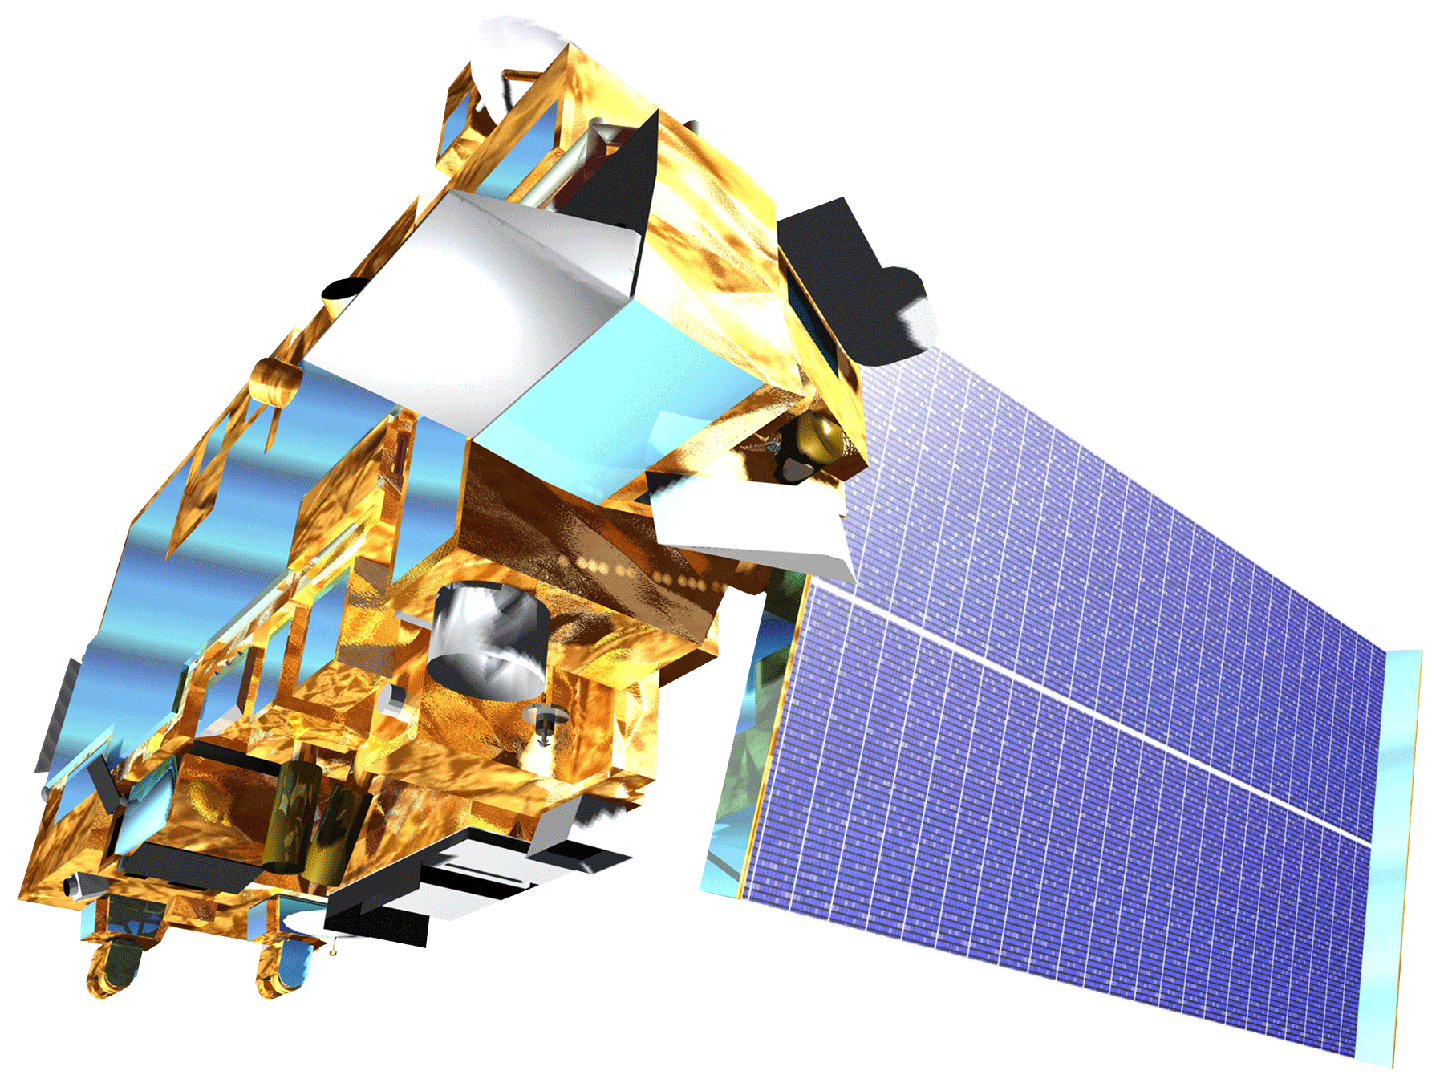
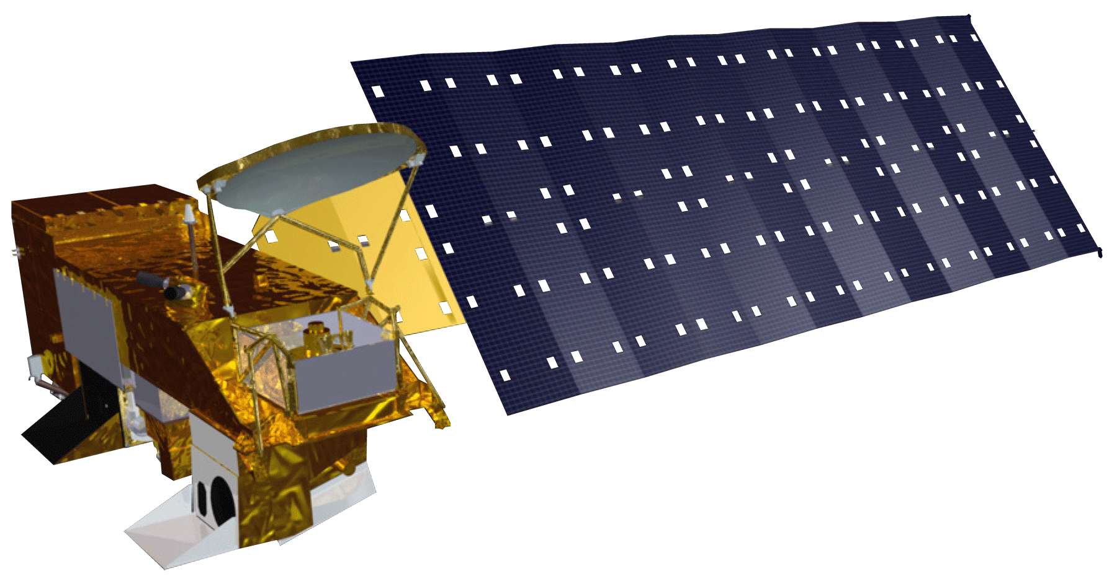
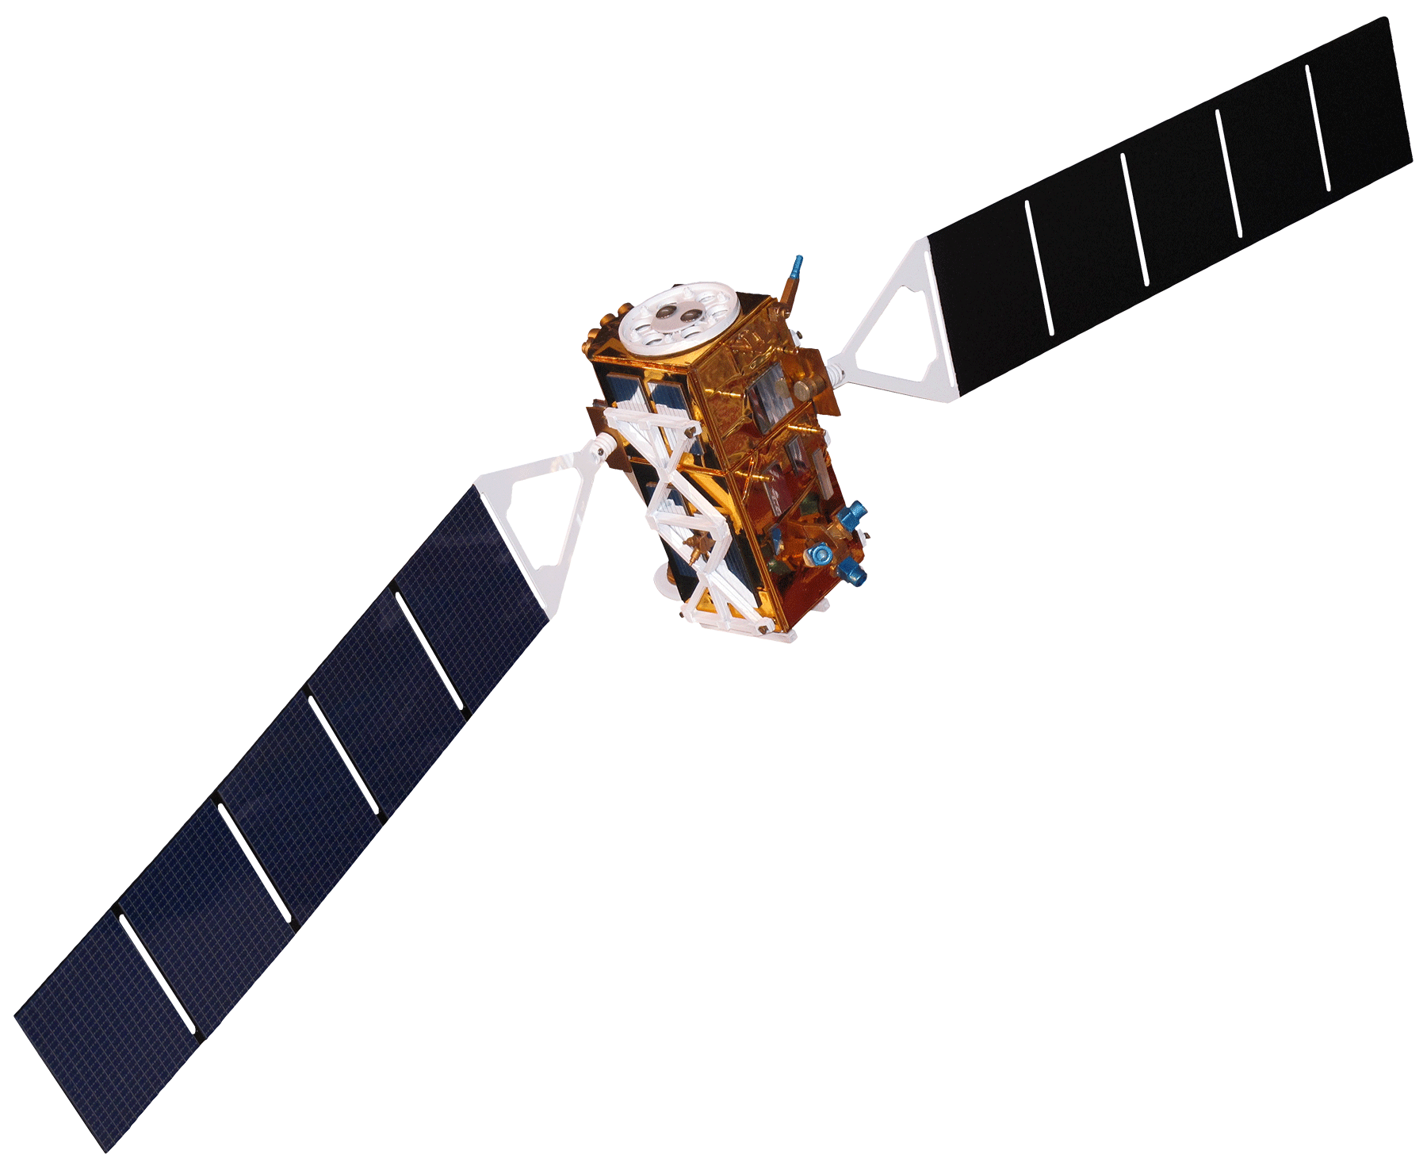
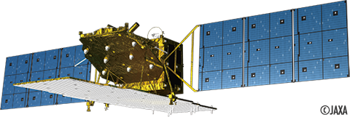
Los Angeles Oceans
Using Remote Sensing to Detect Wastewater Plumes and Assess Their Impact on Public Water Quality in Los Angeles County, California
Rebecca Trinh (Project Lead), Lindsay Almaleh, Mark Barker
NASA DEVELOP National Program - JPL
Abstract
Objectives
Coordinate with the Hyperion Treatment Plant research team in obtaining in-situ readings taken in the LA Basin
Combine NASA Earth Observations and in situ readings taken during the outflow event
Determine whether the expelled effluent is negatively impacting the local plant and wildlife or washing ashore to potentially contaminate popular beaches
Study Area
Methodology
NASA EOS Observations:
Landsat 8
MODIS
Chlorophyll-a
Surface Sediment
Effluent
impact
on local
plant
and wildlife
Sea Surface Temperature
Spatiotemporal
Analysis of combined
datasets
ASTER
Study Period: September – November 2015
Partner Agency Data:
Earth Observations
ALOS – 2 (JAXA)
Sentinel – 1 (ESA)
Sea Surface Roughness
In Situ Measurements
Landsat 8
Terra-ASTER
Aqua - MODIS
Results
Sentinel - 1
ALOS - 2
Use images.
Make sure that it has some sort of flow, that it makes sense. Show your results in a logical order.
No bullets.
Conclusions
Use bullets.
Use complete sentences with periods.
Team Members
Project Partners
Acknowledgements
Hyperion Treatment Plant – City Of Los Angeles
We would like to thank our science advisors, Ben Holt and Michelle Gierach (NASA JPL) for assisting us in data retrieval and analysis.
We would also like to acknowledge our project partners: Curtis Cash, Ashley Booth, and Mas Dojiri at the Hyperion Treatment Plant. Their contributions, along with the NASA DEVELOP Program, have made this project possible.
We would lastly like to thank Christine Rains and Jack Pan, contributors on the first phase of this project.
Left to right: Lindsay Almaleh, Mark Barker, Rebecca Trinh (Team Lead)
NASA Jet Propulsion Laboratory

